Slide 1



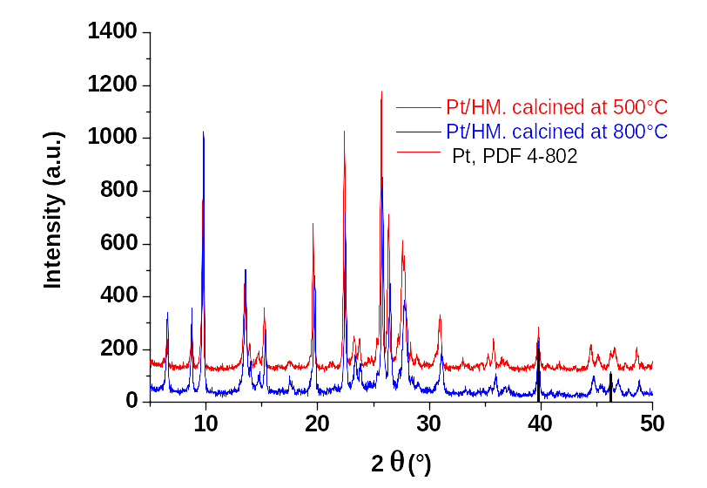
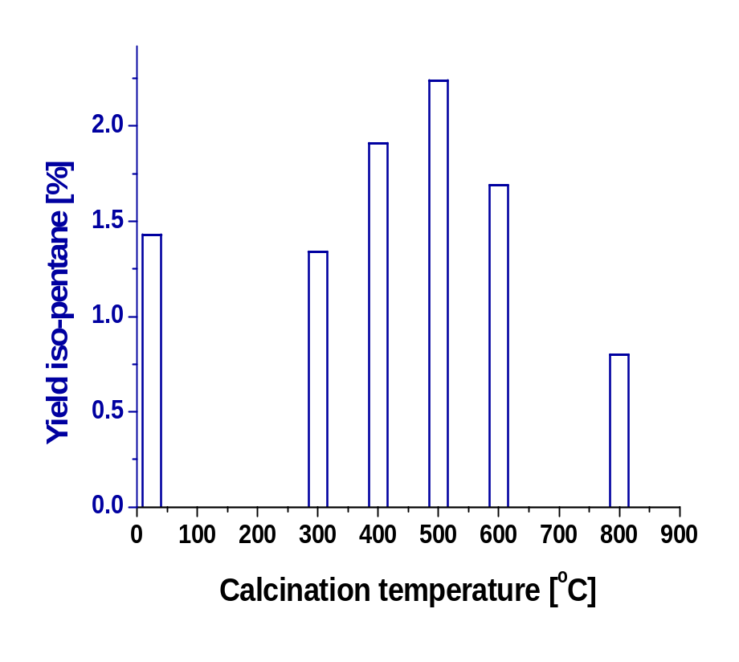

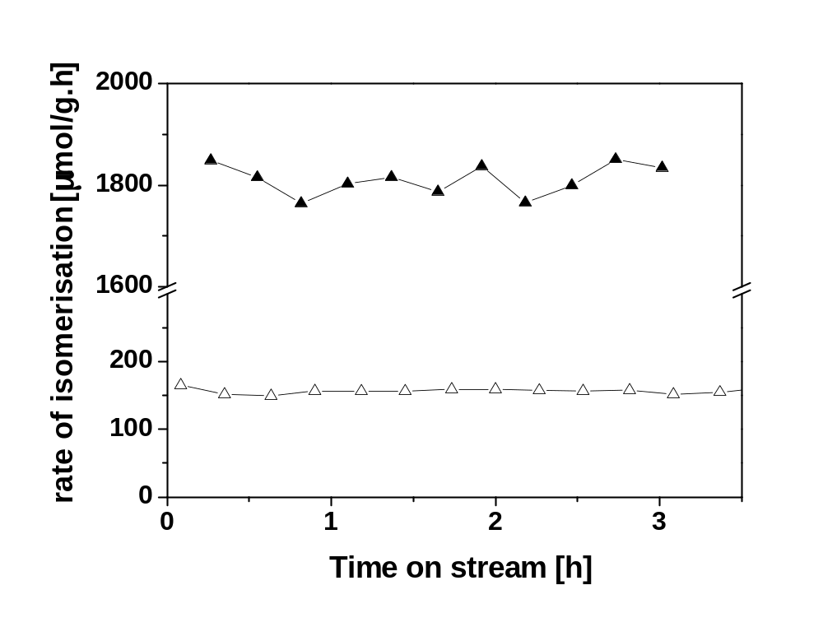
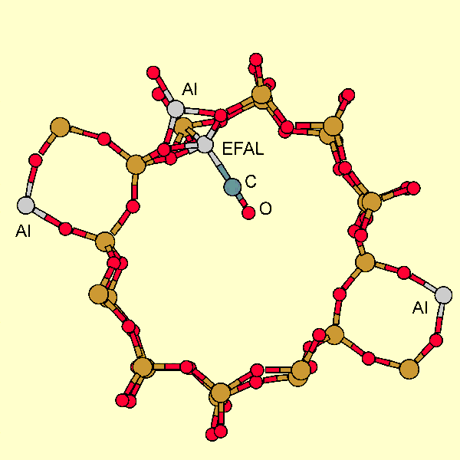
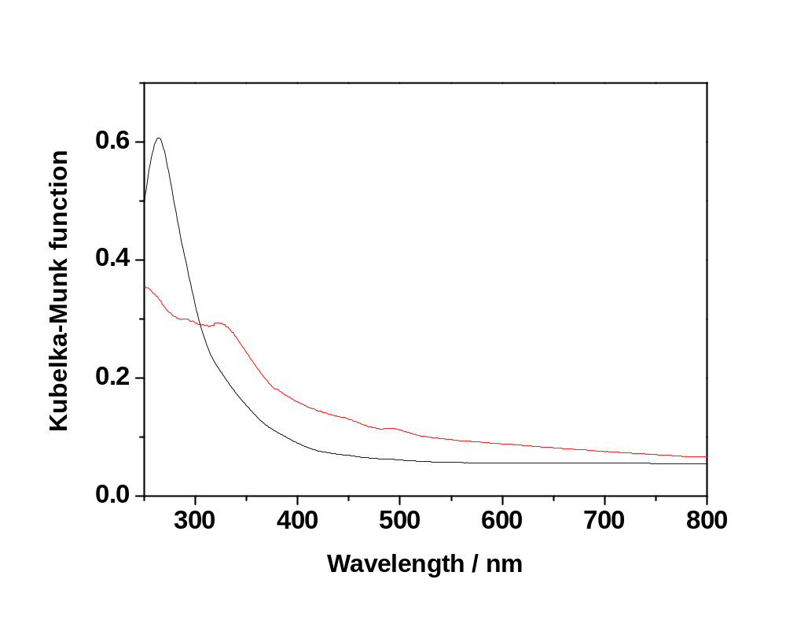
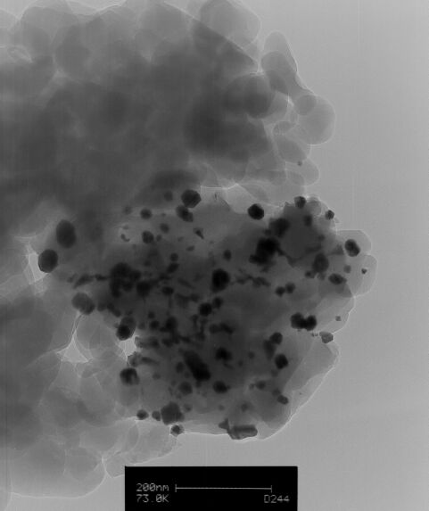
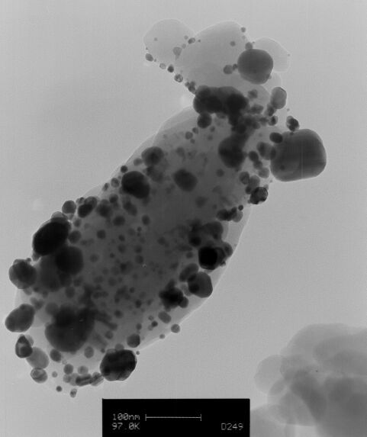
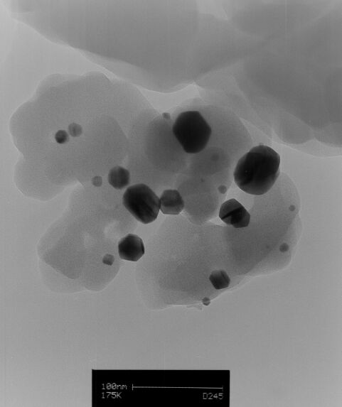
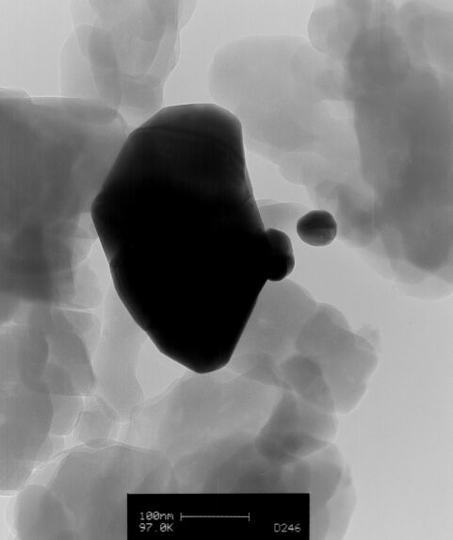
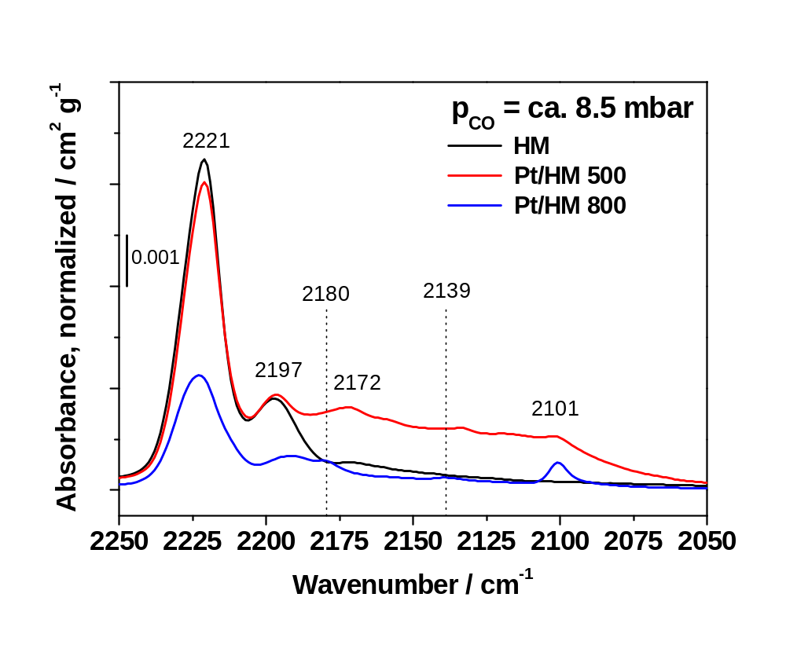
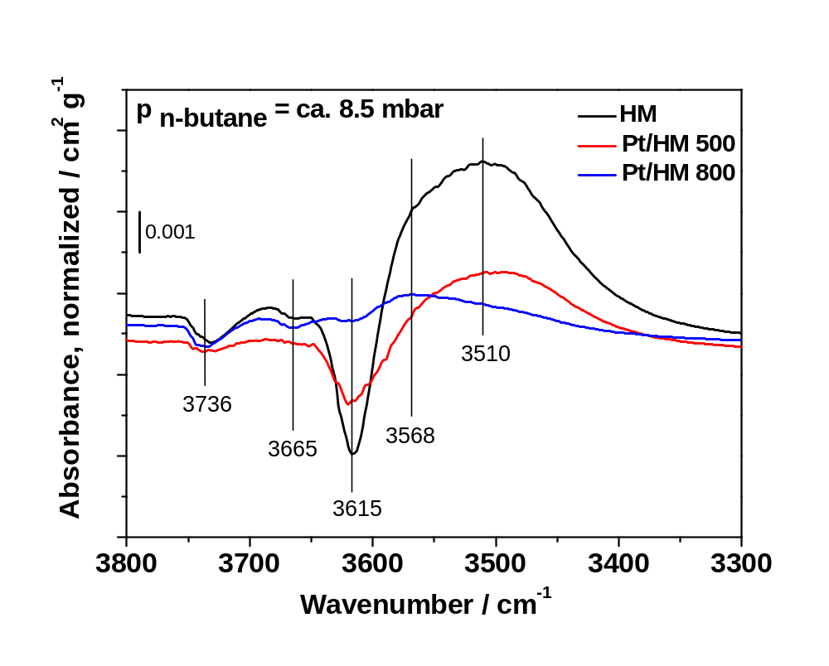
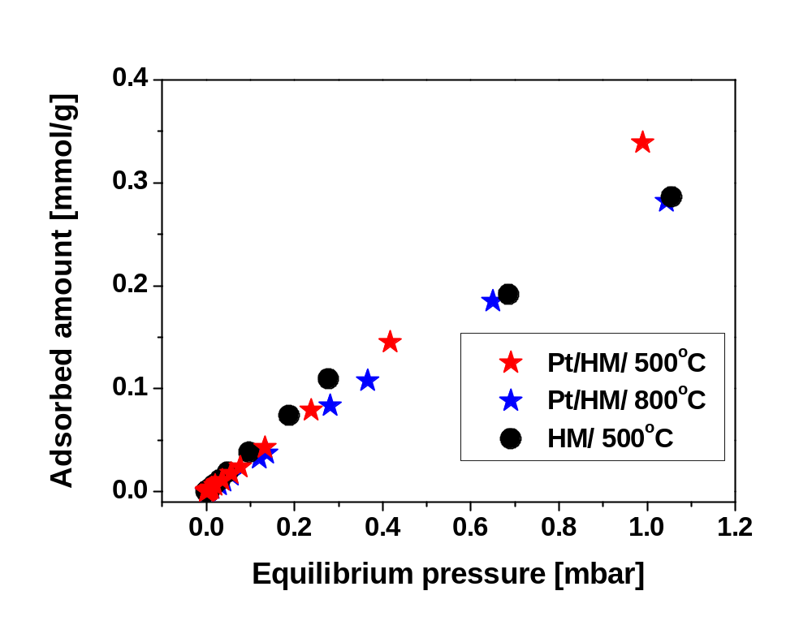
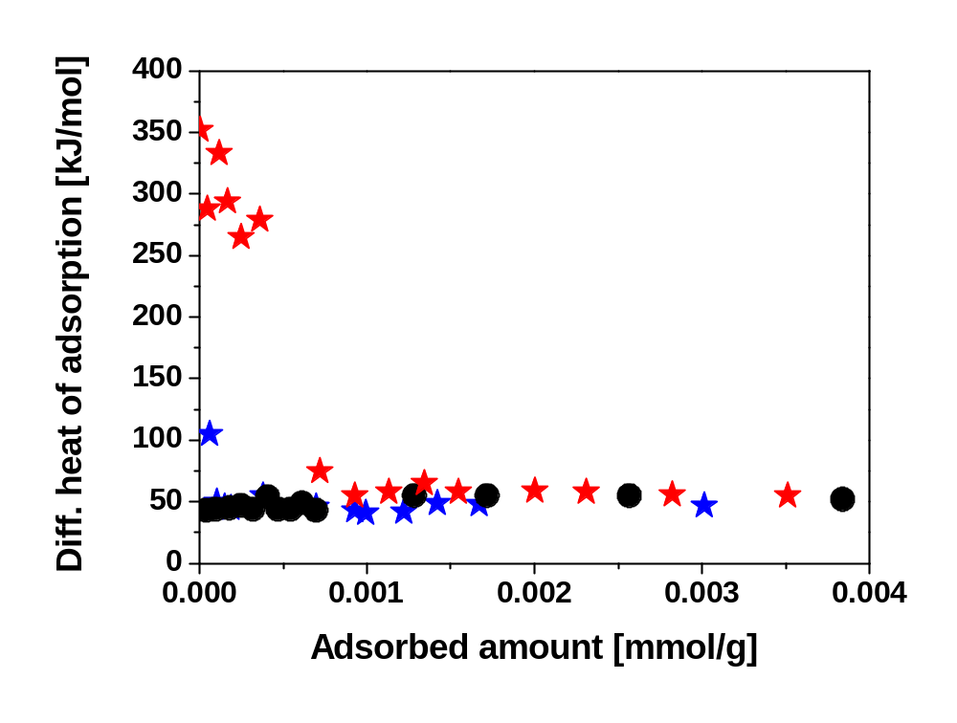
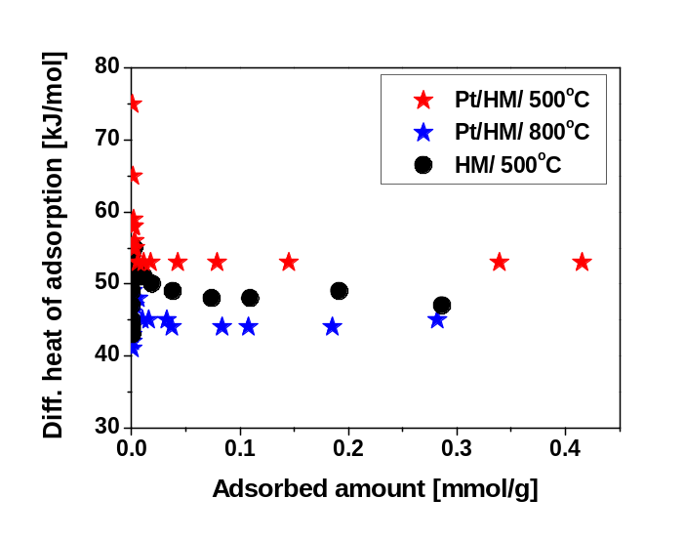
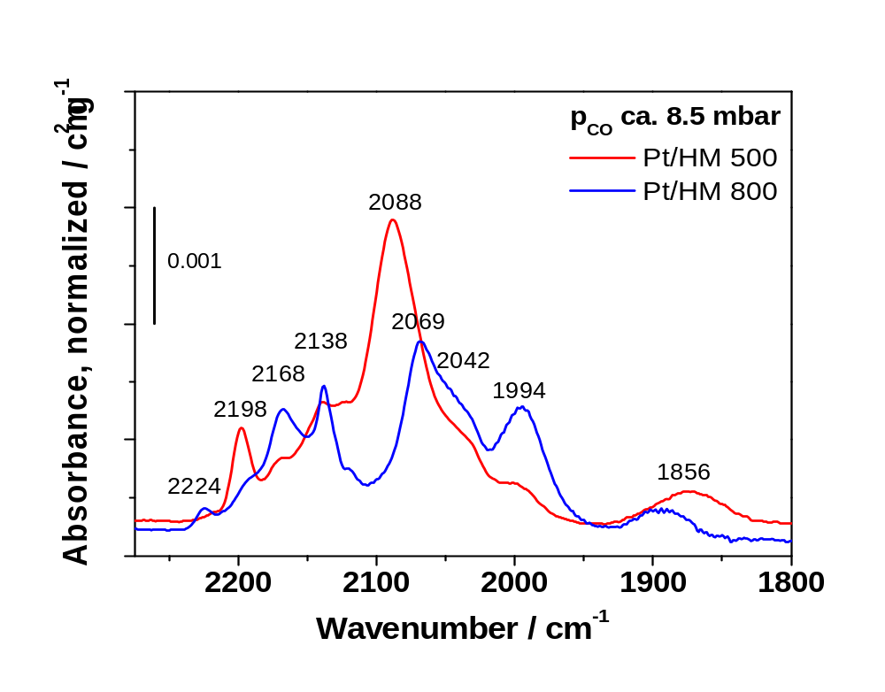
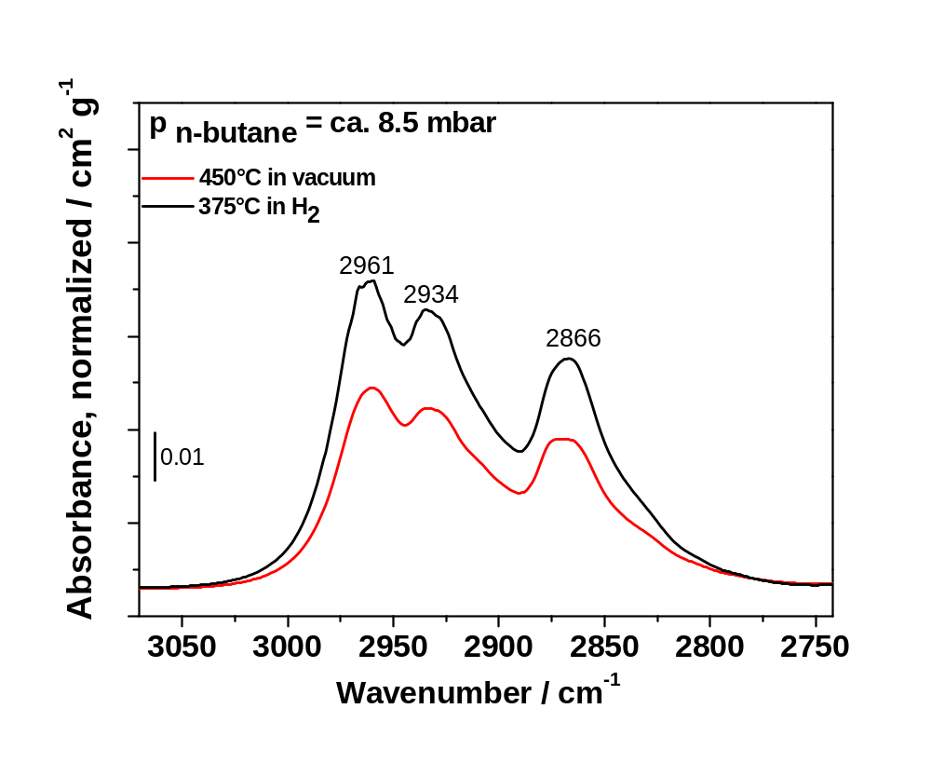
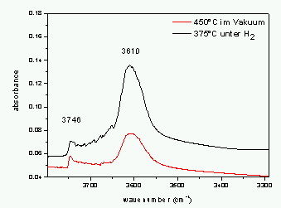
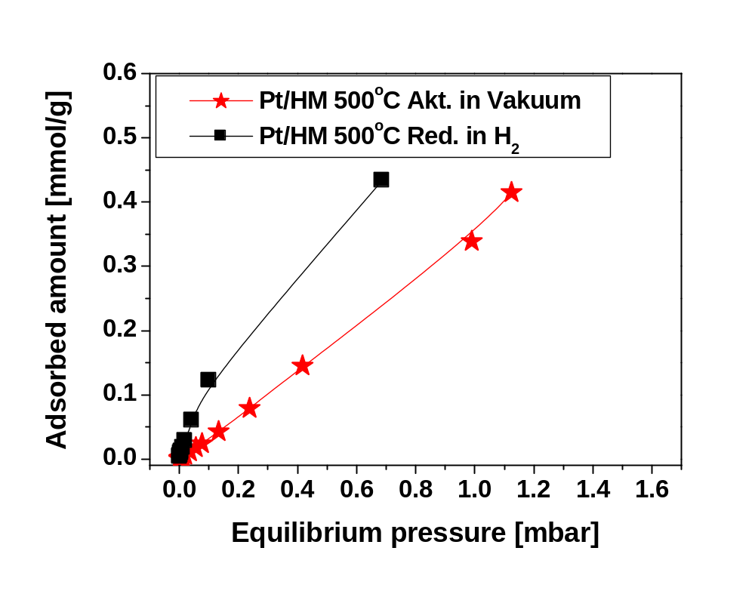
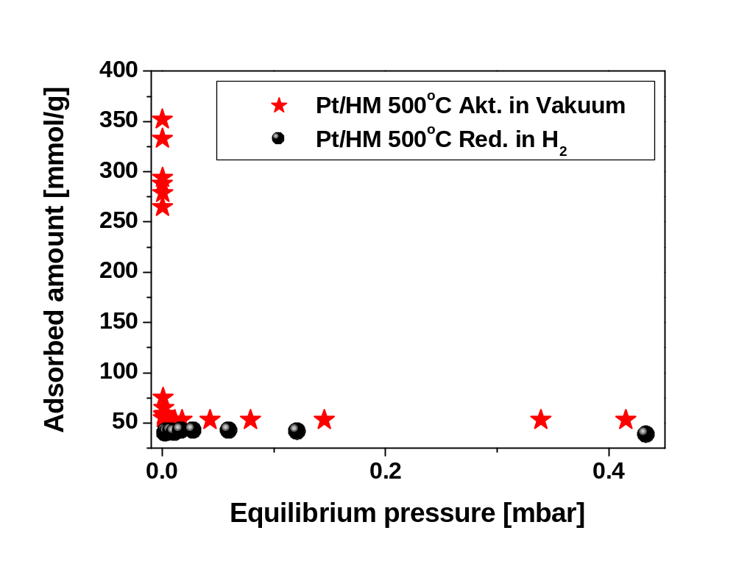
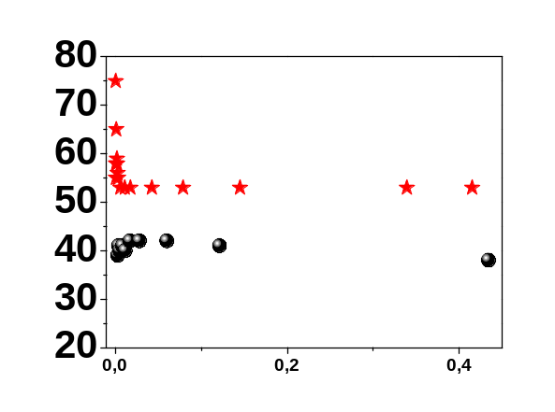
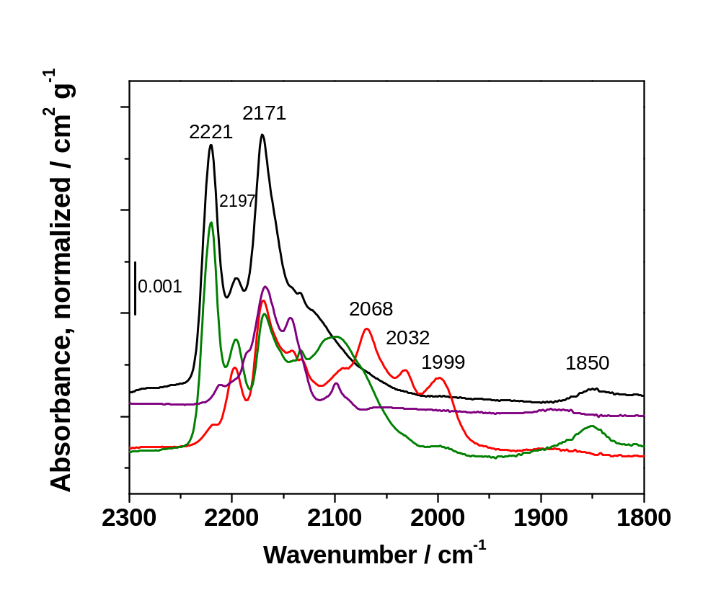
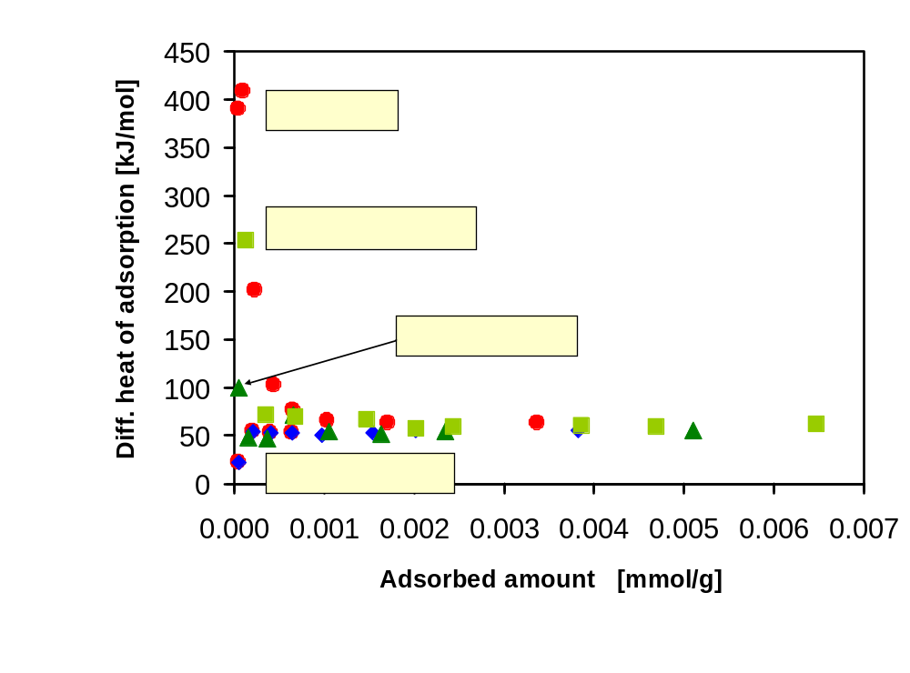

Active State of Pt/H-Mordenite Identified by Microcalorimetry,
UV-vis and FTIR Spectroscopy
Sabine Wrabetzª, Genka Tzolova-Müllerª, Jutta Kröhnertª, Friederike C. Jentoft^{b}, and Robert Schlöglª
ª Fritz-Haber-Institut der Max-Planck-Gesellschaft, Faradayweg 4-6, 14195 Berlin, Germany
^{b} Chemical, Biological & Materials Engineering, University of Oklahoma, Norman, OK 73019, USA
Pt-doped H-mordenite (Pt/HM) is used as a solid acid catalyst for the isomerization of light alkanes [1]. This bifunctional catalyst requires optimization of the acid site distribution and the metal site reactivity. Crucial for the achievement of this goal are the preparation and even more so the activation of the material.
Introduction
Selected samples – the catalyst with the highest (calcined at 500 °C, Pt/HM 500), and with the lowest (calcined at 800 °C, Pt/HM 800) activity for alkane isomerization and the bare HM.
Sample characterization
XRD: crystalline phases: Mordenite and Pt
The drastic difference in rates may not be solely attributable to variations in state of the platinum; thus further investigation of the sites are performed. Pt/HM catalysts with differing activity are activated by various procedures and then their interaction with n-butane or CO is investigated by microcalorimetry [2] and FTIR spectroscopy.
0.5 wt. % Pt/HM
15 kPa n-butane in H₂ at 300 ºC
CO molecule adsorbed on the extra-framework aluminium particles (EFAL), 2225cm⁻¹.
metallic Pt
Si
H
growth of nano-sized catalytic Pt and Pt oxide
catalyst activated in H₂ at 350 ºC for 2 h
O
metallic Pt (hexagonal shape of the Pt particles)
inhomogeneous distribution of Pt particles
Pt/HM 500 contains smaller Pt particles
After H₂ reduction the Pt particles range from 1–3 nm for both calcined samples
catalyst activated in H₂ at 300 ºC for 1 h
framework Al³⁺ (FAl), Lewis acid site
Pt
H
Brønsted acid OH sites
UV-vis spectroscopy:
The increased absorbance above 400 nm for the activated sample can be attributed to metallic Pt absorption [3]
Experimental
L. Bencoa, T. Bucko, J. Hafner, H. Toulhoat, in preparation
http://expuma.itc.univie.ac.at/%7Ehans/hpsc/2003/Kresse/lubomir/benco.html
TEM of the calcined samples before activation:
Preparation of Pt/H-mordenite series:
HM was impregnated with (NH₄)₂PtCl₆ (1 wt% Pt)
dried at RT
calcined at 300 – 800 °C
Activation: inert atmosphere at 450 ºC or in H₂ at 375 ºC
Methods:
PE2000 FTIR spectrometer;
spectra are normalized to wafer area weight
Microcalorimeter SETARAM MS 70 with volumetric system
UV-vis-NIR PerkinElmer Lambda 950 with Harrick DR attachment and HVC reaction chamber; on-line GC
Pt/HM 500
Pt/HM 800
before activation
after activation in H₂
200 nm
100 nm
100 nm
100 nm
IR: CO adsorption at RT
IR: n-butane adsorption at RT
Microcalorimetry:
n-butane adsorption at 40 ºC
Al³⁺ (EFAL)
Al³⁺_{tetr/oct}
(FAL)
Pt⁴⁺/ Pt²⁺/ Pt⁺-
carbonyls
Pt⁰/ Pt(111)/ Pt_{x}-CO
Si-O-H
H
O
Si Al
Oxidized Pt
activation in inert atmosphere at 450 °C of Pt/HM500, Pt/HM800, HM
various platinum forms: metallic and oxidized Pt
strong Lewis acid sites (LAS)
Pt/HM 500 contains oxidized Pt species
Pt/HM 800 is characterized by polycrystalline Pt
Pt/HM 500 and HM show significant shift of OH bands of ~111 cm⁻¹ and more OH groups than Pt/HM 800
Pt/HM 800 shows a small change in the OH region
→ n-butane interacts with acidic OH groups of the zeolite
Pt/HM 500 has more adsorption sites for n-butane (~70 µmol/g) than Pt/HM 800 and HM at 1 mbar; in good correlation with the IR results.
Pt containing catalysts exhibit high initial heats of adsorption (low coverage): interaction of n-butane with oxidized Pt (IR).
Majority of sites on individual sample equivalent (high coverage); slightly higher average for Pt/HM 500 than for Pt/HM 800 due to LAS (IR)
Al³⁺ (EFAl)
Al³⁺
(FAl)
Pt⁴⁺/ Pt²⁺/ Pt⁺-
carbonyls
Pt⁰ / Pt(111) / Pt_{x}-CO
450 ºC in vacuum
375 ºC in H₂
X
υ(OH)
Oxid. Pt
υ(CH)
in vacuum
in H₂
in vacuum
in H₂
activation in H₂ at 375 °C of Pt/HM 500 (comparison with inert atmosphere)
Diff. heat of adsorption [kJ/mol]
Loss of strong Lewis acid sites
active Pt/HM 500 contains a significant fraction of metallic Pt
Pt/HM 800 is characterized by more oxidized Pt species than Pt/HM500
H₂ reduction leads to:
more adsorption sites for n-butane
more Brønsted OH species
acidity of Brønsted OH groups not changed (diff. spectra not shown)
Adsorbed amount [mmol/g]
H₂ reduction of active Pt/HM 500 generates more adsorption sites (Brønsted acidic OH groups and metallic Pt (IR)) for n-butane than activation in inert atmosphere (450 and 200 μmol/g at 0.7 mbar, respectively).
very weak interaction of the active surface with the reactant n-butane, ~ 40 kJ/mol
H₂ reduction of less active Pt/HM 800 _{(not shown)}: 330 μmol/g at 0.7 mbar, ~ 40 kJ/mol
Al³⁺ (EFAL)
Pt⁴⁺/ Pt²⁺/ Pt⁺-
carbonyls
Pt⁰ / Pt(111) / Pt_{x}-CO
→ activation temperature and atmosphere determine number of sites
X
Al³⁺(FAL)
Conclusions
UHV-450°C act. then CO adsorption
H₂-375°C act. then CO adsorption
O₂-200°C act. then CO adsorption
n-butane-40°C then CO adsorption
The active states of Pt/HM are characterized by:
Brønsted acidic OH groups
a small amount of strong Lewis acid sites
well dispersed metallic platinum particles (1-3 nm)
weak interaction of the surface acid sites with alkanes.
activation in inert, reducing and oxidizing atmosphere of Pt/HM 500
Alkanes reduce Pt oxide (as found by re-oxidation studies) → Nature of surface sites on Pt/HM catalysts during alkane isomerization reaction is dynamic.
H₂ reduction of the oxidized Pt is accompanied by disappearance of strong Lewis acid sites
O₂ treatment results in oxidized Pt → high initial heats at low n-butane coverage; regenerates strong Lewis acid sites
during n-butane adsorption, similar to H₂ treatment, strong Lewis acid sites disappear and oxidized Pt is reduced
→loss of the sites producing the high initial heats
Acknowledgments The Max Planck Institute for Coal Research in Mülheim/Ruhr and Åbo Akademi in Turku are kindly acknowledged for providing zeolite samples. TU München is thanked for pyridine adsorption and pentane isomerization measurements. The project was financially supported by BMBF grant 03C0307E.
References: [1] N. Essayem, Y. Ben Taârit, C. Feche, P.Y. Gayraud, G. Sapaly, C. Naccache J. Catal. 219 (2003) 97–106;
[2] L.C. Jozefowicz, H.G. Karge, E.N. Coker, J. Phys. Chem. 98 (1994) 8053−8060;
[3] A. Furube, T. Asahi, H. Masuhara, H. Yamashita, M. Anpo, Chem. Phys. Lett. 336 (2001) 424.

