Slide 1

Machine Learning Model to Predict
a Priority Level of University Admission:
Case study for multiclass classification
by
M. Prabhashrini Dhanushika
Machine Learning Foundation - Batch 04
Data Science Academy
Dialog Axiata PLC

Slide 2
Outline:
Problem Statement
Data
Methodology
Results
Testing the Model
Conclusion
Limitations

Slide 3






Problem Statement
GRE
TOEFL
Uni Rating
SOP
1st Priority
2nd Priority
ML Model
3rd Priority
LOR
CGPA
Research Chance of Admit
4th Priority

Slide 4
Data
Source: https://www.kaggle.com/datasets/akshaydattatraykhare/data-for-admission-in-the-university
Total Number of Records: 400
GRE Scores (out of 340) TOEFL Scores (out of 120) University Rating (out of 5) Statement of Purpose (SOP) (out of 5)
Letter of Recommendation (LOR) Strength (out of 5) Undergraduate GPA (out of 10) Research Experience (either 0 or 1) Chance of Admit (ranging from 0 to 1)
1st Priority = Class 1
1
2nd Priority = Class 2
2
3rd Priority = Class 3
3
4th Priority = Class 4
4
Based on quartiles

Slide 5
Methodology
Step 1: Remove duplicate records
univariate analysis
(Pie chart, Histogram, Boxplot)
bivariate analysis
(Density Curves and Descriptive statistics by group)
correlation function
Step 2: Remove rows with missing values
Step 3: Optimize the memory usage
Step 4: Data exploration
Step 5: Identifying feature variables and target variable
Feature variables
GRE Scores
TOEFL Scores
University Rating
Statement of Purpose (SOP)
Letter of Recommendation (LOR) Strength
Undergraduate GPA (CGPA)
Research Experience
Target variable as Priority Level (y_act)
Step 6: Split dataset to 70:30 ratio to get the train and test
Step 6: Split dataset to 70:30 ratio to get the train and test
Step 7: Multiple models were fitted for training dataset.
Step 8: Get the best model by Hyperparameter tuning
Step 9: Develop Inference pipeline (Post_processing Function,
Score Function, and Prediction Function)
Step 10: Explain the model and prediction given by the best
model with LIME
Logistic regression
Decision Tree
Random Forest
Support Vector Machine
k-nearest neighbors

Slide 6
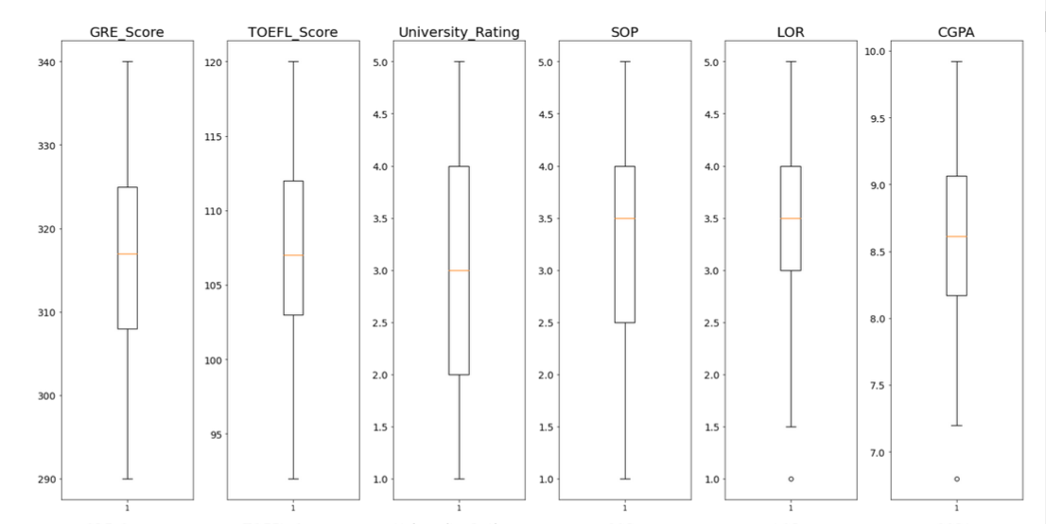
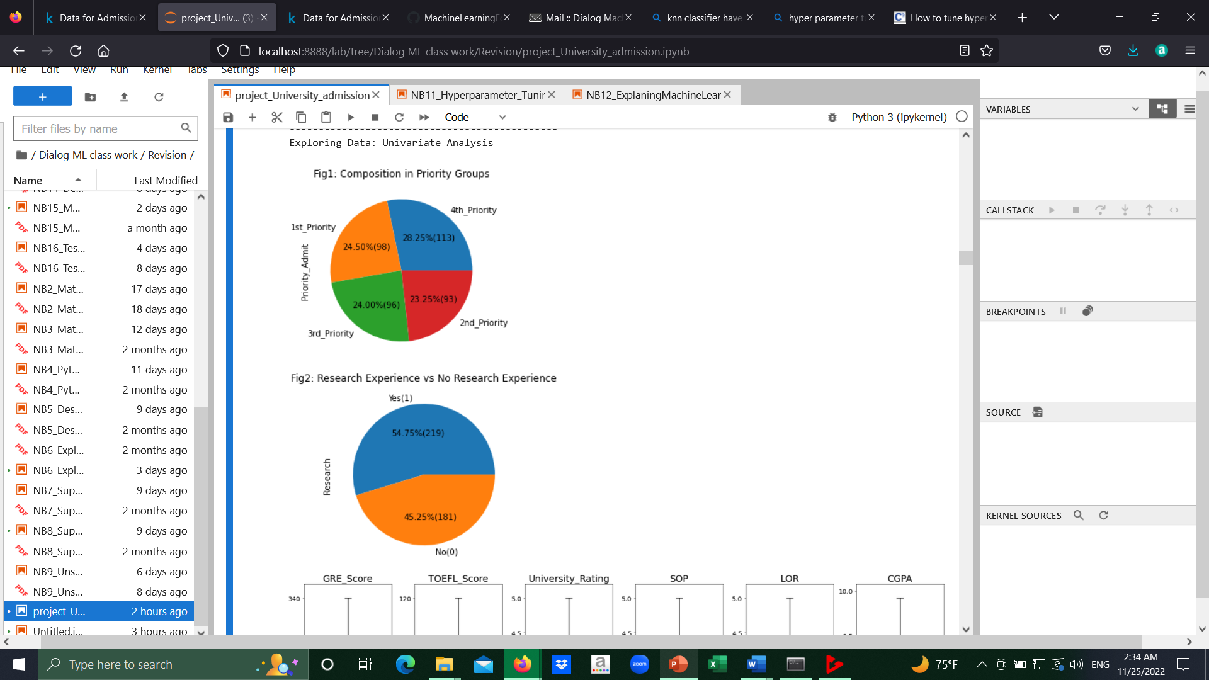
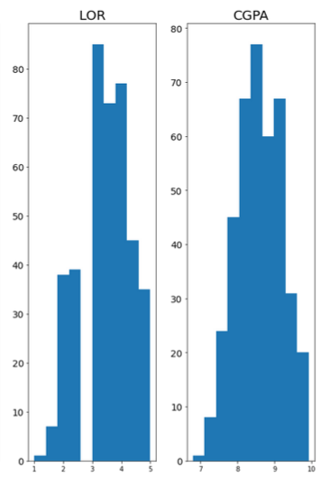
Results - Results of Data Exploration –
Univariate Analysis
Class balance exists since categorized as per quartiles
LOR, CGPA show some outliers
(as per boxplots)
No any significant impact from them
(as per histograms)
No significant difference between two groups

Slide 7
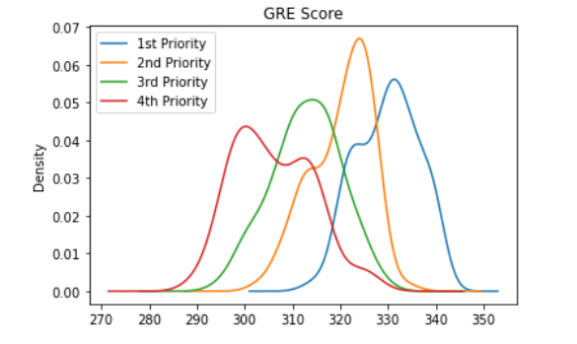
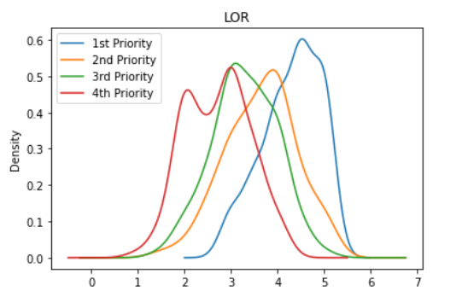
Results - Results of Data Exploration – Bivariate Analysis
Distribution functions (Density functions) of the quantitative variables drawn by group indicate that:
GRE_Score and Toefl_Score –
approximately same distributions
different mean values
SOP, LOR, and CGPA -
closely distributed functions
CGPA has different range
Descriptive Statistics by Group:
Mean of all the variables increases from less priority level to high priority level
No any significant indication that other variables have an impact from research experience.

Slide 8
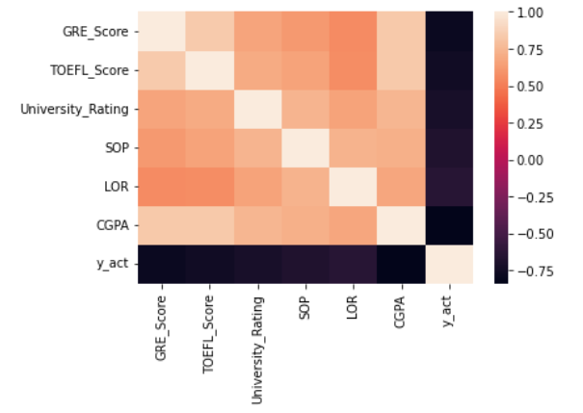
Results - Results of Data Exploration – Correlation Matrix

Slide 9
Results – Training ML Model – Hyperparameter Tuning
Model Type | f1 | Recall | Precision | Accuracy
Logistic Regression Tuned Model Parameters: {'C': 0.5} | 0.678918 | 0.675000 | 0.687430 | 0.675000
Decision Tree Tuned Model Parameters: {'max_depth': 5, 'min_samples_leaf': 10, 'min_samples_split': 2} | 0.629361 | 0.616667 | 0.673416 | 0.616667
Random Forest Tuned Model Parameters: {'min_samples_split': 20, 'min_samples_leaf': 5, 'max_depth': 100} | 0.646133 | 0.633333 | 0.670059 | 0.633333
SVC Tuned Model Parameters: {'C': 1, 'gamma': 1, 'kernel': 'linear'} | 0.652687 | 0.641667 | 0.669670 | 0.641667
Model Type | Less importance | More importance
Logistic Regression | LOR | GRE Score
Decision Tree | Research Experience and University Rating | CGPA
Random Forest | Research Experience | CGPA
SVC | GRE Score | CGPA
Fitted the models with different feature set as per the information gained through
Feature importance analysis
Correlation Matrix

Slide 10
Testing the Model
Input
 | ID | GRE_Score | TOEFL_Score | University_Rating | SOP | LOR | CGPA | Research | Chance_of_Admit | Priority_Admit_Range | Priority_Admit | y_act
183 | 184 | 314 | 110 | 3 | 4.0 | 4.0 | 8.80 | 0 | 0.75 | (0.73, 0.83] | 2nd_Priority | 2
146 | 147 | 315 | 105 | 3 | 2.0 | 2.5 | 8.48 | 0 | 0.75 | (0.73, 0.83] | 2nd_Priority | 2
Inference Pipeline
pred_prob_class1 | pred_prob_class2 | pred_prob_class3 | pred_prob_class4 | pred_class
0.251317 | 0.374074 | 0.288266 | 0.086342 | 2
0.005333 | 0.111109 | 0.329080 | 0.554477 | 4

Slide 11
Conclusion
The best Machine Learning model for this multi class classification problem
Logistics Regression model with parameter C = 0.5
LIME
f1 | Recall | Precision | Accuracy
0.678918 | 0.675000 | 0.687430 | 0.675000
Features
GRE
TOEFL
University Rating
SOP
LOR
CGPA
Research
Target variable
Priority Level (y_act)
Will explain the model prediction for a given record

Slide 12
Limitations
Issue with ROC and PRC curves:
Even though this case study indicates that the best model is logistic regression model, both the Receiver Operating characteristic (ROC) curve and Precision Recall curve (PRC) do not provide the well-fitted curves. However further study is needed to find whether there is any other model which will be best fitted with this data.
Issue when fitting logistic regression model:
Since standardization has already been applied in the program before training the model, fitted logistic regression model always gave 1 for class 1 probability. Since the issue could not be solved, the next best model (SVM) was selected. It also gave 1 always for class 1 probability. I could notice that the issue comes with Standardization. Therefore, standardization was deactivated when training model for all the model except logistic regression model.

Slide 13
THANK YOU

