Slide 1




Vendor Risk Analysis using SAP Vendor Aging

Slide 2


Problem Statement
Why Vendor Aging Analysis is Critical
Business Context
⚠ Supply Interruption
💰 Penalty Interest
In every organization, vendors supply goods and services on credit. The company records these unpaid liabilities in SAP Financial Accounting (SAP-FI) under Accounts Payable (AP).
When invoices exceed their credit period, they become overdue — creating significant financial and operational risk that must be actively monitored.
Vendor blocks new orders
Additional charges accumulate
⚖ Legal Action
📉 Cash Flow Issues
Litigation and disputes
Working capital erosion
Solution: Classify unpaid invoices into aging buckets, apply ML clustering, identify top-risk vendors, and generate AI-driven insights for proactive decision-making.
Key Objectives
Classify invoices into 5 aging buckets
K-Means ML clustering by payment risk
Identify Top 10 overdue vendors
AI chatbot for natural language queries

Slide 3
Business Impact of the Problem
Consequences of Unmonitored Vendor Aging
5
Top 10
4
0–100
Aging Buckets
High-Risk Vendors
Risk Categories
Risk Score Range
0–30 to 120+ days
Monitored continuously
Low → Critical
ML-powered scoring
Operational Impact
Financial Impact
Strategic Impact
Supply chain disruptions due to blocked vendors
Penalty interest charges on overdue balances
Reputational damage with key suppliers
Emergency procurement at premium costs
Working capital erosion and liquidity strain
Reduced credit limits from vendors
Damaged vendor relationships & trust
Cash flow mismanagement and forecasting errors
Compliance risk and audit findings
Inability to negotiate favorable terms
Legal costs from disputes and arbitration
Poor AP team performance metrics

Slide 4

Project Objectives
What this system is designed to achieve
01
Invoice Aging Classification
02
ML-Based Risk Clustering
Classify all unpaid vendor invoices from SAP BSIK into 5 aging buckets: 0-30, 31-60, 61-90, 91-120, and 120+ days overdue.
Apply K-Means clustering (k=4) to group vendors by payment behaviour — Low, Medium, High, and Critical risk categories.
03
Top Vendor Identification
04
AI Insight Generation
Identify the Top 10 vendors with the highest overdue amounts and escalate for immediate AP team review and action.
Use OpenRouter AI (Trinity-Large + Qwen3 fallback) to generate automated insights and natural language chatbot queries.
05
Interactive Dashboard
06
Performance Optimization
Render a Flask-powered web dashboard with charts, aging summaries, vendor risk tables, and an AI intelligence page.
Achieve ~90% payload reduction using gzip compression, 7-day static caching, and async JSON data loading.

Slide 5
Solution Overview
End-to-End SAP Vendor Risk Monitoring System
📁
⚙
📅
🤖
💡
📊
SAP Data
Upload
Data
Processing
Aging
Calculation
ML Risk
Clustering
AI
Insights
Dashboard
& Alerts
Stateless Architecture
Dual AI Model Fallback
90% Compression
Natural Language Query
Flask backend processes per request. No persistent DB — results saved as UUID-keyed JSON for 24 hours.
Primary: Trinity-Large (128K context). Fallback: Qwen3 (1M context) with chain-of-thought reasoning.
Gzip middleware reduces 4.4MB payloads to ~400KB. 7-day static caching with async data fetch.
AI chatbot answers questions about vendor risk, aging stats, overdue invoices using the dataset snapshot.

Slide 6
Data Sources — SAP Tables
Three core SAP Financial Accounting tables integrated via LIFNR
BSIK
LFA1
LFB1
Open Vendor Items
Vendor Master — General
Vendor Master — Company
Core Transaction Table
Vendor Identity Table
Payment Terms Config
Field
Type
Meaning
Field
Type
Meaning
Field
Type
Meaning
LIFNR
Char(10)
Vendor Number (FK joins all tables)
LIFNR
Char(10)
Vendor Number (Primary Key)
LIFNR
Char(10)
Vendor Number (FK)
BLDAT
Date
Invoice Date
NAME1
Char(35)
Vendor Name
BUKRS
Char(4)
Company Code
BUDAT
Date
Posting Date
LAND1
Char(3)
Country Code (ISO)
ZTERM
Char(4)
Payment Terms (credit days)
ZFBDT
Date
Baseline Date — payment start
WRBTR
Currency
Invoice Amount (transaction currency)
ZTERM
Char(4)
Payment Terms code

Slide 7
System Architecture
Stateless web application — Flask backend + Browser rendering
Browser (Frontend)
⚡ Performance
index.html results.html vendors.html intelligence.html
~90%
Payload Reduction
Gzip compression: 4.4MB → 400KB
Flask Backend (app.py)
Receives CSVs • Orchestrates pipeline • Jinja2 templates • AI proxy
7 days
Static Cache
Cache-Control immutable assets
ML Model (ml_model.py)
K-Means Clustering • Risk Scoring (0–100) • Feature Normalization
300s
Data API Cache
Private /api/data caching
File Storage
24 hrs
Result Expiry
UUID-keyed JSON auto-cleanup
uploads/ (auto-delete) • results/ UUID-keyed JSON (24hr expiry)
OpenRouter AI Gateway
2-model
AI Fallback
High availability intelligence
Primary: Trinity-Large (128K) • Fallback: Qwen3-Plus (1M context)

Slide 8
End-to-End Workflow
From SAP CSV upload to interactive AI-powered dashboard
1
Upload SAP Data
2
File Validation
User uploads BSIK, LFA1, LFB1 CSV files via browser
Flask validates presence & CSV format. HTTP 400 if invalid
3
Data Processing
4
Aging Calculation
Merge DataFrames on LIFNR, standardize dates, clean nulls
Compute due dates (Baseline + Credit Days), assign buckets
5
Vendor Risk Calculation
6
K-Means Clustering
Aggregate per vendor. Identify Top 10 overdue vendors
Normalize features → K-Means (k=4) → assign risk categories
7
Save JSON Result
8
Render Dashboard
UUID-keyed result saved to results/ folder (24hr expiry)
Browser fetches /api/data → renders charts, tables, AI cards

Slide 9
Aging Buckets Classification
Classifying overdue invoices into 5 risk tiers
Bucket
Days Overdue
Risk Level
Business Impact
Urgency
Bucket 1
0 – 30 Days
Mild Delay
Acceptable — monitor regularly
20%
Bucket 2
31 – 60 Days
Moderate Delay
Follow up; risk of penalty interest
40%
Bucket 3
61 – 90 Days
High Delay
Escalate — possible supply disruption
60%
Bucket 4
91 – 120 Days
Severe Delay
Urgent action; vendor may block orders
80%
Bucket 5
120+ Days
Critical Delay
Legal action risk; cash flow impact; blacklisting
100%
Example: Invoice Baseline Date = 1 Jan 2024 + Payment Terms = 30 days → Due Date = 31 Jan 2024. If unpaid after that, classified by days past due date.

Slide 10
Vendor Risk Calculation & Feature Engineering
ML inputs derived from SAP data per vendor
ML Feature Inputs
Risk Category Output
Feature
Source Field
Description
Low Risk
Cluster 0
Invoice Amount
WRBTR (BSIK)
Total value of unpaid invoice
0 – 25
Routine monitoring; maintain payment schedule
Credit Days
ZTERM (LFB1)
Allowed payment period from baseline date
Medium Risk
Cluster 1
26 – 50
Schedule review; ensure invoices are queued
Overdue Days
Calculated
Current Date minus Due Date (positive = overdue)
Transaction Frequency
Count of BSIK rows
Number of open invoices per vendor
High Risk
Cluster 2
51 – 75
Immediate follow-up; escalate to AP manager
Max Overdue Days
Calculated per vendor
Worst-case overdue invoice for the vendor
Avg Overdue Days
Calculated per vendor
Mean overdue days across all vendor invoices
Critical Risk
Cluster 3
76 – 100
Urgent payment or negotiation; legal risk
⚙ ML Pipeline: Load → Clean → Merge (LIFNR) → Feature Engineering → StandardScaler Normalization → K-Means (k=4) → Risk Scoring → JSON Result

Slide 11
AI Chatbot & Insight Generation
Intelligent natural language interface on the /intelligence page
🤖 AI Architecture
✅ Chatbot Capabilities
Vendor risk scores & categories
PRIMARY MODEL
Arcee Trinity-Large Preview (128K context)
Overdue invoice details & amounts
Standard vendor risk queries, insight generation, chatbot responses
Aging bucket statistics
Vendor payment trends
Top overdue vendor list
FALLBACK MODEL
Risk distribution summary
Qwen3-Plus (1M context)
Auto-activated if primary fails. Chain-of-thought reasoning built-in
⚠ Scope & Limitations
Cannot access external data sources
📊 Dataset Snapshot sent to AI (compressed context):
No vendor reputation data from outside dataset
Total vendors & overdue amount
High-risk & critical-risk vendor counts
History resets after page refresh
Aging bucket totals (all 5 buckets)
Risk distribution across 4 categories
Context auto-trimmed to prevent token overrun
Top overdue vendors with amounts
Country distribution & payment terms stats
Responses are Anthropic-style JSON format

Slide 12
API Endpoints Reference
Flask routes serving templates, data, and AI proxy
Method
Endpoint
Module
Purpose
POST
/analyze
ml_model.py
Accept CSV uploads, run aging + ML analysis, save JSON result
GET
/results
results.html
Load main dashboard page with charts and aging summary
GET
/vendors
vendors.html
Display vendor risk table with scores and risk categories
GET
/intelligence
intelligence.html
Load AI insights page with insight cards and chatbot
POST
/api/claude
OpenRouter proxy
Forward prompts to Trinity/Qwen3 AI; return Anthropic-style JSON
GET
/api/data
JSON response
Serve result JSON async (Cache-Control: private, max-age=300)
🔄 AI Proxy Strategy: /api/claude routes through OpenRouter with automatic 2-model fallback. Returns Anthropic-style content[].type/text JSON so frontend intelligence.js requires zero
changes when models switch.

Slide 13
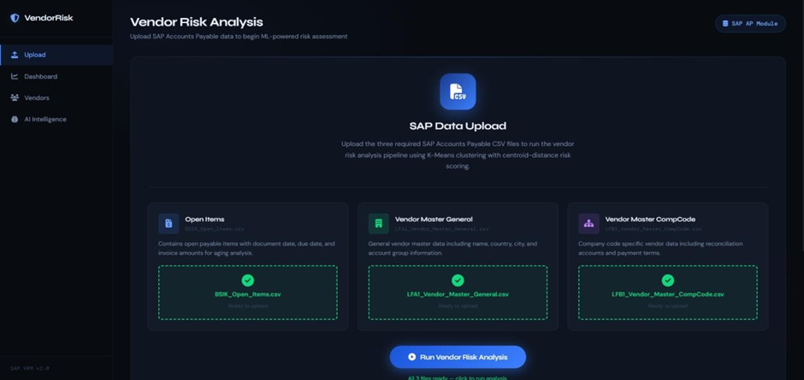
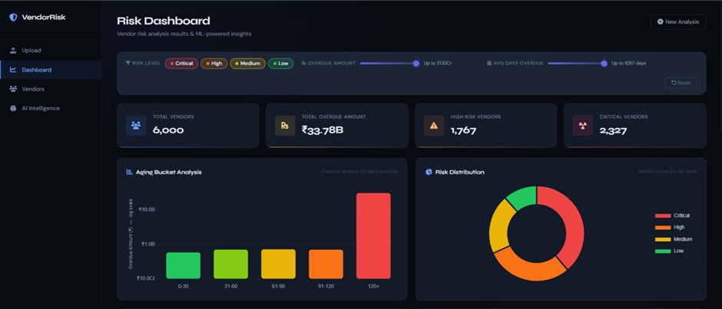
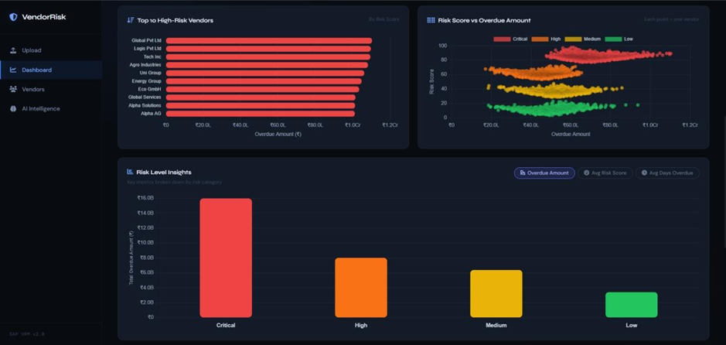
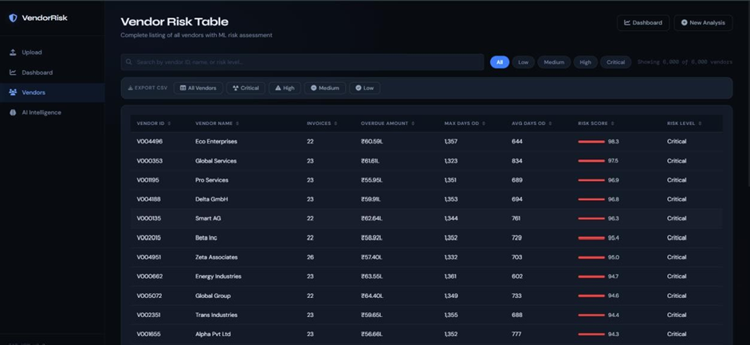
User Interface
01001000 01100101 01101100 01101100 01001000 01100101 01101100 01101100 01001000 01100101 01101100 01101100 01001000 01100101 01101100 01101100 01001000 01100101 01101100 01101100 01001000 01100101 01101100 01101100 01001000 01100101 01101100 01101100 01001000 01100101 01101100 01101100 01001000 01100101 01101100 01101100 01001000 01100101 01101100 01101100 01001000 01100101 01101100 01101100 01001000 01100101 01101100 01101100 01001000 01100101 01101100 01101100 01001000 01100101 01101100 01101100 01001000 01100101 01101100 01101100
Notes:
Notes:
The SAP Business Suite is not just another portfolio of solutions—it’s a transformation engine that creates a virtuous cycle of innovation and continuous improvement.
Here’s how it works:
Unparalleled Applications: SAP’s business applications and technology platform aren’t siloed tools; they integrate every process end-to-end. This integration ensures that every action taken within these applications generates trusted, business-critical data at its source.
Unmatched Data: We then centralize, harmonize, and enrich this data in the SAP Business Data Cloud. No matter where it’s generated—SAP or non-SAP systems—we unify it into a single source of truth. Contextualized, reliable, and accessible, this data becomes the fuel for advanced AI-driven insights
Unrivaled AI: SAP Business AI goes beyond basic automation. Through Joule, our AI copilot, employees can orchestrate intelligent agents to collaborate across functions. This breaks down silos, driving real-time, cross-enterprise optimization. Where others may deploy AI in pockets, SAP weaves it throughout your organization, unlocking value and resilience at scale.
As AI refine processes, they generate richer data that fuels even smarter decisions—creating that virtuous cycle of innovation that no one else can match.
This is what makes SAP different. We bring together applications, data, and AI like never before

Slide 14
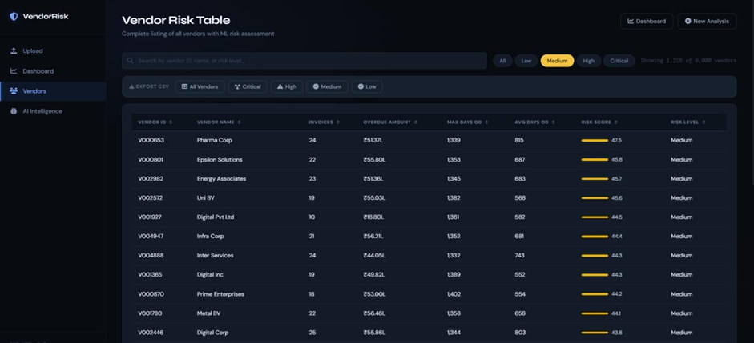
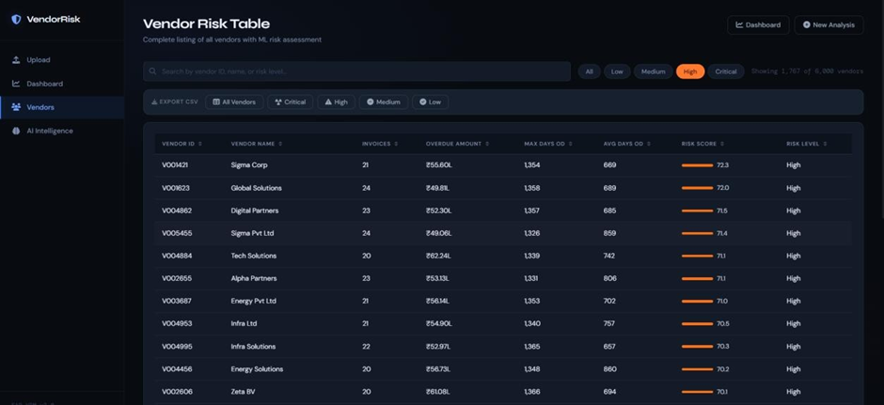
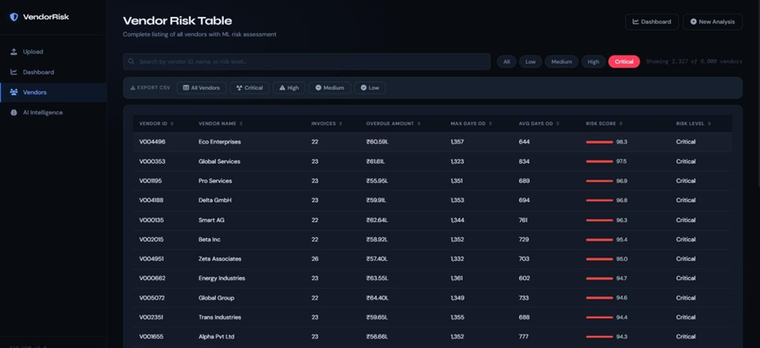
01001000 01100101 01101100 01101100 01001000 01100101 01101100 01101100 01001000 01100101 01101100 01101100 01001000 01100101 01101100 01101100 01001000 01100101 01101100 01101100 01001000 01100101 01101100 01101100 01001000 01100101 01101100 01101100 01001000 01100101 01101100 01101100 01001000 01100101 01101100 01101100 01001000 01100101 01101100 01101100 01001000 01100101 01101100 01101100 01001000 01100101 01101100 01101100 01001000 01100101 01101100 01101100 01001000 01100101 01101100 01101100 01001000 01100101 01101100 01101100
Notes:
Notes:
The SAP Business Suite is not just another portfolio of solutions—it’s a transformation engine that creates a virtuous cycle of innovation and continuous improvement.
Here’s how it works:
Unparalleled Applications: SAP’s business applications and technology platform aren’t siloed tools; they integrate every process end-to-end. This integration ensures that every action taken within these applications generates trusted, business-critical data at its source.
Unmatched Data: We then centralize, harmonize, and enrich this data in the SAP Business Data Cloud. No matter where it’s generated—SAP or non-SAP systems—we unify it into a single source of truth. Contextualized, reliable, and accessible, this data becomes the fuel for advanced AI-driven insights
Unrivaled AI: SAP Business AI goes beyond basic automation. Through Joule, our AI copilot, employees can orchestrate intelligent agents to collaborate across functions. This breaks down silos, driving real-time, cross-enterprise optimization. Where others may deploy AI in pockets, SAP weaves it throughout your organization, unlocking value and resilience at scale.
As AI refine processes, they generate richer data that fuels even smarter decisions—creating that virtuous cycle of innovation that no one else can match.
This is what makes SAP different. We bring together applications, data, and AI like never before

Slide 15
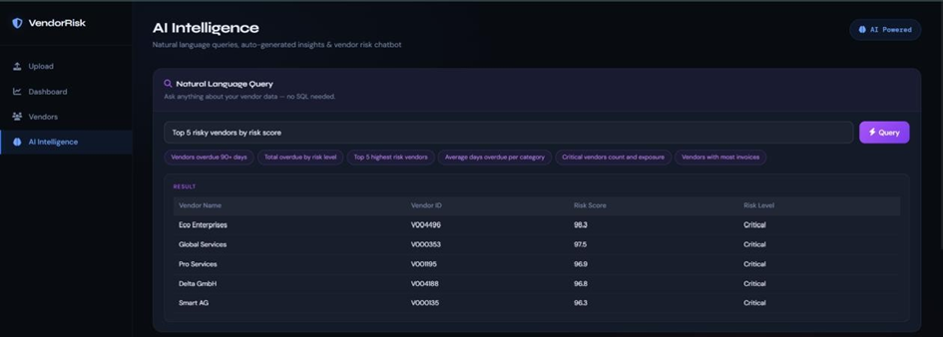
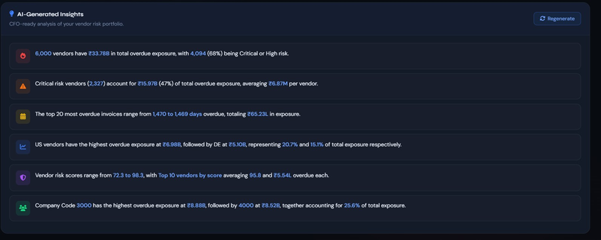
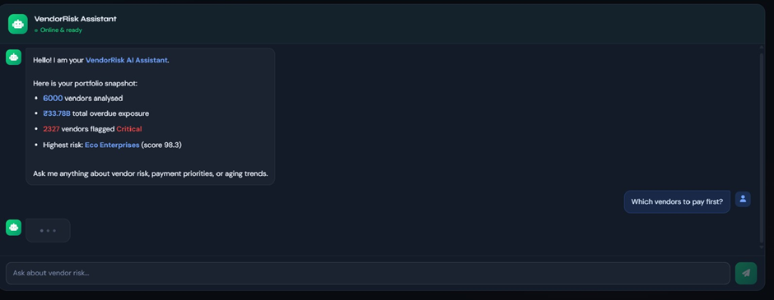
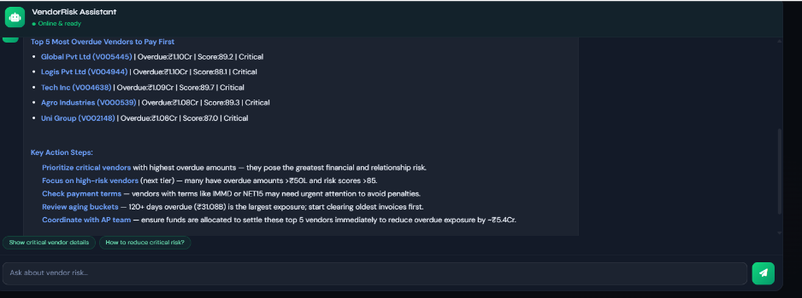
01001000 01100101 01101100 01101100 01001000 01100101 01101100 01101100 01001000 01100101 01101100 01101100 01001000 01100101 01101100 01101100 01001000 01100101 01101100 01101100 01001000 01100101 01101100 01101100 01001000 01100101 01101100 01101100 01001000 01100101 01101100 01101100 01001000 01100101 01101100 01101100 01001000 01100101 01101100 01101100 01001000 01100101 01101100 01101100 01001000 01100101 01101100 01101100 01001000 01100101 01101100 01101100 01001000 01100101 01101100 01101100 01001000 01100101 01101100 01101100
Notes:
Notes:
The SAP Business Suite is not just another portfolio of solutions—it’s a transformation engine that creates a virtuous cycle of innovation and continuous improvement.
Here’s how it works:
Unparalleled Applications: SAP’s business applications and technology platform aren’t siloed tools; they integrate every process end-to-end. This integration ensures that every action taken within these applications generates trusted, business-critical data at its source.
Unmatched Data: We then centralize, harmonize, and enrich this data in the SAP Business Data Cloud. No matter where it’s generated—SAP or non-SAP systems—we unify it into a single source of truth. Contextualized, reliable, and accessible, this data becomes the fuel for advanced AI-driven insights
Unrivaled AI: SAP Business AI goes beyond basic automation. Through Joule, our AI copilot, employees can orchestrate intelligent agents to collaborate across functions. This breaks down silos, driving real-time, cross-enterprise optimization. Where others may deploy AI in pockets, SAP weaves it throughout your organization, unlocking value and resilience at scale.
As AI refine processes, they generate richer data that fuels even smarter decisions—creating that virtuous cycle of innovation that no one else can match.
This is what makes SAP different. We bring together applications, data, and AI like never before

Slide 16
Conclusion
A complete end-to-end SAP Vendor Risk Monitoring System
The SAP Vendor Risk Monitoring System provides a complete solution for analyzing accounts payable aging and vendor payment risk. By integrating BSIK, LFA1, and LFB1 tables through the LIFNR key, the system calculates due dates, overdue days, and aging buckets — giving the finance team clear visibility into unpaid liabilities.
📊
🤖
💡
Data-Driven Analysis
Machine Learning Risk
AI Intelligence Layer
SAP BSIK, LFA1, LFB1 integrated via LIFNR. 5 aging buckets computed from baseline dates and payment terms for complete AP visibility.
K-Means (k=4) clusters vendors by payment behaviour — going beyond simple overdue thresholds to data-driven risk scoring (0–100).
Natural language chatbot and automated insights via OpenRouter AI (Trinity-Large + Qwen3 fallback), enabling conversational AP analysis.

Slide 17

Contact Us
www.bpterp.com
+91 8366800068
info@bpterp.com ; sales@bpterp.com
India
Middle East
Saudi Arabia
USA
Canada

