Slide 1

File Systems Unfit as
Distributed Storage Backends:
Lessons from 10 Years of Ceph Evolution
Abutalib Aghayev
Sage Weil (Red Hat), Michael Kuchnik, Mark Nelson (Red Hat),
Greg Ganger, George Amvrosiadis
PARALLEL DATA LABORATORY
Carnegie Mellon University
http://www.pdl.cmu.edu/
Abutalib Aghayev © Nov 5, 2019

Slide 2

What is Ceph?
  A distributed storage system started in 2004 at UCSC
  Today, a widely used object, block, and file system
S3
block device
POSIX
librados
RADOS
(distributed object store)
http://www.pdl.cmu.edu/
Abutalib Aghayev © Nov 5, 2019

Slide 3
10,000-feet View of Distributed Storage Systems
Client Nodes
● ● ●
Metadata Service
High-speed network
● ● ●
Storage Nodes
http://www.pdl.cmu.edu/
Abutalib Aghayev © Nov 5, 2019

Slide 4
Traditional Approach to Storage Backend Design
Systems that build the storage backend atop FS
  AFS [SOSP ‘87], GFS [SOSP ‘03], PanFS [FAST ’08]
  GlusterFS, Lustre, OrangeFS, BeeGFS, XtreemFS,...
Storage Backend
Why start with FS?
  Block allocation
  Metadata management
  Crash recovery
Why stick with FS?
  Performance
  Stability
  Tooling
FS (ext4/XFS/...)
SSD/HDD
It takes ~10 years for a FS to mature
http://www.pdl.cmu.edu/
Abutalib Aghayev © Nov 5, 2019

Slide 5
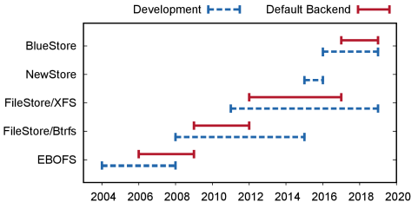




Stages of Storage Backend Grief :-)
Denial
Anger
Bargaining
Acceptance
http://www.pdl.cmu.edu/
Abutalib Aghayev © Nov 5, 2019

Slide 6
BlueStore Highlights and Takeaways
  2x speedup, checksums, transparent compression, erasure-coding
  Better performance and new features are not surprising
    Some databases bypass FS: Stonebraker [CACM ‘81]
    Exokernels: Engler et al. [SOSP ‘95], Kaashoek et al. [SOSP’ 97]
  What is surprising is that BlueStore stabilized in less than 2 years
Takeaways:
Storage backend is performance-critical, should bypass FS
A small, custom backend matures faster than POSIX FS
Full control of I/O stack accelerates new hardware adoption
http://www.pdl.cmu.edu/
Abutalib Aghayev © Nov 5, 2019

Slide 7

Challenge – Efficient Transactions
Transactional API
  It is hard to build efficient and simple transactions
    Valor [FAST ‘09], TxFS [ATC ‘18]
    Amino [TOS ‘07], Inversion [USENIX ‘93]
    QuickSilver [SOSP ‘91], TxOS [SOSP ‘09]
Storage Backend
How to build efficient
transactions?
  Ceph tried common approaches:
    Hooking into FS internals: FileStore/Btrfs
    Implementing a user-space WAL: FileStore/XFS
    Using a database with transactions: NewStore
POSIX
FS (ext4/XFS/...)
SSD/HDD
  BlueStore bypassed FS for efficient transactions
http://www.pdl.cmu.edu/
Abutalib Aghayev © Nov 5, 2019

Slide 8
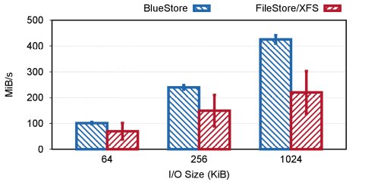
Object Write Throughput
  Bluestore avoids data journaling → ~2x higher throughput than FileStore/XFS
http://www.pdl.cmu.edu/
Abutalib Aghayev © Nov 5, 2019

Slide 9
Challenge – Controlling Writes
  OS page cache uses write-back policy
    Good for interactive system
    Bad for I/O-heavy system
1. write
2. ack
Cache
3. write
Disk
Write-back of dirty meta/data interferes with WAL writes → high tail latency
1. write
4. ack
Cache
BlueStore cache uses write-through policy
No background writes to interfere with foreground writes
2. write
3. ack
Disk
http://www.pdl.cmu.edu/
Abutalib Aghayev © Nov 5, 2019

Slide 10
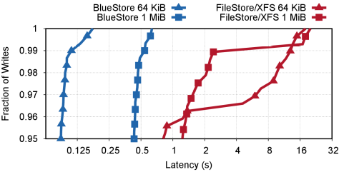
Object Write Tail Latency
  BlueStore tail latency is an order of magnitude lower than FileStore/XFS
http://www.pdl.cmu.edu/
Abutalib Aghayev © Nov 5, 2019

Slide 11
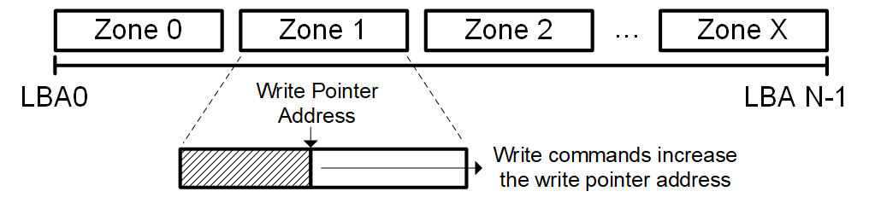
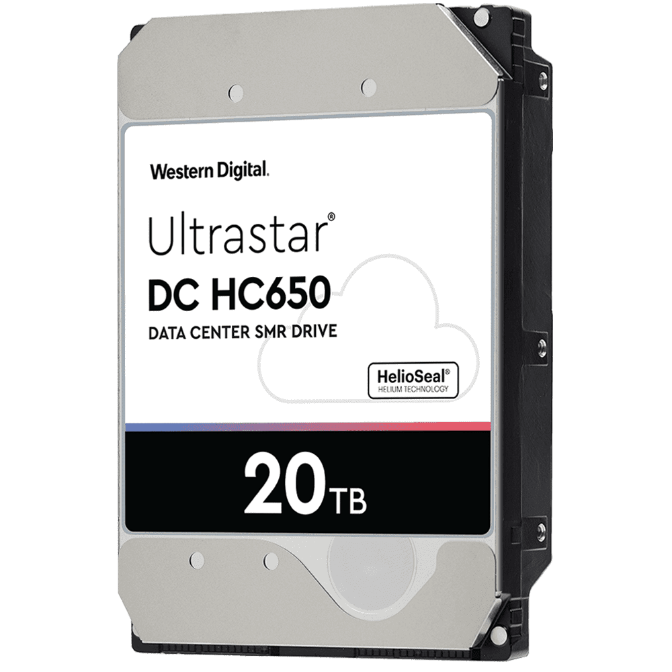
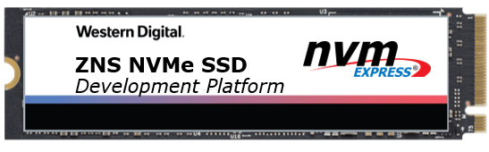
Challenge – Backward-Incompatible Hardware
  New data center drives are emerging with attractive features but zone interface
    Shingled Magnetic Recording HDDs: 20%+ extra capacity
    Zoned Namespace SSDs: no GC → low I/O tail latency
  Zone interface requires log-structured approach
    FSs are slow to adopt – need fundamental changes
    BlueStore already can store metadata; data is WIP
http://www.pdl.cmu.edu/
Abutalib Aghayev © Nov 5, 2019

Slide 12
BlueStore Design Highlights and New Challenges
    Written in user space, O_DIRECT + libaio
    All metadata in RocksDB
    RocksDB runs on minimal user space FS
    All data on raw disk; large writes are CoW
BlueStore
data
metadata
RocksDB
BlueFS
Storage Device
    BlueStore is the first step; challenges ahead:
      RocksDB compaction and write amplification limits performance
      I/O-bound workloads become CPU-bound with high-end NVMe SSDs
http://www.pdl.cmu.edu/
Abutalib Aghayev © Nov 5, 2019

Slide 13
Conclusion
  Distributed storage systems:
    Uniformly adopt file systems as backend
    Work around limitations → accidental complexity, lost performance
  Ceph experience:
    8 years wrestling file systems; <2 years to build a new backend
    Build a custom backend, win performance back, embrace new hardware
(I am on the academic job market.)
http://www.pdl.cmu.edu/
Abutalib Aghayev © Nov 5, 2019

