Slide 1
NH3
N input
Photosynthesis
N uptake
Volatilization
NO3
denitrification
labile
1
NOx, N₂O
N₂
Nitrification
NH4
aboveground
6
8
soil mineral N
heartwood
foliage
fine roots
long-term storage
sapwood
7
fruit organs
9
2
4
RA
belowground
sapwood
heartwood
Biomass
3
5
Leaching
aboveground
woody
structural
metabolic
10
12
14
Litter
RH
belowground
woody
structural
15
11
13
metabolic
N mineralization
16
Surface
Active
Slow
Passive
17
18
19
N immobilisation
ER

Slide 2
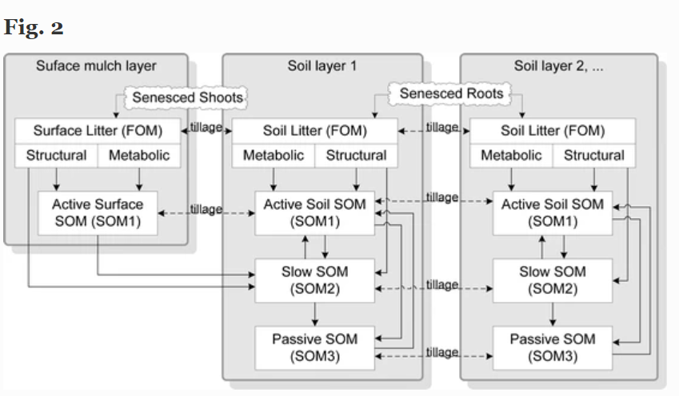
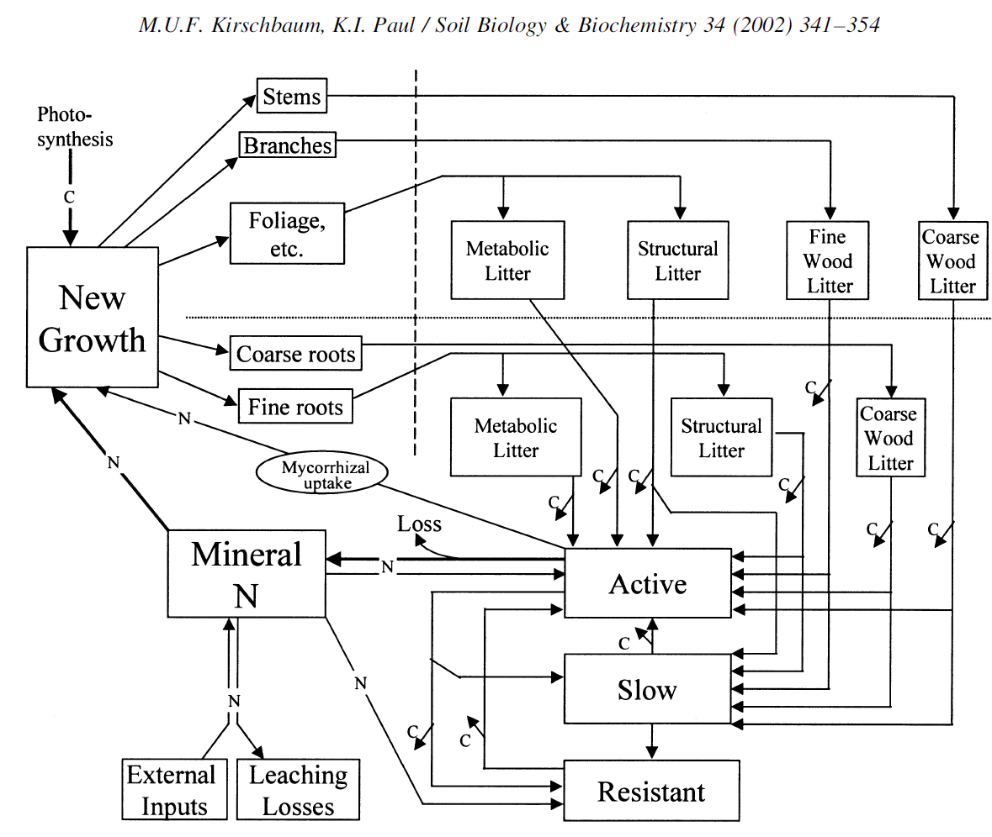
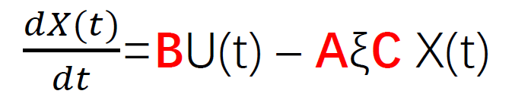
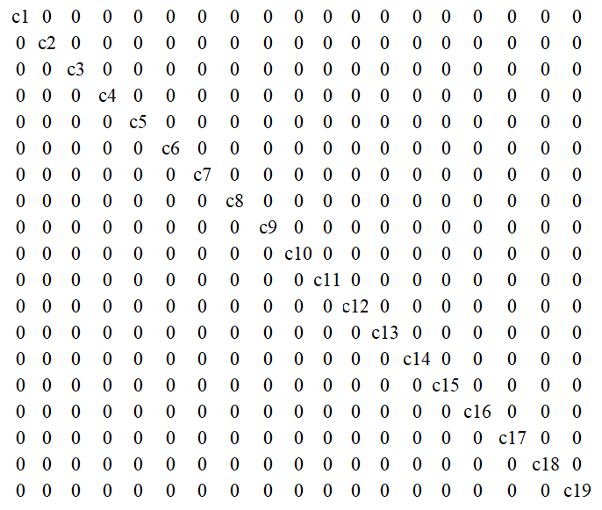
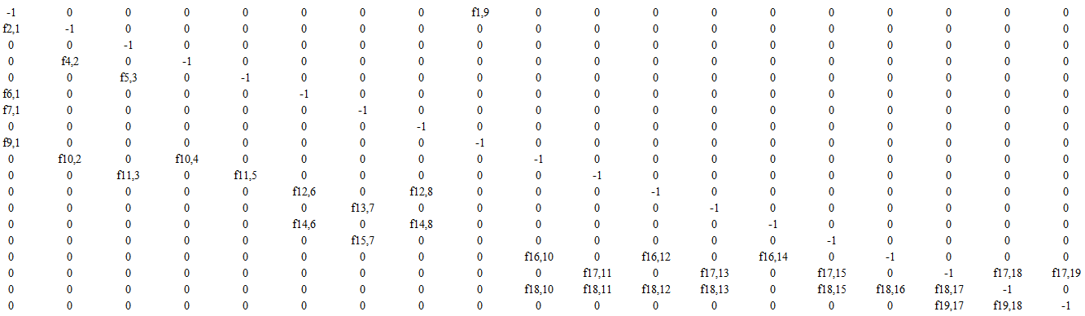
(Porter et al.,2010)
+
I

