Slide 1
1. Model name: The Integrated BIosphere Simulator (IBIS)
2. Lead PI or contact person: Wenping Yuan (Sun Yat-sen Univ.)
3. Static or dynamic vegetation: Dynamic
4. Number of plant functional types: 12
5. What disturbances are simulated (e.g., land use or fire etc.)?
Wood harvest and forest degradation, cropland harvest, fire
6. Number of pools: 10

Slide 2
GPP
CO₂
NPP
Leaf
Wood
Root
Decomposable plant matter
(leaf litter, fine roots, wood)
Structural plant matter
(leaf litter, fine roots, wood)
Resistant (lignin) plant matter
(leaf litter, fine roots, wood)
CO₂
CO₂
Protected slow C
Microbial C
CO₂
Unprotected slow soil C
CO₂
Leaching
Passive slow C
CO₂
Carbon flow diagram of IBIS

Slide 3
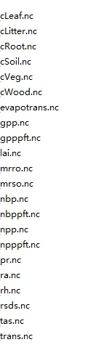
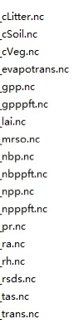
S0-S2: 22 variables
S3: 18 variables
Output variables for TRENDY

Slide 4
References
In the Trendy Project webpage, no contact for IBIS
Yuan et al. 2014. Multiyear precipitation reduction strongly decreases carbon uptake over northern China, J. Geophys. Res.- Biogeo., 119, 881–896, 2014.
(This is cited in Friedlingstein et al. 2020. Global Carbon Budget 2020. Earth Syst. Sci. Data, 12, 3269-3340)
Foley et al. 1996. An integrated biosphere model of land surface processes, terrestrial carbon balance, and vegetation dynamics, Global Biogeochem. Cycles, 10, 603-628.
(This is cited in Yuan et al 2014, but it is IBIS 1 without soil biogeochemistry model)
Kucharik et al. 2000. Testing the performance of a Dynamic Global Ecosystem Model:
Water balance, carbon balance, and vegetation structure, Global Biogeochem. Cycles, 14, 795-825
(This is IBIS 2 with soil biogeochemistry model)

