Slide 1
Matrix approach to CMIP6 and TRENDY
Working group
Model: JULES-ES
Yu Zhou
22 June 2021

Slide 2
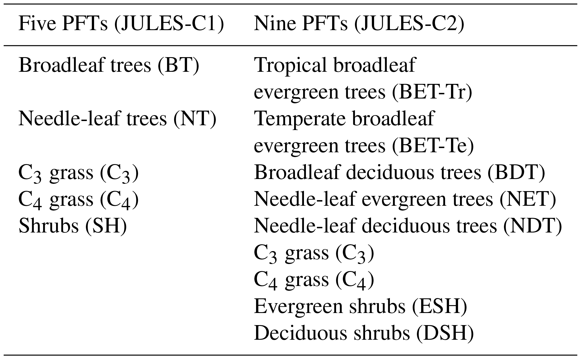
Description of a model
1. Model name
Joint UK Land Environment Simulator- Earth System Configuration (JULES-ES)
2. Lead PI or contact person and her/his affiliation
Andy Wiltshire, Met Office, UK (andy.wiltshire@metoffice.gov.uk)
For TRENDY TRIFFID/JULES: Stephen Sitch (S.A.Sitch@exeter.ac.uk)
3. Static or dynamic vegetation
Dynamic, based on dynamic global vegetation model, TRIFFID (Top-down Representation of Interactive Foliage and Flora Including Dynamics)
4. Number of plant functional types:
Extended PFTs to 13: 5 trees, 2 shrubs, 2 grasses and 4 managed land classes

Slide 3
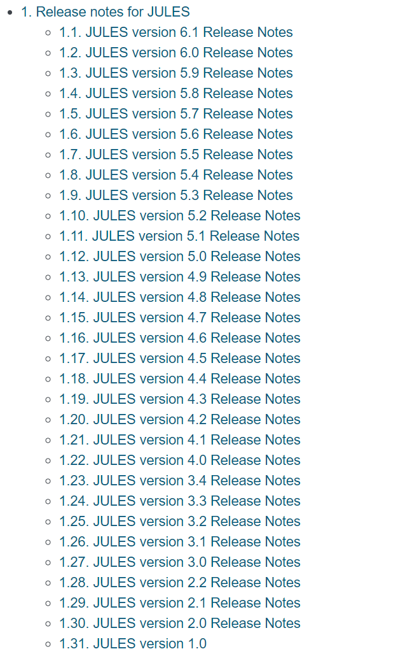
Description of a model
5. What disturbances are simulated (e.g., land use or fire etc.)
No disturbance in CIMP6 (Arora et al 2020), but Burton et al (2019) showed, in vn4.9, they have coupled the fire model INFERNO to dynamic vegetation within JULES and use the HYDE (History Database of the Global Environment) land cover dataset to analyze the impact of land-use change on the simulation of present day vegetation.
6. Number of pools
3 live carbon pools (leaf, wood, root) and 4 dead carbon pools (litter pools, and soil pool)
7. How are pools connected? (i.e., carbon flow diagram)
Slide 5
8. Outputs for CMIP6 or TRENDY
Slides 7 and 8
Used in CIMP6, which is a coupled terrestrial carbon–nitrogen scheme

Slide 4
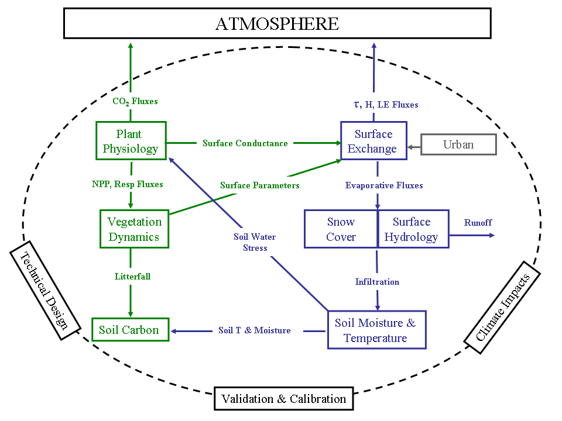
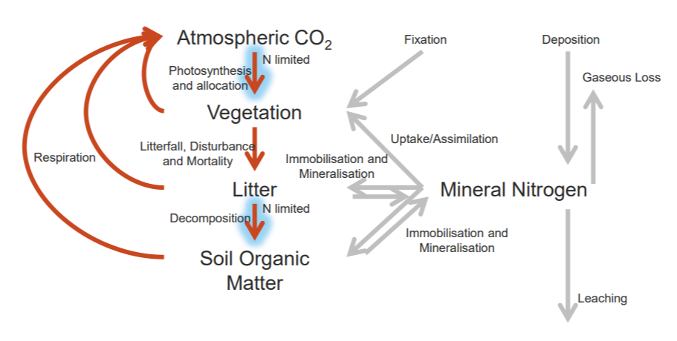
Model modules:
Source: https://jules.jchmr.org/sites/default/files/3_JULES_meeting_AWiltshire_JULES-ES.pdf
https://jules.jchmr.org/sites/default/files/AndyW_JULES-ES.pdf

Slide 5
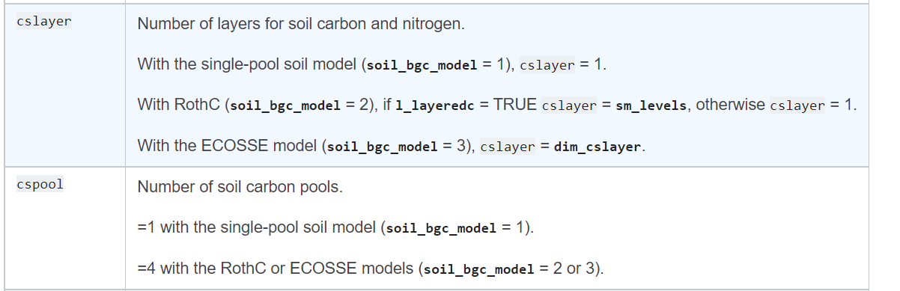
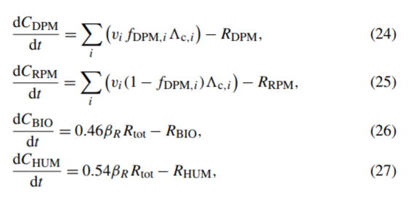
GPP
Carbon flow diagram:
Leaf
Wood
Root
Clark et al. 2011;
Wiltshire et al. 2020;
JULES Technical Documentation
Leaf
litter
Wood
litter
Root
litter
Soil C
Decomposable plant material (DPM)
Resistant plant material (RPM)
Microbial biomass (BIO)
?
Long-lived humified
(HUM)
Soil carbon is represented by the four pool RothC scheme (Coleman and Jenkinson, 1999).

Slide 6
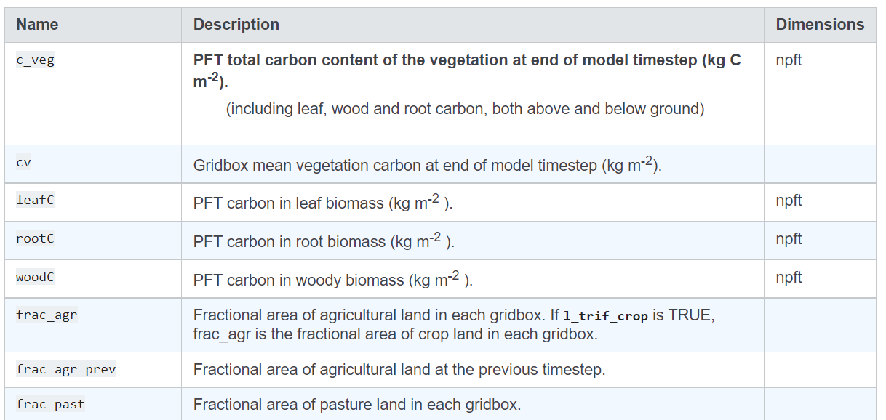
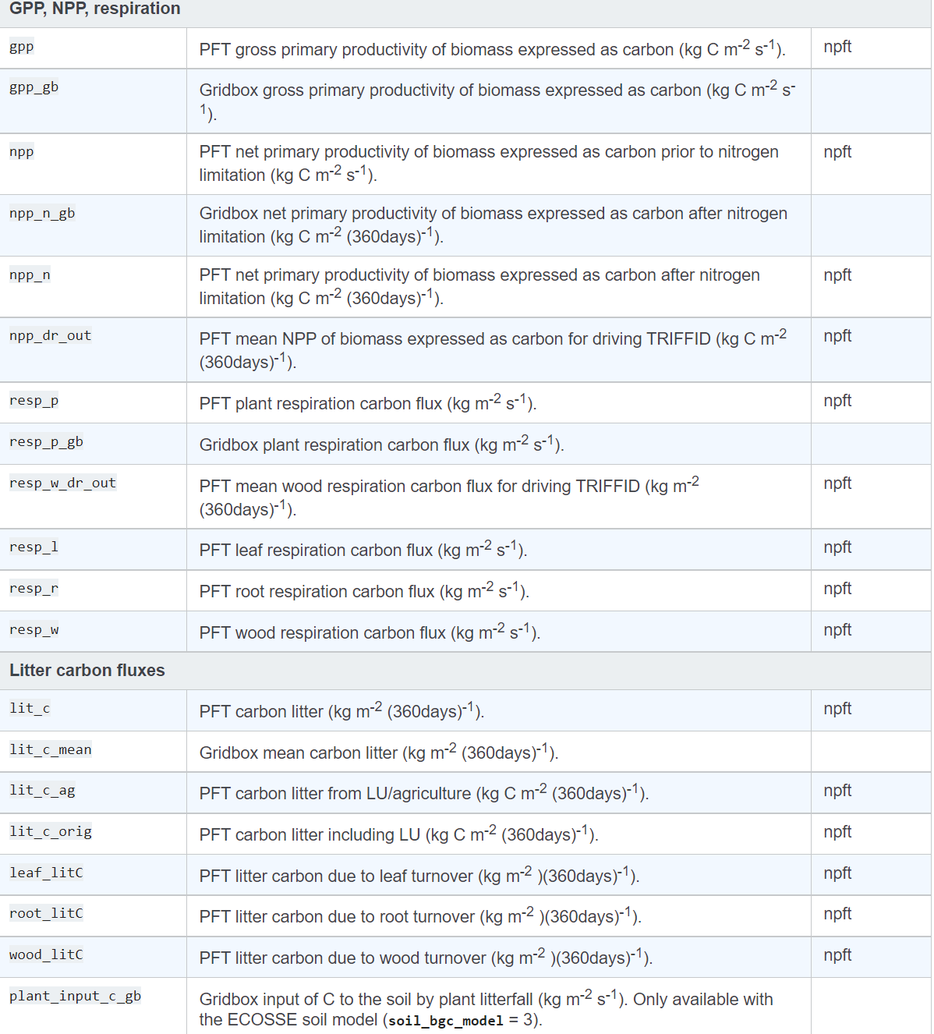
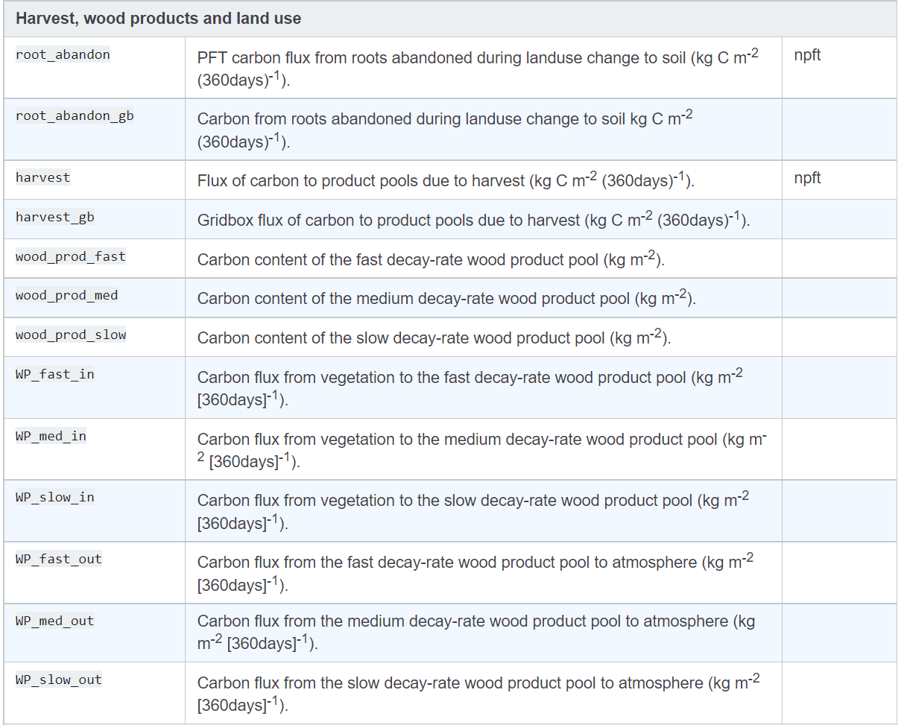
C-related output variables
C fluxes
C stock
C fluxes from harvest and land use

Slide 7
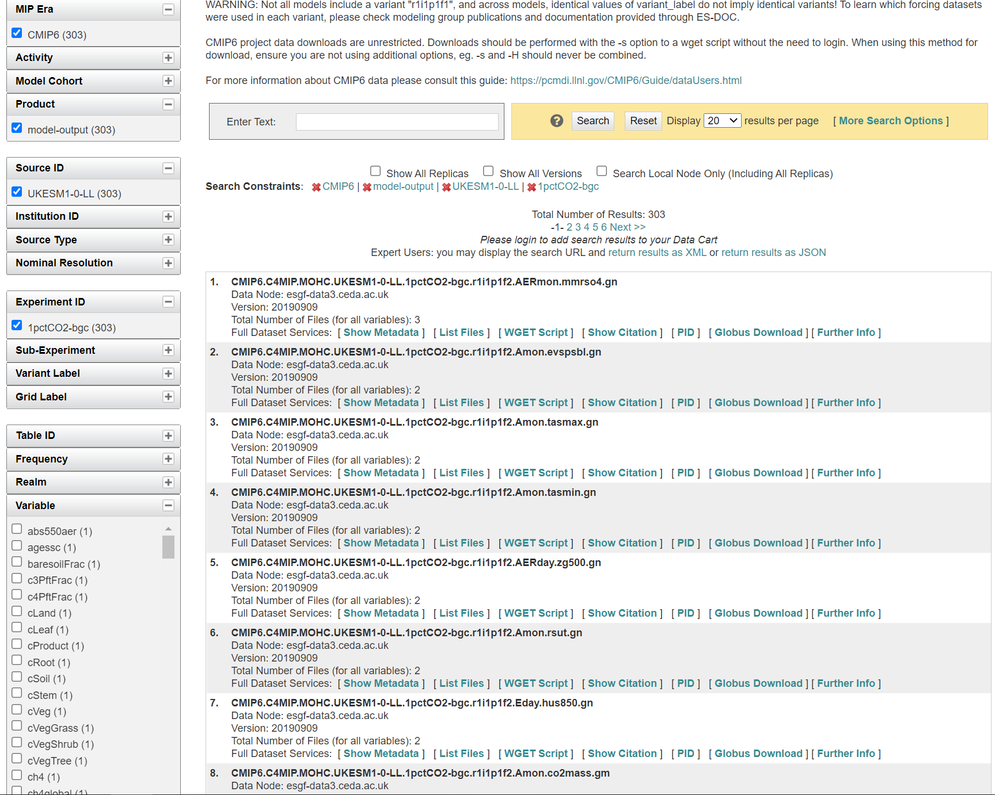
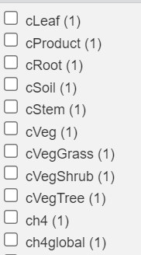
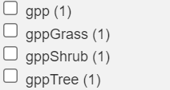
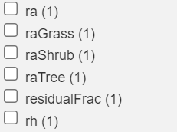
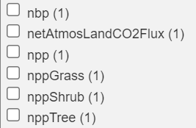
Outputs for CMIP6:
JULES-ES 1.0
https://esgf-node.llnl.gov/search/cmip6/

Slide 8
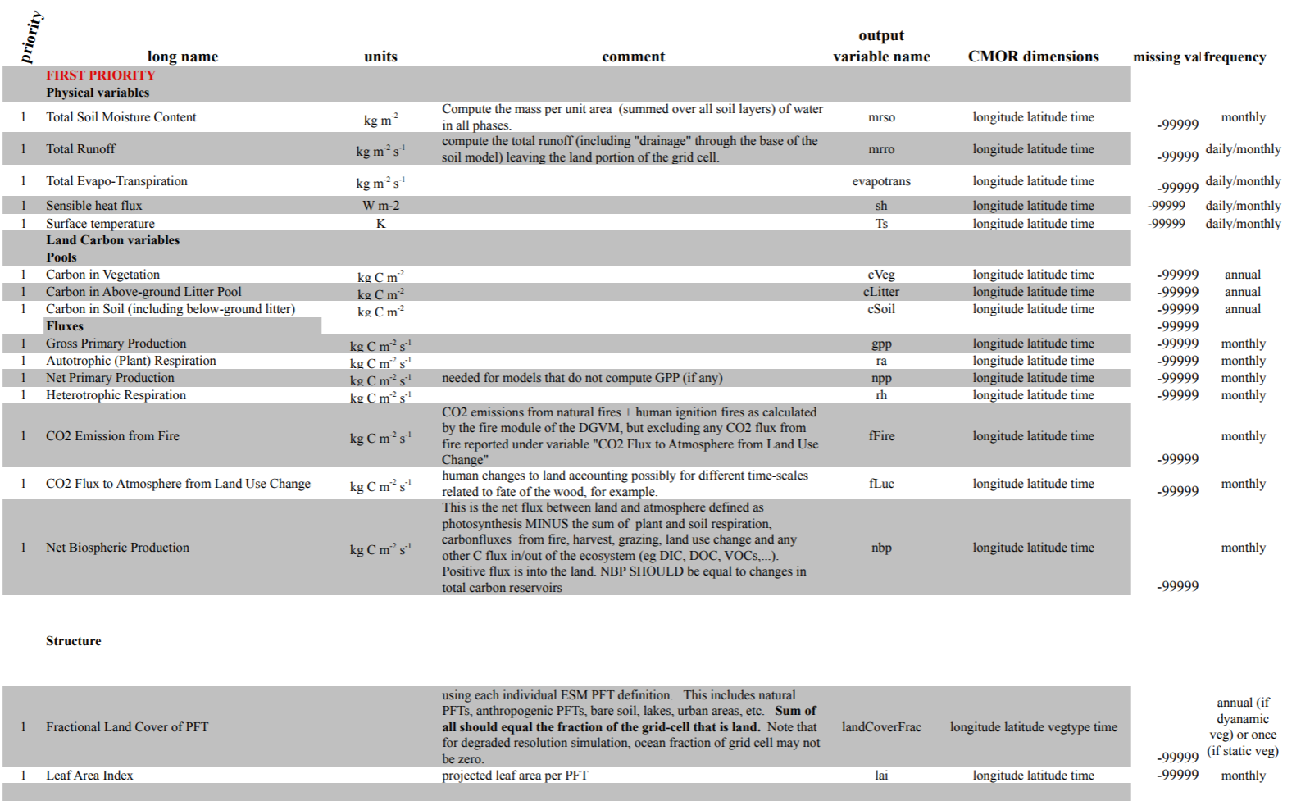
Outputs for TRENDY:
JULES
Full list of output variables: http://dgvm.ceh.ac.uk/files/Trendy_ListofVariables_Nov2011.pdf
Level 1 variables: essential

Slide 9
References:
Arora, V. K., Katavouta, A., Williams, R. G., Jones, C. D., Brovkin, V., Friedlingstein, P., Schwinger, J., Bopp, L., Boucher, O., Cadule, P., Chamberlain, M. A., Christian, J. R., Delire, C., Fisher, R. A., Hajima, T., Ilyina, T., Joetzjer, E., Kawamiya, M., Koven, C. D., Krasting, J. P., Law, R. M., Lawrence, D. M., Lenton, A., Lindsay, K., Pongratz, J., Raddatz, T., Séférian, R., Tachiiri, K., Tjiputra, J. F., Wiltshire, A., Wu, T. & Ziehn, T. 2020. Carbon–concentration and carbon–climate feedbacks in CMIP6 models and their comparison to CMIP5 models. Biogeosciences, 17, 4173-4222.
Burton, C., Betts, R., Cardoso, M., Feldpausch, T. R., Harper, A., Jones, C. D., Kelley, D. I., Robertson, E. & Wiltshire, A. 2019. Representation of fire, land-use change and vegetation dynamics in the Joint UK Land Environment Simulator vn4.9 (JULES). Geoscientific Model Development, 12, 179-193.
Clark, D. B., Mercado, L. M., Sitch, S., Jones, C. D., Gedney, N., Best, M. J., Pryor, M., Rooney, G. G., Essery, R. L. H., Blyth, E., Boucher, O., Harding, R. J., Huntingford, C. & Cox, P. M. 2011. The Joint UK Land Environment Simulator (JULES), model description – Part 2: Carbon fluxes and vegetation dynamics. Geoscientific Model Development, 4, 701-722.
Wiltshire, A. J., Burke, E. J., Chadburn, S. E., Jones, C. D., Cox, P. M., Davies-Barnard, T., Friedlingstein, P., Harper, A. B., Liddicoat, S., Sitch, S. & Zaehle, S. 2021. JULES-CN: a coupled terrestrial carbon–nitrogen scheme (JULES vn5.1). Geoscientific Model Development, 14, 2161-2186.

