Slide 1
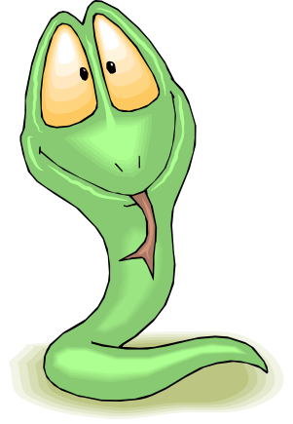
Introduction to Matplotlib
Basic plotting with python in matlab-style

Slide 2
introduction
„make easy things easy and hard things possible:“
  create simple plots with just a few commands
  “emulate” MATLABs plotting capabilities
matplotlib is conceptually divided into three parts
  Pylab interface : MATLAB like plotting
  Matplotlib API : abstract interface
  Backends : managing the output
available at (including many examples)
http://matplotlib.sourceforge.net/
GGNB - An Introduction to Python

Slide 3
Basic 2D - plotting
Matlab like example:
import numpy as np # import numpy
import pylab as pl # import pylab interface
times = np.arange ( 0, 5, 0.01 ) # define x-vector
fun = lambda x : np.cos (20 *x) * np.exp (- pl.absolute(x) )
# define some function fun (x)
pl.plot ( times, fun(times) ) # plot fun (t) vs. t
pl.xlabel ('time' ) # creating x-label
pl.ylabel ('position') # creating y-label
pl.title ( 'damped oscillation') # setting the title
pl.show() # show the plot
GGNB - An Introduction to Python

Slide 4
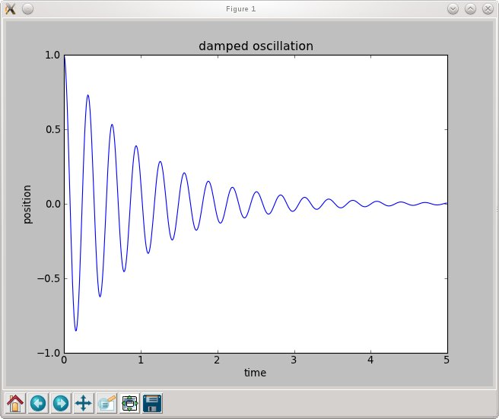
Basic 2D - plotting
line plot represents data
title and labels
toolbar for zooming, saving/exporting etc.
appearance depend on backend
GGNB - An Introduction to Python

Slide 5
Subplots
import numpy as np # import numpy
import pylab as pl # import pylab interface
times = np.arange ( 0, 5, 0.01 ) # define x-vector
fun = lambda x : np.cos (20 *x) * np.exp (- pl.absolute(x) )
fun2 = lambda x : np.sin (10 *x**2) # define two functions
pl.subplot (2,1,1) # choose a subplot ( rows, colums, idx)
pl.plot ( times, fun(times) ) # plot fun(t)
pl.subplot (2,1,2) # choose a subplot ( rows, colums, idx)
pl.plot ( times, fun2(times) ) # plot fun2(t)
pl.show()
GGNB - An Introduction to Python

Slide 6
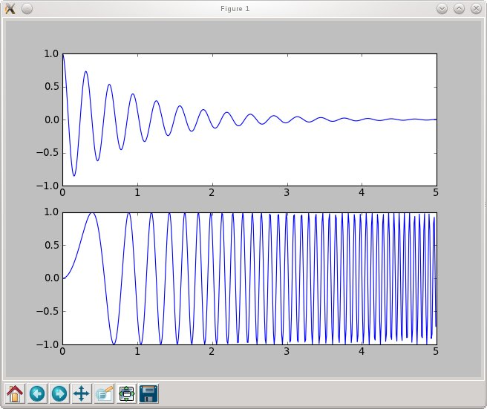
Subplots
subplot (2,1,1) :
2 columns, 1 row
choose first subplot
! Indexing starts with 1
subplot (2,1,2) :
2 columns, 1 row
choose second subplot
GGNB - An Introduction to Python

Slide 7
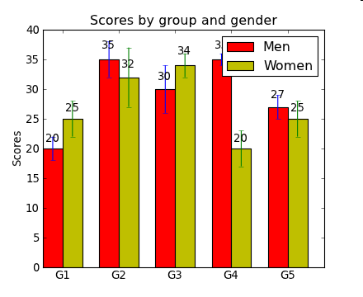
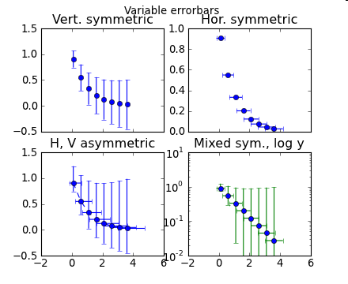
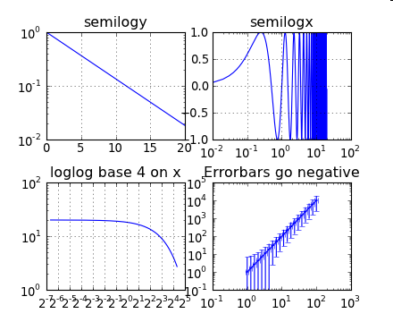
Other basic plotting commands
pl.bar () # box plot
pl.errorbar() # plot with errorbars
pl.loglog() # logarithmically scaled axis
pl.semilogx () # x-axis logarithmically scaled
pl.semilogy () # y-axis logarithmically scaled
GGNB - An Introduction to Python

Slide 8
Histograms
import numpy as np # import numpy
import pylab as pl # import pylab interface
data = 3. + 3. * np.random.randn (100000)
# generate normally distributed randonnumbers
pl.subplot (2,1,1)
pl.hist (data, 100) # make histogram with 100 bins
pl.subplot (2,1,2)
pl.hist ( data, bins = np.arange(3, 25, 0.1) )
# make histogram with given bins
pl.axis ( (3, 15,0,2000 )) # specify axis (x1,x2,y1,y2)
pl.show()
GGNB - An Introduction to Python

Slide 9
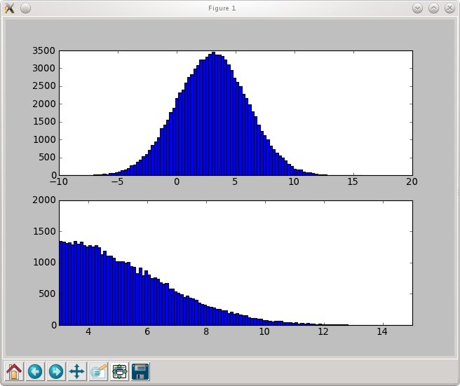
Histograms
(automatic) histogram with 100 bins
histogram for data between 3. and 25. with binsize 0.1
axis set to (3,15,0,2000)
GGNB - An Introduction to Python

Slide 10
Basic Matrix Plotting
import numpy as np # import numpy
import pylab as pl # import pylab interface
data = np.random.randn (100,100)
# generate random data
pl.pcolor (data) # plot data
pl.colorbar() # show a colorbar
pl.show()
GGNB - An Introduction to Python

Slide 11
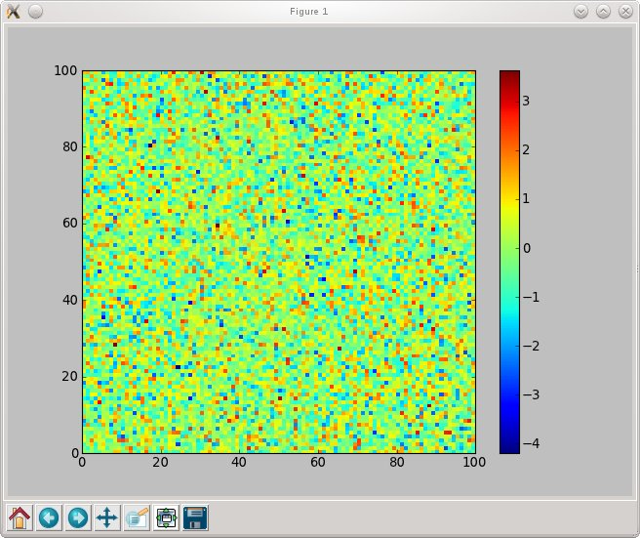
Basic Matrix Plotting
dimensions of matrix used as coordinates
entries are translated to a colorcode
GGNB - An Introduction to Python

Slide 12
2D - Functions
import numpy as np # import numpy
import pylab as pl # import pylab interface
x = np.arange ( -4, 4.01, 0.1) # x-values
y = np.arange ( -4, 4.01, 0.1) # y-values
X,Y = np.meshgrid(x,y) # Create a meshgrid !
Z = np.zeros ( X.shape ) # Matrix for function values
Z = 1./2/np.pi * np.exp ( - (X**2 + Y**2) )
pl.pcolor(X,Y,Z) # plot function
pl.axis ( (-4,4,-4,4) ) # set axis
pl.colorbar() # show colorbar
pl.show()
GGNB - An Introduction to Python

Slide 13
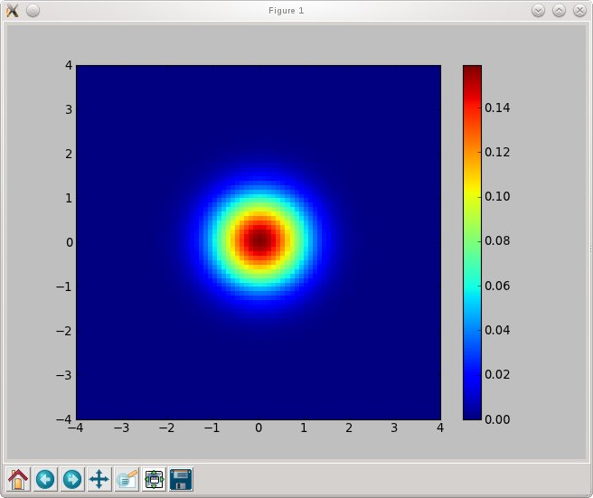
2D - Functions
0
x
1
x
1
x
1
1
:
:
:
X
=
@
x
2
x
2
x
2
A
:
:
:
:
:
:
:
:
:
:
:
:
0
y
1
y
2
y
3
1
:
:
:
Y
=
@
y
1
y
2
y
3
A
:
:
:
:
:
:
:
:
:
:
:
:
0
f
(
x
1
y
1
)
f
(
x
1
y
2
)
1
;
;
:
:
:
Z
=
@
f
(
x
2
y
1
)
f
(
x
2
y
2
)
A
;
;
:
:
:
GGNB - An Introduction to Python
:
:
:
:
:
:
:
:
:

Slide 14
Contour Plots
import numpy as np # import numpy
import pylab as pl # import pylab interface
x = np.arange ( -4, 4.01, 0.01) # x-values
y = np.arange ( -4, 4.01, 0.01) # y-values
X,Y = np.meshgrid(x,y) # Create a meshgrid !
Z = np.zeros ( X.shape ) # Matrix for function values
Z = 1./2/np.pi * np.exp ( - (X**2 + Y**2) )
pl.imshow(Z, extent=(-4,4,-4,4), cmap = pl.cm.Reds )
pl.colorbar()
pl.contour(X,Y,Z) # Creates a contour plot
pl.colorbar()
pl.show()
GGNB - An Introduction to Python

Slide 15
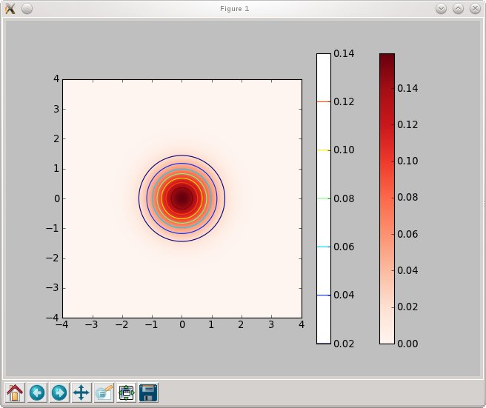
Contour Plots
GGNB - An Introduction to Python

Slide 16
Working with text
Include text with text() or annotate()
  you can use TeX (translated by matplotlib itself)
  you can use real LaTeX ( matplotlib.rc (‘text’, usetex=‘true’) )
import numpy as np # import numpy
import pylab as pl # import pylab interface
…
pl.contour(X,Y,Z) # make a contour plot
pl.text (0,3, 'function is : '+ r'$\frac{1}{2\pi} e^{- (x^2 + y^2) } $' )
# (x,y, text); r‘….‘ indicates rawtext
pl.annotate ( 'center', xy = (0,0), xytext = (-3,-3), arrowprops = {'facecolor':'black'} )
# xy <= where the arrow ends
# xytext <= position of the text
pl.show()
GGNB - An Introduction to Python

Slide 17
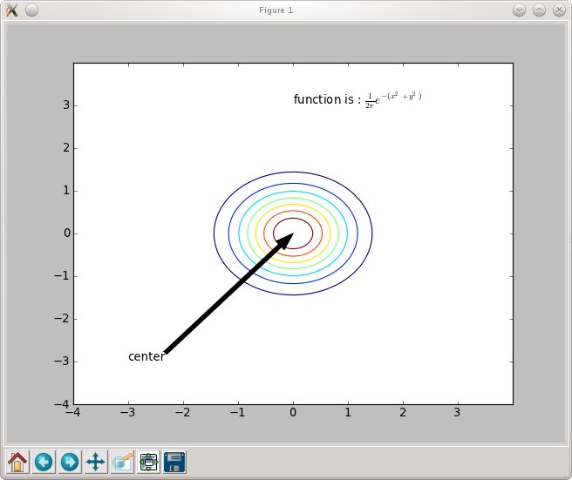
Working with text
GGNB - An Introduction to Python

Slide 18
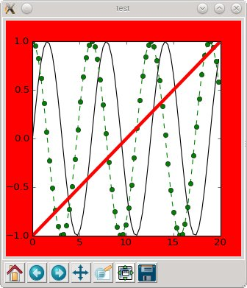
Formatting the figures (keywords)
Using pylab, properties of plots can be set by keywords:
import numpy as np # import numpy
import pylab as pl # import pylab interface
pl.figure( “test“ , figsize = (4,4), facecolor = 'r')
# create figure with title test, 4x5 inches, red backgound
x = np.arange ( 0, 20, 0.3 ) # x – values
# for basic properties: using formatstring
pl.plot (x, np.sin(x), 'k' ) # black line
pl.plot (x, np.cos(x), 'go--' ) # green dotted line with circles
# using keywords
pl.plot (x, x / 10. - 1, color = 'red', linewidth = 4)
pl.show()
For details: help(command) or http://matplotlib.sourceforge.net/
GGNB - An Introduction to Python

Slide 19
Using the API
When creating figures, subplots etc. an object reference is returned that can be used for manipulations:
import numpy as np # import numpy
import pylab as pl # import pylab interface
fig1 = pl.figure() # reurns the figure object
graph = fig1.add_subplot(111) # returns an axes object
line = graph.plot ( np.arange(10), np.arange(10)**2 )
# returns a list of lines object
xlabel = graph.set_xlabel ( 'x values' ) # returns a text object
# modify the objects
xlabel.set_color('red') # set the color of xlabel
line[0].set_linewidth(10) # set the width of the first line
graph.set_xlim(0,15) # set the extent of x-axis
pl.show()
GGNB - An Introduction to Python

Slide 20
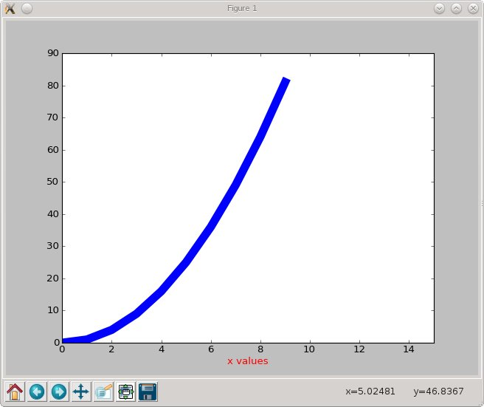
GGNB - An Introduction to Python

Slide 21
pylab.getp(), pylab.setp()
Once you have the objects, you can manipulate them via
the methods provided by the class:
  there are thousands of object.get_xxx and object.set_xxx methods
  use the <tab> or look at http://matplotlib.sourceforge.net/api
GGNB - An Introduction to Python

Slide 22
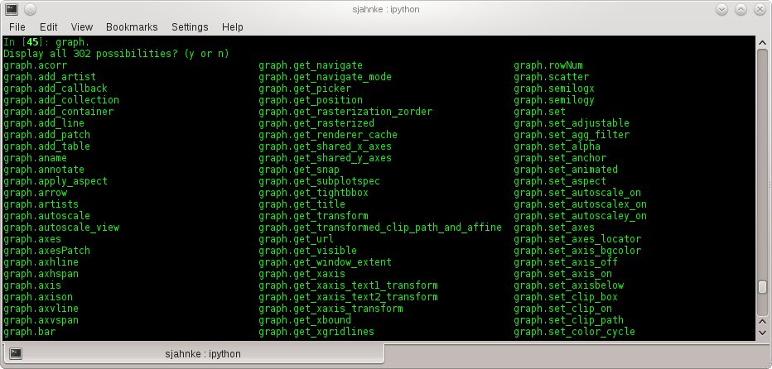
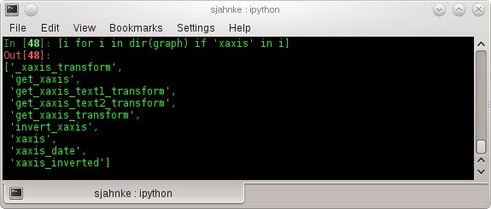
“search” through
methods:
GGNB - An Introduction to Python

Slide 23
pylab.getp(), pylab.setp()
Once you have the objects, you can manipulate them via
the methods provided by the class:
  there are thousands of object.get_xxx and object.set_xxx methods
  use the <tab> or look at http://matplotlib.sourceforge.net/api
pylab.setp() command:
  pylab.getp(obj) returns all properties of the object
  pylab.getp(obj, property) returns value of current property
  pylab.setp(obj, property) returns possible values for property
  pylab.setp(obj, propety=value)
GGNB - An Introduction to Python

Slide 24
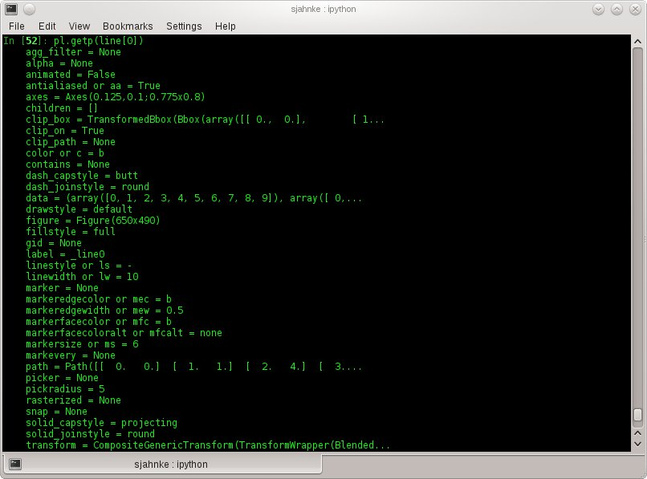
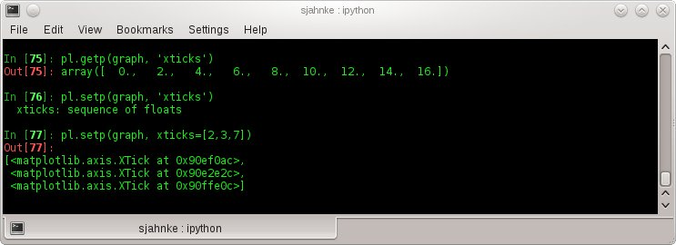
GGNB - An Introduction to Python

Slide 25
Example 1: bar plots
The task:
Plot the function in the interval
in with a red thick line.
Make a bar plot showing the upper sum (blue) and lower sum (green) approximating the Riemann integral (width = 0.4).
Hint: You can use pylab.ion() to start the interactive mode. Then the results are directly displayed. With pylab.draw() you can update the figure after changing it.
f
(
x
)
=
x
2
+
1
[
0
2
]
;
GGNB - An Introduction to Python

Slide 26
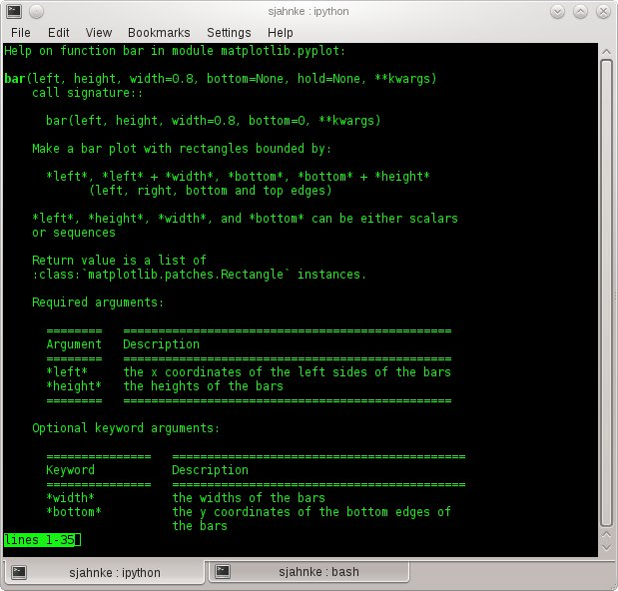
GGNB - An Introduction to Python

Slide 27
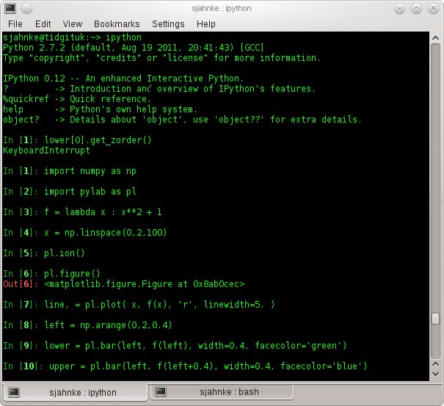
GGNB - An Introduction to Python

Slide 28
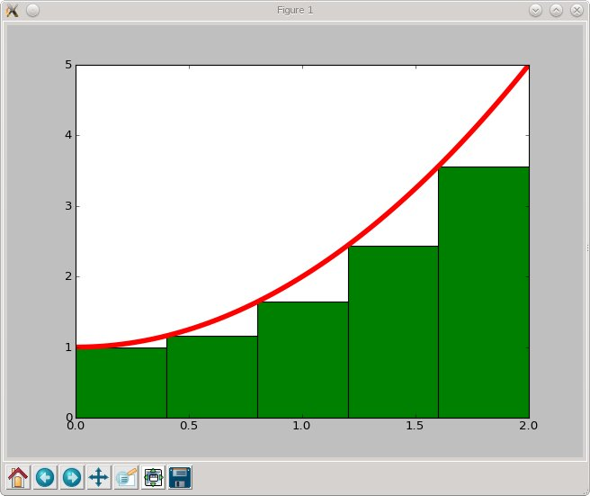
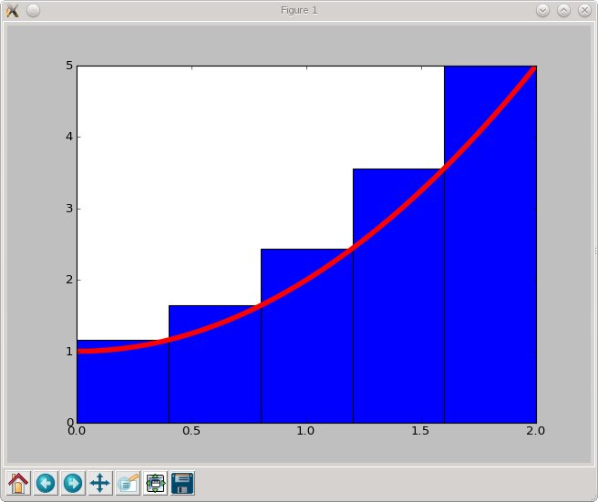
GGNB - An Introduction to Python

Slide 29
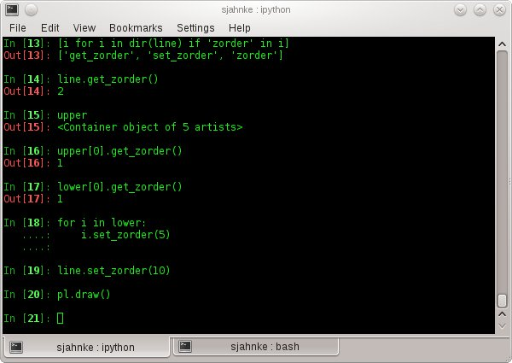
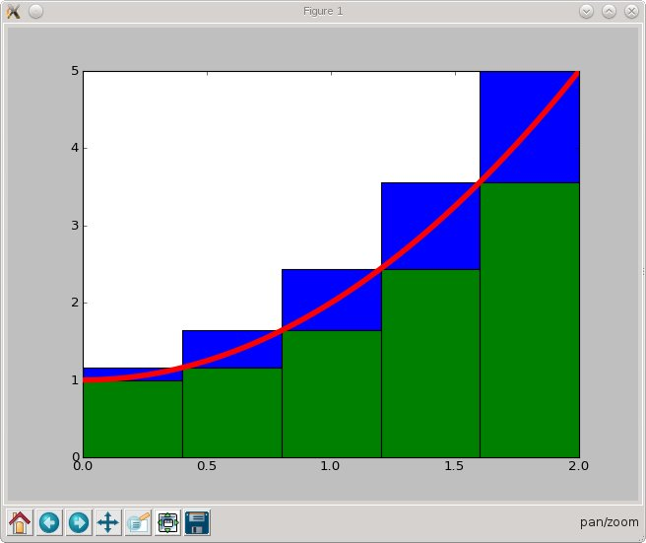
GGNB - An Introduction to Python

Slide 30
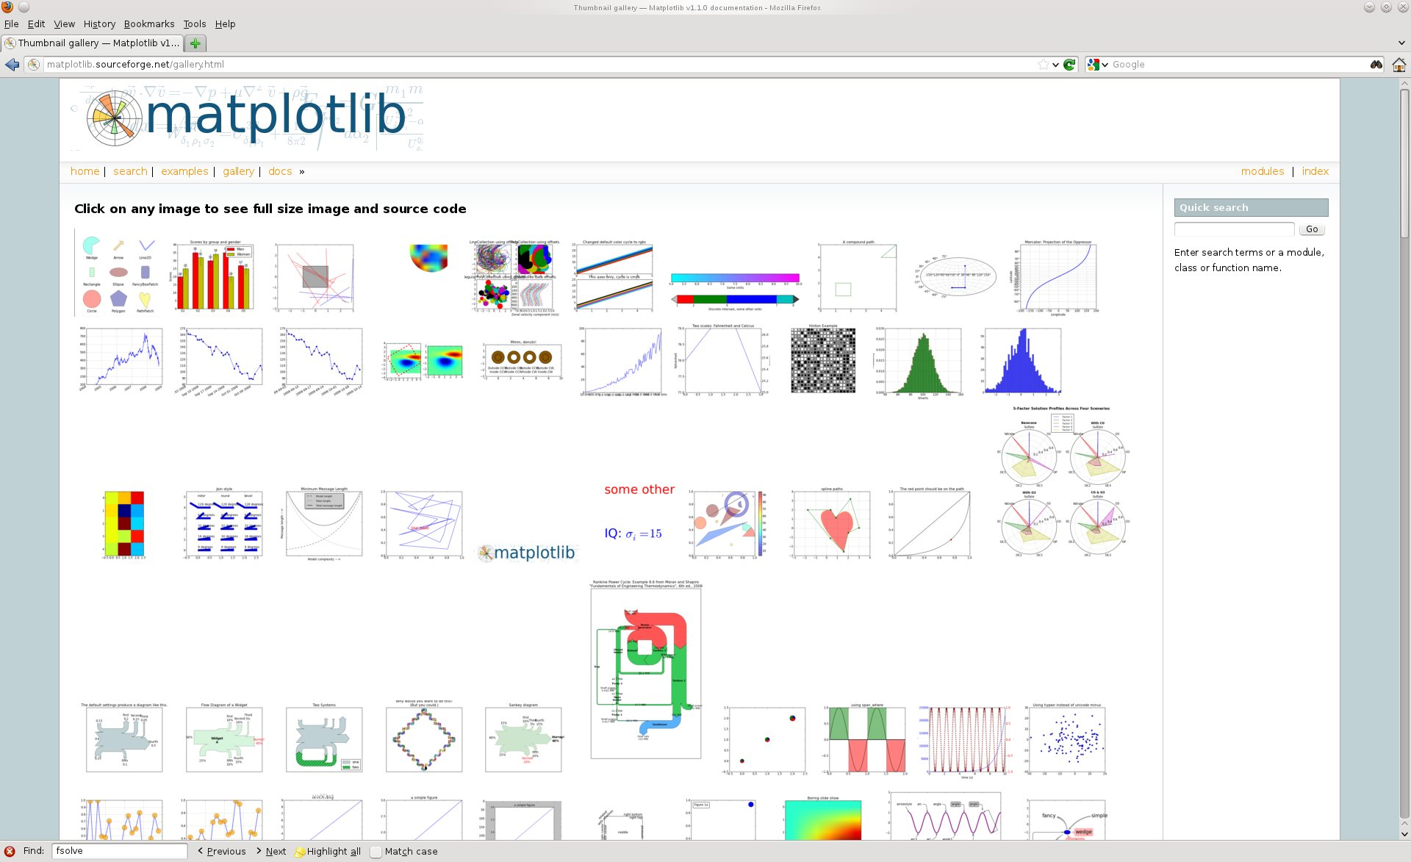
The Gallery
http://matplotlib.sourceforge.net/gallery.html
GGNB - An Introduction to Python

