Slide 1

Introduction to NumPy
Scientific Computation With Python

Slide 2
overview
there are lots of packages available for python
in particular for scientific use:
  Numpy (handling and manipulation of large arrays)
  SciPy (lots of user-friendly and efficient numerical routines)
  Matplotlib (2D plotting library)
=> provide an open source alternative to MATLAB
(http://www.scipy.org/NumPy_for_Matlab_Users)
available at
http://numpy.scipy.org/
http://matplotlib.sourceforge.net/
GGNB - An Introduction to Python

Slide 3
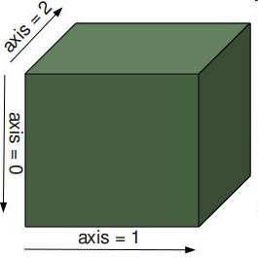
numpy array
provides a powerful N-dimensional array object:
  table of items of same type
  more efficient than python lists
can be directly created from lists
>> import numpy as np
>> a = np.array ( [1,2,3,4] )
>> import numpy as np
>> M = np.array ([ [1,2],[3,4] ] )
GGNB - An Introduction to Python

Slide 4
numpy array creation
arange() : improved range() – function
zeros(), ones() : fill with zeros or ones
eye() : identity
rand(), randn() : random matrix
>> a = np.arange ( 0, 0.4, 0.1 )
>> M1 = np.ones ( (2,2) )
>> M2 = np.zeros ( (2,3) )
! the shape has to be specified !
>> M = np.eye ( 3 )
>> M = np.random.rand ( 2,2 )
GGNB - An Introduction to Python

Slide 5
indexing & slicing
>> a = np.arange ( 0, 0.4, 0.1 )
>> a[0]
0.0
>> a[1:3]
[0.1, 0.2]
1-D arrays can be index,
sliced and iterated like lists
N-D arrays can have one index per axis
>> M [0,2]
2
>> M [:,1]
[1,4,7]
>> M[:-1,::-1]
[ [2,1,0],
[5,4,3] ]
not specified axes considered complete slices
>> M[1] # eqv. To M[1,:]
[3,4,5]
GGNB - An Introduction to Python

Slide 6
unary operations
many unary operations are implemented as methods of array class:
>> M = np.array ( [ [1,2], [3,4] ] )
>> M.sum()
10
>> M.mean()
2.5
>> M.max()
4
>> M.sum( axis=0 )
array( [4,6] )
>> M.mean( axis=0 )
array ( [2, 3] )
>> M.max( axis=0 )
array ([3,4])
“handle array like lists”
axis can be specified
More examples:
argmax(), argsort(), conjugate(), cumsum(),
conj(), imag(), real(), transpose(), …
GGNB - An Introduction to Python

Slide 7
properties of arrays
a = np.array( [ [0,1,2,3,4], [5,6,7,8,9] ] )
a.shape
(2,5)
access attributes of numpy array:
  a.shape (the dimensions) is (2,5)
  a.ndim (number of axis) is 2
  a.size (total number of elements) is 10
  a.dtype (datatype of elements) is int64
  a.itemsize (size of element in bytes) is 8
additonal datatypes:
  int8, int16, int32, int64
  float32, float64, float96
  complex64, complex128,
  complex192
can be specified with dtype
a = np.array( [ [0,1,2,3,4], [5,6,7,8,9] ], dtype=np.complex64 )
GGNB - An Introduction to Python

Slide 8
basic operations
arithmetic operations apply elementwise
new array created
>> A * B
[ [5,12],
[21,32] ]
>> A – c
[ [5,12],
[21,32] ]
>> A ** B
[ [1, 64],
[2187, 65536] ]
>> A<3
[ [True, False],
[False, False] ]
matrix product:
some operators act in
place (similar to C++):
>> np.dot (A,B)
[ [19,22],
[43,50] ]
>> A *= 2
>> print A
[ [2,4],
[6,8] ]
GGNB - An Introduction to Python

Slide 9
reshaping
reshaping an array (usually no copy):
>> x = np.arange (10)
>> M = x.reshape(2,5)
>> N = x.reshape(5,-1)
>> O = x.reshape(3,-1)
==> returns an error
“-1” means whatever needed
modifying x, M or N modifies all objects
working with copies:
>> x = np.arange (10)
>> O = x.copy().reshape(2,5)
>> O[0,0] = 40
x is unchanged
GGNB - An Introduction to Python

Slide 10
resizing
resize an array with resize():
>> X = np.arange(10)
>> X.resize(3,3)
>> Y = np.arange(7)
>> Y.resize(3,3)
references may impede resizing:
>> x = np.arange (10)
>> M = x.reshape(2,5)
>> M.resize(3,3)
==> error: does not own data
>> x.resize(3,3)
==> error: referenced by other array
>> del M; x.resize(3,3)
==> this works
alternatively use a copy:
>> y = x.copy().resize(3,3)
>> y = np.resize(x, (3,3) )
GGNB - An Introduction to Python

Slide 11
fancy indexing
Indexing with arrays of indices
>> x = np.arange ( 0, 10, 2)
>> idx = np.array ( [0,4,4,2])
>> y = x [ idx ]
>> print y
[0, 8, 8, 4 ]
also works with N-dimensional index arrays
>> x = np.arange ( 0, 10, 2)
>> idx = np.array ( [[0,4] , [4,2] ])
>> M = x [ idx ]
>> print M
[ [0, 8],
[8, 4 ] ]
GGNB - An Introduction to Python

Slide 12
fancy indexing II
also can present higher dimensional index
>> A = np.arange (9).reshape(3,3)
>> i = np.array ( [0, 2] )
>> j = np.array ( [1,2] )
>> x = A [ i, j ]
>> B = A [ i,: ]
µ
1
0
¶
i
=
>> i = np.eye (2, dtype = int )
>> j = np.ones( (2,2), dtype = int)
>> C = A[ i, j]
0
1
µ
1
1
¶
j
=
1
1
GGNB - An Introduction to Python

Slide 13
fancy indexing III
Boolean indexing, explicitly choose the elements
>> A = np.arange(1,5).reshape(2,2)
>> idx = np.array ( [ [True, False], [True, True] ])
>> x = A [ idx ]
>> idx = [ [True, False], [True, True] ]
>> y = A[idx] # !be careful
>> idx = A<3
>> z = A[idx]
GGNB - An Introduction to Python

Slide 14
universal functions
Numpy provides a useful set of mathematical functons. They are called „universal functions“ and work elementwise.
>> x = np.arange(5)
>> np.sqrt (x)
[0., 1., 1.41421, 1.730225]
>> x = np.arange(5)
>> np.exp (x)
[1., 2.71828, 7.3891, 20.0855]
Fast and very usefull for data processing,
  eg. consider you have a list with data
>> absdata = [abs(i) for i in data ] #have to iterate over list
>> absdata = np.abs(data) #can direclty manipulate array
arccos, arctan, ceil, conjugate, cos, exp, fabs, floor, fmod, log, log10, sin, sinh, sqrt, …
GGNB - An Introduction to Python

Slide 15
Scipy package
Based on the numpy package scipy provides advanced methods for science and engineering:
  Constants (scipy.constants)
  Fourier transforms (scipy.fftpack)
  Integration and ODEs (scipy.integrate)
  Interpolation (scipy.interpolate)
  Linear algebra (scipy.linalg)
  Orthogonal distance regression (scipy.odr)
  Optimization and root finding (scipy.optimize)
  Signal processing (scipy.signal)
  Special functions (scipy.special)
  Statistical functions (scipy.stats)
  C/C++ integration (scipy.weave)
  And more …
Check: http://docs.scipy.org/doc/
GGNB - An Introduction to Python

Slide 16
Example 1: some numpy
The task:
How many of the first million numbers are dividable by 7?
(Yes, please really test the numbers ☺)
  Implement a function using a for loop to do the task.
  Use list comprehension to do the task.
  Use numpy and avoid loops at all.
Use the “magic function” %timeit to compare the
runtimes of the three versions.
How many of the first million numbers are dividable by 3 and 7?
GGNB - An Introduction to Python

Slide 17
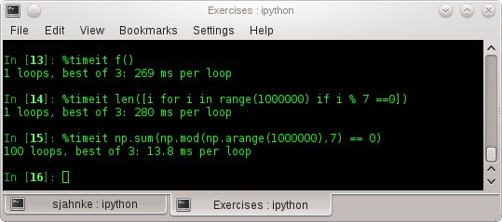
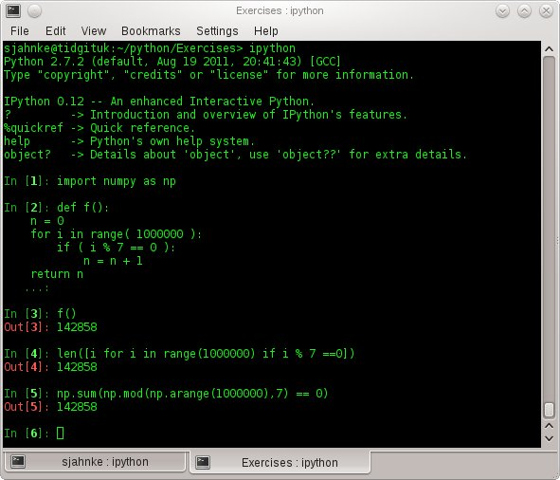
numbers
GGNB - An Introduction to Python

Slide 18
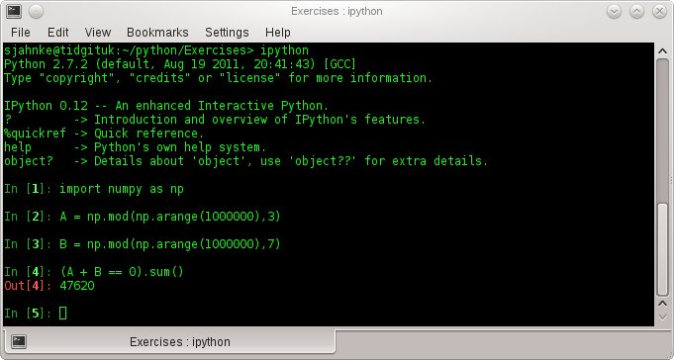
numbers
GGNB - An Introduction to Python

Slide 19
Ex. 2: solving system of linear eqns
The task:
You find three shopping bags with following content:
bag A: 10 kg apples, 5 kg pears, 1 kg oranges (35.35 EUR)
bag B: 1 kg apples, 8 kg pears, 1 kg oranges (24.91 EUR)
bag C: 9 kg apples, 3 kg pears, 5 kg oranges (40.38 EUR)
Determine the price of apples, oranges and pears.
(a) Formulate a linear system of equations describing the shopping bags.
(b) Use scipy.linalg.solve() to solve the system of equations.
(c) Verify the results by using numpy.dot()
GGNB - An Introduction to Python

Slide 20
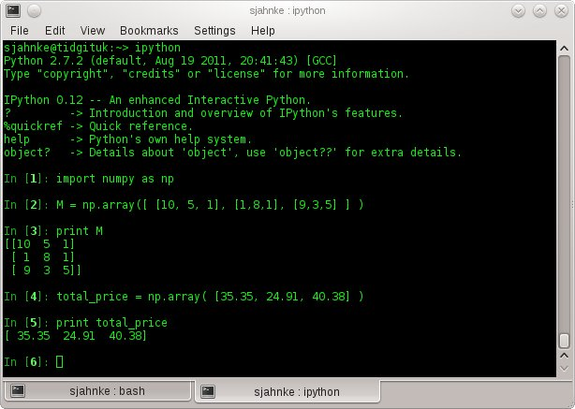
Create the matrix
GGNB - An Introduction to Python

Slide 21
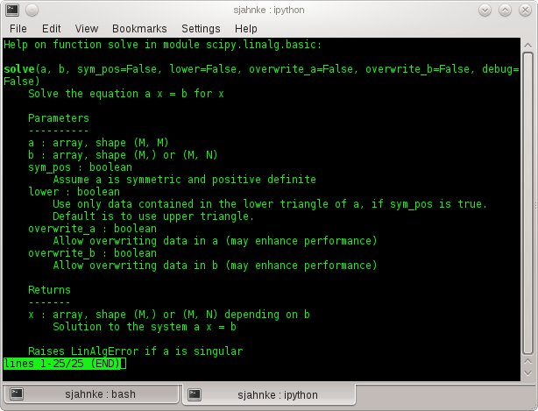
>> import scipy.linalg as la
>> help(la.solve)
GGNB - An Introduction to Python

Slide 22
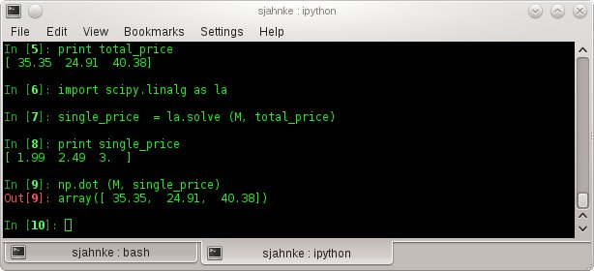
Solve the equations
GGNB - An Introduction to Python

Slide 23
Example 3: polynomial fitting (polyfit)
The task:
Generate data by a polynomial function
Fit a polynomial ( scipy.polyfit() ) and recover the coefficients of the polynomial.
Try the same procedure with noisy data.
( use np.random.randn() to add noise to the data)
GGNB - An Introduction to Python

Slide 24
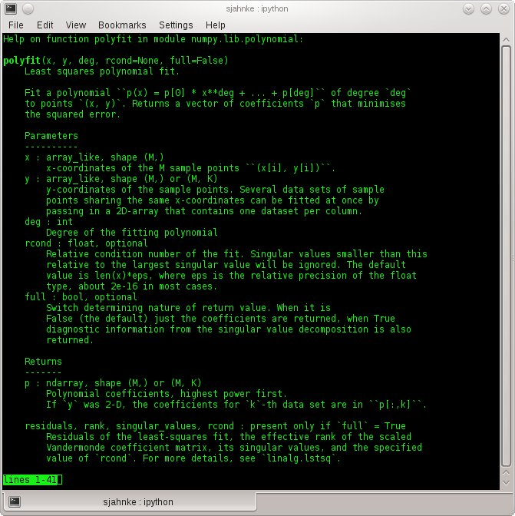
>> import scipy as sc
>> help(sc.polyfit)
GGNB - An Introduction to Python

Slide 25
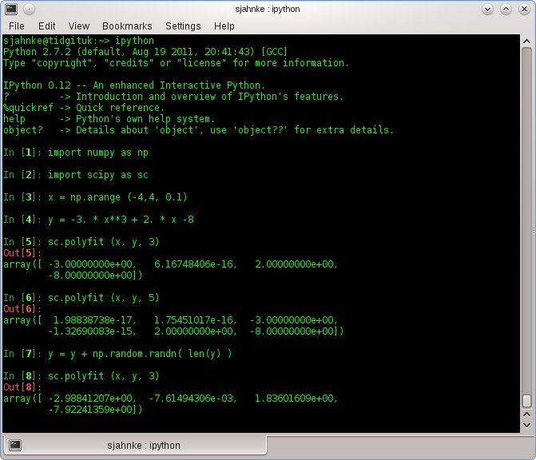
Polynomial fitting
GGNB - An Introduction to Python

Slide 26
Example 5: nonlinear fitting
The task:
Define the function
Generate noisy data from that function with parameters
Make a simple plot of the data
Use scipy.optimize.curve_fit() to estimate a and b from the
data and plot the results.
>> import pylab as pl
>> pl.plot ( xvalues, yvalues )
>> pl.show()
GGNB - An Introduction to Python

Slide 27
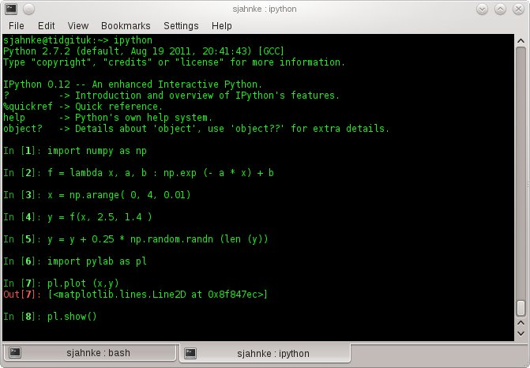
Generate and plot data
GGNB - An Introduction to Python

Slide 28
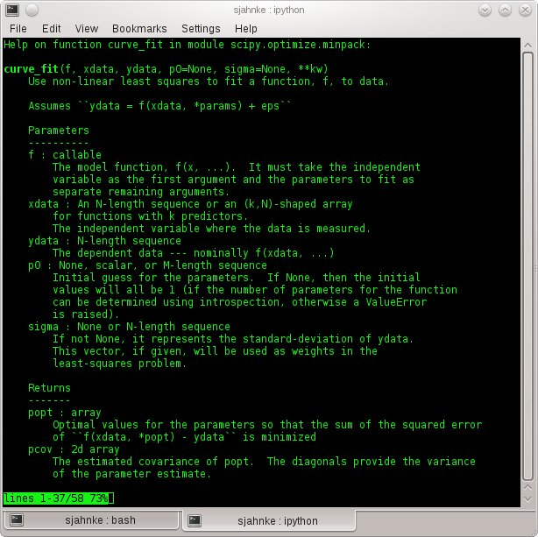
>> import scipy.optimize as opt
>> help( opt.curve_fit )
GGNB - An Introduction to Python

Slide 29
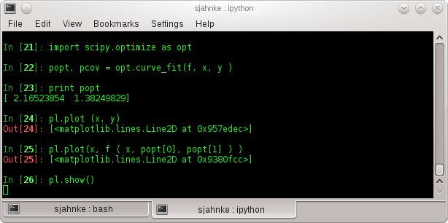
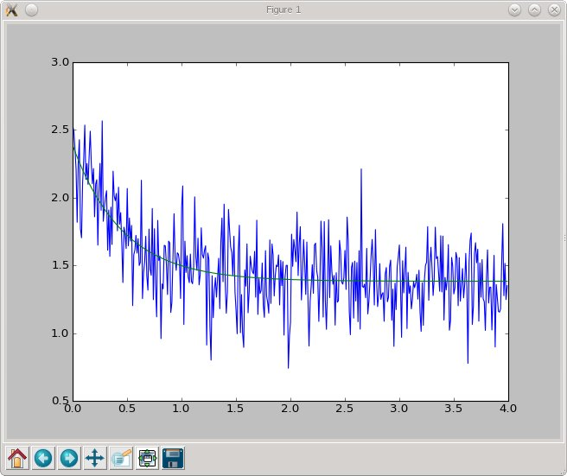
Nonlinear curve - fitting
GGNB - An Introduction to Python

Slide 30
Example 6: integration
The task:
Define the function
Vectorize the function by using np.vectorize() such that
the function also accepts lists of xvalues.
Calculate the integral by “hand”
using Riemann sums.
Use scipy.integrate.quad() to evaluate the integral.
Try to calculate and
GGNB - An Introduction to Python

Slide 31
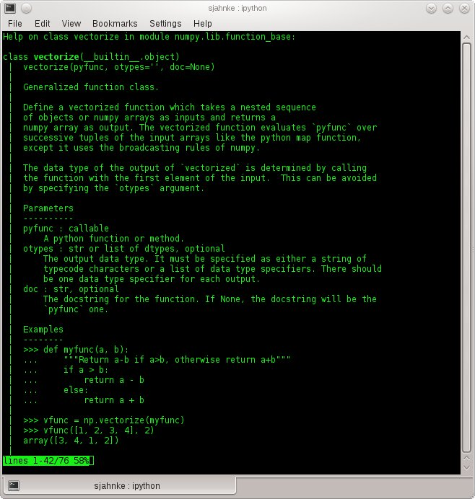
>> import numpy as np
>> help(np.vectorize)
GGNB - An Introduction to Python

Slide 32
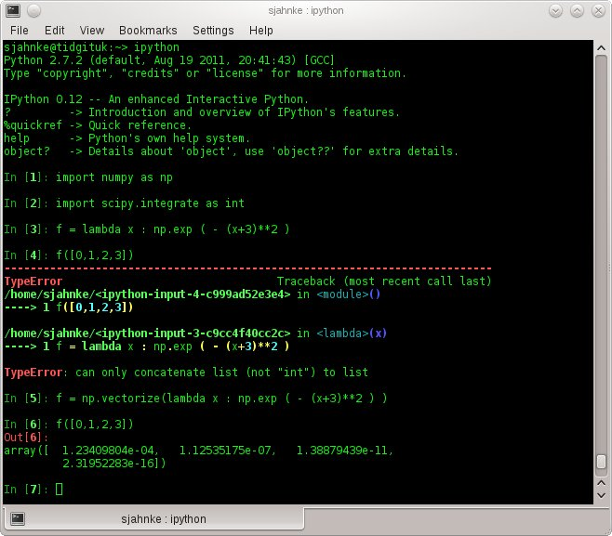
Vectorize a function
GGNB - An Introduction to Python

Slide 33
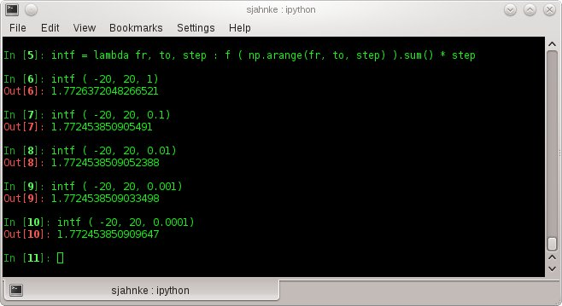
Calculating the Riemann sum
GGNB - An Introduction to Python

Slide 34
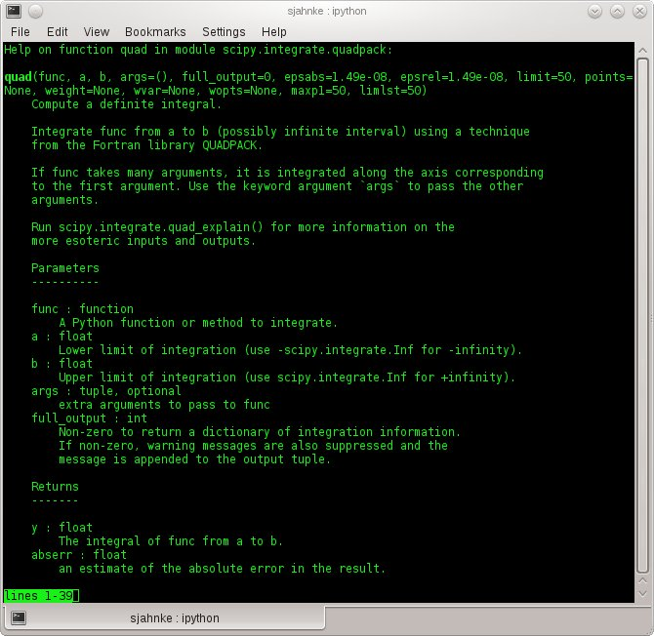
>> import scipy.integrate as int
>> help(int.quad)
GGNB - An Introduction to Python

Slide 35
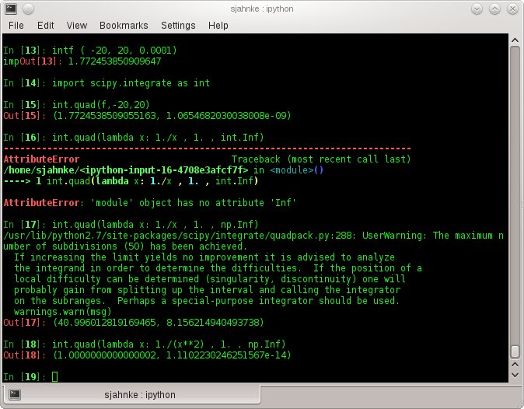
Calculating integrals using scipy.integrate.quad()
GGNB - An Introduction to Python

Slide 36
Example 7: Lotka-Voltera equation
The task:
Consider the Lotka-Voltera equation (predator-prey-eqn)
Number of preys and predators
parameters representing the growth and interaction
Find the fixed points of the system for the following parameters
Solve the system of equations for the following initial conditions:
GGNB - An Introduction to Python

Slide 37
Example 7: Find the fixed points
Define a function that returns the growing rates.
Because we will use scipy.integrate.odeint() in the next step, choose the parameters of the function accordingly.
Use scipy.optimize.fsolve() to find the fixed points of the system.
GGNB - An Introduction to Python

Slide 38
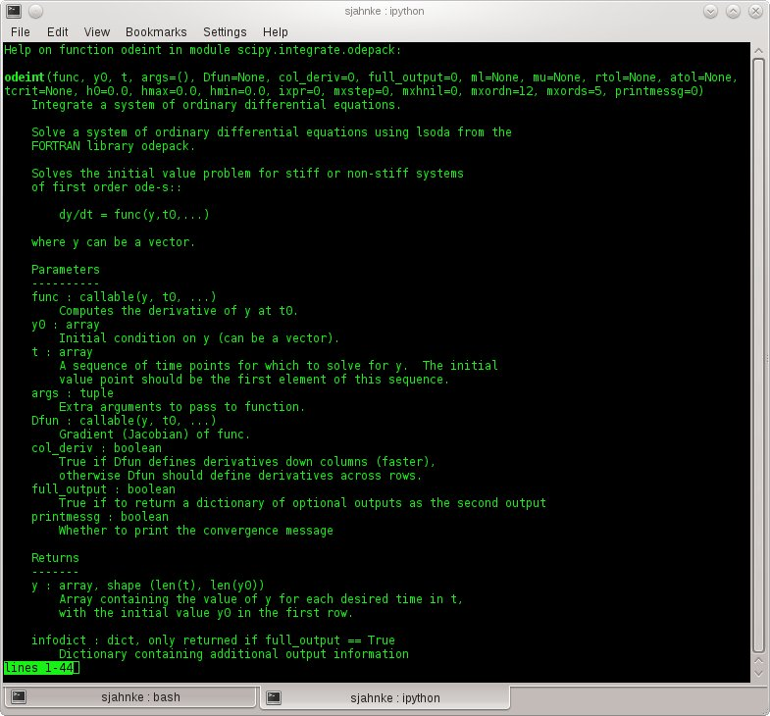
>> import scipy.integrate as int
>> help(int.odeint)
GGNB - An Introduction to Python

Slide 39
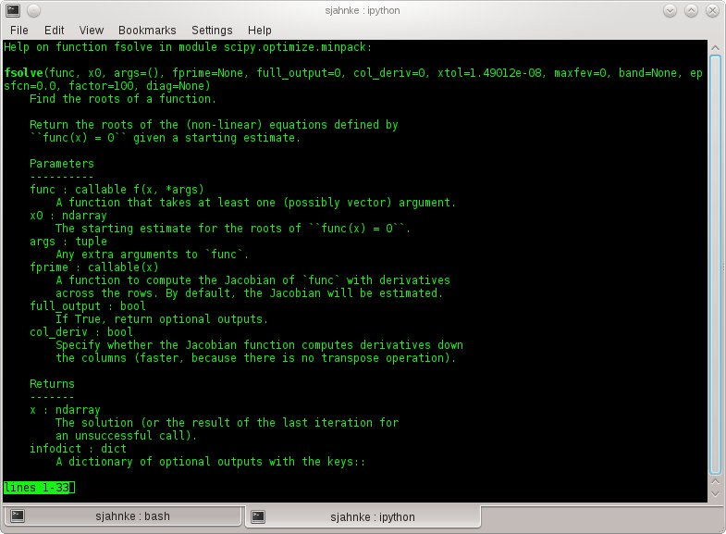
>> import scipy.optimize as opt
>> help(opt.fsolve)
GGNB - An Introduction to Python

Slide 40
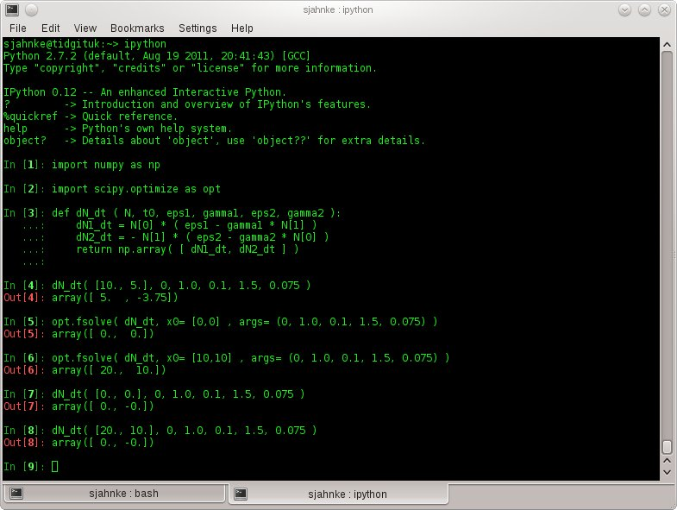
Finding the fixed points
GGNB - An Introduction to Python

Slide 41
Example 7: Solve the system
Define a vector containing the time steps for the integration and one for the initial conditions.
Solve the system, using scipy.integrate.odeint()
Plot the results for two different time step sizes.
GGNB - An Introduction to Python

Slide 42
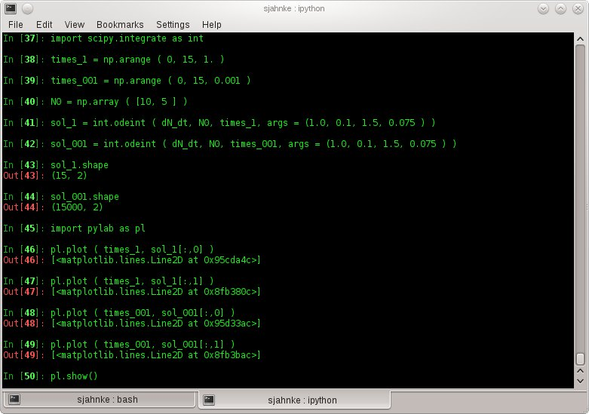
Integration the ODE
GGNB - An Introduction to Python

Slide 43
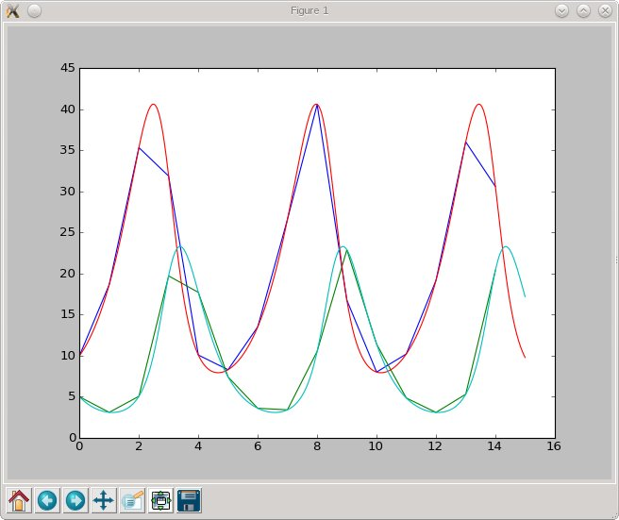
Integration the ODE
GGNB - An Introduction to Python

Slide 44
Finally I/O functions
read & save text files
>> np.savetxt ( filename, variable) #format can be specified
>> data = np.loadtxt ( filename ) #adds an .npy to filename
read & save binary data
>> np.save ( file, variable ) #adds an .npy to filename
>> data = np.load ( file.npy ) #loading file
reading matlab files
>> import scipy.io as io
>> matdata = io.loadmat (filename.mat) #returns a dictonary
>> print matdata[ ‘data’ ] #if the matlabfile contains data struct
GGNB - An Introduction to Python

Slide 45
For help take a look at the reference pages:
scipy:
  http://docs.scipy.org/doc/scipy/reference/
numpy:
  http://docs.scipy.org/doc/numpy/reference/
Have fun in the exercises!
GGNB - An Introduction to Python

