Slide 1
Introduction to NumPy, SciPy and Matplotlib
Scientific Computation With Python

Slide 2
Overview
Important packages for scientific use:
  NumPy (handling and manipulation of large arrays)
  SciPy (lots of user-friendly and efficient numerical routines)
  Matplotlib (plotting library)
=> provide an open source alternative to MATLAB
(http://www.scipy.org/NumPy_for_Matlab_Users)
available at
http://numpy.scipy.org/
http://matplotlib.sourceforge.net/
Introduction to Python - NumPy
8

Slide 3
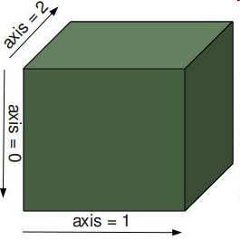
NumPy Array
provides a powerful N-dimensional array object:
  table of items of same type
  more efficient than python lists
can be directly created from lists
>>> import numpy as np
>>> a = np.array ( [1,2,3,4] )
>>> M = np.array([ [1,2],[3,4] ])
Introduction to Python - NumPy
8

Slide 4
NumPy Array Creation
arange() : improved range() – function
zeros(), ones() : fill with zeros or ones
eye() : identity
rand(), randn() : random matrix
>> a = np.arange ( 0, 0.4, 0.1 )
>> M1 = np.ones ( (2,2) )
>> M2 = np.zeros ( (2,3) )
! the shape has to be specified !
>> M = np.eye ( 3 )
>> M = np.random.rand ( 2,2 )
Introduction to Python - NumPy
8

Slide 5
Indexing & Slicing
>> a[0]
0.0
>> a[1:3]
[0.1, 0.2]
>> a[:3]
[0.0,0.1,0.2]
>> a[::2]
[0.0,0.2]
1-D arrays can be indexed,
sliced and iterated like lists
N-D arrays can have one index per axis
>> M [0,2]
2
>> M [:,1]
[1,4,7]
>> M[:-1,::-1]
[ [2,1,0],
[5,4,3] ]
not specified axes considered complete slices
Introduction to Python - NumPy
8

Slide 6
Unary Operations
many unary operations are implemented as methods of array class:
>> M = np.array ( [ [1,2], [3,4] ] )
>> M.sum()
10
>> M.mean()
2.5
>> M.max()
4
>> M.sum( axis=0 )
array( [4,6] )
>> M.sum( axis=1 )
array ([3,7])
>> M.mean( axis=0 )
array ( [2, 3] )
“handle array like lists”
axis can be specified
More examples:
argmax(), argsort(), conjugate(), cumsum(),
conj(), imag(), real(), transpose(), …
Introduction to Python - NumPy
8

Slide 7
Properties of Arrays
a = np.array( [ [0,1,2,3,4], [5,6,7,8,9] ] )
a.shape
(2,5)
access attributes of numpy array:
  a.shape (the dimensions) is (2,5)
  a.ndim (number of axis) is 2
  a.size (total number of elements) is 10
  a.dtype (datatype of elements) is int64
  a.itemsize (size of element in bytes) is 8
additonal datatypes:
  int8, int16, int32, int64
  float32, float64, float96
  complex64, complex128,
  complex192
  object
can be specified with dtype
a = np.array( [ [0,1,2,3,4], [5,6,7,8,9] ], dtype=np.complex64 )
Introduction to Python - NumPy
8

Slide 8
Basic Operations
arithmetic operations apply elementwise
new array created
>> A * B
[ [5,12],
[21,32] ]
>> A – c
[ [5,12],
[21,32] ]
>> A ** B
[ [1, 64],
[2187, 65536] ]
>> A<3
[ [True, True],
[False, False] ]
matrix product:
some operators act in
place (similar to C++):
>> np.dot (A,B)
[ [19,22],
[43,50] ]
>> A *= 2
>> print A
[ [2,4],
[6,8] ]
Introduction to Python - NumPy
8

Slide 9
Reshaping
reshaping an array (usually no copy):
>> x = np.arange (10)
>> M = x.reshape(2,5)
>> N = x.reshape(5,-1)
>> O = x.reshape(3,-1)
==> returns an error
“-1” means whatever needed
modifying x, M or N modifies all objects
working with copies:
>> x = np.arange (10)
>> O = x.copy().reshape(2,5)
>> O[0,0] = 40
x is unchanged
Introduction to Python - NumPy
8

Slide 10
Resizing
resize an array with resize():
>> X = np.arange(10)
>> X.resize(3,3)
>> Y = np.arange(7)
>> Y.resize(3,3)
references may impede resizing:
>> x = np.arange (10)
>> M = x.reshape(2,5)
>> M.resize(3,3)
==> error: does not own data
>> x.resize(3,3)
==> error: referenced by other array
>> del M; x.resize(3,3)
==> this works
alternatively use a copy:
>> y = x.copy().resize(3,3)
>> y = np.resize(x, (3,3) )
Introduction to Python - NumPy
8

Slide 11
Fancy Indexing
Indexing with arrays of indices
>> x = np.arange ( 0, 10, 2)
>> idx = np.array ( [0,4,4,2])
>> y = x [ idx ]
>> print y
[0, 8, 8, 4 ]
also works with N-dimensional index arrays
>> x = np.arange ( 0, 10, 2)
>> idx = np.array ( [[0,4] , [4,2] ])
>> M = x [ idx ]
>> print M
[ [0, 8],
[8, 4 ] ]
Introduction to Python - NumPy
8

Slide 12
Fancy Indexing II
also can present higher dimensional index
>> A = np.arange (9).reshape(3,3)
>> i = np.array ( [0, 2] ) # defines rows
>> j = np.array ( [1,2] ) # defines columns
>> x = A [ i, j ]
>> B = A [ i,: ]
µ
1
0
¶
i
=
>> i = np.eye (2, dtype = int )
>> j = np.ones( (2,2), dtype = int)
>> C = A[ i, j]
0
1
µ
1
1
¶
j
=
1
1
Introduction to Python - NumPy
8

Slide 13
Fancy Indexing III
Boolean indexing, explicitly choose the elements
>> A = np.arange(1,5).reshape(2,2)
>> idx = np.array ( [ [True, False], [True, True] ])
>> x = A [ idx ]
>> idx = [ [True, False], [True, True] ] # this is a list
>> y = A[idx] # be careful!
>> idx = A<3
>> z = A[idx]
Introduction to Python - NumPy
8

Slide 14
Universal Functions
Numpy provides a useful set of mathematical functons. They are called „universal functions“ and work elementwise.
>> x = np.arange(5)
>> np.sqrt (x)
[0., 1., 1.41421, 1.730225]
>> x = np.arange(5)
>> np.exp (x)
[1., 2.71828, 7.3891, 20.0855]
Fast and very usefull for data processing,
  eg. consider you have a list with data
>> absdata = [abs(i) for i in data ] #have to iterate over list
>> absdata = np.abs(data) #can direclty manipulate array
arccos, arctan, ceil, conjugate, cos, exp, fabs, floor, fmod, log, log10, sin, sinh, sqrt, …
Introduction to Python - NumPy
8

Slide 15
Is everything installed correctly?
Open iPython notebook and run the following commands:
>>> import numpy as np
>>> import scipy as sc
>>> import pylab as pl
If nothing happens, everything is fine :)
Introduction to Python - NumPy
8

Slide 16
Example: Efficiency of NumPy
Go through the numbers from one to one million and count the numbers that are divisible by 7.
  Implement a function using a for loop to do the task.
  Use list comprehension to do the task.
  Use numpy and avoid loops at all.
  Hint: np.sum, np.mod, np.arange
To compare the runtimes of each version, use the “magic function” %timeit.
Introduction to Python - NumPy
8

Slide 17
Example: Efficiency of NumPy
(a) For loop:
(b) List comprehension:
>> def func(N):
>> n = 0
>> for i in range(N):
>> if i % 7 == 0:
>> n += 1
>> return n
>> print func(1000000)
142858
>> len([i for i in xrange(1000000) if i%7 == 0])
142858
(c) Numpy:
>> import numpy as np
>> np.sum(np.mod(np.arange(1000000),7)==0)
142858
Performance:
>> %timeit func(1000000)
>> %timeit len([i for i in xrange(1000000) if i%7==0])
>> %timeit np.sum(np.mod(np.arange(1000000),7)==0)
10 loops, best of 3: 186 ms per loop
10 loops, best of 3: 59.7 ms per loop
100 loops, best of 3: 13 ms per loop

Slide 18
SciPy Package
Based on the numpy package scipy provides advanced methods for science and engineering:
  Constants (scipy.constants)
  Fourier transforms (scipy.fftpack)
  Integration and ODEs (scipy.integrate)
  Interpolation (scipy.interpolate)
  Linear algebra (scipy.linalg)
  Orthogonal distance regression (scipy.odr)
  Optimization and root finding (scipy.optimize)
  Signal processing (scipy.signal)
  Special functions (scipy.special)
  Statistical functions (scipy.stats)
  C/C++ integration (scipy.weave)
  And more …
Check: http://docs.scipy.org/doc/
Introduction to Python - SciPy
8

Slide 19
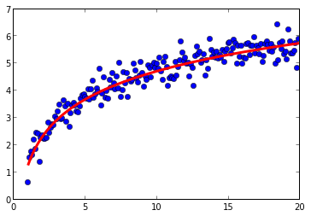
Example: scipy.optimize
from scipy.optimize import curve_fit
def func(x, a, b):
return a*np.log(x) + b
popt, pcov = curve_fit(func, xdata, ydata)
a,b = popt

Slide 20
Example: scipy.weave
>> import scipy.weave
>> N = 1000000
>> ccode = '''int n = 0;
>> for(int i=0;i<N;i++){
>> if(i%7==0){
>> n++;
>> }
>> }
>> return_val = n;
>> '''
>> scipy.weave.inline(ccode, ['N'])
142858

Slide 21
Matplotlib Package
„make easy things easy and hard things possible:“
  create simple plots with just a few commands
  “emulate” MATLABs plotting capabilities
matplotlib is conceptually divided into three parts
  Pylab interface : MATLAB like plotting
  Matplotlib API : abstract interface
  Backends : managing the output
available at (including many examples)
http://matplotlib.sourceforge.net/
Introduction to Python - Matplotlib
8

Slide 22
Basic 2D Plotting
MATLAB like example:
import numpy as np # import numpy
import pylab as pl # import pylab interface
times = np.arange ( 0, 5, 0.01 ) # define x-vector
fun = lambda x : np.cos (20 *x) * np.exp (- pl.absolute(x) )
# define some function fun (x)
pl.plot ( times, fun(times) ) # plot fun (t) vs. t
pl.xlabel ('time' ) # creating x-label
pl.ylabel ('position') # creating y-label
pl.title ( 'damped oscillation') # setting the title
pl.show() # show the plot
Introduction to Python - Matplotlib
8

Slide 23
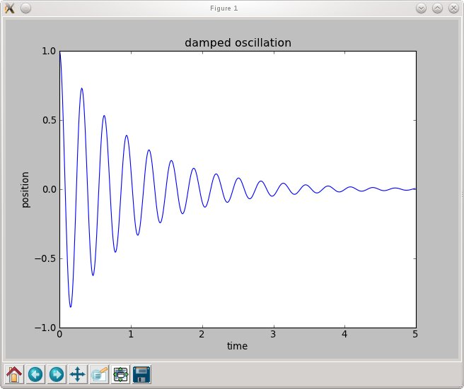
Basic 2D Plotting
appearance depend on backend
Introduction to Python - Matplotlib
8

Slide 24
Interactive Plotting
For Python scripts you use pylab.show() to show the plot after setting the parameters.
Working in the Python shell you usually want to know how things look like immediately. Therefor you can use pylab.ion() to start the interactive mode.
With pylab.draw() you can update the figure after changing it.
Introduction to Python - Matplotlib
8

Slide 25
Subplots
import numpy as np # import numpy
import pylab as pl # import pylab interface
times = np.arange ( 0, 5, 0.01 ) # define x-vector
fun = lambda x : np.cos (20 *x) * np.exp (- pl.absolute(x) )
fun2 = lambda x : np.sin (10 *x**2) # define two functions
pl.subplot (2,1,1) # choose a subplot ( rows, colums, idx)
pl.plot ( times, fun(times) ) # plot fun(t)
pl.subplot (2,1,2) # choose a subplot ( rows, colums, idx)
pl.plot ( times, fun2(times) ) # plot fun2(t)
pl.show()
Introduction to Python - Matplotlib
8

Slide 26
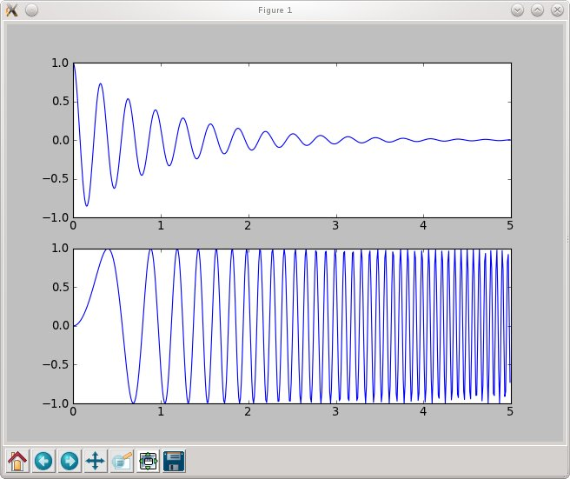
Subplots
subplot (2,1,1) :
2 columns, 1 row
choose first subplot
! Indexing starts with 1
subplot (2,1,2) :
2 columns, 1 row
choose second subplot
Introduction to Python - Matplotlib
8

Slide 27
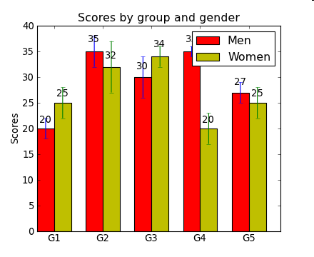
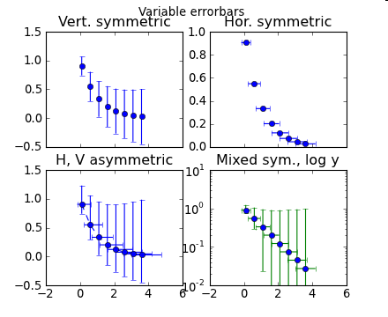
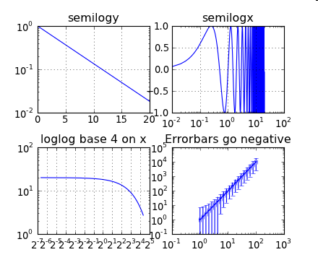
Other basic plotting commands
pl.bar () # box plot
pl.errorbar() # plot with errorbars
pl.loglog() # logarithmically scaled axis
pl.semilogx () # x-axis logarithmically scaled
pl.semilogy () # y-axis logarithmically scaled
Introduction to Python - Matplotlib
8

Slide 28
Histograms
import numpy as np # import numpy
import pylab as pl # import pylab interface
data = 3. + 3. * np.random.randn (100000)
# generate normally distributed randonnumbers
pl.subplot (2,1,1)
pl.hist (data, 100) # make histogram with 100 bins
pl.subplot (2,1,2)
pl.hist ( data, bins = np.arange(3, 25, 0.1) )
# make histogram with given bins
pl.axis ( (3, 15,0,2000 )) # specify axis (x1,x2,y1,y2)
pl.show()
Introduction to Python - Matplotlib
8

Slide 29
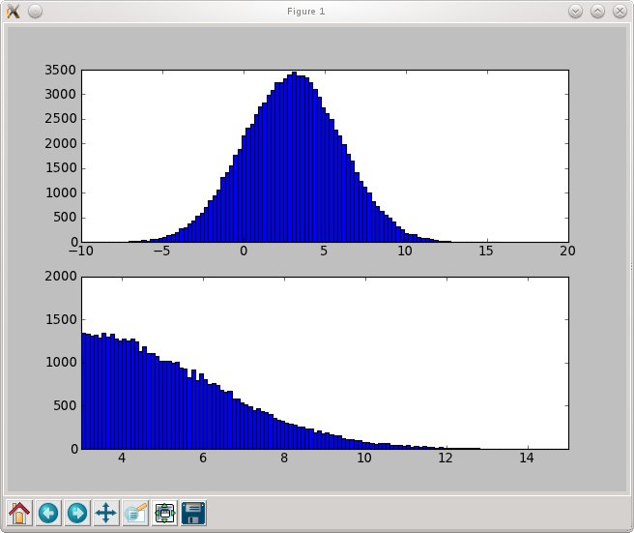
Histograms
(automatic) histogram with 100 bins
histogram for data between 3. and 25. with binsize 0.1
axis set to (3,15,0,2000)
Introduction to Python - Matplotlib
8

Slide 30
Basic Matrix Plotting
import numpy as np # import numpy
import pylab as pl # import pylab interface
data = np.random.randn (100,100)
# generate random data
pl.pcolor (data) # plot data
pl.colorbar() # show a colorbar
pl.show()
Introduction to Python - Matplotlib
8

Slide 31
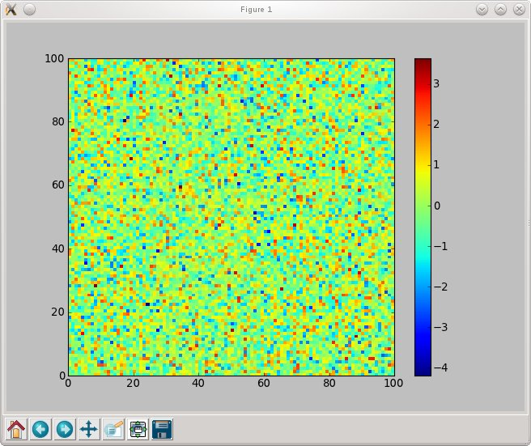
Basic Matrix Plotting
dimensions of matrix used as coordinates
entries are translated to a color code
Introduction to Python - Matplotlib
8

Slide 32
2D - Functions
import numpy as np # import numpy
import pylab as pl # import pylab interface
x = np.arange ( -4, 4.01, 0.1) # x-values
y = np.arange ( -4, 4.01, 0.1) # y-values
X,Y = np.meshgrid(x,y) # Create a meshgrid !
Z = np.zeros ( X.shape ) # Matrix for function values
Z = 1./2/np.pi * np.exp ( - (X**2 + Y**2) )
pl.pcolor(X,Y,Z) # plot function
pl.axis ( (-4,4,-4,4) ) # set axis
pl.colorbar() # show colorbar
pl.show()
Introduction to Python - Matplotlib
8

Slide 33
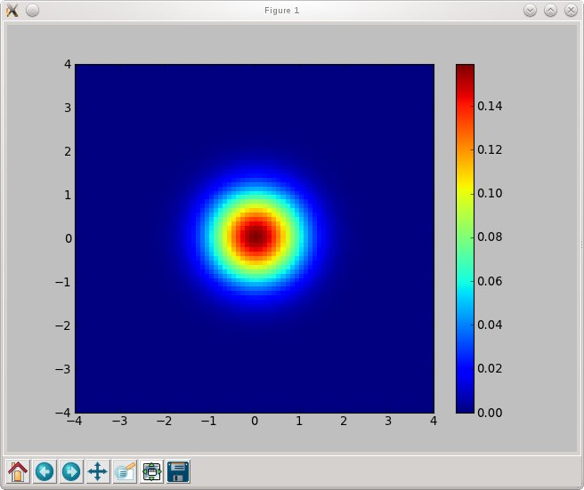
2D - Functions
0
x
1
x
1
x
1
1
:
:
:
X
=
@
x
2
x
2
x
2
A
:
:
:
:
:
:
:
:
:
:
:
:
0
y
1
y
2
y
3
1
:
:
:
Y
=
@
y
1
y
2
y
3
A
:
:
:
:
:
:
:
:
:
:
:
:
0
f
(
x
1
y
1
)
f
(
x
1
y
2
)
1
;
;
:
:
:
Z
=
@
f
(
x
2
y
1
)
f
(
x
2
y
2
)
A
;
;
:
:
:
Introduction to Python - Matplotlib
:
:
:
:
:
:
:
:
:
8

Slide 34
Contour Plots
import numpy as np # import numpy
import pylab as pl # import pylab interface
x = np.arange ( -4, 4.01, 0.01) # x-values
y = np.arange ( -4, 4.01, 0.01) # y-values
X,Y = np.meshgrid(x,y) # Create a meshgrid !
Z = np.zeros ( X.shape ) # Matrix for function values
Z = 1./2/np.pi * np.exp ( - (X**2 + Y**2) )
pl.imshow(Z, extent=(-4,4,-4,4), cmap = pl.cm.Reds )
pl.colorbar()
pl.contour(X,Y,Z) # Creates a contour plot
pl.colorbar()
pl.show()
Introduction to Python - Matplotlib
8

Slide 35
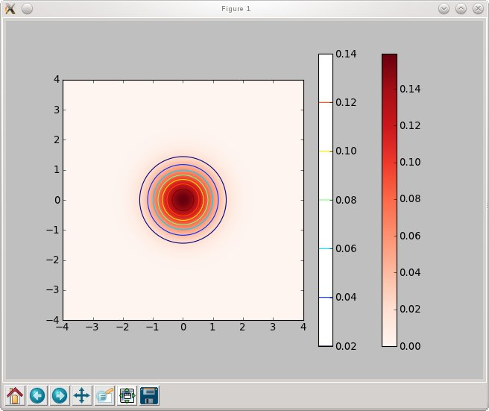
Contour Plots
Introduction to Python - Matplotlib
8

Slide 36
Working with text
Include text with text() or annotate()
  you can use TeX (translated by matplotlib itself)
  you can use real LaTeX ( matplotlib.rc (‘text’, usetex=‘true’) )
import numpy as np # import numpy
import pylab as pl # import pylab interface
…
pl.contour(X,Y,Z) # make a contour plot
pl.text (0,3, 'function is : '+ r'$\frac{1}{2\pi} e^{- (x^2 + y^2) } $' )
# (x,y, text); r‘….‘ indicates rawtext
pl.annotate ( 'center', xy = (0,0), xytext = (-3,-3), arrowprops = {'facecolor':'black'} )
# xy <= where the arrow ends
# xytext <= position of the text
pl.show()
Introduction to Python - Matplotlib
8

Slide 37
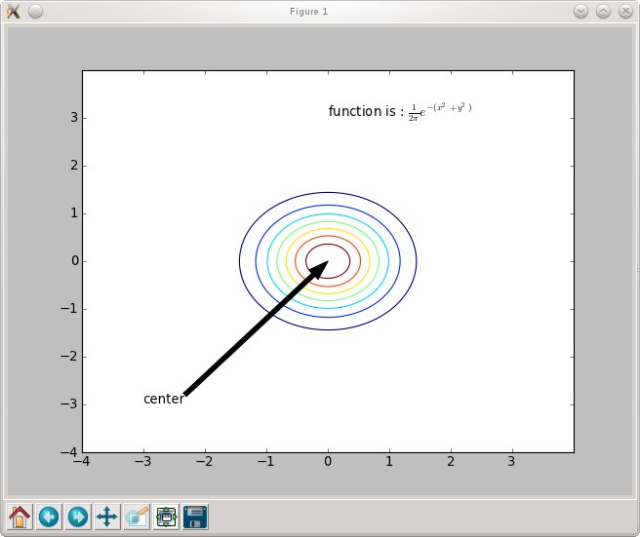
Working with text
Introduction to Python - Matplotlib
8

Slide 38
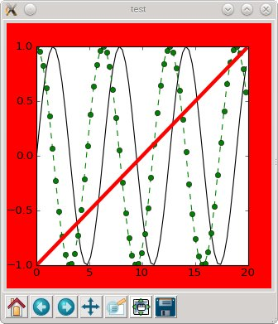
Formatting Figures (Keywords)
Properties of plots can be set by keywords:
import numpy as np # import numpy
import pylab as pl # import pylab interface
pl.figure( “test“ , figsize = (4,5), facecolor = 'r')
# create figure with title test, 4x5 inches, red backgound
x = np.arange ( 0, 20, 0.3 ) # x – values
# for basic properties: using formatstring
pl.plot (x, np.sin(x), 'k' ) # black line
pl.plot (x, np.cos(x), 'go--' ) # green dotted line with circles
# using keywords
pl.plot (x, x / 10. - 1, color = 'red', linewidth = 4)
pl.show()
For details: help(command) or http://matplotlib.sourceforge.net/
Introduction to Python - Matplotlib
8

Slide 39
pylab.getp(), pylab.setp()
Once you have the objects, you can manipulate them via
the methods provided by the class:
  there are thousands of object.get_xxx and object.set_xxx methods
  use the <tab> or look at http://matplotlib.sourceforge.net/api
pylab.setp() command:
  pylab.getp(obj) returns all properties of the object
  pylab.getp(obj, property) returns value of current property
  pylab.setp(obj, property) returns possible values for property
  pylab.setp(obj, propety=value)
Introduction to Python - Matplotlib
8

Slide 40
Animation (simple)
import numpy as np
import pylab as pl
pl.ion()
import time
xdata = np.arange(0,6*np.pi,0.01)
func = lambda x,p: np.sin(p)*np.sin(x)
line, = pl.plot(xdata,func(xdata,0)) #keep reference to the Line2D-object!
pl.ylim(-1.5,1.5) #prevent autoscaling
for value in np.arange(0,7,0.1):
line.set_ydata(func(xdata,value)) #update the ydata of the line
pl.draw()
time.sleep(0.05)

Slide 41
Animation (pro)
import numpy as np
import pylab as pl
import matplotlib.animation as animation
fig = pl.figure()
pl.ylim(-1.5,1.5)
xdata = np.arange(0,6*np.pi,0.01)
func = lambda x,p: np.sin(p)*np.sin(x)
line, = pl.plot(xdata, func(xdata,0)) #keep reference to Line2D-object.
def update(i): #this will be executed for each frame.
line.set_ydata(func(xdata,0.1*i))
return line
swinging_sine = animation.FuncAnimation(fig, update, frames=1000, interval=50)
pl.show() #show animation
#swinging_sine.save('swinging_sine.mp4') #save animation as mp4

Slide 42
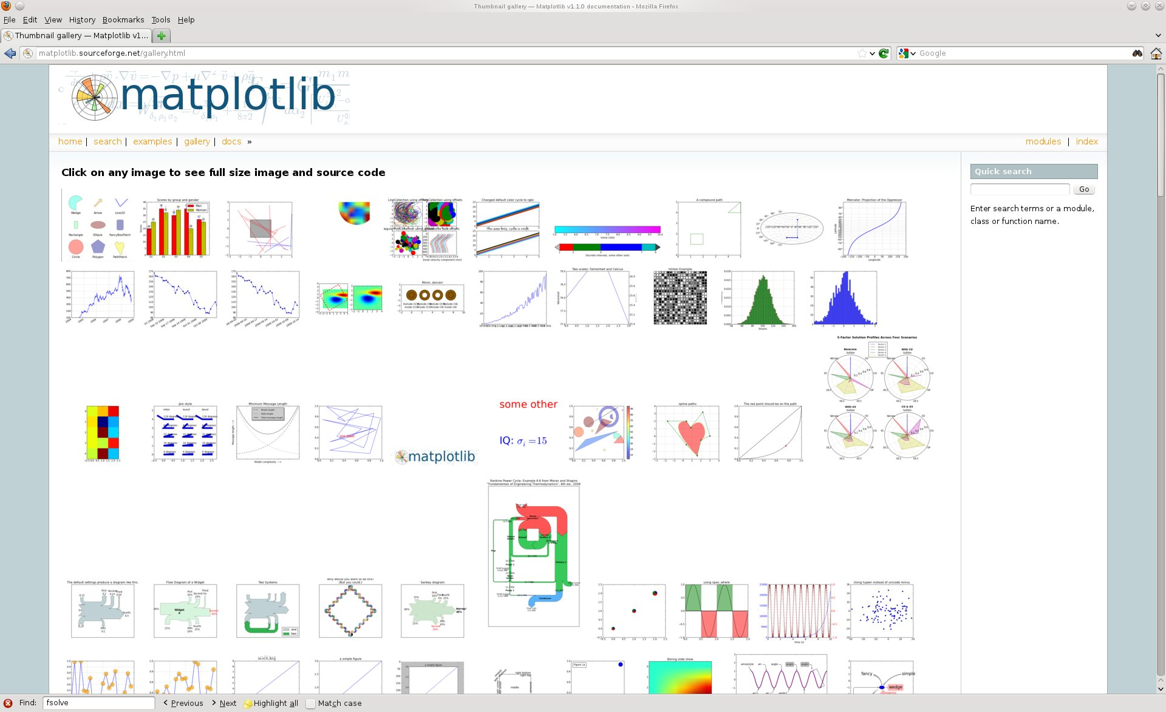
The Gallery
http://matplotlib.sourceforge.net/gallery.html
Introduction to Python - Matplotlib
8

Slide 43
For help take a look at the reference pages:
SciPy:
  http://docs.scipy.org/doc/scipy/reference/
NumPy:
  http://docs.scipy.org/doc/numpy/reference/
Matplotlib:
  http://matplotlib.org/contents.html
Have fun in the exercises!
Introduction to Python
8

Slide 44
One last tip:
For in-line plotting of figures, open your ipython
notebook with:
  ipython notebook --pylab=inline
Or open a notebook and use the magic command:
>> %matplotlib inline
Introduction to Python
8

