Slide 1
Python: A Simple Introduction
part i
Highly adapted from slides for CIS 530 (University of Pennsylvania) originally by Prof. Mitch Marcus

Slide 2
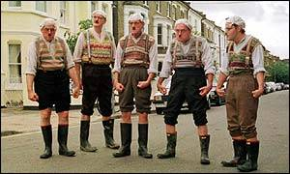
Python
Python is an open source scripting language.
Developed by Guido van Rossum in the early 1990s
It's design philosophy emphasizes code readability
Python saves your time, rather then CPU time.
Available for download from http://www.python.org
    http://www.python.org/doc/humor/
Notes:
High level
object-oriented, imperative and, to a lesser extent, functional programming styles.
Python 3.0 was released in December 2008, but still Python 2.5 and 2.6 are widely used, because of backward compatibility.
An important goal of the Python developers is making Python fun to use → clear, rather than fast.
The Python programming language, named after Monty Python, prefers to use spam, ham, and eggs as metasyntactic variables, instead of the traditional foo, bar, and baz.
Many problems are IO bound.
Interpreter is wonderful for quickly experimenting

Slide 3
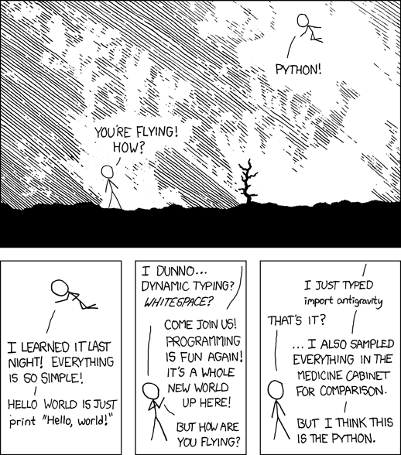
Programming is fun again

Slide 4
Technicalities
Running Python

Slide 5
The Python Interpreter
Start Python:
% python
  Python 2.5 (r25:51908, May 25 2007, 16:14:04)
  [GCC 4.1.2 20061115 (prerelease) (SUSE Linux)] on linux2
  Type "help", "copyright", "credits" or "license" for more information.
  >>>
Interactive command line interface
Quit Python:
  In Unix, type CONTROL-d
  In Windows, type CONTROL-z + <Enter>
  Or type quit()

Slide 6
The Python Interpreter
Python interpreter evaluates inputs:
>>> 3*(7+2)
27
>>> print ‘Hello’
Hello
There is no standard IDE, but you can use any editor to write scripts.
Though, the following you might find helpful:
  IDLE
  iPython

Slide 7
Running Scripts
% python filename.py arguments
Or: You can run a script from python interpreter by
  >>> execfile(‘filename.py’)
Or (Linux only): You can make the *.py file executable and add the following text on top:
  #!/usr/bin/python
  (often seen alternative: #! /usr/bin/env python)

Slide 8
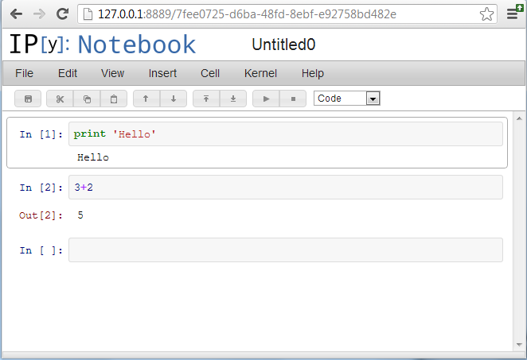
iPython notebook
Provides a simple (and more interactive) interface to Python
% ipython notebook

Slide 9
The Basics

Slide 10
A Simple Example Script
x = 34 - 23 # A comment.
y = “Hello” # Another one.
z = 3.45
if z == 3.45 or y == “Hello”:
x = x + 1
y = y + “ World” # String concatenation
print x
print y

Slide 11
Enough for Understanding the Script
= Assignment but comparison ==.
For numbers + - * / % are as expected.
  Special use of + for string concatenation.
  Special use of % for string formatting (as with printf in C)
Logical operators are words (and, or, not) not symbols
The basic printing command is print.
The first assignment to a variable creates it.
  Variable types don’t need to be declared.
  Python figures out the variable types on its own.
Notes:
How is % used for string formatting, put an example.

Slide 12
Basic Data Types
Integers (default for numbers)
  z = 5 / 2 # Answer is 2, integer division.
Floats
  x = 3.456
  x = float(3) or x = 3.
Strings
  Can use “ ” or ‘ ’ to specify.
  “abc” ‘abc’ (same thing.)
  Unmatched quotes can occur within the string.
  “matt’s” or ’matt”s’
  Use triple double-quotes for multi-line strings or strings that contain both ‘ and “ :
  “““a‘b“c”””
Notes:
What about double and what about numerical precision?

Slide 13
Python and Types
Python determines the data types of variable
bindings in a program automatically. “Dynamic Typing”
But Python’s not casual about types, it
enforces the types of objects. “Strong Typing”
So, for example, you can’t just append an integer to a string. You must first convert the integer to a string itself.
x = “the answer is ” # Decides x is bound to a string.
y = 23 # Decides y is bound to an integer.
print x + y # Python will complain about this.

Slide 14
Whitespace
Whitespace is meaningful in Python: especially indentation and placement of newlines.
Use a newline to end a line of code.
  Use \ when must go to next line prematurely.
No braces { } to mark blocks of code in Python…
Use consistent indentation instead.
  The first line with less indentation is ending the block
  The first line with more indentation starts a nested block
Often a colon appears at the start of a new block. (e.g. for function and class definitions)
Notes:
Use slide structure to explain indentation

Slide 15
A Simple Example Script
x = 34 - 23 # A comment.
y = “Hello” # Another one.
z = 3.45
if z == 3.45 or y == “Hello”:
x = x + 1
y = y + “ World” # String concatenation
print x
print y

Slide 16
Comments
Start comments with # – the rest of line is ignored.
Can include a “documentation string” as the first line of any new function or class that you define.
  def my_function(x, y):
  “““This is the docstring. This
  function does blah blah blah.”””
  # The code would go here...
The development environment, debugger, and other tools use it: it’s good style to include one.

Slide 17
Assignment
Binding a variable in Python means setting a name to hold a reference to some object.
  Assignment (x = y) creates references, not copies
Names in Python do not have an intrinsic type. Objects have types.
  Python determines the type of the reference automatically based on the data object assigned to it.
You create a name the first time it appears on the left side of an assignment expression:
x = 3
A reference is deleted via garbage collection after any names bound to it have passed out of scope.
Notes:
Last point is important especially if variables use a lot of working memory

Slide 18
Accessing Non-Existent Names
If you try to access a name before it has been created (by placing it on the left side of an assignment), you’ll get an error:
>>> y
Traceback (most recent call last):
File "<pyshell#16>", line 1, in -toplevel-
y
NameError: name ‘y' is not defined
>>> y = 3
>>> y
3
Notes:
No print is needed to print the content of a variable

Slide 19
Multiple Assignment
You can also assign to multiple names at the same time.
>>> x = y = 1
>>> x
1
>>> y
1
and
>>> x, y = 2, 3
>>> x
2
>>> y
3

Slide 20
Naming Rules
Names are case sensitive and cannot start with a number. They can contain letters, numbers, and underscores.
  bob Bob _bob _2_bob_ bob_2 BoB
There are some reserved words:
and, assert, break, class, continue, def, del, elif, else, except, exec, finally, for, from, global, if, import, in, is, lambda, not, or, pass, print, raise, return, try, while

Slide 21
Logical Expressions

Slide 22
True and False
Other values equivalent to True and False:
  False: zero, None, empty container or object
  True: non-zero numbers, non-empty objects
  (N.B. In direct comparison True == x gives True only if x = 1
    and False == x gives True only if x = 0)
Comparison operators: ==, !=, <, <=, >, >=
  X and Y have same value: X == Y
  Compare with X is Y :
    X and Y are two variables that refer to identical objects.

Slide 23
Boolean Logic Expressions
You can also combine Boolean expressions.
  true if a is true and b is true: a and b
  true if a is true or b is true: a or b
  true if a is false: not a
Use parentheses as needed to disambiguate complex Boolean expressions.

Slide 24
Special Properties of and and or
Actually and and or don’t return True or False.
They return the value of one of their sub-expressions (which may be a non-Boolean value).
X and Y and Z
  If all are true, returns value of Z.
  Otherwise, returns value of first false sub-expression.
X or Y or Z
  If all are false, returns value of Z.
  Otherwise, returns value of first true sub-expression.
and and or are so called short-circuit operators.

Slide 25
Special Properties of and and or
This page has to be rearranged!
Examples: and and or do lazy evaluation, so no further expressions are evaluated.
>>> x = True
>>> x or quit()
True
>>> li = []
>>> if x[0] == 42 and len(x) != 0:
print “But what is the question?”
Traceback (most recent call last):
File "<stdin>", line 1, in <module>
IndexError: list index out of range

Slide 26
Conditional Expressions: New since Python 2.5
x = true_value if condition else false_value
Uses short-circuit evaluation:
  First, condition is evaluated
  If True, true_value is evaluated and returned
  If False, false_value is evaluated and returned
Suggested syntax:
x = (true_value if condition else false_value)

Slide 27
Sequence types:
Tuples, Lists, and Strings

Slide 28
Sequence Types
Tuple
  Immutable ordered sequence of items
  Items can be of mixed types
Strings
  Immutable
  Conceptionally very much like a tuple
List
  Mutable ordered sequence of items
  Items can be of mixed types

Slide 29
Similar Syntax
All three sequence types (tuples, strings and lists) share much of their syntax and functionality.
The operations shown in this section can be applied to all sequence types
  most examples will just show the operation performed on one

Slide 30
Sequence Types 1
Tuples are defined using parentheses (and commas).
>>> tu = (23, ‘abc’, 4.56, (2,3), ‘def’)
Lists are defined using square brackets (and commas).
>>> li = [“abc”, 34, 4.34, 23]
Strings are defined using quotes (“, ‘, or “““).
>>> st = “Hello World”
>>> st = ‘Hello World’
>>> st = “““This is a multi-line
string that uses triple quotes.”””

Slide 31
Sequence Types 2
We can access individual members of a tuple, list, or string using square bracket “array” notation.
Note that all are 0 based…
>>> tu = (23, ‘abc’, 4.56, (2,3), ‘def’)
>>> tu[1] # Second item in the tuple.
‘abc’
>>> li = [“abc”, 34, 4.34, 23]
>>> li[1] # Second item in the list.
34
>>> st = “Hello World”
>>> st[1] # Second character in string.
‘e’

Slide 32
Positive and negative indices
>>> t = (23, ‘abc’, 4.56, (2,3), ‘def’)
Positive index: count from the left, starting with 0.
>>> t[1]
‘abc’
Negative lookup: count from right, starting with –1.
>>> t[-3]
4.56

Slide 33
Slicing: Return Copy of a Subset 1
>>> t = (23, ‘abc’, 4.56, (2,3), ‘def’)
Return a copy of the container with a subset of the original members. Start copying at the first index, and stop copying before the second index.
>>> t[1:4]
(‘abc’, 4.56, (2,3))
You can also use negative indices when slicing.
>>> t[1:-1]
(‘abc’, 4.56, (2,3))

Slide 34
Slicing: Return Copy of a Subset 2
>>> t = (23, ‘abc’, 4.56, (2,3), ‘def’)
Omit the first index to make a copy starting from the beginning of the container.
>>> t[:2]
(23, ‘abc’)
Omit the second index to make a copy starting at the first index and going to the end of the container.
>>> t[2:]
(4.56, (2,3), ‘def’)

Slide 35
Copying the Whole Sequence
To make a copy of an entire sequence, you can use [:].
>>> t[:]
(23, ‘abc’, 4.56, (2,3), ‘def’)
Note the difference between these two lines for mutable sequences:
>>> list2 = list1 # 2 names refer to 1 ref
# Changing one affects both
>>> list2 = list1[:] # Two independent copies, two refs
Remember: it’s the Paranoia emoticon!

Slide 36
The ‘in’ Operator
Boolean test whether a value is inside a container:
    >>> t = [1, 2, 4, 5]
    >>> 3 in t
    False
    >>> 4 in t
    True
    >>> 4 not in t
    False
For strings, tests for substrings
    >>> a = 'abcde'
    >>> 'c' in a
    True
    >>> 'cd' in a
    True
    >>> 'ac' in a
    False

Slide 37
The + Operator
The + operator produces a new tuple, list, or string whose value is the concatenation of its arguments.
>>> (1, 2, 3) + (4, 5, 6)
(1, 2, 3, 4, 5, 6)
>>> [1, 2, 3] + [4, 5, 6]
[1, 2, 3, 4, 5, 6]
>>> “Hello” + “ ” + “World”
‘Hello World’

Slide 38
The * Operator
The * operator produces a new tuple, list, or string that “repeats” the original content.
>>> (1, 2, 3) * 3
(1, 2, 3, 1, 2, 3, 1, 2, 3)
>>> [1, 2, 3] * 3
[1, 2, 3, 1, 2, 3, 1, 2, 3]
>>> “Hello” * 3
‘HelloHelloHello’

Slide 39
Flow Control

Slide 40
Flow Control
There are several Python expressions that control the flow of a program. All of them make use of boolean conditional tests.
  if statements
  while and for loops
  assert, break, continue statements

Slide 41
if Statements
    if x == 3:
    print “X equals 3.”
    elif x == 2:
    print “X equals 2.”
    else:
    print “X equals something else.”
    print “This is outside the ‘if’.”
Note:
Use of indentation for blocks
Colon (:) before block starts

Slide 42
while Loops
x = 3
while x < 10:
x = x + 1
print “Still in the loop.”
print “Outside the loop.”

Slide 43
break and continue and assert
Use break inside a loop to leave it before stopping condition is fulfilled.
You can use the keyword continue inside a loop to stop processing the current iteration of the loop and to immediately go on to the next one.
An assert([condition]) statement will stop the program if its argument is false.

Slide 44
For Loops / List Comprehensions
Python’s list comprehensions and split/join operations provide natural idioms that usually require a for-loop in other programming languages.
  As a result, Python code uses many fewer for-loops
  Nevertheless, it’s important to learn about for-loops.
Caveat! The keywords for and in are also used in the syntax of list comprehensions, but this is a totally different construction.

Slide 45
For Loops 1
A for-loop steps through each of the items in a list, tuple, string, or any other type of object which is “iterable”
  for <item> in <collection>:
  <statements>
If <collection> is a list or a tuple, then the loop steps through each element of the sequence.
If <collection> is a string, then the loop steps through each character of the string.
  for someChar in “Hello World”:
  print someChar

Slide 46
For Loops 2
  for <item> in <collection>:
  <statements>
<item> can be more complex than a single variable name.
  When the elements of <collection> are themselves sequences, then <item> can match the structure of the elements.
  This multiple assignment can make it easier to access the individual parts of each element.
  for (x, y) in [(a,1), (b,2), (c,3), (d,4)]:
  print x

Slide 47
For loops and the range() function
range(5) returns [0,1,2,3,4]
So we could say:
for x in range(5):
print x

Slide 48
Dictionaries

Slide 49
Dictionaries: A Mapping type
Dictionaries store a mapping between a set of keys and a set of values.
  Keys can be any immutable type.
  Values can be any type
  A single dictionary can store values of different types
You can define, modify, view, lookup, and delete the key-value pairs in the dictionary.

Slide 50
Creating and accessing dictionaries
>>> d = {‘user’:‘bozo’, ‘pswd’:1234}
>>> d[‘user’]
‘bozo’
>>> d[‘pswd’]
1234
>>> d[‘bozo’]
Traceback (innermost last):
File ‘<interactive input>’ line 1, in ?
KeyError: bozo

Slide 51
Updating Dictionaries
>>> d = {‘user’:‘bozo’, ‘pswd’:1234}
>>> d[‘user’] = ‘clown’
>>> d
{‘user’:‘clown’, ‘pswd’:1234}
Keys must be unique.
Assigning to an existing key replaces its value.
>>> d[‘id’] = 45
>>> d
{‘user’:‘clown’, ‘id’:45, ‘pswd’:1234}
Dictionaries are unordered
  New entry might appear anywhere in the output.
(Dictionaries work by hashing)

Slide 52
Removing dictionary entries
>>> d = {‘user’:‘bozo’, ‘p’:1234, ‘i’:34}
>>> del d[‘user’] # Remove one.
>>> d
{‘p’:1234, ‘i’:34}
>>> d.clear() # Remove all.
>>> d
{}

Slide 53
Useful Accessor Methods
>>> d = {‘user’:‘bozo’, ‘p’:1234, ‘i’:34}
>>> d.keys() # List of keys.
[‘user’, ‘p’, ‘i’]
>>> d.values() # List of values.
[‘bozo’, 1234, 34]
>>> d.items() # List of item tuples.
[(‘user’,‘bozo’), (‘p’,1234), (‘i’,34)]

Slide 54
Importing and Modules

Slide 55
Importing and Modules
Use classes & functions defined in another file.
A Python module is a file with the same name (plus the .py extension)
Like Java import, C++ include.
Three formats of the command:
import somefile (as sf)
from somefile import *
from somefile import className

Slide 56
import …
import somefile
Everything in somefile.py gets imported.
To refer to something in the file, append the text “somefile.” to the front of its name:
somefile.myFunction(34)
somefile.className.method(“abc”)
import somefile as sf
To refer to something in the file, append the text “sf.” to the front of its name.

Slide 57
from … import *
from somefile import *
Everything in somefile.py gets imported
To refer to anything in the module, just use its name. Everything in the module is now in the current namespace.
Caveat! Using this import command can easily overwrite the definition of an existing function or variable!
myFunction(34)
className.method(“abc”)

Slide 58
from … import …
from somefile import myFunction
Only the item myFunction in somefile.py gets imported.
After importing myFunction, you can just use it without a module prefix. It’s brought into the current namespace.
Caveat! This will overwrite the definition of this particular name if it is already defined in the current namespace!
myFunction(34) ⬅ This got imported by this command.
myOtherFunction(34) ⬅ This one didn’t.

Slide 59
Commonly Used Modules
Some useful modules to import coming along with Python installation:
Module: sys - Lots of handy stuff.
  argv, …
Module: os - OS specific code.
  listdir, system, …
Module: os.path - Directory processing.
  exists, …

Slide 60
More Commonly Used Modules
Module: math - Mathematical code.
  sin, cos, exp, log, sqrt, …
Module: Random - Random number code.
  uniform, choice, shuffle

Slide 61
For Scientists
Module: numpy - basis for numerics
  powerful numpy array
  efficient functions on numpy arrays
Module: scipy - advanced methods
  linear algebra
  integration, ODE solving, …
Module: matplotlib - matlab like plotting
  plotting

Slide 62
Finally: Getting help
Interactive help
  help()
Information on functions
  help(‘print’) shows help for print statement
  help(‘os’) shows help on module OS
  help(‘os.system’) shows help on command system of module OS
  help([1,2]) shows help on list object
Very useful command
  dir() shows all stuff that was defined in your actual session
Useful auto-completion with <tab>
  random. <tab> shows all functions, classes and so on
Documentation on the web:
  http://docs.python.org

Slide 63
Have fun solving some exercises!

