Slide 1
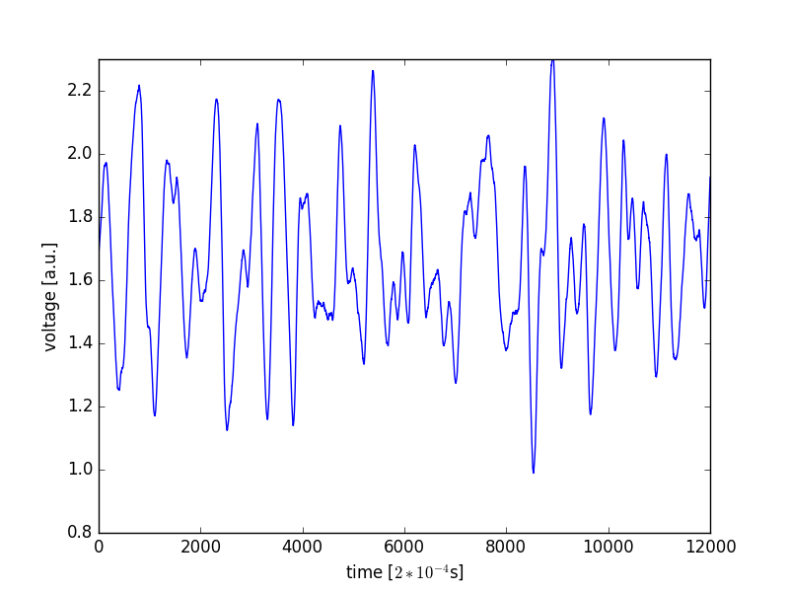
ECG classification

Slide 2
ECG
Clinically used for detection of cardiac arrhythmias and other diseases
Measures the voltage between two points
Sees the far field of electric currents in the heart that indicate contraction
Very characteristic for different types of arrhythmias

Slide 3
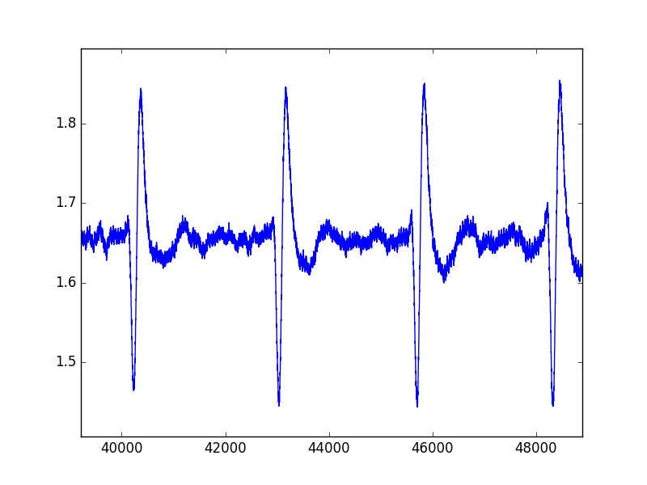
Sinus Rhythm (normal)

Slide 4
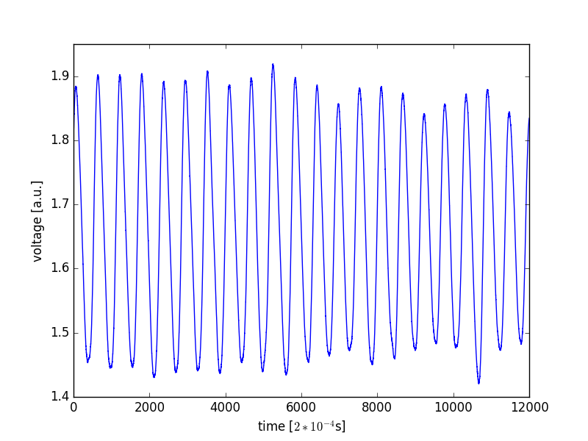
Ventricular Tachycardia

Slide 5
Ventricular Fibrillation

Slide 6
Project
Write a program that classifies each ECG of a supplied data base with partial classification
The solution requires plotting, file io, data manipulation with numpy and some basic signal analysis
There are many ways to do this; from simple to very sophisticated

Slide 7
Guidance
This project comes with a set of help files that provides you with hints and guidance
For example: “Subtasks.txt”

