Slide 1
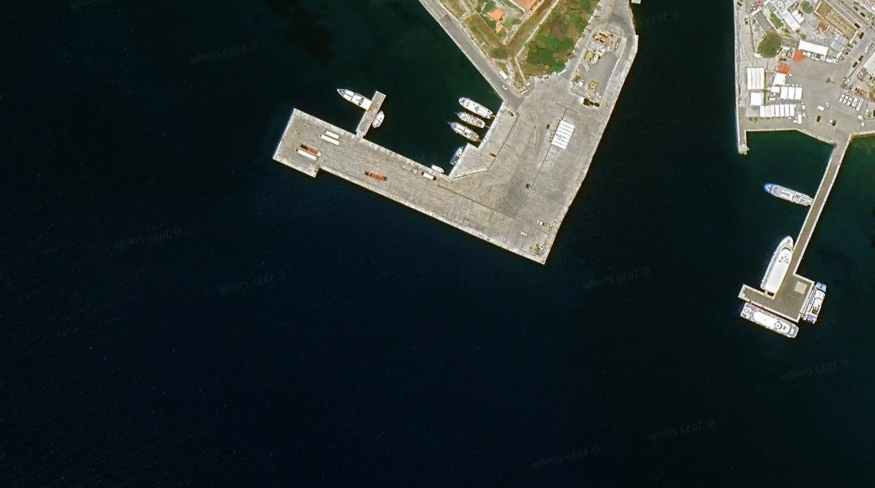
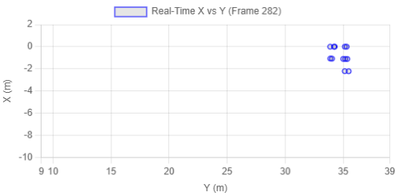
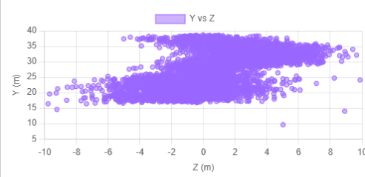
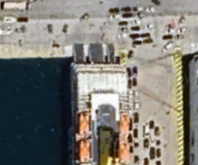
Input Data:
FMCW Radar
Detected points
Frequency 77-81GHz
20 fps
Metadata:
Kos port
05:40 duration
Night
Arrival
Coordinates:
36°53'50"N 27°17'28"E
Distance: 43.4m
Distance to obstacle:
43.4m

