Slide 1
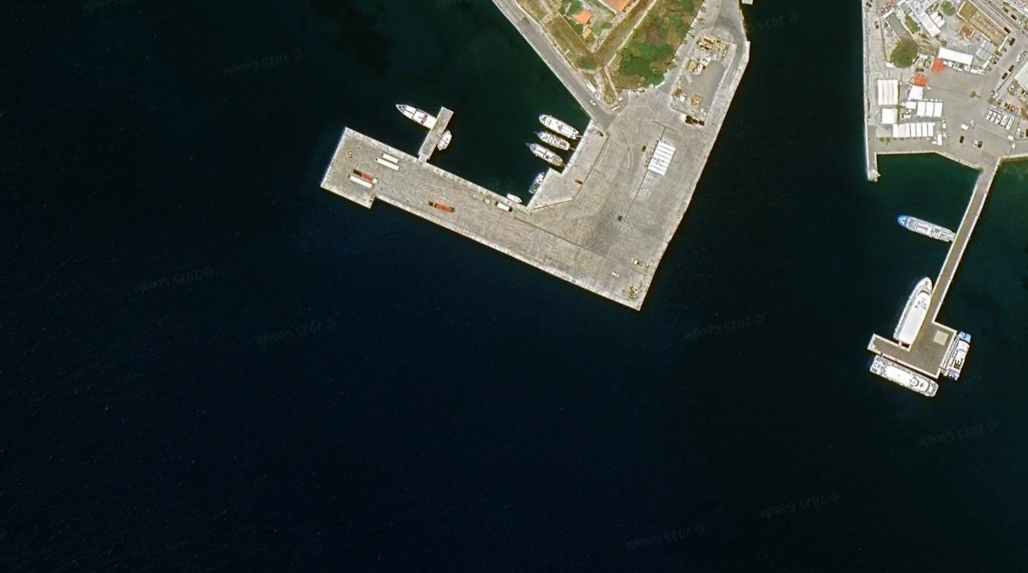
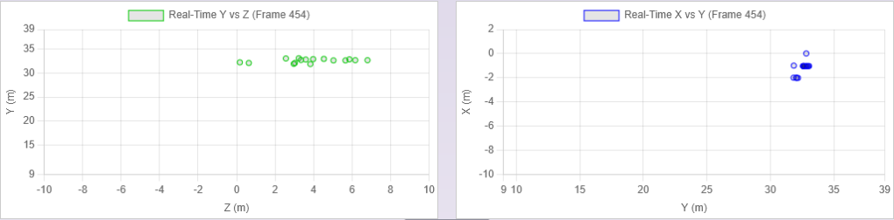
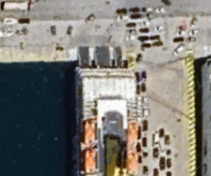

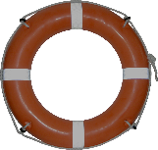

Map
2D Plots
Input Data:
Files (preloaded & browse)
Port: Kos 36°53'50"N 27°17'28"E
Arrival
Time: 05:40:10
05:40|25:12
3D View
About: Contributors:
Fotios Papadopoulos
Ioannis Christopoulos
Supervisors:
Henrique M. Gaspar
Stelios Mitilineos Documentation
Small Description
Distance: 43.4m
Distance to closest obstacle:
43.4m (color coded based on distance)

