Slide 1

GLOBAL AIR TRANSPORTATION NETWORK

Slide 2
GOVINDAMMAL ADITANAR COLLEGE FOR WOMEN
TEAM MEMBERS :
Kavitha Devi.S
Maria Prince Melvina.M
Mohamed Fathima.M.L
Muthu Lakshmi.S
III BSc Physics.

Slide 3
INTRODUCTION
Air transport is the fastest mean of movement from one place to other place.It has reduced distances by minimizing the travel time.It is very essential for a vased country like India,where the distance are large and the climatic condition are diversed.Air tranport in India made a begining in 1911.When airmail operation over a little distance 10km between Ahemadabad and Naini.But its real development took place in post independent period.The airpoty authority of India is responsible for providing safe,efficient air traffic and aeronautical communication service in the Indian Air Space.The authorities manages 125 airports.The air transport in India is managed by two corporations.Air India and Indian Airlines after nationalisation.Now many private companies have also started passanger services.

Slide 4
PURPOSE:
The purpose of air transport lies in its ability as an economic engine to generate and support jobs and strengthen trades and connectivity between people and countries,promotes tourism and connect remote communities.It is mainly used for transporting goods and passangers during natural calamities like eartquake and flood etc...during war,air transport place an important role in caring soldiers as well as supplies to the required areas.Air transport may be classifieed as domestic and international airport.While domestic airports mainly used for movements within the country.Inrenational airports used for carrying goods and passanger between different countries.Air transport carried out fixed air route.This is for protection for themselves,or their families and goods in the event of bad things.Thus,in flight there is also wide range of protection for serving the customers depending on the requirement of the uses.

Slide 5
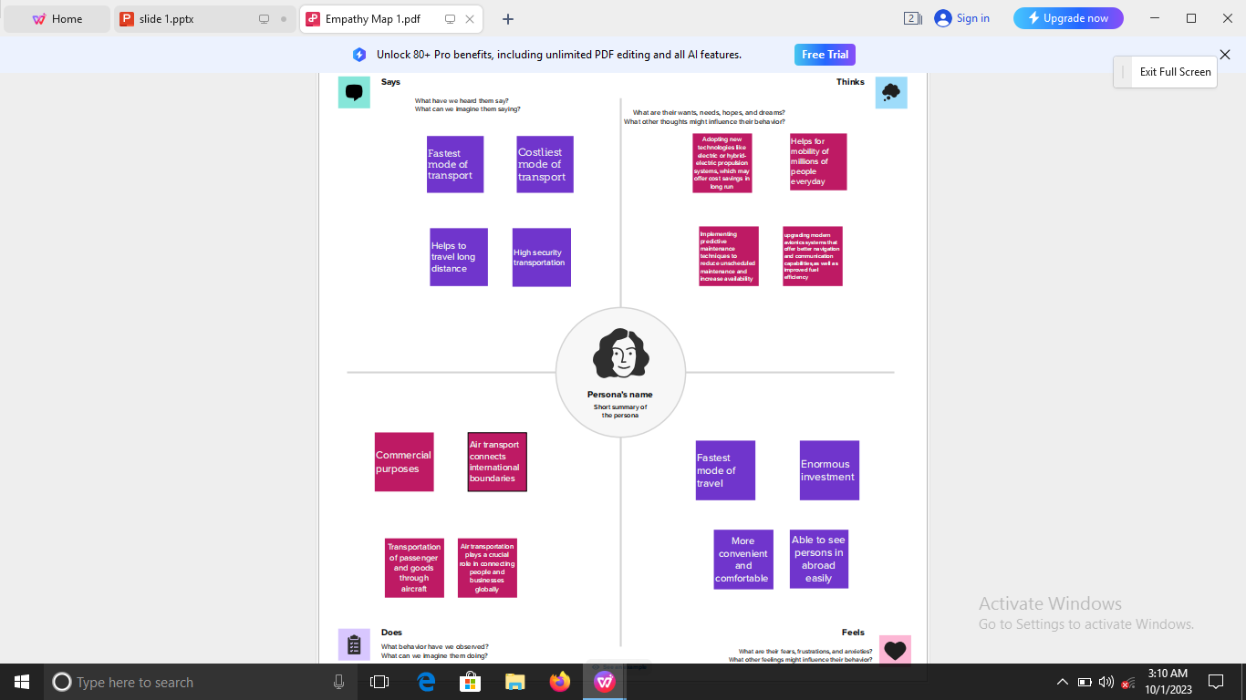
Empathy map

Slide 6
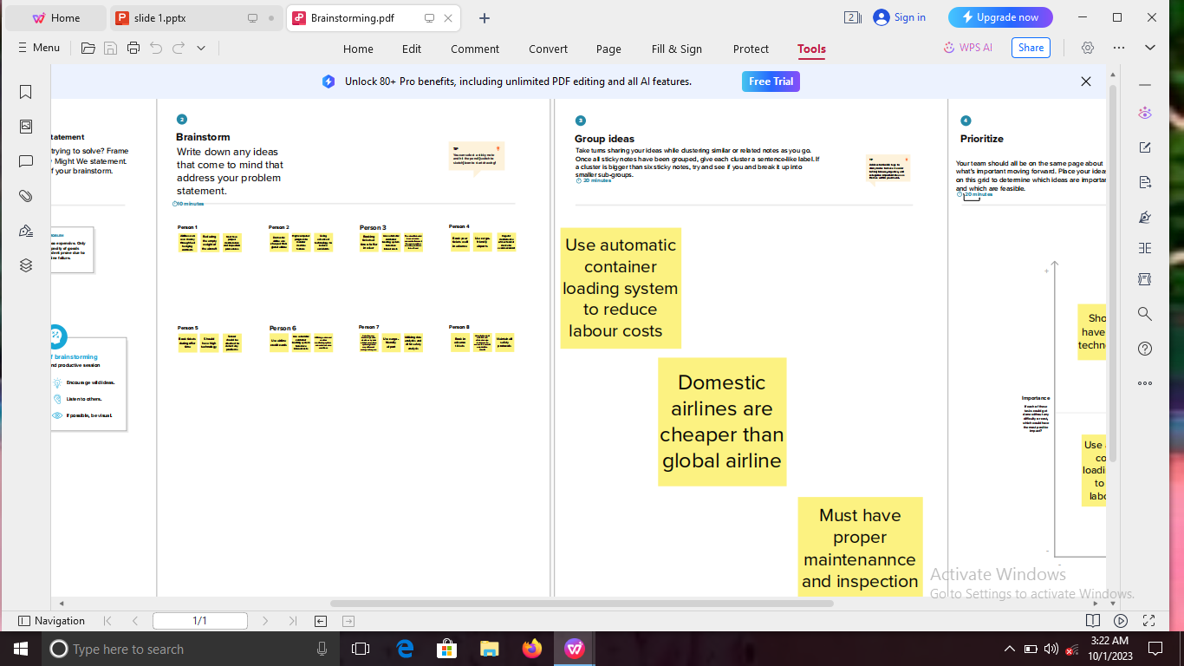
Literature survey

Slide 7
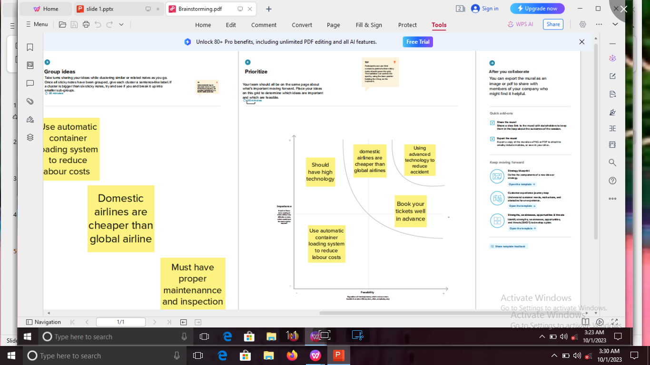

Slide 8
Literature Survey
Airlines can save money through fuel hedging contracts . Reducing the empty weight of aircraft. Must have proper maintenance and inspection procedures. Domestic airline are cheaper than global airline. High computer program to moniter machine failures. Using advanced technology to reduce accidents. Booking tickets at time of offer in wiser. Use automatic container loading system to reduce labour costs. The aircraft should have advance seniors to forecast the poor weather and also problems to be faced. Book your tickets well in advance. Use cargo friendly airports. Regular maintenance of mechanical device to avoid accidents. Book tickets during offer time. Should have high technology. Sensor should be attached to detect any problems. Use airline credit cards. Use automatic container loading system to reduce labour costs.

Slide 9
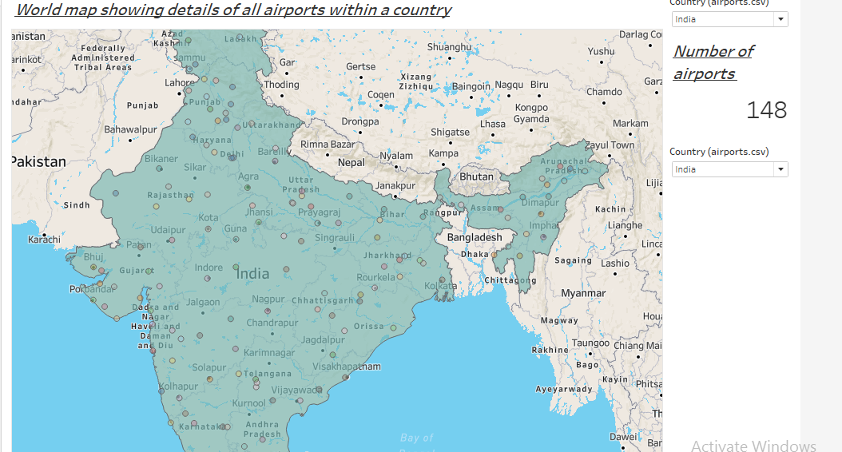
Data Visualisation

Slide 10
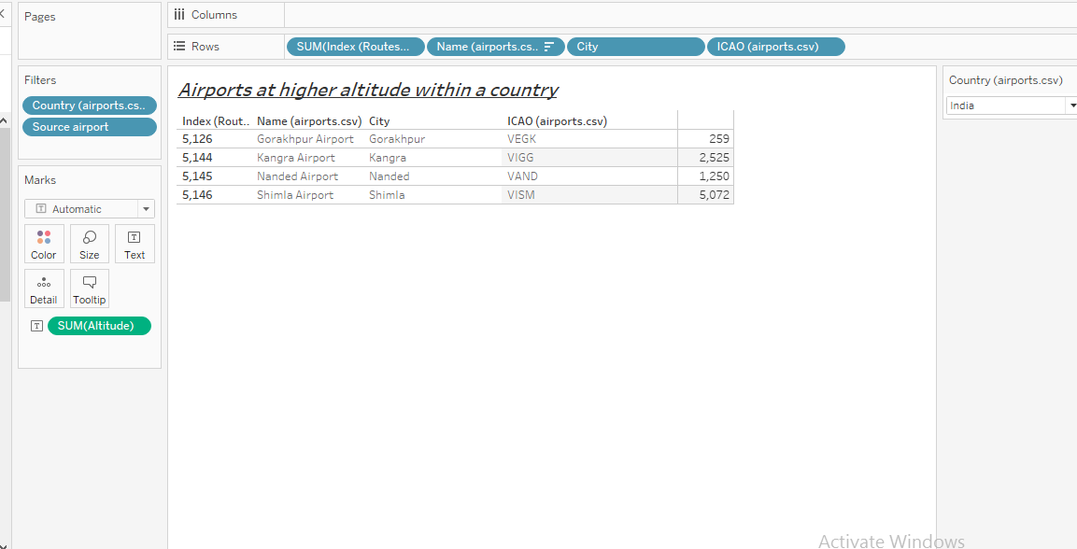

Slide 11
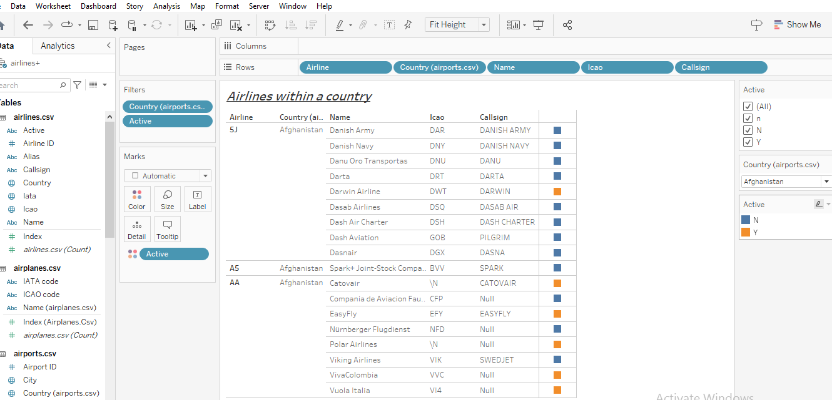

Slide 12
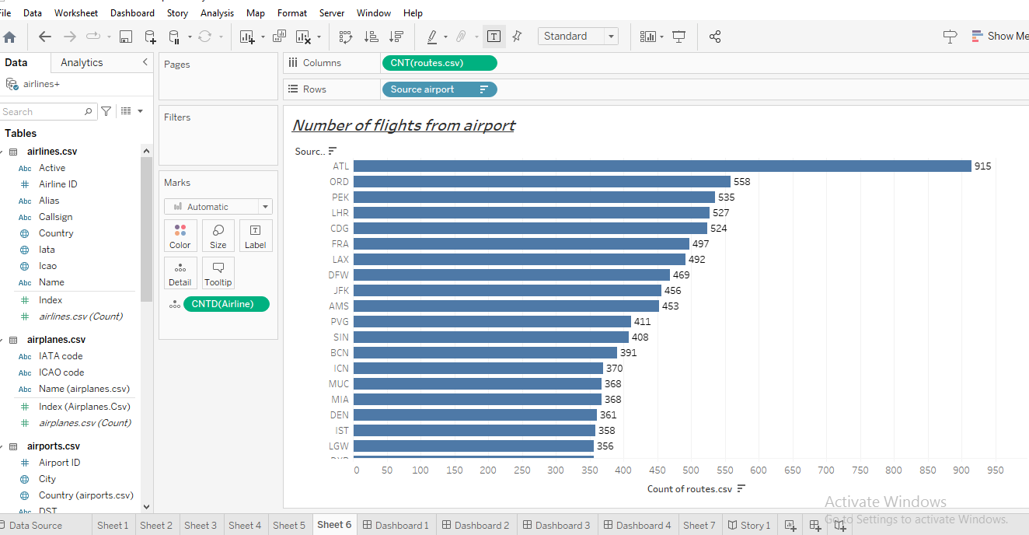

Slide 13
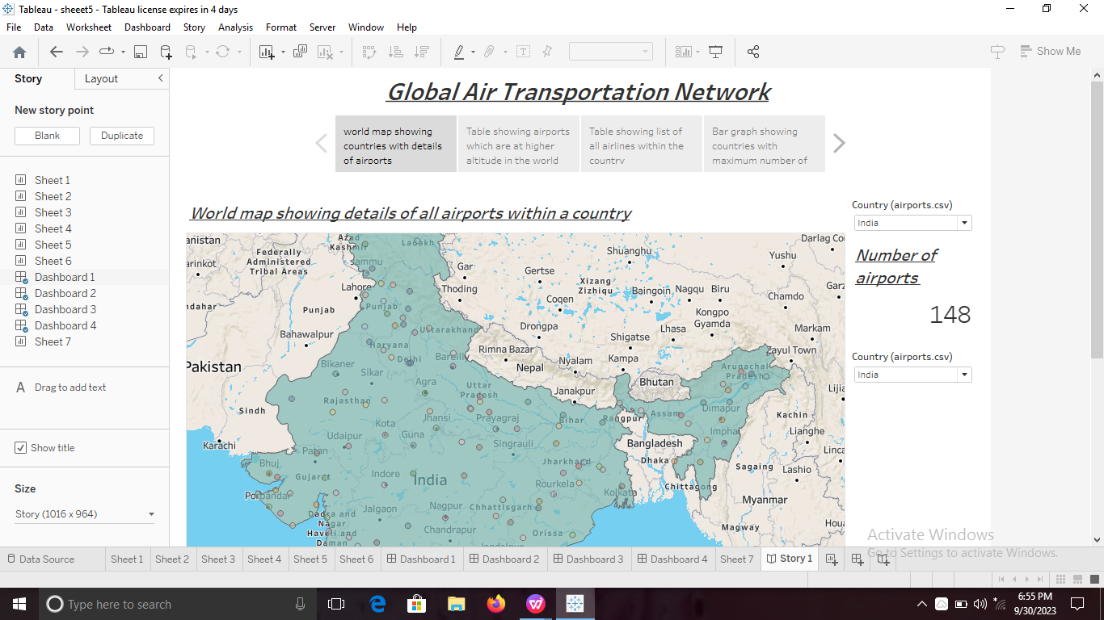
Dash Board
The map showing all airports within a country

Slide 14
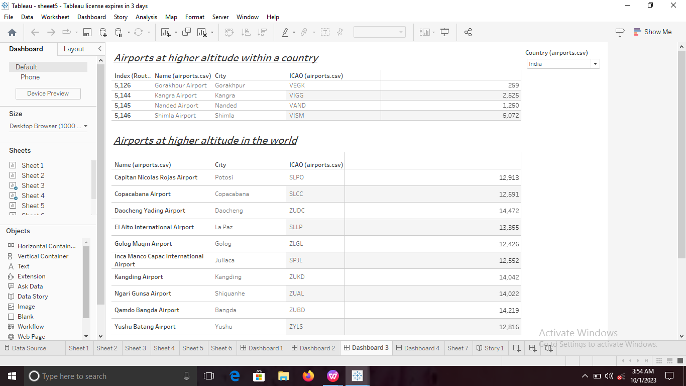

Slide 15
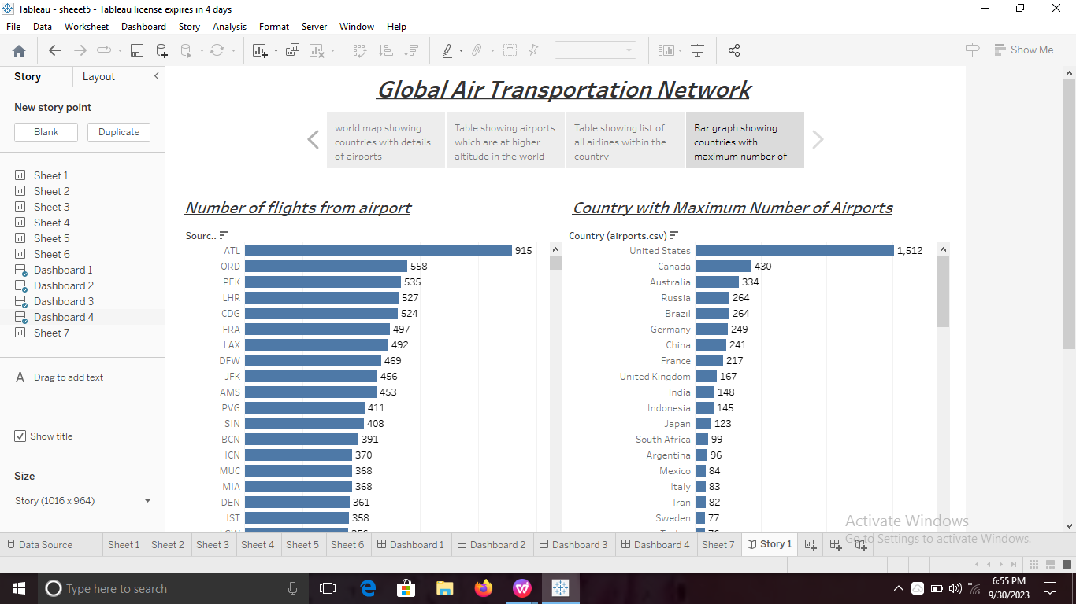

Slide 16
STORY

Slide 17
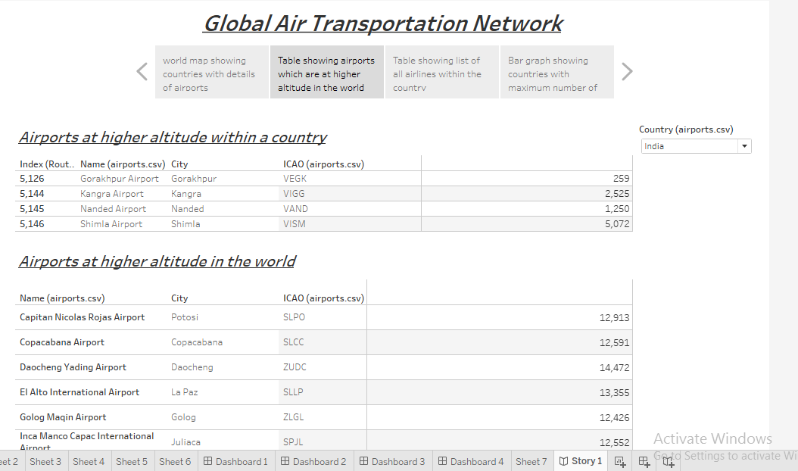

Slide 18
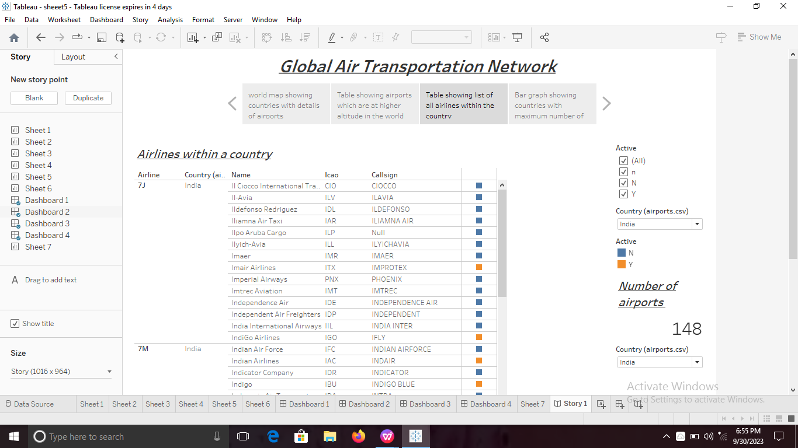

Slide 20
ADVANTAGES
Speed:
Air travel is one of the fastest modes of transportation available. It allows people and goods to reach their destinations quickly, which is especially important for long distance and time sensitive journeys.
Global Connectivity:
Air travel provides access to destinations all over the world. Airports are located in virtually every country ,making it possible to connect to even remote and distant locations.
Safety:
Air travel is satistically one of the safest modes of transportation. Airlines invest heavily in safety measures ,including rigorous training for pilots and maintenance of aircraft ,to ensure the safety of passengers and cargo.

Slide 21
Disadvantages:
Cost:
Air travel can be expensive,especially for long distance or international flights. Ticket prices often include taxes,fees,and baggage charges,making it less affordable for some travellers.
Limited capacity:
Airplanes have limited seating and cargo space compared to other modes of transportation.
Delays and Cancellation
Air travel id susceptible to delays and cancellations due to various factors,including technical issues,air trafffic congestion and crew availiability.

Slide 22
THANKING YOU

