Slide 1

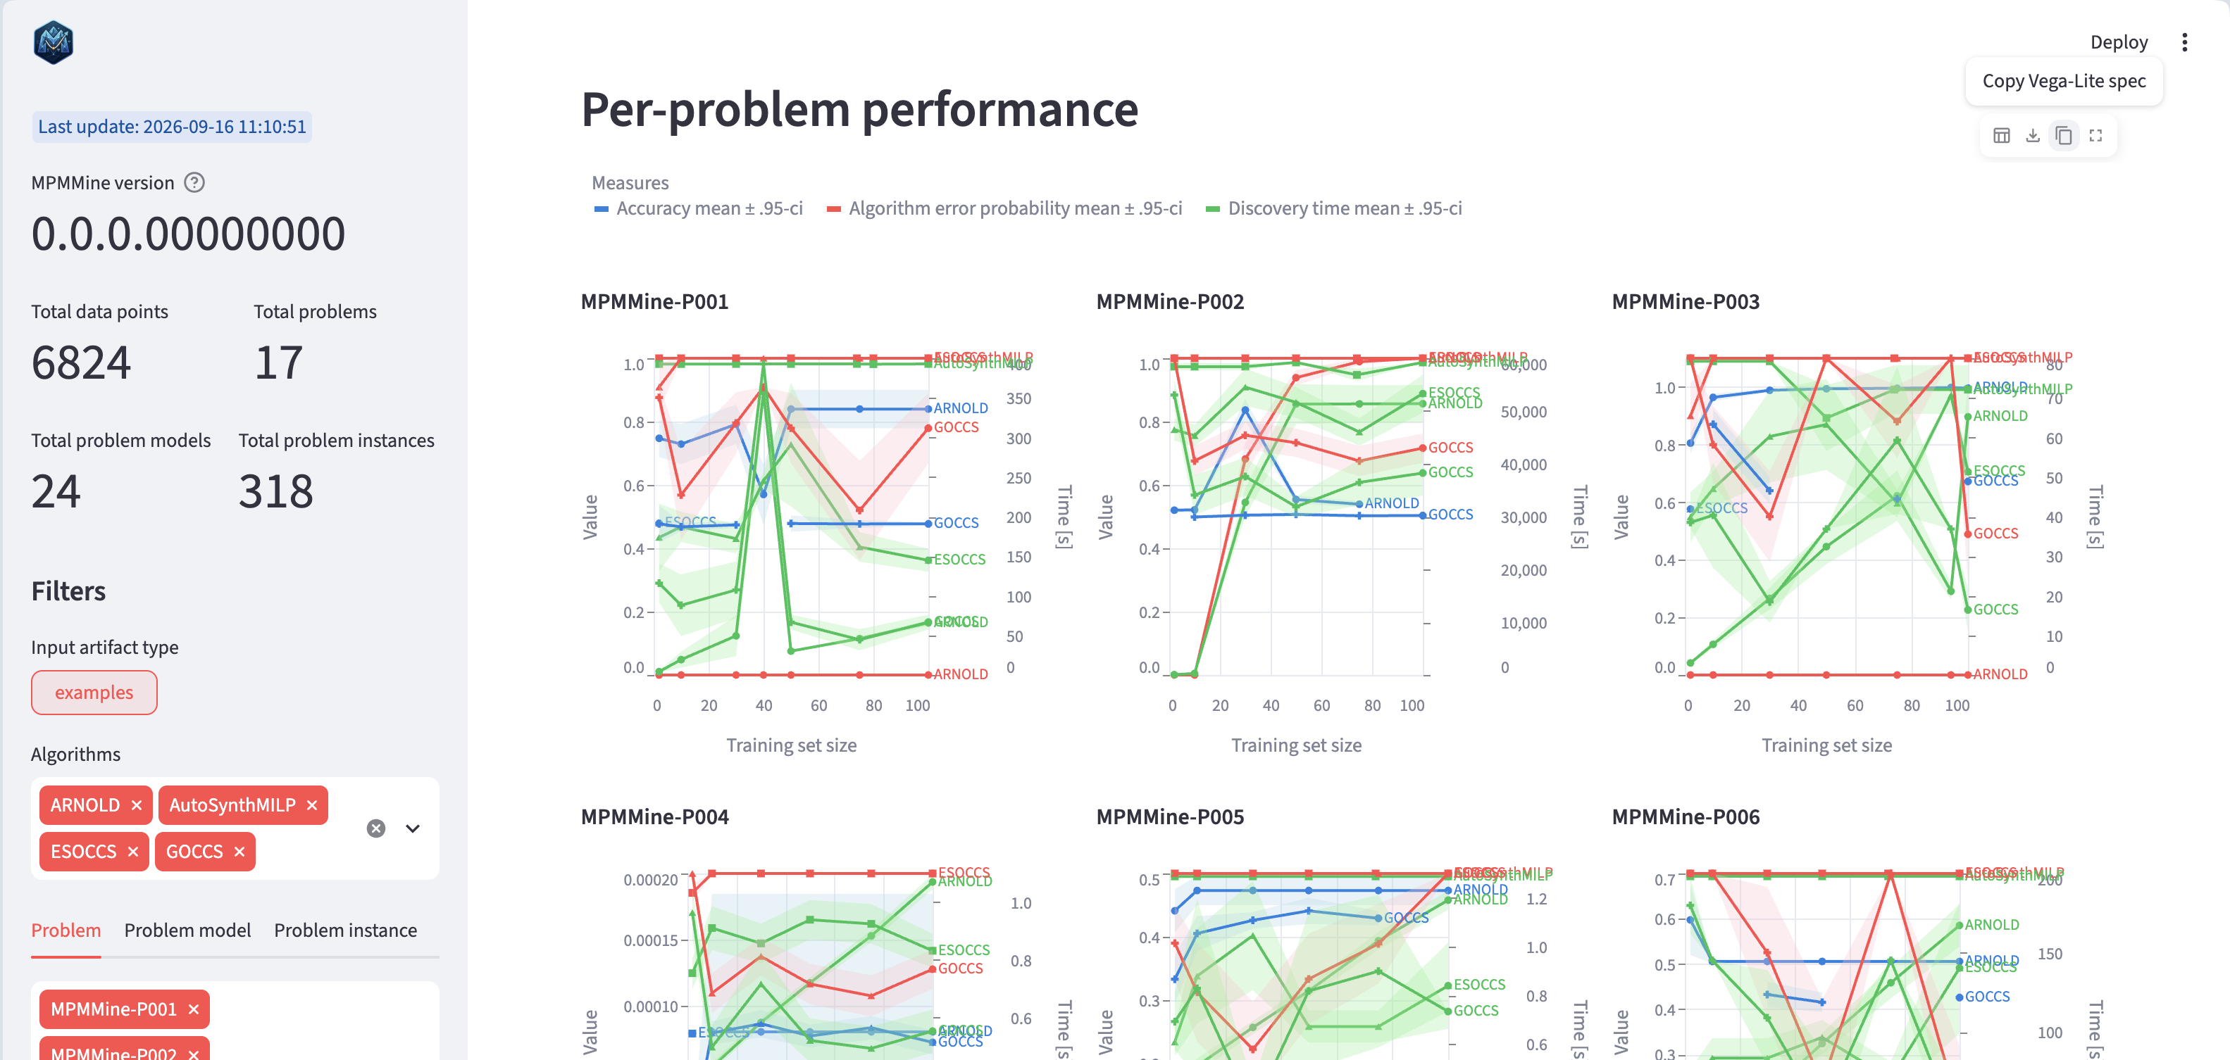
MPMMine Leaderboard
https://github.com/MPMMine/Leaderboard
Step
1
Prepare adapter and evaluate using MPMMine
/algorithms
run_benchmark.py
Adapters
Executors
Training data
mpmmine-py
AutoSynthMILP
github.com/MPMMine/AutoSyncMILP (fork)
Slurm workload manager
Process pool
Single thread
(for debugging)
MPMMine
benchmark dataset
ARNOLD
github.com/MPMMine/algorithm-mohitKU… (fork)
Test data
mpmmine-py
https://github.com/MPMMine/MPMMine
.
.
.
Evaluator
External libraries
Other algorithm X
github.com/MPMMine/<algorithm_X> (fork)
Measures
Parse, interpret, check satisfaction
Mini
Zinc
Gurobi Optimizer
Confusion matrix-based
Error-based
Temporal
Containers
TP | FN
FP | TN
Python
Java
.NET/ mono
Step
2
Aggregate results into leaderboard
/results
Raw results
calculate_leaderboard.py
Statistics
Step
3
Display leaderboard report locally… …or using a cloud-based service
/leaderboard.csv
https://mpmmine.streamlit.app
serve_leaderboard.py
http://localhost:8051
Local report
Cloud report

