Slide 1

Marketing and Retail Analytics: Capstone Project
By :
Sharadhi Kulkarni
Muddada Prasana Manikanta Sai Kiran
Sumit Bhatia

Slide 2

Agenda
Objectives
Background
Visualizations
Insights
Recommendations
Appendix –
Data Sources
Data Methodology
Data Assumptions

Slide 3
Background
OList is an e-commerce company that has faced some losses recently and they want to manage their inventory very well so as to reduce any unnecessary costs that they might be bearing.
In this project, we will be managing the inventory cost of this e-commerce company OList.
We will be identifying top products that contribute to the revenue and also use market basket analysis to analyze the purchase behaviour of individual customers to estimate with relative certainty, what items are more likely to be purchased individually or in combination with some other products.

Slide 4
Objective
Manage the inventory cost of e-commerce company Olist.
Identify the most ordered products by quantity and revenue.
Identify combinations of product categories that are ordered frequently and visualize them as required with the help of market basket analysis.

Slide 5
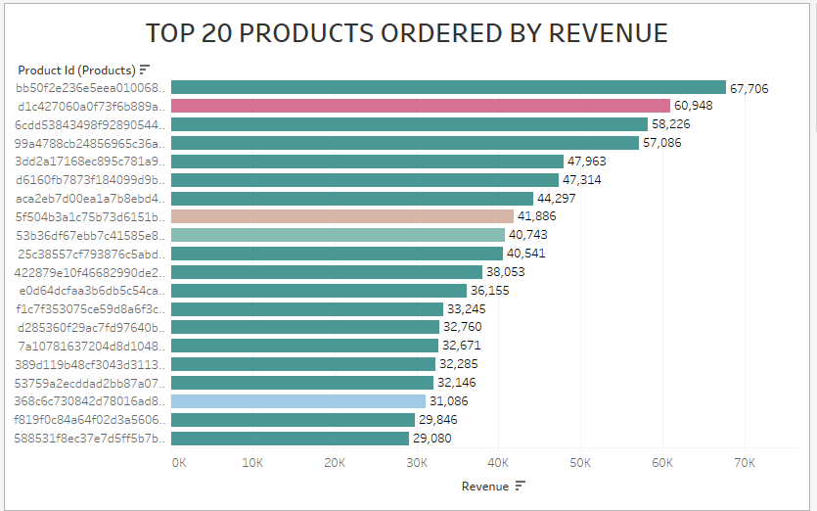
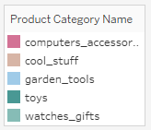
TOP 20 PRODUCTS ORDERED BY REVENUE
Insights :
Highest revenue generating product comes from the toys category.
Second highest revenue generating product comes from computer accessories category.
Toys are the highest contributors to the revenue.

Slide 6
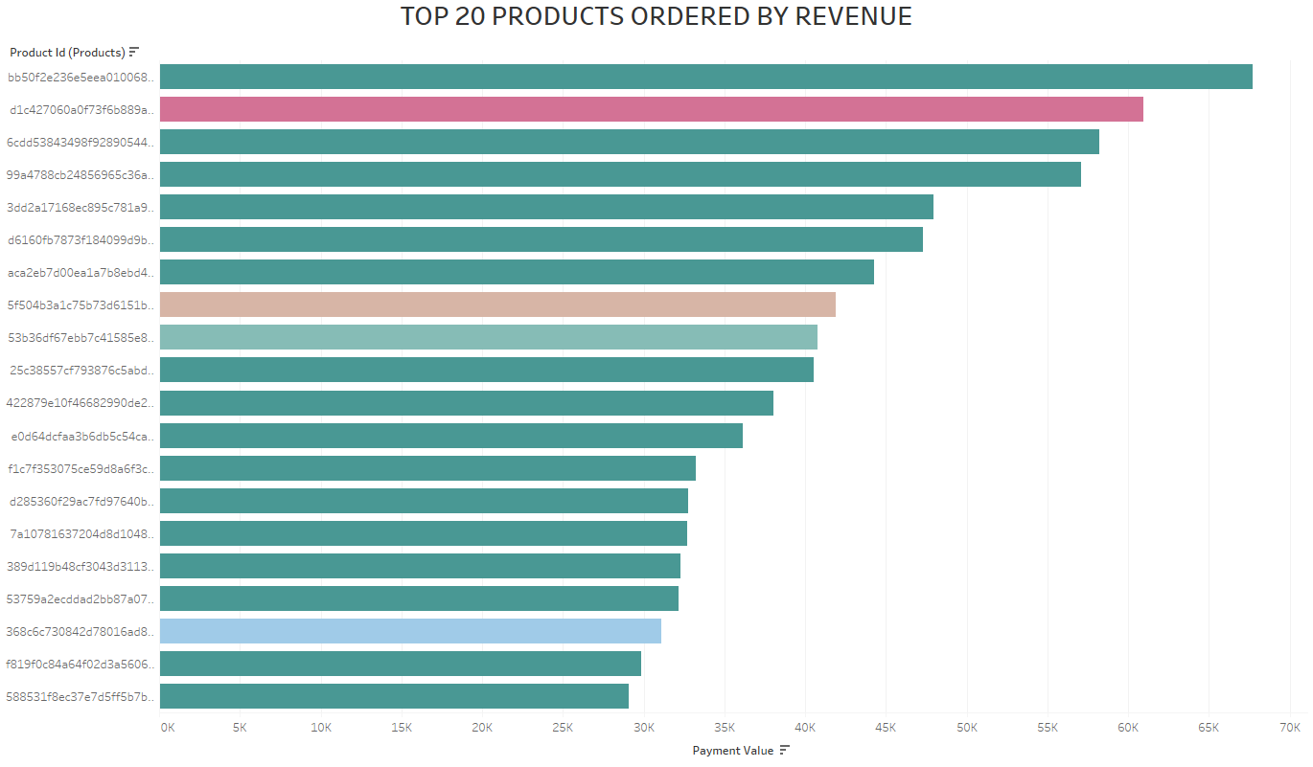
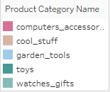
Top Ordered Products by Quantity
Insights :
The product with highest number of orders comes from toys category.
The second highest product in terms of number of orders comes from health_beauty category.

Slide 7
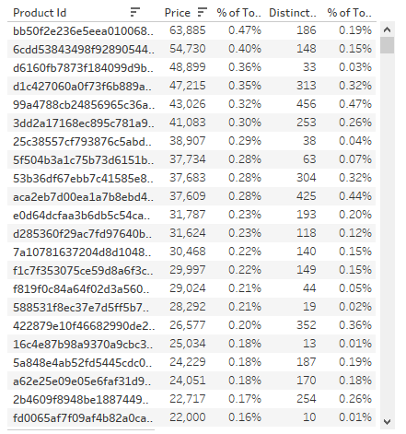
Percent Running Totals
The Percentage of Total Running Revenue and Quantity Ordered has been broken down by Product Id.
The contribution of each product towards the total revenue can be identified.

Slide 8

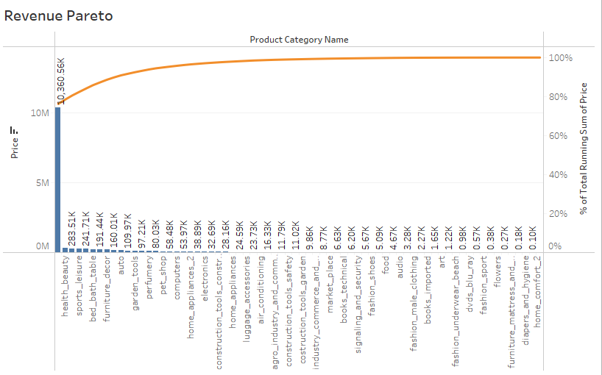
Revenue Pareto
Insights :
Toys, health_beauty and watches_gift combine generate 80.56% of the revenue.
Toys alone generates 76.23% of the revenue.
The rest of the 70+ product categories generates 19.44% of the revenue.

Slide 9
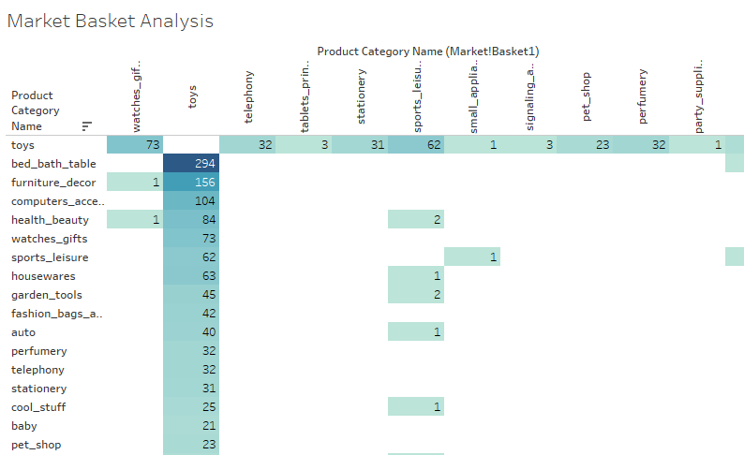
Market Basket Analysis
Market Basket Analysis was performed to find the frequently ordered product combinations.
Highest ordered product combinations are as follows:
Toys with bed_bath_table
Toys with furniture_decor
Toys with computer accessories
Toys with heath_beauty
Toys with watches_gifts

Slide 10

Combined Insights
Highest revenue generating product comes from the toys category.
Second highest revenue generating product comes from computer accessories category.
Toys are the highest contributors to the revenue. The product with
Highest number of orders comes from toys category.
The second highest product in terms of number of orders comes from health_beauty category.
Toys, health_beauty and watches_gift combine generate 80.56% of the revenue.
Toys alone generates 76.23% of the revenue.
The rest of the 70+ product categories generates 19.44% of the revenue.
Highest ordered product combinations are as follows:
Toys with bed_bath_table
Toys with furniture_decor
Toys with computer accessories
Toys with heath_beauty
Toys with watches_gifts

Slide 11
Recommendations
The company should focus on the categories which generate more than 80% of the revenue i.e toys by always keeping them in stock.
The company should target customers who are more likely to buy toys to boost sales as the category toys is the most ordered category.
Offer promo-codes or discounts on the frequently ordered category associations to encourage cross selling among the products.
The company can reduce some of the sub categories which have very low sales.

Slide 12
Data Sources
Here is a snapshot of our data dictionary:
Order details such as order id, order status, order purchased timestamp, etc.
Order Items detail such as order item id, seller id, price, shipping charges, etc.
Customer details such as customer is, customer city, customer state, etc.
Payment details such as payment type, payment value, etc.
Product details such as product id, product category name, product dimensions, etc.
The following data sources were used:
OList retail dataset containing order-related information.
The data consisted for the year 2016 to 2018.

Slide 13

Data Methodology
A thorough analysis of the OList Retail Dataset was conducted. The process included:
The dataset was cleaned and transformed using the python libraries of Pandas and Numpy in the Jupyter Notebook.
The missing values for the various columns were replaced with the best values.
The redundant and duplicate records were discarded and only first occurrence is kept.
Exploratory data analysis was done using the python libraries of Matplotlib and Seaborn in the Jupyter Notebook.
Various visualizations and Market Basket Analysis was conducted in Tableau.

Slide 14
Data Assumptions
Only the cases having order status as ‘delivered’ are considered.
We assumed that the data provided was achieving the desired revenue.
We assumed that the company does not want to expand to new warehouses.
The company’s strategies are decided considering there is constant growth in sales.

Slide 15
Thank You

