Slide 1
Deconstruction of a science paper’s data-evidence basis
Wei-Ming Tsai
MPO/ATM 624
Spring 2018

Slide 2
My Paper
Reexamining the Nonlinear Moisture-Precipitation Relationship Over the Tropical Oceans
Rushlely S. S., Kim D., Bretherton, C. S., & Ahn, M.-S, 2018, GRL
Size of evidence set:
4 figures, 0 tables, 2 magic-number (in-text) results
Notes:
.

Slide 3
Instructions
Copy each figure, table, or # into a slide of this powerpoint
Categorize it according to the list at EVIDENCE_TYPES.md on the course repo
If none of those categories quite fit, expand EVIDENCE_TYPES.md in your fork, and make a pull request! Try to follow the outline there, to keep our ideas compact and coherent. I may suggest edits before final PR acceptance.
Finally, put the Abstract on a last slide. Annotate it with little figure thumbnails connected to each claim or account of nature, to show how those are rooted in the figures (and thus in data).
Put your .pptx in your fork of the class repo, and make a pull request.

Slide 4
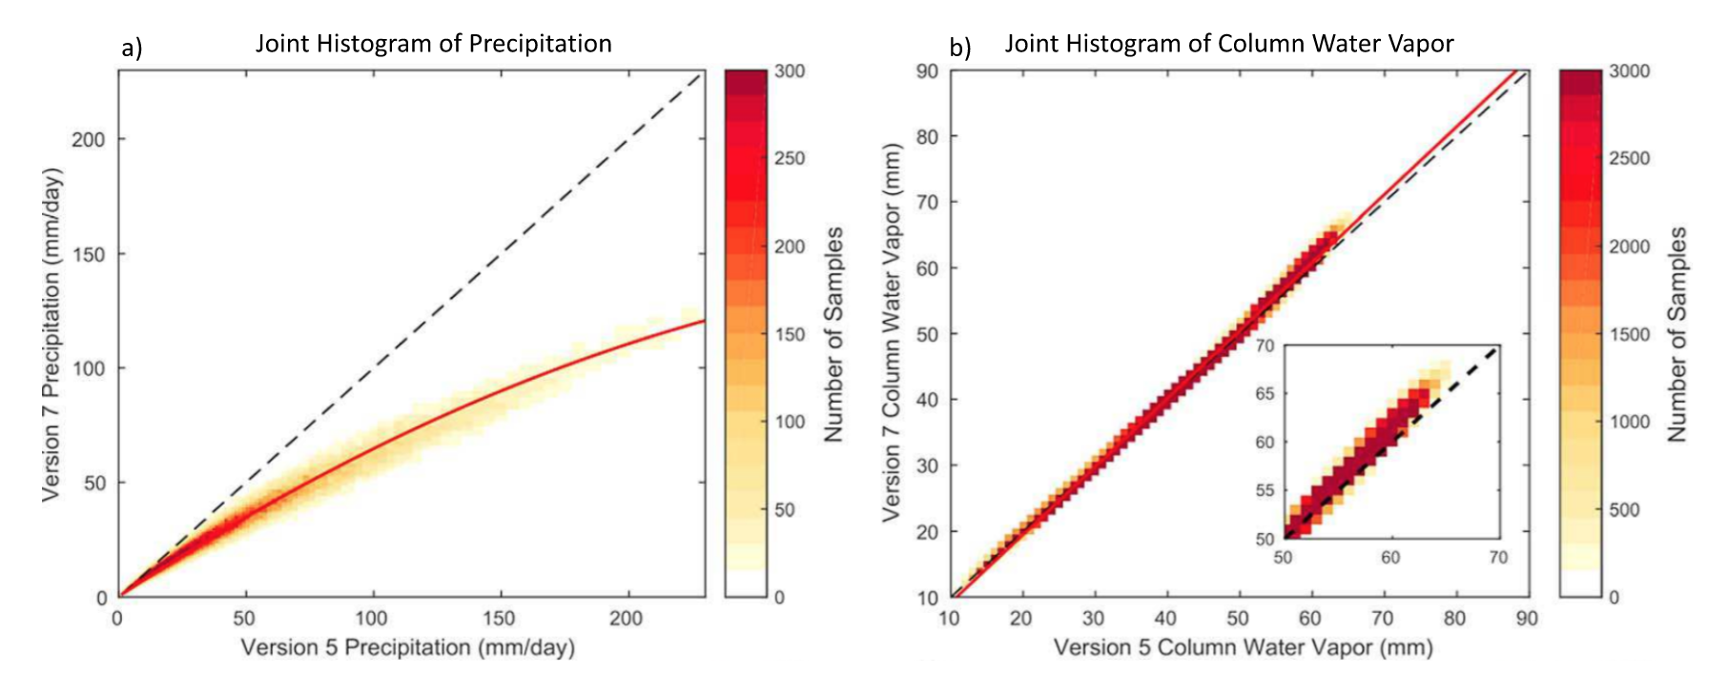
Figure 1
Difference
Similarity
“Relationship is claimed to exist here”: difference & similarity / “Row display of data”
Presenting comparison of parameters between two versions to indicate biases.

Slide 5
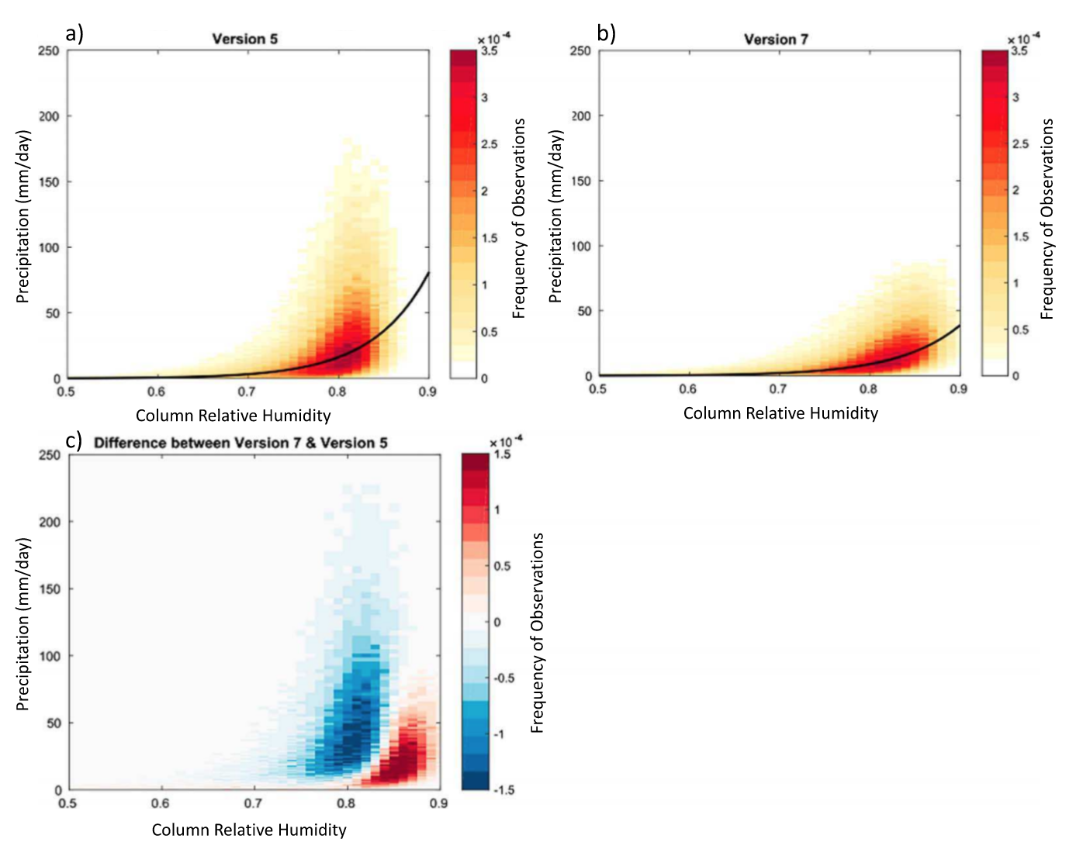
Figure 2
Difference
“Relationship is claimed to exist here”: difference
Variations in the derived relationship (fitting curves) between parameters among data versions.

Slide 6
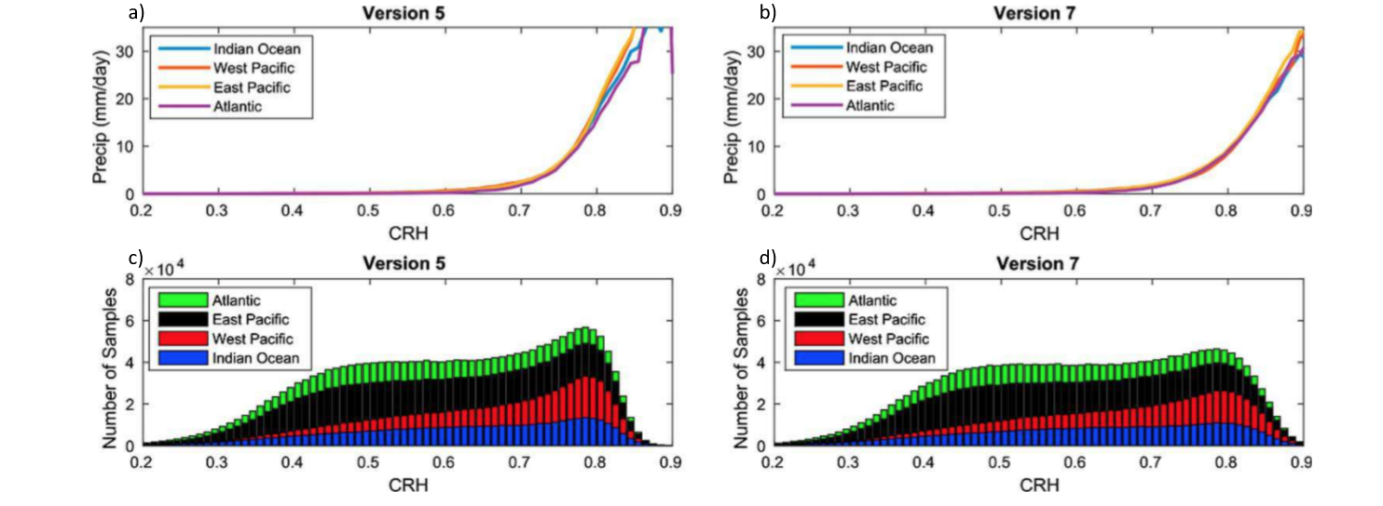
Figure 3
Regional analysis
“Relationship is claimed to exist here” / “Summary display of row data”
Down-scaling to specific regions. Parameter relationships over these regions show differences between versions.

Slide 7
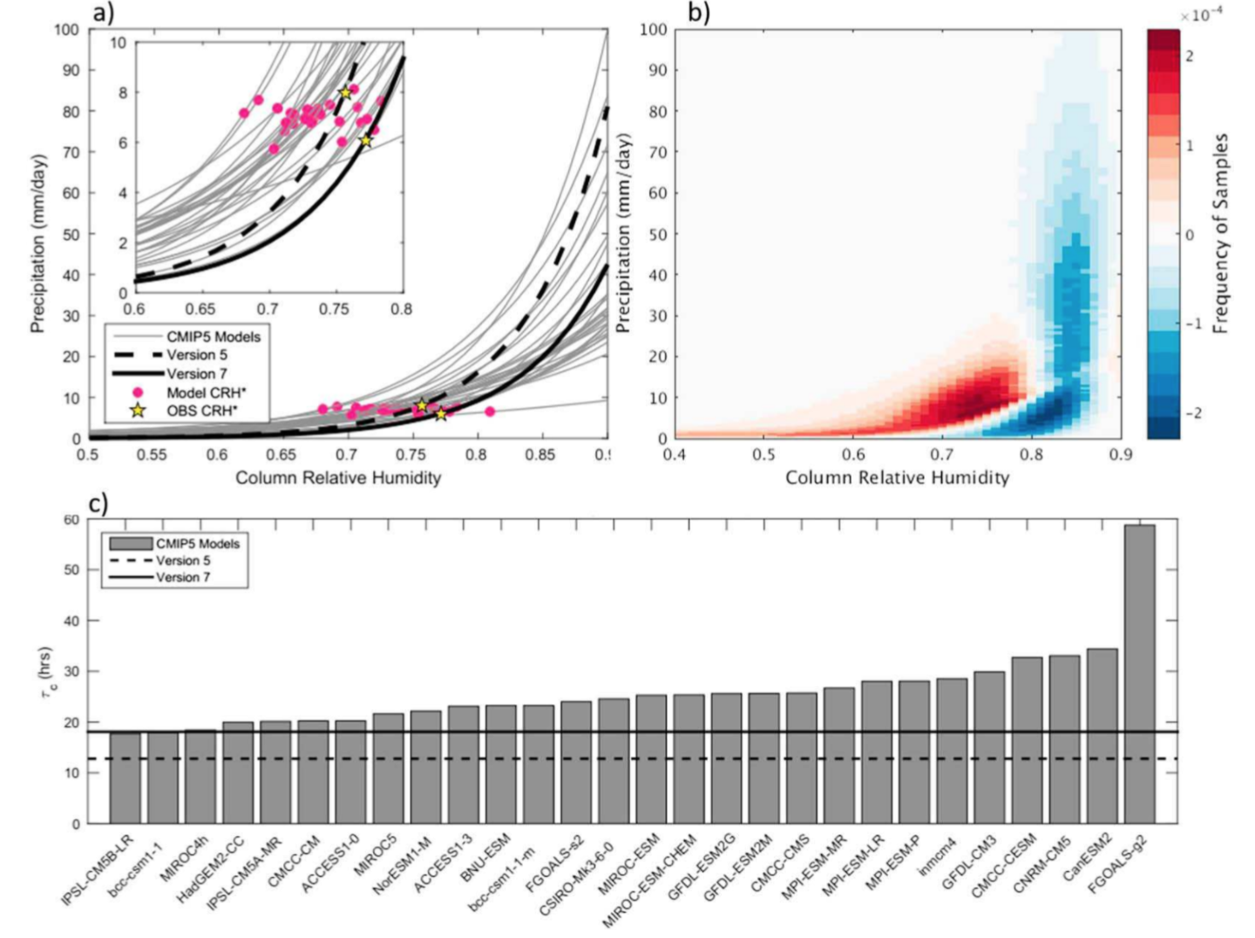
Figure 4
Overestimate in models
“Relationship is claimed to exist here”: Parameter relationship is examined among models.
“Feature is claimed to exist here” : Model biases lead to deficiency of presenting observed features.

Slide 8
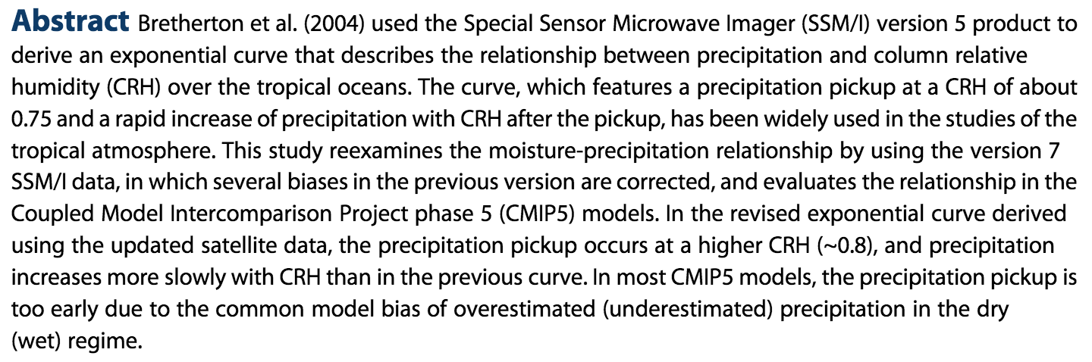
The Abstract, and how figures support its claims
0.75
0.8

