Slide 1
Employee Data Analysis using Excel
STUDENT NAME: PRIYADARSHINI M
REGISTER NO: 59D7EECA95E5336A13B4EA374B37061C / 312208739
DEPARTMENT: B.COM[GENERAL]
COLLEGE : MEENAKSHI COLLEGE FOR WOMEN

Slide 2
PROJECT TITLE
Employee Data Analysis Based on Gender , Department and Salary Using Excel.

Slide 3


AGENDA
Problem Statement
Project Overview
End Users
Our Solution and Proposition
Dataset Description
Modelling Approach
Results and Discussion
Conclusion
3/21/2024 Annual Review

Slide 4

PROBLEM STATEMENT
To analyze and gain insights into employee data with a focus on gender, department, and salary. This analysis aims to identify patterns, disparities, and trends that could inform HR decisions and support equitable workplace practices.

Slide 5

PROJECT OVERVIEW
Organizations strive to maintain a balanced and equitable work environment. Analyzing employee data related to gender, department, and salary can provide valuable insights into diversity and pay equity within the organization. This analysis can help identify any disparities or trends that may need addressing to promote fairness and inclusivity.
To perform a comprehensive analysis of employee data focusing on gender, departmental distribution, and salary metrics using Excel. The goal is to uncover patterns, disparities, and trends to inform decision-making processes and support equitable practices within the organization.

Slide 6

WHO ARE THE END USERS?
HUMAN RESOURCE DEPARTMENT
MANAGEMENT AND LEADERSHIP
TEAM LEEADERS AND SUPERVISORS
EMPLOYEES
EXECUTIVE LEADERSHIP
BUSINESS ANALYSTS

Slide 7

OUR SOLUTION AND ITS VALUE PROPOSITION
1. Filtering – Remove values
2. Pivot table – summary of employee performance
3. Bar diagram – final report

Slide 8
Dataset Description
Employee Data Set - KAGGLE
7 features in excel
Employee ID – A unique identifier assigned to each employee .
NAME : The name of the employee
GENDER – The gender of the employee
DEPARTMENT : The employee work in various department such as training , marketing , support etc
SALARY : This feature contain average income of each employee
START DATE : It shows the joining date of the employee .
FTE : This shows the efficiency of the employees .
EMPLOYEE TYPE : It varies like temporary , fixed , permanent .
WORK LOCATION : The employees work in different location .

Slide 9

THE "WOW" IN OUR SOLUTION
1. Identifying Inequities
2. Improving Decision-Making
3. Enhancing Transparency and Accountability
4. Supporting Strategic HR Initiatives
5. Facilitating Compliance and Benchmarking
3/21/2024 Annual Review
9

Slide 10
STEP – 1 : Download the employee data set and open it in KAGGLE . STEP – 2 : Select the entire data and click on the data then choose filter option STEP – 3 : Sort from A-Z order STEP – 4 : Select the entire data then click on insert and click on pivot table to create a table STEP – 5 : Drag the needed data and create a pivot table STEP – 6 : Select the pivot table and click on insert STEP – 7 : Now choose the chart type that you want STEP – 8 : The chart is created
MODELLING
10

Slide 11
RESULTS
TABLE:
11

Slide 12
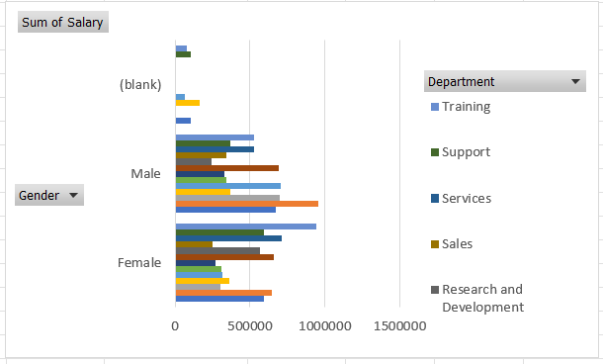
2. BAR DIAGRAM:

Slide 13
conclusion
The analysis of employee data focusing on gender, department, and salary using Excel provides critical insights that can significantly impact organizational practices and policies. By leveraging Excel’s analytical and visualization tools, organizations can uncover valuable patterns and disparities that drive informed decision-making and strategic planning.

