Slide 1
Langchain Agents and React

Slide 2
Agents
Some applications will require not just a predetermined chain of calls to LLMs/other tools, but potentially an unknown chain that depends on the user's input. In these types of chains, there is a “agent” which has access to a suite of tools. Depending on the user input, the agent can then decide which, if any, of these tools to call.
Tools : How language models interact with other resources.(wikipedia, llm-math, Search), A specific abstraction around a function that makes it easy for a language model to interact with it. Specificlaly, the interface of a tool has a single text input and a single text output.
Agents : The language model that drives decision making. An Agent is a wrapper around a model, which takes in user input and returns a response corresponding to an “action” to take and a corresponding “action input”.
Toolkits: Sets of tools that when used together can accomplish a specific task. Groups of tools that can be used/are necessary to solve a particular problem.(wikipedia, llm-math, Search)
Agent Executor: The logic for running agents with tools. An Agent Executor is an Agent and set of Tools. The agent executor is responsible for calling the agent, getting back and action and action input, calling the tool that the action references with the corresponding input, getting the output of the tool, and then passing all that information back into the Agent to get the next action it should take

Slide 3
Agents Working using LangChain
User Input
User Inp
Agent Executor
Action and Action Input
Toolkits(list of tools)
Observation/Output
Observation
Tool1 – wikipedia search
Tool2 – llm-math
User Inp
Action
Action Input
Perform Action
LLM (Thought, action, action inp)
User Inp/Observation
Agent
Data Source
Action/Action inp

Slide 4
QNA problem we are solving
Problem : Since the model is generative and asking complex question may result in wrong answers. Reasons may be there are many steps involved in finding the answers or direct answer to question is not present but all other information is available which can help to reach final output.
Example :
Question asked with simple prompt : How would I get from Singapore to San Francisco?
Answer by model : The most direct route from Singapore to San Francisco is to fly. There are several airlines that offer direct flights from Singapore to San Francisco, including Singapore Airlines, United Airlines, and American Airlines. The flight time is approximately 15 hours.(Answer First Justify Later, reason of junk results)
Question asked with prompt to give answer step by step: Explain step by step. How would I get from Singapore to San Francisco?
Answer by model(COT) : 1. Book a flight from Singapore to San Francisco. You can do this online or through a travel agent.
2. Check the visa requirements for entering the United States. Depending on your nationality, you may need to apply for a visa before you travel.
3. Pack your bags and make sure you have all the necessary documents for your trip.
4. Arrive at the airport in Singapore and check in for your flight.
5. Board your flight and fly from Singapore to San Francisco.
6. Upon arrival in San Francisco, go through immigration and customs.
7. Collect your luggage and make your way to your accommodation.

Slide 5
React(Advancement of COT)
ReAct combines chain of thought reasoning with action planning.
Idea is reason first and then answer
ReAct Components
ReAct prompts guide LLMs through reasoning and action steps.
Prompts include: Question, Thought (reasoning step), Action (pre-defined choices), Observation (external data context).
ReAct Actions
ReAct employs pre-defined actions: search, lookup, finish.
Small Python API interacts with external sources like Wikipedia.
Actions guide LLMs toward the solution by following a structured path.
Example
question = "How old is the president of the United States?"
Answer:
Thought: I need to search the president of the United States, find their age, and answer the question.
Action: Search[president of the United States]
Observation: Joe Biden is the 46th and current president of the United States.
Thought: Joe Biden is the president of the United States. I need to search Joe Biden and find his age.
Action: Search[Joe Biden]
Observation: Joseph Robinette Biden Jr. (born November 20, 1942) is an American politician who is the 46th and current president of the United States.
Thought: Joe Biden was born in 1942, so he is 78 years old.
Action: Finish[78 years old]
Note : the first thought is chain of thought and other thoughts are based on observations

Slide 6
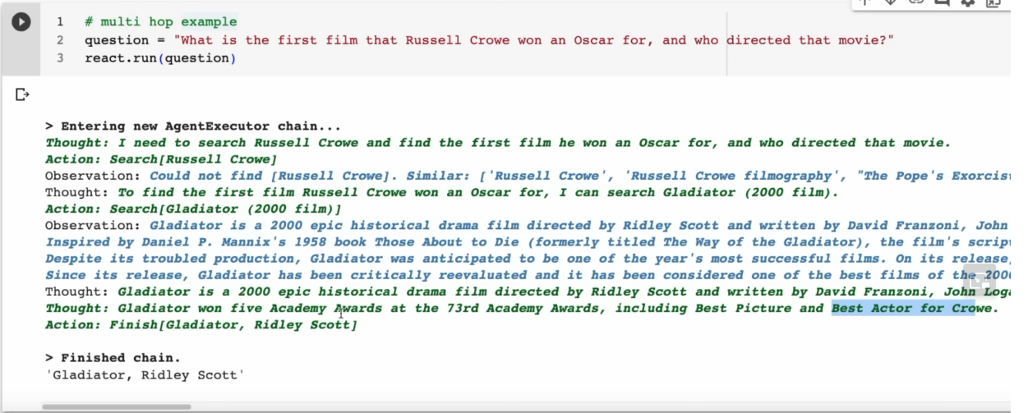
Actual Example run

Slide 7
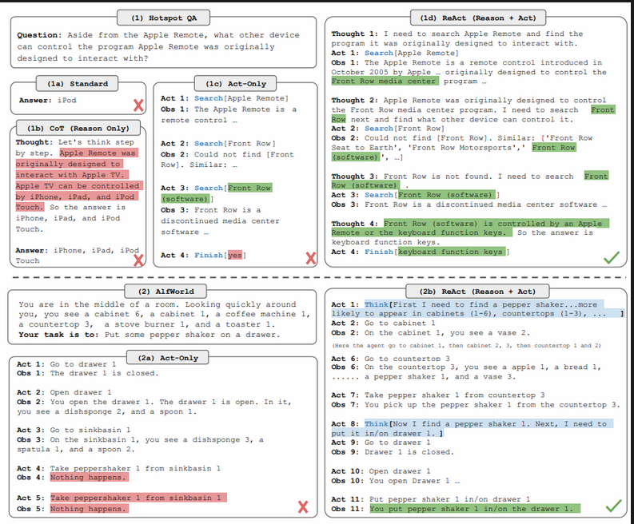
How does REACT compares with other methods

Slide 8
LangChain Framework
LangChain provides modular components for LLM-powered applications.
Includes prompt templates, memory, and tools for various tasks.
Optimized chains available for specific use cases.
LangChain agents allow dynamic decision-making based on user input.
Agents interpret user input and decide which tools or chains to use.
Larger LLMs are ideal for advanced techniques like PAL and ReAct.

