Slide 1
MODEL TRAINING
Teaching a Computer to Recognize Faces
Workshop 1

Slide 2
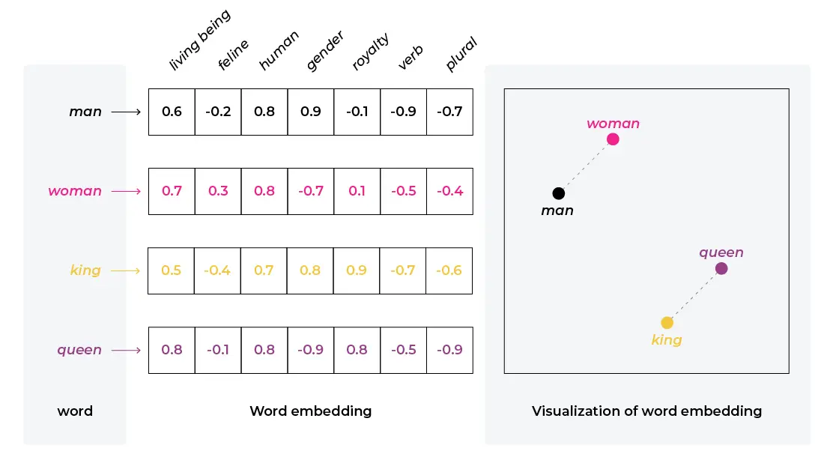
Understanding Embeddings
Technical term
An embedding is a compact vector. In this lab, the model maps each face image to 128 numbers. Similar faces should land near each other in embedding space.
Classroom analogy
Imagine a passport that lists 128 precise numbers about a face instead of showing a photo.

Slide 3

Classification vs Embedding
Classification model
Embedding model
Good for fixed categories like cat, dog, or car. A new student usually means changing the class list and retraining.
Stores one or more embeddings per person. Adding someone means adding examples to the database, not retraining the whole network.
Add person $→$ add embedding

