Slide 1


DiRAC: Dynamically Reconfigurable Architecture Template and Cycle-Accurate Simulator for Dataflow Accelerators
Shail Dave Compiler Microarchitecture Lab, ASU

Slide 2
Tutorial Outline
What does this simulator do?
How to work with the simulator?
How can simulation infrastructure help?
What kind of functionalities you can simulate?
What variations of accelerator architecture you can simulate?
What is the underlying microarchitecture? How does it execute?
How can you configure the execution (through specification files)?

Slide 3
Overview
for(i=0; i <10; i++)
out += arr[i];
Cycle-level Architectural Simulation of
Dataflow Accelerator
Kernel (nested loop)
Execution Cycles
Architecture Description
Output Data
controller
Scratch-Pad Memory
Expected Output Data
==
is_correct
DRAM (Off-Chip)
Execution Configurations
For managing PEs/memories/interconnect
Provided by programmer/compiler

Slide 4
Explore Dataflow Executions in DiRAC
Installation
Setup accelerator execution
test1/arch: Target architecture
test1/data: Input data operands, [Golden reference for output data]
test1/kernel: Kernel functionality, Configurations for accelerator including for PEs, scratchpad, RFs, interconnect, scheduling comm. to PEs via interconnect, and DMA transfers.
Kick-starter examples: Vector summation, matrix multiply, convolution.
Simulate
git clone --recursive <repository-url>
cd /path/to/DiRAC/
make
Summation of 10-element vector op1 DRAM -> scratchpad -> interconnect
-> PE
-> interconnect -> scratchpad -> DRAM
./out/DiRAC --path ./tests/test1/ [--cmp-golden 1]
Input Files: op1.txt – 2 3 5 6 4 7 1 8 9 5 op2.txt – 1 golden_op3.txt – 50
Output Files: op3.txt – 50
Notes:
Documentation in progress.

Slide 5
Simulation Infrastructure: Use Cases
given that coarse-grained dataflow or spatial architectures are basic blocks in several ML and other domain-specific accelerators …
Faster design time; provides reusable blocks or at least a good kick-start vs. efforts from the scratch.
Simulation with plug-and-play environment before going to silicon. Makes possible easy emulation on FPGA (e.g., through Vivado HLS).
Although programmable, FPGA design is often challenging. Dataflow accelerators serve as a template for virtualization of FPGA designs.
Serves as a learning tool for students/professionals including non-experts.

Slide 6
Loop Functionalities that can be Simulated
Any nested loop.
Any number of input/output operands.
All loop operations should be expressed as a multiply-and-accumulate.
out = a*b; a, b, and out are scalars or elements of arrays.
No conditional statements (No if-then-else, switch-case).
Notes:
Simulator can be extended to perform operations other than multiply/add.
Plan for future release.

Slide 7
Variations of Accelerator Design
PE-grid layout
PE pipeline
Pipeline stages for function units, size of instruction memory, length of FIFOs for buffering data from interconnect
Register file configuration (local to PEs)
Size, buffering, partitioning
Interconnect
Number of networks for communicating input and output data
Scratchpad memory configuration (shared with PE-array)
Size, buffering, partitioning
DMA (direct memory access) controller
Setup time, link bandwidth
controller
Scratch-Pad Memory
DRAM (Off-Chip)

Slide 8
Toy Example 1
Vector Summation on Accelerator with 1 PE
for(i=0; i <10; i++)
out += arr[i];
Notes:
Why 1 PE?
Makes understanding the interconnect’s configuration easier.
Convolution or matrix multiply example features more PEs.
Presentation is in call-and-response (or theory-and-practical) manner:
- First comes some details about underlying microarchitecture blocks
- Then comes real example about how you can configure them

Slide 9
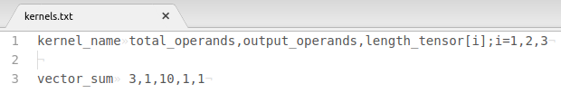
Kernel Specification
File: test/kernel/kernels.txt
Includes both input and output operands
length of each operand
Targeted Kernel:
out = 0;
for(i=0; i <10; i++)
out += arr[i] * 1;
Operand0: arr (input vector)
Operand1: 1 (input scalar)
Operand2: out (output variable; zero-initialized on accelerator)
Rules: i) Each scalar or variable is treated as a separate data operand.
ii) Each loop operation has to be in Multiply-and-ACcumulate (MAC) form.
Q: Why not to specify details about loop operations in kernels.txt ?
A: Data dependencies of loop operations are taken care of while specifying PE instructions.

Slide 10
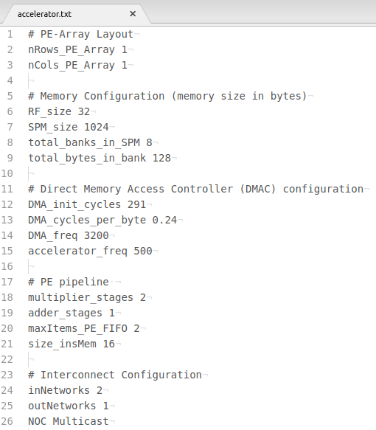
Architecture Specification
File: test/arch/accelerator.txt
Accelerator treats each data operand as of same type.
Default: uint16_t
Defined in DiRAC/include/definitions.h
typedef uint16_t data_type
Simulator is parameterized. If needed, change data_type and re-build simulator.
MHZ
MHZ
instruction words

Slide 11



Providing Data Files
arr
out
Files:
test/data/op1.txt
test/data/op2.txt
test/data/golden_op3.txt

Slide 12
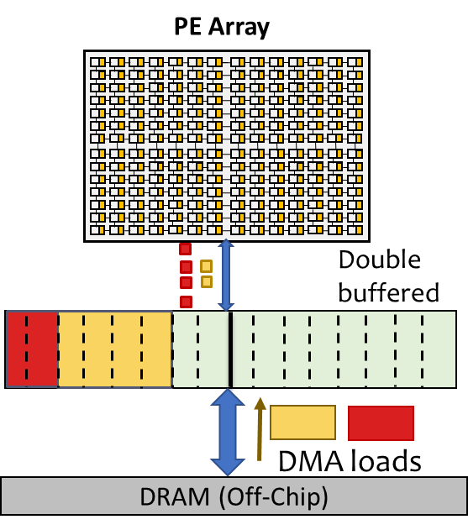
Execution of SPM Passes
SPM pass: Processing of the data in SPM by PE array.
Each SPM pass usually consists of multiple RF passes.
Scratchpads are typically double-buffered (ping-pong execution); in an SPM pass, while PE-array processes data from one buffer of the scratchpad, DMA controller communicates data between another buffer and DRAM.
Size of the data to be transferred depends on tiling of the loops
Data reused in consecutive passes depends on ordering of loops.
SPM Pass #0
Schedule DMA transfer for prefetch to SPM; PE-array idle.
SPM Pass #1
.
.
SPM Pass #n
Schedule DMA transfer for: - [prefetch to SPM]
- [write-back from SPM]
Scheduling of data transfers determines data reuse in SPM.
SPM Pass #n+1
Schedule DMA transfer for write-back from SPM; PE-array idle.
[dMazeRunner, S. Dave et al., TECS 19]
n: Total SPM passes for PE-array processing
Notes:
Longer version: Need a slide that explains how buffer indices are accurately updated upon meeting certain conditions.

Slide 13
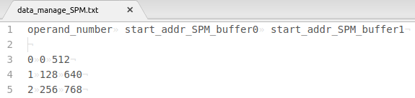
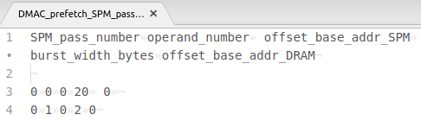
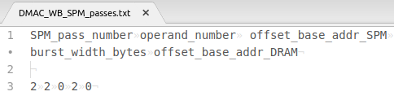
Managing Double-Buffered Scratchpad
Specify the starting address of each operand for double buffers.
Better practice: Allocate different operand in separate banks (avoid data access conflicts).
Currently, lacking multi-bank management.
File: test/kernel/data_manage_SPM.txt
Each bank houses 128 bytes.
File: test/kernel/DMAC_prefetch_SPM_passes.txt
Schedule DMA transfers.
SPM Pass #0
prefetch to SPM; PE-array idle.
Small data. Multiple DMA transfers are not required. PE-array processes the data.
SPM Pass #1
Prefetch arr[0:9]
Prefetch a scalar with value 1
File: test/kernel/DMAC_WB_SPM_passes.txt
SPM Pass #2
write-back from SPM; PE-array idle.
n = 1 = SPM passes for PE-array processing
Specifying DMAC schedules are analogous to APIs:
Write-back a variable out
Absolute addresses calculated in accel. controller. generated dynamically in processing tensors.

Slide 14
Execution During an SPM Pass
Since SPM accommodates more data than RFs, each SPM pass typically consists of many RF passes. In each RF pass, data is communicated between SPM and PE-array via interconnect.
Scheduling SPM accesses for data communication:
Size of the data to be transferred depends on tiling of the loops
Data reused in consecutive passes depends on ordering of loops.
RF Pass #0
Schedule SPM Read for prefetch to PE-array; PE-array idle.
RF Pass #1
.
.
RF Pass #m
Schedule SPM accesses for: - [prefetch to PE-array]
- [write-back from PE-array]
Scheduling of data transfers determines data reuse in RFs of PEs.
RF Pass #m+1
Schedule SPM Write for write-back from SPM; PE-array idle.
[dMazeRunner, S. Dave et al., TECS 19]
m: Total RF passes for PE-array processing
Notes:
Longer version: Need a slide that explains how buffer indices are accurately updated upon meeting certain conditions.

Slide 15
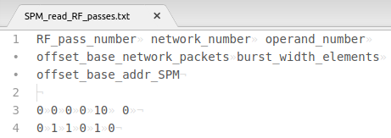
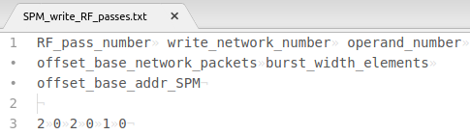
Accessing SPM in Multiple RF Passes
File: test/kernel/SPM_read_RF_passes.txt
Schedule SPM accesses.
Network number refers to input network.
Packets are required for finding out what interconnect metadata to communicate.
RF Pass #0
prefetch from SPM to PEs; no computation on PE-array.
ID of beginning packet for an operand. Non-zero when variable size data communicated at different RF passes.
RF Pass #1
Small data. Multiple data transfers are not required. PE-array processes the data.
Read arr[0:9]
Read a scalar with value 1
RF Pass #2
write-back from PEs to SPM; no computation on PE-array.
File: test/kernel/SPM_write_RF_passes.txt
Network number refers to output network.
n = 1 = RF passes for PE-array processing
For an operand, need to communicate burst_width elements from the packets, beginning with packet-id as specified offset_base_network_packets.
Packet = metadata and data for interconnect; data is read/written from/to SPM.
Write-back a variable out
Offset_base_addr_SPM (in bytes) indicates the starting address of a data operand from which #burst_width should be communicated to PEs in a concerned RF pass. Absolute address is determined from adding offset to the start address of the operand in an SPM buffer.

Slide 16
Overview of Multi-Cast (MC) Interconnect
Column-Wise MC Controllers
PE
n/w features row-wise MC controllers
Each row-wise MC connected to multiple col-wise MC controllers.
Each col-wise MC controller -> PE
Accelerator Controller
Row-Wise MC Controller

Slide 17
Configuring MC Controller
4-Tuple: <configVal, start_offset, cnt_keepVal, cnt_skipVal>
MC controller consists of a counter that increments upon getting new packet.
Processes packet only if: counter’s value is within bounds defined by offset and keepVal, otherwise skip the packet for skipVal times. Forwards packet upon matching tag of the processed packet, i.e.,
(counter >= start_offset) && (counter < start_offset + cnt_keepVal) && (configVal == *TagIn)
2
2
1
1
TagIn
<1,0,1,1>
<1,1,1,1>
Data
PE# (row,col)
<1,0,4,0>
Data
1
1
1
(1,1)
2
2
MC Row1
MC Row1, Col1
MC Row1, Col2
offset=0, keep=4, skip=0
<2,0,1,1>
<2,1,1,1>
(1,2)
1
1
offset=0, keep=1, skip=1
<2,0,4,0>
2
2
1
1
offset=1, keep=1, skip=1
2
(2,1)
(2,2)
2
2
MC Row2
MC Row2, Col1
MC Row2, Col2
offset=0, keep=4, skip=0
Value in blue box is configVal for MC controller
1
1
offset=0, keep=1, skip=1
1
1
offset=1, keep=1, skip=1
Rule: TagIn refers to rowTagIn for a row-wise MC controller, colTagIn otherwise.

Slide 18
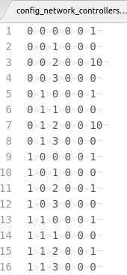
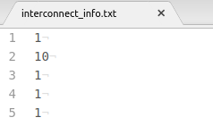
Configuring MC Interconnects
Simple configuration in this example. Pass all data to the only PE.
File: test/kernel/config_network_controllers.txt
Specify length of data operand packets
For each operand, length corresponds to maximum number of packets communicated in an RF pass.
Specify length of packets for output_networks.
For PE trigger (explained later), delay is maximum output elements communicated by a PE through a network in an RF pass (specifies writeback/reduction of data for a PE).
Format: <network, id_MC_controller, idx_tuple, rowTag, colTag, tuple-value>
configVal
row- wise MC
offset
keepVal
skipVal
network0
col- wise MC
File: test/kernel/interconnect_info.txt
row-
Wise
MC
keepVal
network1
PE_trigger_latency = max_elements_ per_PE_ per_output_network
col-
Wise
MC
length of packets for each of total_operands
4-Tuple: <configVal, start_offset, cnt_keepVal, cnt_skipVal>
length of packets for each of output_networks
Rule: Configurations for all row-wise MCs of a network specified first before col-wise MCs
Notes:
colTag for col-wise MCs does not matter. Can specify as 0.

Slide 19
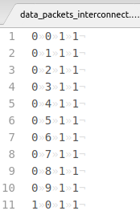

Configuring Metadata of Data Packets
Metadata of all data operands for input networks
Metadata of all packets for output networks
File: test/kernel/data_packets_interconnect.txt
File: test/kernel/data_packets_interconnect.txt
Format:
<network, idx, rowTagIn, colTagIn>
Offset indicates that for a given burst size, how far the concerned data element should be stored in SPM from the beginning address for the specified burst.
Depending on scheduling communication in RF passes, packets with indices varying for burst_width elements are read from offset_base_network_packets (as specified in test/configs/SPM_read_RF_passes.txt).
arr
For example,
Beginning address for this burst is x.
packet1: offset = 0; SPM address = x
packet2: offset = 2; SPM address = x + 2
packet3: offset = 1; SPM address = x + 1
packet4: offset = 3; SPM address = x + 3
scalar
Here rowTagIn and colTagIn are 1 for all elements,
since they should reach to both the MC controllers and then to the only PE.
This may happen because depending on the dataflow execution, one PE may produce T[i] and T[i+2] while another PE may produce T[i+1] and T[i+3].
Note: For each operand, length corresponds to maximum number of packets communicated in an RF pass.
Some/all of these packet information can be used for some/all of RF passes in some/all of SPM passes.

Slide 20
Triggering the PEs for Execution
For computation, PEs are triggered at beginning of each RF pass; RF passes are: #1 to #m; m = total_RF_passes for PE-array processing.
Upon triggered, a PE processes data from the part of the RF (RFs are usually double-buffered). Depending on the data reuse, triggers inform whether PEs should switch the buffer for processing new data.
All PEs write-back through the same output network; each PEs should output ‘x’ elements via network one-after-another at every ‘x’ cycles. Therefore, PEs are triggered for write-back one-by-one at every ‘x’ cycles (x = PE_trigger_latency).
Same mechanism can apply for reducing data spatially among PEs.
t
t
t
t+x
1-bit triggers
1-bit triggers
pe_exec
(1,1)
(1,2)
(1,1)
(1,2)
is_zero_init
is_write_back
change_RF_buf_Op1
is_spatial_reduce
t+2x
t+3x
t
t
change_RF_buf_Op2
(2,1)
(2,2)
(2,1)
(2,2)
change_RF_buf_Op3
For computation: Trigger all PEs at beginning of RF pass (e.g., at cycle #t).
For write-back: Trigger PEs at beginning of RF pass, one-by-one with offset of ‘x’ cycles.

Slide 21
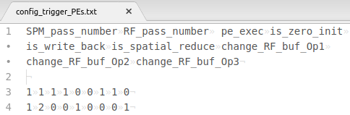
Scheduling Triggers for PE Executions
File: test/kernel/data_packets_interconnect.txt
Rule: For triggering buffer change of operands,
If an input operand was prefetched in RF pass u,
trigger swapping of buffers for the operand in RF pass u+1.
If an operand is going to be written back in RF pass v,
trigger swapping of buffers for the operand in RF pass v.
SPM_pass_number RF_pass_number pe_exec is_zero_init is_write_back is_spatial_reduce
1 1 1 1 0 0
1 2 0 0 1 0
compute
writeback
SPM_pass_number RF_pass_number
1 1
1 2
change_RF_buf_Op1 change_RF_buf_Op2 change_RF_buf_Op3
1 0
0 0 1

Slide 22
Processing Data in Double-buffered RFs
0
reg_buf1_startIdx_Opi
Data processed by function unit
.
.
Register File
Data communicated via interconnect with accelerator controller
reg_buf2_startIdx_Opi
.
.
total_registers-1
Buffer indices swapped upon trigger to PEs for executing different RF pass.
Possible to reuse data throughout multiple RF passes.
Programmer/compiler provides starting address of each data operand
Allows single buffer management: both buffers should indicate to same set of registers while data communication and computation is done sequentially.
Notes:
Interleaves communication with communication to reduce impact of the miss penalty for PEs.

Slide 23
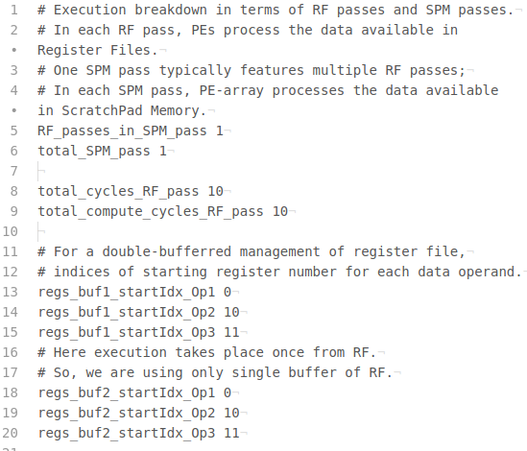
Configuring PE Execution
File: test/kernel/config_PEs.txt
Latency of the shortest RF pass.
Total cycles in which PEs fetch new instructions and perform operations.
Specify partitioning of RF for double-buffering
In this example of vector summation, since there is 1 effective RF and SPM pass, we do not benefit from double buffering. So we set the indices for both buffers to the same values.

Slide 24
PE Execution Pipeline
RF Read
Multiplication
Fetch
Decode
RegFile
Op1
x
reg_Op1 reg_Op2
reg_Op3 is_add_Op2_self
Op2
Fetched Instruction
Op3
is_zero_init
0
s_fetch
s_decode
s_RF_read
s_mult_stages[0]
Addition
RF Write
s_mult_stages[1:x]
s_add_stages[0]
RegFile
reg_Op3
+
add_ Op2_self
Op2_init
s_add_stages[1:y]
s_xxx indicates state variables (1-bit) that determine whether the next stage should execute.
s_RF_write
Notes:
Note that mux is in the last stage of adder for selecting val from self.

Slide 25
PE Instruction Format
[31:24]
[23:16]
[15:8]
[7:0]
00000000
00011011
00000001
0000000 1
idx_Op1
idx_Op2
idx_Op3
unused
add_Op2_self
reg_Op1 = reg_idx_Op1_comp + idx_Op1
reg_Op2 = reg_idx_Op2_comp + idx_Op2
reg_Op3 = reg_idx_Op3_comp + idx_Op3
When 1 – adder op2 is either a register value or 0,
When 0 – adder adds upon value computed in previous cycle.
reg_idx_Op1_comp = regs_startId_Op1[buffer_num_comp]
reg_idx_Op2_comp = regs_startId_Op2[buffer_num_comp]
reg_idx_Op3_comp = regs_startId_Op3[buffer_num_comp]
Determined at each RF pass
(depending on PE trigger, buffer idx is swapped between 0 and 1)
Notes:
Some of unused bits to be used for more functionality like reduction, write-back
Rest can be reserved, e.g., for future enhanced PE functionality

Slide 26
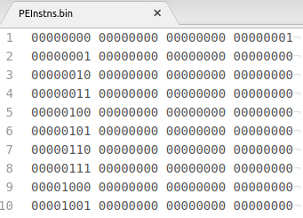
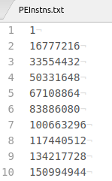
Preparing PE Instructions
File: test/kernel/PEInstns.bin
File: test/kernel/PEInstns.txt
Index for Op1
Index
for Op2
Index for Op3
adder_Op2_self=1
i.e., adder input is from register/zero. Need to set this for zero initialization. For next 9 times, set
the bit to 1, since we want to accumulate ‘out’.
Simulator actually processes this file. Convert binary of PEInstns.bin to unsigned integer.
0:9 for 10-element vector
0 for a scalar
0 for a variable
reg_Op1 = 0 + (0 -> 9)
reg_Op2 = 10 + 0
reg_Op3 = 11 + 0

Slide 27

Simulation Output
File: test/data/op3.txt

Slide 28
Making Programming the Simulator Easy
Learning from Simulator Behavior
Throws error if any configuration/data file is missing.
Assertions inform programmer to rectify any mismatch in specifying configurations.
Unending execution informs incorrect data transfer schedules (at incorrect passes, wrong burst widths).
Invalid data addresses (of SPM buffers, tensors in DRAM) leads to segmentation faults.
Throws error if output data does not match expected values (still some mismatch in configurations).
Resources
Examples: tests/vector_sum, tests/convolution_output_stationary, tests/mat_mul [a few more coming soon.]
Common files: Sample code for generating PE instructions, network configurations.
Detailed documentation [ongoing].
Optimize mappings for executing RF/SPM passes: dMazeRunner [TECS 19]

