Slide 1

B-AWARE: Blockage Aware RSU Association Policy for 5G Enabled Autonomous Vehicles
Presenter: Matthew Szeto, M.S. Student
Committee: Dr. Aviral Shrivastava, Dr. Robert LiKamWa, Dr. Ryan Meuth

Slide 2
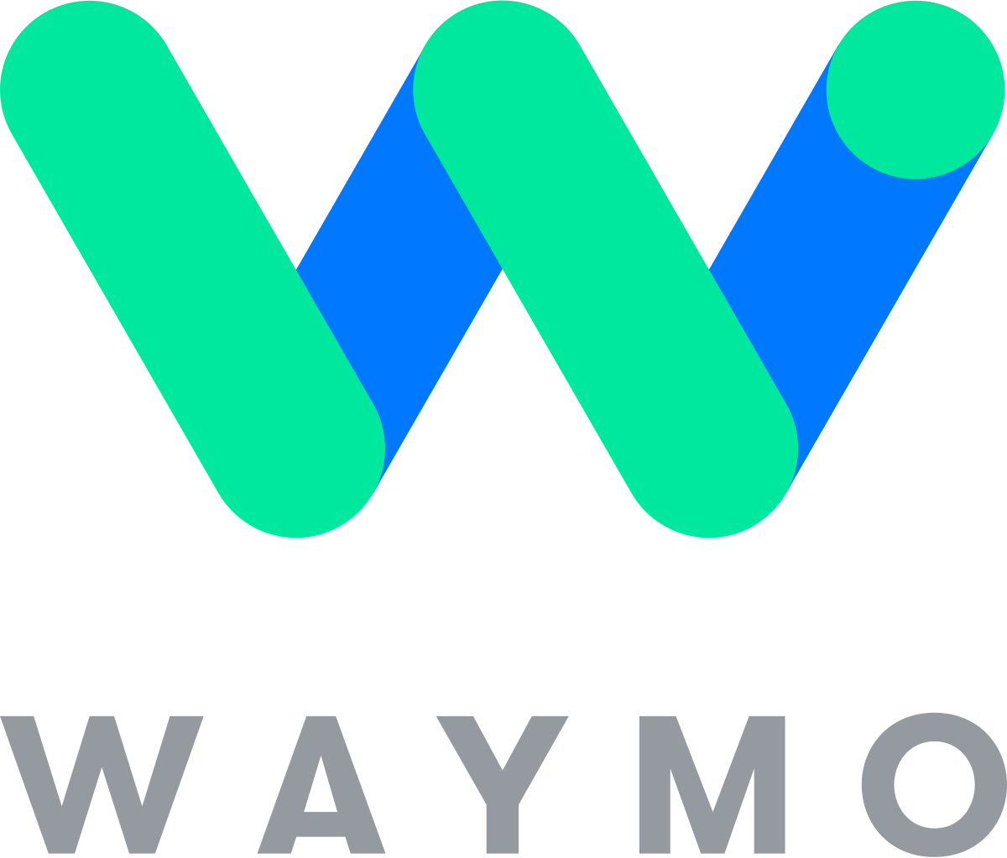

Autonomous Vehicles - Not Safe Yet
AV Companies
Tesla
Waymo
Cruise
Comma.ai
AVs should be safer than human operated vehicles
Currently: 9.1 crashes per million miles traveled, compared to 4.1 for conventional cars
source: https://1800injured.care/self-driving-car-accident-statistics/

Slide 3
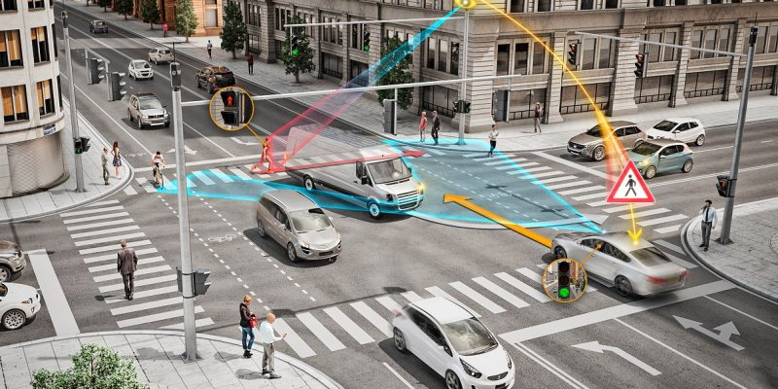
Toward Safety - The Internet of Vehicles (IoV)
Vehicle to Infrastructure (V2I) Benefits
Reduced Uncertainty
Improved perception through cooperative sensing
Remote takeover
Technology Requirements
Reliable
Highbandwidth
source: https://www.tu-auto.com/continental-teams-with-3m-over-v2i/

Slide 4
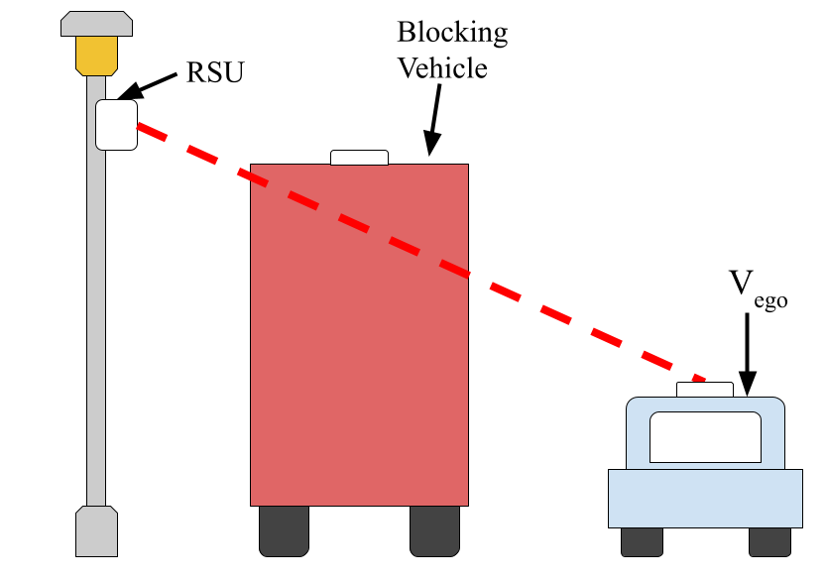
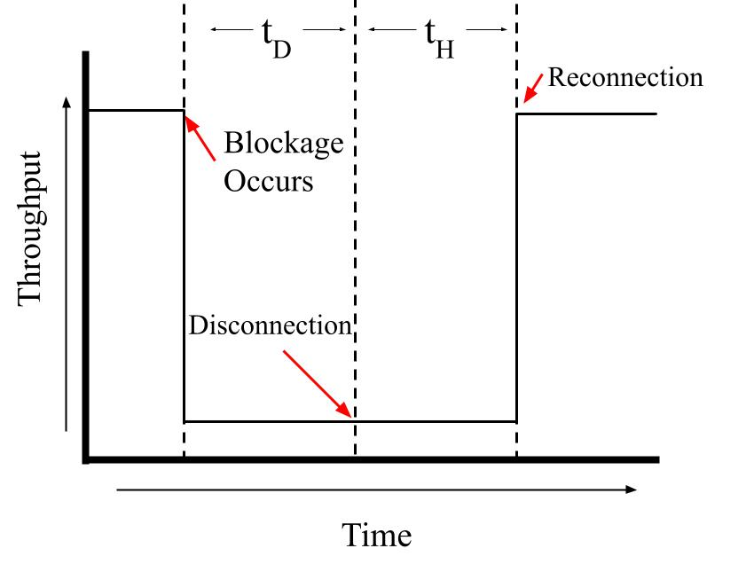
Challenge in Using 5G for V2I
mmWave requires line of site (LOS) to a strong connection
High beamforming overhead causes large association times

Slide 5
Related Works for Applying 5G to V2I
Handling Blockages
ML or statistical model to learn which beams are blocked in an environment
Backup link to switch to when blockage occurs
Handover Time Reduction
Use predicted position or GPS position to reduce association time
Problems
Reactive, probability based, or no dynamic blockage consideration

Slide 6
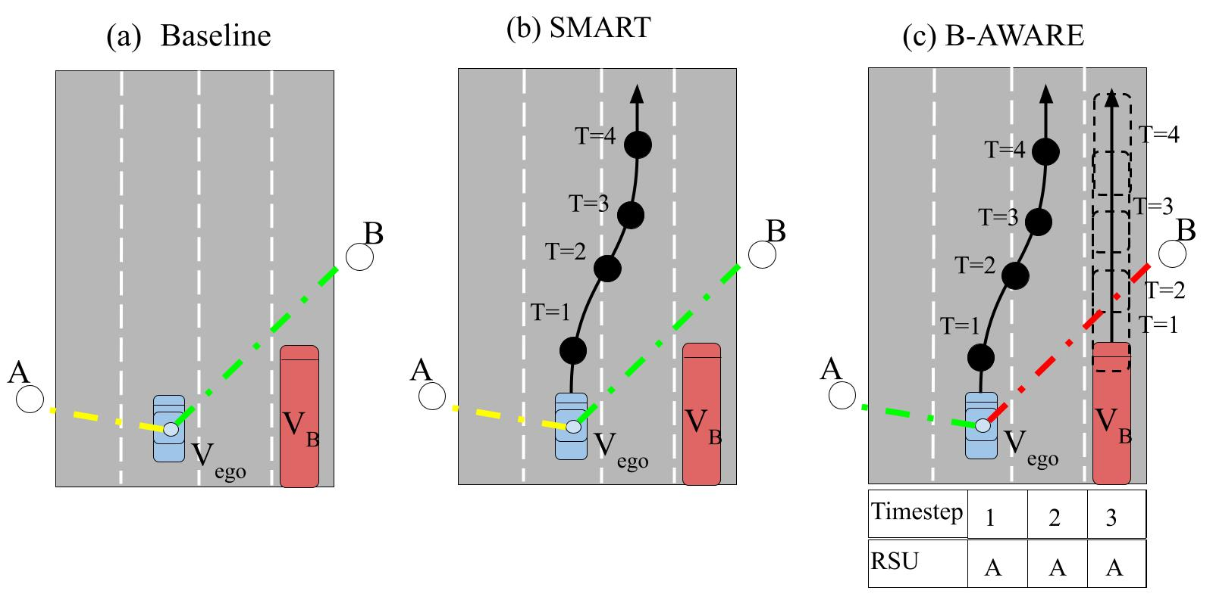
Existing Association Policies and My Approach
Fail to avoid blockage!
Sun, Yao, et al. "The SMART handoff policy for millimeter wave heterogeneous cellular networks." IEEE Transactions on Mobile Computing 17.6 (2017): 1456-1468.

Slide 7
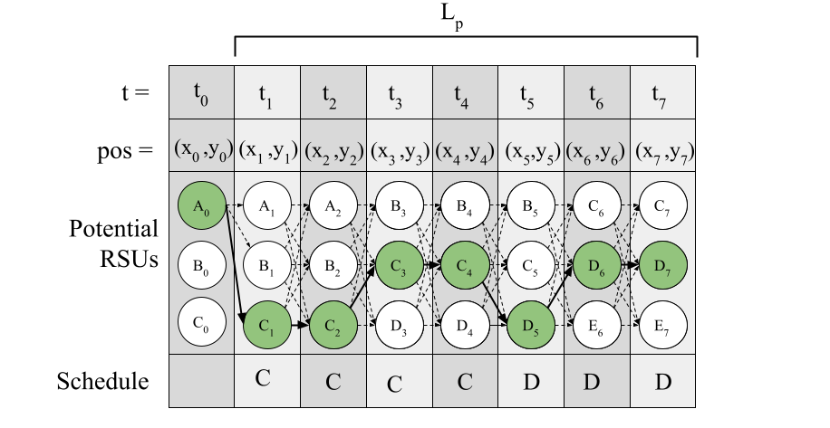
Key Idea - Planned Communication
Using vehicles predicted trajectory, select RSUs which will not become blocked
Vehicles follow an association schedule which tells them which RSU to connect to and when

Slide 8
System Model - Road Side Units (RSUs)
RSUs
Equipped with 60GhZ MIMO antennas
Can connect with multiple vehicles at a time
Have knowledge of map data (building locations and RSU positions)
RSUs are connected to one-another via a high bandwidth backhaul link
Placed along streetlights of varying height

Slide 9
System Model - Vehicles
Vehicles
Autonomous
Planned position up to a certain time
Knowledge of map data (RSU positions, buildings)
Knowledge of their own size
Equipped with a 5G antenna

Slide 10


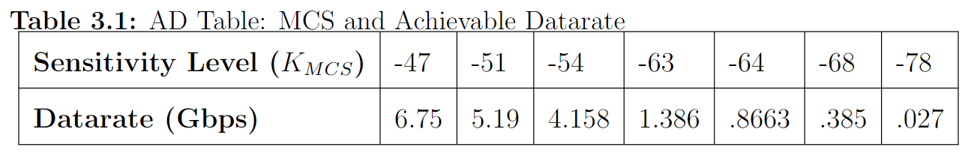
System Model - Channel Model
Channel
Freespace Pathloss
RSS a function of distance
Datarate from RSS threshold

Slide 11
Modeling Handovers - Event Overheads
Cannot transmit during handovers or blockage
O_{H} = t_{H}
O_{PH} < O_{H}
O_{BH} = t_{D} + t_{H}

Slide 12
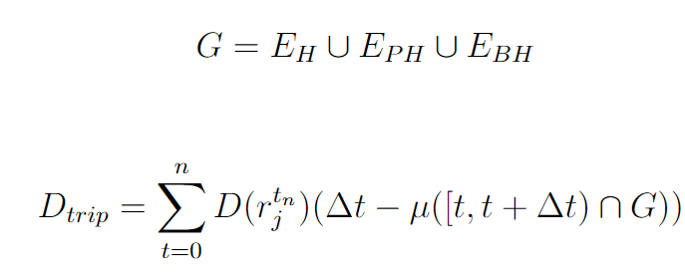
Total Achievable Data
Achievable data = datarate*(time you can transmit)

Slide 13
Problem Formulation
Given a set of vehicle paths, RSU positions, and building locations. For each vehicle, find the RSU at each time step that maximizes the potential data transmission for a vehicle’s schedule.
Notes:
Metric is related to RSS but accounts for handovers

Slide 14
Creating the Connection Schedule
Each vehicle connects to the RSU according to its connection schedule.
2. Using the knowledge of vehicle trajectories and sizes, the RSU finds the schedule for each vehicle which maximizes the potential datarate.
3. Each RSU then sends the optimal blockage aware association schedules back to each vehicle connected to it.

Slide 15
Optimizing the Association Schedule
Potential choices and decisions through time can be modeled as a directed acyclic graph (DAG)
t = 1
t = 2
t = 3
t = 4
RSU A
RSU A
RSU A
RSU B
RSU B
RSU B
RSU C

Slide 16
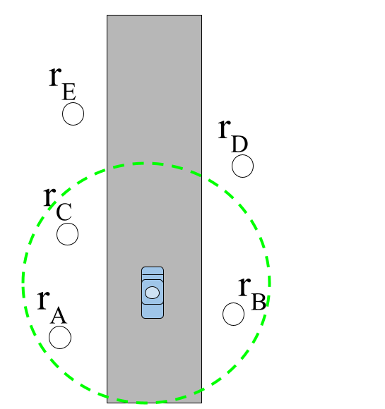
Nodes and Edges Representation
RSU A
D(B, T)
RSU A
RSU B
RSU B
D(B, T)
RSU B
RSU B
RSU C
Nodes = Available connections at a timestep
Edge Weights = Potential Max Data transmitted while connected to the RSU in it’s timestep

Slide 17
DAG Construction Example
Building
2
Building
Current Scenario at
t = 0
3
1
Building
Building
t = 0
t = 1
t = 2
t = 3
1

Slide 18
DAG Construction Example
Building
2
Building
Expected Scenario at
t = 1
3
1
Building
Building
t = 0
t = 1
t = 2
t = 3
0
1
1
0
2
D 1->3
3

Slide 19
DAG Construction Example
Building
2
Building
Expected Scenario at
t = 2
3
D _{3->3} > D _{3->1}= D _{3->2}
1
Building
Building
t = 0
t = 1
t = 2
t = 3
1
1
1
D 3->1
D 3->2
2
2
D 1->3
3
3
D 3->3

Slide 20
DAG Construction Example
Building
2
Building
Expected Scenario at
t = 3
3
1
Building
Building
t = 0
t = 1
t = 2
t = 3
1
1
1
1
D 3->1
D 3->2
E
2
2
2
D 1->3
3
3
3
D 3->3

Slide 21
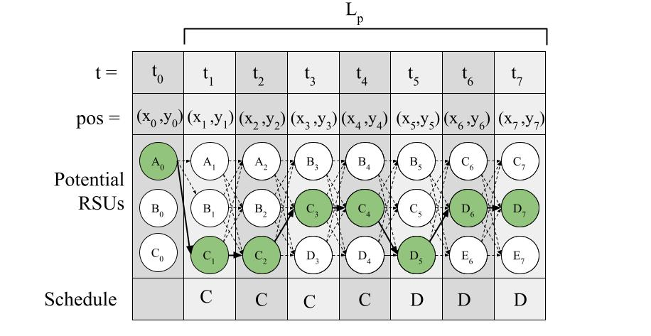
Complete Schedule Generation
Finding the best schedule
Negate edge weights
Single Source shortest path from start to end node
Topological sort, process nodes sequentially
O(V+E)

Slide 22
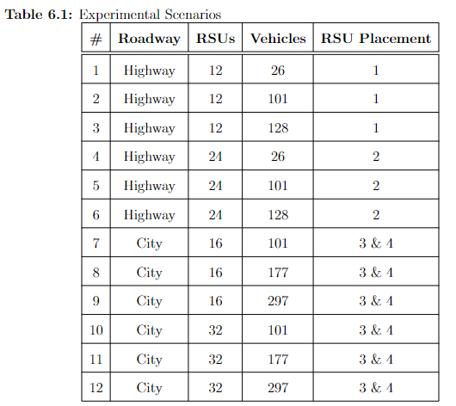
Experiments
Maps - Imported from Open Street Map (OSM)
Vehicles - Traffic generated with SUMO, 3:1 regular to blocking
RSUs - Sparse and Dense Deployments
Path plan uncertainty - 25% chance of change in later path
Algorithms - Tested Baseline, SMART, B-AWARE in each scenario

Slide 23
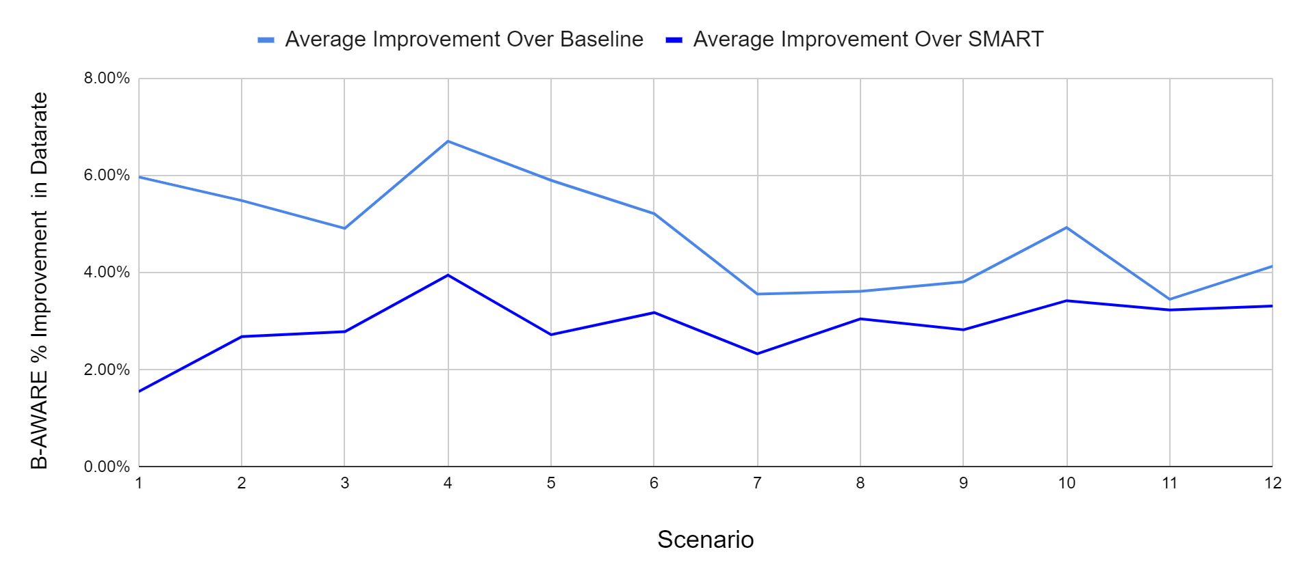
B-AWARE: Better Max Data Over Other Approaches
B-AWARE is robust to path plan changes and can improve the datarate over existing approaches in the average case for all scenarios

Slide 24
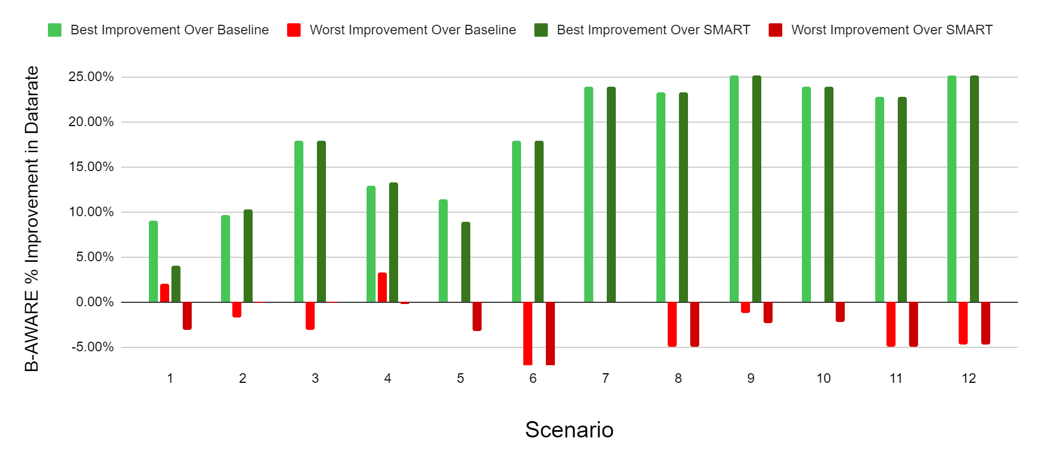
B-AWARE: Best and Worst Case
The worst case datarate degradation is not as high as the potential benefit

Slide 25
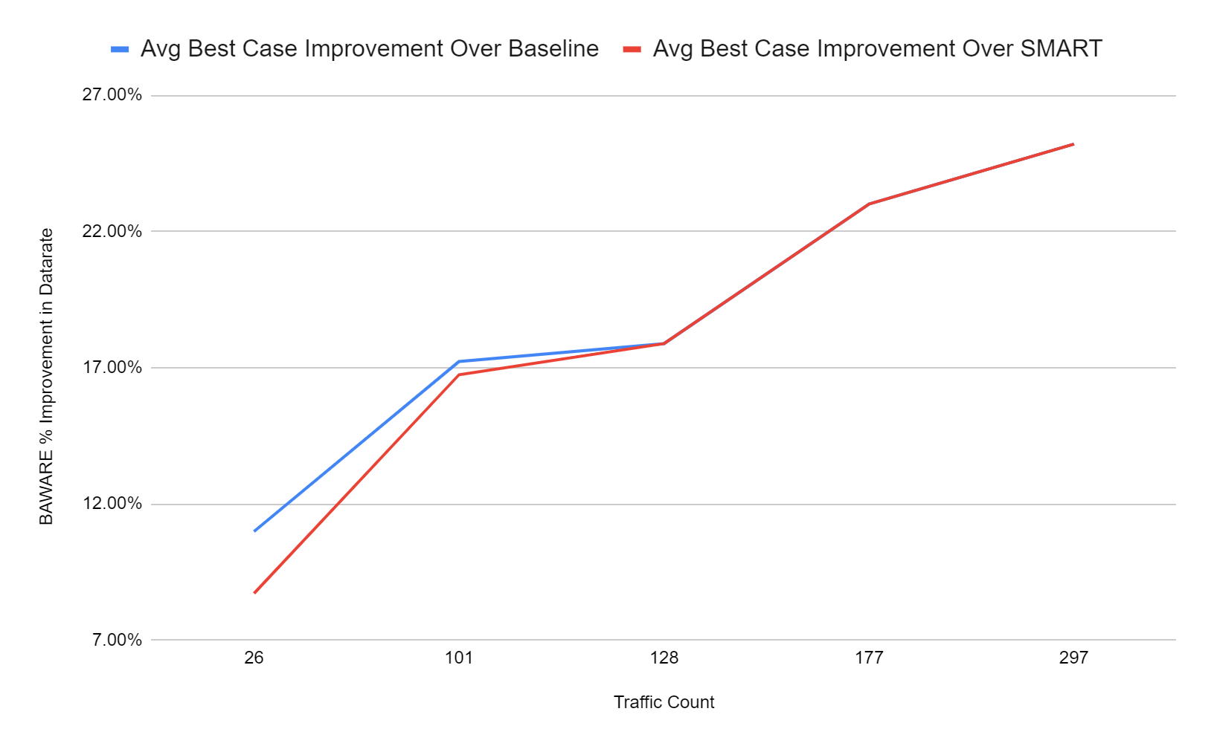
B-AWARE: Improvement with Traffic Scaling
Potential improvement from using B-AWARE increases as rate of blockages increases

Slide 26
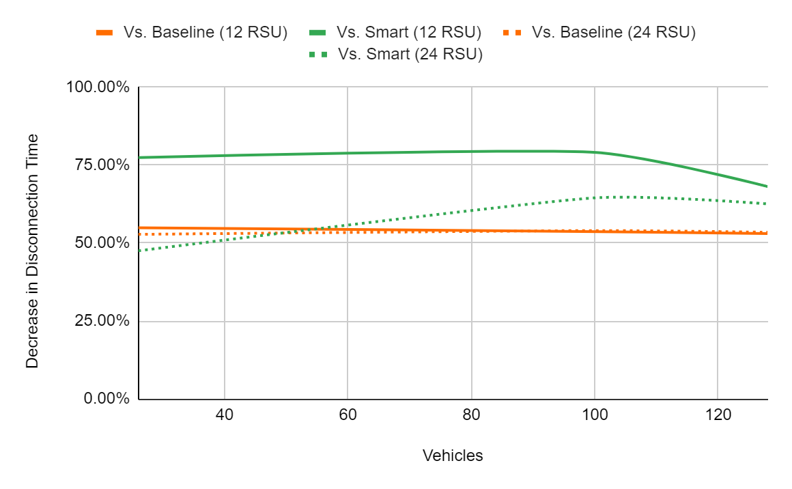
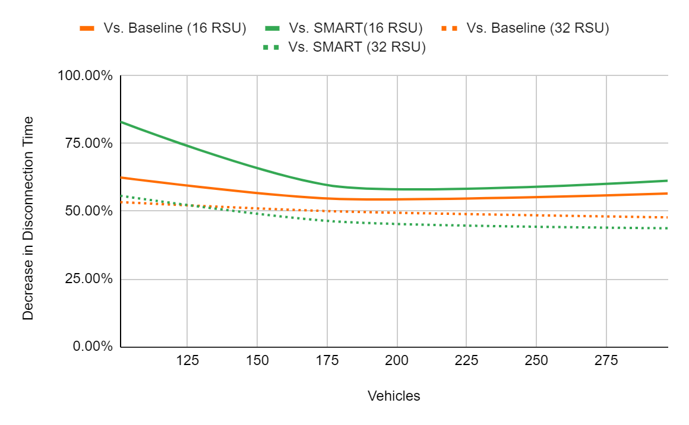
Decrease in disconnection time from B-AWARE

Slide 27
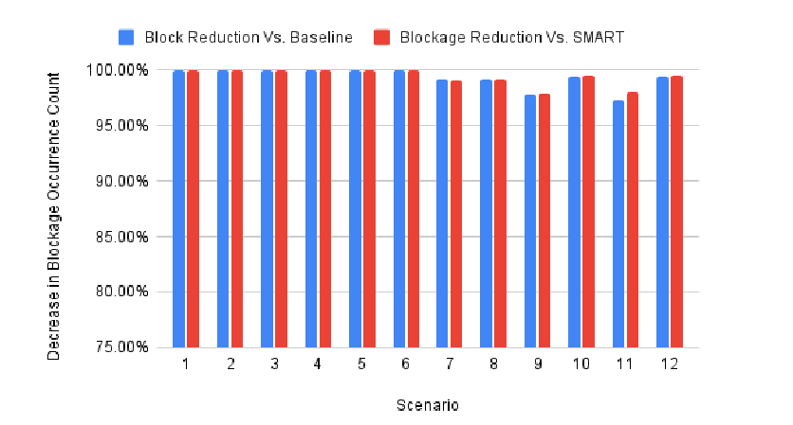
Large Reduction in Blockage Occurrences

Slide 28
Concluding Remarks
There are challenges in applying mmWave to CAVs
I proposed an RSU association schedule which tells CAVs what to connect to and when.
I demonstrated creation and optimization of said schedule
Results show by considering other vehicles paths, we can predict and avoid blockages, thus increasing potential throughput and reducing network downtime

Slide 29

Thank You!

