Slide 1
ADAPT: Asymmetric Device Adaptive
Parallel Training for Small-Scale
Heterogeneous Systems​
Masters Thesis Defense
Presented By: Rishab Kashyap​
Thesis Committee:
Dr. Aviral Shrivastava
Dr. Aman Arora
Dr. Nakul Gopalan

Slide 2
PROBLEM STATEMENT

Slide 3
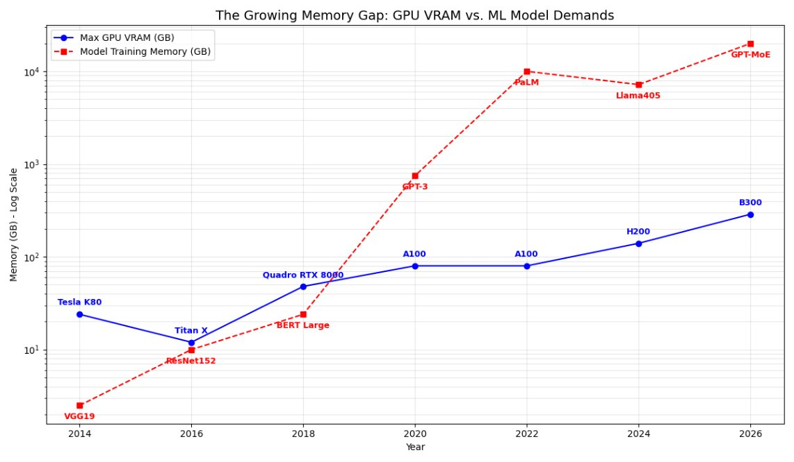

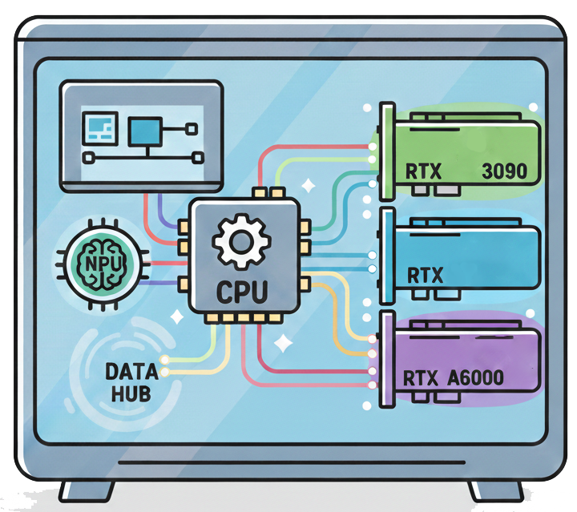

Heterogeneous Resources in Desktop-like systems
Large Machine Learning models are too large to train on a single device: Limited compute capability and memory availability.
Parallel computing is a non-trivial task on small-scale heterogeneous systems: System composed of multiple device types.
Current solutions only work well for homogeneous GPU systems → Poor performance on heterogeneous setups.
The Problem: How do we achieve an efficient distribution of the training load to ensure near-optimal execution time while effectively leveraging the resources of a heterogeneous system?
* All images from FlatIcon
Notes:
LLMs take up a lot of memory and demand high compute
Small-scale lab servers and desktops can barely fit the “small” versions of it
Distributed Computing is a solution → not present for heterogeneous systems
Problem statement

Slide 4
RELATED WORK

Slide 5
Related Works
Previous Works | Parallelism Type(s) | Approach | Limitations
PyTorch Distributed (Li et al.^{[1]}) | Data | Automatically splits data equally across available GPUs | No heterogeneous execution Cannot detect load and memory imbalance
PiPPy (Reed et al.^{[2]}) | Pipeline | Schedules a GPipe-like pipelining approach and automatically splits layers equally by layer count | Cannot detect OOM errors Incorrect splitting points
ALPA (Zheng et al.^{[3]}) | Data + Pipeline | Creates an automatic pipeline parallel scheduler across different GPU clusters using a latency-based cost function | All devices must be homogeneous Splits are performed purely on latency values
Whale (Jia et al.^{[4]}) | Data + Pipeline + Tensor | Utilizes a memory-sensitive cost function to split the workload across heterogeneous GPUs | Does not include CPU in training Static splitting Purely memory dependent
ADAPT (Our Method) | Data + Pipeline | Considers all available devices Differentiates based on memory and latency of devices Can execute at runtime | Limited Parallelism Types Performs slow search on residuals Limited to small-scale systems Sensitive to system noise for small models
[1] Li, S., Zhao, Y., Varma, R., Salpekar, O., Noordhuis, P., Li, T., Paszke, A., Smith, J., Vaughan, B., Damania, P., & Chintala, S. (2020). PyTorch Distributed: Experiences on Accelerating Data Parallel Training. Proceedings of the VLDB Endowment (PVLDB), 13(12), 3005–3018. https://doi.org/10.14778/3415478.3415530.
[2] Reed, J., Belevich, P., Wen, K., Huang, H., & Constable, W. (2022). PiPPy: Pipeline Parallelism for PyTorch. https://github.com/pytorch/PiPPy
[3] Zheng, L., Li, Z., Zhang, H., Zhuang, Y., Chen, Z., Huang, Y., Wang, Y., Xu, Y., Zhuo, D., Xing, E. P., Gonzalez, J. E., & Stoica, I. (2022). Alpa: Automating inter- and intra-operator parallelism for distributed deep learning. In 16th USENIX Symposium on Operating Systems Design and Implementation (OSDI 22) (pp. 559–578). USENIX Association. www.usenix.org
[4] Jia, X., Jiang, S., Wang, W., Xiao, J., Jiao, Z., Zhang, J., Luo, Y., & Chen, J. (2022). Whale: Scaling deep learning model training to the heterogeneous GPU cluster. In Proceedings of the 27th ACM International Conference on Architectural Support for Programming Languages and Operating Systems (ASPLOS 2022) (pp. 358–370). Association for Computing Machinery
Notes:
DDP: Divides an ML training load equally across all devices
PiPPy does the same with a different parallelism type
Cannot detect OOMs or heterogeneous execution
ALPA creates a latency-based analytical model
Only homogeneous setting
Whale has heterogeneous only on GPU, and purely memory-based operation

Slide 6
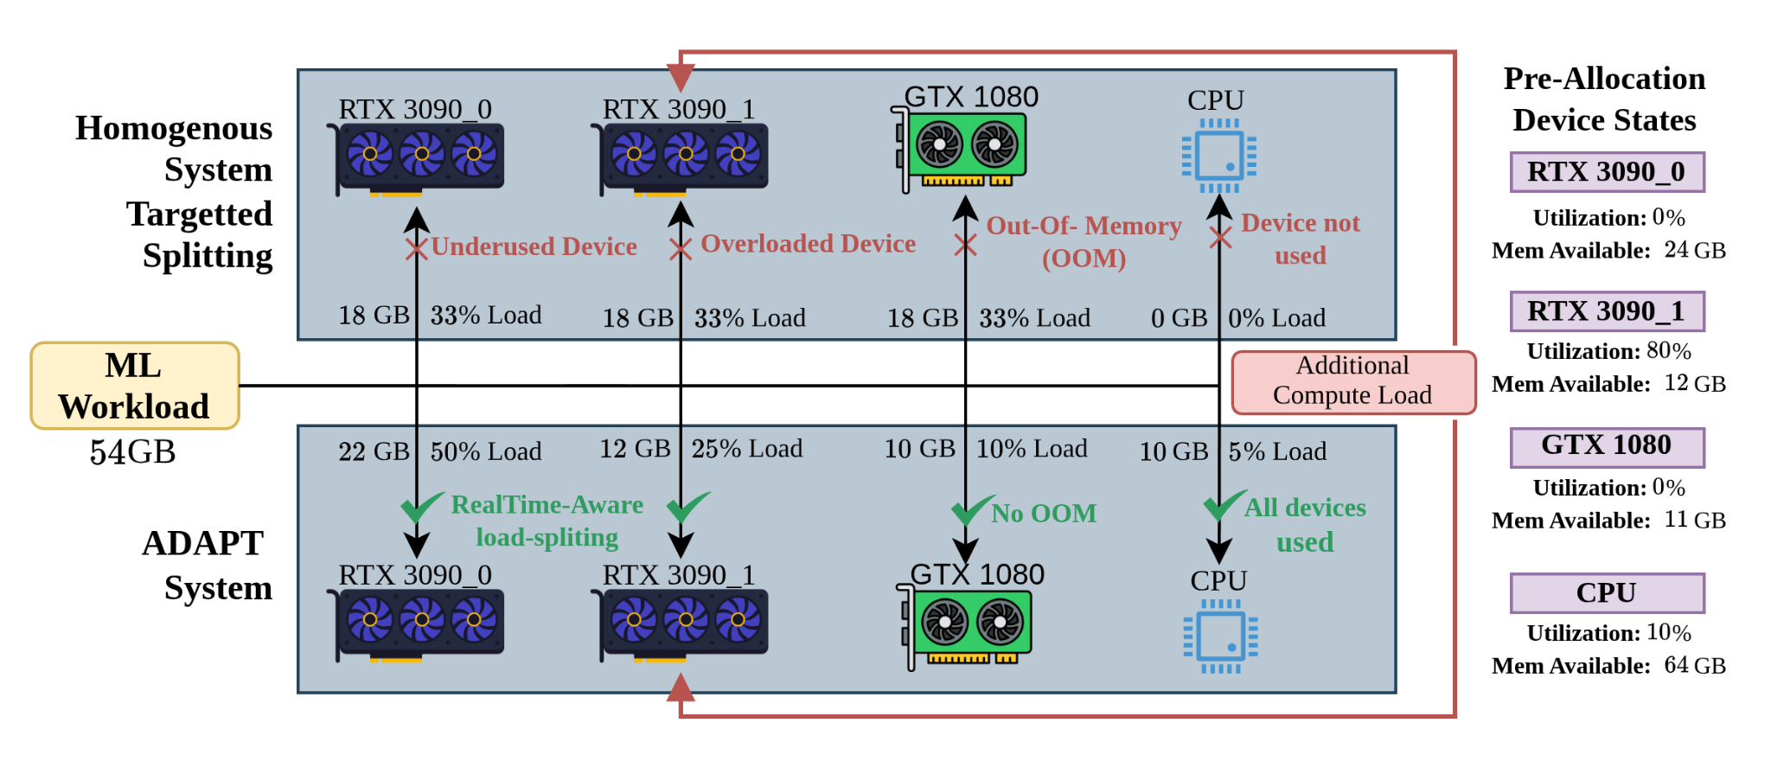
ADAPT vs Previous Work
Devices can get loaded by other system or user processes especially on shared systems. Previous approaches do not account for this leading to overloaded and underused but otherwise identical devices. ADAPT monitors this in real-time
Previous methods assume uniform access to memory across all devices which leads to OOM access.
Previous methods did not use the CPU during training.
Notes:
System with 4 major problems
Homogeneous devices can operate differently due to computational overload from external
Out of Memory issues when working with smaller devices
Inclusion of CPUs as a part of training

Slide 7
THE ADAPT ARCHITECTURE

Slide 8
ADAPT: Core Contributions
Dynamic Profiling
Analytical Cost Model
Low - Overhead
The ADAPT framework provides a method to dynamically profile and adjust training configurations across heterogeneous systems (GPU + CPU ) while mitigating resource contention issues.
A novel analytical cost model for Data and Pipeline Parallelism
Utilizes real-time memory capacity, compute capability and communication latency values,
Communication backends (NCCL and GLOO) Aware.
Heuristic Optimization strategies are introduced to prune through and search for all training configurations that result in faster execution time.
Notes:
Runtime-based profiling on heterogeneous setups (Click)
Cost model using real-time metrics with multi-communication backend (Click)
Heuristic-based optimization

Slide 9
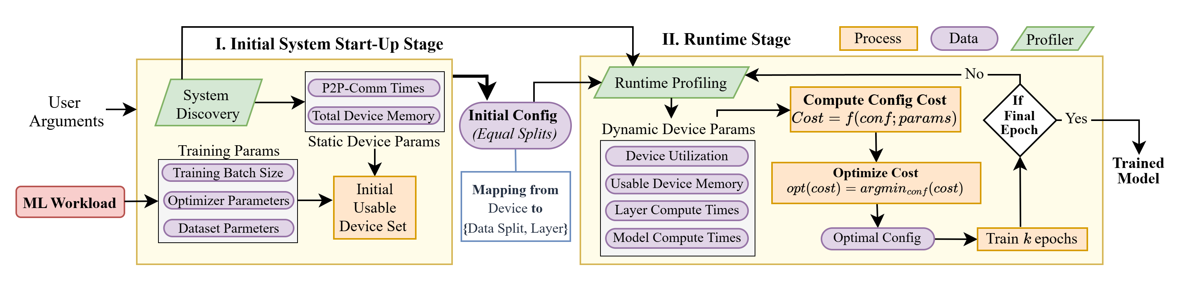
ADAPT Architecture
| Overview
Initial Startup Stage
Identifies all the properties of the heterogeneous system and the ML workload, and selects usable devices to create the initial configuration.
Training Configuration: Mapping between all devices and their workload split.
Workload Split: Subset of Data or Layers.
Runtime Stage
Profiles real-time execution metrics per epoch to compute the cost of executing the configuration.
Performs optimization over the cost to find the best training configuration.
Continues until training completion.
Notes:
Two stages → Initial startup and runtime
Click
Initial startup stage collects all the required information from the system and ML workload to produce an init config
Define config and workload split
Click
Runtime stage profiles the training per epoch, and applies the analytical cost model and optimizer to generate better training configurations
Iterates over K epochs until end of training

Slide 10
ADAPT Architecture
| Overview
1
3
4
2
5
6
1
System Discovery
3
Runtime Profiling
5
Cost Optimizer
ADAPT identifies all devices in the system, their properties (e.g. memory, compute, etc), and the communication latencies between all device pairs.
Profiling to obtain real-time training metrics involving compute and communication latencies and memory utilization.
Prunes and searches through multiple possible configurations to find an optimal configuration.
2
Initial Usable Set
4
Configuration Cost
6
Iterative Training
ADAPT selects a usable set of devices based on static device parameters and training parameters.
Cost of configuration to obtain the estimated runtime of the initial training configuration. Function of static and training params, and config.
ADAPT iteratively repeats the runtime stage for k epochs until the training ends.
Notes:
Discover all devices
Select usable devices
Profile runtime metrics – comp, comm, mem
Cost func – estimate runtime
Optimizer – Searches for optimal config
Iterate over training

Slide 11
ADAPT DATA PARALLELISM

Slide 12
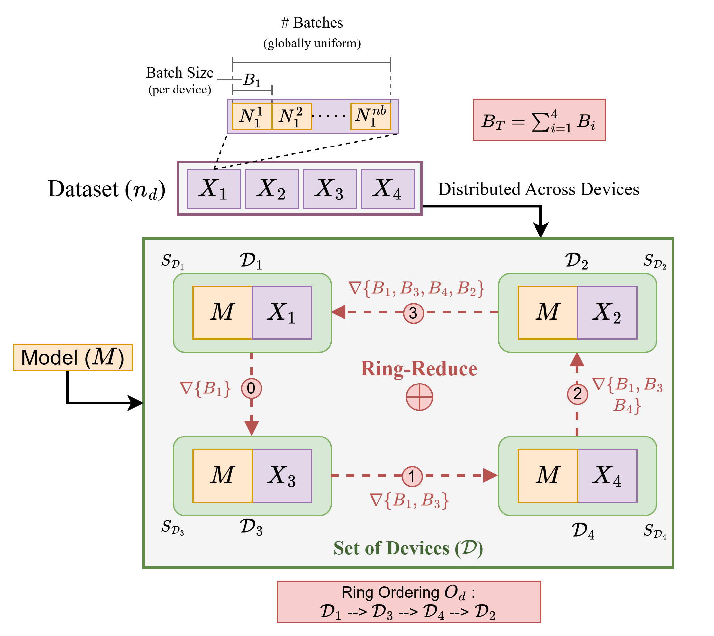
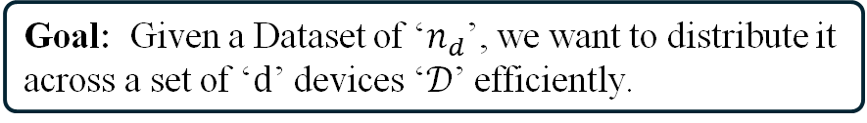
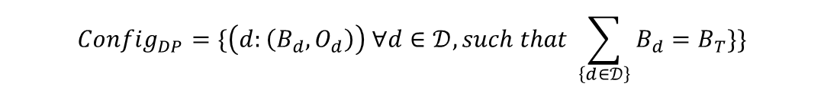
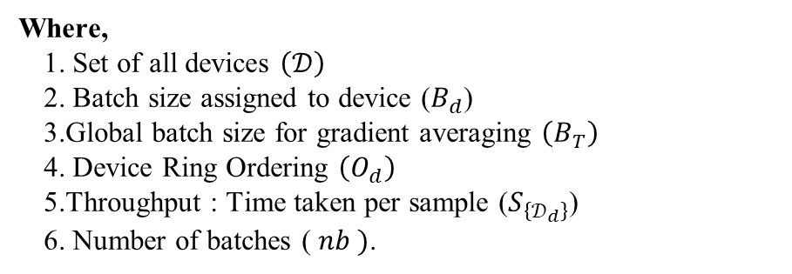
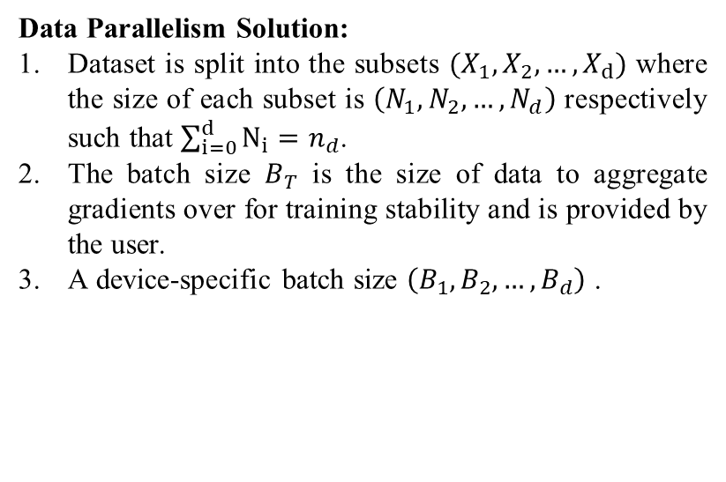
Overview of Data Parallelism (DP)
Goal: Given a Dataset of ‘$n_{d}$’, we want to distribute it across a set of ‘$d$’ devices ‘$𝒟$’ efficiently.
Data Parallelism Solution:
Dataset is split into the subsets ${(X}_{1},X_{2},…,X_{d})$ where the size of each subset is $\left(N_{1},N_{2},…,N_{d}\right)$ respectively such that $\sum_{i=0}^{d}{N_{i}}=n_{d}$.
The batch size $B_{T}$ is the size of data to aggregate gradients over for training stability and is provided by the user.
A device-specific batch size $\left(B_{1},B_{2},…,B_{d}\right)$ .
$$Config_{DP}=\{\left(d:\left(B_{d}, O_{d}\right)\right) ∀d∈𝒟, such that \sum_{\left\{d∈𝒟\right\}}{B_{d}=B_{T}}\}\}$$
Where,
Set of all devices $\left(𝒟\right)$
Batch size assigned to device ($B_{d}$)
Global batch size for gradient averaging $\left(B_{T}\right)$
Device Ring Ordering $\left(O_{d}\right)$
Throughput : Time taken per sample ($S_{\left\{𝒟_{d}\right\}}$)
Number of batches ( $nb )$.
Notes:
Data split equally among devices
Ring reduce to aggregate gradients for uniform back prop
Our additions: Variable batch sizes based on compute capability
DP configuration is defined as a mapping from a device to the batch size it runs, and its ordering in the ring.

Slide 13
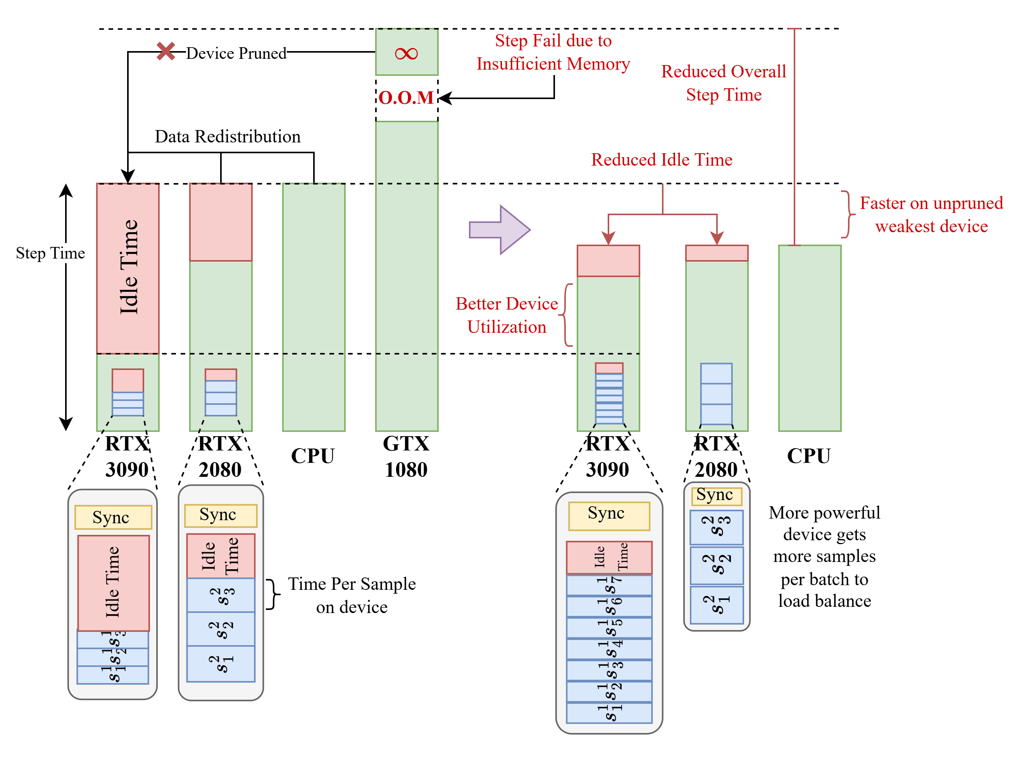
Idle Time Reduction
Better device utilization
Powerful devices are underutilized – samples are processed very fast
Device Out of Memory pruned out
Data is redistributed across the usable devices
More samples per batch to balance the compute load
Notes:
Underutilized device
Data redistribution to solve this issue
OOM devices are pruned
Variable batching is applied to balance computation completion timings

Slide 14
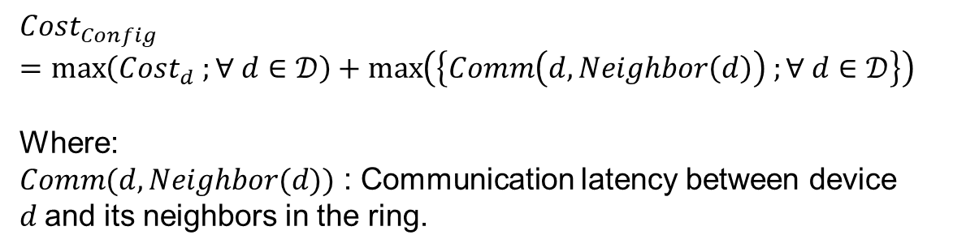
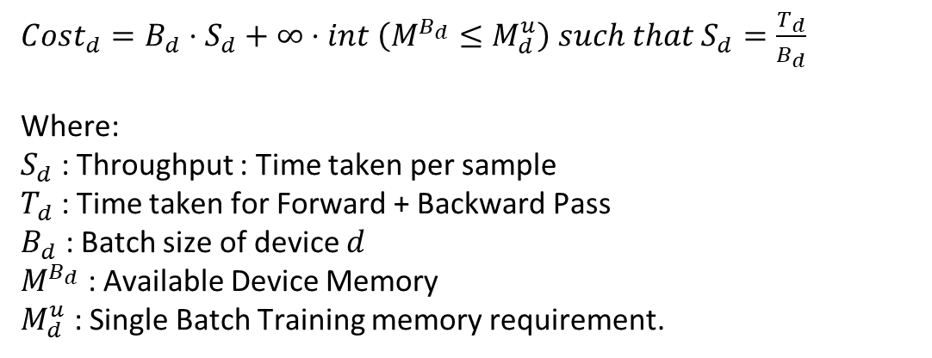
ADAPT DP: Cost Per Device
$Cost_{d}=B_{d}⋅S_{d}+∞⋅int \left(M^{B_{d}}≤M_{d}^{u}\right) such that S_{d}=\frac{T_{d}}{B_{d}}$
Where:
$S_{d}$ : Throughput : Time taken per sample
$T_{d}$ : Time taken for Forward + Backward Pass
$B_{d}$ : Batch size of device $d$
$M^{B_{d}}$ : Available Device Memory
$M_{d}^{u}$ : Single Batch Training memory requirement.
$$Cost_{Config} =\max\left(Cost_{d} ;∀ d∈𝒟\right)+\max\left(\left\{Comm\left(d, Neighbor\left(d\right)\right) ;∀ d∈𝒟\right\}\right)$$
Where:
$Comm(d, Neighbor(d))$ : Communication latency between device $d$and its neighbors in the ring.
Notes:
Per device cost is the batch size assigned to that device times the throughput of the device plus an infinite memory cost if the model does not fit on the device
Configuration cost is the bottleneck of the compute across devices, and the bottleneck device communication in the ring

Slide 15
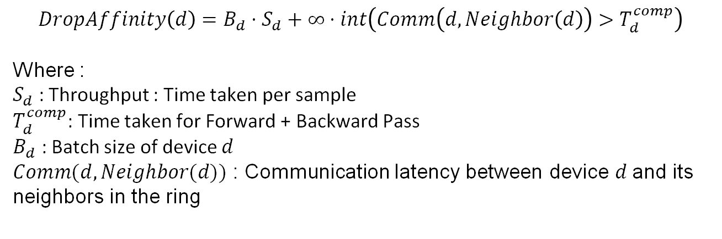
Data Parallelism Cost Optimizer (DPCO)
Calculate current configuration cost (old_config)
Find the bottleneck device using the DropAffinity score
Drop that device from the list of devices and calculate optimal ring arrangement.
Ring reduce
Confirm new list of devices, ordering and new splits
TRUE
If cost(new_config) < cost(old_config)
Calculate cost of new configuration (new_config)
Ring reduce
Confirm old config as best configuration and exit
$$DropAffinity\left(d\right)=B_{d}⋅S_{d}+∞⋅int\left(Comm\left(d, Neighbor\left(d\right)\right)>T_{d}^{comp}\right)$$
Where :
$S_{d}$ : Throughput : Time taken per sample
$T_{d}^{comp}$: Time taken for Forward + Backward Pass
$B_{d}$ : Batch size of device $d$
$Comm(d, Neighbor(d))$ : Communication latency between device $d$and its neighbors in the ring
FALSE
Notes:
Optimizer finds a better training configuration using the cost function as a heuristic.
Drop affinity is similar to cost per device, but ensures that a device’s wait time is never longer than its compute time
TSP is applied to find the best ring order
Data split ratios are calculated for the new config
If the cost is less than the old config, we repeat the process
Else we return the old config as best and exit
This concludes data parallelism

Slide 16
ADAPT PIPELINE PARALLELISM

Slide 17
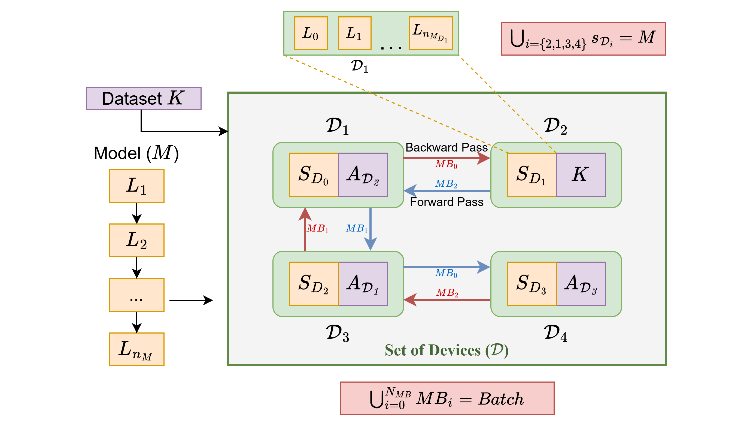
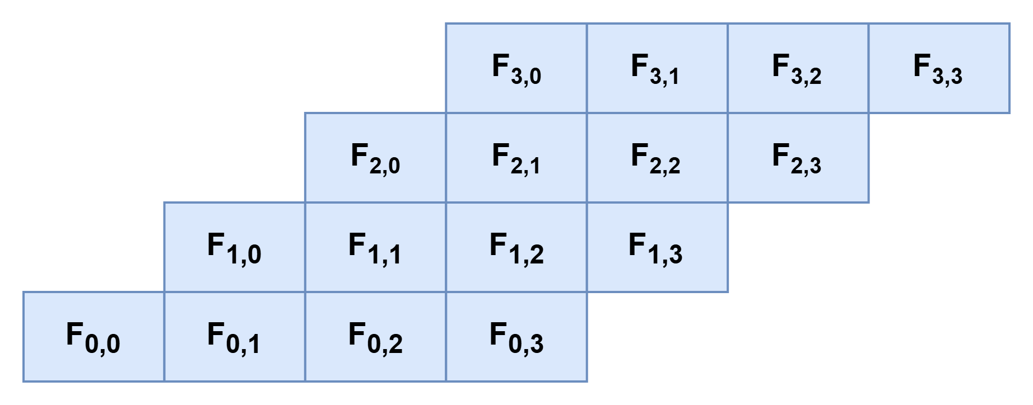
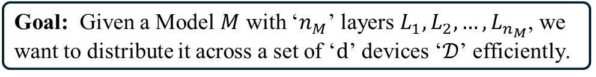
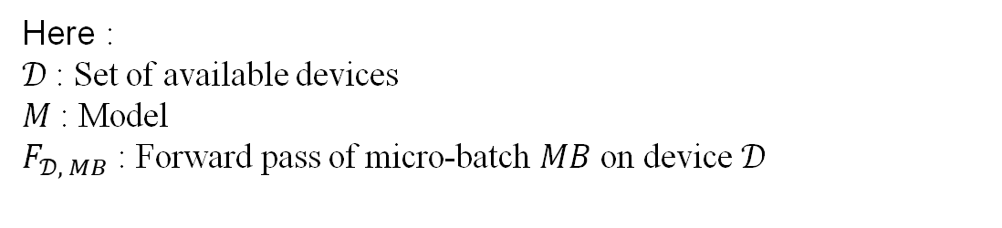
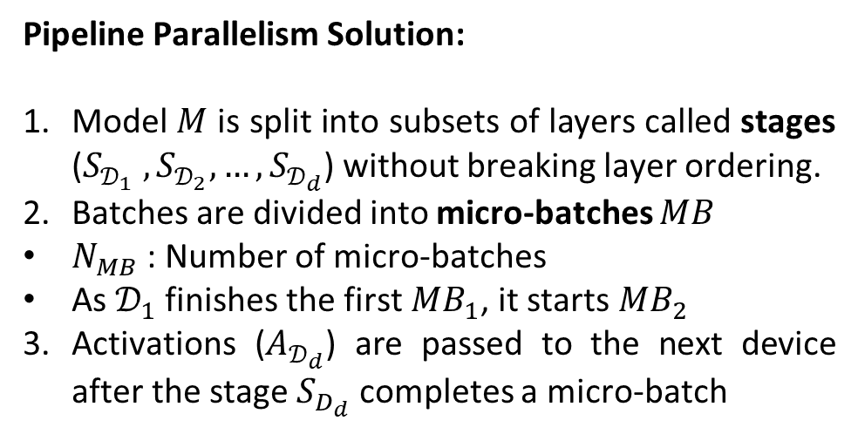
Overview of Pipeline Parallelism (PP)
Goal: Given a Model $M$ with ‘$n_{M}$’ layers $L_{1}, L_{2}, …, L_{n_{M}}$, we want to distribute it across a set of ‘$d$’ devices ‘$𝒟$’ efficiently.
Pipeline Parallelism Solution:
Model $M$ is split into subsets of layers called stages ($S_{𝒟_{1}} , S_{𝒟_{2}}, …,S_{𝒟_{d}}$) without breaking layer ordering.
Batches are divided into micro-batches $MB$
$N_{MB}$ : Number of micro-batches
As $𝒟_{1}$ finishes the first $MB_{1}$, it starts $MB_{2}$
Activations ($A_{𝒟_{d}}$) are passed to the next device after the stage $S_{D_{d}}$ completes a micro-batch
$$Config_{PP}=\left\{\left(L →D\right) ∀L∈M , ∃ d∈𝒟\right\}$$
Here :
$𝒟$ : Set of available devices
$M$ : Model
$F_{𝒟, MB}$ : Forward pass of micro-batch $MB$ on device $𝒟$
Notes:
Similar to distributing data, here we want to distribute model layers across different devices
Each device gets a subset of the model layers called a “stage.”
Once the stages are set, training begins batch-wise
Batches are divided into even smaller units called micro-batches.
When one micro-batch finishes on one device and is moved to the next, the second micro-batch starts executing on that device
Communication latency is the amount of activations transferred between devices

Slide 18
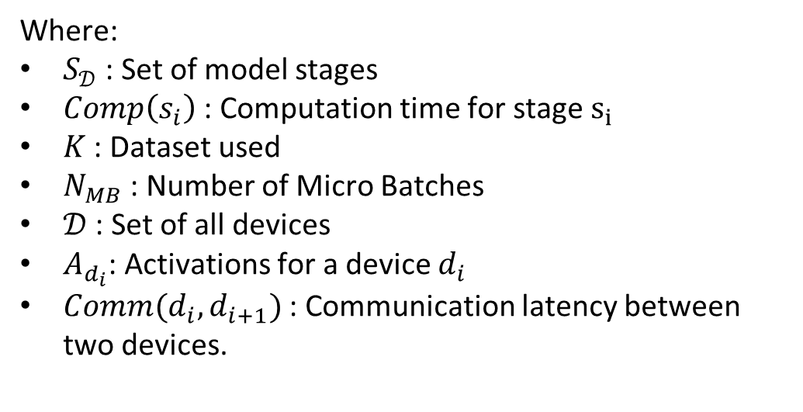
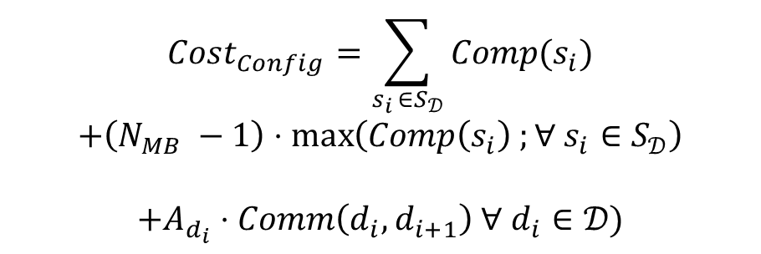
Pipeline Parallelism Cost Function
$$Cost_{Config}=\sum_{s_{i }∈S_{𝒟}}{Comp(s_{i})}$$
$$+\left(N_{MB} −1\right)⋅\max\left(Comp\left(s_{i}\right) ;∀ s_{i}∈S_{𝒟}\right)$$
$$+A_{d_{i}}⋅Comm\left(d_{i}, d_{i+1}\right) ∀ d_{i}∈𝒟)$$
Where:
$S_{𝒟}$ : Set of model stages
$Comp\left(s_{i}\right)$ : Computation time for stage $s_{i}$
$K$ : Dataset used
$N_{MB}$ : Number of Micro Batches
$𝒟$ : Set of all devices
$A_{d_{i}}$: Activations for a device $d_{i}$
$Comm(d_{i}, d_{i+1})$ : Communication latency between two devices.
Notes:
Cost of a configuration is the time it takes for a single micro-batch to complete execution across all the devices,
plus the time taken for the bottleneck stage to process the remaining micro-batches,
plus the overall communication time times activation

Slide 19
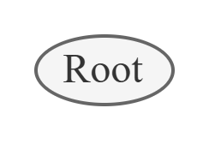
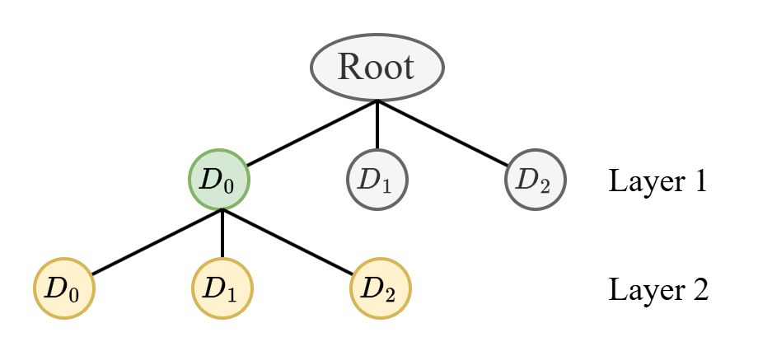
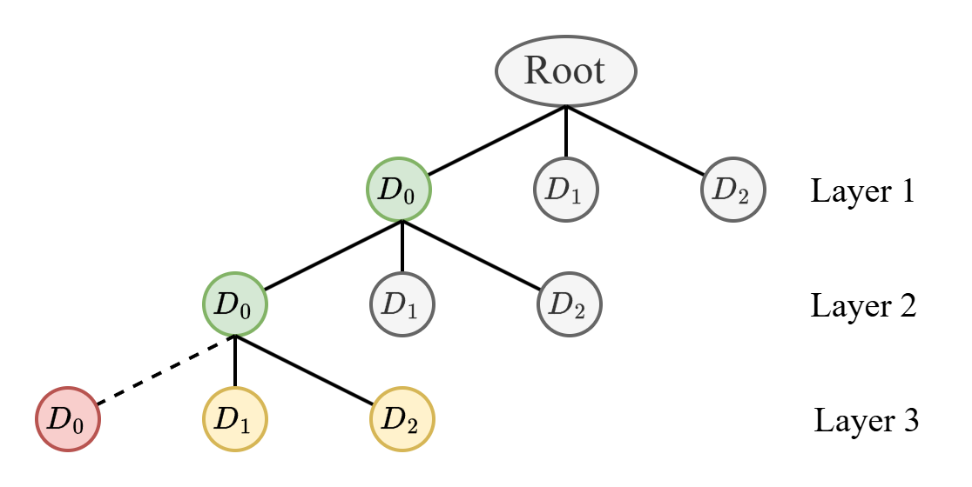
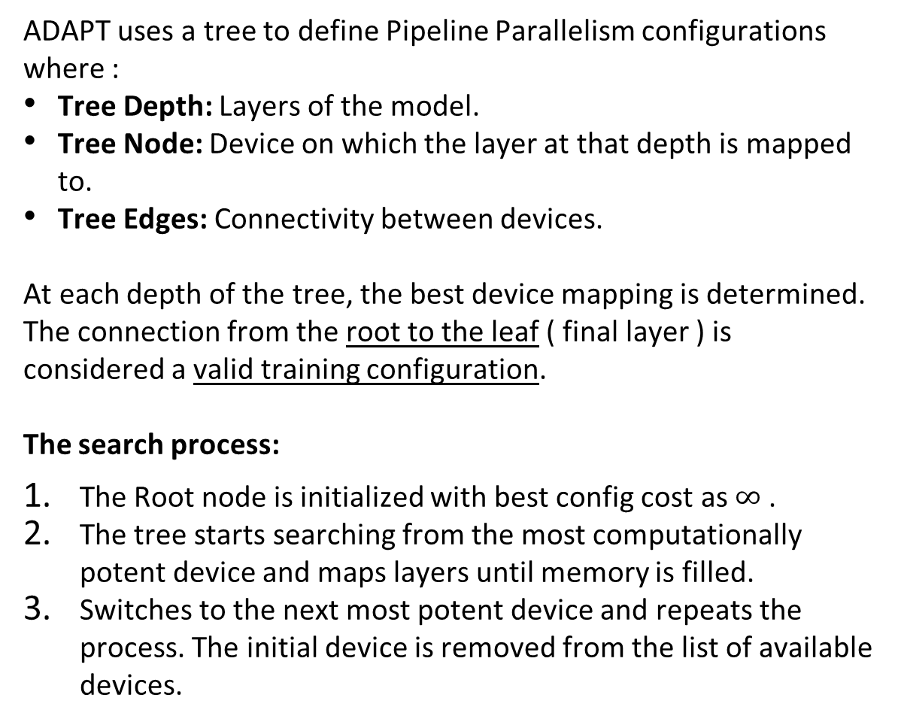
Pipeline Parallelism Cost Optimizer (PPCO)
ADAPT uses a tree to define Pipeline Parallelism configurations where :
Tree Depth: Layers of the model.
Tree Node: Device on which the layer at that depth is mapped to.
Tree Edges: Connectivity between devices.
At each depth of the tree, the best device mapping is determined. The connection from the root to the leaf ( final layer ) is considered a valid training configuration.
The search process:
The Root node is initialized with best config cost as $∞$ .
The tree starts searching from the most computationally potent device and maps layers until memory is filled.
Switches to the next most potent device and repeats the process. The initial device is removed from the list of available devices.
1
2
3
Notes:
The optimizer treats the search as a tree-based problem
Each level of the tree depth represents a model layer, the nodes represent the devices each layer is mapped to, and the edges define the flow of the mapping
A complete configuration is reached once every layer is mapped to a device, which happens only at the leaf node ( because depth is num layers )
How does the search work?
First, the root initializes the info from the model and system. The best cost is infinite
The most potent device is chosen first, and layers are mapped to it until memory runs out
Once it does, the device is labeled unusable, and the tree moves to the next potent device. This process continues until the leaf node. The cost of that valid config becomes the new cost.

Slide 20
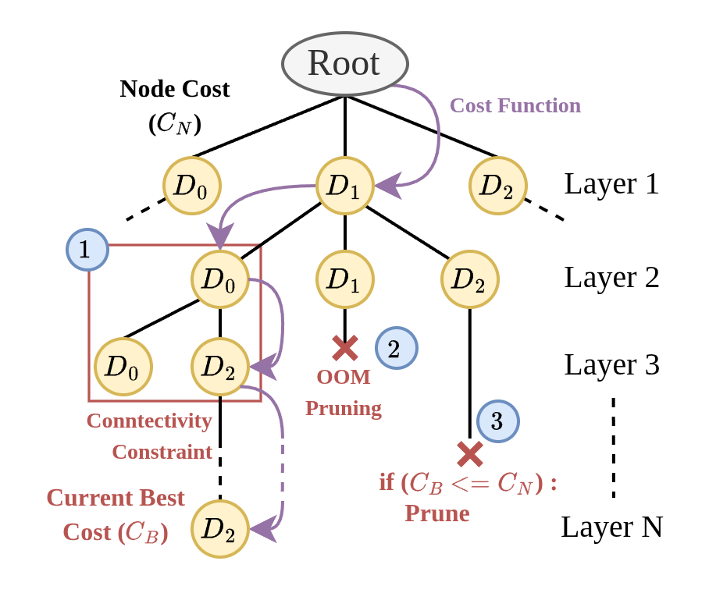
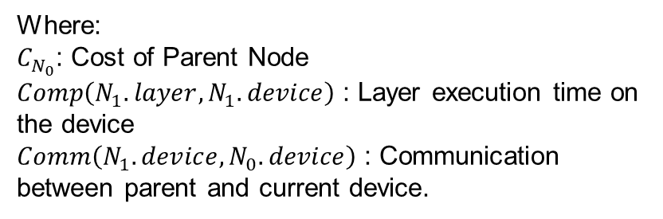
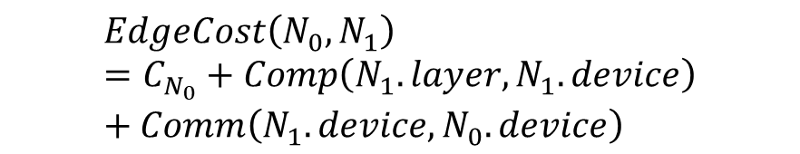
ADAPT: Pipeline Parallelism Cost Optimizer (PPCO)
Connectivity Constraint:
Once a device has been used and taken out of the tree search, it cannot appear again.
Ensures layer-based connectivity.
Out Of Memory Pruning:
If the final device in the search runs out of memory before mapping all layers, the configuration is pruned.
Running cost based pruning:
If the running cost exceeds the best cost, the configuration is pruned.
$$EdgeCost\left(N_{0},N_{1}\right)=C_{N_{0}}+Comp\left(N_{1}.layer, N_{1}.device\right)+Comm\left(N_{1}.device, N_{0}.device\right)$$
Where:
$C_{N_{0}}$: Cost of Parent Node
$Comp\left(N_{1}.layer, N_{1}.device\right)$ : Layer execution time on the device
$Comm\left(N_{1}.device, N_{0}.device\right)$ : Communication between parent and current device.
Notes:
Constraints are applied to the search to preserve layer ordering for PP
Device taken out never comes back
If all devices are exhausted before a leaf, the search tree prunes that branch
If the running cost in the middle of the search tree exceeds the best cost, the branch is pruned
Edge cost is a different way of representing the original cost for a tree structure → Parent cost is taken for running cost, compute time of that layer on the device, and communication between the parent to the child device.

Slide 21



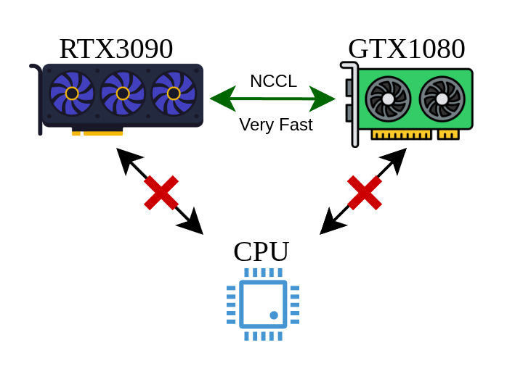
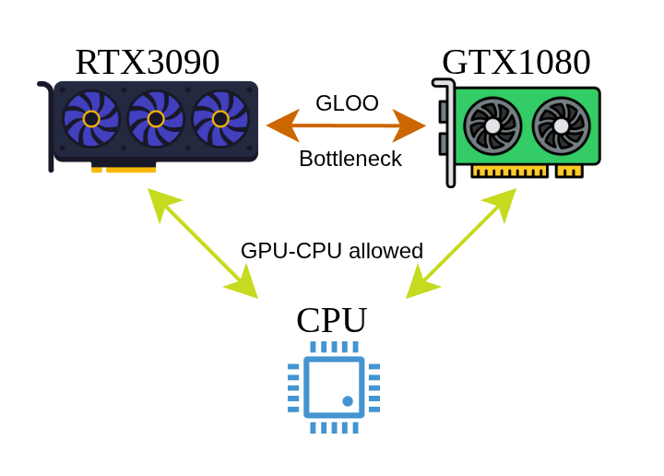
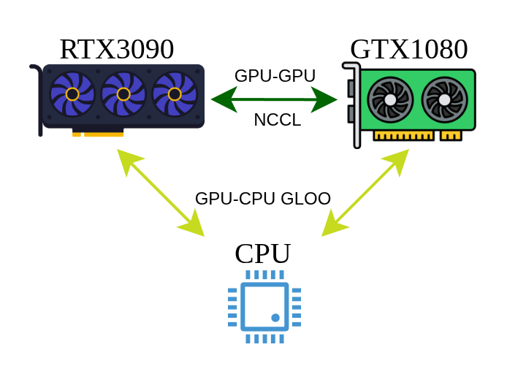
ADAPT Communication Medium Switch
ADAPT can simultaneously utilize GLOO CPU - GPU communication and NCCL GPU - GPU communication mediums for both Pipeline and Data Parallelism
NCCL is faster than GLOO, but cannot be used with CPUs.
GLOO slows down GPU processing due to a communication bottleneck.
ADAPT utilized best of both worlds by grouping communication media.
Notes:
ADAPT in general supports multi-communication backend
It can utilize NCCL for GPU-GPU and GLOO for CPU-GPU simultaneously to ensure no device endures a large communication bottleneck

Slide 22
EXPERIMENTS AND RESULTS

Slide 23

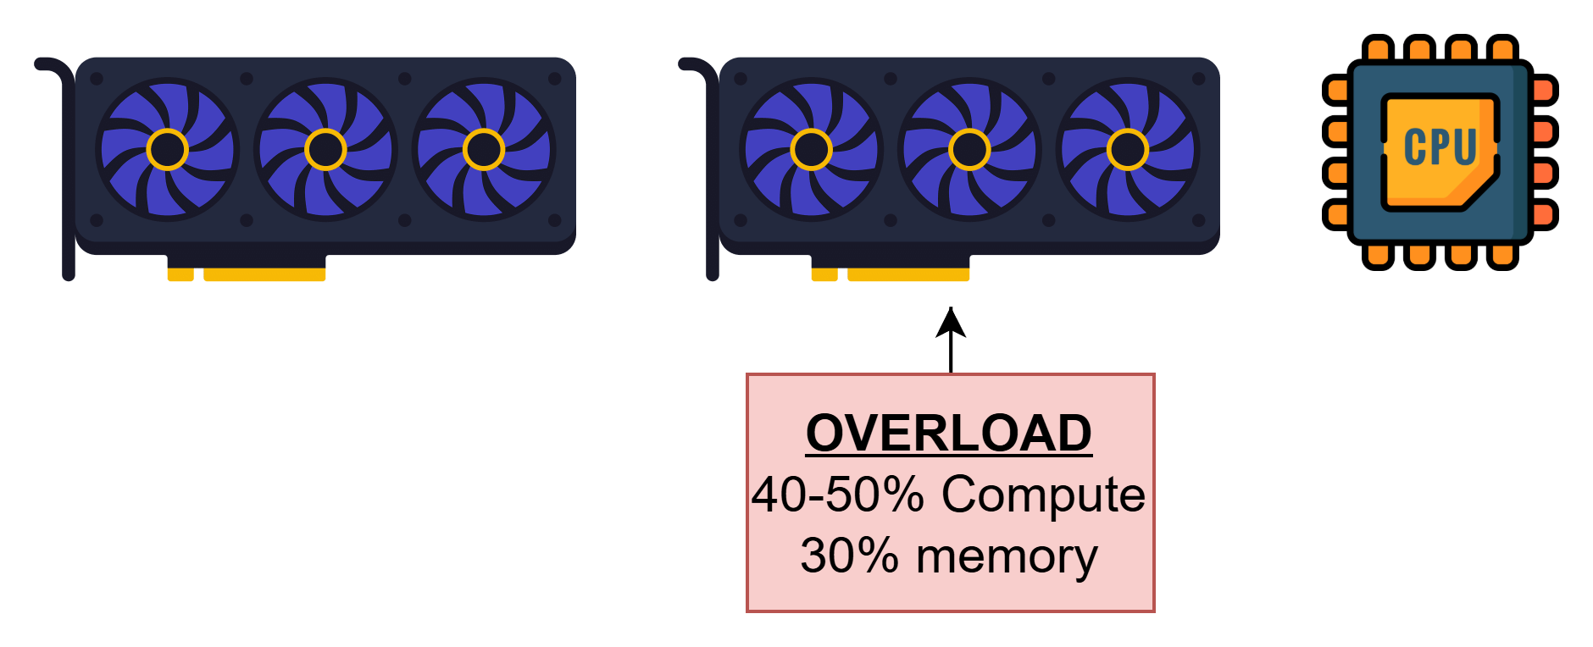
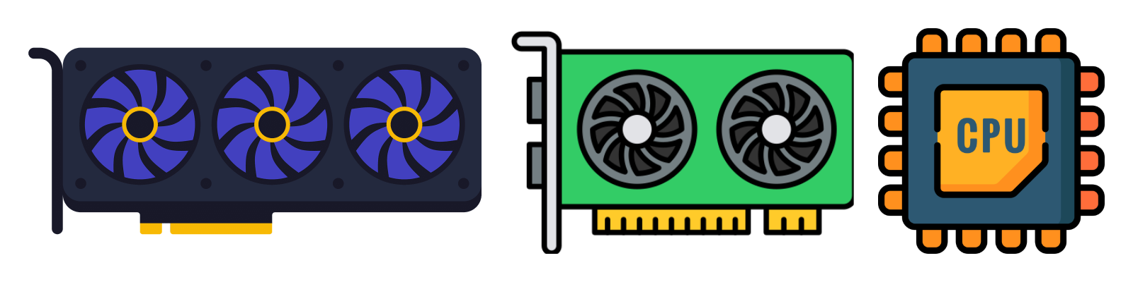
Experimental Setup
Models used:
EfficientNet-V2-Small
EfficientNet-V2-Large
ConvNext-Base
ConvNext-Large
VGG19
Vision Transformer
Swin Transformer
MLP_Mixer
MobileNetV4
LLAMA_1B
Architectures used:
1. Homogeneous Base:
Two A6000 GPUs + CPU
Two RTX5000 GPUs + CPU
2. Homogeneous Overloaded:
Homogeneous Base setup,
with one GPU having an
additional load on it
(40-50% compute, 30% mem)
3. Heterogeneous Base:
RTX3090 + GTX1080 + CPU
Baselines:
Data Parallelism: Distributed Data Parallel
Pipeline Parallelism: PiPPy ( Gpipe )
Notes:
10 models are used across 3 different training setups
Models are CNNs, MLPs and LLMs
3 Architectures used based on heterogeneity constraints.
Baselines used are via PyTorch for data and pipeline ( DDP, PiPPy )

Slide 24
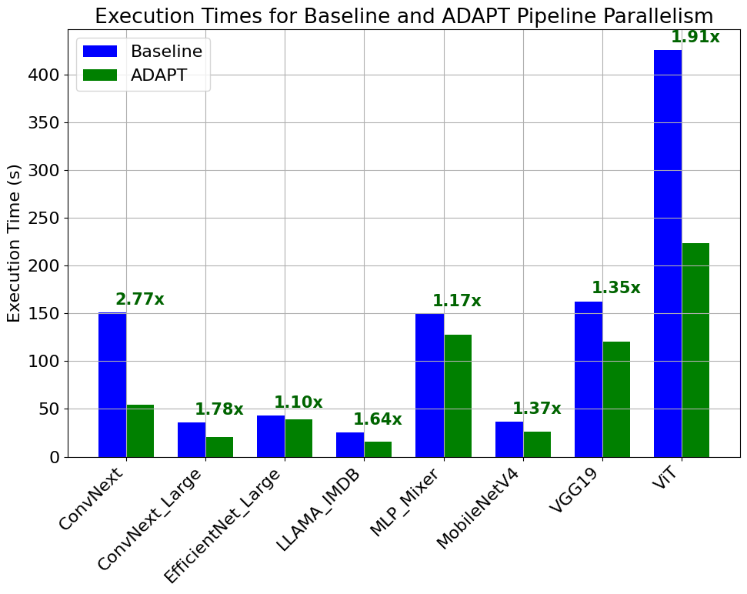
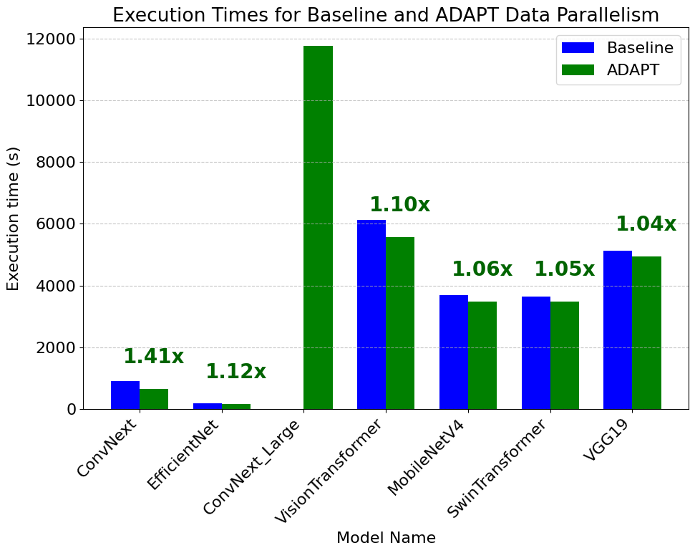
Claim 1: Overloading Adaptability Speedups
Claim 1: ADAPT generated better training configurations on a homogeneous system where one of the devices are overloaded
ADAPT optimization results in nearly 2.77x improvement in execution time for pipeline parallelism.
It improves Data Parallelism training by nearly 1.4x compared to the baseline.
Notes:
The first claim proves that in a condition where one of the devices are already in use (overloaded), ADAPT can detect this and shift the workload splits accordingly.
Show results and x improvement

Slide 25
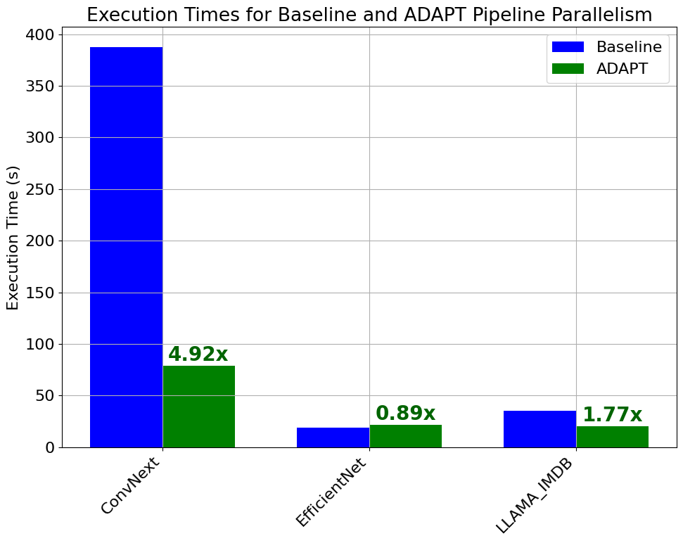
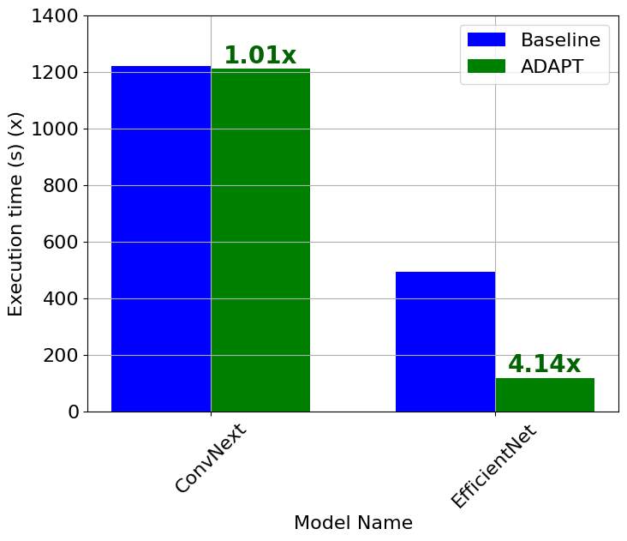
Claim 2: Better Heterogeneous Training Performance
Claim 2: ADAPT can perform better for heterogeneous setups with a mix of different GPU types and CPUs included
Pipeline shows a speedup of nearly 4.9x, and data parallelism shows small speedups of 1.01x.
0.89x → Drop in performance due to external system noise and tiny model size.
Notes:
The second claim addresses the classic heterogeneous system training issues.
Showcase large training scale-ups
0.89x is because the model is too small to be split across different devices, and system noise can easily affect the training time

Slide 26
Claim 3: ADAPT Device Inclusion and OOM Prevention
Model | Parallelism Type | Speedup (x) | Baseline devices | ADAPT devices
ConvNext | Pipeline | 2.2 | 2x GPU | 2x GPU + CPU
ConvNext_Large | Pipeline | 1.78 | 2x GPU | 2x GPU + CPU
EfficientNet_Large | Pipeline | 1.1 | 2x GPU | 2x GPU + CPU
Model | Parallelism Type | Baseline | ADAPT (s)
VGG19 | Data | OOM! | 1756.89
ConvNext_Large | Data | OOM! | 11780.96
ViT_1 | Pipeline | OOM! | 340.28
ViT_2 | Pipeline | OOM! | 333.84
Table 1: Execution time speedups with CPU inclusion
Table 2: OOM errors overcome by ADAPT optimization
Claim 3: ADAPT can include previously unused devices such as different GPUs or include a CPU to generate better configurations:
Inclusion of CPU in configurations displayed in Table 1 show speedups of nearly 2.2x over baseline.
Inclusion of CPUs, and diverting load to less loaded GPUs prevents OOM errors as shown in Table 2.
Notes:
ADAPT includes every device on the system and showcases better performances in some cases. ( Show 3 models )
It can also prevent OOM errors by pushing more of the load on the next most compute-capable device with free memory.
Models that could not be trained before on such systems can train now

Slide 27
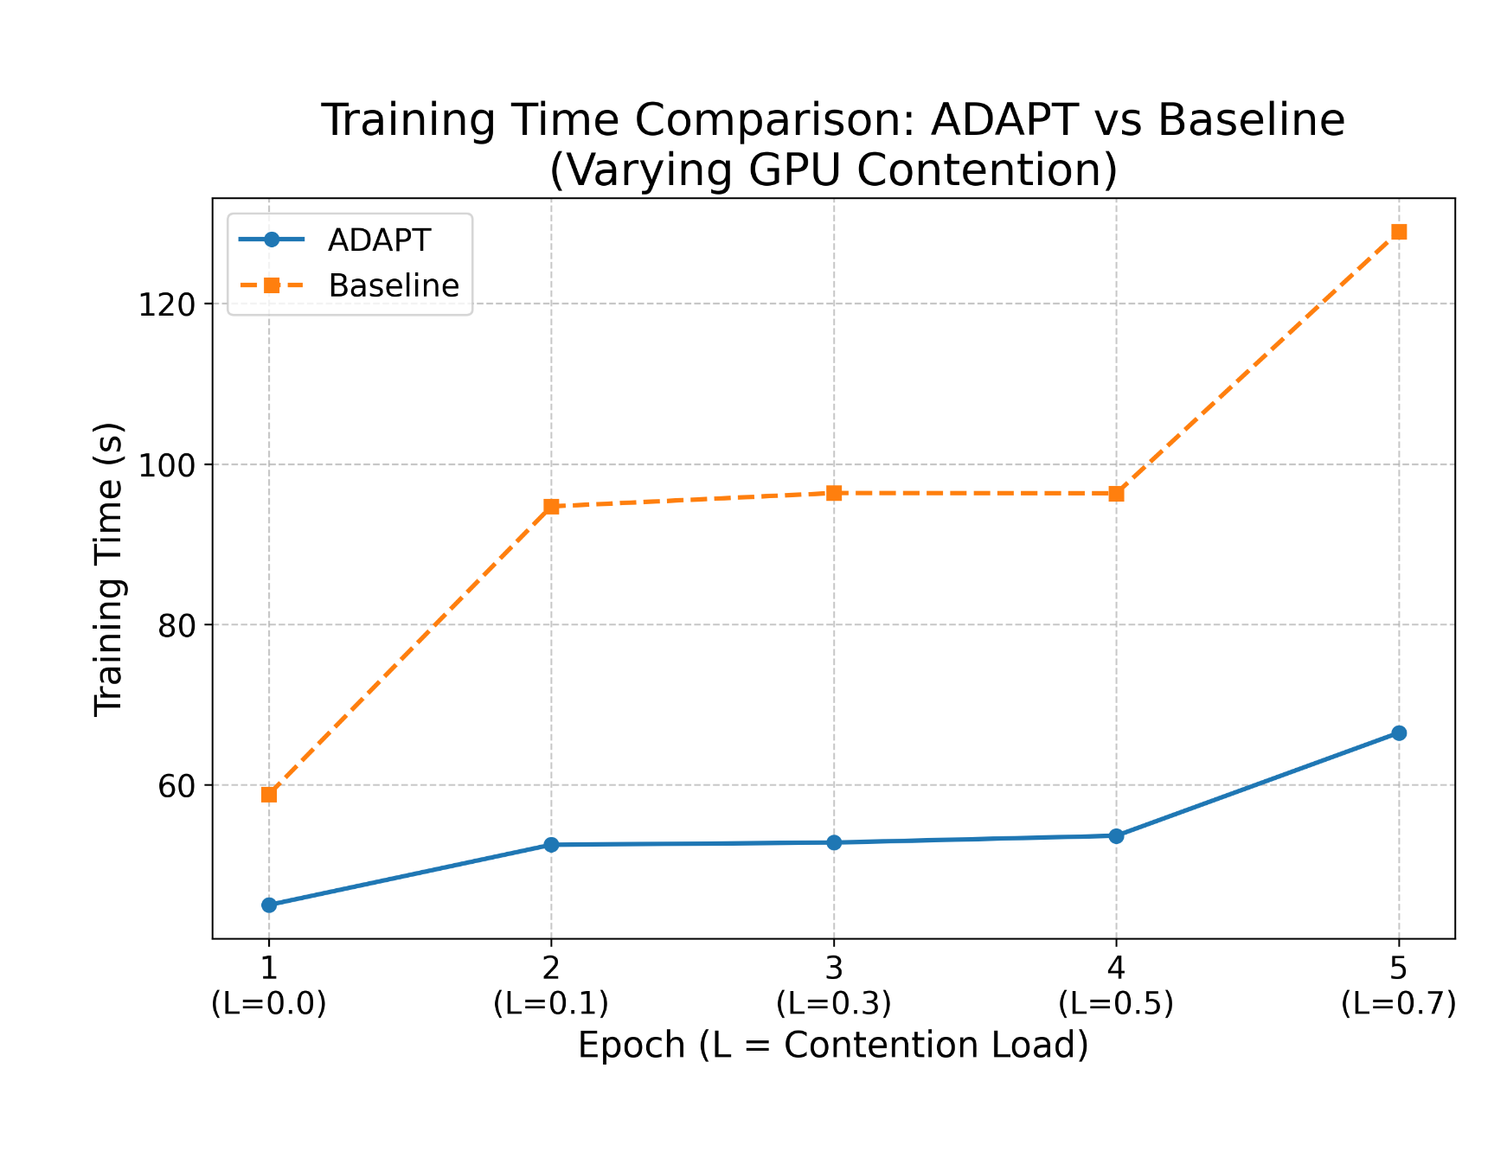
Claim 4: Real-Time Optimization
Claim 4: ADAPT can perform real-time optimizations and provide better training configurations on the fly
ADAPT detects change in load per epoch and adjusts the distribution at every epoch.
As shown in the figure, the baseline gets progressively worse with increase in load on a single GPU, while ADAPT shows little deterioration in overall execution time.
Notes:
As the background load increases over time, ADAPT shows larger improvements over baseline due to real-time optimization of configuration to account for the increased load.
Per epoch, the load increases by 0.2 ( from 0.1 ), with a 30% memory utility.
Baseline increases to nearly double the time, while ADAPT, though shows increase, is comparable to the base execution time

Slide 28
Summary and Conclusion
Heterogeneous Architectures are hidden gems → Difficult to work with.
ADAPT introduces one way to take advantage of training on such architectures while performing real-time optimizations.
Limitations:
Difficult to judge the behavior of smaller models like Wide ResNet, MobileNet, etc.
Struggles with certain model architectures such as Residual layers.
Future work:
Better ways to perform profiling.
Minor fixes to generalize working of more model architecture types.
Include Tensor and Graph level parallelism methods.
Notes:
Gems → Because they are very underutilized due to the problem statement, which ADAPT addresses and fixes
Limits ADAPT has and Future work.
Thank you!

