Slide 1
Primer on Data in Quantum Machine Learning
Aviral Shrivastava, Vinayak Sharma,
Arizona State University

Slide 2
Set the Expectations
We hope you know
What do we expect you to learn
How do we expect you to learn
Some prior experience with machine learning. This would include
Linear & Logistic Regression
Kernel Classifiers/SVMs
Basics of Deep Neural Networks
Some background in quantum computing . This would include:
Qubits and Single Qubit gates
Measurement in Quantum Computing
Multi-Qubit gates and Entanglement
Understand what machine learning looks like on Near Intermediate Scale Quantum (NISQ) devices.
Explore the most popular families of Quantum Machine Learning (QML) models
Understand the differences between these model families and how they relate to each other.
Math – We will look at some of the mathematical differences and implications of the models
Code – We will be going through code implementations of the model families in order to better understand the implementations. All code will be in Pennylane

Slide 3
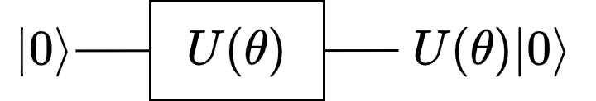
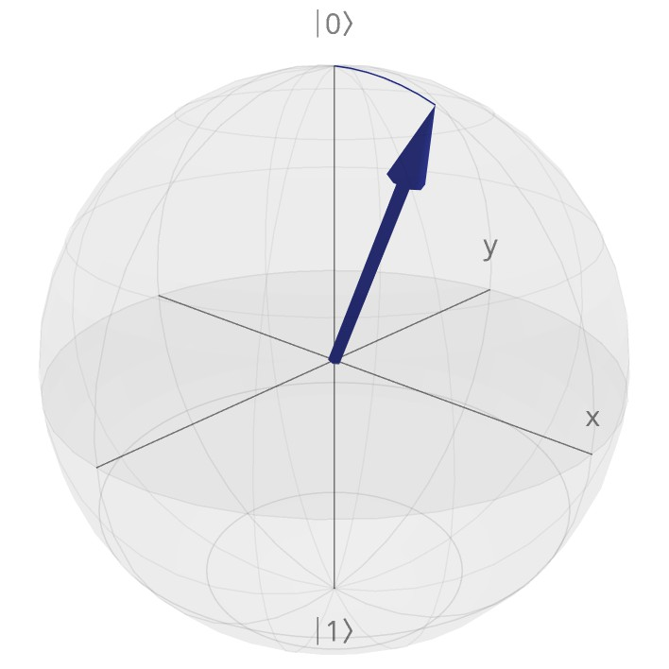

Basics of Quantum Computing
Quantum State
Quantum Computation
The state of a quantum system is defined in terms qubits. Each qubit has an associated state which is a point on the surface of a hypersphere (Bloch Sphere)
1. All quantum computation is carried out on the quantum state of the qubits.
Gates act on the quantum states (i.e.) the state vectors
2. The postulates of Quantum Mechanics define the types of computation we can do.
Quantum Computation is bounded by 3 main rules:
No Cloning theorem
State Collapse
Unitary Constraint
The no cloning theorem limits our ability to make state copies
State Collapse prevents us from observing intermediate computation steps
The unitary constraints of reversibility and normality limit compute operations we can undertake
𝜓 = cos |0⟩ + sin |1⟩
0.2𝜋
0.2𝜋
Quantum State Information

Slide 4
State Measurement
General Idea
: While the information a single run of the quantum circuit provides is limited, if we know the gates applied, we can run a
circuit multiple times (often called shots) to extract more useful statistical information.
× 𝑛
Running this ‘Q’ qubit circuit ‘n’ times provides us with ‘n’ eigen values. We can represent this as
a row (𝑀) vector of shape (𝑛,) of the form :-
𝑀 = 𝑚_{𝑖} 𝑚_{𝑖} ∈ −1,1 ^{⊗𝑄} and 𝑖 ∈ [0, 𝑛]}
From this set of readings, we can now compute statistically useful properties.
|0⟩
𝑈
0
|0⟩
𝑈₁
|0⟩
𝑈_{𝑄}
Statistical Readings from Measurements
Counts
Probability
Expectation Value
Variance
The number of times each eigen value occurs.
Ex: −1 , . . 𝑛 𝑡𝑖𝑚𝑒𝑠 = t occurrences
The probability of any eigenvalue.
Ex:
𝑃 −1 , . . 𝑛 𝑡𝑖𝑚𝑒𝑠 =
𝑝_{𝑛}
The expected value of the measurement operation on that state.
Ex: 𝐸 𝑀 = σ_{𝑖∈𝑀} 𝑖 ⋅ 𝑃(𝑖)
The variance in the readouts.
Ex: 𝐸 𝑀² − 𝐸[𝑀]

Slide 5
Section 2 - Quantum Machine Learning.
QML Overview

Slide 6
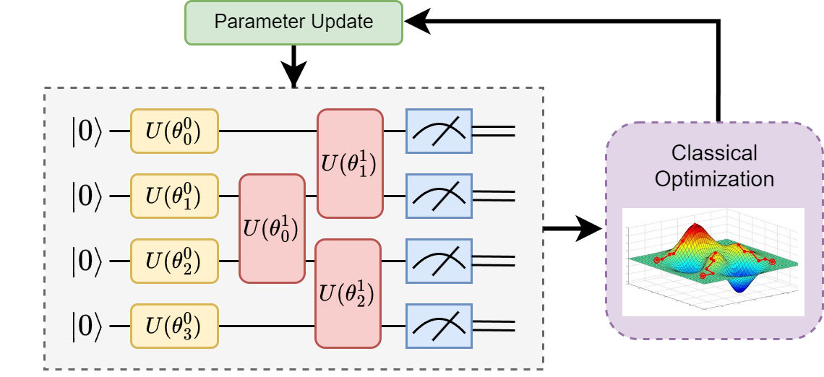
Anatomy of a QML Circuit
Data Encoding
In order to compute on classical data, we need
to encode it into a quantum state. This is done via some parameterized unitary where our data is the parameter.

Slide 7
Anatomy of a QML Circuit
Trainable Quantum Circuit
Also known as “Parameterized Quantum
Circuits” (PQC). They normally use rotational gates ( 𝑅_{𝑋}, 𝑅_{𝑌}, 𝑅_{𝑍}) with trainable rotational angles (𝜃).

Slide 8
Anatomy of a QML Circuit
Measurement
Every quantum circuit can only output a result of
measurement. A single measurement only produces a single basis state (generally |0⟩ or |1⟩). We can use multiple measurements to extract statistical values such as probability of a basis state or expectation values. These measurement outputs are incorporated into loss functions.

Slide 9
Anatomy of a QML Circuit
Optimization
Classical gradient based optimization
methods such as gradient descent are used to calculate weight updates.

Slide 10
Anatomy of a QML Circuit
Parameter Update
The rotational angles are updated based on the
calculated gradients.

Slide 11

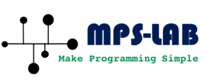
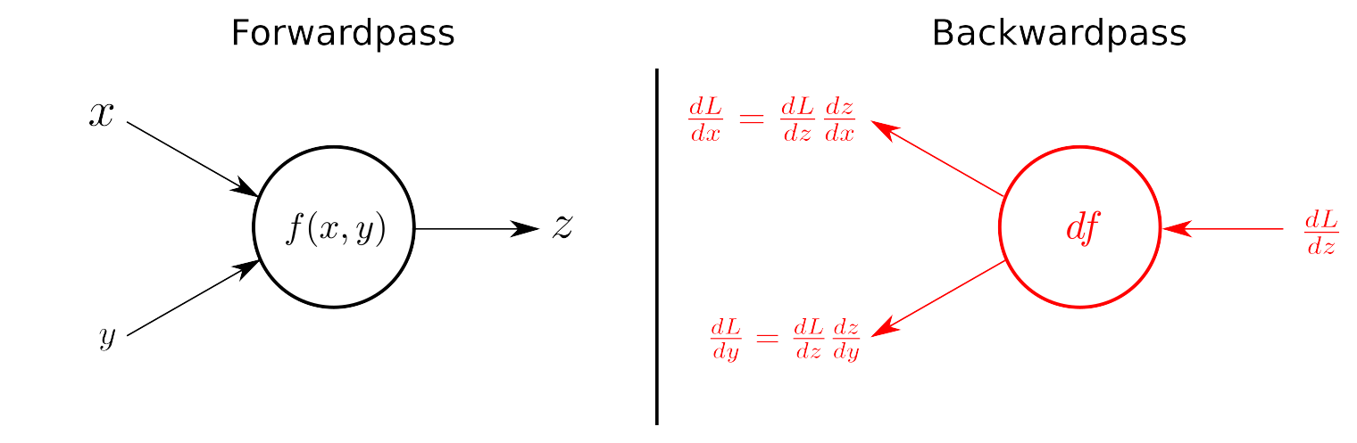
Gradients in Quantum Machine Learning
Classical Backpropagation
As might be apparent, analytical differentiation and more importantly backpropagation relies on caching the results from forward passes.
The Problem !!!
Due to the measurement principle, we cannot access the intermediate states of a quantum circuit. This makes it difficult to compute gradients. Consider the circuit below -
1
2
|0⟩
𝑅_{𝑌}(𝜃₀)
𝑅_{𝑋}(𝜃₁)
However, this is not a problem for simulators… As simulators always have access to the entire state vector, we can compute gradients on them using the analytical method and gradient descent.
Without access to (1) , we cannot compute the derivate for the first gate.
11

Slide 12




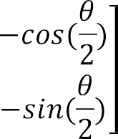
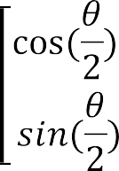
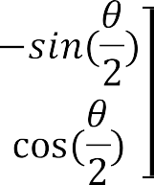


Gradients on Real Devices
Parameter-Shift
Recall that,
Our gates 𝑈(𝜃) can w.l.o.g be written as a composition of Pauli-
rotational gates:
i.e., 𝑈 𝜃 = 𝑅_{𝑋} 𝜃₀ . 𝑅_{𝑌} 𝜃₁ . 𝑅_{𝑍} 𝜃₂
Rotational gates are function of sin and cosine functions, whose derivatives are just function shifted versions of themselves. This allows us to efficiently compute derivates by running the forward pass with shifted parameters.
While backprop works for simulators, we cannot compute gradients no real devices using that method, the use of real quantum devices is limited.
Solution … Numerical Methods
Unlike analytical methods, numerical methods can compute gradients up to a level of noise using the outputs.
An example of this is the ‘finite difference’ method which approximates gradients by discretizing the outputs. However, these values are approximate and error prone.
Enter … Parameter Shift
The parameter shift method leverages the special properties of
quantum gates to produce ‘exact gradients’.
Example: ∇_{𝜃} sin 𝜃 = cos 𝜃 = sin
𝜋
2
− 𝜃 = sin 𝜃 + ^{𝜋}
(original
2
function shifted by a parameter ( ^{𝜋} ) )
2
𝑅_{𝑌}(𝜃)

Slide 13
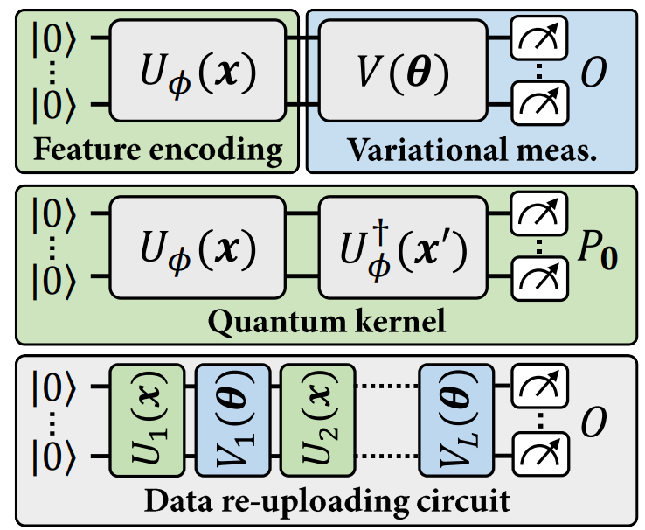
Families of QML Models
Explicit Model
An explicit quantum model, where the label of a data point x is specified by the expectation value of a variational measurement on its associated quantum feature state ρ(x)
Implicit Model
The quantum kernel associated to these quantum feature states. The expectation value of the projection 𝑃₀ = |0⟩⟨0| corresponds to the inner product between ρ(𝑥) and ρ(𝑥′). An implicit quantum model is defined by a linear combination of such inner products, for 𝑥 an input point and 𝑥′ training data points.
Data Reuploading Model
A data re-uploading model, interlaying data encoding and variational unitaries before a final measurement. It draws inspiration from classical neural networks
Source: [1]

Slide 14
Section 3 - Explicit Models..
Looking at the Details

Slide 15


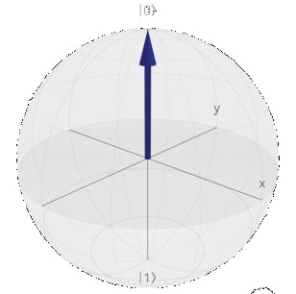
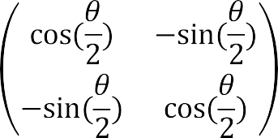
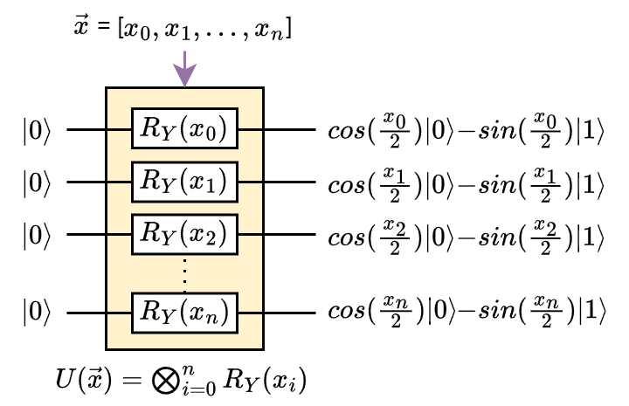



Data Encoding
𝑈 𝑥Ԧ 0 ^{⊗𝑛} Encoded State
The 𝑅_{𝑌} Gate creates the state seen above
 | 𝑅_{𝑌}(23°) |  | 𝑅 E
The base
0 state
𝑅_{𝑌} Gate matrix formula. As evident, the R_{Y} gate is parameterized by the angle 𝜃.
During data encoding 𝜃 are the classical scalars
to be encoded.
During data processing, they are trainable
parameters.
𝑌
ncoder
Encoded State
Data Encoding Circuit. The data encoding circuit has 0 trainable parameters. The circuit encodes classical data onto the state of the quantum computer. The most common method is using rotational gates.

Slide 16
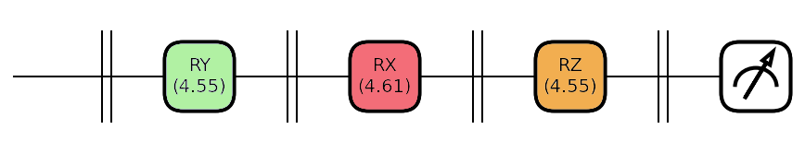
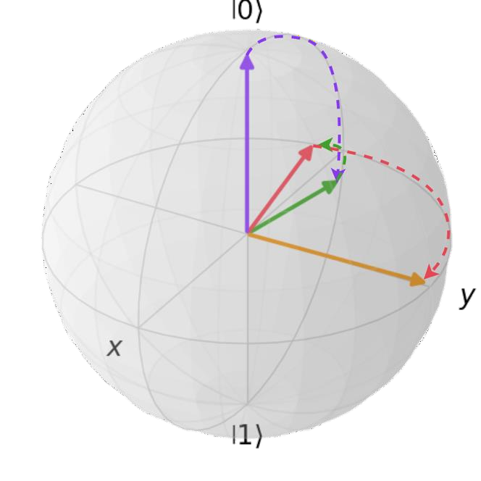
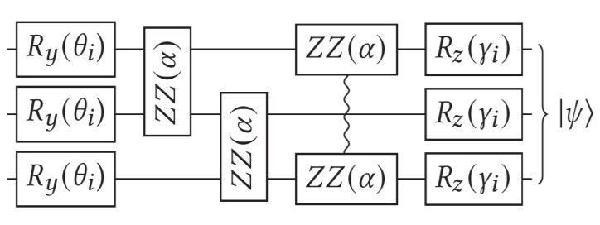
Data Processing
A multi-qubit variational layer generally includes entanglement and multiple sets or rotational gates.
Entanglement creates intractable feature maps, which help with training.
Rotational Gates cause our state
vector to rotate along the Bloch
sphere.
This creates functional
mappings on our encoded data.
Source:[1] | Parameterized Quantum Circuit using
𝑅_{𝑌} and 𝑅_{𝑍} Gates. The circuit also uses a 𝑍𝑍 𝜃
Gate to create entanglement across multiple qubits.
Explicit Quantum Models
[1]. Vinayak Sharma, & Aviral Shrivastava. (2023). Quantum Polar Metric Learning: Efficient Classically Learned Quantum Embeddings.

Slide 17
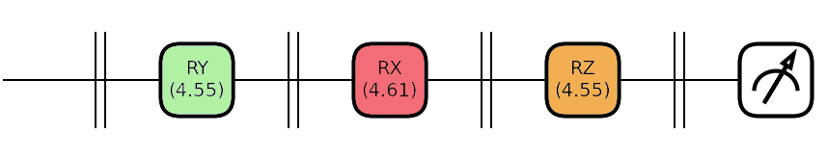
Circuit Output and Loss Functions
The only valid output of a
quantum circuit is a measurement
Measuring out a quantum state
𝑀 𝑈 𝑥; 𝜃
𝐿 = 𝑓(𝑀(𝑈 𝑥; 𝜃 )
Valid loss functions
Statement: Any valid loss function for a hybrid model must be a function of the circuit measurement.
This is a direct result of the quantum state collapse property which limits us to only knowing the results of the measurements of quantum circuits.
NEW PROBLEM !
What about the
gradients then?
Therefore, any valid quantum circuit must yield a measurement. Hence, the loss must also be based on measurements.

Slide 18
Explicit Models as Hyperplanes – Projective Measurement I
Projection Valued Measures
Definition | PVM | Measurement in Quantum Computing can be thought of as a ‘Projection’ from our | ‘ Quantum Feature Space’ | onto a ‘Observable’
Let’s break this down !!!
Quantum Feature Space
Simplifying: We can think of it as a coordinate plane with 2^{𝑛} axes. The additional property is that our points need to satisfy the equation of a unit sphere in this space.
Definition: A Quantum Feature Space can be formally defined as the surface of a hyper sphere
A Hilbert Space is a vector space
that is inner product complete. (i.e.
𝑢, 𝑣 ∈ 𝐻 ∀ 𝑢, 𝑣 ∈ 𝐻)
in a 2^{𝑛}-dimensional
Hilbert Space.
Where, 𝑛 = number of qubits.

Slide 19
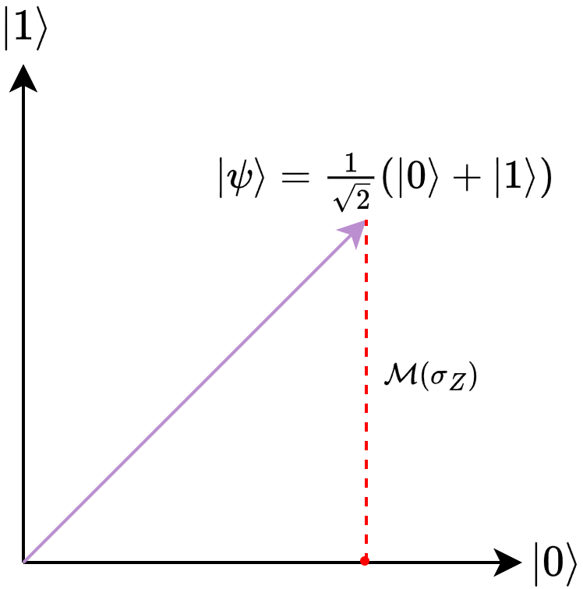
Explicit Models as Hyperplanes – Projective Measurement II
Definition | PVM Measurement in Quantum Computing can be thought of as a | ‘Projection’ | from our ‘ Quantum Feature Space’ onto a | ‘Observable’
Measurement as Projection
Quantum Observables/ Measurement Operators
Definition: Measurement of a quantum system can be defined as projecting a state (𝜓) into some operator (𝑶).
Definition: An observable is any quantity that can be measured. In quantum mechanics, these are normally Quantum Operators.
An operator is any quantum gate that is self-adjoint
(i.e. is its own inverse) and has real eigen values.
𝑀_{𝑂} = ⟨𝜓|𝑂|𝜓⟩
Computational Basis
_{𝜎𝑍 =} 1 0
0 −1
The “Computational Basis” is when we measure against the Pauli-Z (𝜎_{𝑍}) Operator.
Pauli-Z Operator

Slide 20
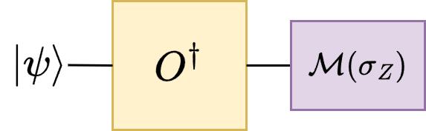
Measurement in Arbitrary Basis
Measuring in an arbitrary basis.
Proof:
We can perform measurement of a state w.r.t to any arbitrary operator or basis by applying the inverse of the operator to our state and then measuring in the standard basis.
Statement: The measurement operation on our evolved state 𝑶†|𝜓⟩ w.r.t 𝜎_{𝑍} ≡ ⟨𝜓|𝑶 0⟩|² --(1). Assuming, that the operator 𝑶
produces the state |𝜙⟩ when applied to |0⟩ (i.e. 𝜓 = 𝑶|0⟩) our previous equation (1) simplifies to 𝜓 𝜙
2.
Proof:
Let our initial state be 𝜓 , Applying the operator 𝑶† on our state would result in our new state Ω = 𝑶† 𝜓 .
Clearly ,
Ω = (|Ω⟩ † = 𝑶† 𝜓 † = ⟨𝜓|𝑶
Applying our measurement operation w.r.t our 𝜎_{𝑍} projector |0⟩⟨0|, Ω 0⟩ 0 Ω = 𝜓 𝑂 0 0 𝑂† 𝜓 --(3)
As the inner product here produces a real scalar, they are unaffected by applying the conjugate operator. (i.e. 𝑎 𝑏 = ⟨𝑏|𝑎⟩)
2 ₌
2
∴ Eq. 3 = 𝜓 𝑂 0 0 𝑂† 𝜓 † = 𝜓 𝑂 0 𝜓 𝑂 0 = 𝜓 𝑂 0 𝜓 𝜙
Note: This proof can be generalized to n-qubit states by assuming our operator and initial states to be multi-qubit states and replacing the
0 ⟨0| projector with 0 ^{𝑛}⟨0|^{𝑛}

Slide 21
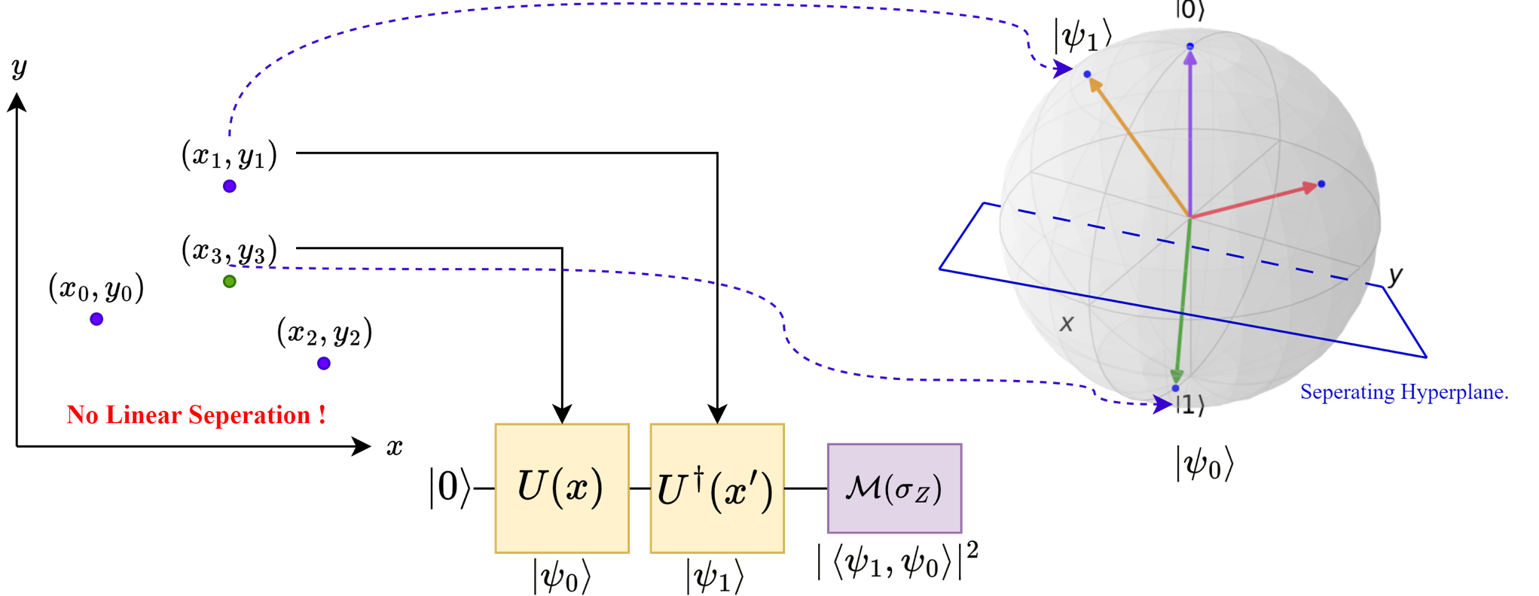
Explicit Models as Hyperplanes
Mapping between our feature spaces via a Quantum Feature Map (data encoding)
The vector space of our input data,
with 2 classes (purple and green)
𝜙(𝑥)
𝑈(𝜃)

Slide 22
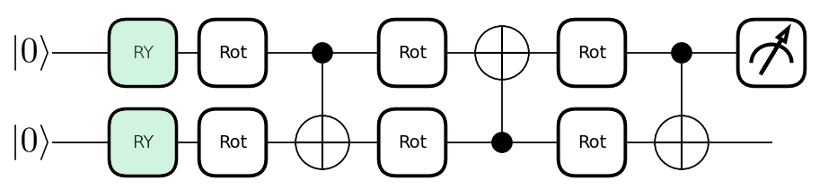

Explicit Model in Code
@qml.qnode(dev, interface='tf') def explicit_model(input, weights):
qml.RY(input[0], wires=0) qml.RY(input[1], wires=1)
for layer in range(weights.shape[0]): for wire in range(2): qml.Rot(*weights[layer][wire], wires=wire) if(layer%2==0): qml.CNOT([0, 1]) else: qml.CNOT([1, 0]) return qml.expval(qml.PauliZ(0))
Data Encoding
The data encoding block uses 𝑅_{𝑌} Gates to encode our target classical data into
the amplitude of our quantum state.
→ 𝐸 𝜓 = ⟨𝜓 𝑍 𝜓⟩
𝜓 = 𝑈 𝜃_{𝐿1} ⋅ 𝑈 𝜃_{𝐿0} ⋅ (𝑅_{𝑌}
_{𝑥}0
⊗ 𝑅_{𝑌}(𝑥¹)) |0⟩

Slide 23
Explicit Model in Code
@qml.qnode(dev, interface='tf') def explicit_model(input, weights): qml.RY(input[0], wires=0) qml.RY(input[1], wires=1)
for layer in range(weights.shape[0]): for wire in range(2): qml.Rot(*weights[layer][wire], wires=wire) if(layer%2==0): qml.CNOT([0, 1]) else: qml.CNOT([1, 0])
return qml.expval(qml.PauliZ(0))
Variational Circuit
The variational circuits consists of parameterized 𝑅𝑜𝑡 𝜃_{𝑋}, 𝜃_{𝑌}, 𝜃_{𝑍} which are equivalent to R_{X} 𝜃_{𝑋} ⋅ R_{Y} 𝜃_{𝑌} ⋅ R_{Z} 𝜃_{𝑍} . Layers of them are separated by CNOT entanglers.
→ 𝐸 𝜓 = ⟨𝜓 𝑍 𝜓⟩
𝜓 = 𝑈 𝜃_{𝐿1} ⋅ 𝑈 𝜃_{𝐿0} ⋅ (𝑅_{𝑌}
_{𝑥}0
⊗ 𝑅_{𝑌}(𝑥¹)) |0⟩

Slide 24
Explicit Model in Code
@qml.qnode(dev, interface='tf') def explicit_model(input, weights): qml.RY(input[0], wires=0) qml.RY(input[1], wires=1) for layer in range(weights.shape[0]): for wire in range(2): qml.Rot(*weights[layer][wire], wires=wire) if(layer%2==0): qml.CNOT([0, 1]) else: qml.CNOT([1, 0])
return qml.expval(qml.PauliZ(0))
Measurement
Finally, we measure the expectation value w.r.t to the Pauli-Z operator (or computational basis) to be used for our loss function.
→ 𝐸 𝜓 = ⟨𝜓 𝑍 𝜓⟩
𝜓 = 𝑈 𝜃_{𝐿1} ⋅ 𝑈 𝜃_{𝐿0} ⋅ (𝑅_{𝑌}
_{𝑥}0
⊗ 𝑅_{𝑌}(𝑥¹)) |0⟩

Slide 25
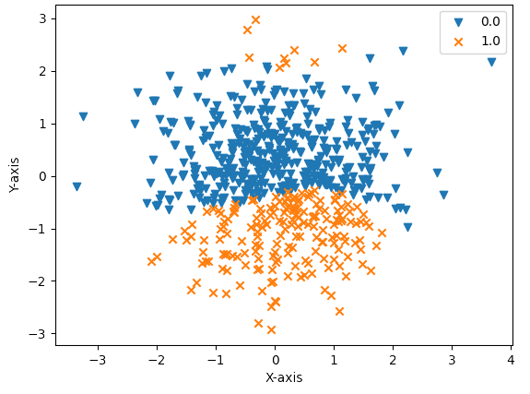
Input/Output Space
Input/Output Space
In QML, the feature space can also refer to
functional space that represents:
The space on the left is the projection of a 3-D space where the x,y coordinates correspond to the inputs and the z-axis would represent the circuit output.
ℂ^{𝑛} → ℝ
Where, n= number of input features.
Here we project the data onto the X-Y plane and use the np.sign function to label our data. (This would make the z=0 our separating hyperplane)
This represents the function space of our inputs to outputs. The inputs may be complex, but measurements always yield real values.

Slide 26
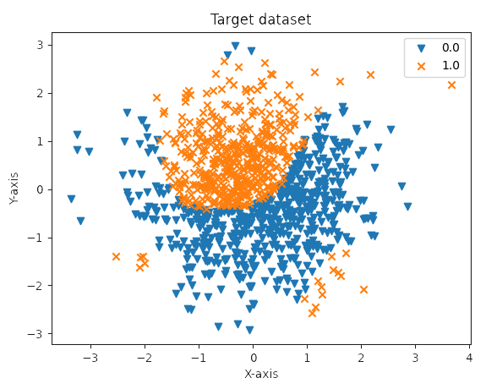
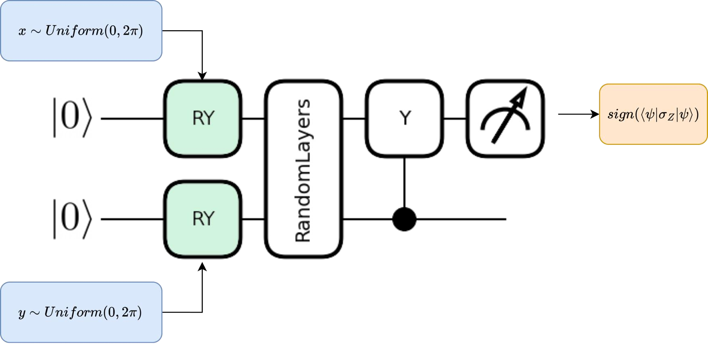


Code Demos
Function to approximate.
Label data points based on the sign of the expectation value
Data Generator

Slide 27
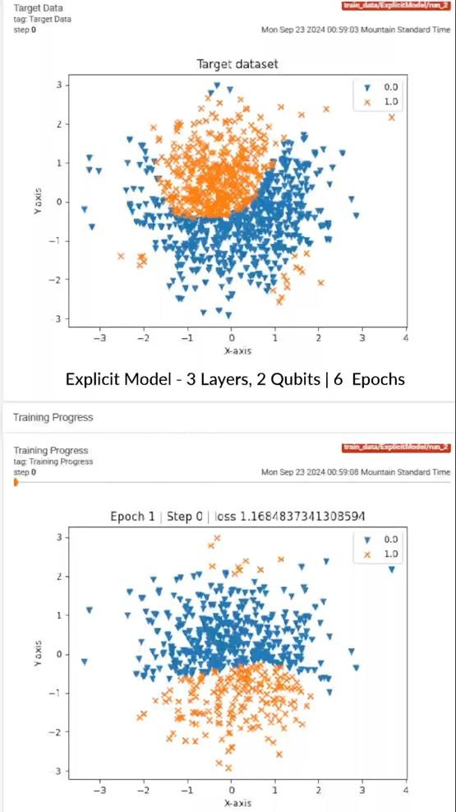
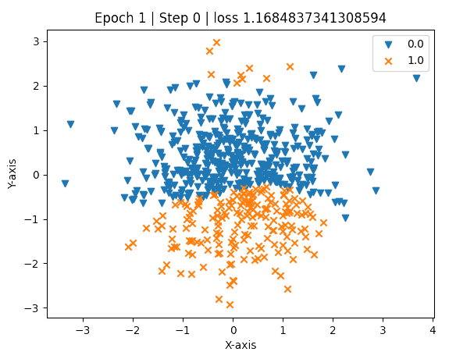
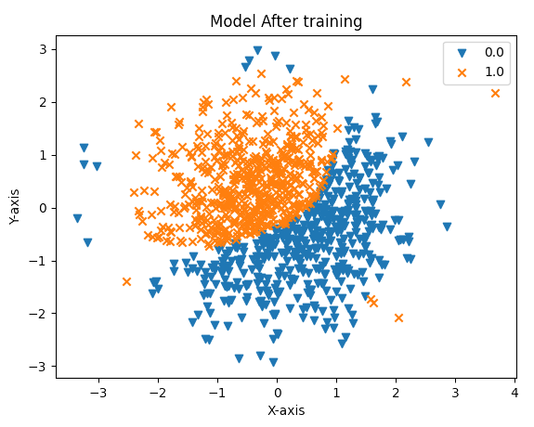



Training Evolution
Feature Space before training.
Feature Space after training.
Random Feature space
Training
Trained feature space
matches target
Hybrid Loss Function
𝐿 𝑥 = Binary Cross Entropy (𝜙_{𝑀} 𝑥 , 𝜙_{𝑇} 𝑥 )
𝜙_{𝑀} 𝑥 = Model Function
𝜙_{𝐿} 𝑥 = True Function

Slide 28


Code Walkthrough
Explicit Quantum Model

Slide 29
Section 4 – Data Reuploading Models..
Looking at the Details

Slide 30
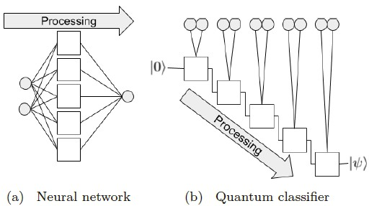


Data Reuploading (DR) Model
SOLUTION ! Data Reuploading
We can get around the no cloning theorem by classically copying our inputs and ‘Reuploading’ them repeatedly back into the circuit.
Motivation
A single layer deep neural network can be a universal classifier given an infinite number of units. This is due to the ability to learn multiple functions of the same data.
PROBLEM ! NO CLONING Theorem.
The resultant Unitary from our repeated encoding and processing:
Problem Statement: The No- Cloning theorem makes it impossible to clone quantum data, and hence we cannot pass our features as inputs to different functions
𝑈 𝜙, 𝑥Ԧ = 𝑈 𝜙_{𝑁} 𝑈 𝑥 …𝑈(𝜙₁) 𝑈(𝑥)
Source: [1]
∴ The final state
𝜓 = 𝑈 𝜙, 𝑥Ԧ |0⟩
Data Reuploading Quantum Models
[1] A. Pérez-Salinas, A. Cervera-Lierta, E. Gil-Fuster, J.I. Latorre, Data re-uploading for a universal quantum classifier, Quantum. 4 (2020) 226.

Slide 31
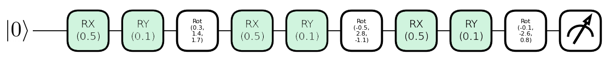
Data Reuploading Circuit
𝑈 𝜙, 𝑥Ԧ
= 𝑈(𝑥)𝑈 𝜙_{𝑁} 𝑈 𝑥 …𝑈(𝜙₁) 𝑈(𝑥)
Initial Data Encoding
Data Reuploading
Trainable Transformation
𝐹₁(𝑋Ԧ)
𝐹₂(𝑋Ԧ)
𝐹₃(𝑋Ԧ)

Slide 32
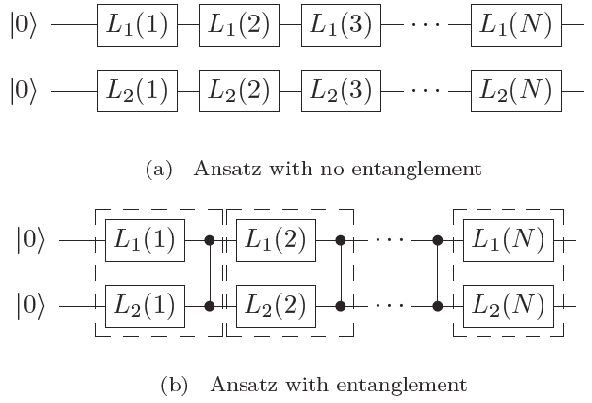

Data Reuploading Variations
IDEA ! Encode linear units.
Multi-Qubit DR Models
Linear – Weighted DR Models
Source: [1]
Weighted Sum DR Models
We can incorporate a stronger idea from deep neural networks into the DR framework – functions of weighted sum. A trivial but powerful modification of DR models is to swap the vanilla reuploading process with the Dense Layer style weighted features. This allows the model to learn richer functions from the data.
𝑥Ԧ
𝑤₀ ∘ 𝑥Ԧ
𝑤₁ ∘ 𝑥Ԧ
Procedure: I. No Entanglement
We can trivially extend the DR framework to multiple
qubits but thinking of each qubit learning different features.
Procedure: II. With Entanglement
When we extend the framework to multiple qubits, we can also take advantage of entanglement.
Encode
Encode
Encode
Generalized Form
Resultant Unitary Operator
𝐿 𝑖 = 𝑈(𝜃_{𝑖} + 𝑤_{𝑖} ∘ 𝑥Ԧ)
𝑈 𝜙, 𝑥Ԧ, 𝑤 = 𝑈 𝜙_{𝑁} 𝑈 𝑤_{𝑛}𝑥 …𝑈(𝜙₁) 𝑈(𝑤₁𝑥)
The i^{th} Layer of our model
The resultant unitary now learns even richer
functions of x due to the weighted sums.
We can create cyclic entanglement between different qubits similar to explicit models.
[1] A. Pérez-Salinas, A. Cervera-Lierta, E. Gil-Fuster, J.I. Latorre, Data re-uploading for a universal quantum classifier, Quantum. 4 (2020) 226.

Slide 33
DR Model in Code
@qml.qnode(dev) def DR_model(input, weights): for layer in range(weights.shape[0]):
qml.RX(input[0],wires=0) qml.RY(input[1],wires=0)
qml.Rot(*weights[layer], wires=0) return qml.expval(qml.PauliZ(0))
Data Encoding
The DR Classifier repeatedly applies the data encoding layer, interleaving it with variational compute layers.

Slide 34
DR Model in Code
@qml.qnode(dev) def DR_model(input, weights): for layer in range(weights.shape[0]): qml.RX(input[0],wires=0) qml.RY(input[1],wires=0)
qml.Rot(*weights[layer], wires=0)
return qml.expval(qml.PauliZ(0))
Variational Circuit
The variational circuits consists of parameterized
𝑅𝑜𝑡 𝜃_{𝑋}, 𝜃_{𝑌}, 𝜃_{𝑍} similar to explicit models, however, they
interleaved with the data encoding

Slide 35
DR Model in Code
@qml.qnode(dev) def DR_model(input, weights): for layer in range(weights.shape[0]):
qml.RX(input[0],wires=0) qml.RY(input[1],wires=0) qml.Rot(*weights[layer], wires=0)
return qml.expval(qml.PauliZ(0))
Layers in a DR Model
The layers of a DR model correspond to a single set of data encoding and variational transformation.

Slide 36
DR Model in Code
@qml.qnode(dev)
def DR_model(input, weights):
for layer in range(weights.shape[0]): qml.RX(input[0],wires=0) qml.RY(input[1],wires=0) qml.Rot(*weights[layer], wires=0)
Measurement
We measure the expectation value w.r.t to the Pauli-Z operator to be used for our loss function.
return qml.expval(qml.PauliZ(0))

Slide 37
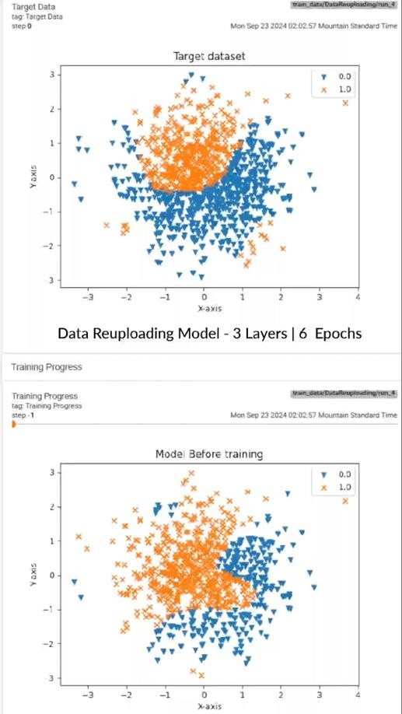
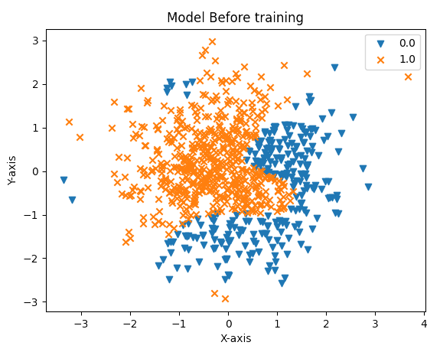
Training Evolution
Feature Space before training.
Feature Space after training.
Random Feature space
Training
Trained feature space
matches target
Hybrid Loss Function
𝐿 𝑥 = Binary Cross Entropy (𝜙_{𝑀} 𝑥 , 𝜙_{𝑇} 𝑥 )
𝜙_{𝑀} 𝑥 = Model Function
𝜙_{𝐿} 𝑥 = True Function

Slide 38
Code Walkthrough
DR Quantum Model

Slide 39
Section 5 – Implicit Models..
Looking at the Details

Slide 40
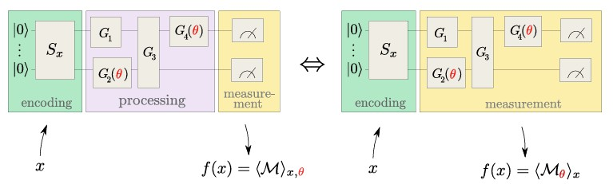
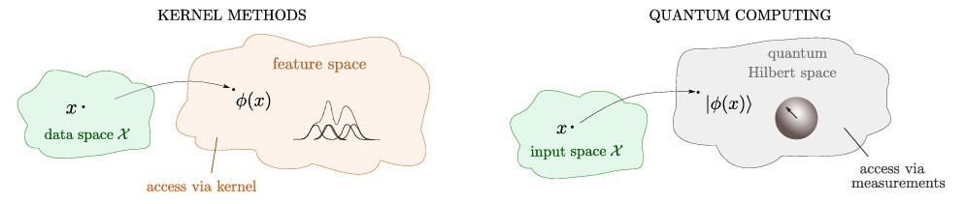
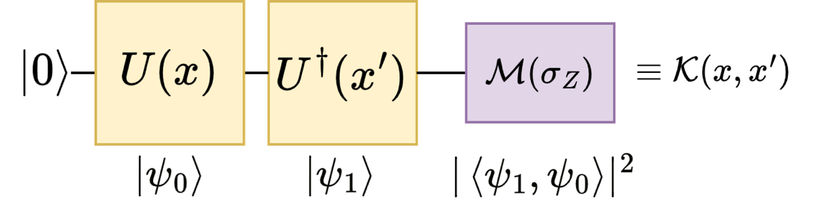
Implicit Quantum Models
Under this interpretation we can re contextualize all explicit models as kernel methods where the variational model is trying to find the appropriate measurement basis (or separating hyperplane)
Quantum Models as Kernel Functions.
When compared against classical kernel methods
we see a direct correlation between the 2 schemes
Statement: We can treat any unitary parameterized by our data as a feature map. Measuring against the adjoint of our 𝑈 with different data creates a kernel function.
We can write down our implicit model, as a kernel function.

Slide 41
Visualizing the Kernel Process
Mapping between our feature spaces via a Quantum Feature Map (data encoding)
The vector space of our input data,
with 2 classes (purple and green)

Slide 42
Visualizing the Kernel Process
Quantum Vector Space in higher dimensions. This forms a Hilbert Space.
A hyperplane separating our 2 classes in higher dimensional feature space
The implicit model computing the distance metric (fidelity) in Hilbert Space.

Slide 43
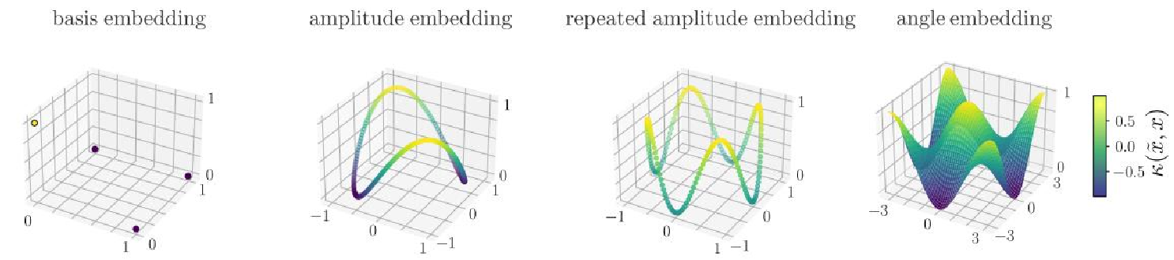
Effect of Encoding on Kernel Map
Encoding | Kernel 𝑘(𝑥, 𝑥′)
Basis | 𝑛−1 2 𝑖_{𝑥}′ 𝑗_{𝑥} ቚ ; 𝑖_{𝑥} = ෍ 2^{𝑘}𝑥_{𝑘} 𝑘=0
Amplitude | _{𝑥}† _{𝑥}′ ²
Rotational | 𝑁 𝖦 cos 𝑥′ − 𝑥_{𝑘} ² 𝑘 𝑘=1
Repeated Amplitude | _{𝑥† 𝑥′} 2𝑟
Table 1: Kernel Functions created by different data
encoding schemes.
Source: [1] | Figure 3: Visualizing the kernels from different encoding schemes. The X-Y plane (bottom) represents our input data, while the Z-axis shows the expectation value from our kernel function. Note that angle encoding has a more continuous domain compared to the other encoding schemes.
[1]. M. Schuld, Supervised quantum machine learning models are kernel methods, 2021.

Slide 44
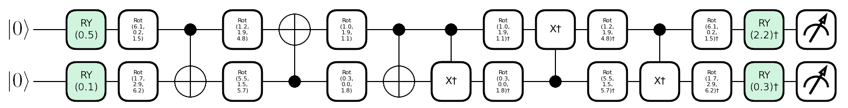
Implicit Model in Code
@qml.qnode(dev)
def Q_Kernel(x0,x1, weights): encoding(x0,weights)
qml.adjoint(encoding)(x1,weights) return qml.probs(wires=range(n_qubits))
def implicit_model(x0,x1, weights): return Q_Kernel(x0,x1, weights)[0]
def encoding(inp, weights):
qml.RY(inp[0], wires=0) qml.RY(inp[1], wires=1)
for layer in range(weights.shape[0]): for wire in range(2): qml.Rot(*weights[layer][wire], wires=wire) if(layer%2==0): qml.CNOT([0, 1]) else: qml.CNOT([1, 0])
Data Encoding
The Implicit model takes as an input 2 different data points and encodes them.

Slide 45
Implicit Model in Code
@qml.qnode(dev)
def Q_Kernel(x0,x1, weights): encoding(x0,weights)
qml.adjoint(encoding)(x1,weights) return qml.probs(wires=range(n_qubits))
def implicit_model(x0,x1, weights): return Q_Kernel(x0,x1, weights)[0]
def encoding(inp, weights): qml.RY(inp[0], wires=0) qml.RY(inp[1], wires=1)
for layer in range(weights.shape[0]):
for wire in range(2): qml.Rot(*weights[layer][wire], wires=wire)
if(layer%2==0):
qml.CNOT([0, 1])
else:
qml.CNOT([1, 0])
Variational Circuit
The variational model is applied twice, with its adjoint being applied to the 2nd point.

Slide 46
Implicit Model in Code
@qml.qnode(dev)
def Q_Kernel(x0,x1, weights): encoding(x0,weights)
qml.adjoint(encoding)(x1,weights)
def implicit_model(x0,x1, weights): return Q_Kernel(x0,x1, weights)[0]
def encoding(inp, weights): qml.RY(inp[0], wires=0) qml.RY(inp[1], wires=1)
for layer in range(weights.shape[0]):
for wire in range(2): qml.Rot(*weights[layer][wire], wires=wire)
if(layer%2==0):
qml.CNOT([0, 1])
else:
qml.CNOT([1, 0])
return qml.probs(wires=range(n_qubits))
Measurement
Measurement in Implicit models computes the fidelity between 2 different states.

Slide 47
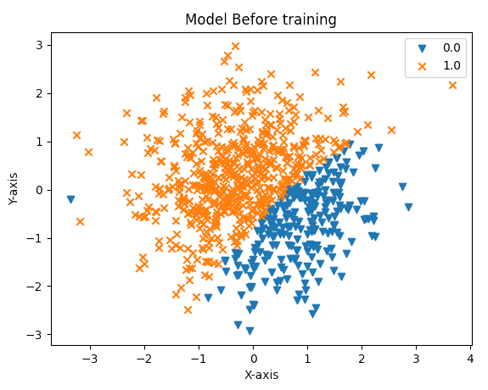
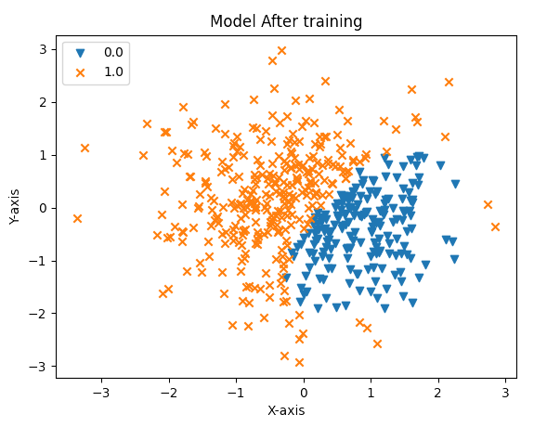
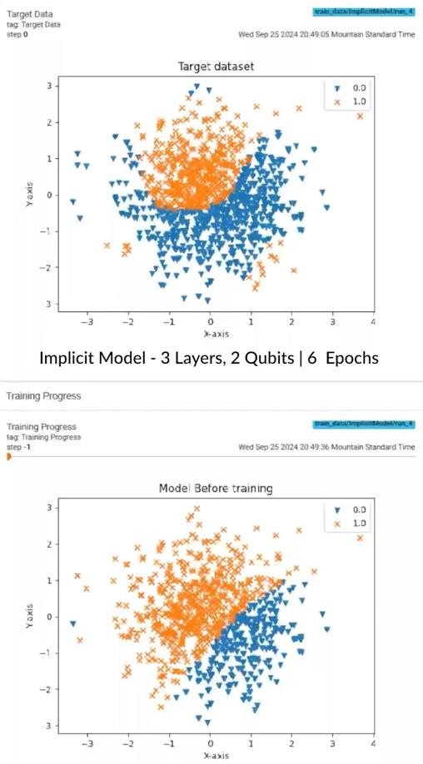
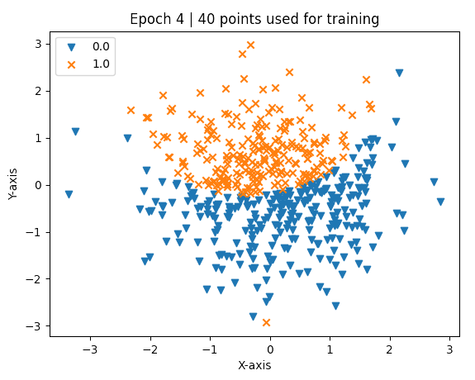
Training Evolution
Sample Points & Train
Update Weights
Compute Kernel Alignment
Best Alignment Kernel
Select best weights

Slide 48

Code Walkthrough
DR Quantum Model

Slide 49


