Slide 1


Maintaining Sanity: Algorithm-based Comprehensive Fault Tolerance for CNNs
Paper #379
Jinhyo Jung*, Hwisoo So#, Woobin Ko*, Sumedh Joshi#, Yebon Kim*, Yohan Ko*, Aviral Shrivastava#, Kyoungwoo Lee*
* Yonsei University, # Arizona State University
Presented by Jinhyo Jung

Slide 2



Reliability: a Key Design Concern
Reliable protection technique for CNNs required
CNNs now being applied even in safety-critical applications
Transient faults pose significant threat to reliability
Transient faults: temporary system glitch caused by hardware/network issues
Autonomous Vehicles
Aerospace Applications
Disease Diagnosis

Slide 3


Previous Methods: Modular Redundancy
Makes redundant copies of the system to detect/correct faults
Hard to apply in resource-constrained environments due to high overheads
Dual Modular Redundancy
Triple Modular Redundancy
Comparator
Voter
Fault Detected
Fault Corrected

Slide 4
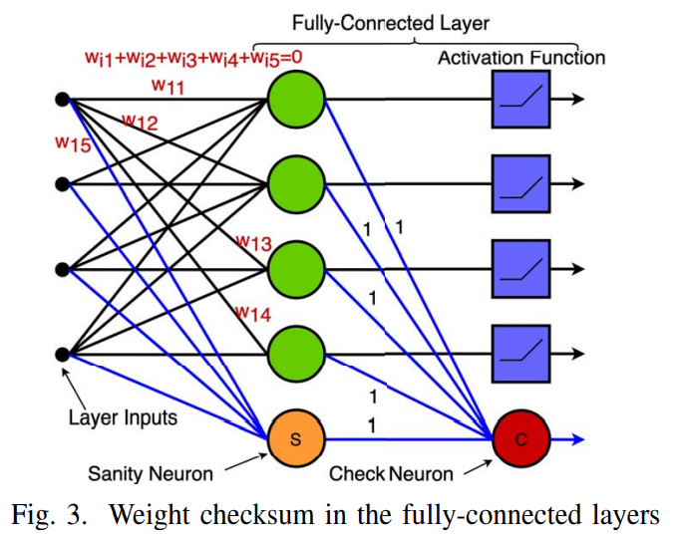
























Previous Methods: Sanity-Check ^{[Ozen, ATS ‘19]}
$$O_{1}$$
$$+ + + =$$
$$O_{1}$$
$$I_{1}w_{11}$$
$$I_{2}w_{21}$$
$$I_{3}w_{31}$$
$$I_{4}w_{41}$$
$$O_{2}$$
$$+ + + =$$
$$O_{2}$$
$$I_{1}w_{12}$$
$$I_{2}w_{22}$$
$$I_{3}w_{32}$$
$$I_{4}w_{42}$$
$$O_{3}$$
$$+ + + =$$
$$O_{3}$$
$$I_{1}w_{13}$$
$$I_{2}w_{23}$$
$$I_{3}w_{33}$$
$$I_{4}w_{43}$$
$$O_{4}$$
$$+ + + =$$
$$O_{4}$$
$$I_{1}w_{14}$$
$$I_{2}w_{24}$$
$$I_{3}w_{34}$$
$$I_{4}w_{44}$$

Slide 5








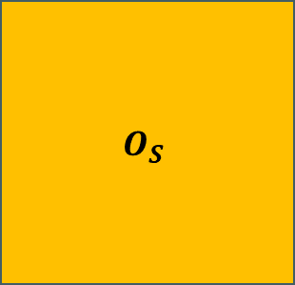


Previous Methods: Sanity-Check ^{[Ozen, ATS ‘19]}
$$I_{1}w_{11}$$
$$I_{2}w_{21}$$
$$I_{3}w_{31}$$
$$I_{4}w_{41}$$
$$O_{S}$$
$$I_{1}w_{12}$$
$$I_{2}w_{22}$$
$$I_{3}w_{32}$$
$$I_{4}w_{42}$$
$$+ + + =$$
$$I_{1}w_{13}$$
$$I_{2}w_{23}$$
$$I_{3}w_{33}$$
$$I_{4}w_{43}$$
$$I_{1}w_{14}$$
$$I_{2}w_{24}$$
$$I_{3}w_{34}$$
$$I_{4}w_{44}$$

Slide 6






Previous Methods: Sanity-Check ^{[Ozen, ATS ‘19]}
Fault detected through checksum
$$O_{1}+O_{2}+O_{3}+O_{4}+O_{S}≠0$$
Fault in parameter only affects one output
Possible correction with fault location
$$O_{3}=−(O_{1}+O_{2}+O_{4}+O_{S})$$
$$O_{1}$$
$$O_{S}$$
$$O_{2}$$
$$O_{3}$$
$$O_{4}$$

Slide 7
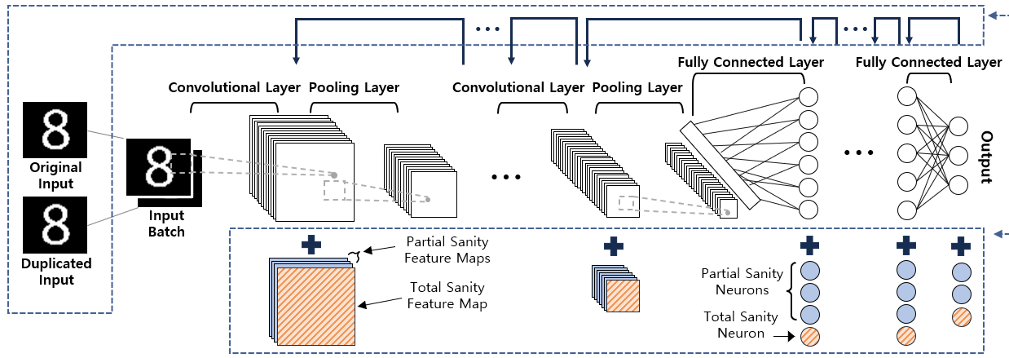
Maintaining Sanity: Overview
Categorize data to model parameters and layer inputs
Apply checksum-based protection to correct faults in model parameter faults
Apply redundancy-based protection to correct faults in layer inputs

Slide 8
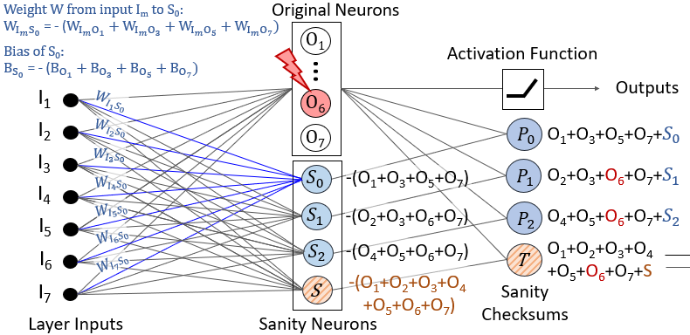
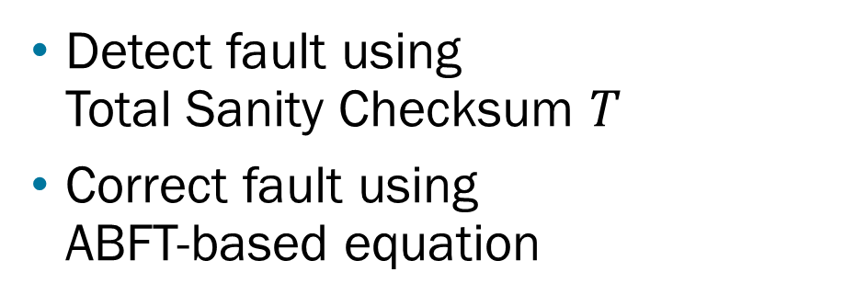
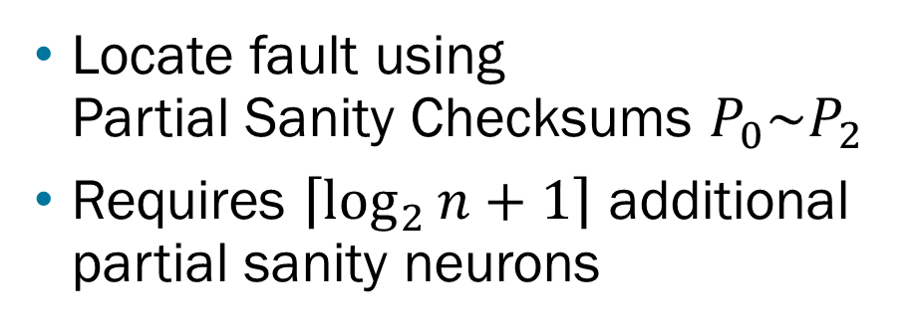
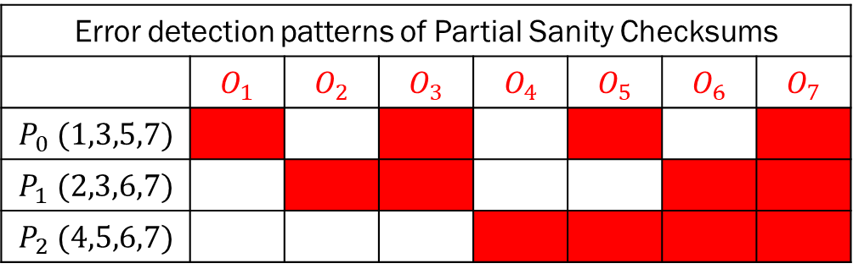
Model Parameter Redundancy: FC Layer
Error detection patterns of Partial Sanity Checksums
 | $$O_{1}$$ | $$O_{2}$$ | $$O_{3}$$ | $$O_{4}$$ | $$O_{5}$$ | $$O_{6}$$ | $$O_{7}$$
$$P_{0} (1,3,5,7)$$
$$P_{1} (2,3,6,7)$$
$$P_{2} (4,5,6,7)$$
Detect fault using Total Sanity Checksum $T$
Correct fault using ABFT-based equation
Locate fault using Partial Sanity Checksums $P_{0}\sim P_{2}$
Requires $\left\lceil \log_{2}{n+1}\right\rceil$ additional partial sanity neurons

Slide 9
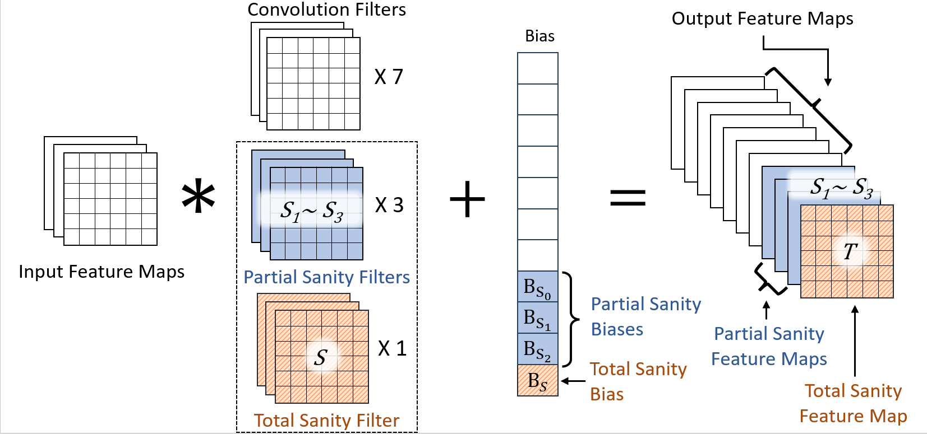

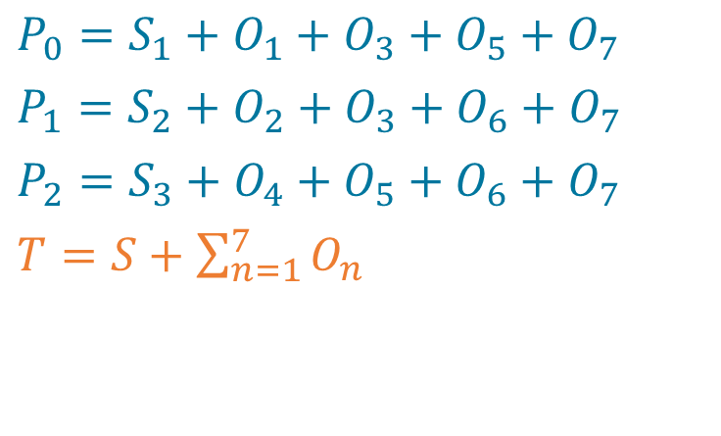
Model Parameter Redundancy: Conv Layer
Addition of $\left\lceil \log_{2}{n+1}\right\rceil$ partial sanity filters
Detect fault with Total Sanity Checksum $T$
Locate fault with Partial Sanity Checksums $P_{0}\sim P_{2}$
Correct fault using the ABFT-based equation
$P_{0}=S_{1}+O_{1}+O_{3}+O_{5}+O_{7}$
$P_{1}=S_{2}+O_{2}+O_{3}+O_{6}+O_{7}$
$P_{2}=S_{3}+O_{4}+O_{5}+O_{6}+O_{7}$
$T=S+\sum_{n=1}^{7}{O_{n}}$

Slide 10
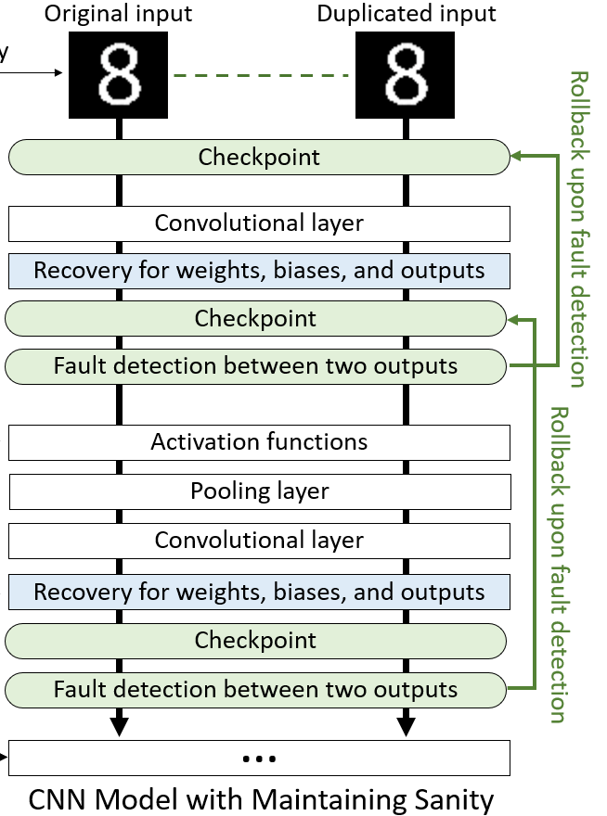
Layer Input Redundancy
Dual Modular Redundancy to detect faults
Checksum method requires use of batch inputs
Cannot provide fast recovery
Duplicate only the original input to network
Each duplication induces single-point-of-failure
Minimize window of vulnerability
Checkpoint and rollback to correct error
Intertwine check and store to eliminate vulnerability

Slide 11
Experimental Setup
Target CNNs
LeNet-5 pretrained on MNIST
AlexNet, ResNet18, VGG16 pretrained on ImageNet
Implemented in PyTorch using float32, run in Intel Xeon 2.2GHz CPU
Error model
Inject one bit-flip per run to collect cases of classification faults (critical faults)
Check if protection technique detects/corrects critical faults

Slide 12


Experimental Setup: Baseline Techniques
N-TMR(Network-level TMR)
Triplicate entire network and input
I-TMR(Input-level TMR)
Triplicate only the input
Spa-SC(Spatial-only Sanity-Check)
Sanity-Check w/o input redundancy
SC(Sanity-Check)
Sanity-Check implemented for single-inputs
MS(Maintaining Sanity)
Our technique
I-TMR
N-TMR
Spa-SC
SC
MS

Slide 13
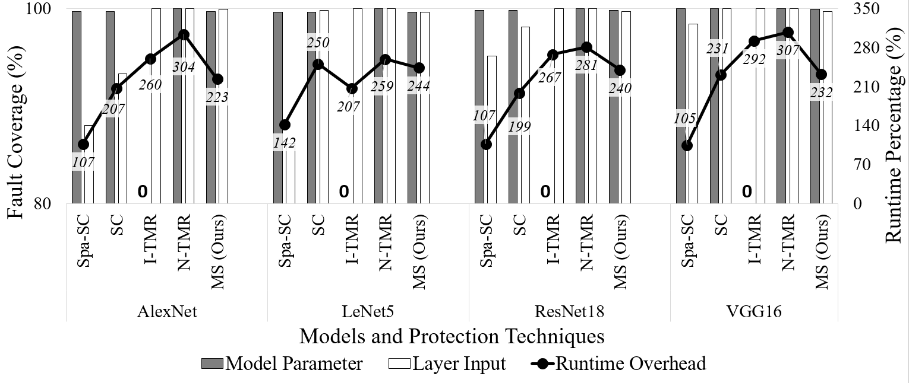
Results: Coverage and Runtime

Slide 14
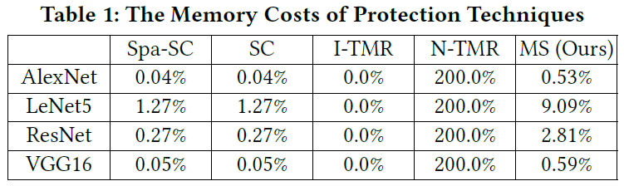
Results: Memory Costs
Memory Costs
MS requires less than 10% additional parameters for LeNet5
Normalized overhead decreases as model size increases

Slide 15
Summary
Maintaining Sanity
Checksum-based protection for layer parameter faults
Duplication-based protection for layer input faults
Almost perfect fault coverage with 135% runtime overhead and minimal additional memory costs
27% lower runtime overhead compared to full triple modular redundancy
Other techniques that are faster suffer from incomprehensive coverage

