Slide 1




Scaling of Union of Intersections for Inference of Granger Causal Networks from Observational Data
Mahesh Balasubramanian¹, Trevor Ruiz², Brandon Cook³, Mr Prabhat³
Sharmodeep Bhattacharyya², Aviral Shrivastava¹, Kristofer Bouchard³
1. Arizona State University, AZ, USA 2. Oregon State University, OR, USA 3. Lawrence Berkeley National Laboratory, CA, USA
Email: mbalasubramanian@asu.edu; kebouchard@lbl.gov

Slide 2
Introduction
The growth of the Internet and social media applications has paved the way for the development of highly sophisticated machine learning and statistical data analysis tools.
Further scientific data collection strategies have grown exponentially over the years by innovation in the field of sensors and advanced data collection methods.
Introduced for the analysis of econometric time series, Granger causality is the amount of variance in one time series accounted for by the past of another time series
Vector autoregressive (VAR) models are well suited for inference of Granger causal networks from such high-dimensional, multi-variate observational time series data.
Although VAR models provide a flexible framework and are probabilistically tractable scaling VAR inference to massive data sets is a major challenge due to unfavorable scaling of the problem size with the number of nodes or features in the network.

Slide 3
Union of Intersections
The Union of Intersections (UoI) framework developed in [1] is a powerful statistical-machine learning framework which has natural algorithmic parallelism.
The main mathematical innovations of UoI are
1) creating a family of potential model supports through an intersection operation for a range of regularization parameters in model selection, and
2) combining the above-computed supports with a union operation so as to increase prediction accuracy on held out data in model estimation.
Methods based on UoI, utilize the notion of stability to perturbations by multiple random resampling of the data.
[1] Kristofer E. Bouchard et al. Union of Intersections (UoI) for Interpretable Data Driven Discovery and Prediction. In Advances in Neural Information Processing Systems, 2017

Slide 4
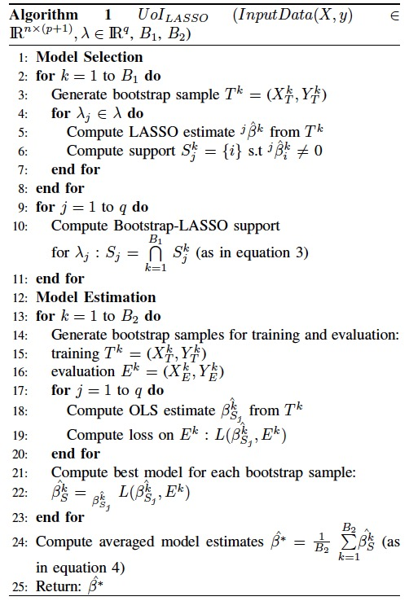
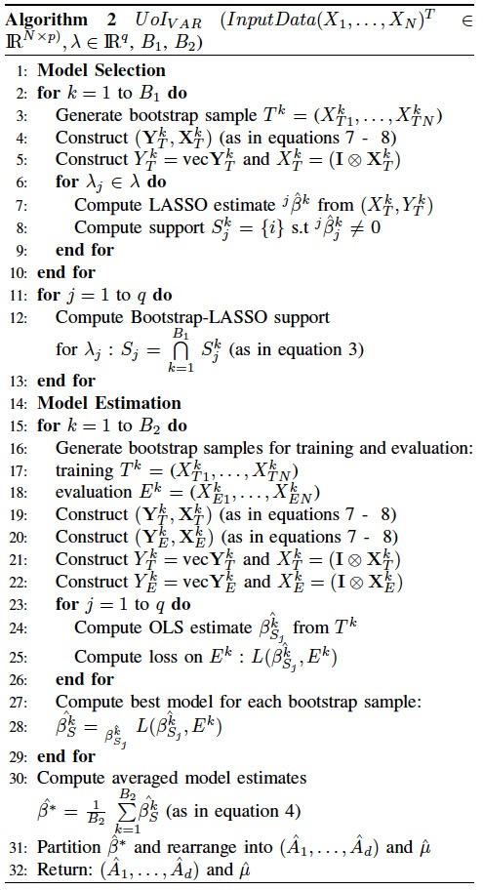
Methods
UoI_{LASSO}
UoI_{VAR}^{[2]}
Bootstrap parallelization
hyperparameter parallelization
Distributed LASSO-ADMM [1]
[1] Stephen Boyd et al. Distributed optimization and statistical learning via the alternating direction method of multipliers. Foundations and Trends® in Machine Learning, 3(1):1–122, 2011.
[2] Trevor Ruiz, Mahesh Balasubramanian, Kristofer E Bouchard, and Sharmodeep Bhattacharyya. Sparse, low-bias, and scalable estimation of high
dimensional vector autoregressive models via union of intersections. arXiv preprint arXiv:1908.11464, 2019.

Slide 5
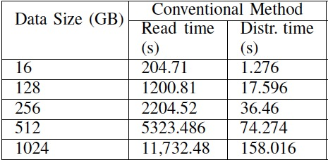
Challenges in Scaling UoI_{LASSO} and UoI_{VAR}
UoI_{LASSO}
UoI_{VAR}
Data I/O : For large input data set sizes conventional methodology¹ repeatedly access the data file that takes a lot of data access time.
Dividing the data set into chunks for faster access reduces selection and estimation accuracy.
Beyond 1TB data set size the conventional method’s data read time exceeded 5 hours².
Although VAR models provide a flexible framework and are probabilistically tractable scaling VAR inference to massive data sets is a major challenge due to unfavorable scaling of the problem size with the number of nodes or features in the network.
It is rare to encounter VAR models with more than 50 nodes or features.
There has been no previous formalization for parallelizing the Kronecker product and vectorization.
Reading the data file in chunks, using single core, and distributing the data to the other cores.
The read and distribution times are collected by executing the conventional method implementation on NERSC’s Cori KNL supercomputer. The data sets were synthetic in HDF5 file format.

Slide 6
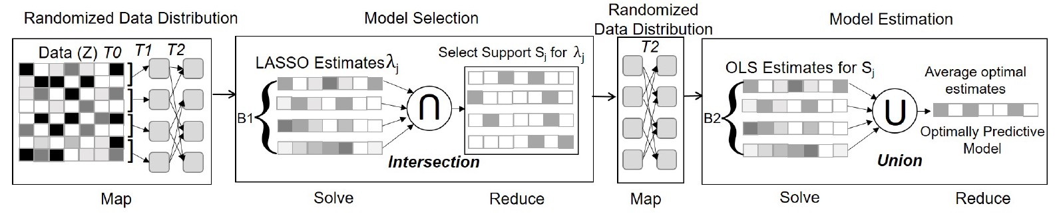
Randomized Data Distribution
To reduce the data read time for UoI_{LASSO} we introduce a novel Randomized Data Distribution strategy.
HDF5 parallel is employed to read data is contiguous chunks
MPI One sided communication is used to randomly distribute the data to the computation cores.

Slide 7
Distributed Kronecker Product and Vectorization
The input data set size is small (few 10s of MB), so only a few cores read the data and the problem is created using Kronecker product and vectorization.
Since temporal dependence should be honored for time series model, a block bootstrap approach is implemented by randomly selecting time series blocks for each bootstrap.
The reader cores holding the block bootstraps create windows for MPI one sided communication.
The computation cores then execute the vectorization and Kronecker product routines to get the corresponding cores.
Explicit computation is not required but increases the communication time.

Slide 8
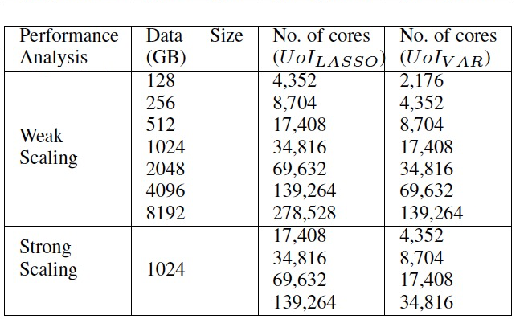
Experimental Setup
The multi-node runs were conducted on Cori Knights Landing (KNL) supercomputer at NERSC.
9,688 nodes of 1.4 GHz Intel Xeon Phi processors with a
68 cores per node.
The aggregated memory for a single node in KNL is 16GB MCDRAM and a 96GB DDR.
Algorithms implementation
C++ using Eigen3 library for Linear Algebra.
Intel-MKL for BLAS operations.

Slide 9
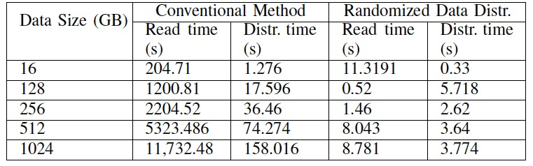
Improved Read and Distribution time
The traditional methodology has three issues, namely:
Read only a small chunk of data at a time,
Repeatedly open the data file to read the data completely,
Cannot store the loaded data due to limited space availability (aggregated memory of single KNL node is 96GB, but the data set size is in order of 100s of GBs and TBs).
Randomized Data Distribution design improved the Data Read and Distribution time compared to Conventional method. Beyond 1TB data set size the conventional method’s data read time exceeded 5 hours whereas Randomized Data Distribution read time was below 100 seconds.

Slide 10
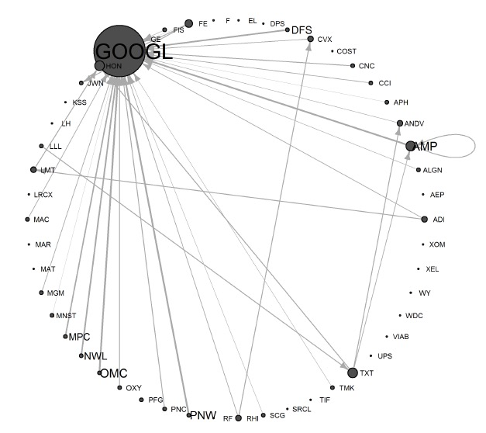
VAR(1) model for S&P 500 Index
We use a financial time series data set to illustrate a data analysis using UoI_{VAR} in a real application: the data are daily closes on the S& P Index for the years 2013 - 2018.
Granger causality analysis using UoI_{VAR}
we randomly chose 50 companies on the index in the years 2013 and 2014, aggregated the data to weekly closes, and took first differences to obtain a plausibly stationary vector time series.
The matrix of parameter estimates is represented as a directed graph with nodes for each vector component (company), plotted with node sizes proportional to node degree and labeled according to company ticker, and with directed edges from node j to node i shown when the estimate of a_{ij} is nonzero, with line thickness proportional to estimate magnitude.

