Slide 1
CODES+ISSS 2: Reliable Neural Networks ProGIP: Protecting Gradient-based Input Perturbation Approaches for Out-of-distribution Detection From Soft Errors
Sumedh Joshi, Arizona State University
Hwisoo So (Presenter), Kyungpook National University, Yonsei University, Arizona State University
Soyeong Park, Yonsei University
Woobin Ko, Yonsei University
Jinhyo Jung, Yonsei University
Yohan Ko, Yonsei University
Uiwon Hwang, Ewha Womans University
Kyoungwoo Lee, Yonsei University
Aviral Shrivastava, Arizona State University

Slide 2
Agenda
Background and motivation
Out-of-distribution (OOD)
Gradient-based input perturbation (GIP)
Soft errors on GIP solutions
ProGIP: Protecting GIP solutions from soft errors
Experiments
Conclusion

Slide 3








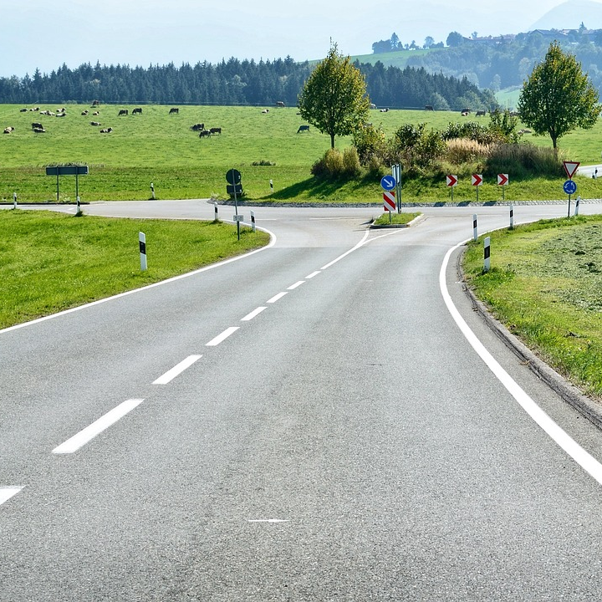
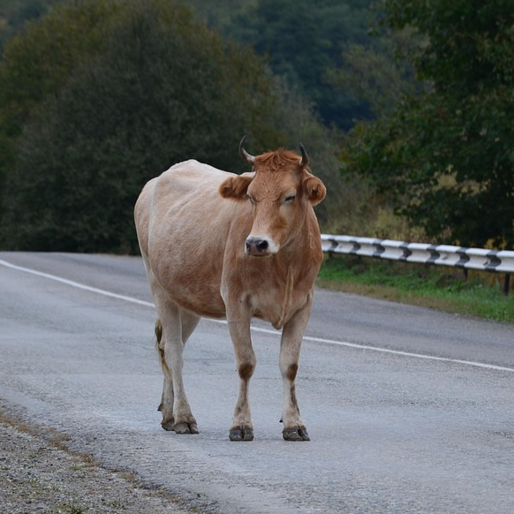
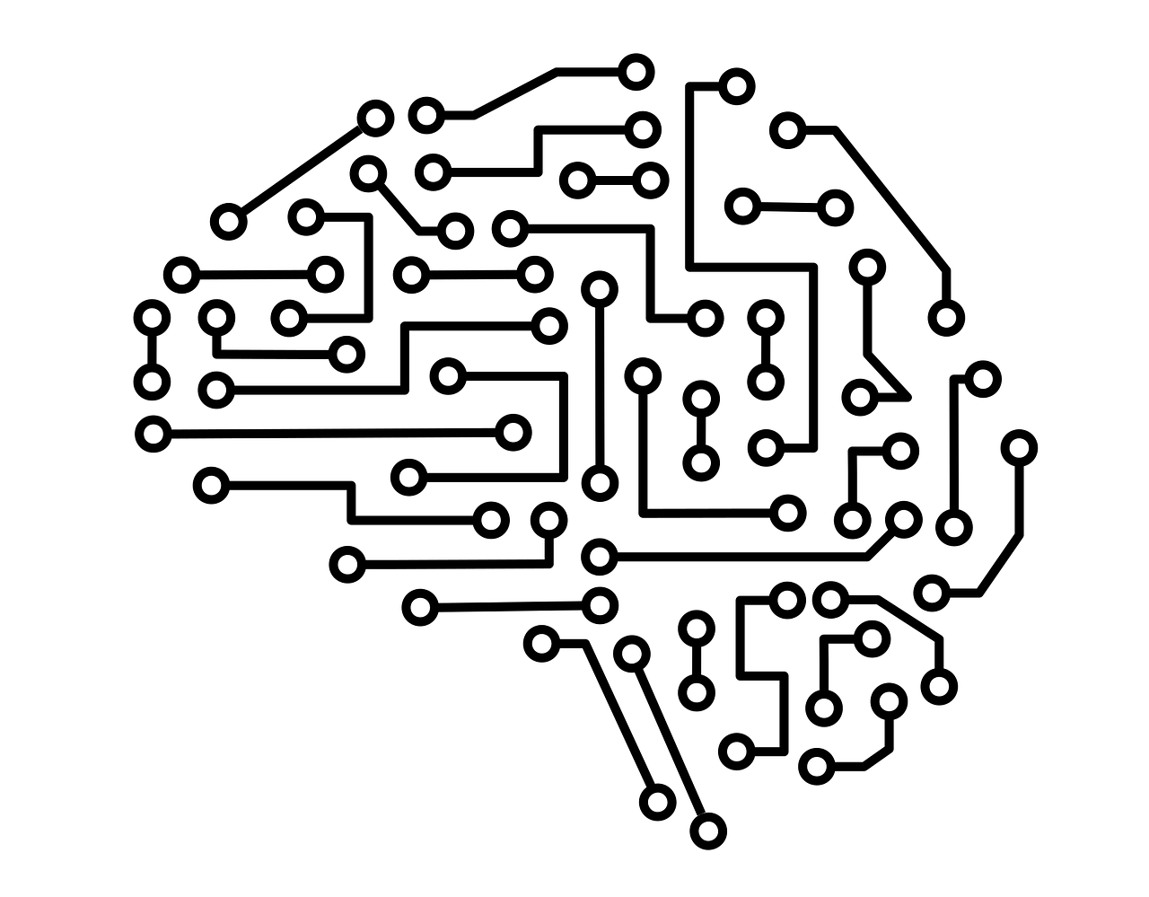
Out-of-distribution (OOD)
Images from Pixabay
In-distribution data
Car
Pedestrian
Empty road
Training
Car
Pedestrian
Empty road
OOD input
Solution: Rejecting OOD inputs
Deep learning model

Slide 4
OOD Detection for Deep Learning Models
Images from Pixabay
Maximum softmax probability (MSP) score
Mahalanobis distance-based score
…
How to detect OOD inputs?
ID/OOD score: 0.85
Classification: Car
ID
ID/OOD score: 0.40
Classification: Empty road
OOD
DL model

Slide 5
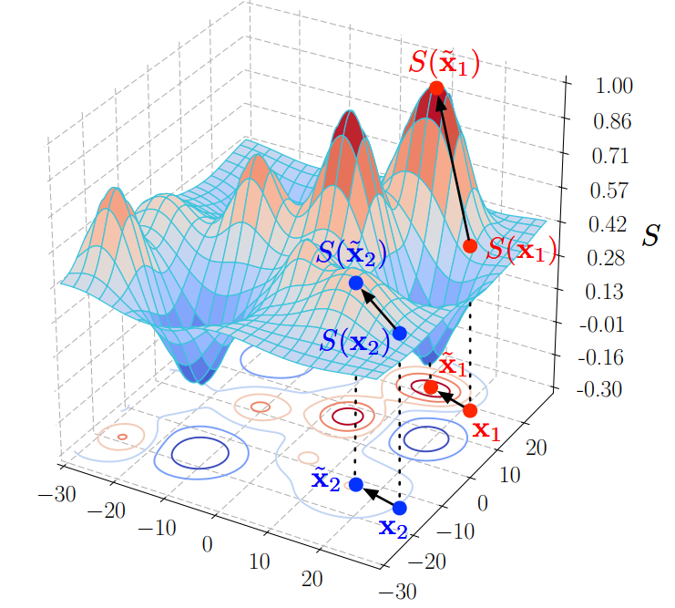
Gradient-based Input Perturbation (GIP)
Images from Pixabay
Goal: increasing score gaps between ID and OOD samples
GIP is similar to “reversed” adversarial attacks
it increases the confidences of inputs, with a greater effect on ID than on OOD
ID
Higher score
Perturbed input
3
-5
1
-1
e.g.
Magnitude
-1
2
-1
1
𝑥˜ = 𝑥 − 𝜖 ∗ 𝑠𝑖𝑔𝑛(−∇𝑥𝑠𝑐𝑜𝑟𝑒 (𝑥))
Original input
Gradient
OOD
Image from
Shiyu Liang, Yixuan Li, and R. Srikant. 2018. Enhancing the reliability of out-of-distribution image detection in neural networks. In Proceedings of the International Conference on Learning Representations (ICLR).

Slide 6
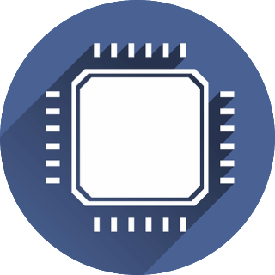
GIP Solutions: Drawback
Image from Pixabay
Soft error: transient bit-flip
GIP requires gradient from forward + backward passes
𝑥˜ = 𝑥 − 𝜖 ∗ 𝑠𝑖𝑔𝑛(−∇𝑥𝑠𝑐𝑜𝑟𝑒 (𝑥))
ID/OOD score
Strike of external particles (e.g., alpha particles or cosmic rays)
Classification result
source
+
drain
0→1
+
+
-
+
-
-
-
Processor
Transistor
The saved bit is flipped from 0 to 1,
Input
First forward pass
Backward pass
Perturbed
Input
Second forward pass
or from 1 to 0
3x execution passes → 3x exposure time to soft errors!

Slide 7
Soft Errors on GIP Solutions?
Images from Pixabay
GIP solution
Classification failure
ID/OOD score: 0.85 (ID)
Classification: Car
Empty Road
GIP solution
ID/OOD detection failure
0.98 (ID)
ID/OOD score: 0.40 (OOD)
Classification: Empty Road

Slide 8
Our Solution: ProGIP
Protecting GIP solutions for OOD detection against soft errors
Goal: efficiently detecting soft errors on GIP solutions
ProGIP adds only two detectors to protect three passes in GIP solutions
ProGIP 1st detector
GIP process
ProGIP 2nd detector

Slide 9
ProGIP: Design Principle
Observation in Prior Studies [Chen et al. (2021), Ghavami et al. (2022)]
High-order bit-flips primarily contribute to failures in ML models
Original value: 0.5
0 | 0 | 1 | 1 | 1 | 1 | 1 | 1 | 0 | 0 | 0 | 0 | …
Sign
Exponent
Mantissa
Bit-flip on higher bit
Faulty value: 1.7014118 × 10³⁸
0 | 1 | 1 | 1 | 1 | 1 | 1 | 1 | 0 | 0 | 0 | 0 | …
…
Sign
Exponent
Mantissa
Abnormally high values* → Symptoms of failures
…
*Both Extremely positive and extremely negative values

Slide 10
ProGIP: GIP Process and High Values
Image from Pixabay
Abnormally high values
Symptoms of failures in the first forward and backward passes disappear after the GIP process
𝑥˜ = 𝑥 − 𝜖 ∗ 𝑠𝑖𝑔𝑛 (−∇𝑥𝑠𝑐𝑜𝑟𝑒 (𝑥))
1 if positive
-1 if negative
Classification result
Abnormally high values will become 1 or -1 (normal values)
Input
First forward pass
Backward pass
Perturbed
Input

Slide 11
ProGIP: Two Detectors
One detector to detect high values before the GIP process
Before GIP removes the symptoms of failures
One detector to detect high values after the GIP process
Protecting first forward and backward passes
ProGIP 1st detector
GIP process
ProGIP 2nd detector
Protecting second forward pass

Slide 12
First Detector for First Forward Pass
Image from Pixabay
First detector protects first forward and backward passes
High logits
*Maha.: Mahalanobis-based distance
High-order bit-flip
MSP scoring: 0 loss Maha.* Scoring: high loss
MSP scoring: 0 gradient Maha. Scoring: high gradient
ProGIP 1st detector
Input
First forward pass
Backward pass
The inference is faulty if 𝑚𝑎𝑥 (𝑎𝑏𝑠 (𝑔𝑟𝑎𝑑𝑖𝑒𝑛𝑡)) ≈ 0 or
𝑚𝑎𝑥 (𝑎𝑏𝑠 (𝑔𝑟𝑎𝑑𝑖𝑒𝑛𝑡)) > 𝑡ℎ𝑟𝑒𝑠ℎ𝑜𝑙𝑑

Slide 13
First Detector for Covering Backward Pass
Image from Pixabay
First detector protects first forward and backward passes
High-order bit-flip
ProGIP 1st detector
high gradient
Input
First forward pass
Backward pass
The inference is faulty if 𝑚𝑎𝑥 (𝑎𝑏𝑠 (𝑔𝑟𝑎𝑑𝑖𝑒𝑛𝑡)) ≈ 0 or
𝑚𝑎𝑥 (𝑎𝑏𝑠 (𝑔𝑟𝑎𝑑𝑖𝑒𝑛𝑡)) > 𝑡ℎ𝑟𝑒𝑠ℎ𝑜𝑙𝑑

Slide 14
Second Detector for Second Forward Pass
Image from Pixabay
Second detector protects second forward pass
High logits
High-order bit-flip
*Extremely negative scores
MSP scoring: high scores Maha. Scoring: low scores*
ProGIP 1st detector
ProGIP 2nd detector
…
Perturbed
Input
Second forward pass
The inference is faulty if 𝑠𝑐𝑜𝑟𝑒(𝑥˜) > 𝑡ℎ𝑟𝑒𝑠ℎ𝑜𝑙𝑑 (MSP scoring)
𝑠𝑐𝑜𝑟𝑒(𝑥˜) ≤ 𝑡ℎ𝑟𝑒𝑠ℎ𝑜𝑙𝑑 (Maha. scoring)

Slide 15
Experiments: Setup
Fault injection: injected one fault per each GIP inference
Runtime measurement: measured on NVIDIA RTX 4070 & A6000
Networks | DenseNet-BC ^{[Huang et al. (2017)]}, ResNet-34 ^{[Zisselman and Tamar (2020)]}, MobileNetV2 ^{[Sandler et al. (2018)]}
ID dataset | ID: CIFAR-10 ^{[Krizhevsky (2009)]} / OOD: Tiny ImageNet ^{[Deng et al. (2009)]}
OOD detection | ODIN ^{[Liang et al. (2018)]} (MSP-based), Mahalanobis ^{[Lee et al. (2018)]} (Mahalanobis distance-based)
Fault detection | No protection (original) ProGIP (ours) Detection-only Ranger ^{[Chen et al. (2021)]}
checks abnormal values at all activation function layers (Implemented by Pytorch Hooks) Note: original Ranger is designed to detect and correct faults
100,000 injections × 2 (OOD detection schemes) × 2 (data types) × 3 (passes) × 3 (networks)
= 3.6M fault injection runs

Slide 16
Experiments: Results
Inserting detectors at every activation layer
Inserting only two detectors
Detection-only Ranger ^{[Chen et al. (2021)]}
ProGIP (ours)
Fault coverage: classification failure
99.74%
99.57%
Fault coverage: ID/OOD detection failure
97.33%
96.29%
Runtime overhead compared to original
+135.07%
+0.84%

Slide 17
Experiments: Ablation Study
Removing ProGIP’s first fault detector
Measuring fault coverages for faults on first forward and backward passes
ProGIP 1st detector
GIP process
ProGIP 2nd detector
Fault coverage: classification failure
99.57%
0%
Ablation
Fault coverage: ID/OOD detection failure
96.29%
0%
Ablation

Slide 18
Applicability: Activation Modification Schemes
Some OOD detection schemes modify activation values
…
ProGIP detection point #1
ProGIP detection point #2
Penultimate layer
Activation modification
Last layer
Layers before penultimate layer
Example 1: ASH ^{[Djurisic et al. (2023)]}
Example 2: ReAct ^{[Sun et al. (2021)]}
0.1956 | 1.9398 | … | 0.3137 | 0.2822
0.1956 | 1.9398 | … | 0.3137 | 0.2822
Top 10%
> threshold
0.0000 | 1.9398 | … | 0.0000 | 0.0000
0.1956 | 1.500 | … | 0.3137 | 0.2822
Such modifications can hide abnormally high values

Slide 19
Conclusion
ProGIP protects three passes of GIP solutions with two detectors
Fault coverage: 97.70% of critical soft error-induced failures
Average overhead: 0.84%
ProGIP 1st detector
GIP process
ProGIP 2nd detector

Slide 20
References (1/2)
[Chen et al. (2021)] Zitao Chen, Guanpeng Li, and Karthik Pattabiraman. 2021. A low-cost fault corrector for deep neural networks through range restriction. In 2021 51st Annual IEEE/IFIP International Conference on Dependable Systems and Networks (DSN). IEEE, 1–13.
[Ghavami et al. (2022)] Behnam Ghavami, Mani Sadati, Zhenman Fang, and Lesley Shannon. 2022. FitAct: Error resilient deep neural networks via fine-grained post-trainable activation functions. In 2022 Design, Automation & Test in Europe Conference & Exhibition (DATE). IEEE, 1239–1244.
[Huang et al. (2017)] Gao Huang, Zhuang Liu, Laurens Van Der Maaten, and Kilian Q Weinberger. 2017. Densely connected convolutional networks. In Proceedings of the IEEE conference on computer vision and pattern recognition. 4700–4708.
[Zisselman and Tamar (2020)] Ev Zisselman and Aviv Tamar. 2020. Deep residual flow for out of distribution detection. In Proceedings of the IEEE/CVF Conference on Computer Vision and Pattern Recognition. 13994–14003.
[Sandler et al. (2018)] Mark Sandler, Andrew Howard, Menglong Zhu, Andrey Zhmoginov, and Liang-Chieh Chen. 2018. Mobilenetv2: Inverted residuals and linear bottlenecks. In Proceedings of the IEEE conference on computer vision and pattern recognition. 4510–4520.

Slide 21
References (2/2)
[Krizhevsky (2009)] Alex Krizhevsky, 2009. Learning multiple layers of features from tiny images. Master's thesis. University of Toronto, Toronto, Ontario.
[Deng et al. (2009)] Jia Deng, Wei Dong, Richard Socher, Li-Jia Li, Kai Li, and Li Fei-Fei. 2009. Imagenet: A large-scale hierarchical image database. In 2009 IEEE conference on computer vision and pattern recognition. Ieee, 248–255.
[Liang et al. (2018)] Shiyu Liang, Yixuan Li, and R Srikant. 2018. Enhancing The Reliability of Out-of-distribution Image Detection in Neural Networks. In International Conference on Learning Representations (ICLR).
[Lee et al. (2018)] Kimin Lee, Kibok Lee, Honglak Lee, and Jinwoo Shin. 2018. A simple unified framework for detecting out-of-distribution samples and adversarial attacks. Advances in Neural Information Processing Systems 31 (2018). 7167–7177.
[Djurisic et al. (2023)] Andrija Djurisic, Nebojsa Bozanic, Arjun Ashok, and Rosanne Liu. 2023. Extremely simple activation shaping for out-of-distribution detection. In Proceedings of the International Conference on Learning Representations. Retrieved from https://arxiv.org/abs/2209.09858.
[Sun et al. (2021)] Yiyou Sun, Chuan Guo, and Yixuan Li. 2021. React: Out-of-distribution detection with rectified activations. Advances in Neural Information Processing Systems 34 (2021), 144–157.

Slide 22

Thank You for Listening!
Image from Pixabay
Q&A

