Slide 1

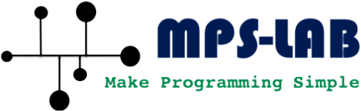
HELM
Compiler-Guided Heterogeneous Execution for Large Language Models
on Memory-Constrained Systems
CPU
GPU
Atharva Khedkar*, Shashwat Pandey*, Aviral Shrivastava
Arizona State University
* equal contribution
Notes:
[0:00–0:15]
Hi everyone, I'm Atharva from Arizona State. This is joint work with Shashwat Pandey, who is co-first author, and our advisor Aviral Shrivastava.
The one-line version of the talk: when an LLM doesn't fit in your GPU, HELM decides at compile time which layers run on the CPU and which on the GPU, and then never moves a weight again.

Slide 2
16 GB model, 8 GB laptop GPU: today’s systems fail or crawl
Running example: Qwen3-8B (FP16) on an RTX 4060 laptop
Decode throughput (tok/s)
Model weights
Qwen3-8B weights ≈ 16 GB (+ KV cache)
vLLM
OOM at load / compilation
GPU VRAM
RTX 4060 · 8 GB
✗ 8 GB short
DeepSpeed
OOM
Accelerate
0.8
Host DRAM
i7-13700H · 16 GB
HELM
HELM
4.1
CPU + GPU memory together can hold the model.
The question is how to split it.
5.1×
faster decode than Accelerate,
and 64× longer context (8K vs 128)
Can we run one model across CPU and GPU without moving weights every token?
2
Notes:
[0:15–1:05]
Let me start with a concrete case that I'll carry through the whole talk. Qwen3-8B in FP16 is about 16 GB of weights. A gaming laptop with an RTX 4060 has 8 GB of VRAM. So the model is 8 GB short on the GPU, but CPU plus GPU memory together can hold it.
What happens with today's systems? vLLM refuses to load it. DeepSpeed also runs out of memory. Hugging Face Accelerate does run it, at 0.8 tokens per second.
HELM runs the same model on the same laptop at 4.1 tokens per second, 5.1 times faster, and supports 64 times longer context.
So the question of this talk: can we use the CPU and the GPU together, without shuffling weights across PCIe on every token?

Slide 3
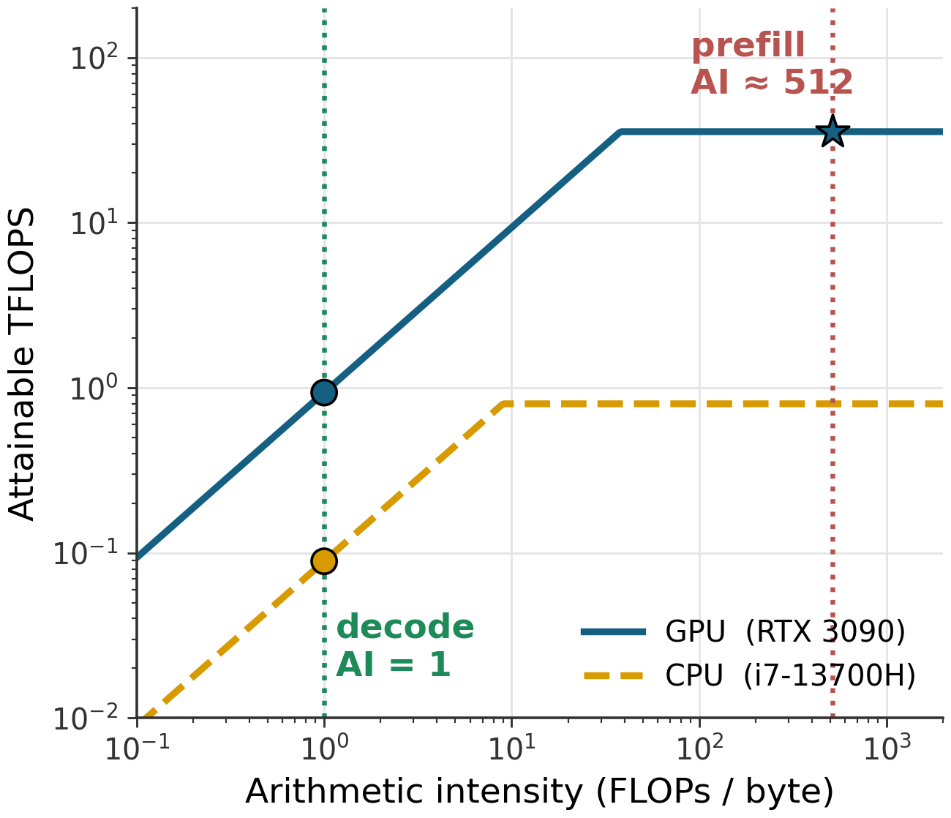
Decode is memory-bound: intensity drops from 512 to 1
Prefill · whole prompt at once (T = 512 tokens)
W (q_proj)
4096 × 4096
FLOPs = 2·T·H² = 17.2 G
weights = 2·H² B = 33.6 MB
X
512 × 4096
Y
512 × 4096
×
=
AI ≈ 512 → compute-bound
Decode · one new token per step
x
1 × 4096
W (q_proj)
4096 × 4096
y
1 × 4096
FLOPs = 2·H² = 33.6 M
weights = 2·H² B = 33.6 MB
×
=
Decode speed is set by memory bandwidth, so CPU DRAM bandwidth adds real tokens/s.
AI = 1 → bandwidth-bound
3
Notes:
[1:05–2:00]
Why can a CPU help at all? Take one weight matrix of our running example, the query projection of Qwen3-8B, 4096 by 4096.
In prefill, the whole prompt goes through at once: a 512 by 4096 matrix times W. That is 17 GFLOPs over 34 MB of weights, an arithmetic intensity of about 512, so prefill is compute-bound and belongs on the GPU.
In decode we generate one token at a time. Now it's a single row times W: 34 MFLOPs over the same 34 MB. Arithmetic intensity 1.
On the roofline, AI of 1 is left of the ridge point of both the GPU and the CPU. So decode is bandwidth-bound everywhere, and tokens per second is set by memory bandwidth. CPU DRAM bandwidth is lower than GPU bandwidth, but it is not zero; layers on the CPU add real throughput, as long as their weights stay put.

Slide 4
Existing systems move weights across PCIe every token
vLLM / SGLang
HF Accelerate
DeepSpeed
SOSP’23 · NeurIPS’24
Gugger et al., 2022
ZeRO, SC’20
CPU DRAM
—
GPU VRAM
all weights
✗ exceeds VRAM
CPU DRAM
overflow layers
GPU VRAM
first layers (greedy fill)
CPU DRAM
all weights
GPU VRAM
one layer at a time
weights
every token
every layer,
every token
Whole model must fit in GPU memory.
Streams CPU-layer weights to the GPU through Python hooks.
Keeps weights in CPU RAM, prefetches each layer on demand.
OOM at load time
PCIe weight traffic every token
PCIe round-trips dominate
Common problem: placement is decided at runtime, and weights move every token.
4
Notes:
[2:00–2:40]
What do existing systems do? vLLM and SGLang assume the whole model fits in VRAM; when it doesn't, they fail at load.
Accelerate fills the GPU greedily and leaves the overflow layers on the CPU, but it streams those layers' weights to the GPU through Python hooks on every token.
DeepSpeed keeps weights in CPU RAM and prefetches each layer to the GPU on demand, so PCIe round-trips dominate decode.
The common problem: placement is decided at runtime, and weights move every token. Let me show you what that costs on our laptop.

Slide 5
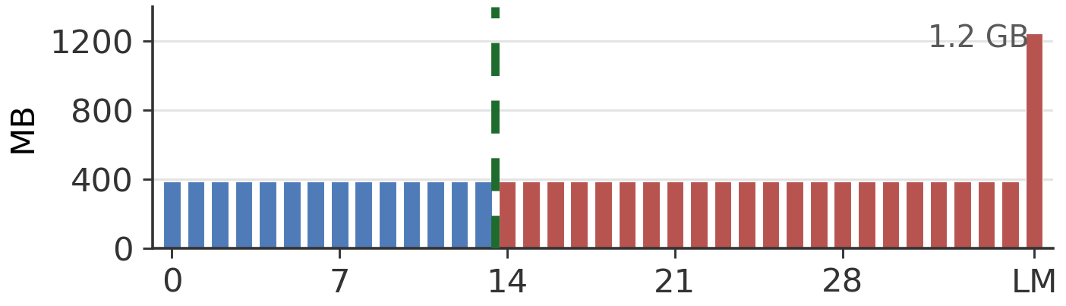
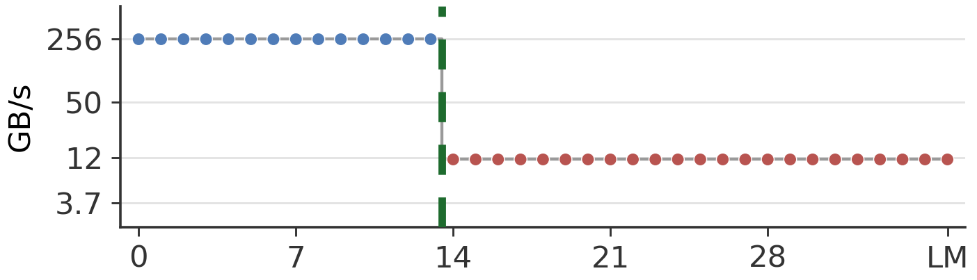
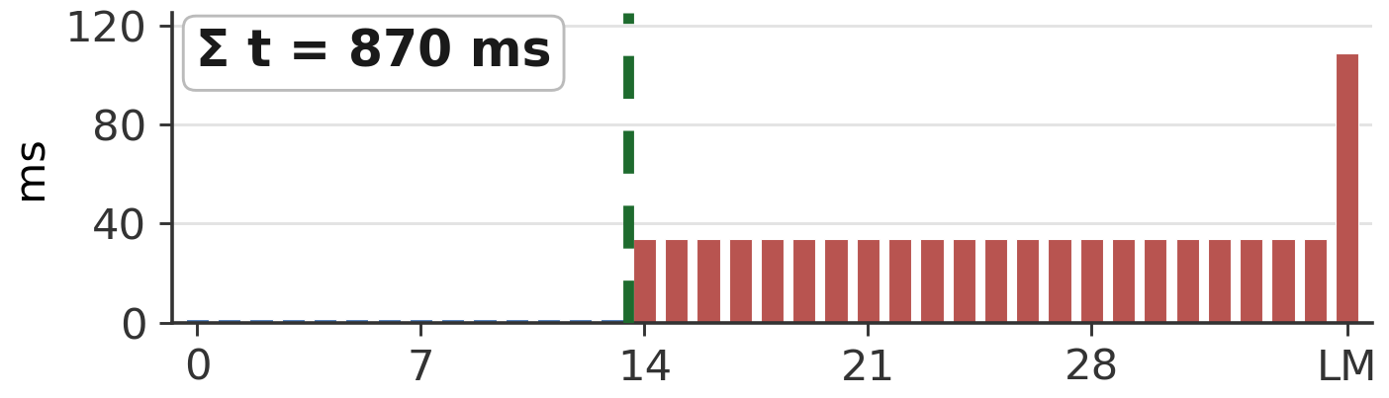
Motivation: runtime offloading re-sends 9.7 GB over PCIe for every token
One decode token · Qwen3-8B on the 8 GB laptop · Accelerate’s plan
HF Accelerate (simplified)
device_map = "auto" # GPU first
def pre_forward(layer, x):
layer.to("cuda") # 386 MB
def post_forward(layer, y):
layer.to("cpu") # evict
weight bytes
W_{i}
÷
GPU-resident layers
streamed from CPU
bandwidth used
B_{i}
Placement fixed greedily at load time
22 layers + LM head cross PCIe every token
=
0.87 s modeled · 1.21 s measured
time per layer
t_{i} = W_{i} / B_{i}
But W_{i} and B_{i} are static: known before the first token.
5
Notes:
[2:40–3:40]
Let me make this concrete with our running example, Qwen3-8B on the laptop, under Accelerate's plan.
Top: the bytes of each layer. 36 decoder layers of 386 MB each and a 1.2 GB LM head. Accelerate fills the GPU first, 14 layers in blue, and offloads the rest, in red. The green dashed line is the split.
Middle: the bandwidth each layer is read at. GPU layers read from VRAM at about 256 GB/s. But the offloaded layers are copied over PCIe on every token by a pre-forward hook, so they run at PCIe speed, about 12 GB/s.
Bottom: divide one by the other and you get time per layer. The red layers dominate: summed over the token, the model predicts 0.87 seconds, and we measure 1.2 seconds per token.
The key point is lost information: this placement is fixed greedily at load time, and 9.7 GB crosses PCIe every single token. But none of these quantities change at runtime. The layer sizes and the bandwidths are static, known before the first token. That's what a compiler can exploit.
(The bandwidth values are cost-model inputs for this laptop; the 1.21 s is measured p50.)

Slide 6
HELM decides placement at compile time and executes static graphs at run time
HELM compiler · offline, before the first token
PyTorch
model
1
2
3
Trace & annotate
torch.fx → HELM IR
FLOPs, bytes, activations
Cost model & search
roofline per layer
→ best split k*
Static per-device graphs
CPU graph (AVX2+F16C)
GPU graph
HW profile: bandwidth + FLOPS
deploy
HELM runtime · every token
CPU stage
layers 0 … k*−1
weights pinned in DRAM
GPU stage
layers k* … L−1
weights pinned in VRAM
4
activation only
2H bytes / token
Paged KV cache
streaming attention
evict / prefetch pages
6
Notes:
[3:40–4:25]
Here is HELM end to end. The top half runs once, offline, before the first token.
Step 1: we trace the PyTorch model with torch.fx and annotate every node with FLOPs, weight bytes, and activation size, without loading weights.
Step 2: a roofline cost model, fed by a short hardware profile, scores every possible CPU-GPU split and picks the best one, k-star.
Step 3: we rebuild the graph into two static per-device graphs, a CPU graph with our AVX2 kernel patched in and a GPU graph.
The bottom half is the runtime. Layers 0 to k-star minus 1 run on the CPU with weights pinned in DRAM, the rest run on the GPU with weights pinned in VRAM, and the only thing crossing PCIe is one activation vector, 2H bytes per token.
Step 4, a paged KV cache with streaming attention, takes care of context length. I'll go through the four steps in order.

Slide 7
Example: HELM compilation flow (1) · trace and annotate
1 Trace & annotate
2 Cost model & search
3 Static graphs + AVX2
4 Paged KV runtime
embed_tokens
PyTorch (HF Qwen3, one line of Qwen3Attention)
decoder layer × 36
self.q_proj = nn.Linear(4096, 32 * 128, bias=False)
input_layernorm
torch.fx trace (no weights loaded)
k_proj
v_proj
q_proj
torch.fx graph
attention (softmax(QKᵀ)V)
%q_proj : call_module[layers.0.self_attn.q_proj]
(args = (%hidden_states,))
o_proj
post_attention_layernorm
compute-analysis pass
gate_proj
up_proj
HELM IR
SiLU(gate) · up
%q_proj = call_module[layers.0.self_attn.q_proj]
shape=(1, 4096) dtype=f16
flops=33.6M bytes=33.6MB act=8KB
device=? # decided in step 2
down_proj
norm → lm_head
has weights
no weights
7
Notes:
[4:25–5:20]
Now let's follow the running example through the HELM compiler, step by step.
On the left is the graph of Qwen3-8B: an embedding, 36 identical decoder layers, and the LM head. Blue boxes carry weights; grey ones don't.
Take one node, the query projection. In PyTorch it's one line: a 4096 by 4096 linear layer.
We trace the model with torch.fx using a dummy input built from the config, so no weights are loaded, and we get the graph node on the right.
A compute-analysis pass then annotates every node, and this is HELM IR: output shape, dtype, 33.6 MFLOPs, 33.6 MB of weights, and an 8 KB output activation, which is what would cross PCIe if we cut the graph here. The device field is still empty; that's step 2.
At startup HELM also runs a short hardware profile: CPU and GPU DRAM bandwidth, PCIe bandwidth, and effective FLOPS, using 64 MB buffers.

Slide 8
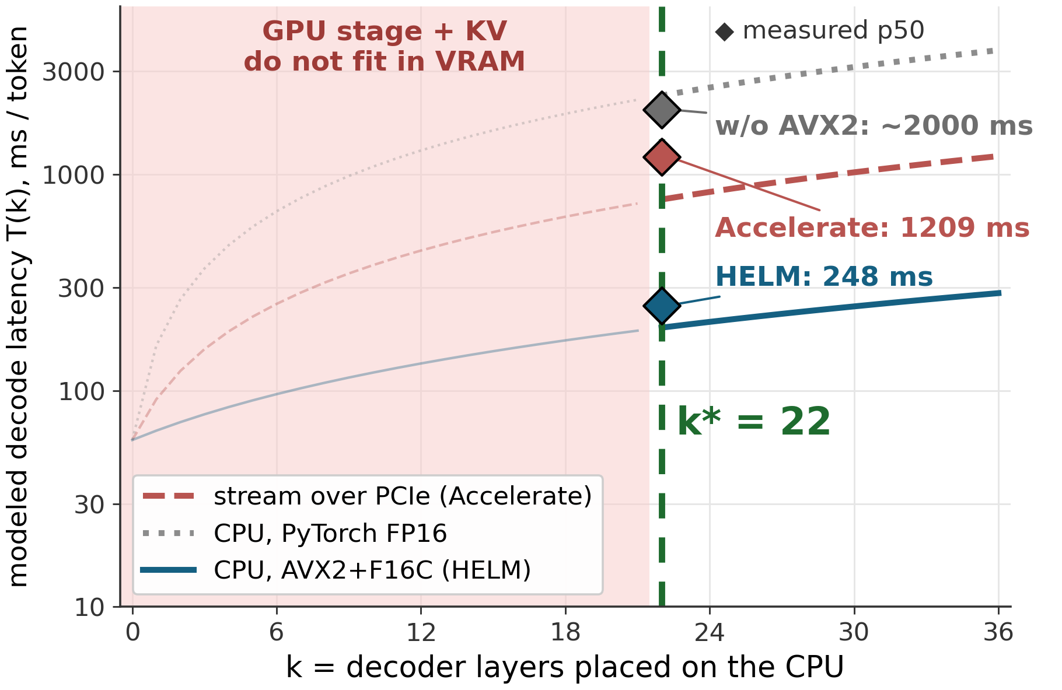
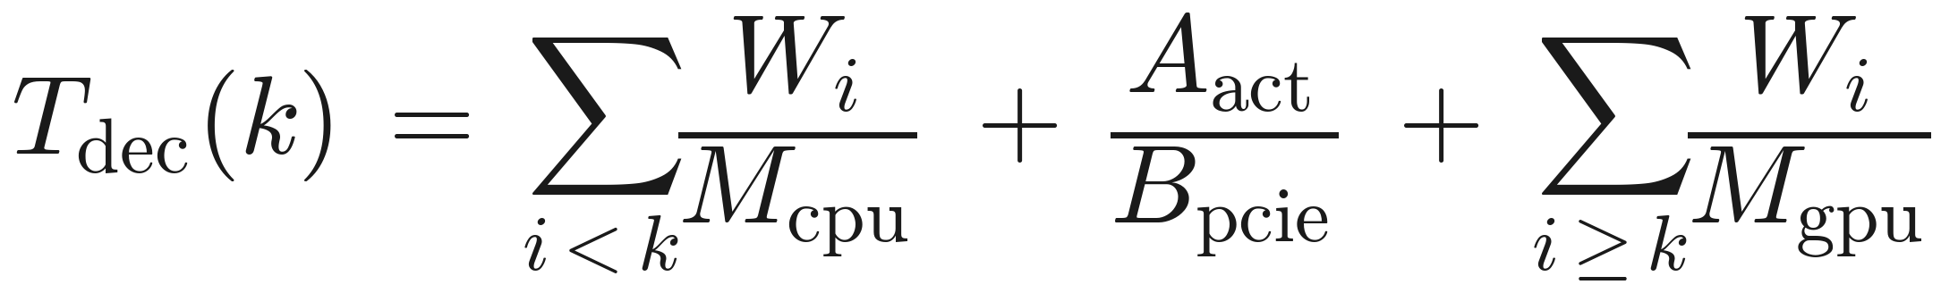
Example: HELM compilation flow (2) · score every split, pick k*
1 Trace & annotate
2 Cost model & search
3 Static graphs + AVX2
4 Paged KV runtime
Cost of a split k (decode)
Inputs for the laptop
W_{i} = 386 MB per layer (HELM IR)
M_{cpu} ≈ 50 GB/s (AVX2 GEMV)
M_{gpu} ≈ 256 GB/s
B_{pcie} ≈ 12 GB/s
VRAM for weights ≈ 6.8 GB
37 splits scored in < 1 ms
k* = fewest CPU layers that still fit: 22 of 36
Model tracks measurement: 196 ms modeled vs 248 ms measured
8
Notes:
[5:20–6:25]
Step 2 scores every possible split. k is the number of decoder layers we place on the CPU. For each k the cost model adds up CPU weight bytes over CPU bandwidth, one activation over PCIe, and GPU weight bytes over GPU bandwidth.
Everything left of k equals 22 is infeasible on this laptop: the GPU stage plus KV cache would not fit in 8 GB, so the search skips it. To the right, all three curves rise, because every extra CPU layer is slower than on the GPU. So k-star is the smallest feasible CPU stage, 22 of 36 layers. Scoring all 37 splits takes under a millisecond.
The three curves are three ways of handling those 22 layers. Streaming them over PCIe, the Accelerate strategy, is the red dashed line. Running them in place on the CPU with PyTorch's FP16 fallback is the grey dotted line, even worse. Running them in place with our AVX2 kernel is the blue line.
The diamonds are measured p50 latencies: 1209 ms for Accelerate, about 2 seconds without AVX2, and 248 ms for HELM. The model tracks the measurements, so the cost model is ranking plans correctly.

Slide 9
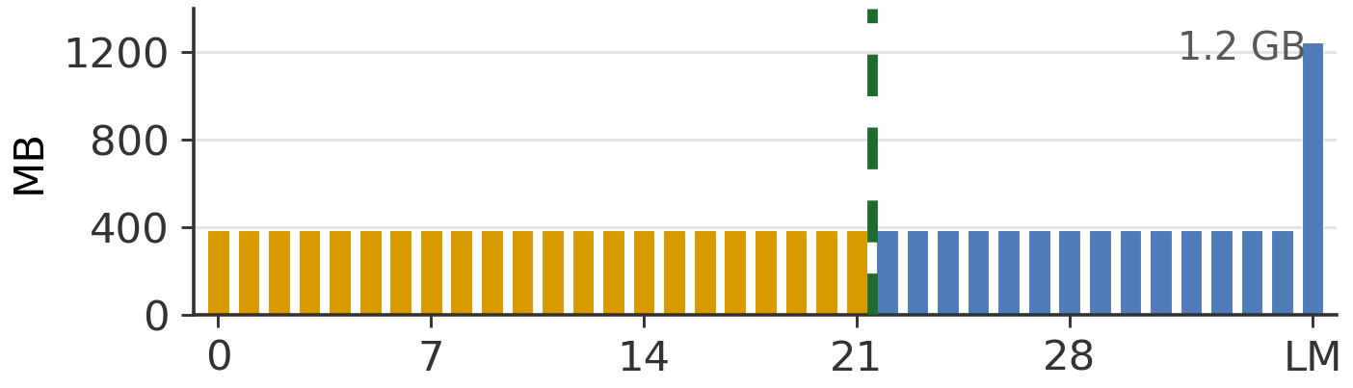
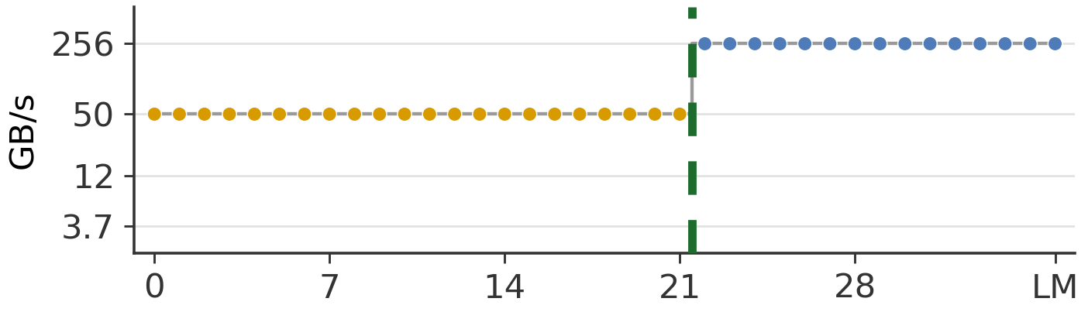
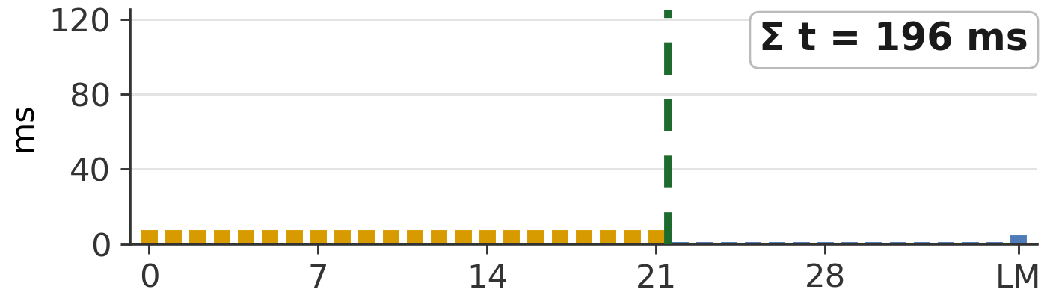
Example: HELM compilation flow (3) · 8 KB per token, not 9.7 GB
1 Trace & annotate
2 Cost model & search
3 Static graphs + AVX2
4 Paged KV runtime
One decode token · Qwen3-8B on the 8 GB laptop · HELM’s plan
CPU graph · layers 0–21 · weights in DRAM
%h = rms_norm(%x)
%q = gemv_avx2(%h, %W_q)
... # 22 layers
%a = %x22 # 8 KB
weight bytes
W_{i}
÷
PCIe: one activation / token
GPU graph · layers 22–35 + LM head · VRAM
bandwidth used
B_{i}
%g = to_cuda(%a)
%q = linear(%g, %W_q)
... # 14 layers
%logits = lm_head(%h)
=
time per layer
t_{i} = W_{i} / B_{i}
0.20 s modeled · 0.25 s measured
4.9× lower p50 latency than Accelerate on the same laptop
9
Notes:
[6:25–7:20]
Step 3 applies the plan. Same token, same three plots as before, but now with HELM's plan.
The first 22 layers are placed on the CPU, in orange, and their weights are loaded into DRAM once. The remaining 14 layers and the LM head go to the GPU, in blue, loaded into VRAM once.
Middle plot: CPU layers now run in place at DRAM bandwidth, about 50 GB/s, instead of being pulled across PCIe at 12.
Bottom plot: each CPU layer takes about 8 ms instead of 33, and the GPU layers are almost free. The token costs about 0.20 s in the model and 0.25 s measured.
On the right is what the compiler emits: two static graphs. The CPU graph calls our AVX2 GEMV; the GPU graph uses ordinary kernels. Between them, the only thing that crosses PCIe per token is one 4096-element activation, 8 KB, instead of 9.7 GB of weights. That is 4.9 times lower median latency than Accelerate on the same laptop.

Slide 10
The CPU stage only pays off with an AVX2+F16C GEMV kernel
1 Trace & annotate
2 Cost model & search
3 Static graphs + AVX2
4 Paged KV runtime
for (i = 0; i < M; i++) { // PyTorch FP16 on x86
float acc = 0;
for (j = 0; j < N; j++) // 1 weight / iteration
acc += half_to_float(W[i][j]) * x[j];
y[i] = acc;
}
Before: PyTorch fallback
scalar convert,
1 weight / iteration
3.7 GB/s
GEMV is bandwidth-bound: just stream W at DRAM speed
Without it: ~13× slower than modeled, wrong k*
HELM patches every CPU-stage GEMV at compile time (JIT-built, cached)
for (i = 0; i < M; i++) {
__m256 a0 = zero(), a1 = zero();
for (j = 0; j < N; j += 16) { // 16 fp16 = 256 bit
__m256i w = load256(&W[i][j]);
a0 = fma(cvtph(lo(w)), load(&x[j]), a0);
a1 = fma(cvtph(hi(w)), load(&x[j+8]), a1);
}
y[i] = hsum(a0 + a1);
}
After: HELM kernel
F16C convert + FMA,
16 weights / iteration
~50 GB/s
fma = _mm256_fmadd_ps
cvtph = _mm256_cvtph_ps (F16C)
loop shown schematically
10
Notes:
[7:20–8:05]
There is one catch that makes the CPU stage work. PyTorch has no FP16 GEMV kernel for x86. It falls back to a loop that converts and multiplies one weight at a time and reaches about 3.7 GB/s, far from the DRAM ceiling.
HELM patches every CPU-stage GEMV at compile time with a small AVX2 plus F16C kernel. Each iteration loads 16 FP16 weights, 256 bits, converts them to FP32 with the F16C instruction, and accumulates with fused multiply-add. That reaches about 50 GB/s, the practical DRAM ceiling. It's JIT-compiled on first use and cached.
For us this is also a correctness requirement: without it the CPU stage runs about 13 times slower than the cost model assumes, and k-star would be wrong. That was the grey curve on the previous plot.

Slide 11
A paged KV cache with streaming attention bounds context by host RAM, not VRAM
1 Trace & annotate
2 Cost model & search
3 Static graphs + AVX2
4 Paged KV runtime
GPU VRAM · KV pages
Streaming paged attention for one query token q
m, l, o = -inf, 0, 0
for p in page_table[seq]: # pages in VRAM or DRAM
K, V = fetch(p) # prefetch if evicted
s = q @ K.T / sqrt(d)
m2 = max(m, s.max())
l = l * exp(m - m2) + exp(s - m2).sum()
o = o * exp(m - m2) + exp(s - m2) @ V
m = m2
out = o / l # exact softmax(qK^T)V
80% watermark
evict LRU
prefetch
Host DRAM · evicted pages
VRAM per step stays constant
context grows into host RAM
Freed VRAM
room for concurrent requests
KV fits in VRAM: one contiguous attention call, zero overhead
11
Notes:
[8:05–8:55]
Step 4 is about the other half of memory: the KV cache, which grows with context.
The KV cache is split into fixed-size pages tracked in a page table. When VRAM crosses an 80 percent watermark, the least recently used pages are evicted to host RAM, and pages are prefetched back when needed.
Attention then runs page by page with online softmax, on the right: for each page we compute the scores, keep a running max, a running sum and a running output, and rescale them as each page arrives. The result is exactly softmax of q K-transpose times V, but the VRAM needed per step stays constant however long the context is.
And if the KV cache fits, HELM skips all of this and does one contiguous attention call, so there is no overhead on large GPUs.

Slide 12



Evaluation: 3 platforms × 4 models × 3 baselines, all FP16
RTX 4060 Laptop
RTX 3090
NVIDIA L40S
laptop / edge
workstation
datacenter
8 GB VRAM
24 GB VRAM
48 GB VRAM
Intel i7-13700H · 16 GB DRAM
AMD EPYC 7H12 · 125 GB DRAM
AMD EPYC 7413 · 60 GB DRAM
Models
Qwen3-4B · ~8 GB
Qwen3-8B · ~16 GB
Qwen3-14B · ~28 GB
Qwen3-32B · ~64 GB
Baselines
vLLM
HF Accelerate
DeepSpeed
Metrics
decode tok/s
p50 per-token latency
max context
batched throughput
12
Notes:
[8:55–9:15]
We evaluate on three platforms that span the range: an RTX 4060 laptop with 8 GB of VRAM, an RTX 3090 workstation with 24 GB, and an L40S server with 48 GB.
Four Qwen3 models from 4B to 32B, all in FP16, so no quantization. Baselines are vLLM, Hugging Face Accelerate, and DeepSpeed. We report decode throughput, per-token latency, maximum context, and batched throughput.

Slide 13
HELM runs every feasible configuration, up to 5.1× faster where memory is tight
GPU | Model | HELM | Accelerate | DeepSpeed | vLLM
RTX 4060 8 GB | Qwen3-4B | 17.2 (2.6×) | 6.7 | OOM | OOM
 | Qwen3-8B | 4.1 (5.1×) | 0.8 | OOM | OOM
 | Qwen3-14B | exceeds CPU + GPU memory
 | Qwen3-32B | exceeds CPU + GPU memory
RTX 3090 24 GB | Qwen3-4B | 27.1 | 26.6 | 24.3 | 86.0
 | Qwen3-8B | 22.9 | 23.3 | 23.8 | 50.6
 | Qwen3-14B | 6.1 (4.7×) | 1.3 | OOM | OOM
 | Qwen3-32B | 1.2 (only) | OOM | OOM | OOM
L40S 48 GB | Qwen3-4B | 27.1 | 23.9 | 25.8 | 79.4
 | Qwen3-8B | 25.1 | 23.3 | 24.3 | 46.7
 | Qwen3-14B | 20.7 | 21.2 | 20.3 | 26.3
 | Qwen3-32B | 1.1 (2.2×) | 0.5 | OOM | OOM
10 / 10
feasible configurations run; HELM is the only system that runs them all
5.1×
max speedup (4060, Qwen3-8B)
3.6×
mean speedup on memory-constrained configurations
When the whole model fits in VRAM, vLLM’s serving kernels are faster; HELM targets the regime where GPU-only systems OOM.
Decode tok/s, batch 1. (×) = speedup over the best baseline that runs.
13
Notes:
[9:15–10:15]
Here is decode throughput across all twelve combinations. Two rows are grey: 14B and 32B on the 4060 laptop need more memory than CPU and GPU have combined, so no system can run them. That leaves ten feasible configurations, and HELM is the only system that runs all ten.
Where memory is tight, the gap is large. Our running example, Qwen3-8B on the 4060: 4.1 versus 0.8 tokens per second, 5.1x. Qwen3-14B on the 3090: 4.7x. Qwen3-32B on the 3090: every baseline runs out of memory and HELM runs. Averaged over the memory-constrained configurations the speedup is 3.6x.
To be upfront about the top rows: when the whole model fits in VRAM, vLLM's optimized serving kernels are faster than any of the offloading systems, including ours. HELM's GPU stage uses stock PyTorch kernels. HELM targets the regime where GPU-only systems can't run at all.

Slide 14
In-place CPU execution and the AVX2 kernel drive the speedup
Compute CPU layers in place: 2.3–4.9× lower p50 latency
Fast CPU stage: up to 12×, growing with CPU layers
14
Notes:
[10:15–10:55]
Where does the speed come from? Two things, and you need both.
Left: median per-token latency against Accelerate on the memory-constrained configurations. Accelerate streams its CPU layers over PCIe every token; HELM computes them in place under a cost-model plan. That gives 2.3 to 4.9x lower p50 latency across configurations, not just on the laptop.
Right: the same HELM plan with and without our AVX2 kernel. The benefit grows with the number of CPU layers: 2.3x on 4B on the laptop, 8.2x on 8B, and 12x on the 32B model on the 3090, where 43 layers run on the CPU. Without the kernel the right partition is not enough.

Slide 15
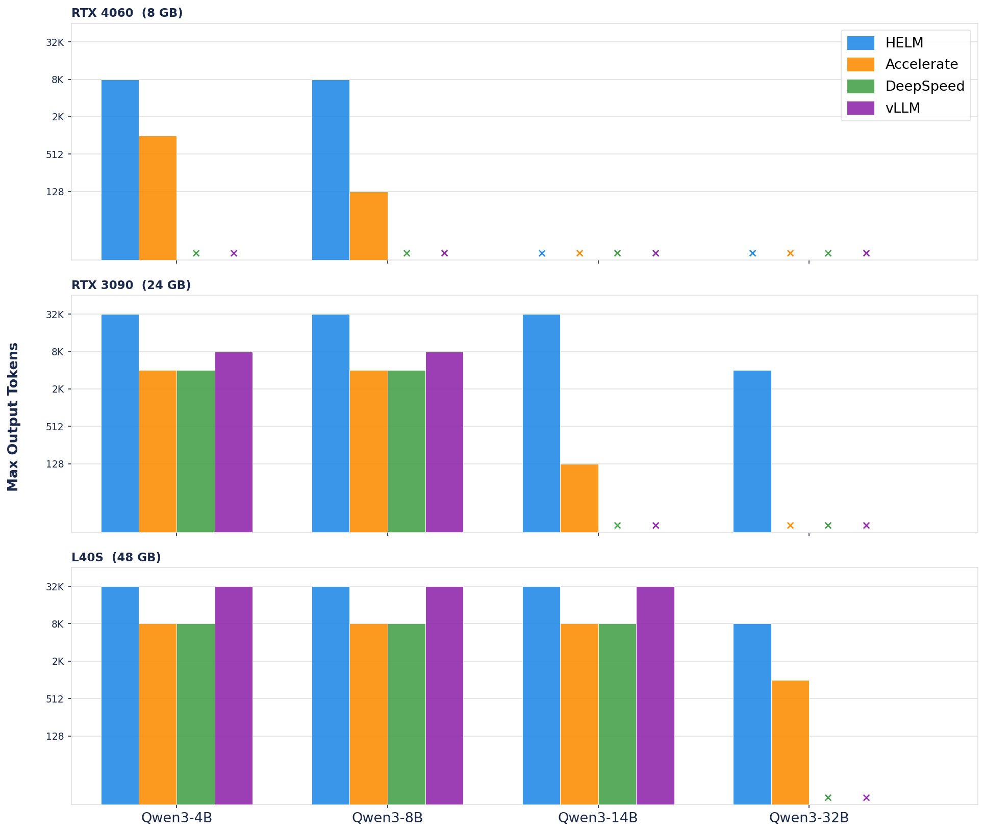
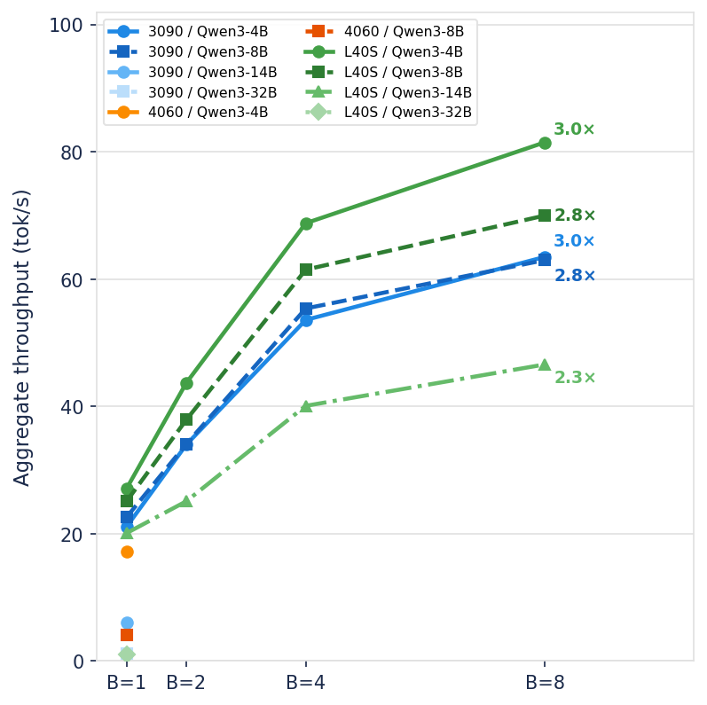
Paging the KV cache extends context and enables batching
64× longer context than Accelerate
(4060, Qwen3-8B: 8K vs 128 tokens); full 32K on the 3090
3.0× aggregate throughput at batch 8
when all layers fit in VRAM
15
Notes:
[10:55–11:30]
Finally, the paged KV cache. On the left is the maximum context each system reaches before running out of memory; x marks mean it can't run at all. GPU-only systems are capped by whatever VRAM is left after the weights. HELM pages KV to host RAM, so on the 4060 with Qwen3-8B it reaches 8K tokens versus 128 for Accelerate, 64x, and on the 3090 it reaches the full native 32K window for the 4B, 8B and 14B models.
On the right: because the KV cache no longer pins VRAM, there is room for concurrent requests, and throughput scales to 3x at batch size 8 when all layers fit on the GPU.

Slide 16
HELM turns the GPU memory wall into a compile-time placement problem
1
Decide once
roofline cost model + O(L) search pick the CPU–GPU split before the first token
10 / 10
feasible configs run; no other system runs all
2
Never move weights
static per-device graphs; only a 2H-byte activation crosses PCIe
5.1× / 3.6×
max / mean decode speedup
3
Make the CPU count
AVX2+F16C GEMV runs at DRAM bandwidth (~50 vs 3.7 GB/s)
4.9×
lower p50 per-token latency
4
Page the KV cache
context length bounded by host RAM, not VRAM
64×
longer context on a laptop GPU
Questions?
Atharva Khedkar · Shashwat Pandey · Aviral Shrivastava
Arizona State University
16
Notes:
[11:30–12:10]
To wrap up. HELM treats CPU-GPU inference as a compile-time problem. It decides the split once with a roofline cost model and an exhaustive search, it never moves a weight after startup, it makes the CPU stage actually run at DRAM bandwidth, and it pages the KV cache so context is bounded by host RAM.
The result: it's the only system that runs all ten feasible configurations, up to 5.1x and on average 3.6x faster where memory is tight, 4.9x lower latency, and 64x longer context on a laptop GPU. All in FP16, with no quantization and no extra hardware.
Thank you, I'm happy to take questions.

Slide 17
Backup
17

Slide 18
When the model fits in VRAM, vLLM is fastest; HELM matches the offloading systems
HELM’s GPU stage runs stock PyTorch kernels; vLLM uses optimized serving kernels.
Among systems that can offload, HELM is on par when nothing needs to be offloaded.
HELM’s contribution is the placement: it applies exactly where vLLM cannot load the model.
Running HELM’s plan on an optimized GPU backend is a natural next step.
18
Notes:
If asked why vLLM is 2-3x faster on the small models: vLLM has heavily optimized serving kernels; our GPU stage is stock PyTorch. HELM is about placement when the model does not fit; the plan is orthogonal to the GPU kernel library.

Slide 19

Full cost model: decode picks k*, prefill reuses it
Per-layer roofline cost
Decode (batch 1, AI = 1: bandwidth-bound everywhere)
Prefill (batch T: GPU GEMM becomes compute-bound)
F_i, W_i, A_act from HELM IR; P, M, B_pcie measured at startup. k* minimizes decode cost (decode dominates generation time) and is reused for prefill.
19
Notes:
Backup for questions on prefill or on why the split is chosen on decode cost.

Slide 20



HELM opens several directions for heterogeneous inference
Multi-device topologies
extend the partition search to multi-GPU and heterogeneous device chains
Quantized execution
INT4 / INT8 paths (bitsandbytes, AWQ, GGUF) in the same cost model
Mixture-of-Experts
place sparse experts across CPU and GPU
Vision-language models
add the vision encoder to the partitioned graph
20
Notes:
Future work, for Q&A.

