Slide 1
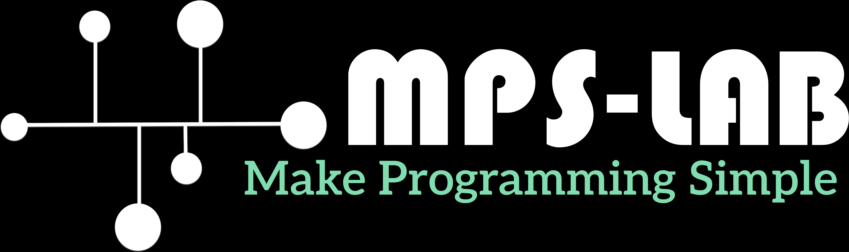

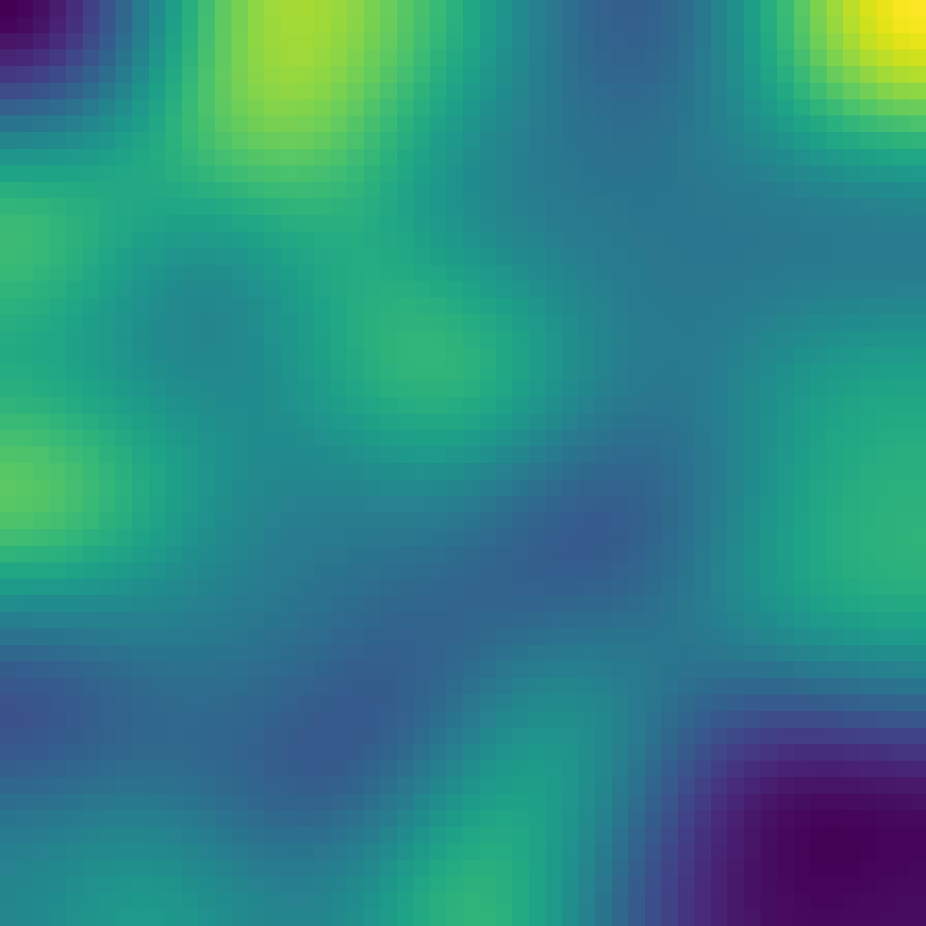
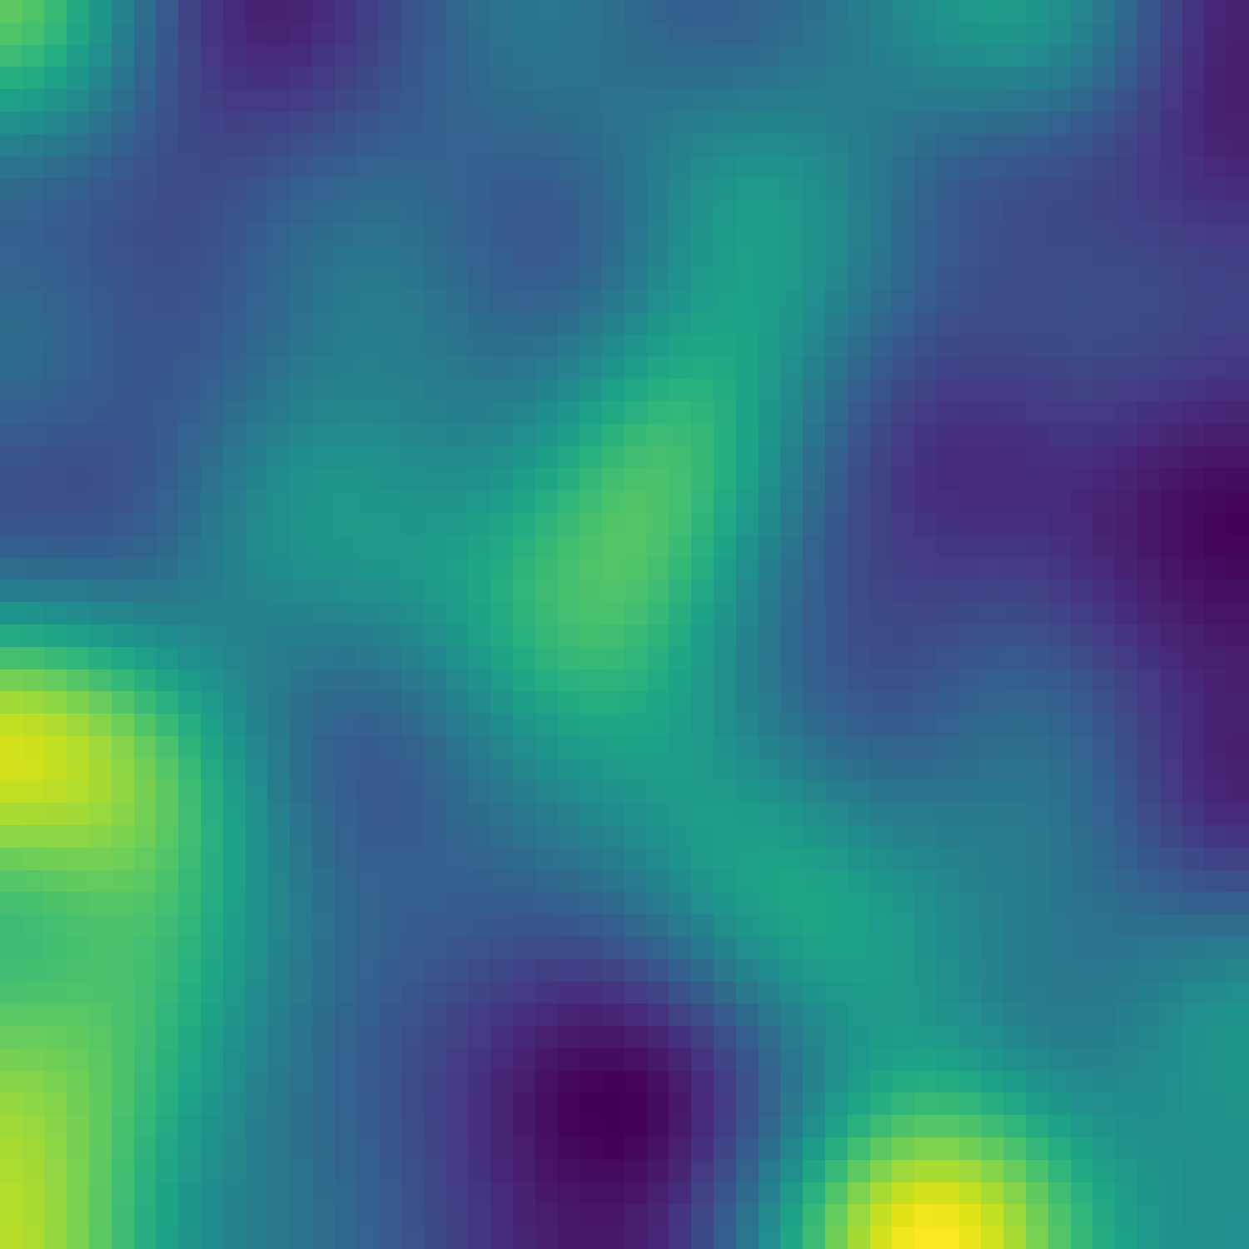
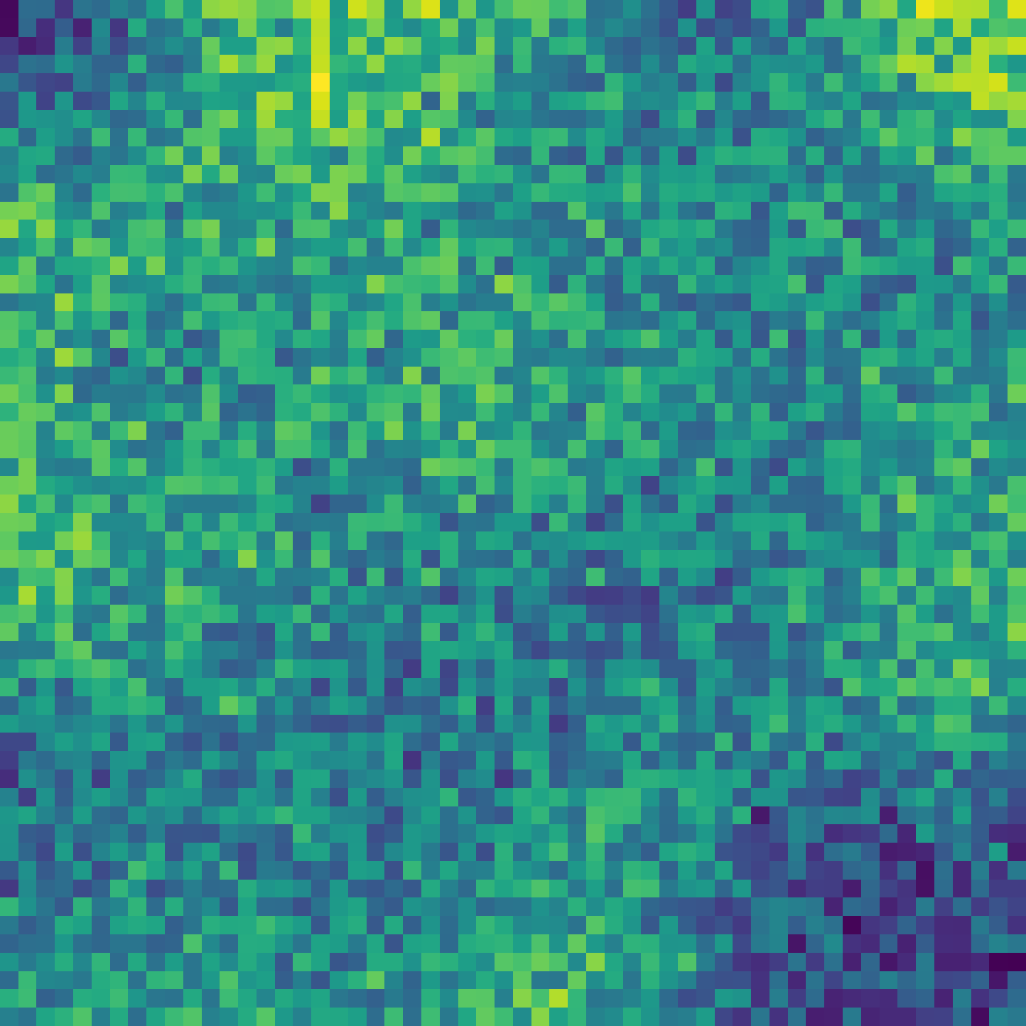
Viyog
Separating Adversarial
and Out-of-Distribution
ID · smooth
OOD · smooth
A first-layer roughness score that tells attacks apart from natural distribution shift
Aman Singh¹, Abhinav Kumar¹, Rishab Kashyap¹, Soyeong Park¹, Ameya Gurjar¹,
Yohan Ko², Hwisoo So³, Uiwon Hwang⁴, Kyoungwoo Lee², Aviral Shrivastava¹
ADV · rough
¹Arizona State University ²Yonsei University ³Kyungpook National University ⁴Ewha Womans University
Notes:
Open with the systems problem, not the formula. The one thing to remember: abnormal inputs should not all get the same response. Viyog reads first-layer dormant-channel roughness to tell an attack from a natural distribution shift, without retraining and without an extra forward pass.

Slide 2






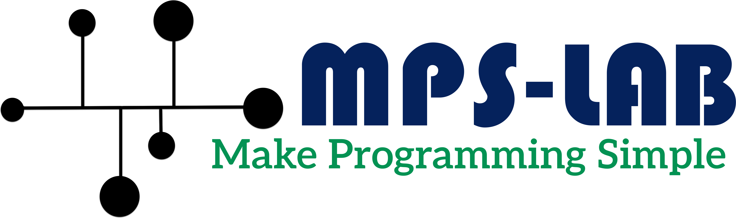
THE PROBLEM
Abnormal inputs need different responses, not one score
ID
Pass to the classifier
The gap
Most lightweight anomaly detectors return one score. They flag "unusual" without saying whether the input is a natural shift or an attack.
OOD
Abstain · flag for review
Input
Classifier
normal, shifted or attacked
can be confident for all three
ADV
Reject · raise a security alert
Viyog's job: split the non-ID pool into OOD (abstain) versus ADV (reject), cheaply and without retraining the model.
Viyog: Separating Adversarial and Out-of-Distribution
2
Notes:
Emphasize response semantics. An out-of-distribution input is not malicious: the right move is to abstain or ask for review. An adversarial input is a security event: reject and alert. The classifier can be confident in all three cases, and most lightweight detectors only say 'unusual'. Viyog's job is the missing split: OOD versus ADV.

Slide 3
WHY NOT CONFIDENCE?
Output confidence barely separates attacks from clean inputs
0.659
best T2 AUROC of any confidence score
5 of 6
logit scores flip direction across architectures on T2: no fixed threshold works
Attacks are built to be confidently wrong, so output confidence looks normal. The signal has to come from somewhere else.
Viyog: Separating Adversarial and Out-of-Distribution
3
Notes:
Held-out ID-versus-ADV AUROC on the 17-architecture CIFAR-100 panel. Every confidence or logit score sits between 0.60 and 0.66, barely above chance. Worse, five of the six flip direction across architectures, so no single threshold works. The raw first-conv magnitude is essentially chance. Attacks are built to be confidently wrong, so confidence looks normal.

Slide 4
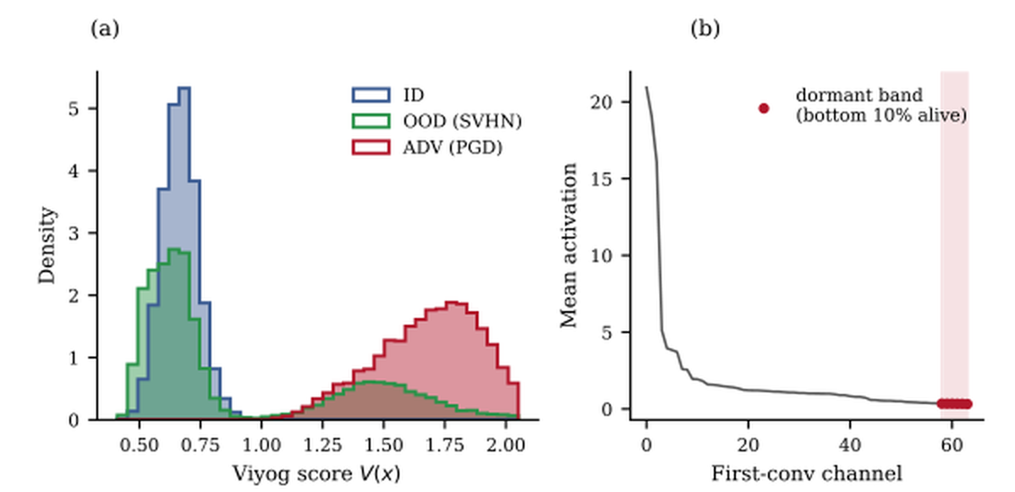



KEY OBSERVATION
Adversarial perturbations make dormant first-layer channels rough
ID and OOD stay smooth
Natural images are low-frequency, so first-layer maps inherit that smoothness.
ADV turns rough
L∞ perturbations are broadband and leave a jagged, high-frequency residue.
Quiet channels amplify it
In the dormant band the clean signal is tiny, so the residue dominates.
From the paper: (a) Viyog score for ID, OOD (SVHN) and ADV (PGD); (b) first-conv channels ranked by mean ID activation, dormant band shaded.
Measure shape, not magnitude.
Viyog: Separating Adversarial and Out-of-Distribution
4
Notes:
Left: the distribution of the Viyog score for ID, OOD and PGD inputs. ID and OOD pile up low; adversarial inputs shift high. Right: first-conv channels ranked by mean ID activation; the dormant band is the quietest 10 percent of alive channels. Intuition: natural images are low-frequency, so first-layer maps are smooth. L-infinity perturbations are broadband and leave rough residue, and in quiet channels that residue dominates. Keep claims to the evaluated datasets and threat model.

Slide 5


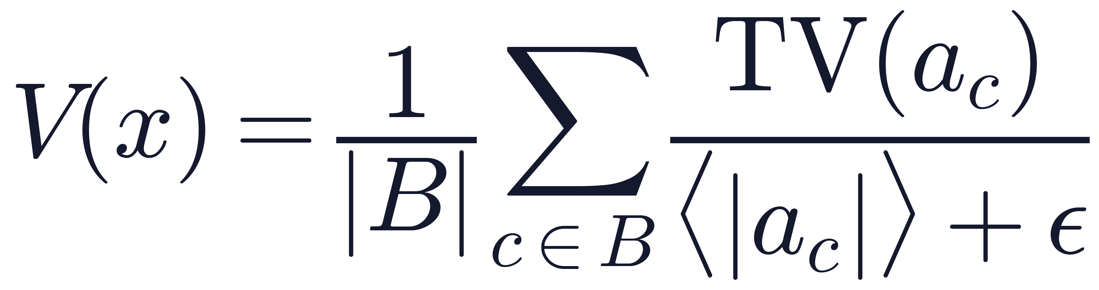

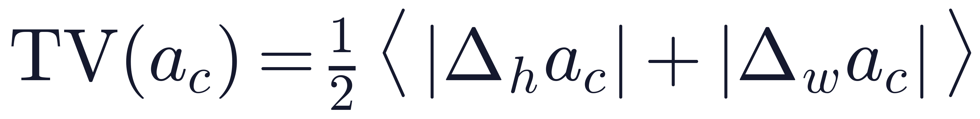


METHOD
Viyog reads dormant-band roughness in one forward pass
1
2
3
4
5
Hook first conv
Select band B
Measure roughness
Normalize & score
Route
Read a = f₀(x) from the forward pass you already run
Quietest 10% of alive channels, fixed on ID calibration
Total variation of each map in B
Divide by mean activation; average over B
V(x) > τ → ADV (reject), else OOD (abstain)
No retraining, no gradients calibration fixes the band, polarity and threshold once
No extra forward pass a hook on the first conv layer
O(C) state about 0.3 KB for 64 channels
Scale-invariant rescaling a channel map leaves V unchanged
B = dormant band · ⟨·⟩ = spatial mean · ε = 10⁻⁶
Viyog: Separating Adversarial and Out-of-Distribution
5
Notes:
Keep the math to about thirty seconds. B is the dormant band: the quietest 10 percent of alive first-conv channels, chosen once on ID calibration data. For each channel we take total variation, the mean pixel-to-pixel jump, and divide by the channel's mean activation, which removes magnitude. Average over B, compare to a threshold fit on calibration, and route. No gradients, no retraining, and the only state is a per-channel profile.

Slide 6

EVALUATION
Held-out evaluation across architectures, attacks and datasets
17
4
2 + 4
20 / 80
architectures
L∞ attacks
datasets
calibration / test
CNN, ViT and hybrid backbones, ImageNet-pretrained
FGSM, BIM, PGD, APGD-CE at ε = 8/255
ID: CIFAR-100, GTSRB · OOD: SVHN, iSUN, LSUN, Places365
thresholds frozen before test
T1
ID vs OOD
T2
ID vs ADV
T3
OOD vs ADV
Distribution-shift detection. Logit scores' home turf.
Attack detection. The security question.
The routing decision: abstain or reject?
Everything is fit on the calibration split and frozen before test: no test-set tuning, no oracle direction.
Viyog: Separating Adversarial and Out-of-Distribution
6
Notes:
Do not list all 17 architectures. The points are breadth, from ResNets to ViT and Swin, and protocol: the band, polarity and threshold are fit on a 20 percent calibration split and frozen before the 80 percent test split. Three tasks: T1 is ordinary OOD detection, T2 is attack detection, and T3, OOD versus ADV, is the routing decision Viyog is built for.

Slide 7
MAIN RESULT
First-layer shape detects attacks where confidence scores fail
0.980
T2 AUROC · ID vs ADV
best confidence score: 0.659
0.844
T3 AUROC · OOD vs ADV
best logit score (GEN): 0.812
Logit scores still win T1 (about 0.86 vs 0.66). Viyog is a complement to them, not a replacement.
Viyog: Separating Adversarial and Out-of-Distribution
7
Notes:
This is the central slide; pause here. On T2, Viyog reaches 0.980 held-out AUROC; the best confidence score reaches 0.659. On T3, the routing task, Viyog reaches 0.844, ahead of the best logit score, GEN, at 0.812. Be upfront that logit scores win T1, plain OOD detection, around 0.86 versus 0.66. That is the point of the next slide: the two signals are complementary.

Slide 8

THREE-WAY ROUTING
Logit scores catch OOD; Viyog catches ADV
Two-stage cascade at 5% ID false-positive rate
Logit score
ADV recall
e.g. Energy · strong on OOD
ID · OOD · ADV
one routing decision
Energy only
0.157
+ Viyog
0.834
Viyog V(x)
OOD recall
first-layer shape · strong on ADV
Energy only
0.343
+ Viyog
0.424
ID→ADV mis-escalation: 0.002 → 0.000
0.798
0.863
0.758 / 0.768
3-way balanced accuracy
3-way balanced accuracy
logit + Viyog only
CIFAR-100, full detector panel
GTSRB, full detector panel
CIFAR-100 / GTSRB, no retraining
Viyog: Separating Adversarial and Out-of-Distribution
8
Notes:
The message is complementarity. A logit score such as Energy is strong on OOD and blind to confident adversarial inputs; Viyog is the opposite. As a two-stage cascade at a 5 percent ID false-positive rate, adding Viyog raises ADV recall from 0.157 to 0.834 and OOD recall from 0.343 to 0.424, and ID-to-ADV mis-escalation drops from 0.002 to zero. As a three-way classifier, the full detector panel reaches balanced accuracy 0.798 on CIFAR-100 and 0.863 on GTSRB; the logit plus Viyog pair alone gets 0.758 and 0.768.

Slide 9
WHY THE FIRST LAYER?
The most discriminative layer is also the cheapest to read
Mean T2 AUROC, depth sweep (6 architectures × 2 attacks)
Why shape works early
Shape V(x) · first conv
0.965
Normalizing total variation by mean activation cancels magnitude: the score depends on the map's shape only.
Raw magnitude only becomes informative deep in the network; shape is strongest at the very first conv.
Reading the first conv means the detector adds almost no work to inference.
Raw ‖a‖∞ · first conv
0.52
Raw ‖a‖∞ · best layer (depth 6)
0.80
Shape beats the best raw-norm layer at every depth.
Viyog: Separating Adversarial and Out-of-Distribution
9
Notes:
Depth sweep over 6 architectures and 2 attacks. The shape statistic peaks at the first conv, with mean T2 AUROC 0.965, and decays with depth. Raw L-infinity magnitude is the opposite: weakest at the first conv, 0.52, and only reaching 0.80 at depth 6. Shape beats the best raw-norm layer at every depth. The reason shape works early: normalizing total variation by mean activation makes the statistic scale-invariant, so an attacker cannot hide by shrinking magnitude. Systems angle: the signal is read before any expensive deep features.

Slide 10
EFFICIENCY
Low overhead, minimal state, no training
Standalone score-path latency, ms per image (log scale, H200)
~0.3 KB
2.28%
Viyog
0.05
stored state (64 channels)
of CNN MACs
Energy
0.39
vs 4.5–40 MB for feature-distance baselines
exact MAC fraction added to inference
MSP
0.39
ViM
0.41
3.9%
0.05 ms
Mahalanobis
0.83
ODIN
1.29
latency overhead
score path per image
measured, H200, batch 1
standalone, H200
KNN
5.14
MCD (30 passes)
13.91
Viyog: Separating Adversarial and Out-of-Distribution
10
Notes:
Viyog's stored state is a per-channel profile, about 0.3 KB at 64 channels, against 4.5 to 40 MB for feature-distance baselines like Mahalanobis and KNN. In full inference it adds 2.28 percent of a CNN's MACs and 3.9 percent measured latency on an H200 at batch 1. The standalone score path is 0.05 ms per image, the fastest of the detectors compared. Edge energy numbers in the paper are roofline projections, not measurements, so I don't claim them here.

Slide 11
ROBUSTNESS AND LIMITS
A useful low-cost signal, not a robustness certificate
Adaptive attacks (evaluated)
Limits we state explicitly
0%
evasion by a norm-aware attacker that targets the magnitude score
Theory
Conditional bound for affine pre-activations; post-ReLU/GELU behavior is empirical.
Threat model
Four digital L∞ attacks at ε = 8/255; finite adaptive sweeps.
+8%
more attack success for an attacker aware of both signals
Accuracy
T3 FPR@95TPR is 37.4%; OOD recall is not solved by Viyog alone.
Hardware
H200 latency measured; edge energy projected, not measured on device.
We do not claim standalone deployment readiness.
Viyog: Separating Adversarial and Out-of-Distribution
11
Notes:
This slide builds credibility. An attacker who targets only the magnitude-based score is caught every time in our measurements: 0 percent evasion. An attacker aware of both the shape and high-frequency signals succeeds only 8 percent more often. These are evaluated configurations, not a worst-case proof. Then state the limits plainly: the theory covers affine pre-activations, the threat model is four L-infinity attacks, T3 FPR at 95 percent TPR is still 37.4 percent, and edge energy is projected. We do not claim standalone deployment readiness.

Slide 12


Takeaways
1
Signal
Adversarial perturbations make dormant first-layer channels unusually rough; natural shift does not.
2
Method
Normalized total variation reads that shape with no retraining, no gradients and ~0.3 KB of state.
Paper
Live demo
$ pip install viyog
3
System
Paired with a logit score, Viyog routes ID / OOD / ADV at 2.28% of CNN MACs.
Questions?
Notes:
Close quickly and leave time for questions. Three things: the signal, dormant-channel roughness; the method, normalized total variation with O(C) state and no retraining; and the system result, low-overhead three-way routing when paired with a logit score. The QR codes link to the paper and the live demo.

Slide 13
BACKUP
Calibration and inference rule
Calibration · once per model
Inference · per sample
1
Compute per-channel mean ID activation on the calibration split
1
Hook the first conv activation a = f₀(x) during the normal forward pass
2
Drop permanently silent (dead) channels
2
Compute s = average over c ∈ B of TV(a꜀) / (⟨|a꜀|⟩ + ε)
3
Dormant band B = quietest 10% of the remaining alive channels
3
If d · s > τ: ADV → reject / alert
4
Fit polarity d ∈ {−1, +1} and threshold τ on labeled calibration data
4
Otherwise: OOD → abstain / fall back
Optional: a linear discriminant head over [logit score, V(x), …] fit on the calibration split gives the three-class ID / OOD / ADV classifier.
Viyog: Separating Adversarial and Out-of-Distribution
13
Notes:
Use if asked exactly what is fit. Only the channel profile, the dormant band, a polarity and a threshold, all on the calibration split. Optionally, a linear discriminant head over detector scores gives the three-class ID/OOD/ADV classifier.

Slide 14
BACKUP
Held-out results, 17-architecture CIFAR-100 panel
Method | T1 AUROC ↑ | T1 FPR95 ↓ | T2 AUROC ↑ | T2 FPR95 ↓ | T3 AUROC ↑ | T3 FPR95 ↓
Viyog (ours) | 0.663 | 96.5 | 0.980 | 4.9 | 0.844 | 37.4
Energy | 0.863 | 52.1 | 0.600 × | 98.0 | 0.790 | 80.5
MSP | 0.837 | 61.9 | 0.621 × | 98.4 | 0.796 | 79.1
MaxLogit | 0.864 | 52.5 | 0.599 × | 98.6 | 0.794 | 79.5
Entropy | 0.848 | 62.1 | 0.627 × | 98.7 | 0.803 | 77.0
GEN | 0.848 | 63.4 | 0.647 × | 98.6 | 0.812 | 75.6
KL-Match | 0.775 | 82.5 | 0.659 | 79.7 | 0.655 | 83.7
1st-conv ‖a‖∞ | 0.562 × | 98.1 | 0.515 × | 87.6 | 0.577 | 75.0
× = direction-inconsistent across architectures (unusable with a fixed threshold). FPR95 = false-positive rate (%) at 95% TPR. Thresholds and polarity fit on the 20% calibration split.
Viyog: Separating Adversarial and Out-of-Distribution
14
Notes:
Full table behind the main-result chart. The cross marks scores whose direction flips across architectures, so they cannot be deployed with one threshold. FPR is at 95 percent TPR; lower is better.

Slide 15
BACKUP
Current boundaries and follow-up work
Area | Current boundary | Follow-up
Theory | Conditional bound for affine pre-activations; post-ReLU/GELU hooks are empirical | Worst-case nonlinear analysis
Threat model | Four digital L∞ attacks at ε = 8/255; finite adaptive sweeps | Other Lp norms, physical attacks, new objectives
Accuracy | T3 FPR@95TPR 37.4%; cascade OOD recall 0.424 | Better cascade operating points
Generality | Three image datasets, ≤3 seeds per model, one synthetic 1-D task | More modalities and seeds
Hardware | H200 latency measured; edge energy projected | On-device power and latency measurement
Viyog: Separating Adversarial and Out-of-Distribution
15
Notes:
Use if pushed on generality or deployment.

Slide 16
BACKUP
Likely questions
Why the first layer?
Highest AUROC in the depth sweep (0.965 mean T2) and the cheapest place to read.
Why total variation?
It measures spatial roughness; dividing by mean activation removes magnitude dependence.
Does it replace OOD detection?
No. It complements a logit / non-ID score; the pair does the three-way routing.
Does the theory guarantee robustness?
No. The proposition is conditional; the adaptive results are empirical.
Is it deployment-ready?
A promising low-cost signal; we do not claim standalone deployment readiness.
Viyog: Separating Adversarial and Out-of-Distribution
16
Notes:
Short answers; point back to the relevant main slide.

