Slide 1
Making an RTOS for the Raspberry Pi 2B
By, Christian Cunningham
Notes:
https://drive.google.com/file/d/10J1571KYGsSdod0y1LGqQhNBPpM7EoK7/view?usp=sharing

Slide 2
What is Real-Time Operating System?
The three pillars of an RTOS
Determinism (Predictability)
Tightly Bounded Execution Times
Low Latency

Slide 3
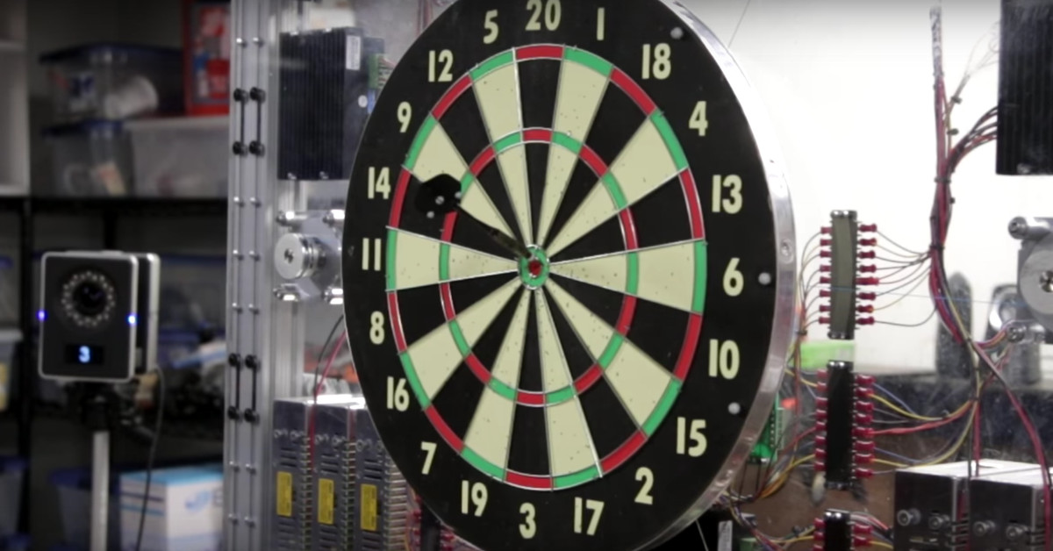
Why use an RTOS?
The System will Interact with the Real-World
Respond to external signals
Send out controller signals within deadlines
Blocking Tasks to Events rather than Waiting and Polling
Examples
Traffic Signals
Flight controllers
Autonomous Vehicles
Robots

Slide 4

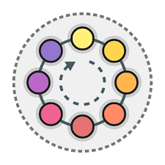
Common RTOS Scheduling Strategies
Event Driven
Fixed Priority Preemptive Scheduling
Earliest Deadline First
Time Sharing
Round Robin

Slide 5
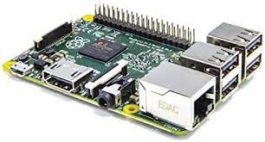
Raspberry Pi 2B
Single Board Computer: ARM Cortex-A7 @ 900MHz
A-Series Processor: Targeted towards Rich Operating Systems
1GB RAM
Peripherals
40 GPIO Pins
UART, SPI
USB
Ethernet
Audio Jack
HDMI
Operating Systems
Raspbian, Ubuntu Core, Retro-Pie, (In Progress) TrampolineOS, etc.
System Clock/ Timers
System Timer, ARM Generic Timer, Cycle Counter
Price: ~20-30$
Notes:
Sys Timer: 1MHz

Slide 6
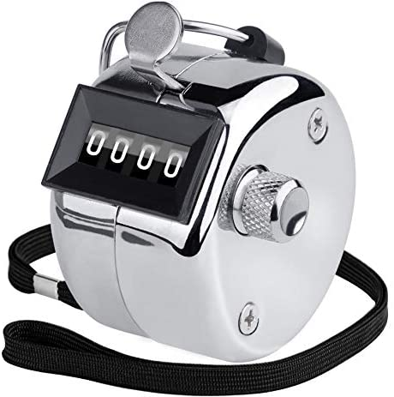

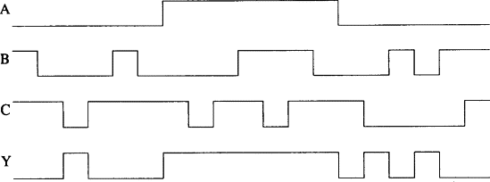

Jobbed - RTOS for Raspberry Pi 2B
Real-Time Operating System
Event Driven
Fixed Priority Preemptive Scheduling
Synchronization Objects
Mutex
Semaphore
Sensing
General Purpose I/O Pins (GPIO)
UART
Delayed Execution
Execute event n microseconds from now

Slide 7
Testing an RTOS
Overhead
Recording the time takes time
Thread Behavior
Create and switch
Mutex Behavior
Create, destroy, unlock, and lock
What happens when threads block each other?
Semaphore Behavior
Signal and wait
Sensing Latency
Stimuli Response Latency
Delayed execution jitter
When does the task actually execute

Slide 8
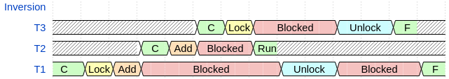
Priority Inversion Test
Timing Diagram without Precautions

Slide 9

Deadlock Test
T₁
T₂
Timing Diagram without Precautions
R₁
R₂

Slide 10
Jobbed’s Mechanisms

Slide 11
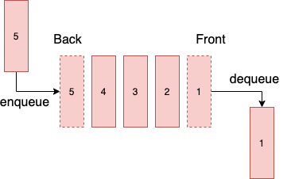
Scheduling
Adding a Thread
Scheduler contains p FIFO queues for each Thread Priority
The thread function, with any specified argument, is added to the specified priority queue
Thread Switching
Preserve Thread’s CPU Context
PC, Linking Register, Stack Pointer, Registers, Current Program Status Register
Get the next running thread from peeking at each FIFO queue until a task is found
If all are empty, the idle wait task is returned
Restore the obtained task’s CPU context

Slide 12

Mutexes
Create
Returns a properly aligned mutex object to the thread and adds it to a Mutex managed queue
Destroy
Removes the mutex from the managed mutex queue
Lock
Checks the Mutex’s lock value
If the lock is unlocked, i.e. it does not have a task locking it, then locks it in a concurrency preserving manner
Otherwise, it blocks the thread and checks to see if the locking thread has a lower priority
If the locking thread has a lower priority, then it promotes the thread to the blocked thread’s priority to prevent priority inversion
Unlock
Unlocks the mutex
Checks the mutex wait queues (highest priorities first) for any thread that is waiting for this mutex and unlocks it

Slide 13

Semaphores
Signal (Produce)
Increases the semaphore’s counter
If the counter was zero, it checks the Semaphore wait queues (highest priority first) and wakes up a thread that was waiting
Wait (Consume)
If the semaphore’s counter is zero, blocks the thread
Otherwise, it decreases the counter in a concurrency preserving manner

Slide 14


Interrupts – Stimuli Response and Delayed Execution
Interrupt Handlers
For each Interrupt Handler
GPIO, UART, Countdown Timer, System Timer Compare (x4)
Check if the Interrupt has a handler
If so, check if the Interrupt was triggered
If so, add the callback task to the specified priority queue and clear the interrupt
Delayed Response – System Timer Compare Interrupt
One notable Interrupt Option for the system timer interrupts is a oneshot flag, where if the flag is not high, triggering the interrupt will also update the timer compare to trigger m microseconds later
⚙️
💡
System

Slide 15
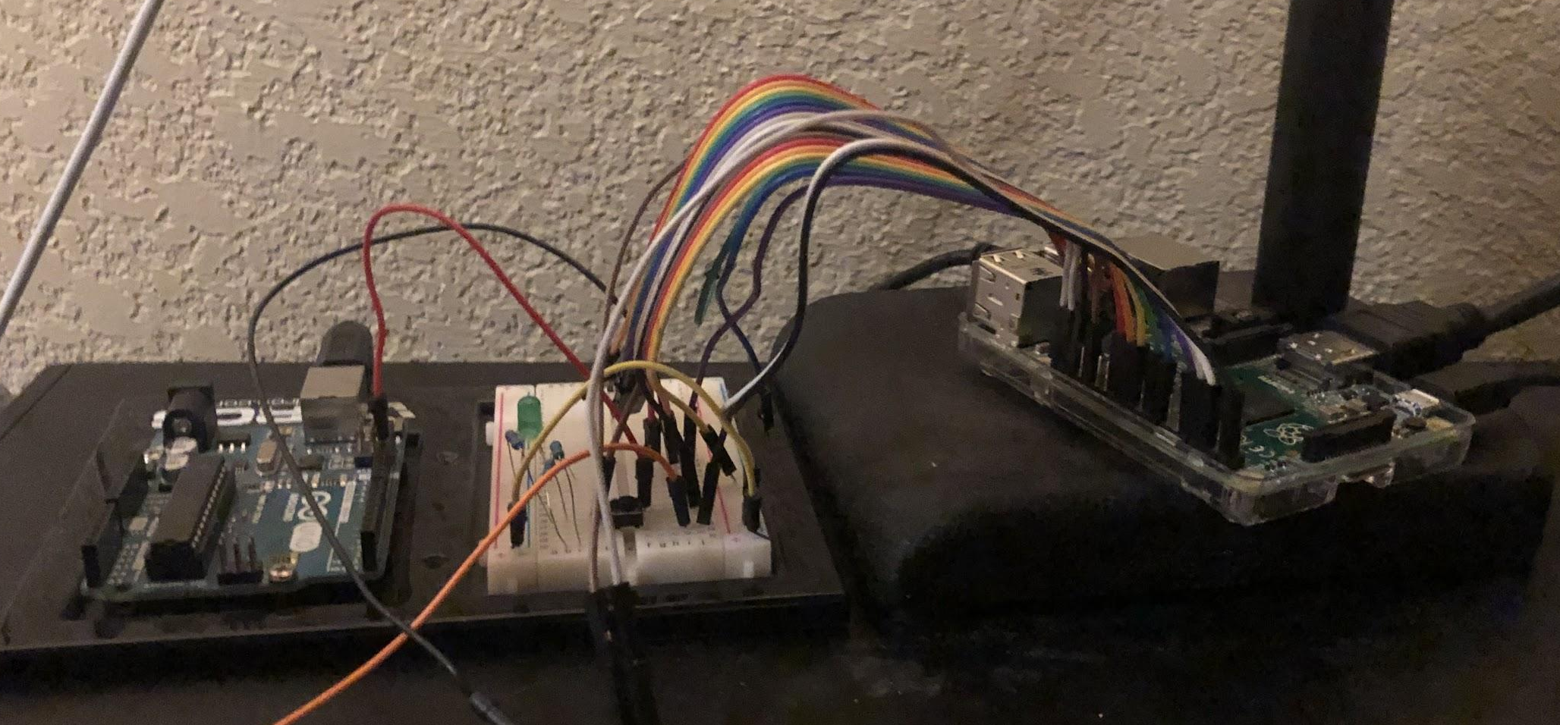
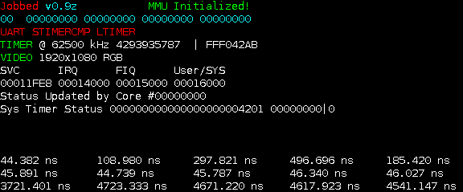
Test Results

Slide 16


Overhead Test - Tracing Test
Tracing
Test (ns) | Raspbian |  |  | Jobbed
 | Mean | σ | Max | Mean | σ | Max
Tracing | 238 | 160 | 2920 | 287 | 452 | 1000

Slide 17

Thread Behaviors
T₁
T₂
Test (μs) | Raspbian |  |  | Jobbed
 | Mean | σ | Max | Mean | σ | Max
Create Low Priority Thread | 96.60 | 26.09 | 825.16 | 1.88 | 0.967 | 5.00
Create High Priority Thread | 221.37 | 56.52 | 1470 | 2.66 | 0.887 | 7.00
Thread Switch | 15.42 | 624.66 | 39980 | 1.42 | 0.742 | 4.00

Slide 18
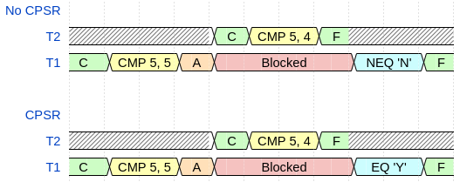
Scheduler CPSR Test

Slide 19
Mutexes
Test (ns) | Raspbian |  |  | Jobbed
 | Mean | σ | Max | Mean | σ | Max
Create | 317 | 1040 | 41410 | 561 | 595 | 3000
Destroy | 321 | 1300 | 45050 | 576 | 585 | 3000
Lock (Contended) | 23690 | 6950 | 205940 | 4910 | 1020 | 9000
Lock (Uncontended) | 365 | 309 | 8440 | 798 | 597 | 3000
Unlock | 400 | 782 | 50050 | 1370 | 572 | 4000

Slide 20
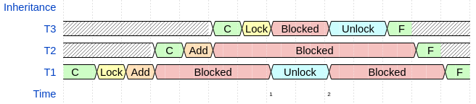
Priority Inversion

Slide 21
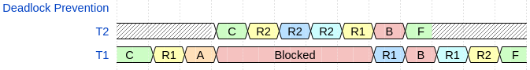
Deadlocks

Slide 22
Semaphores
Test (ns) | Raspbian |  |  | Jobbed
 | Mean | σ | Max | Mean | σ | Max
Wait | 391 | 1550 | 95830 | 427 | 495 | 1000
Signal (Zero) | 2550 | 124640 | 7860000 | 768 | 421 | 1000
Signal (Non-zero) | 313 | 223 | 11670 | 439 | 496 | 1000

Slide 23

Semaphore Behavior

Slide 24

Interrupts – Stimuli Response
Test (μs) | Raspbian |  |  |  | Jobbed
 | Mean | σ | Min | Max | Mean | σ | Min | Max
20μs pulse | 67.99 | 39.34 | 55.73 | 1233 | 25 | 1 | 22 | 32
40μs pulse | 67.91 | 45.63 | 58.07 | 2240 | 45 | 1 | 43 | 52
160μs pulse | 167.02 | 23.46 | 76.25 | 998.75 | 166 | 2 | 163 | 174
1ms pulse | 1018 | 359 | 620 | 23960 | 1012 | 1 | 1003 | 1015
2ms pulse | 2039 | 865 | 254.69 | 57110 | 2025 | 1 | 2005 | 2042

Slide 25

Interrupts – Delayed Execution
Task
Test (μs) | Raspbian |  |  |  | Jobbed
 | Mean | σ | Min | Max | Mean | σ | Min | Max
10μs delay | 690.3 | 89.17 | 610.2 | 1559 | 10.29 | 0.925 | 8 | 14
20μs delay | 463.7 | 90.74 | 383.3 | 1407 | 20.38 | 0.975 | 18 | 24
100μs delay | 781.4 | 75.96 | 696.5 | 1602 | 100.3 | 0.853 | 98 | 104
200μs delay | 897.4 | 160.0 | 799.8 | 9765 | 200.2 | 0.789 | 198 | 204
1ms delay | 1856 | 124.3 | 1637 | 2837 | 1000 | 0.896 | 998 | 1004
5ms delay | 6006 | 177.7 | 5668 | 14820 | 5000 | 0.875 | 4998 | 5004
10ms delay | 11000 | 121.7 | 10680 | 12260 | 10000 | 0.915 | 9998 | 10004

Slide 26
Future Contributions
More Drivers
USB, Ethernet, SD, and SPI
Address Space Layout Randomization
Initialize with ATAG entry information
Memory size and board information to allow it to be used on other Raspberry Pis more efficiently
Explore putting mutex/ semaphore queues on the object rather than in the scheduler
Space versus time optimizations
Doubly Linked List FIFO queue
Some scheduler procedures would execute faster, another space versus time optimization

Slide 27
Concluding Remarks
Jobbed
RTOS with a Fixed Priority Preemptive Scheduler
Always has the highest priority task running at any given time
Avoids Priority Inversion and Deadlock Pitfalls
Average runtimes
At least within 1μs of Raspbian if slower
Considerably faster than Raspbian for many of the processes that it is faster in
Tight Bounds on OS Tasks
Thread, Mutex, Semaphore, Stimuli, and Delayed Execution
Smaller upper bounds

Slide 28
Questions?

