Slide 1



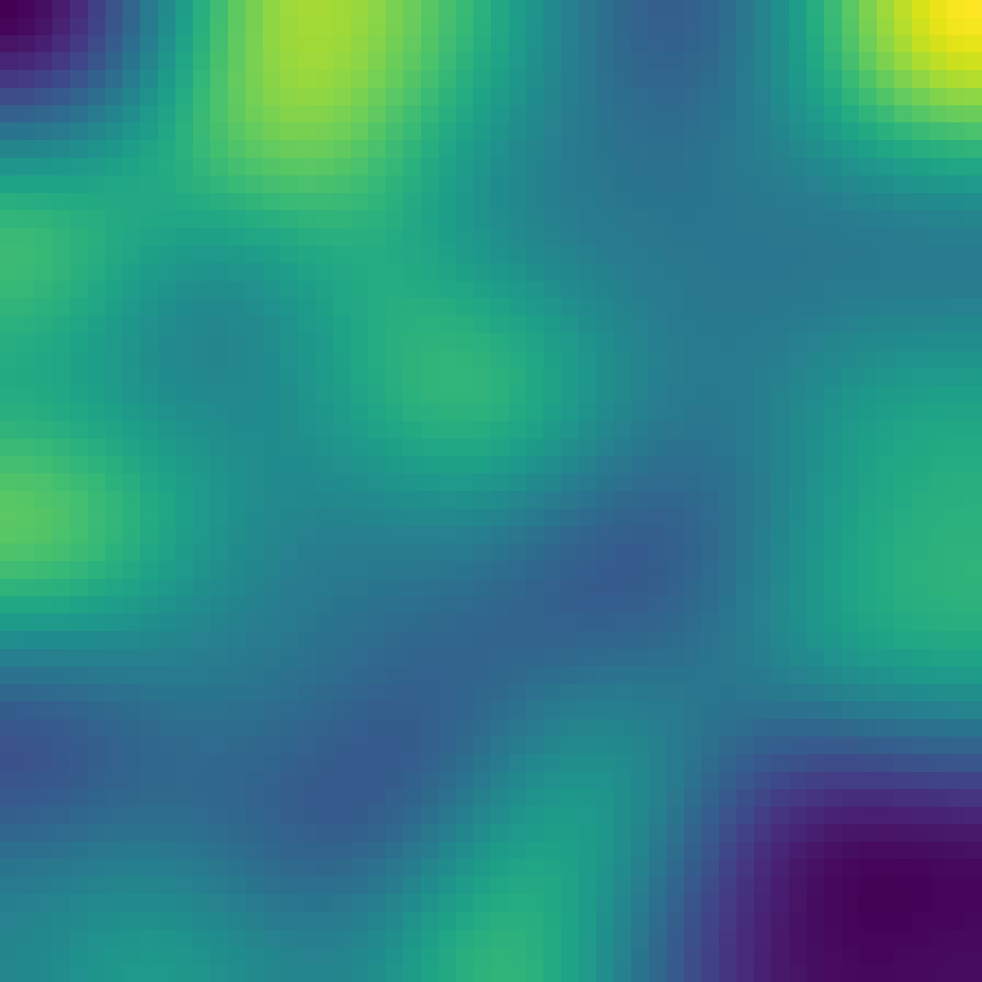
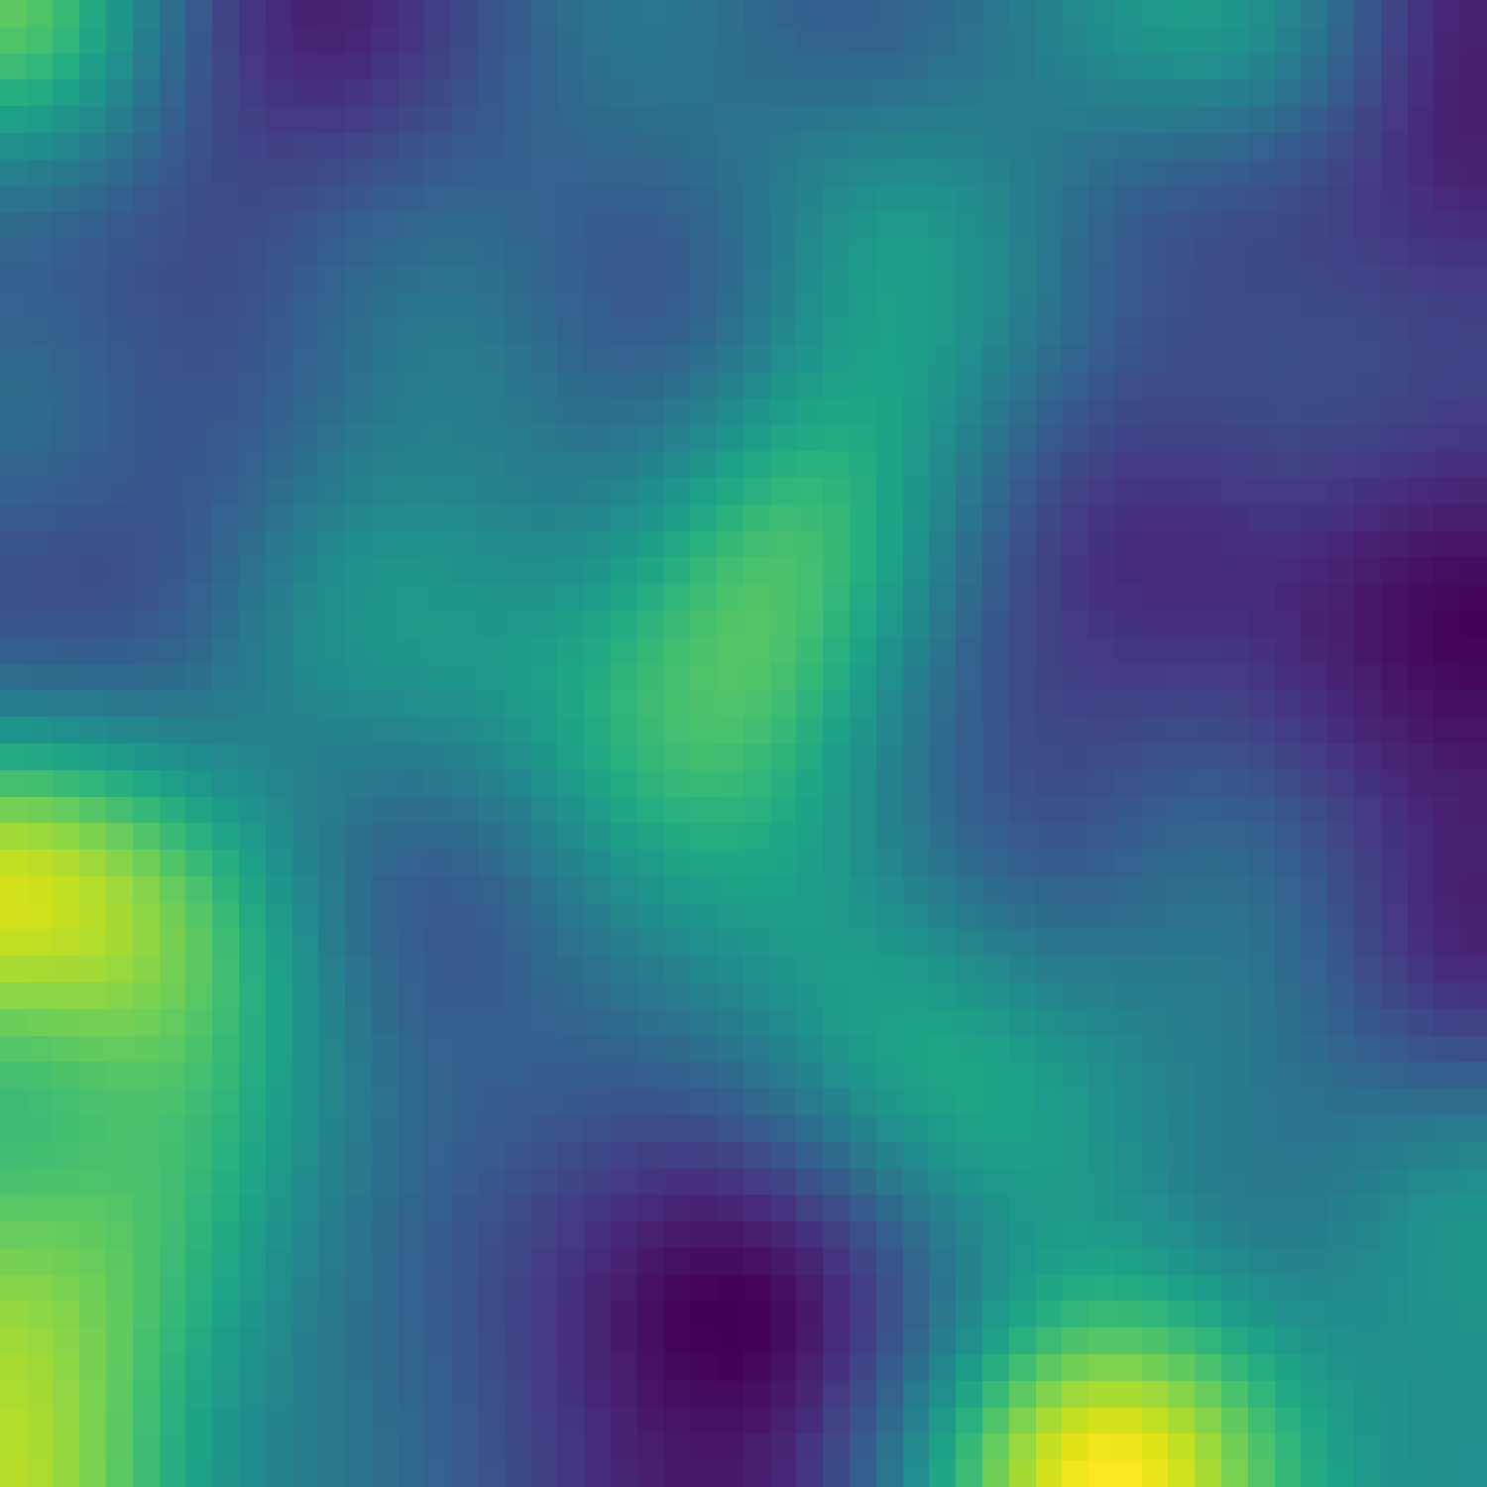
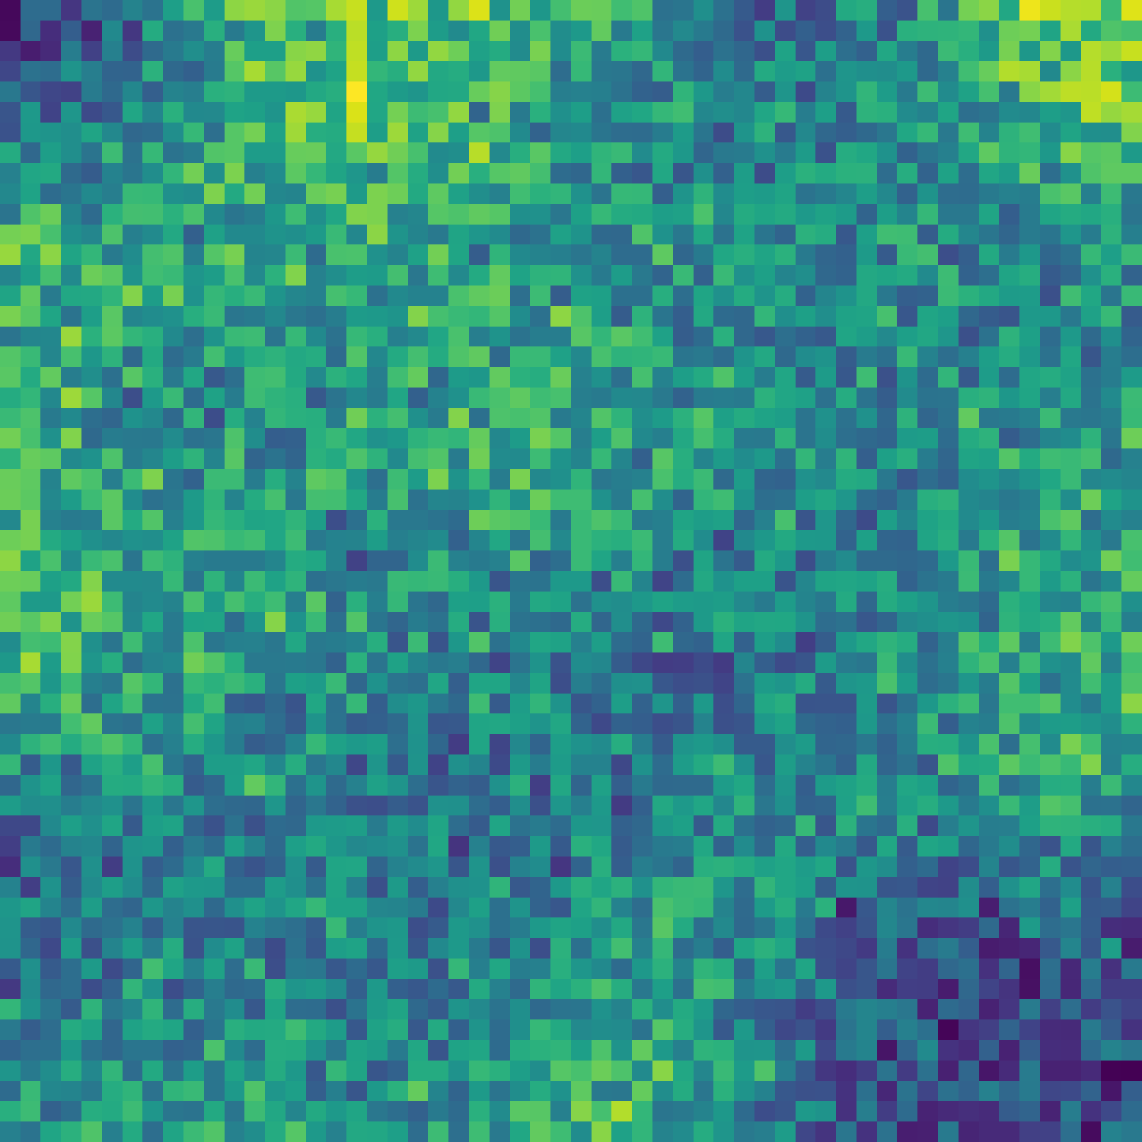




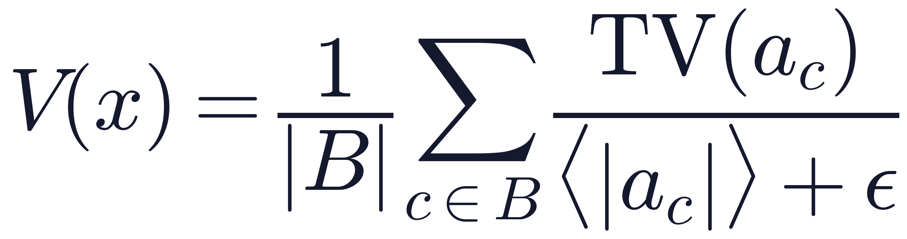






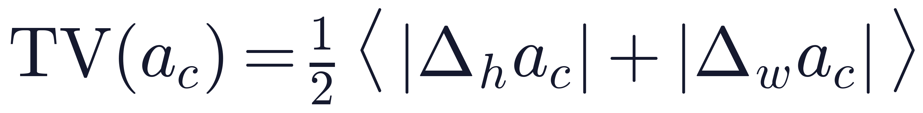


Viyog: Separating Adversarial
and Out-of-Distribution
Aman Singh¹, Abhinav Kumar¹, Rishab Kashyap¹, Soyeong Park¹, Ameya Gurjar¹,
Yohan Ko², Hwisoo So³, Uiwon Hwang⁴, Kyoungwoo Lee², Aviral Shrivastava¹
¹Arizona State University ²Yonsei University ³Kyungpook National University ⁴Ewha Womans University
1
The Problem
2
Key Observation
3
Experimental Setup
Same symptom, opposite cure.
Attacks make quiet channels rough.
Models
Out-of-distribution (OOD) and adversarial (ADV) inputs both fool a classifier, yet need opposite responses. Most lightweight detectors emit one score and can't tell them apart.
Natural images are low-frequency, so first-layer maps stay smooth for ID and OOD alike. Broadband L∞ perturbations make the quietest (dormant) channels jagged.
17 CNN, ViT & hybrid backbones (ResNet … Swin-T), fine-tuned from ImageNet
Data
ID: CIFAR-100, GTSRB · OOD: SVHN, iSUN, LSUN, Places365
ID
Pass to classifier
Attacks
FGSM, BIM, PGD, APGD-CE · L∞, ε = 8/255
OOD
Abstain · flag for review
Protocol
ADV
Reject · security alert
20% calibration / 80% held-out test; thresholds frozen on calibration
ID · smooth
OOD · smooth
ADV · rough
T1 ID vs OOD
T2 ID vs ADV
T3 OOD vs ADV
Schematic dormant-channel maps (illustration)
4
Method: Viyog
A gradient-free, first-layer statistic: one forward pass · no retraining · O(C) stored state
1. Hook first conv
2. Dormant band
3. Roughness
4. Score V(x)
5. Route
Read activation maps a = f₀(x) from the normal forward pass
B = quietest 10% of alive channels, fixed on ID calibration
Total variation of each map, divided by its mean activation
Average over B; invariant to rescaling (0-homogeneous)
V(x) > τ → ADV (reject); otherwise OOD (abstain)
Shape, not magnitude: B = dormant band, ε = 10⁻⁶. Rescaling a channel map leaves V unchanged.
5
Main Results — 17 architectures, CIFAR-100
6
Efficiency
Held-out AUROC. Logit scores win T1; Viyog wins T2 and T3, so the two are complementary.
~0.3 KB
2.28%
0.980
state, vs 4.5–40 MB
of CNN MACs
T2 AUROC · ID vs ADV
3.9%
0.05 ms
best confidence score: 0.659
latency (H200, batch 1)
score path per image
0.844
Standalone score-path latency, ms/image (log scale)
T3 AUROC · OOD vs ADV
Viyog
0.05
best logit score (GEN): 0.812
Energy
0.39
3-way balanced accuracy
Mahalanobis
0.83
0.798
0.863
ODIN
1.29
CIFAR-100
GTSRB
KNN
5.14
MCD (30×)
13.91
7
Why the First Layer?
8
Three-Way Routing
9
Robustness & Limits
Shape peaks at the first conv; raw magnitude is weakest there. Mean T2 AUROC, depth sweep (6 archs × 2 attacks).
Energy gate → Viyog router at 5% ID false-positive rate. ID→ADV mis-escalation: 0.002 → 0.000.
Norm-aware attacker: 0% evasion.
Attacker aware of both signals succeeds only 8% more often.
Shape V(x) · first conv
ADV recall
Limits
0.965
Energy only
0.157
Theory covers affine pre-activations; post-ReLU/GELU is empirical.
L∞ attacks at ε = 8/255; finite adaptive sweeps, no certificate.
T3 FPR@95TPR is 37.4%: not yet a standalone defense.
Edge energy is projected, not yet measured on device.
Raw ‖a‖∞ · first conv
+ Viyog
0.834
0.52
OOD recall
Raw ‖a‖∞ · best layer (depth 6)
Energy only
0.343
0.80
+ Viyog
0.424
Takeaways
1
Dormant-channel roughness separates adversarial attacks from natural distribution shift.
2
Gradient-free and cheap: no retraining, ~0.3 KB state, 2.28% of CNN MACs.
3
Pair with a logit score for three-way ID / OOD / ADV routing.
$ pip install viyog
Live demo

