Slide 1



DSP-MLIR: A Domain-Specific Language and MLIR Dialect for Digital Signal Processing
Arizona State University
Yonsei University
Abhinav Kumar¹, Atharva Khedkar¹, Hwisoo So¹², Megan Kuo¹, Ameya Gurjar¹, Partha Biswas³, and Aviral Shrivastava¹
¹Arizona State University, ²Yonsei University, ³MathWorks
Notes:
Hello everyone! Today I’m excited to introduce you to DSP-MLIR, a domain-specific compiler framework designed to make Digital Signal Processing faster, smarter, and easier to program.

Slide 2
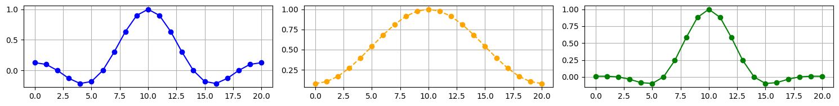
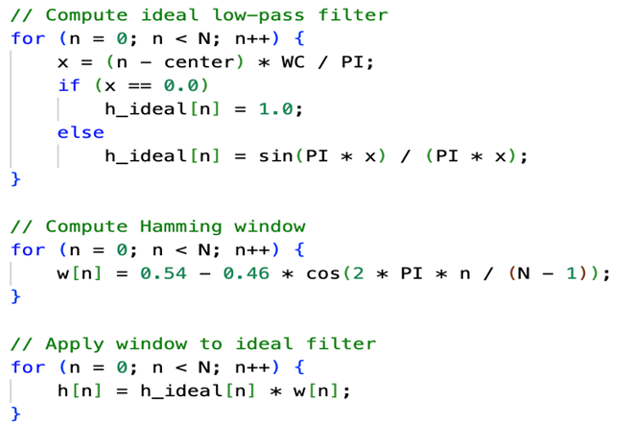
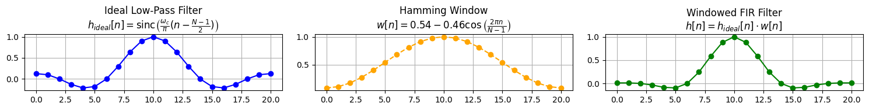



Motivation: Traditional Compilation Flow
FIR Filter Operation
C-level Implementation
=
Lowering
Low-level IR
Optimization
Domain-specific information: Symmetry
Loss of high-level information
Notes:
Challenge of compilers in performing high-level optimizations.

Slide 3
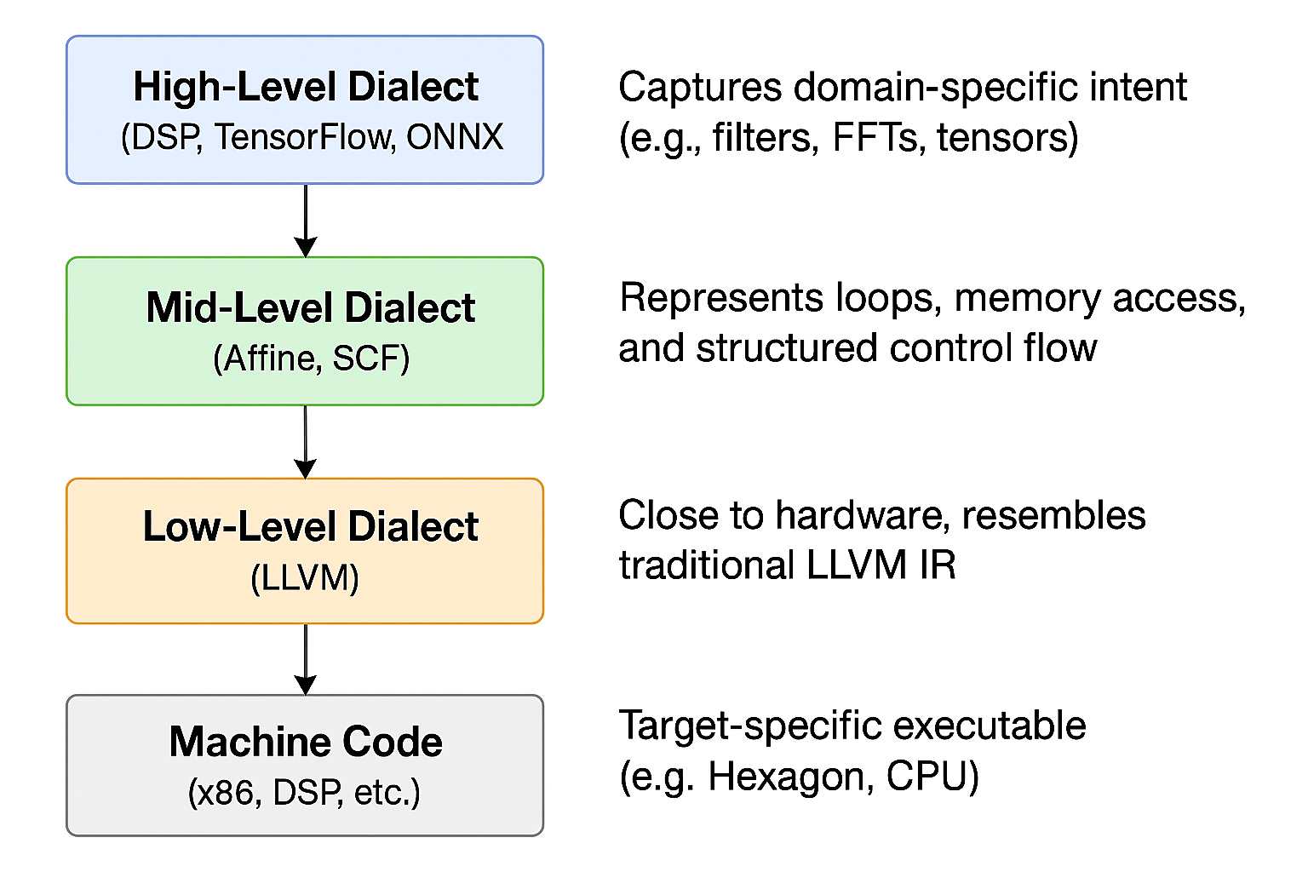
Introduction to MLIR
Multi-level Intermediate Representation (MLIR) is a modern compiler framework in LLVM project.
It enables multiple abstraction levels during compilation.
Code is expressed using dialects, each tailored to a domain.
Supports progressive lowering from high-level operations to machine code.
Already used in compilers for AI, GPUs, FPGAs, encryption, etc.
Notes:
Before diving into DSP-MLIR, let’s understand the foundation it’s built on: MLIR, or Multi-Level Intermediate Representation. It’s a compiler framework developed under LLVM, but with a big difference from traditional compilers: instead of one generic IR, it supports many dialects, each tuned to a specific domain. That means we can represent DSP, AI, or encryption tasks in a way that makes sense for those domains.
MLIR allows us to progressively lower code. We can start with high-level operations like “filter a signal” and gradually lower them to loops and finally to machine instructions. This flexibility enables smarter optimizations and is why MLIR is being adopted in many areas—machine learning (TensorFlow), GPU code (NVVM), and now DSP, which brings us to DSP-MLIR.

Slide 4
DSP-MLIR: A Compiler That Understands DSP
DSP-DSL
High-level Python like language for DSP applications
DSP-dialect
90+ DSP operations
16 DSP pattern-based optimizations
Lowering to LLVM
Transform to fast, portable binaries
DSP DSL
DSP Dialect
DSP Ops
Auxiliary Ops
Optimizations
Mem
Arith
Affine
Math
Func
Legend
New component
scf
Existing dialect
New dialect
mlir-llvm
External to MLIR
LLVM-IR
New lowering
Existing lowering
Clang
Notes:
Our contribution is 3 fold, first we propose DSP-DSL, a high-level python like DSP-specific language, DSP-dialect containing more than 90 operations and 16 DSP specific optimizations and finally lowering to standard MLIR dialects and LLVM IR to support multiple hardwares.
On the right we show the DSP_MLIR compilation flow:
Unlike traditional compilers, DSP-MLIR starts from and carrying domain knowledge all the way through the compiler pipeline.
DSP_DSL lowers to the Dsp-dialect which maps all the language operations directly as a MLIR dialect. We provide key DSP optimizations in this dialect. after this the code is lowered to more generic MLIR dialects like Affine or SCF, and eventually to LLVM IR. So we preserve structure longer and optimize smarter. This leads to better binaries that run faster and are still portable across CPUs and DSPs.

Slide 5

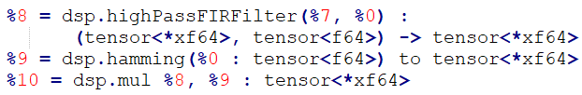
Example: DSP-MLIR CompilationFlow (1)
FIR Filter Operation
DSP-DSL
DSP Dialect
=
Optimized DSP Dialect
Domain-specific information: Symmetry
… (Lower Dialects)
Notes:
Let’s stay with our FIR filter example from Slide 2. generally DSP applications are written in C or lowered to single level of IR representation which is lower than C level.
DSP-MLIR matches this pattern to a built-in operation: FilterHammingOptimized(wc, n) and automatically applies symmetry-aware optimization. We compute half the values and mirror them — cutting cost in half.

Slide 6
Example: DSP-MLIR CompilationFlow (2)
FIR Filter Operation
DSP-DSL
DSP Dialect
=
Optimized DSP Dialect
Domain-specific information: Symmetry
Symmetrical expansion
… (Lower Dialects)
Notes:
Let’s stay with our FIR filter example from Slide 2. generally dsp applications are written in C or lowered to single level of IR representation which is lower than C level.
DSP-MLIR matches this pattern to a built-in operation: FilterHammingOptimized(wc, n) and automatically applies symmetry-aware optimization. We compute half the values and mirror them — cutting cost in half.

Slide 7
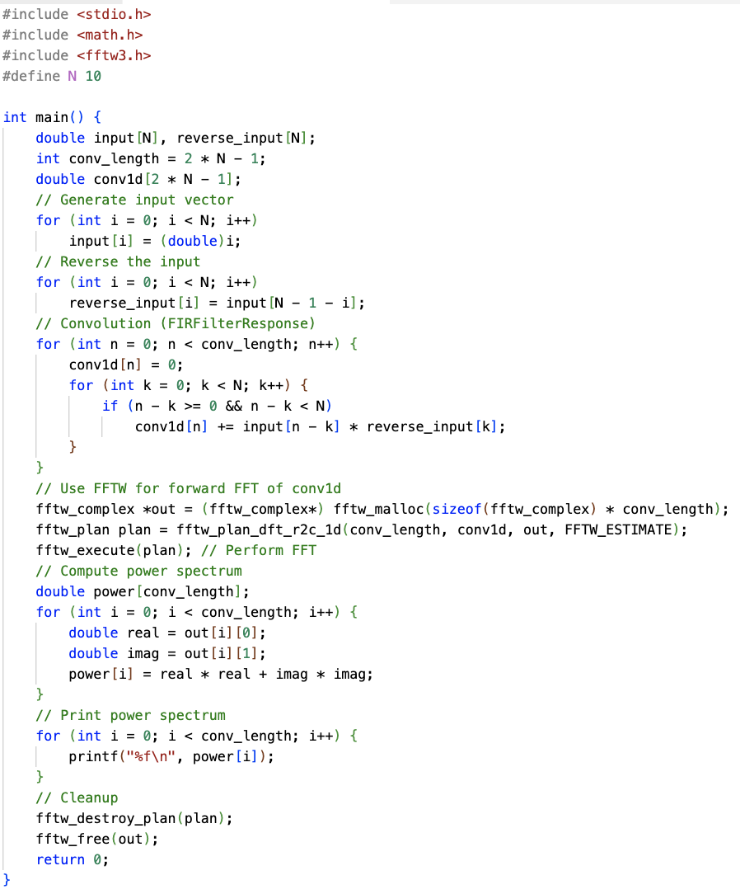

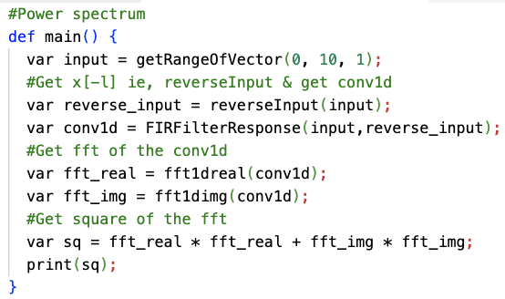
DSP-DSL: An Intuitive Domain-specific Language for DSP
Spectral analysis: C code
DSP-DSL
High-level Python like language for DSP applications
Spectral analysis: DSP-DSL code
Lines of code: 10
Lines of code: 65
Notes:
Now let’s talk about the programming interface of DSP-MLIR — the DSP-DSL. DSP-DSL is a Python-like domain-specific language we designed specifically for writing DSP applications. It has a clean, high-level syntax that lets you express DSP concepts directly: FIR filtering, FFTs, peak detection, etc. — all using one-liners. On the left, we see what this looks like in DSP-DSL. For example, computing a power spectrum might involve just a few intuitive lines.
In contrast, on the right you see what a C-style implementation looks like — it’s verbose, low-level, and error-prone. You’d need to handle loop counters, edge cases, and memory layout manually.
Now what makes DSP-DSL really powerful is the compiler understands these high-level operations and lowers them into the DSP-dialect in MLIR — preserving structure all the way.

Slide 8
DSP-Dialect: Domain-Specific IR
DSP DSL
DSP Operations
Auxiliary Operations
DSP Dialect
DSP Ops
Auxiliary Ops
Optimizations
Mem
Arith
Affine
Math
Func
Signal Ops
Filter Ops
Transform Ops
MLIR Helper
App
Helper
scf
mlir-llvm
Delay,
Quantiz.
FIR ,
Response
FFT,
DCT
Func,
CastOp
Print,
GenVector
LLVM-IR
Clang
Notes:
Now let’s take a closer look at the DSP-dialect, which is at the heart of DSP-MLIR’s compilation process. This dialect is a collection of over 90 DSP-specific operations that represent common patterns and computations in signal processing.
The dialect is split into core DSP operations and auxiliary operations. Core operations include filters, transforms, and convolution — the building blocks of most DSP applications.
Auxiliary operations handle things like vector generation, and utilities like printing.
One important aspect is that signals are represented as tensors — allowing the compiler to reason about them symbolically and structurally. DSP-dialect gives us a powerful middle layer: expressive enough for high-level DSP reasoning, and structured enough for lowering to efficient code.

Slide 9
DSP-Dialect: Optimizations
DSP DSL
Theorem-based Optimizations
Theorem-based Optimizations
Optimization based on DSP theorems such as Parseval's theorem, symmetric filter property, convolution theorem, etc.
DSP Dialect
DSP Ops
Auxiliary Ops
Optimizations
Mem
Arith
Affine
Math
Func
Theorem-based Optimizations
Operation Fusion Optimizations
scf
Optimization based on Operation/Loop fusion not recognized by traditional compilers
mlir-llvm
LLVM-IR
Clang
Notes:
Now let’s take a closer look at the DSP-dialect, which is at the heart of DSP-MLIR’s compilation process. This dialect is a collection of over 90 DSP-specific operations that represent common patterns and computations in signal processing.
The dialect is split into core DSP operations and auxiliary operations. Core operations include filters, transforms, and convolution — the building blocks of most DSP applications.
Auxiliary operations handle things like vector generation, and utilities like printing.
One important aspect is that signals are represented as tensors — allowing the compiler to reason about them symbolically and structurally. DSP-dialect gives us a powerful middle layer: expressive enough for high-level DSP reasoning, and structured enough for lowering to efficient code.

Slide 10
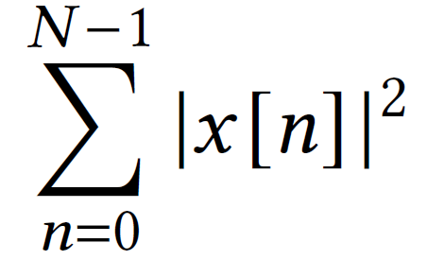
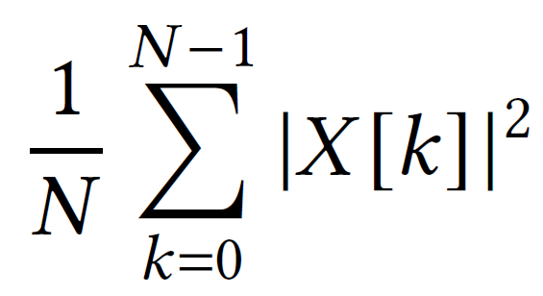
Example: DSP Theorem Optimization – Parseval’s Theorem
Before optimization
After optimization
=
=
Energy
Energy
Time-domain
(FFT-free)
Frequency-domain (requires FFT calculation)
💡 Replaces FFT + complex math with a single loop 💡 Based on Parseval’s Theorem 💡 Achieved up to 5× speedup in Spectral Analysis benchmark 💡 Reduces both compute cost and memory access
Notes:
Lets dive into an example of DSP theorem based optimization:
This optimization is based on a classic DSP identity — Parseval’s Theorem — which states that the total energy of a signal is preserved across time and frequency domains. In many applications, like Spectral Analysis, we compute energy by doing an FFT and summing squares of the real and imaginary parts. But mathematically, we don’t need to — we can just square the signal samples directly in the time domain. DSP-MLIR recognizes this pattern and rewrites it using Div(Sum(Sq(ins)), len(ins)), eliminating the FFT altogether. In our experiments, this optimization gave up to 5× speedup on the Spectral Analysis benchmark. It’s a great example of how incorporating DSP knowledge into the compiler allows us to simplify and accelerate code that would otherwise be handled naively by traditional compilers.

Slide 11
Operation Fusion Optimization – Median + Sliding Window
for (n=0; n < N-2; n++) //Median(ins)
med[n] = median(x[n], x[n+1], x[n+2]);
for (n=0; n < N-4; n++) //SlidingWindowAvg(Median(ins))
y[n] = (med[n] + med[n+1] + med[n+2])/3;
Before (Canonical Pattern): SlidingWindowAvg(Median(ins))
Pseudo code of median filtering and sliding window
💡 Fuses two filtering passes into one loop 💡 Reduces memory reads and loop overhead 💡 Especially useful in edge-preserving denoising
Canonical optimization #7
SlidingWindowAvg(Median(ins)) → Median2SlidingOpt(ins)
for (n=0; n<N-4; n++) { //Median2SlidingOpt(ins)
med[n] = median(x[n], x[n+1], x[n+2]);
med[n+1] = median(x[n+1], x[n+2], x[n+3]);
med[n+2] = median(x[n+2], x[n+3], x[n+4]);
y[n] = (med[n] + med[n+1] + med[n+2])/3;
}
After (Optimized Pattern): Median2SlidingOpt(ins)
Optimized median filtering and sliding window
Notes:
In this example, we look at a very common signal processing pipeline — applying a median filter followed by a sliding window average. Normally, this would be implemented in two separate stages, requiring two full passes over the signal and storing intermediate values. DSP-MLIR detects this composition and replaces it with a single fused operation: Median2SlidingOpt(ins). Not only does this reduce runtime and memory access, but it also makes the pipeline more hardware friendly — fewer instructions and better cache usage. This is especially useful in smoothing tasks like ECG denoising or audio cleanup where edge preservation is key.

Slide 12
DSP-specific optimizations: Full list
Canonical Pattern | Optimized Pattern
Mul(IdealFilter(wc, n), Hamming(n)) | FilterHammOpt(wc, n)
FilterResponse(FilterHammOpt(wc, n)) | FilterResSymmOpt(wc, n)
Div(Sum(Add(Sq(DFTReal(ins)), Sq(DFTImg(ins)))), len(ins)) | Div(Sum(Sq(ins)), len(ins))
IFFT1D(Mul(FFT1D(Padding(ins1)), FFT1D(Padding(ins2)))) | FIRFilterResponse(ins2, ins1)
FilterResponse(ins, ReverseInput(ins)) | FilterResponseYSymmOpt(ins)
DFT1DReal(FilterResponseYSymmOpt (ins)) | DFT1DRealSymmOpt(ins)
Theorem-based Optimizations:
6
Canonical Pattern | Optimized Pattern
SlidingWindowAvg(Median(ins)) | Median2SlidingOpt(ins)
Threshold(FilterResSymmOpt(wc, n), ths) | FilterResSymmThresholdOpt(wc, n, ths)
Normalize(LMSFilterResponse(ins)) | NormalizedLMSFilterResponseOpt(ins)
FindPeaks(LMSFilterResponse(ins), h, dist) | LMS2FindPeaks(ins, h, dist)
Mean(Diff(FindPeaks(in, h, dist), len(peaks)), len(peaks)-1) | FindPeaks2DiffMeanOpt(in, h, dist)
Gain(LMSFilter(ins)) | LMSFilterGainOpt(ins)
Max(Correlation(ins)) | Corr2MaxOpt(ins)
Sq(Sum(Sq(DFTReal(ins)), Sq(DFTImg(ins)))) | DFTAbsOpt(ins)
Threshold(DFTAbsOpt(ins)) | DFTAbsThresholdOpt(ins)
DFTReal(ins), DFTImg(ins) | DFT1D(ins)
Operation Fusion Optimizations:
10
Notes:
These are all the optimizations we have implemented in the dsp-dailect. These kinds of optimizations are encoded as canonicalization patterns in MLIR — which means they can run as part of the standard rewrite engine.
The left column in each table shows the pattern identified by the compiler i.e. Muliplication of IdealFilter and Hamming windows and then replaced by their optimized equivalents. While theorem based optimization from this table might look loke operation fusion optimizations, the optimizations are based of dsp theorems and they may or may not be implemented as single operation.

Slide 13
Performance Gains on CPU (AMD Ryzen)
Evaluation Setup
Machine: AMD Ryzen Threadripper PRO 7955WX
Execution: Single core (taskset -c 0), 30 averaged runs
Compiler Versions:
GCC 11.4.0 (-O3)
Clang 19 (-O3)
MLIR + LLVM backend
Benchmarks: 20 DSP apps from EEMBC, MiBench, DSPStone (e.g., Audio Compression, Radar Signal Processing)
Note: All flows use the same LLVM backend — performance gains come only from MLIR-level DSP optimizations
Flow Name | Description
Affine | DSP-DSL → DSP-dialect → Affine → LLVM IR → Clang (generic CPU)
GCC | C code compiled using GCC with -O3 (generic CPU)
Clang | C code compiled using Clang 19 with -O3 (generic CPU)
DSP-MLIR | Affine + DSP-dialect optimizations for CPU target
Notes:
Let’s look at how DSP-MLIR performs on general-purpose hardware — specifically, an AMD Ryzen Threadripper PRO 7955WX. We ran 20 real-world DSP applications drawn from standard benchmark suites like EEMBC AudioMark, MiBench, and DSPStone.
All executions were single-threaded using taskset, with cache flushing between runs and results averaged over 30 trials — ensuring a fair and stable comparison.
The table shows the meaning of each compilation flow,
Affine meaning using dsp-dsl for writing code and compiling using llvm backend and clang with affine optimiztions from mlir and O3 optimizations from clang.
GCC and Clang meaning using C equivalent code and compiling with gcc and clang with o3 optimizations respectively.
DSP_MLIR is same affine flow but with enabling our dsp-optimizations as discussed previously.
In Spectral Analysis, where we apply Parseval’s Theorem to eliminate FFT computation, we observed nearly a 5× speedup.
Even in basic FIR filter applications, leveraging symmetry gave us up to 2× improvements over baseline MLIR.
The most important point is that Affine, Clang and DSP_MLIR are using same LLVM backend so these performance gains come entirely from high-level, domain-specific optimizations inside DSP-MLIR.

Slide 14
Developer Productivity Gains
Less code = fewer bugs, faster iteration
DSL abstracts away memory management, loop indexing, boilerplate
Readability and maintainability are dramatically improved
Code is more expressive and closer to the algorithm (e.g., FIRFilterResponse() instead of 4 nested loops)
→ DSP-DSL reduces LOC by ~5× on average over C
Notes:
Alongside performance, we also measured developer productivity by comparing the number of lines of code needed to implement the same DSP applications.
On average, we saw about a 5× reduction in LOC using DSP-DSL compared to C. That’s a huge gain in terms of developer velocity, readability, and maintainability — all without compromising performance.

Slide 15
Conclusion
📝 A high-level Python-like DSP-DSL for intuitive, expressive signal processing – making easier to code, makes less error prone etc.
⚙️ A rich DSP dialect in MLIR with 90+ domain-specific operations - because fast etc.
💡 16 powerful optimizations — including DSP theorem rewrites and op fusion – faster code etc.
Notes:
To summarize, DSP-MLIR brings significant benefits across the board. First, it gives developers a Python-like DSL that’s intuitive and expressive — reducing code size by around 5× on average. Second, the DSP-dialect contains over 90 operations and 16 high-level optimizations — including fusions, theorem-based rewrites, and simplifications. These transformations are applied early, while we still have DSP semantics — enabling smarter codegen. The framework integrates cleanly with LLVM, which means it works across CPUs, DSPs, and other targets. And the results speak for themselves: DSP-MLIR outperformed traditional flows in 19 out of 20 benchmarks, often by a wide margin. The entire stack is open-source and modular — making it easy to adopt, adapt, and extend. Whether you care about speed, code clarity, or both — DSP-MLIR delivers.

Slide 16
DSP-MLIR CompilationFlow
FIR Filter Operation
DSP-DSL
DSP Dialect
=
Optimized DSP Dialect
Domain-specific information: Symmetry
Symmetrical expansion
… (Lower Dialects)
Notes:
Let’s stay with our FIR filter example from Slide 2. generally dsp applications are written in C or lowered to single level of IR representation which is lower than C level.
DSP-MLIR matches this pattern to a built-in operation: FilterHammingOptimized(wc, n) and automatically applies symmetry-aware optimization. We compute half the values and mirror them — cutting cost in half.

Slide 17
Future Directions
🧠 Unifying DSP & ML Compilation Integrate DSP-MLIR with machine learning dialects (e.g., TensorFlow, ONNX) → Enable joint optimization for DSP + inference pipelines
🛠️ Hardware-Aware Lowering Add support for automatically mapping ops to vendor-optimized DSP libraries (e.g., QHL, CMSIS-DSP)
📦 More Optimizations & Ops Expand the DSP-dialect with more filters, transforms, adaptive and multi-rate operations
🧪 Auto-Tuning & Cost Models Explore integration of ML-based heuristics to choose the best optimizations dynamically
Notes:
While DSP-MLIR already delivers strong results, there's exciting potential ahead. One direction is to bring together DSP and ML flows — for example, fusing pre-processing with neural network inference, all in a single MLIR pipeline. We also plan to explore hardware-aware lowering, where DSP-MLIR can detect when a given operation matches a vendor-optimized kernel and route it accordingly — combining the benefits of domain-level and hardware-level optimization. On the optimization front, we’re building out more patterns and support for adaptive filtering, multi-rate designs, and hardware-specific scheduling. Longer term, we see opportunities to use ML-based auto-tuning to guide which optimizations to apply, especially in edge or embedded deployments. And finally, this framework is open-source — we’re actively looking to grow a community around it. We hope you’ll explore it, use it, and contribute to it.

Slide 19
Performance Gains on DSP Processor (Qualcomm Hexagon)
Flow Name | Description
Affine | DSP-DSL → DSP-dialect → Affine → LLVM IR → Clang (generic CPU)
Clang | C code compiled using Clang 19 with -O3 (generic CPU)
Affine-hexagon | Affine lowering + LLVM codegen for Hexagon → hexagon-clang & hexagon-link
Clang-hexagon | C code compiled with Qualcomm’s hexagon-clang using DSP-specific backend
DSP-MLIR | Affine + DSP-dialect optimizations for CPU target
DSP-MLIR-hexagon | DSP-MLIR with DSP optimizations + Hexagon LLVM backend
Target Processor: Qualcomm Hexagon v68 Execution: Hexagon Simulator (v8.8.06) LLVM: Official Hexagon LLVM backend Binaries: Executed via hexagon-sim after compilation
Notes:
Similarly for hexagon dsp processor, we use the same compilation flows from previous slide but using clang-hexagon provided with the hexagon toolkit.
First, let’s set expectations: Clang-hexagon already performs well on this hardware, as it generates DSP-tuned instructions and performs aggressive memory alignment.
DSP-MLIR outperforms Clang and clang hexagon by 8% on an average.

Slide 20
FAQ: Why not compare with libraries
Orthogonal approach
Hexagon llvm backend doesn’t generate library calls.

Slide 21
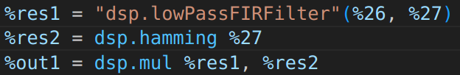
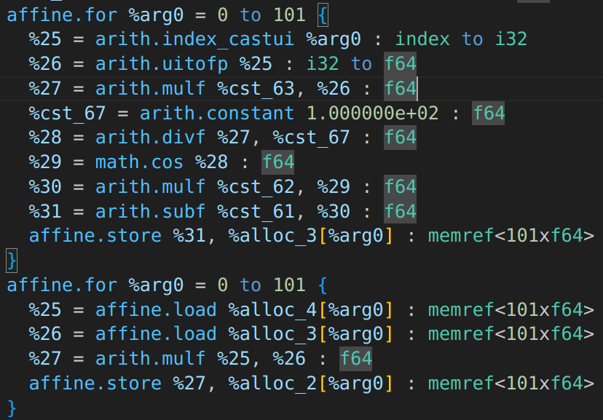
Limitation with Traditional DSP Compiler
Intermediate Representation (IR)
Input Signal + Noisy Signal
Window Function
FIR Filter Design
FIR Filter Response
Output Signal
High-level
dsp.hamming
Traditional compilers optimize the code in C-level
→ Limitation: they cannot utilize high-level Information for optimization
dsp.mul
Low Pass Filtering

Slide 22
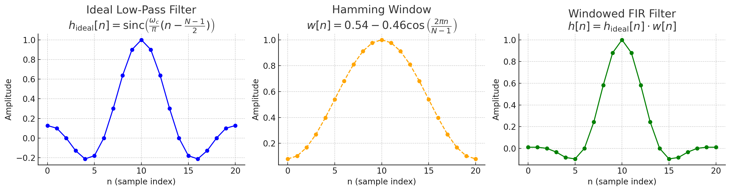



What’s Wrong with Today’s DSP Compilers?
Low-level IR
Missed DSP patterns
General-purpose compilers don’t speak DSP.
Notes:
Traditional compilers like GCC or Clang operate at a low level. They work great for general C/C++ programs, but not for DSP. For instance, when you design an FIR filter using a Hamming window, both inputs are symmetric. A smart DSP engineer knows you can compute only half the values and mirror them—saving time and resources. But general-purpose compilers treat these as two separate operations and miss the opportunity for optimization. Why? Because by the time the compiler sees the code, the semantic meaning—like “this is a symmetric filter”—has been lost. The compiler just sees a series of multiplications and loops. As a result, DSP developers often rely on hand-tuned libraries (which are again difficult to provide with inter-operation optimization) or write low-level code themselves, which is hard to maintain and error-prone. We need a solution that understands DSP from the start—and that’s where DSP-MLIR comes in.

Slide 23
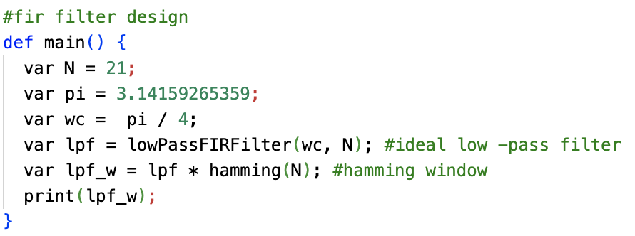
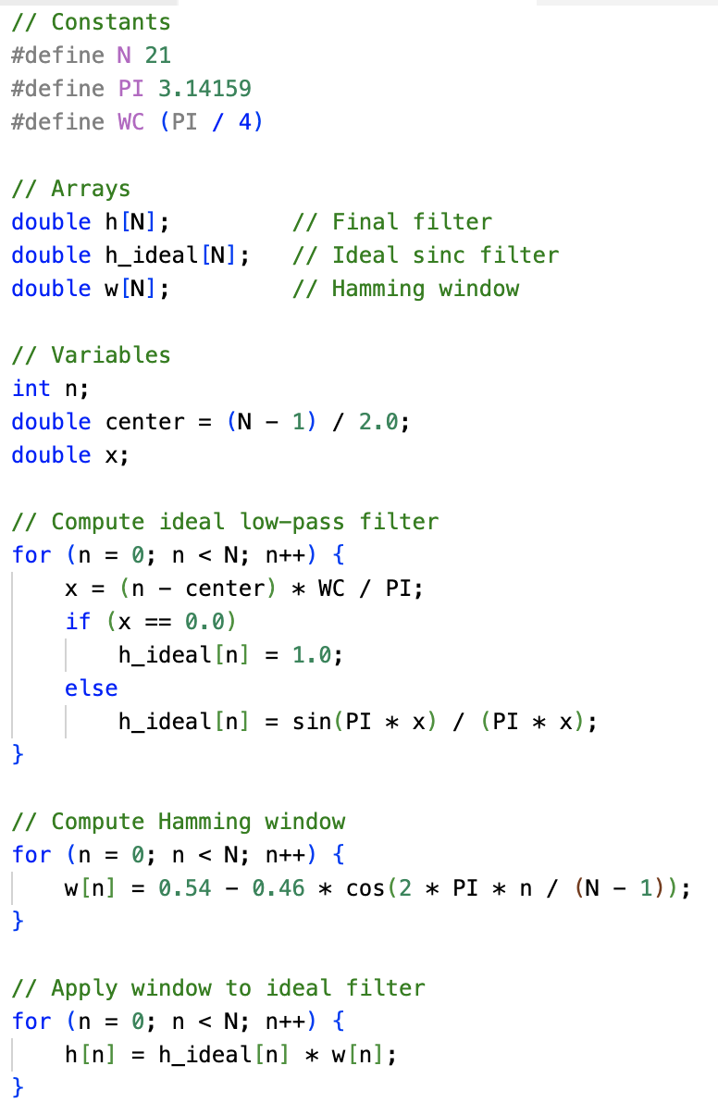
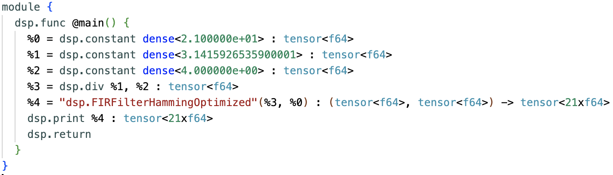
The FIR Filter Example – A Compiler's Perspective
DSP-DSL
C code
DSP-dialect
Notes:
Let’s stay with our FIR filter example from Slide 2. generally dsp applications are written in C or lowered to single level of IR representation which is lower than C level.
DSP-MLIR matches this pattern to a built-in operation: FilterHammingOptimized(wc, n) and automatically applies symmetry-aware optimization. We compute half the values and mirror them — cutting cost in half.

