Slide 1
Cooperative Driving of Connected Autonomous Vehicles using Responsibility Sensitive Safety rules
Harshith Allamsetti
Thesis Defense – June 3rd, 2020
Committee: Dr. Aviral Shrivastava, Dr. Arunabha Sen, Dr. Fengbo Ren

Slide 2
Autonomous Vehicles
There are two dimension to autonomy in vehicles:
  Self-Driving Vehicles – Vehicle performs maneuvers solely from sensing till the actuation.
  Connected Autonomous Vehicles – Vehicles perform driving by interacting with the environment around them.

Slide 3

Connected Autonomous Vehicles(CAV)
CAV - vehicle that is capable of automated driving and connectivity with other road users or the road infrastructure.
Have the capability to not only improve traffic safety, but also improve traffic mobility, efficiency and sustainability.

Slide 4
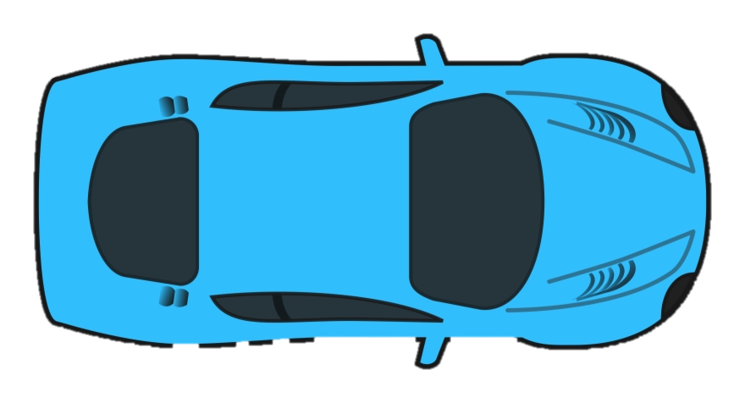
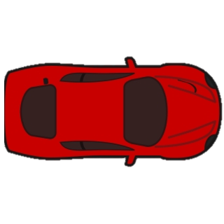
Conflicts between multiple CAVs
Arises when multiple CAV want to access the same physical space simultaneously, but only one can be in it at a given time.
Conflict zone
Conflict zone

Slide 5
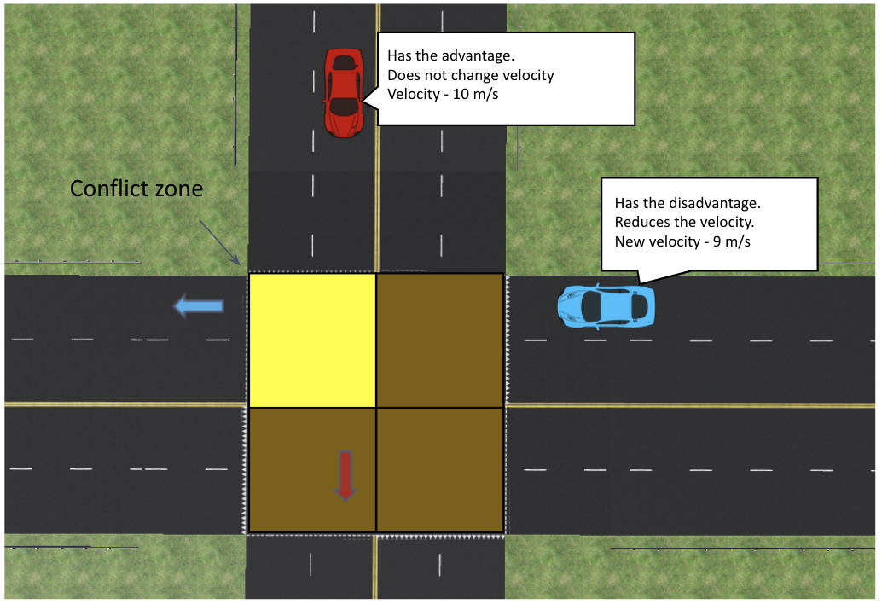
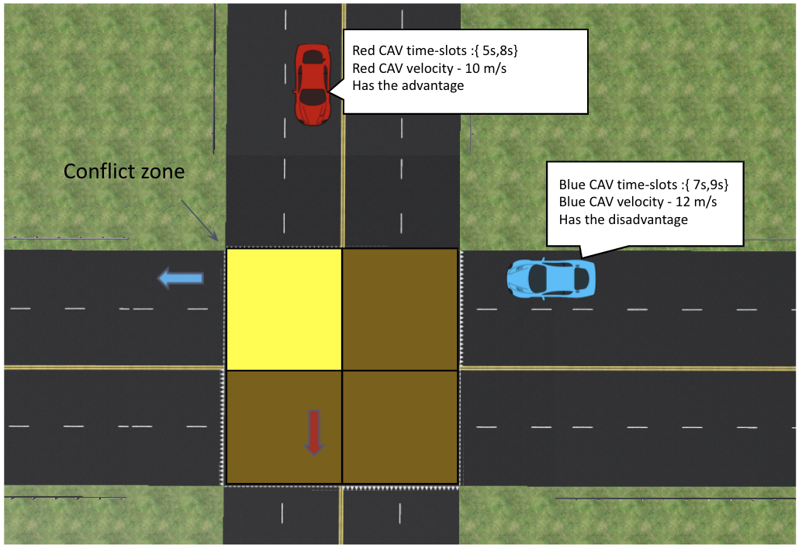
Previous Conflict Resolution technique
An intersection is divided into zones.
Each CAV broadcasts the entry and exit time for each zone - <Zone-{Time-in, Time-out}>
Each CAV determines if it has a conflict with each other CAV.
The CAV with the earlier arrival time has the advantage over the conflict zone.
The other CAV with the disadvantage will decrease its velocity such that there would be no conflict.
Liu, Changliu, et al. "Distributed conflict resolution for connected autonomous vehicles." IEEE Transactions on Intelligent Vehicles 3.1 (2017): 18-29.

Slide 6
Deadlocks in conflict resolution techniques
In general, deadlock can be defined as a situation where two tasks are unable to proceed further.
This occurs when each vehicle is yielding to the other vehicle to occupy the conflict zone.
A simple example - when two CAVs arrive at the intersection at the same instant and follow First Come First Serve principle.
Conflict zone

Slide 7
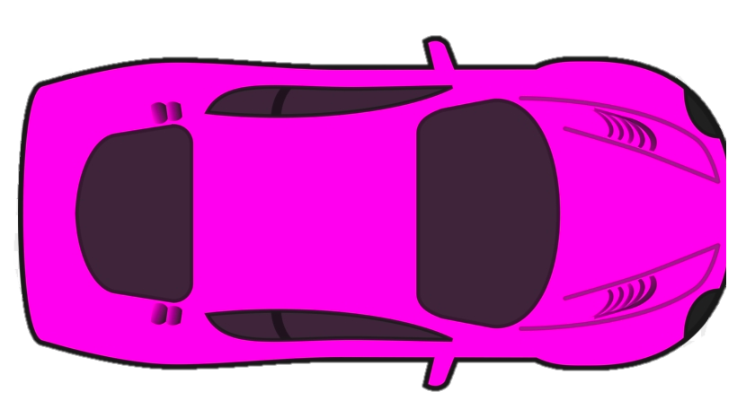
Deadlocks in conflict resolution techniques - example
A more complex deadlock scenario.
  Red CAV – has advantage in C1, disadvantage in C3
  Blue CAV – has advantage in C3, disadvantage in C4
  Pink CAV – has advantage in C4, disadvantage in C1.
Creates a yields-to cycle
C4: 5s, C1: 7s
C4
C3
C1
C2
Yields to
Yields to
Yields to
C1: 6s, C3: 9s
C3:6s , C4: 8s

Slide 8
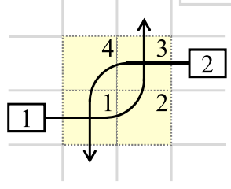
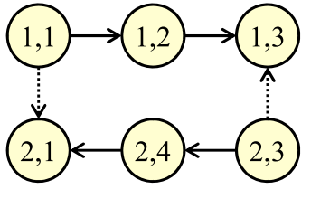
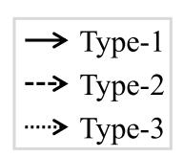
Previous Approach to deadlock resolution
Intersection is modelled as conflict zones.
Creates a timing conflict graph with a vertex present if a vehicle passes through a conflict zone.
Three types of edges -
  Type 1 exists when moving from one zone to another
  Type 2 exists when yielding to a vehicle in the same lane
  Type 3 exists when yielding for a vehicle on another lane
Source: https://dl.acm.org/doi/pdf/10.1145/3358221
Yi-Ting Lin et al. Graph-based modeling, scheduling, and verification for intersection management of intelligent vehicles. ACM Transactions on Embedded Computing Systems (TECS), 18(5s):1–21, 2019.

Slide 9
Previous Approach to deadlock resolution
Deadlocks are detected by creating a resource conflict graph from the timing conflict graph.
If a cycle is present in the resource conflict graph, there is a deadlock.
Deadlocks are removed by removing Type-3 edges in the decreasing order of cost edge.

Slide 10
Limitations of the previous approach
The previous technique can only be applied to CAVs when they are having conflicts at the intersection.
Cannot be extended to city wide traffic management as CAVs do not have conflicts just at intersections.
Cannot be used to detect deadlocks when a CAV will have conflicts not just at intersections but also has conflicts on the same lane or at a merge scenario.

Slide 11
Our Approach
Performs Conflict resolution for CAVs
Provides point-to-point driving solution for CAVs.
Based on V2V communication for sharing information.
Ensures safety by extending Responsibility Sensitive Safety rules for CAVs and providing a unified safety rule for different driving scenarios.
Deadlock detection and resolution for CAVs at different driving scenarios.

Slide 12
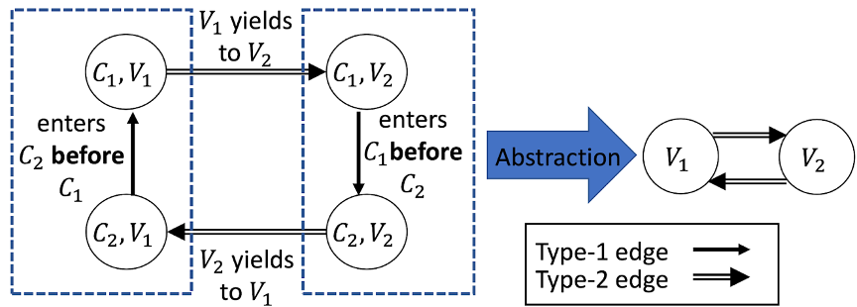
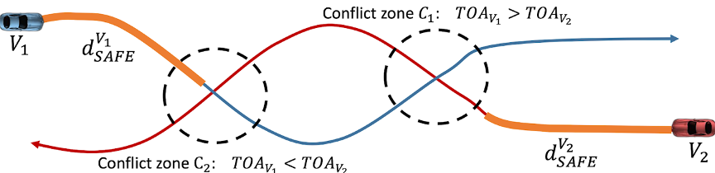
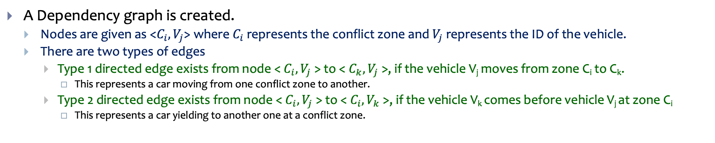
Our approach to deadlock resolution
A Dependency graph is created.
  Nodes are given as <$C_{i},V_{j}$> where $C_{i}$ represents the conflict zone and $V_{j}$represents the ID of the vehicle.
  There are two types of edges
    Type 1 directed edge exists from node < $C_{i},V_{j}$> to < $C_{k},V_{j}$>, if the vehicle V_{j} moves from zone C_{i} to C_{k}.
      This represents a car moving from one conflict zone to another.
    Type 2 directed edge exists from node < $C_{i},V_{j}$> to < $C_{i},V_{k}$>, if the vehicle V_{k} comes before vehicle V_{j} at zone C_{i}
      This represents a car yielding to another one at a conflict zone.

Slide 13
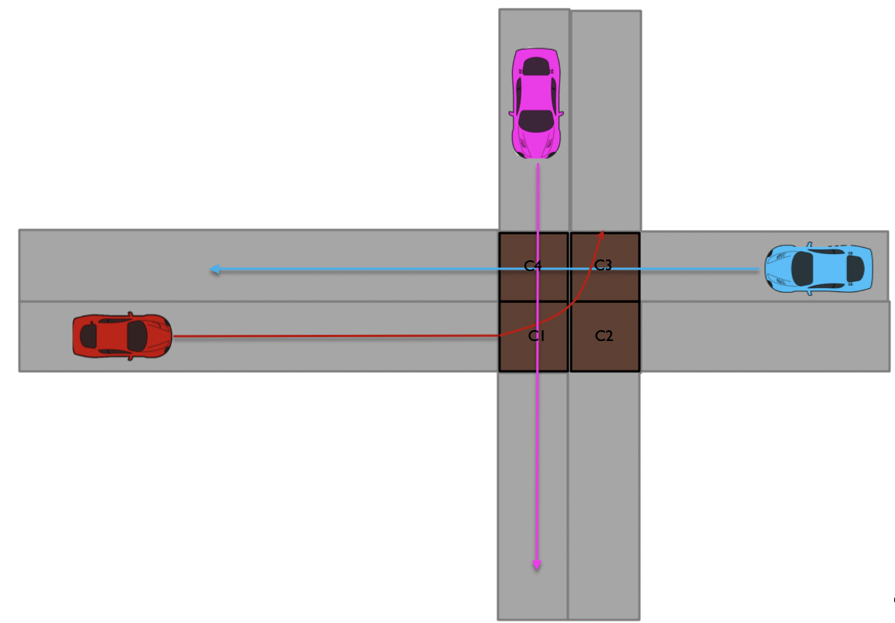
Our approach to deadlock resolution
The resulting graph is Partially Conflict Graph(PCG) which is then combined, so that the Complete Conflict Graph(CCG) is constructed by each vehicle.
(3)
C4: 5s, C1: 7s
(1)
(3)
(2)
Constructed CCG
C3:6s , C4: 8s
PCG of blue CAV
PCG of pink CAV
(3)
(2)
(1)
(3)
(1)
(2)
C5
(1)
(2)
PCG of orange CAV
(2)
(1)
(4)
(4)
(4)
C1: 6s, C3: 9s
C5: 2s
(3)
(4)
(1)
PCG of red CAV

Slide 14
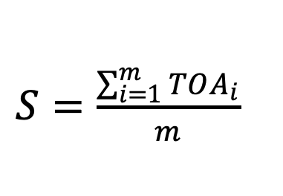
Our approach to deadlock resolution
If a cycle exists, a deadlock is detected, and a score is computed in order to remove the cycles.
The outgoing edges from the nodes with least score is removed and process is repeated until all the cycles are removed.
$S=\frac{\sum_{i=1}^{m}{TOA_{i}}}{m}$
(3)
(3)
(1)
(2)
(1)
(2)
Scores: (1) – (9+6+2)/3 = 5.33
(2) – (8+6)/2 = 7
(3) – (5+7)/2 = 6
(4)
(4)

Slide 15
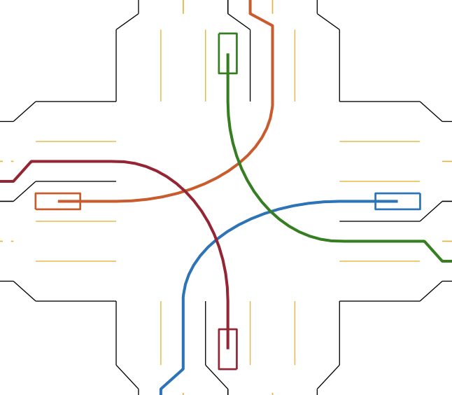
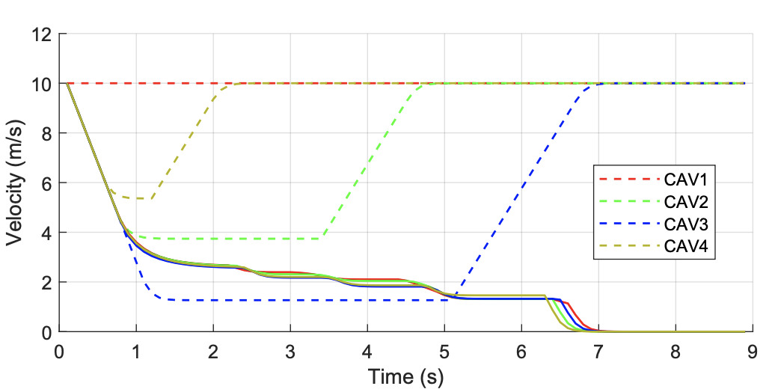
Deadlock resolution evaluation
A deadlock situation is created at an intersection. All the CAVs are at the same distance from the intersection and have conflicts at the intersection.
The blocked graph represents the velocity profile of the CAVs without deadlock resolution and the dotted graph represent the velocity profile of the CAVs with deadlock resolution.

Slide 16
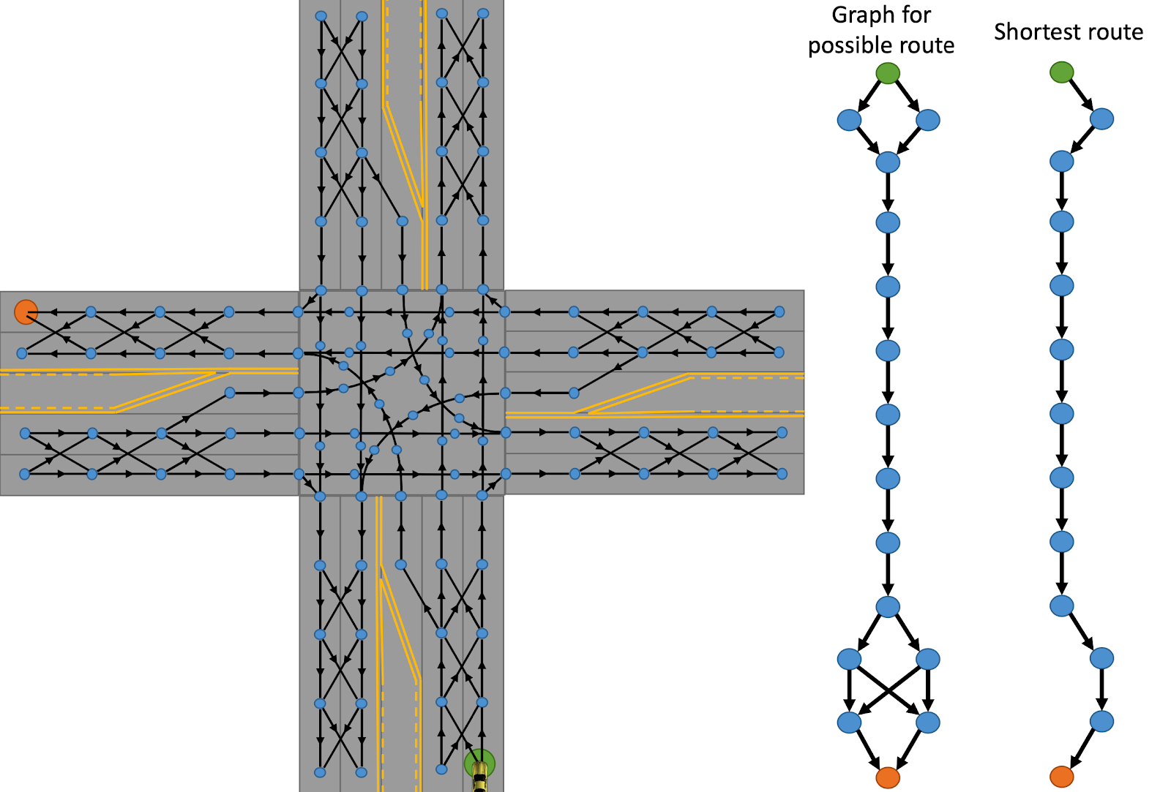
How is routing done?
Done using the global planner.
Made of a directed map graph.
Nodes are unique waypoints and edges represent the path between the waypoints.
Uses the Dijkstra’s algorithm

Slide 17
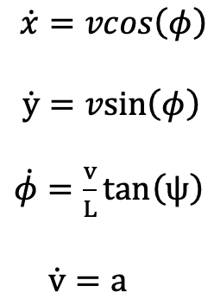
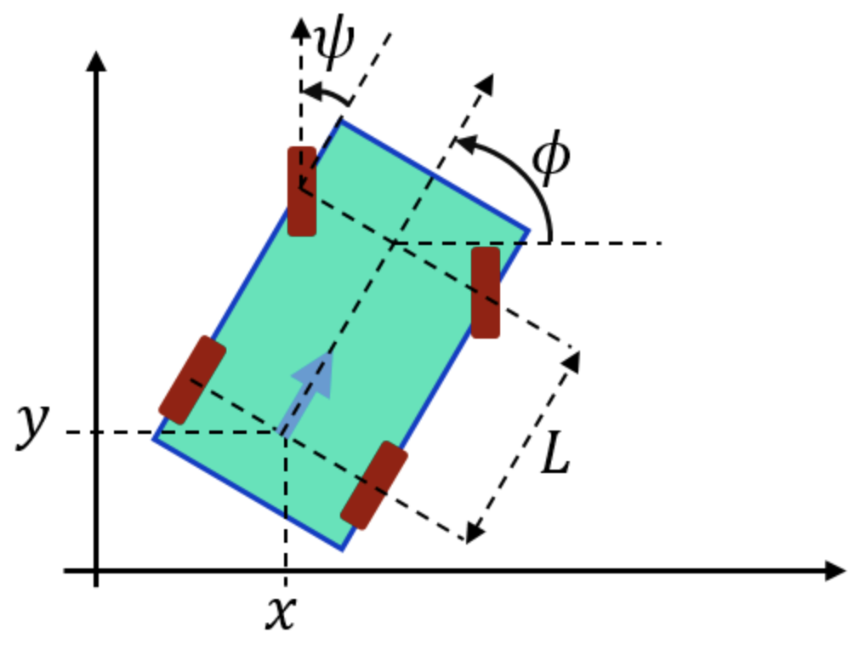
Broadcast of future trajectory
After determining the set of waypoints, each CAV predicts the future trajectory using the kinematic bicycle model.
The predicted trajectory along with the arrival times is broadcasted so that other CAVs can receive the information.

Slide 18
Conflict resolution
Each of the CAVs determine who has the advantage.
Once a CAV determines it has disadvantage, it resolves the conflict by one of the following:
  Search for an alternate path
  If no alternate path exits, the CAV with disadvantage lowers its velocity.
I have advantage
I have disadvantage, I have no alternate path and so I will lower my velocity

Slide 19
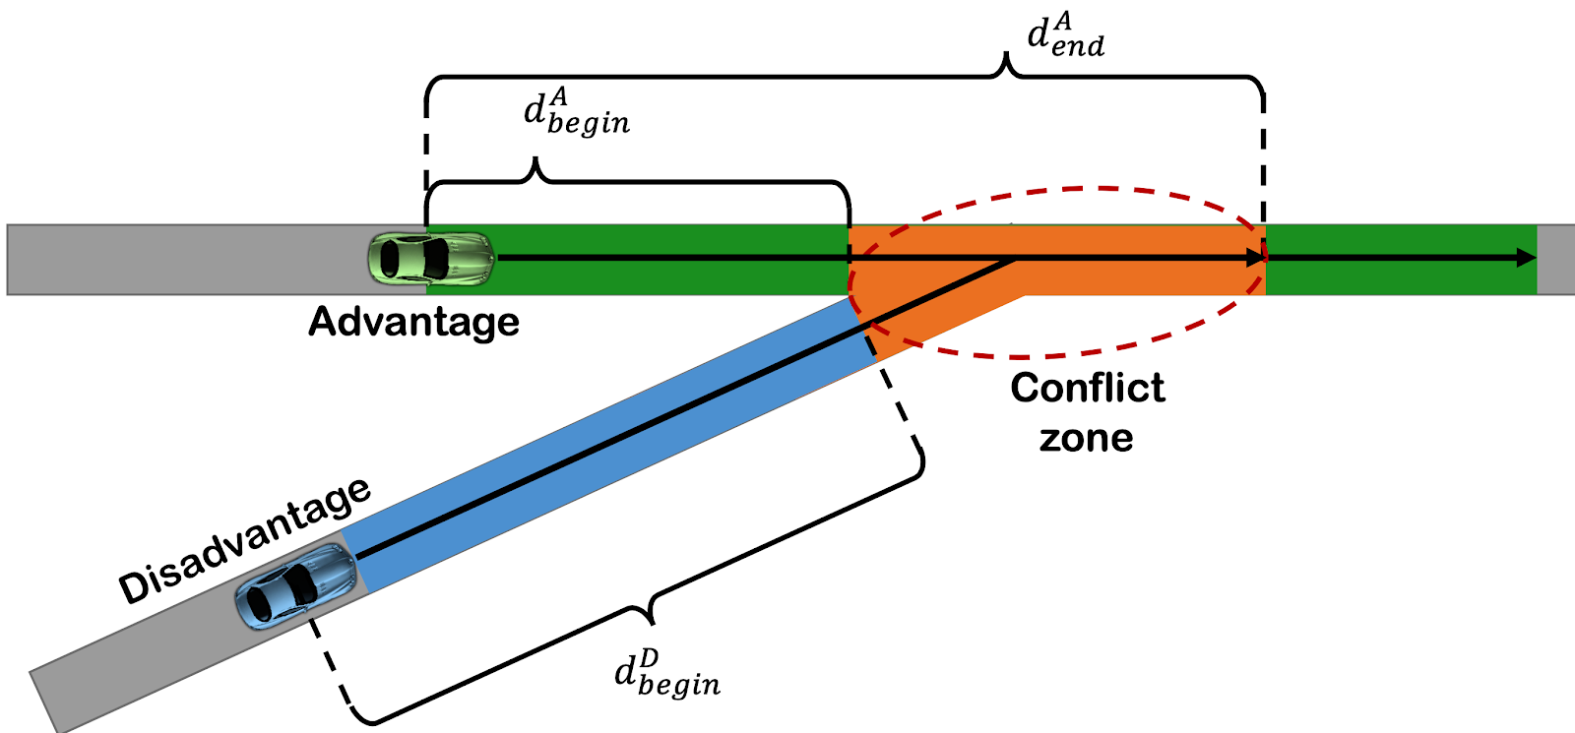
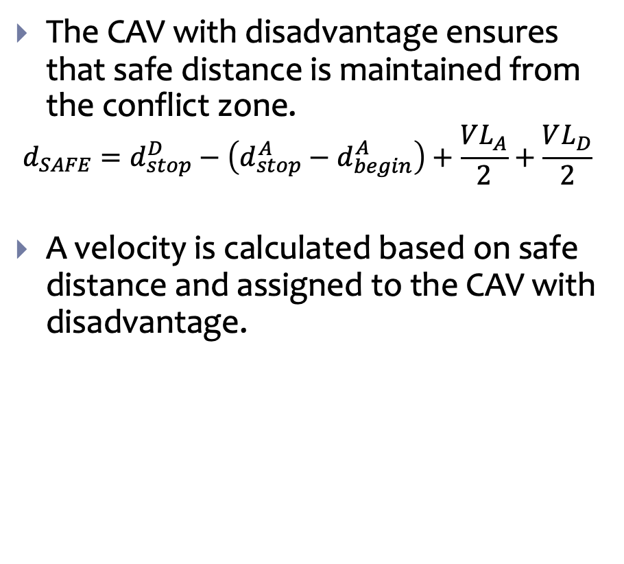
Safe Distance calculation
The CAV with disadvantage ensures that safe distance is maintained from the conflict zone.
$$d_{SAFE}=d_{stop}^{D}−\left(d_{stop}^{A}−d_{begin}^{A}\right)+\frac{VL_{A}}{2}+\frac{VL_{D}}{2}$$
A velocity is calculated based on safe distance and assigned to the CAV with disadvantage.

Slide 20
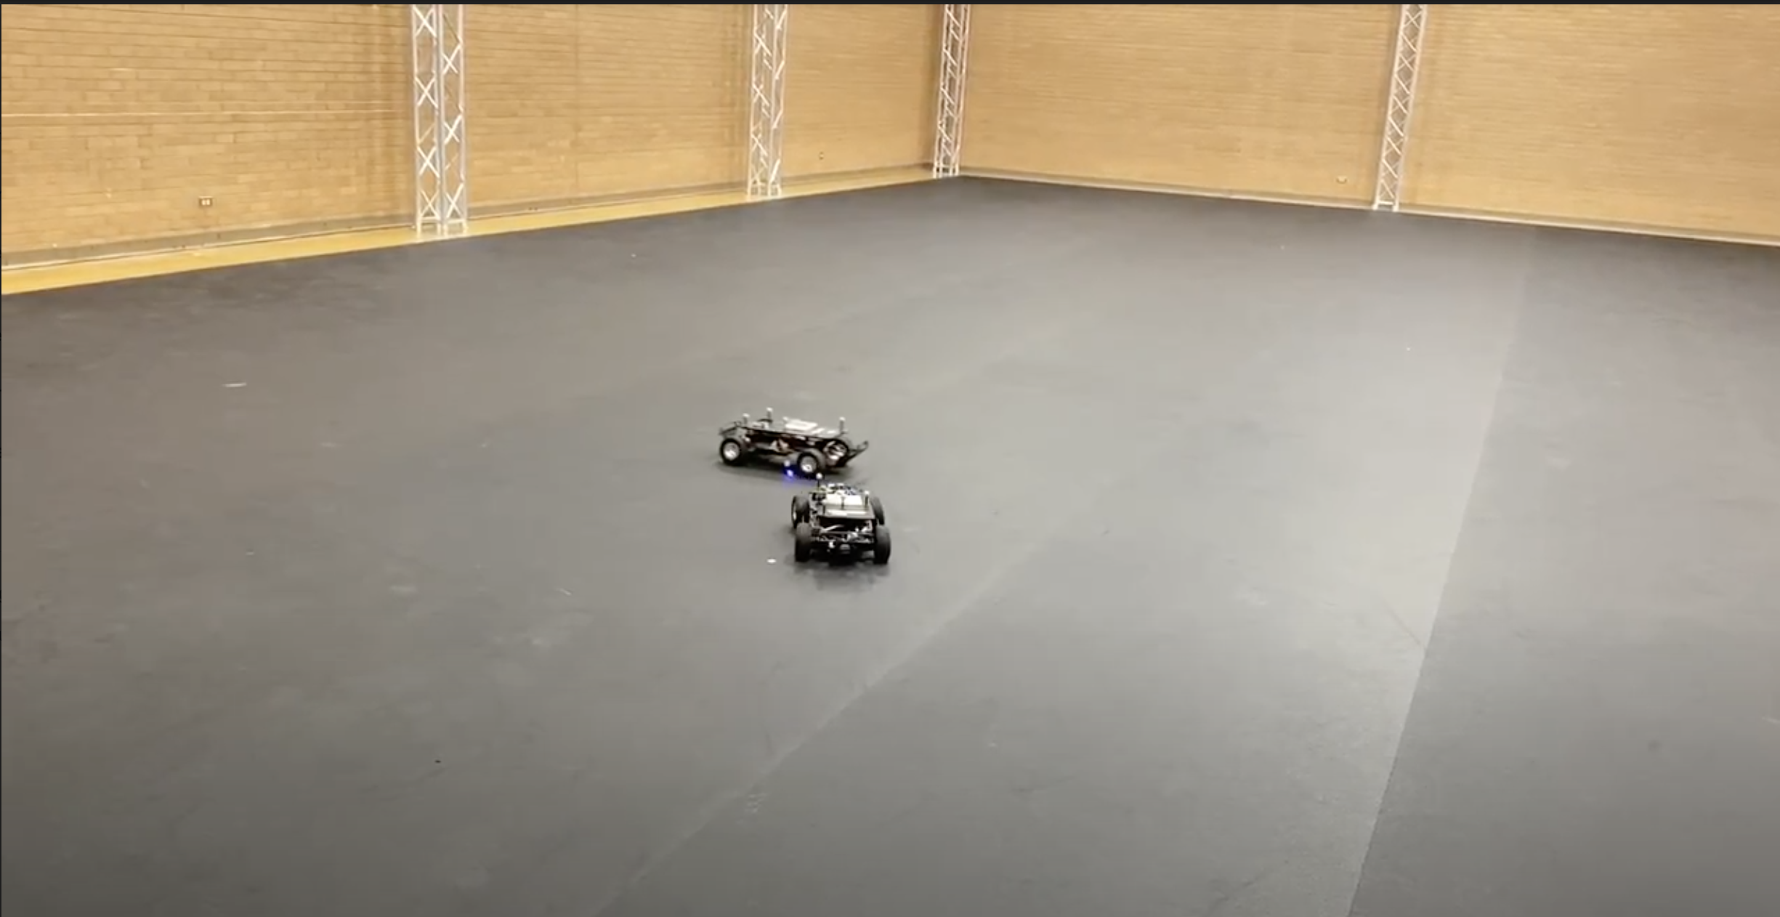
Conflict resolution demonstration on scaled RC cars
Conflict resolution demonstration on scaled RC cars at an intersection.
Tested to study the effect of communication and computation delay inherent in CAVs
Cars equipped with Wi-Fi modules for broadcasting and receiving information.
Whenever there is a conflict, the CAV with disadvantage lowers its velocity and maintains safe distance.

Slide 21
Summary
A conflict resolution algorithm for CAVs for city-wide traffic management using V2V communication.
Ensures safety by considering the worst-case behavior.
Able to detect and resolve deadlocks between CAVs.
A complete solution for point to point navigation of CAVs.

Slide 22
Thank you

Slide 23
Backup Slides

Slide 24
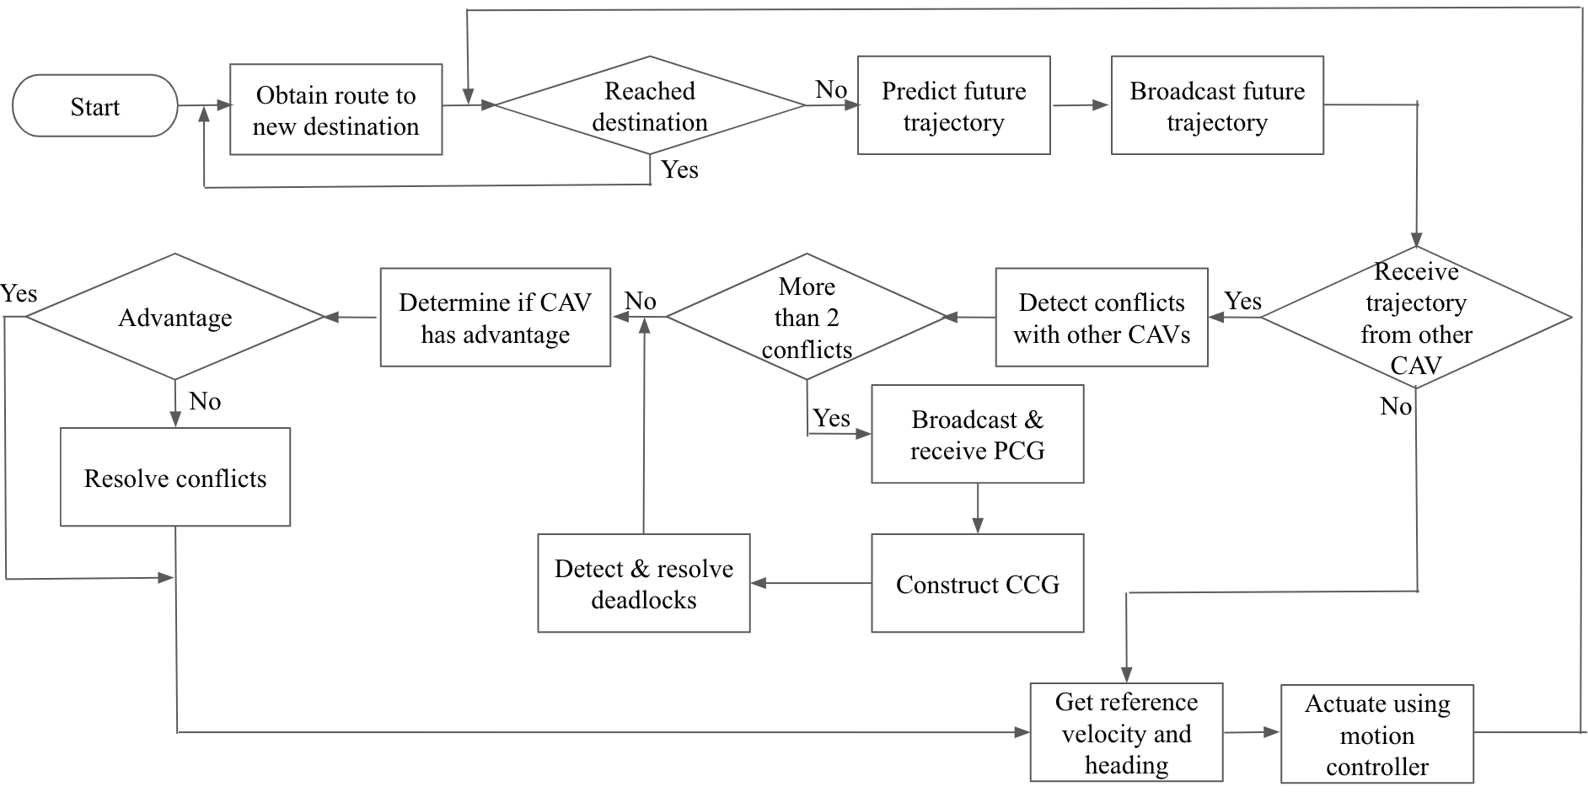
Flowchart of the algorithm

Slide 25
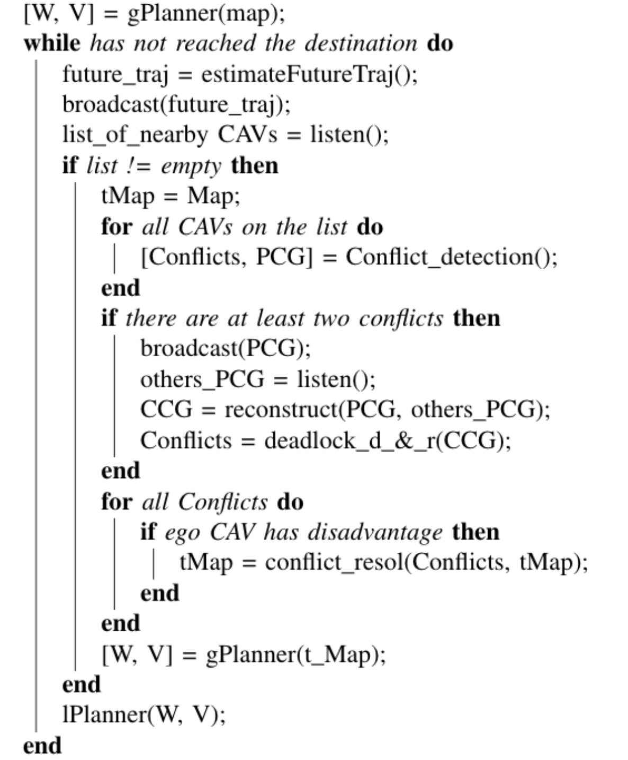
Pseudocode of the algorithm

Slide 26
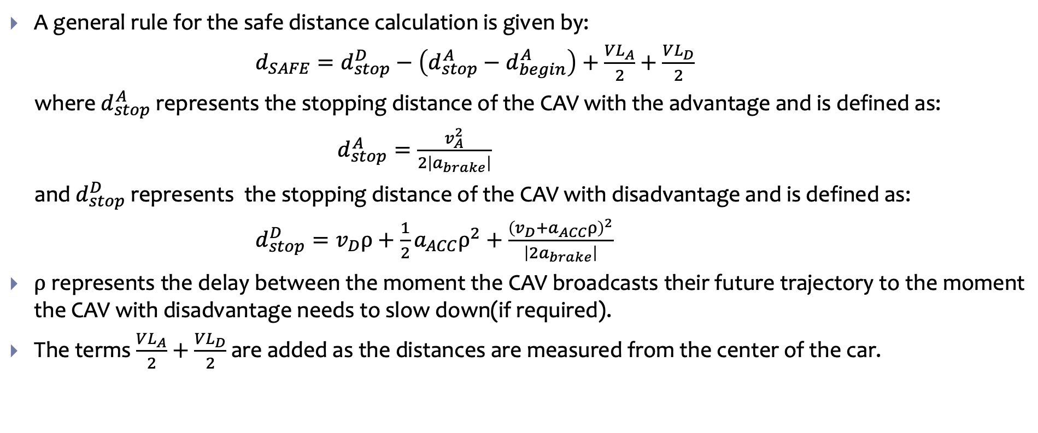
Safe Distance Calculation
A general rule for the safe distance calculation is given by:
$d_{SAFE}=d_{stop}^{D}−\left(d_{stop}^{A}−d_{begin}^{A}\right)+\frac{VL_{A}}{2}+\frac{VL_{D}}{2}$
where $d_{stop}^{A}$represents the stopping distance of the CAV with the advantage and is defined as:
$d_{stop}^{A}=\frac{v_{A}^{2}}{2\left|a_{brake}\right|}$
and $d_{stop}^{D}$represents the stopping distance of the CAV with disadvantage and is defined as:
$d_{stop}^{D}=v_{D}ρ+\frac{1}{2}a_{ACC}ρ^{2}+\frac{{\left(v_{D}+a_{ACC}ρ\right)}^{2}}{\left|2a_{brake}\right|}$
$ρ$ represents the delay between the moment the CAV broadcasts their future trajectory to the moment the CAV with disadvantage needs to slow down(if required).
The terms $\frac{VL_{A}}{2}+\frac{VL_{D}}{2}$ are added as the distances are measured from the center of the car.

Slide 27
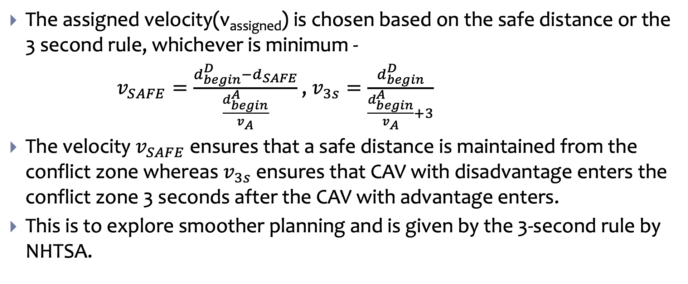
Safe velocity calculation
The assigned velocity(v_{assigned}) is chosen based on the safe distance or the 3 second rule, whichever is minimum -
$v_{SAFE}=\frac{d_{begin}^{D}−d_{SAFE}}{\frac{d_{begin}^{A}}{v_{A}}}$ , $v_{3s}=\frac{d_{begin}^{D}}{\frac{d_{begin}^{A}}{v_{A}}+3}$
The velocity $v_{SAFE}$ ensures that a safe distance is maintained from the conflict zone whereas $v_{3s}$ ensures that CAV with disadvantage enters the conflict zone 3 seconds after the CAV with advantage enters.
This is to explore smoother planning and is given by the 3-second rule by NHTSA.

