Slide 1
A SOFTWARE-ONLY SOLUTION TO STACK DATA MANAGEMENT ON SYSTEMS WITH SCRATCH PAD MEMORY
Arun Kannan
14th October 2008
Compiler and Micro-architecture Lab
Computer Science and Engineering
Arizona State University

Slide 2
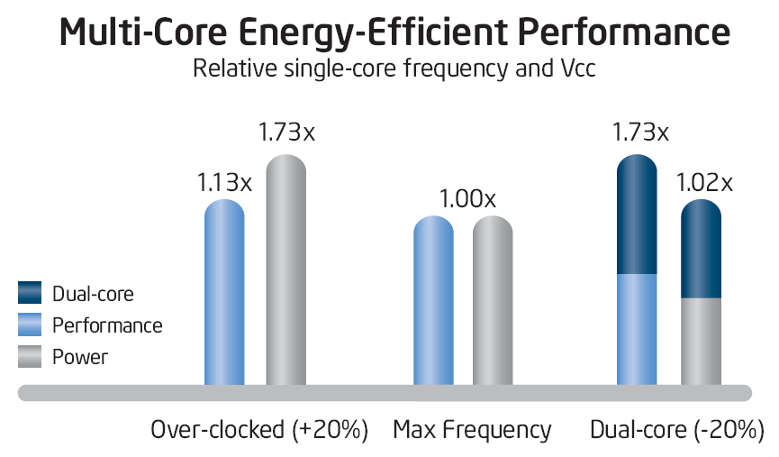
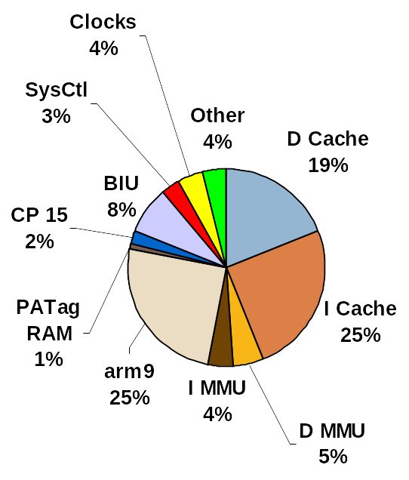
Multi-core Architecture Trends
Multi-core Advantage
  Lower operating frequency
  Simpler in design
  Scales well in power consumption
New Architectures are ‘Many-core’
  IBM Cell (10-core)
  Intel Tera-Scale (80-core) prototype
Challenges
  Scalable memory hierarchy
  Cache coherency problems magnify
  Need power-efficient memory (Caches consume 44% in core)
Distributed Memory architectures are getting popular
  Uses alternative low latency, on-chip memories, called Scratch Pads
  eg: IBM Cell Processor Local Stores
Notes:
Moving to multi-core was inevitable to get performance improvements we have enjoyed over the past two decades
Graph:
-> We add a second core on the under-clocked example. This results in a dual-core processor that at 20% reduced clock frequency effectively delivers 73% more performance while using approximately the same power as a single-core
processor at maximum frequency
Early multi-cores were based on the shared memory architecture
What happens if we have 100’s of cores?
Shared memory architectures are not scalable and can limit the potential performance available, Cache coherency is a problem

Slide 3
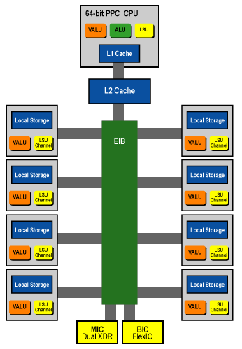
Scratch Pad Memory (SPM)
High speed SRAM internal memory for CPU
Directly mapped to processor’s address space
SPM is at the same level as L1-Caches in memory hierarchy
SPM
SPM
RAM
CPU
CPU Registers
L2 Cache
L1 Cache
IBM Cell Architecture

Slide 4
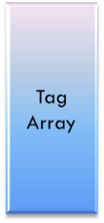
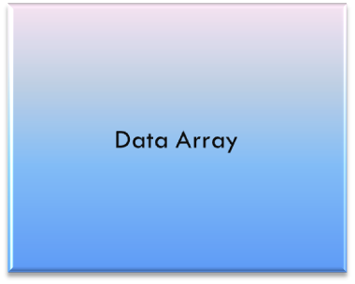
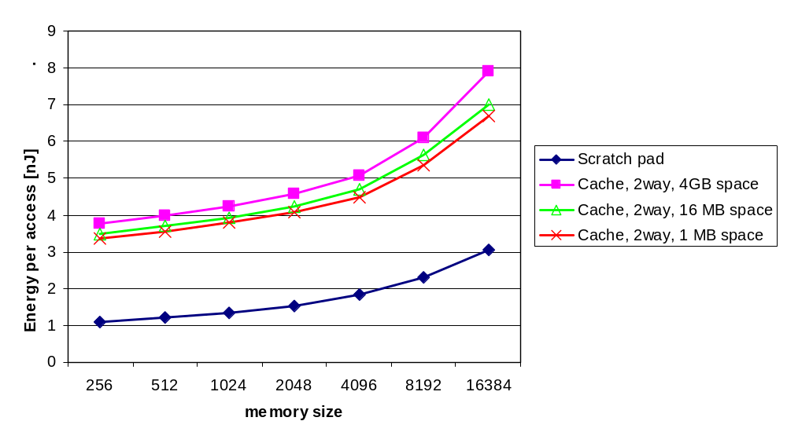

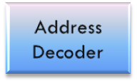
SPM more power efficient than Cache
Tag Array
Data Array
Tag Comparators, Muxes
Address Decoder
Cache
SPM
40% less energy as compared to cache
  Absence of tag arrays, comparators and muxes
34 % less area as compared to cache of same size
  Simple hardware design (only a memory array & address decoding circuitry)
Faster access to SPM than cache

Slide 5
Agenda
Trend towards distributed-memory multi-core architectures
Scratch Pad Memory is scalable and power-efficient
Problems and Objectives
Related work
Proposed Technique
An Optimization
An Extension
Experimental Results
Conclusions

Slide 6
Using SPM
What if the SPM cannot fit all the data?
int global;
f1(){
int a,b;
global = a + b;
f2();
}
int global;
f1(){
int a,b;
DSPM.fetch(global)
global = a + b;
DSPM.writeback(global)
ISPM.fetch(f2)
f2();
}
Original Code
SPM Aware Code
Notes:
The biggest challenge and difference is in the explicit management of SPM contents
Caches are completely transparent to the application!

Slide 7
What do we need to use SPM?
Partition available SPM resource among different data
  Global, code, stack, heap
Identifying data which will benefit from placement in SPM
  Frequently accessed data
Minimize data movement to/from SPM
  Coarse granularity of data transfer
Optimal data allocation is an NP-complete problem
Binary Compatibility
  Application compiled for specific SPM size
Need completely automated solutions

Slide 8
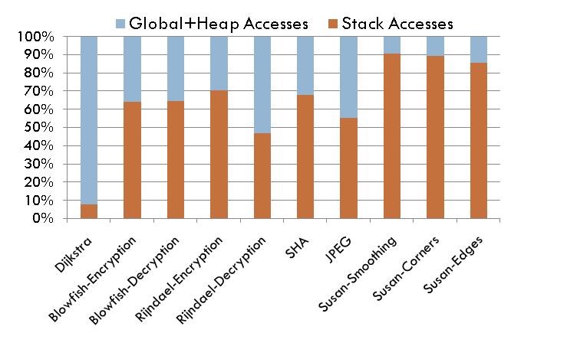
Application Data Mapping
Objective
  Reduce Energy consumption
  Minimal performance overhead
Each type of data has different characteristics
  Global Data
    ‘live’ throughout execution
    Size known at compile-time
  Stack Data
    ‘liveness’ depends on call path
    Size known at compile-time
    Stack depth unknown
  Heap Data
    Extremely dynamic
    Size unknown at compile-time
MiBench Suite
Stack data enjoys 64.29%
of total data accesses

Slide 9
Challenges in Stack Management
Stack data challenge
  ‘live’ only in active call path
  Multiple objects of same name exist at different addresses (recursion)
  Address of data depends on call path traversed
  Estimation of stack depth may not be possible at compile-time
  Level of granularity (variables, frames)
Goals
  Provide a pure-software solution to stack management
  Achieve energy savings with minimal performance overhead
  Solution should be scalable and binary compatible

Slide 10
Agenda
Trend towards distributed-memory multi-core architectures
Scratch Pad Memory is scalable and power-efficient
Problems and Objectives
Related work
Proposed Technique
An Optimization
An Extension
Experimental Results
Conclusions

Slide 11
Need Dynamic Mapping Techniques
SPM
Static
Dynamic
Static Techniques
  The contents of the SPM remain constant throughout the execution of the program
Dynamic Techniques
  Contents of SPM adapt to the access pattern in different regions of a program
  Dynamic techniques have proven superior

Slide 12
Cannot use Profile-based Methods
SPM
Static
Dynamic
Profile-based
Non-Profile
Profiling
  Get the data access pattern
  Use an ILP to get the optimal placement or a heuristic
Drawbacks
  Profile may depend heavily depend on input data set
  Infeasible for larger applications
  ILP solutions do not scale well with problem size
Notes:
Profile based methods are very popular. Most techniques use profiling as their basis.
Keeping feasibility in mind, we cannot depend on profiling forever…

Slide 13
Need Software Solutions
SPM
Static
Dynamic
Profile-based
Non-Profile
Hardware
Software
Use additional/modified hardware to perform SPM management
  SPM managed as pages, requires an SPM aware MMU hardware
Drawbacks
  Require architectural change
  Binary compatibility
  Loss of portability
  Increases cost, complexity

Slide 14
Agenda
Trend towards distributed-memory multi-core architectures
Scratch Pad Memory is scalable and power-efficient
Problems and Objectives
Limitations of previous efforts
Our Approach: Circular Stack Management
An Optimization
An Extension
Experimental Results
Conclusions

Slide 15
Circular Stack Management
F4
SPM Size = 128 bytes
F1
F2
F3
Old
SP
dramSP
F1
F4
28
F2
54
Function | Frame Size (bytes)
F1 | 28
F2 | 40
F3 | 60
F4 | 54
68
F3
128
SPM
DRAM
Notes:
We take an example to understand the concept of circular stack management …
Given a simple program, shown by its call graph
The table shows the frame size for each function
We want to manage the active stack of a program on SPM with the goal of saving energy and improving performance

Slide 16
Circular Stack Management
Manage the active portion of application stack data on SPM
Granularity of stack frames chosen to minimize management overhead
  Eviction also performed in units of stack frames
Who does this management?
  Software SPM Manager
  Compiler framework to instrument the application
It is a dynamic, profile-independent, software technique

Slide 17
Software SPM Manager (SPMM) Operation
Function Table
  Compile-time generated structure
  Stores function id and its stack frame size
The system SPM size is determined at run-time during initialization
Before each user function call, SPMM checks
  Required function frame size from Function Table
  Check for available space in SPM
  Move old frame(s) to DRAM if needed
On return from each user function call, SPMM checks
  Check if the parent frame exists in SPM!
  Fetch from DRAM, if it is absent

Slide 18
Software SPM Manager Library
Software Memory Manager used to maintain active stack on SPM
SPMM is a library linked with the application
  spmm_check_in(int);
  spmm_check_out(int);
  spmm_init();
Compiler instruments the application to insert required calls to SPMM
spmm_check_in(Foo);
Foo();
spmm_check_out(Foo);

Slide 19
SPMM Challenges
SPMM needs some stack space itself
  Managed on a reserved stack area
SPMM does not use standard library functions to minimize overhead
Concerns
  Performance degradation due to excessive calls to SPMM
  Operation of SPMM for applications with pointers

Slide 20
Agenda
Trend towards distributed-memory multi-core architectures
Scratch Pad Memory is scalable and power-efficient
Problems and Objectives
Limitations of previous efforts
Circular Stack Management
Challenges
  Call Overhead Reduction
  Extension for Pointers
Experimental Results
Conclusions

Slide 21
Call Overhead Reduction
SPMM calls overhead can be high
Three common cases
Opportunities to reduce repeated SPMM calls by consolidation
Need both, the call flow and control flow graph
spmm_check_in(F1);
F1();
spmm_check_out(F1);
spmm_check_in(F2);
F2();
spmm_check_out(F2);
spmm_check_in(F1,F2);
F1();
F2();
spmm_check_out(F1,F2)
spmm_check_in(F1)
F1(){
spmm_check_in(F2);
F2();
spmm_check_out(F2);
}
spmm_check_out(F1)
spmm_check_in(F1,F2);
F1(){
F2();
}
spmm_check_out(F1,F2);
while(<condition>){
spmm_check_in(F1);
F1();
spmm_check_out(F1);
}
spmm_check_in(F1);
while(<condition>){
F1();
}
spmm_check_out(F1);
Sequential Calls
Nested Call
Call in loop

Slide 22
Global Call Control Flow Graph (GCCFG)
MAIN ( )
F1( )
for
F2 ( )
end for
END MAIN
F5 (condition)
if (condition)
condition = …
F5()
end if
END F5
F2 ( )
for
F6 ( )
F3 ( )
while
F4 ( )
end while
end for
F5()
END F2
main
F1
L1
F2
F5
L2
L3
F6
F3
F4
Advantages
  Strict ordering among the nodes. Left child is called before the right child
  Control information included (Loop nodes )
  Recursive functions identified

Slide 23
Optimization using GCCFG
Main
Main
F1
SPMM in
F1+ max(F2,F3)
SPMM in F1
SPMM out F1
F1
SPMM out
F1+ max(F2,F3)
L1
F2
F3
GCCFG
SPMM in max(F2,F3)
L1
SPMM out max(F2,F3)
SPMM in max(F2,F3)
SPMM in F2
F2
SPMM out F2
SPMM in F3
F3
SPMM out F3
SPMM out max(F2,F3)
GCCFG un-optimized
GCCFG - Sequence
GCCFG - Nested
GCCFG - Loop

Slide 24
Agenda
Trend towards distributed-memory multi-core architectures
Scratch Pad Memory is scalable and power-efficient
Problems and Objectives
Limitations of previous efforts
Circular Stack Management
Challenges
  Call Overhead Reduction
  Extension for Pointers
Experimental Results
Conclusions

Slide 25
Run-time Pointer-to-Stack Resolution
The Pointer threat
bar_{k=1}
Old
SP
dramSP
void foo(void){
int local = -1;
int k = 8;
bar(k,&local)
print(“%d”,local);
}
void bar(int k, int *ptr){
if (k == 1){
*ptr = 1000;
return;
}
bar(--k,ptr);
}
400
foo
local
24
424
32
bar_{k=5}
56
bar_{k=4}
80
bar_{k=3}
104
bar_{k=2}
128
foo
bar_{k=5}
bar_{k=4}
SPM
DRAM
bar_{k=3}
bar_{k=2}
bar_{k=1}
SPMM call before bar_{k=1} inspects the pointer argument
i.e. address of variable ‘local’ = 24
SPM State List
Uses SPM State List to get new address 424

Slide 26
The Pointer Threat
Circular stack management can corrupt some pointer-to-stack references
Need to ensure correctness of program execution
Pointers to global/heap data are unaffected
Detection and analyzing all pointers-to-stack is a non-trivial problem
Assumptions
  Data from other stack frames accessed only through pointers arguments
  There is no type-casting in the program
  Pointers-to-stack are not passed within structure arguments

Slide 27
Run-time Pointer-to-Stack Resolution
Additional software overhead to ensure correctness
For the given assumptions
  Applications with pointers can still run correctly
Stronger static analysis can allow support for more benchmarks

Slide 28
Agenda
Trend towards distributed-memory multi-core architectures
Scratch Pad Memory is scalable and power-efficient
Problems and Objectives
Limitations of previous efforts
Circular Stack Management
Challenges
  Call Reduction Optimization
  Extension for Pointers
Experimental Results
Conclusions

Slide 29
Experimental Setup
Cycle accurate SimpleScalar simulator for ARM
MiBench suite of embedded applications
Energy models
  Obtained from CACTI 5.2 for SPM
  Obtained from datasheet for Samsung Mobile SDRAM
SPM size is chosen based on maximum function stack frame in application
Compare Energy and Performance for
  System without SPM, 1k cache (Baseline)
  System with SPM
    Circular stack management (SPMM)
    SPMM optimized using GCCFG (GCCFG)
    SPMM with pointer resolution (SPMM-Pointer)

Slide 30

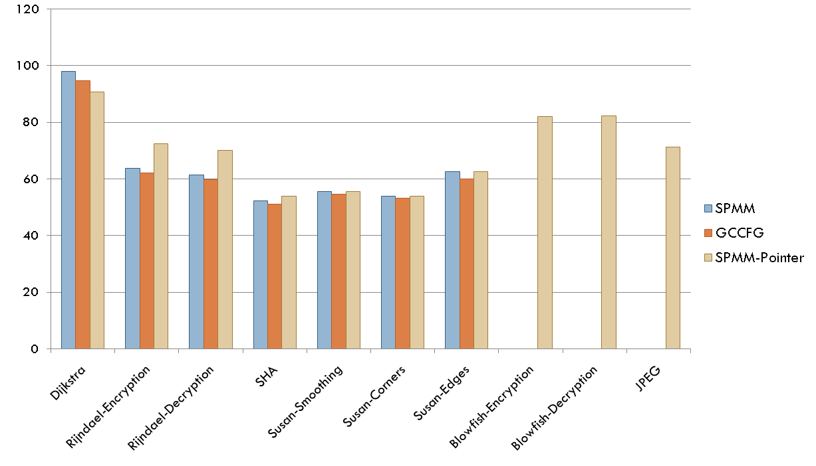
Energy Reduction
Baseline
Average 37% reduction with SPMM combined with GCCFG optimization

Slide 31

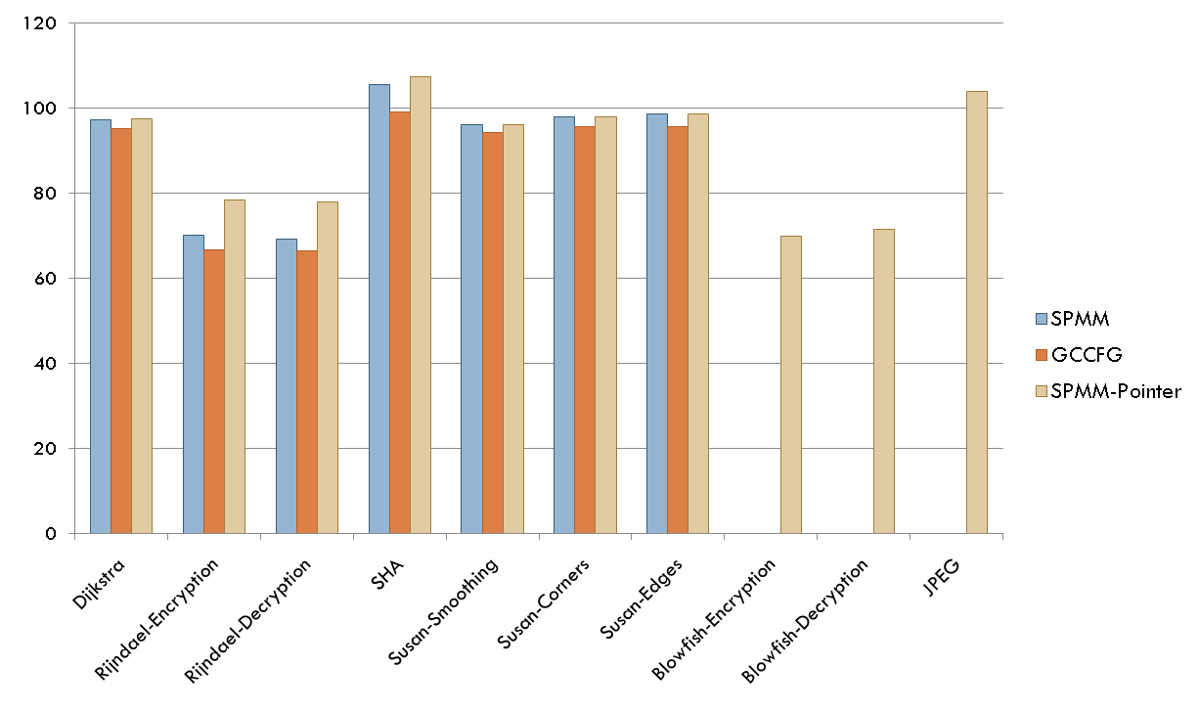
Performance Improvement
Baseline
Average 18% performance improvement with SPMM combined with GCCFG

Slide 32
Agenda
Trend towards distributed-memory multi-core architectures
Scratch Pad Memory is scalable and power-efficient
Problems and Objectives
Limitations of previous efforts
Circular Stack Management
Challenges
  Call Reduction Optimization
  Extension for Pointers
Experimental Results
Conclusions

Slide 33
Conclusions
Proposed a dynamic, pure-software stack management technique on SPM
Achieved average energy reduction of 32% with performance improvement of 13%
The GCCFG-based static analysis method reduces overhead of SPMM calls
Proposed an extension to use SPMM for applications with pointers

Slide 34
Future Directions
A static tool to check for assumptions of run-time pointer resolution
  Is it possible to statically analyze?
    If yes, Pointer-safe SPM size
What if the max. function stack > SPM stack partition?
How to decide the size of stack partition?
How to dynamically change the stack partition on SPM
    Based on run-time information

Slide 35
Research Papers
“A Software Solution for Dynamic Stack Management on Scratch Pad Memory”
  Accepted in the 14th Asia and South Pacific Design Automation Conference, ASPDAC 2009
“SDRM: Simultaneous Determination of Regions and Function-to-Region Mapping for Scratchpad Memories”
  Accepted in the 15th IEEE International Conference on High Performance Computing, HiPC 2008
“A Software-only solution to stack data management on systems with scratch pad memory”
  To be submitted in IEEE Transactions on Computer-aided Design
“SPMs: Life Beyond Embedded Systems”
  To be submitted in IEEE Transactions on Computer-aided Design

Slide 36
Thank you!

Slide 37
Additional Slides

Slide 38
Application Data Mapping
Objective
  Reduce Energy consumption
  Minimal performance overhead
Each type of data has different characteristics
  Global Data
    ‘live’ throughout the execution
    Constant address
    Size known at compile-time
  Stack Data
    ‘live’ in active call path
    Multiple objects of same name exist at different addresses (recursion)
    Address of data depends on call path traversed
    Size known at compile-time
    Stack depth cannot be estimated at compile-time
  Heap Data
    ‘liveness’ may vary dependent on program
    Address constant, known only at run-time
    Size dependent on input-data

Slide 39
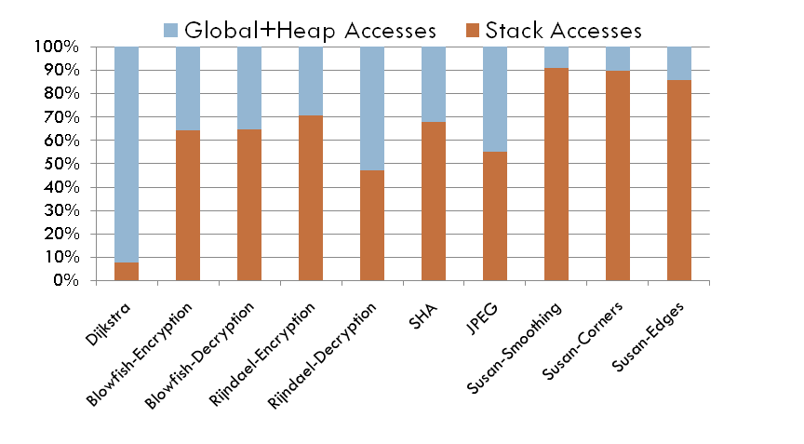
Stack Data Management on SPM
MiBench Benchmark of Embedded Applications
Stack data enjoy 64.29% of total data accesses
The Objective
  Provide a pure-software solution to stack management
  Achieve energy savings with minimal performance overhead
  Solution should be scalable and binary compatible
Notes:
MiBench consists of applications in image processing, cryptography and networks
We concentrate of stack data owing to its significant share of accesses

Slide 40
Taxonomy
SPM
Static
Dynamic
Profile-based
Non-Profile
Hardware
Software
Notes:
Here is a taxonomy of the research work on SPM
We would like to quickly look at the related work while trying to distinguish our work at the same time
Broadly, we have techniques which fall under static and dynamic

Slide 41
Need for methods which are …
Pure software
Dynamic – SPM contents can change during execution
Works on static analysis
Does not require profiling the application
Scales for any size/type of application (embedded, general purpose)
Does not impose architectural changes
Maintains binary compatibility

Slide 42
SPMM Data Structures
Function Table
  Compile-time generated structure
  Stores function Id and its stack frame size
SPM State List
  Run-time generated structure
  Holds the list of current active stack frames in call order
  Each node of the list contains
    Start address of the frame in SPM
    Number of evicted bytes of parent frame(s)
Global pointers to stack areas
  SP for SPM area (program stack)
  SP for SPMM (manager stack)
  Pointer to top of evicted frames in DRAM
  Pointer to oldest frame in SPM

Slide 43
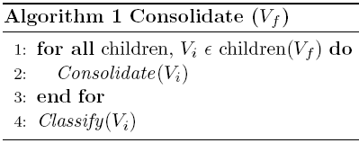
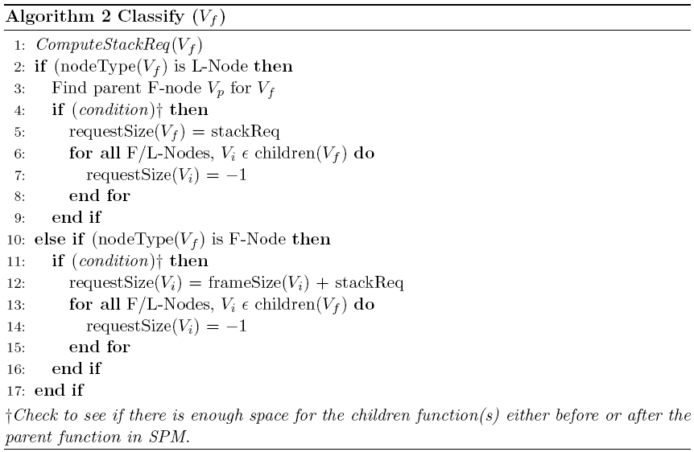
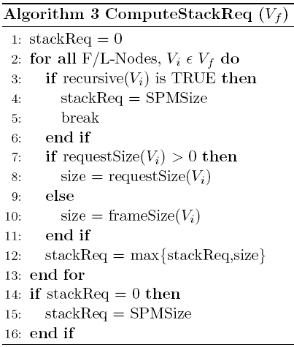
Call Consolidation Algorithm

Slide 44

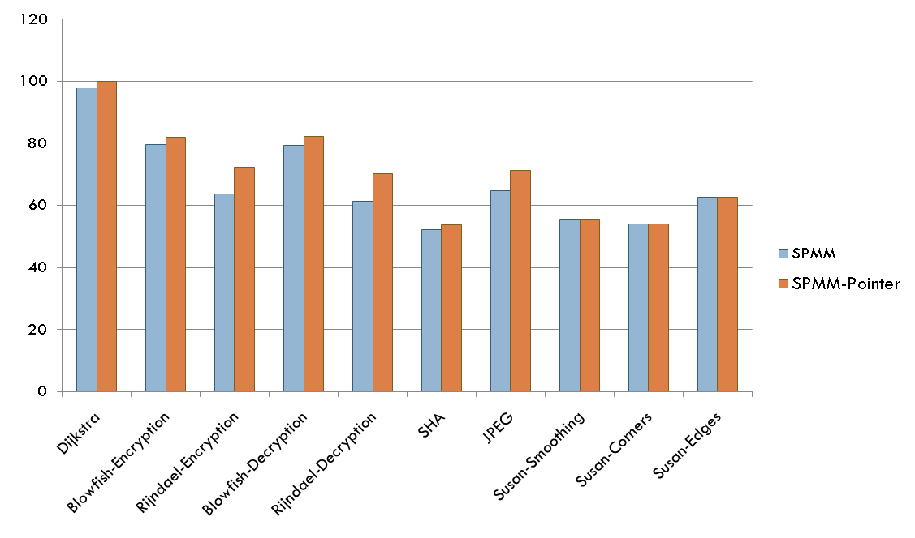
Energy Reduction with Pointer resolution
Baseline
Average 29% reduction with SPMM-Pointer
compared to 32% with SPMM only
Benchmarks running with smaller SPM size
in SPMM-Pointer

Slide 45

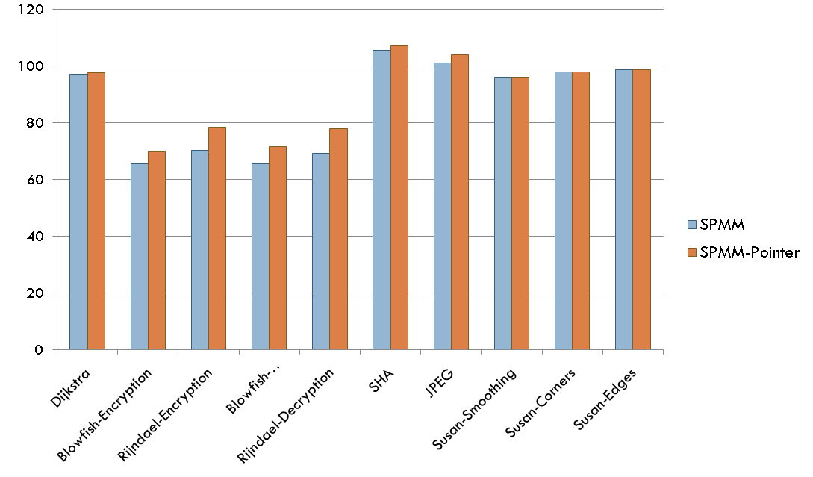
Performance with Pointer resolution
Baseline
Average 10% performance improvement
with SPMM-Pointer
Reduction of energy and performance
improvement seen due to increased software
overhead

Slide 46
Optimization using GCCFG
F1
L1
F2
F3
SPMM F1
SPMM F1
GCCFG
SPMM F1
SPMM F1 + max(F2,F3)
F1
F1
F1
F1
L1
L1
L1
SPMM
max(F2,F3)
SPMM F2
SPMM F3
SPMM
max(F2,F3)
L1
F2
F3
F2
F3
F2
F3
F2
F3
GCCFG - Nested
SPMM F2
SPMM F3
GCCFG - Sequence
GCCFG - Loop
GCCFG with SPM Manager

