Slide 1

R²IM -- Robust and Resilient Intersection Management of Connected Autonomous Vehicles
Mohammad Khayatian, Rachel Dedinsky, Sarthake Choudhary, Mohammadreza Mehrabian and Aviral Shrivastava
The 23rd IEEE International Conference on Intelligent Transportation Systems

Slide 2
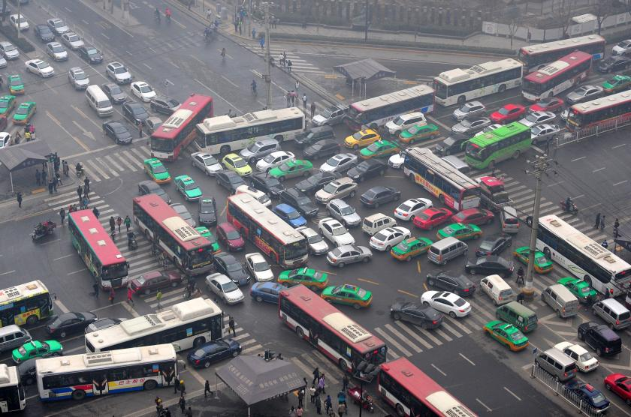
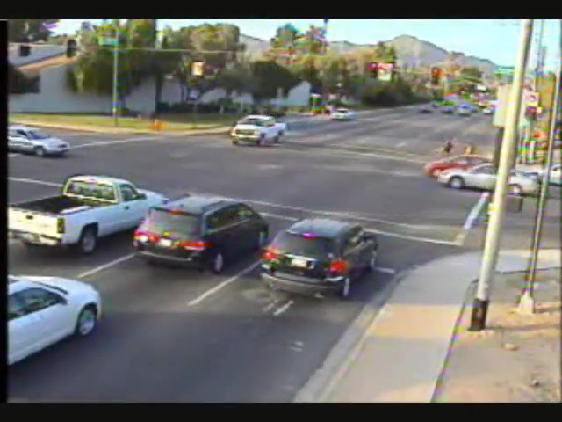
Transportation Problems
Traffic Congestion
  On the average, each person in the US spends around 42 hours per year stuck in the traffic [FHA]
Traffic Accidents
  Between 2010 and 2015 , around 30% of fatal crashes have happened in intersection areas, most of which, due to human errors [FHA]

Slide 3
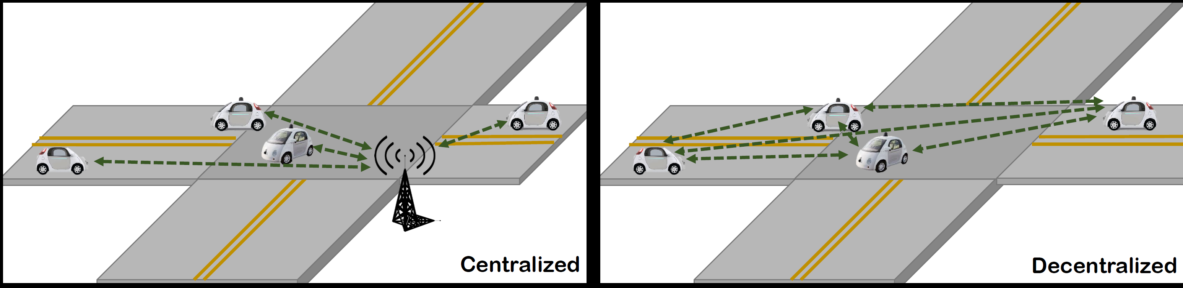
Intersection Management of Connected Autonomous Vehicle (CAVs)
When vehicles become autonomous and connected
No need for traffic lights or stop signs
  CAVs do not need to come to a complete stop
Existing Approaches
  Centralized – CAVs communicate with the infrastructure
  Decentralized – CAVs communicate with each other

Slide 4
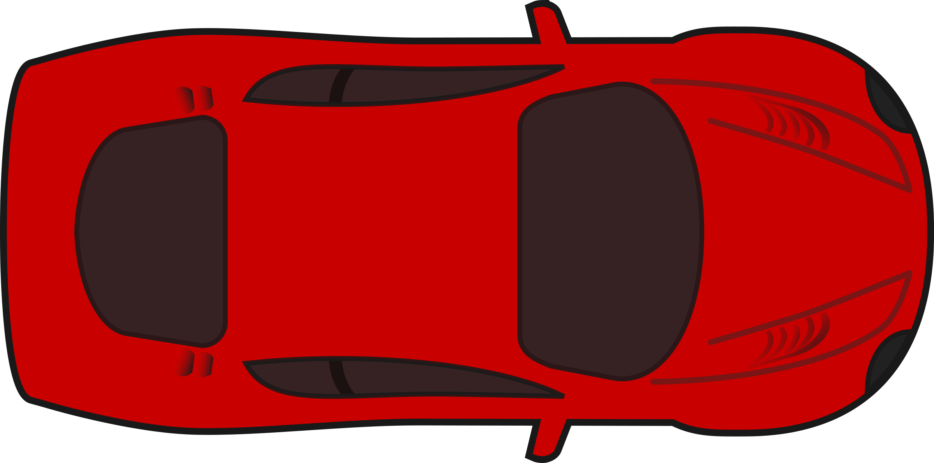
General Overview
1) Upon approaching the intersection, CAVs share their information
  Position, Velocity, outgoing lane, size, ID, etc.
2) A time slot is assigned to a CAV to safely cross the intersection
  Time of Arrival (TOA) and Velocity of Arrival (VOA)
Send Information
Receive Reservation
Continue at VOA
Velocity (m/s)
VOA
Time (s)
TOA

Slide 5
Related Works
There are more than 120 papers on intersection management of CAVs
  Most of them assuming ideal conditions
Some existing works consider more realistic factors
  Localization error exist
    Solution: Consider a buffer around the CAV – the CAV is assumed to be larger
  Communication delay can be large or unbounded
    Solution: Consider a timeout – the CAV will slow down and stop if the response is not received within a threshold
Strong assumptions in almost existing works:
  1) CAVs are honest and share accurate information
  2) CAVs behave as expected and follow the assigned trajectory

Slide 6
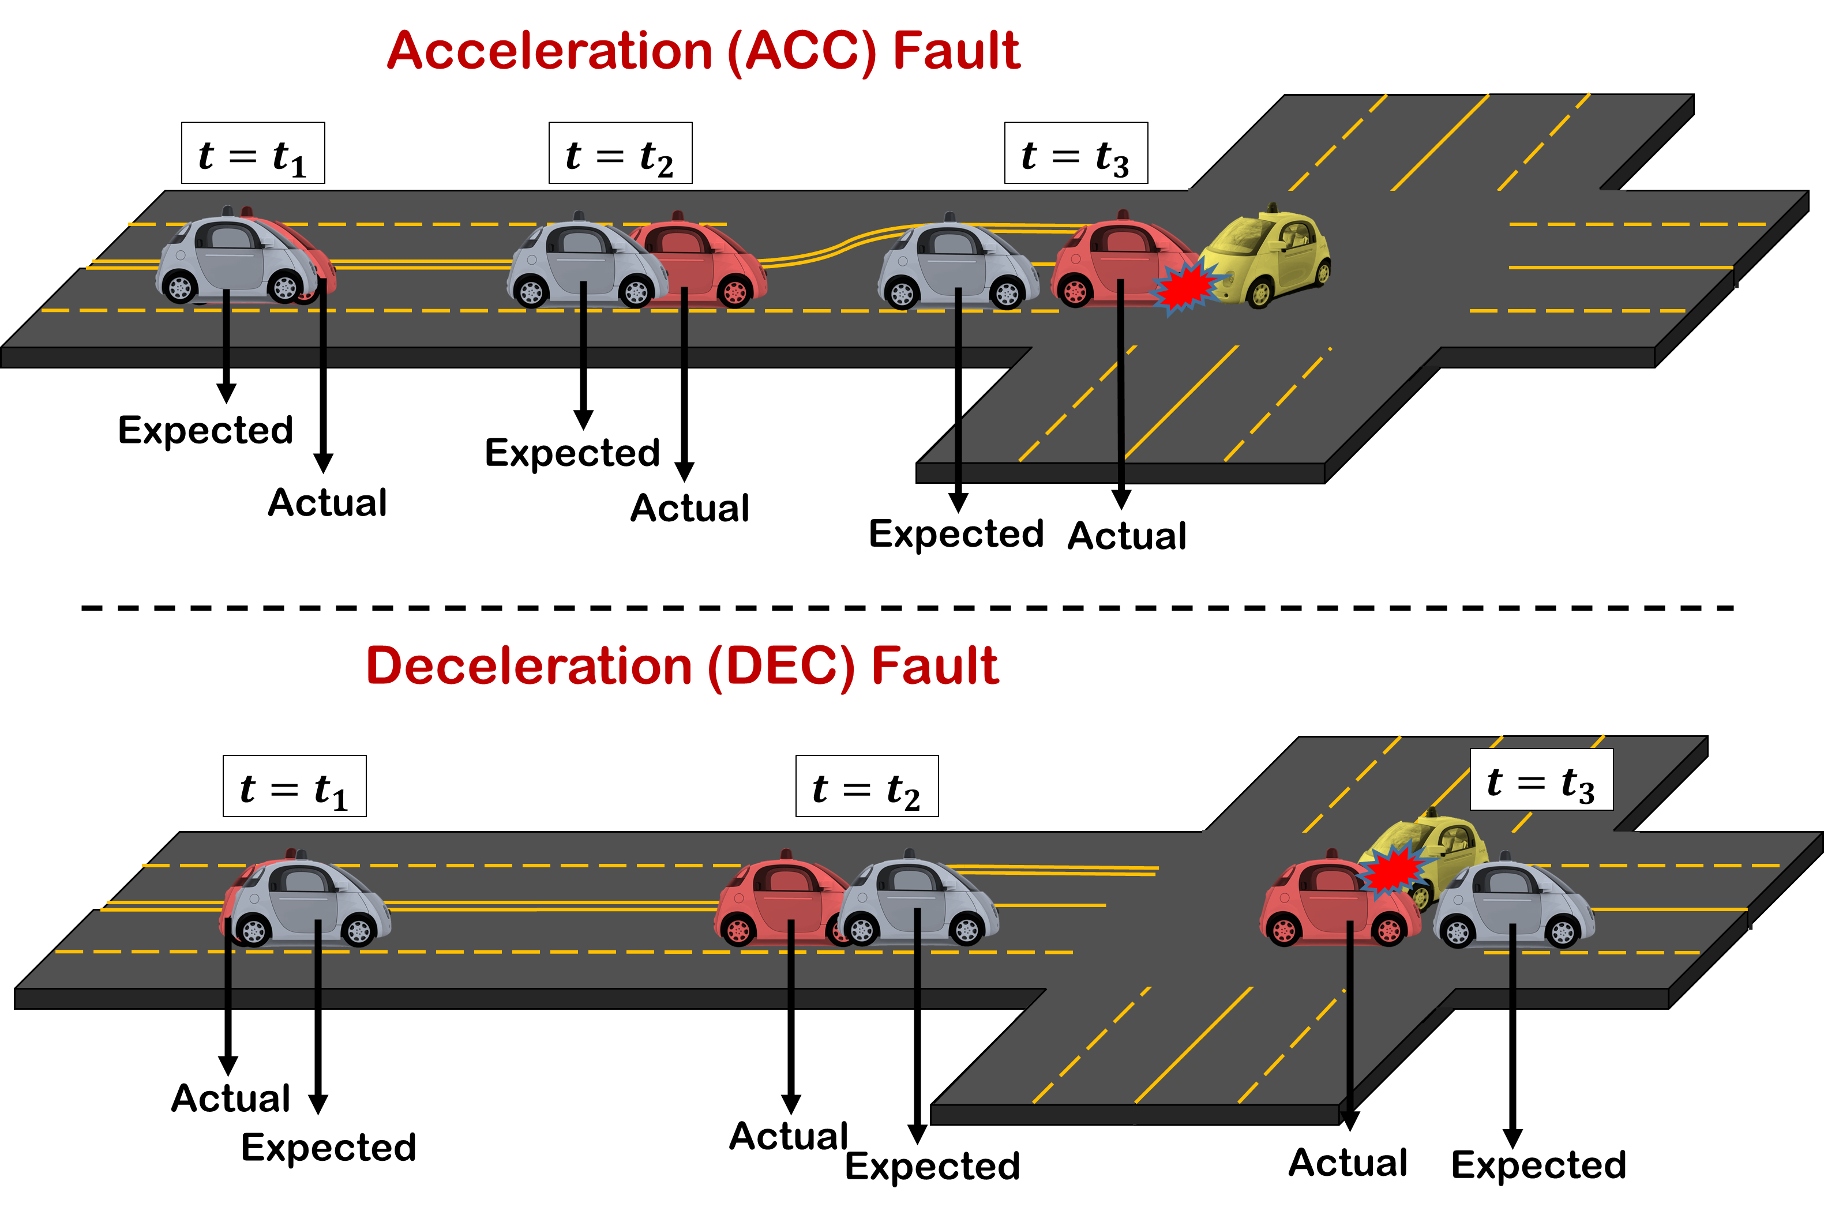
Fault Model (Rogue Vehicle)
What if a CAV sends wrong information?
  e.g. the CAV makes a left turn instead of going straight
What if a CAV does not follow the assigned trajectory ?
  The CAV breaks down
  Being compromised and accelerates
Two extreme cases are
  Deceleration (DEC) fault
  Acceleration (ACC) fault

Slide 7
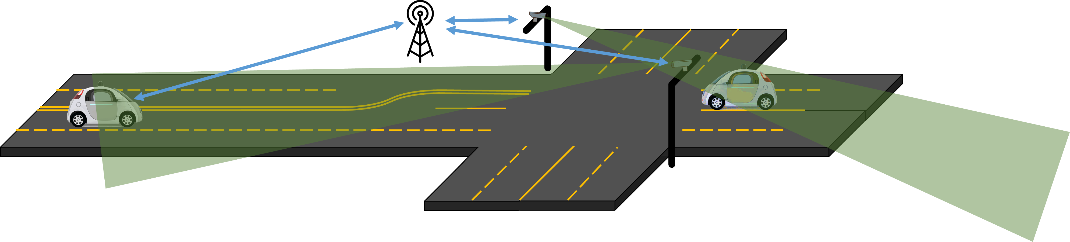
Our Idea
Position of CAVs is being tracked by a surveillance system
The Intersection Manager (IM) can detect rogue vehicles
Let other CAVs know so that they take proper actions
Our Claim:
No accident happens inside the intersection
  If there is only one rouge vehicle at a time

Slide 8
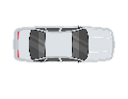
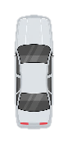


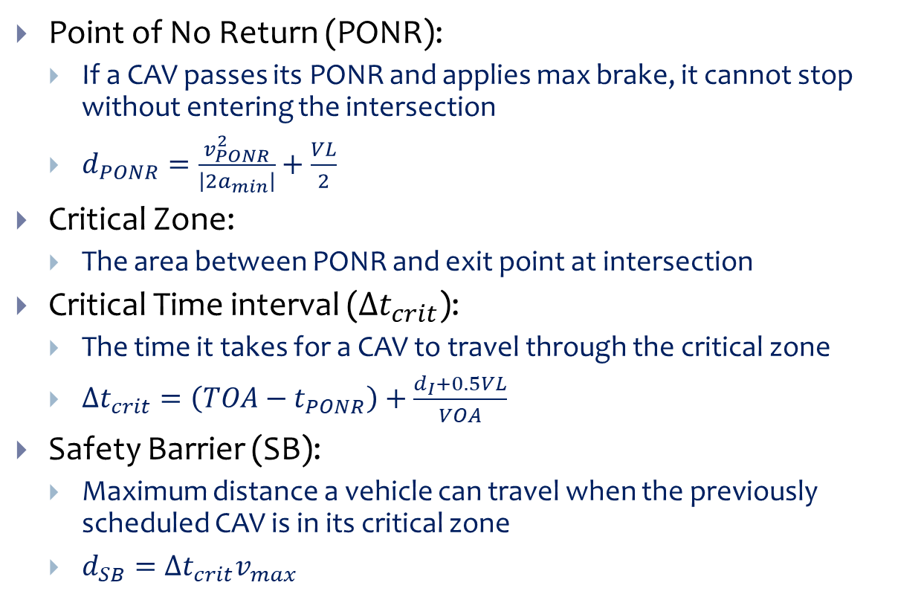


Definitions
Point of No Return (PONR):
  If a CAV passes its PONR and applies max brake, it cannot stop without entering the intersection
  $d_{PONR}=\frac{v_{PONR}^{2}}{\left|2a_{min}\right|}+\frac{VL}{2}$
Critical Zone:
  The area between PONR and exit point at intersection
Critical Time interval ($Δt_{crit}$):
  The time it takes for a CAV to travel through the critical zone
  $Δt_{crit}=\left(TOA−t_{PONR}\right)+\frac{d_{I}+0.5VL}{VOA}$
Safety Barrier (SB):
  Maximum distance a vehicle can travel when the previously scheduled CAV is in its critical zone
  $d_{SB}=Δt_{crit}v_{max}$
Critical Zone
❶
$$d_{PONR,1}$$
$$x_{PONR,1}$$
$$d_{SB,2}$$
$$x_{SB,2}$$
❷

Slide 9
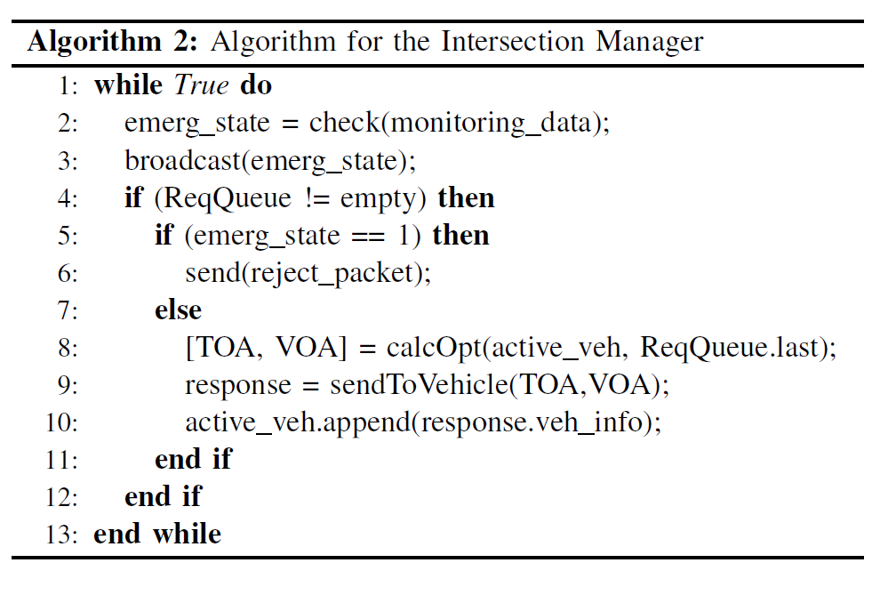
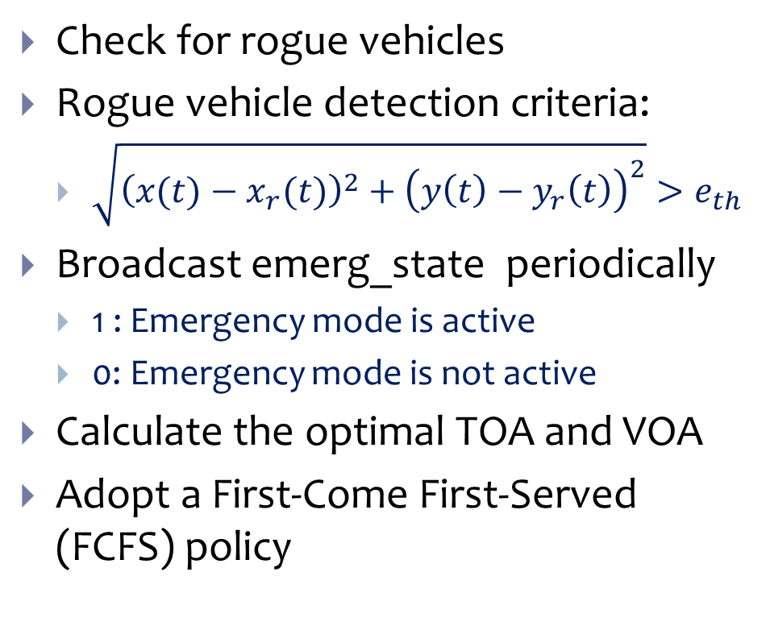
Intersection Manager’s Algorithm
Check for rogue vehicles
Rogue vehicle detection criteria:
  $\sqrt{{\left(x(t)−x_{r}(t)\right)}^{2}+{\left(y\left(t\right)−y_{r}\left(t\right)\right)}^{2}}>e_{th}$
Broadcast emerg_state periodically
  1 : Emergency mode is active
  0: Emergency mode is not active
Calculate the optimal TOA and VOA
Adopt a First-Come First-Served (FCFS) policy

Slide 10
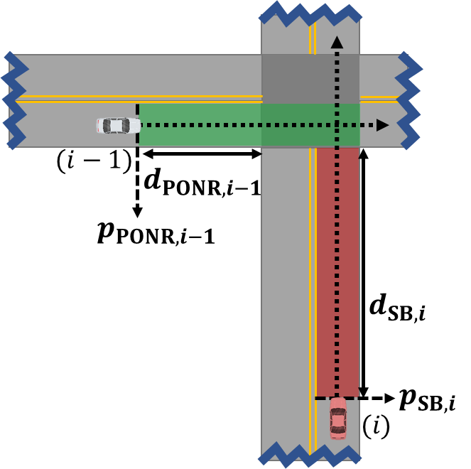
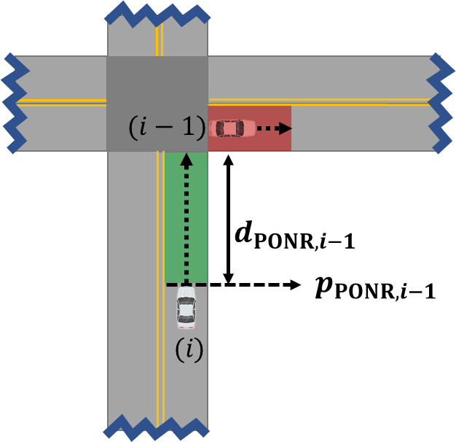
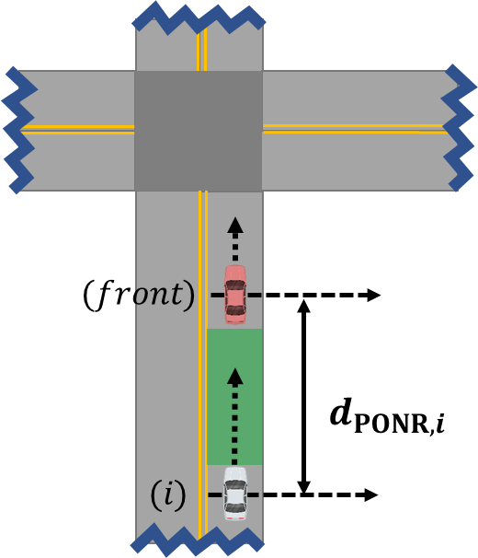
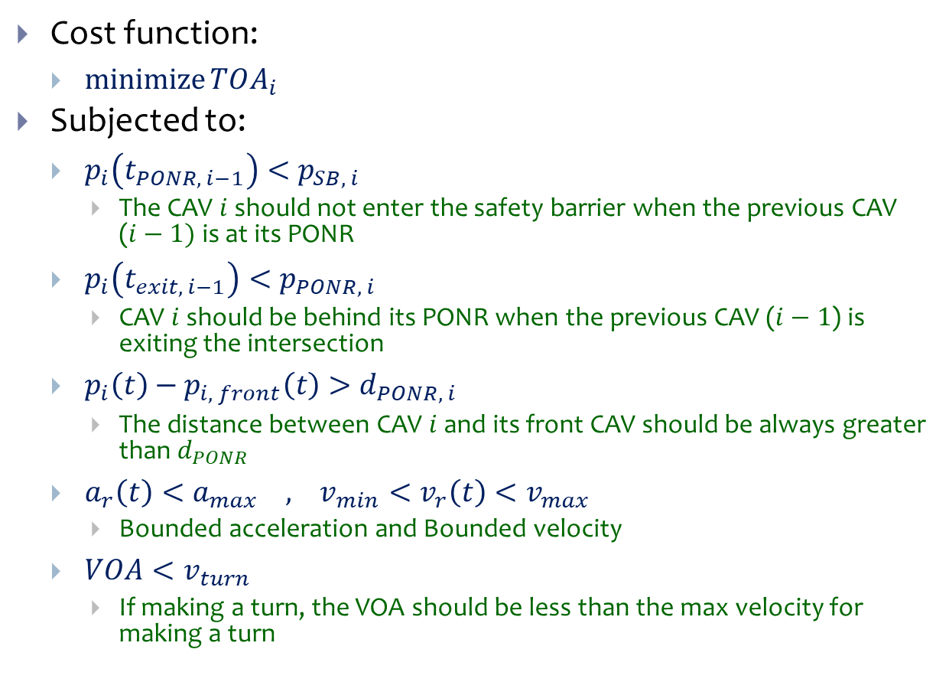
Calculating a Safe TOA and VOA
Cost function:
  $\operatorname{minimize}{TOA_{i}}$
Subjected to:
  $p_{i}\left(t_{PONR, i−1}\right)<p_{SB, i}$
    The CAV $i$ should not enter the safety barrier when the previous CAV ($i−1)$ is at its PONR
  $p_{i}\left(t_{exit, i−1}\right)<p_{PONR, i}$
    CAV $i$ should be behind its PONR when the previous CAV ($i−1$) is exiting the intersection
  $p_{i}\left(t\right)−p_{i, front}\left(t\right)>d_{PONR, i}$
    The distance between CAV $i$ and its front CAV should be always greater than $d_{PONR}$
  $a_{r}\left(t\right)<a_{max} , v_{min}<v_{r}\left(t\right)<v_{max}$
    Bounded acceleration and Bounded velocity
  $VOA<v_{turn}$
    If making a turn, the VOA should be less than the max velocity for making a turn

Slide 11
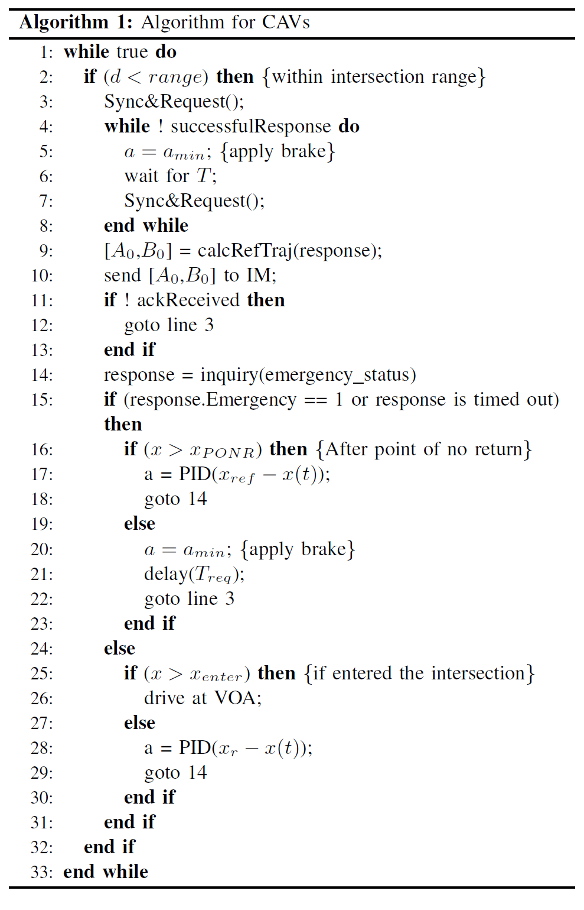
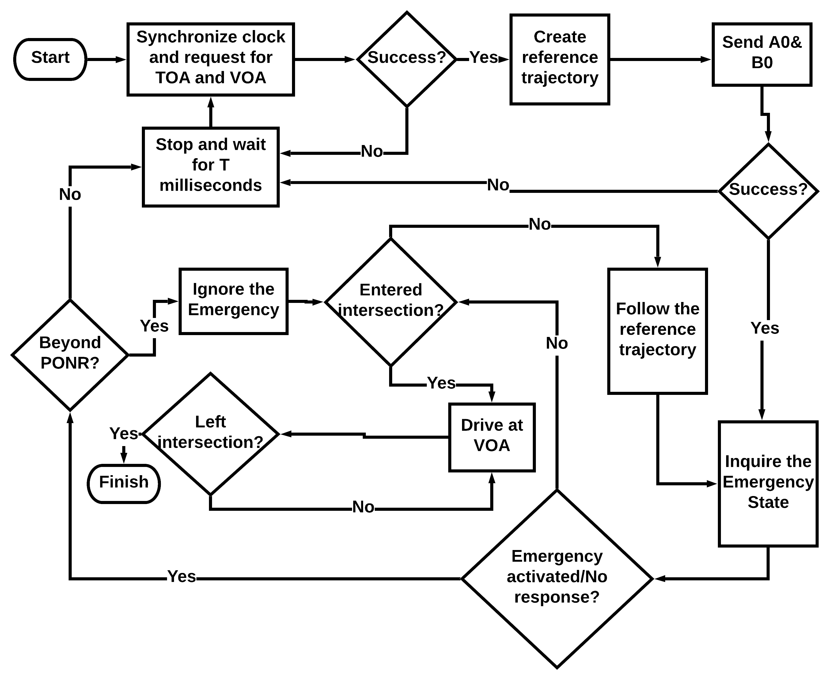
CAV’s Algorithm

Slide 12
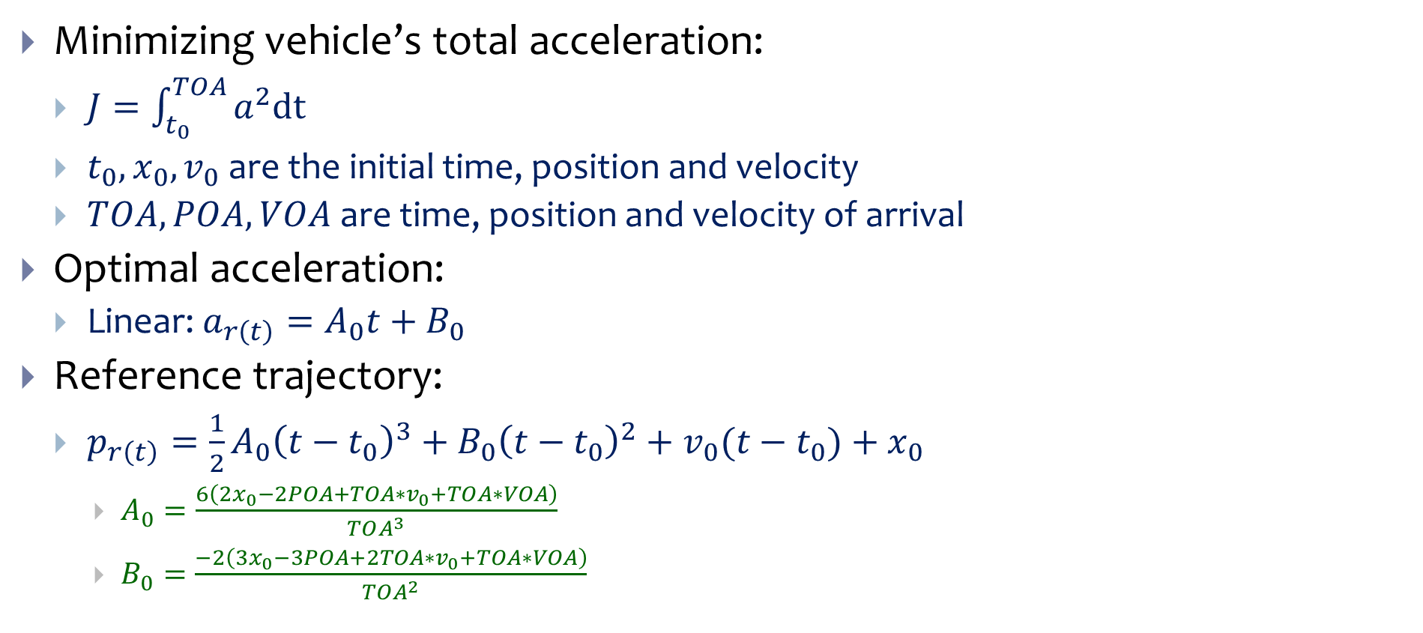
Calculating the Reference Trajectory
Minimizing vehicle’s total acceleration:
  $J=\int_{t_{0}}^{TOA}{a^{2}dt}$
  $t_{0}, x_{0},v_{0}$ are the initial time, position and velocity
  $TOA, POA, VOA$are time, position and velocity of arrival
Optimal acceleration:
  Linear: $a_{r\left(t\right)}=A_{0}t+B_{0}$
Reference trajectory:
  $p_{r\left(t\right)}=\frac{1}{2}A_{0}{\left(t−t_{0}\right)}^{3}+B_{0}{\left(t−t_{0}\right)}^{2}+v_{0}(t−t_{0})+x_{0}$
    $A_{0}=\frac{6\left(2x_{0}−2POA+TOA∗v_{0}+TOA∗VOA\right)}{TOA^{3}}$
    $B_{0}=\frac{−2\left(3x_{0}−3POA+2TOA∗v_{0}+TOA∗VOA\right)}{TOA^{2}}$

Slide 13
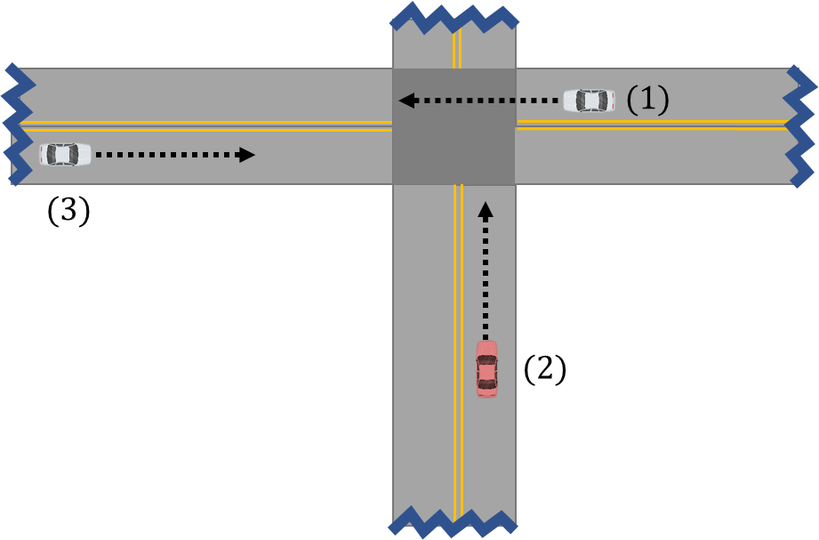
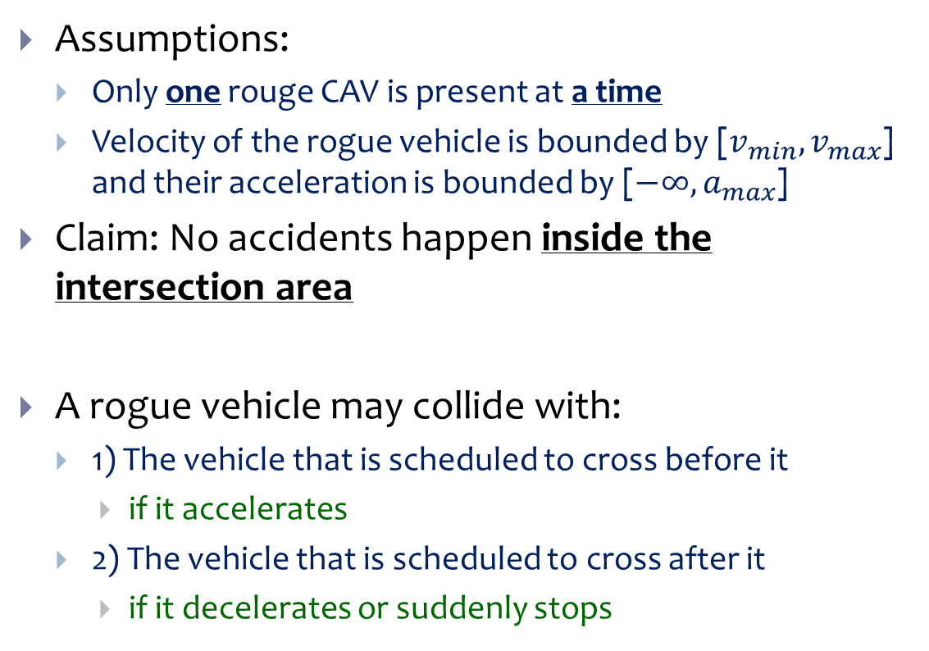
Safety Proof
Assumptions:
  Only one rouge CAV is present at a time
  Velocity of the rogue vehicle is bounded by [$v_{min},v_{max}$] and their acceleration is bounded by [$−∞,a_{max}$]
Claim: No accidents happen inside the intersection area
A rogue vehicle may collide with:
  1) The vehicle that is scheduled to cross before it
    if it accelerates
  2) The vehicle that is scheduled to cross after it
    if it decelerates or suddenly stops

Slide 14
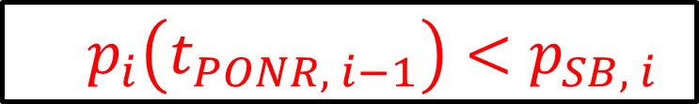


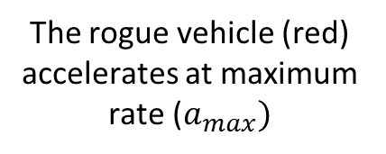
Safety Proof (Case 1)
If CAV2 becomes rouge before reaching the safety barrier
  CAV1 will be behind its PONR and there can stop without entering the intersection
If CAV2 becomes rouge after entering the safety barrier
  CAV1 will be beyond its PONR but it can exit the intersection before CAV2 reaches the intersection
❶
$$d_{PONR,1}$$
$$p_{PONR,1}$$
$$d_{SB,2}$$
The rogue vehicle (red) accelerates at maximum rate ($a_{max})$
$$p_{SB,2}$$
❷
  $$p_{i}\left(t_{PONR, i−1}\right)<p_{SB, i}$$

Slide 15
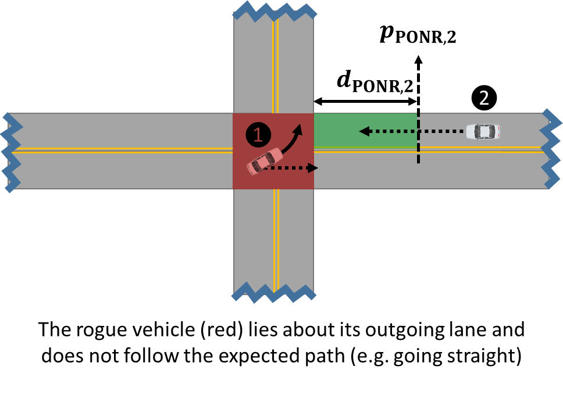

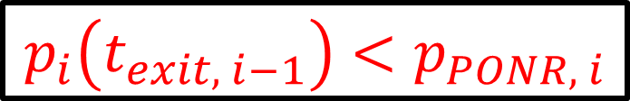

Safety Proof (Case 2)
If CAV1 suddenly stops at the exit edge of the intersection or before that
  CAV2 can stop without entering the intersection
If CAV1 stops after exiting the intersection
  There is no conflict
If CAV1 has lied about its outgoing direction
  It will be detected before CAV2 reaches its PONR and therefore has enough distance to stop without entering the intersection
❶
$$d_{PONR,2}$$
$$p_{PONR,2}$$
❷
The rogue vehicle (red) suddenly stops inside the intersection area
$$p_{i}\left(t_{exit, i−1}\right)<p_{PONR, i}$$

Slide 16
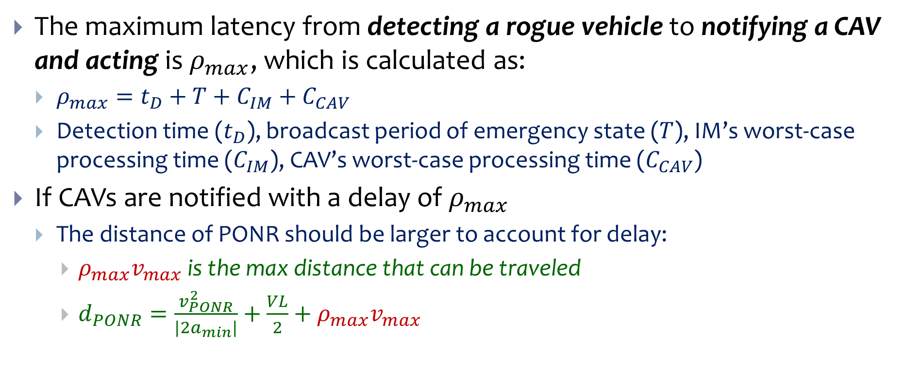
Account for Delay
The maximum latency from detecting a rogue vehicle to notifying a CAV and acting is $ρ_{max}$, which is calculated as:
  $ρ_{max}=t_{D}+T+C_{IM}+C_{CAV}$
  Detection time ($t_{D}$), broadcast period of emergency state ($T$), IM’s worst-case processing time ($C_{IM}$), CAV’s worst-case processing time ($C_{CAV}$)
If CAVs are notified with a delay of $ρ_{max}$
  The distance of PONR should be larger to account for delay:
    $ρ_{max}v_{max}$ is the max distance that can be traveled
    $d_{PONR}=\frac{v_{PONR}^{2}}{|2a_{min}|}+\frac{VL}{2}+ρ_{max}v_{max}$

Slide 17
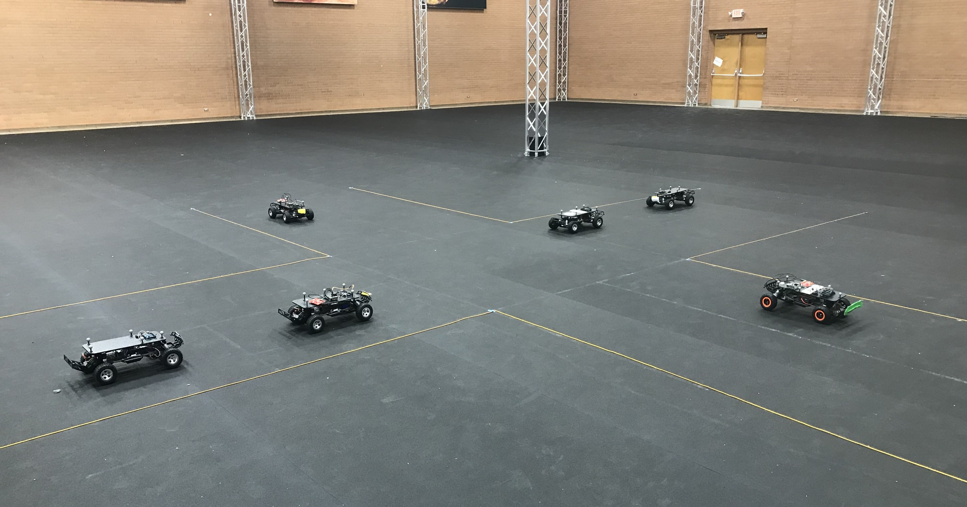
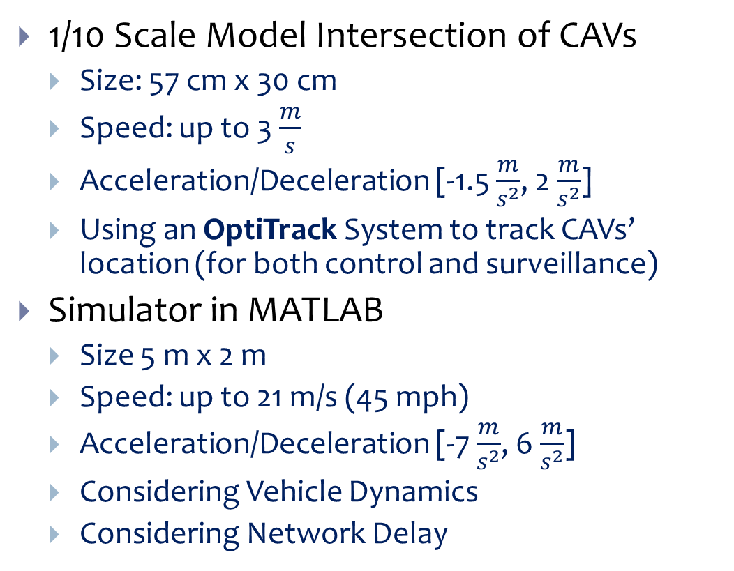
Testbeds
1/10 Scale Model Intersection of CAVs
  Size: 57 cm x 30 cm
  Speed: up to 3 $\frac{m}{s}$
  Acceleration/Deceleration [-1.5 $\frac{m}{s^{2}}$, 2 $\frac{m}{s^{2}}$]
  Using an OptiTrack System to track CAVs’ location (for both control and surveillance)
Simulator in MATLAB
  Size 5 m x 2 m
  Speed: up to 21 m/s (45 mph)
  Acceleration/Deceleration [-7 $\frac{m}{s^{2}}$, 6 $\frac{m}{s^{2}}$]
  Considering Vehicle Dynamics
  Considering Network Delay
https://www.youtube.com/watch?v=Q0tPS6uNTeE

Slide 18
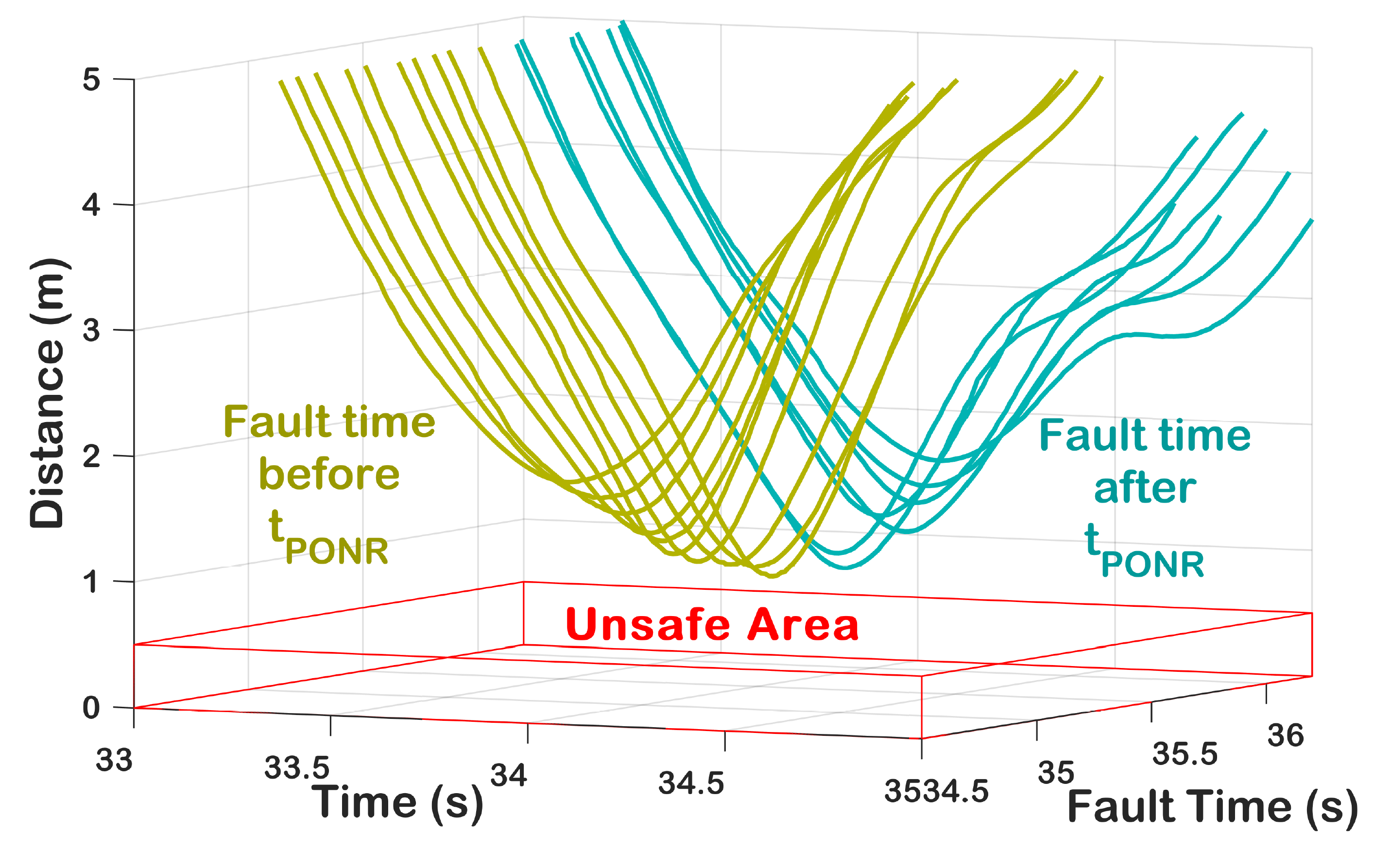

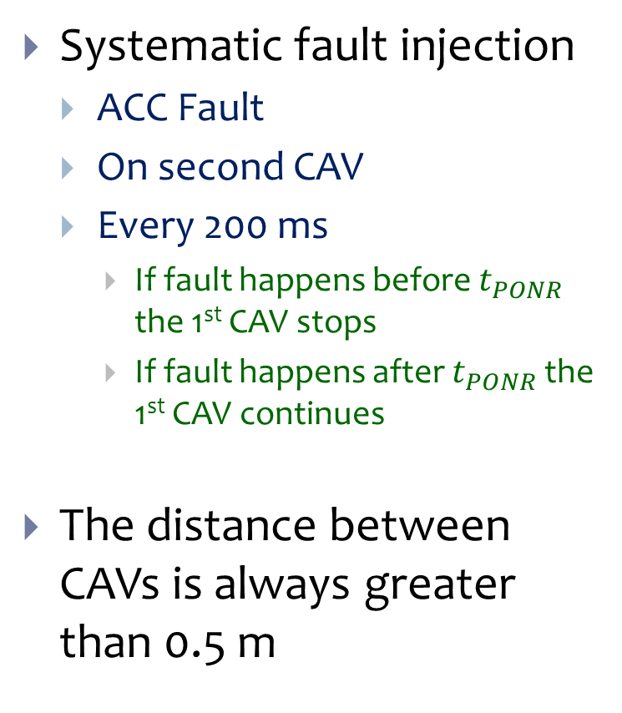



Systematic Fault Injection on 1/10 Scale CAVs
Systematic fault injection
  ACC Fault
  On second CAV
  Every 200 ms
    If fault happens before $t_{PONR}$ the 1st CAV stops
    If fault happens after $t_{PONR}$ the 1st CAV continues
The distance between CAVs is always greater than 0.5 m
$$d_{PONR,i−1}$$
$$d_{PONR,i−1}$$
$$d_{SB,i}$$
$$d_{SB,i}$$

Slide 19
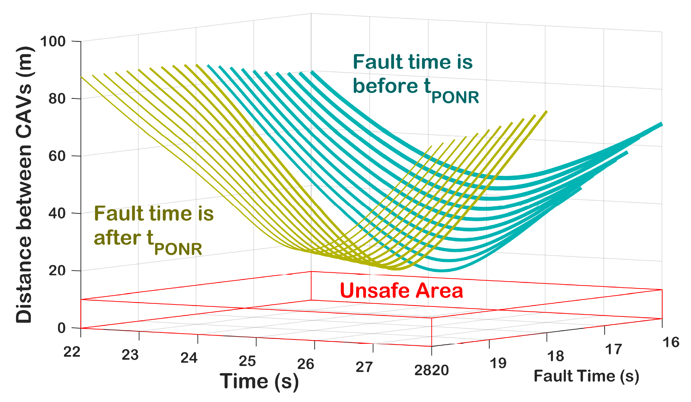
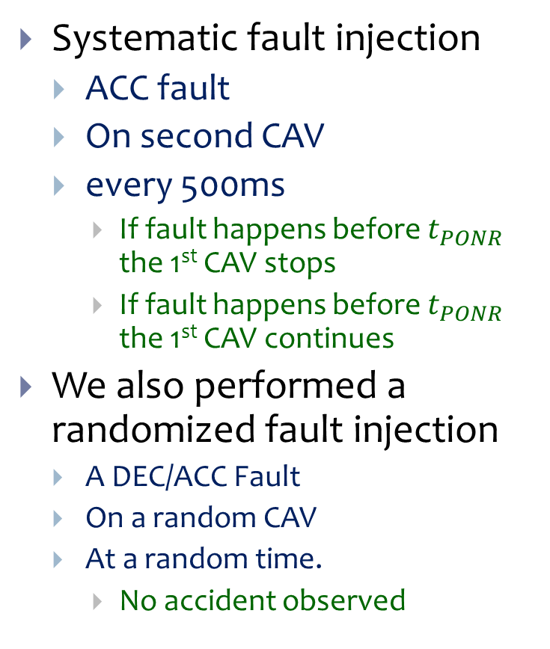
Fault Injection on Our Simulator
Systematic fault injection
  ACC fault
  On second CAV
  every 500ms
    If fault happens before $t_{PONR}$ the 1st CAV stops
    If fault happens before $t_{PONR}$ the 1st CAV continues
We also performed a randomized fault injection
  A DEC/ACC Fault
  On a random CAV
  At a random time.
    No accident observed

Slide 20
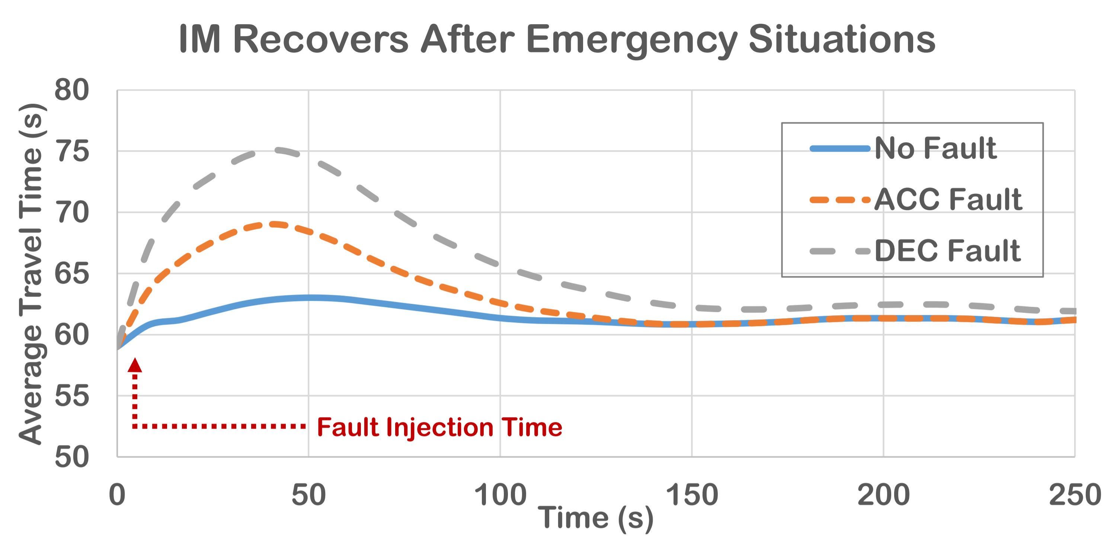
Intersection Recovers after the Fault
Average travel time is measured for a scenario
Use the same scenario and inject an acceleration fault
Use the same scenario and inject a deceleration fault
For DEC fault, the rogue vehicle stops for 10 second and then is removed

Slide 21
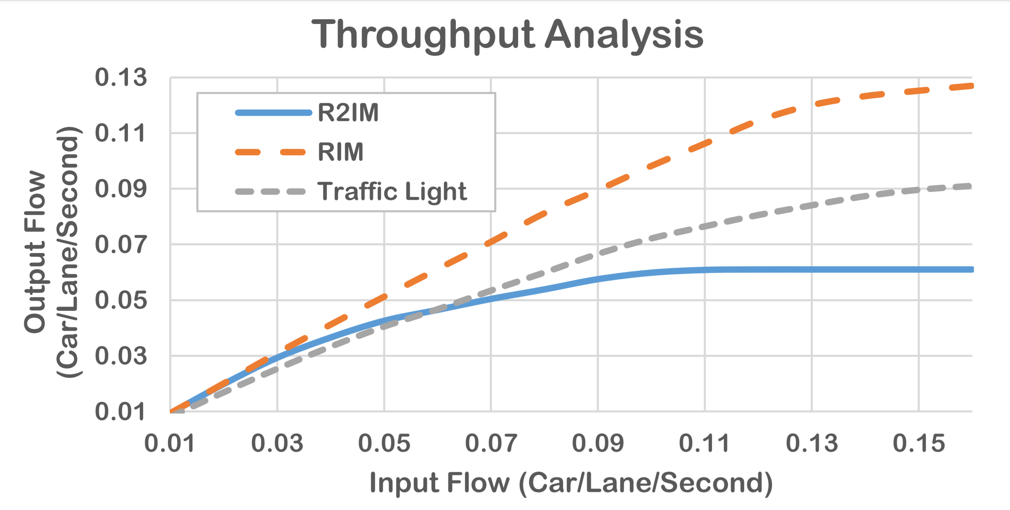
Comparing Throughput
Compare with
  RIM (FCFS)
  Traffic light
    25 seconds green
    5 seconds yellow
    30 seconds red
R2IM achieves a lower throughput than traffic light
R²IM avoid accidents that a traffic light cannot
  (e.g. red-light runner)

Slide 22
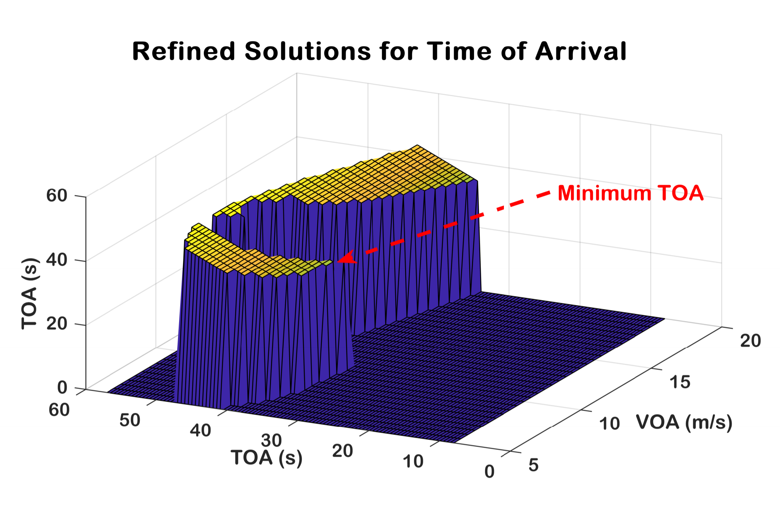
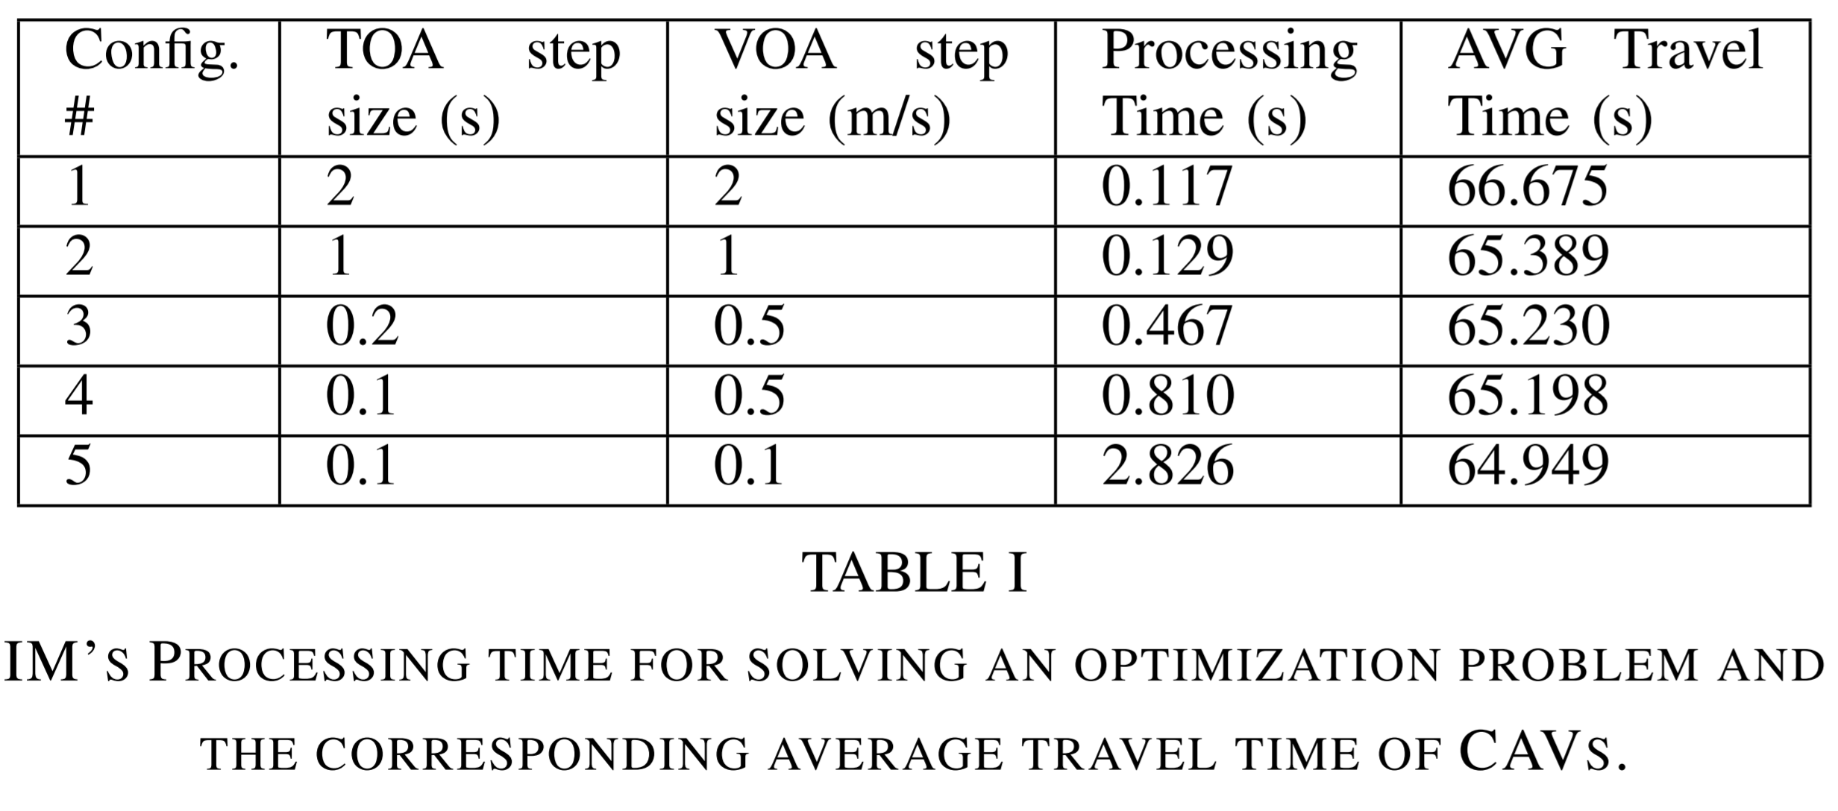
Solving the Optimization Problem in Real Time
Min TOA
Conventional optimization methods/solvers can take up to seconds to find the optimal solution
Discretize the solution space
Our choice

Slide 23
Conclusion and Future Works
We proposed an intersection management for CAVs resilient to rogue vehicles (Accelerate/suddenly stop/share wrong information)
We performed systematic and randomized fault injection on our 1/10 scale mode intersection and our simulator
We also analyzed the performance of our approach in terms of recovery, throughput and processing time of the IM
Future works include extending our approach to multi-lane intersections and distributed implementation of R²IM

Slide 24

Thank You for Your Attention

