Slide 1

Managing Stack Data on Limited Local Memory Multi-core Processors
Saleel Kudchadker
Compiler Micro-architecture Lab
School of Computing, Informatics and Decision Systems Engineering
30th April 2010

Slide 2
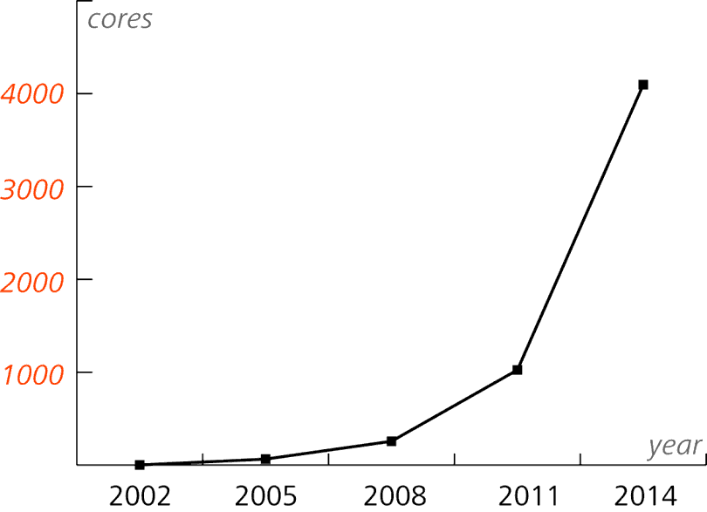

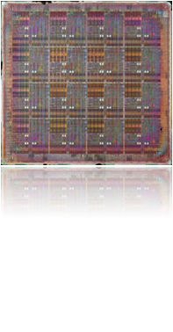
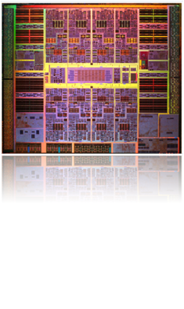
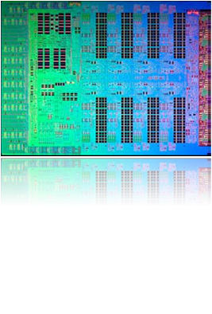
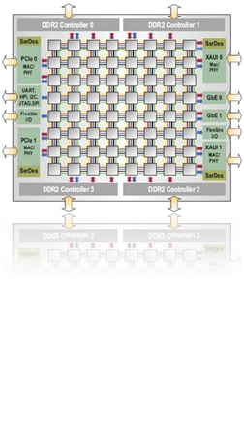
a MANY Core Future
Today
A few large cores on each chip
Only option for future scaling is to add more cores
Still some shared global structures: bus, L2 caches
Tomorrow
100’s to 1000’s of simpler cores [S. Borkar, Intel, 2007]
Simple cores are more power and area efficient
p
p
L1
L1
BUS
L2 Cache
MIT RAW
Sun Ultrasparc T2
IBM XCell 8i
Tilera TILE64

Slide 3
Multi-core Challenges
Power
  Cores are less power hungry ex. No Speculative Execution Unit|
  Power efficient memories , hence No caches (Caches consume 44% in core)
Scalability
  Maintaining illusion of shared memory is difficult
  Cache Coherency protocols do not scale to a very large number of cores
  Shared resources cause higher latencies as cores scale.
Programming
  As there is no unified memory, programming becomes a challenge
  Low power ,limited sized , software controlled memory
  Programmer has to perform data management and ensure coherency

Slide 4
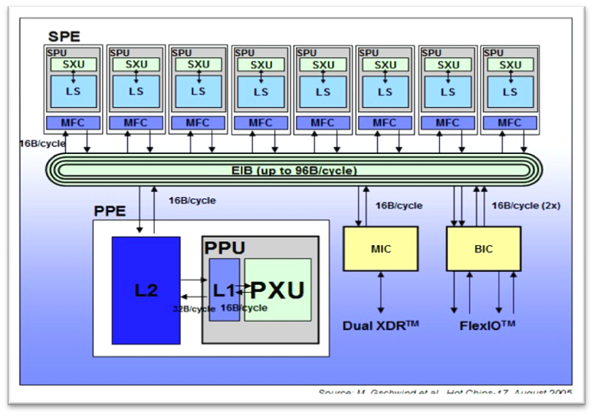
Limited Local Memory Architecture
Distributed memory platform with each core having its own small sized local memory
Cores can access only local memory
Access to global memory is accomplished with the help of DMA
Ex. IBM Cell BE

Slide 5
LLM Programming Model
#include<libspe2.h>
extern spe_program_handle_t hello_spu;
int main(void)
{
int speid, status;
speid = spe_create_thread (&hello_spu);
spe_wait( speid, &status);
return 0;
}
<spu_mfcio.h>
int main(speid, argp)
{
printf("Hello world!\n");
return 0;
}
<spu_mfcio.h>
int main(speid, argp)
{
printf("Hello world!\n");
return 0;
}
<spu_mfcio.h>
int main(speid, argp)
{
printf("Hello world!\n");
return 0;
}
Local Core
Local Core
Local Core
<spu_mfcio.h>
int main(speid, argp)
{
printf("Hello world!\n");
return 0;
}
<spu_mfcio.h>
int main(speid, argp)
{
printf("Hello world!\n");
return 0;
}
<spu_mfcio.h>
int main(speid, argp)
{
printf("Hello world!\n");
return 0;
}
Main Core
Local Core
Local Core
Local Core
LLM architecture ensures:
  The program can execute extremely efficiently if all code and application data can fit in the local memory

Slide 6
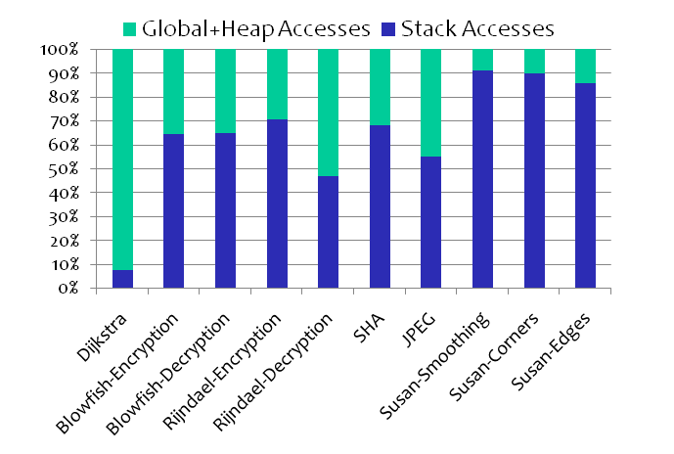
Managing Data on Limited Local Memory
  WHY MANAGEMENT ?
    To ensure efficient execution in the small size of the local memory.
Stack data challenge
  Estimation of stack depth may not be possible at compile-time
  The stack data may be unbound as in case of recursion.
Code
Global
Heap
Stack
Local Memory
How to we manage Stack Data?
MiBench Suite
Stack data enjoys 64.29%
of total data accesses

Slide 7
Working of Regular Stack
F1
Stack Size = 100 bytes
F2
SP
100
F3
F1 50
Function | Frame Size (bytes)
F1 | 50
F2 | 20
F3 | 30
F2 20
F3 30
0
Local Memory

Slide 8
Not Enough Stack Space
F1
Stack Size = 70 bytes
F2
SP
70
F3
F1 50
Function | Frame Size (bytes)
F1 | 50
F2 | 20
F3 | 30
F2 20
0
F3 30
No space for F3
Local Memory

Slide 9
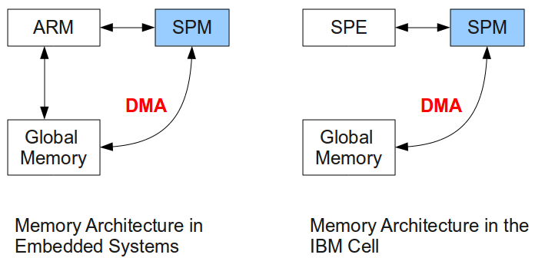
Related Work
Techniques have been developed to manage data in constant memory
    Code: Janapsatya2006, Egger2006, Angiolini2004, Nguyen2005, Pabalkar2008
    Heap: Francesco2004
    Stack: Udayakumaran2006, Dominguez2005, Kannan2009
Udayakumaran2006, Dominguez2005 maps non recursive and recursive functions respectively to stack using scratchpad
    Both works keep frequently used stack portion to scratchpad memories.
    They use profiling to formulate an ILP
Only work that maps the entire stack to
SPM is circular management scheme of
Kannan2009
    Applicable only for Extremely
    Embedded Systems.
LLM in multi-cores are very similar to scratchpad memories (SPM) in embedded systems.

Slide 10
Agenda
Trend towards Limited Local memory multi-core architectures
Background
Related work
Circular Stack Management
Our Approach
Experimental Results
Conclusion

Slide 11
Kannans’ Circular Stack Management
F1
Stack Size = 70 bytes
F3 30
F2
70
Main
MemPtr
F3
F1 50
Function | Frame Size (bytes)
F1 | 50
F2 | 20
F3 | 30
F2 20
SP
0
Local Memory
Main Memory

Slide 12
Kannans’ Circular Stack Management
F1
Stack Size = 70 bytes
F2
70
F3
F3 30
F1 50
SP
F2 20
Main
MemPtr
Function | Frame Size (bytes)
F1 | 50
F2 | 20
F3 | 30
0
Local Memory
Main Memory

Slide 13
Circular Stack Management API
Original Code
Stack Managed Code
F1() {
int a,b;
F2();
}
F2() {
F3();
}
F3() {
int j=30;
}
fci()- Function Check in
Assures enough space on stack for a called function by eviction of existing function if needed.
fco()- Function Check out
Assures that the caller function exists in the stack when the called function returns.
F1() {
int a,b;
fci(F2);
F2();
fco(F1);
}
F2() {
fci(F3);
F3();
fco(F2);
}
F3() {
int j=30;
}
Only suitable for extremely embedded systems where application size is known.
Notes:
Function Table
Compile-time generated structure
Stores function id and its stack frame size, current stack pointer and start and end address of main

Slide 14
Limitations of Previous Technique
Pointer Threat
Memory Overflow
  Overflow of the Main Memory buffer
  Overflow of the Stack Management Table

Slide 15
Limitations: Pointer Threat
Stack Size= 100 bytes
Stack Size= 70 bytes
F1() {
int a=5, b;
fci(F2);
F2(&a);
fco(F1);
}
F2(int *a) {
fci(F3);
F3(a);
fco(F2);
}
F3(int *a) {
int j=30;
*a = 100;
}
SP
SP
EVICTED
100
Aha! FOUND “a”
100
F1 50
F1 50
a
a
90
90
a
50
50
F2 20
F2 20
Wrong value of “a”
30
30
F3 30
0
F3 30
Local Memory
Local Memory

Slide 16
Limitations: Table Overflow
j=5;
F1() {
int a=5, b;
fci(F2);
F2();
fco(F1);
}
F2() {
fci(F3);
F3();
fco(F2);
}
F3() {
j--;
if(j>0){
fci(F3);
F3();
fco(F3);
}
}
TABLE_SIZE = 3
Stack Management Table (Local Memory)
Entry 1 | F2
Entry 2 | F3
Entry 3 | F3
Entry 4 | F3
OVERFLOW

Slide 17
Limitations: Main Memory Overflow
j=5;
F1() {
int a=5, b;
fci(F2);
F2();
fco(F1);
}
F2() {
fci(F3);
F3();
fco(F2);
}
F3() {
j--;
if(j>0){
fci(F3);
F3();
fco(F3);
}
}
Static buffer quickly gets filled as recursion can result in an unbounded stack.
F3 30
70
F1 50
F3 30
Size=70
F3 30
F2 20
SP
0
OVERFLOW!
Local Memory
Main Memory

Slide 18
Our Contribution
Our technique is comprehensive and works for all LLM architectures without much loss of performance.
We
  Dynamically manage the Main Memory
  Manage the stack management table in fixed size
  Resolve all pointer references

Slide 19
Managing Main Memory Buffer
Main Memory
Management Thread
Local Processor Thread
Main Memory Buffer
Hence a STATIC buffer
If DYNAMIC
How to send buffer address
The local processor cannot allocate buffer in the main memory.
If dynamically allocated ,the local processor needs address of the main memory buffer to store evicted frames using DMA
Solution!! Run a Main Memory Manager Thread!

Slide 20
Dynamic Management of Main Memory
Local Program Thread
Main Memory
Management Thread
F3 30
Need To Evict ==TRUE
fci()
70
F1 50
Allocate Memory
F2 20
Send main memory buffer address
0
Evict Frames to
Main Memory
Local Memory
Main Memory

Slide 21
Dynamic Management of Stack Management Table
If FULL
  EXPORT to main memory
  Reset pointer
If EMPTY
  Import TABLE_SIZE entries to local memory.
  Set Pointer to MAX size
Stack Management Table (Local Memory)
Entry 1 | F3
Entry 1 | F1
Entry 2 | F2
Entry 2 | F3
Table Pointer
Export to Main Memory (DMA)
The same Main Memory Manager Thread can allocate space for evicting the table to the main memory

Slide 22
Pointer Resolution
Space for stack = 70 bytes
F1() {
int a=5,b;
fci(F2);
F2(&a);
fco(F1);
}
F2(int *a) {
fci(F3);
F3(a);
fco(F2);
}
F3(int *a) {
int j=30;
a = getVal(a);
*a = 100;
a = putVal(a);
}
181270
F1 50
a
181260
getVal calculates linear address &fetches the pointer variable to the local memory
F3 30
181220
Main memory
STACK WITHOUT ANY MANAGEMENT
ACTUAL STACK
100
F3 30
100
F1 50
a
90
70
50
50
F2 20
F2 20
30
30
Displacement= 30+20+40 = 90
Local memory
00
putVal places it back to the main memory
Offset = (100-0) – 90 = 10
Global Address = 181270 – 10 = 181260

Slide 23
Agenda
Trend towards Limited Local memory multi-core architectures
Background
Related work
Circular Stack Management
Our Approach
Experimental Results
Conclusion

Slide 24
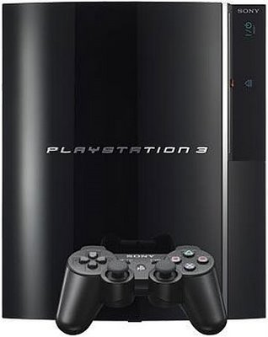
Experimental Setup
Sony PlayStation 3 running a Fedora Core 9 Linux.
MiBench Benchmark Suite
The runtimes are measured with spu_decrementer() for SPE and _mftb() for the PPE provided with IBM Cell SDK 3.1
Each benchmark is executed 60 times and average is taken to abstract away timing variability.
Each Cell BE SPE has a 256KB local memory.

Slide 25
Results
We test the effectiveness of our technique by
Enabling Unlimited Stack Depth
Testing runtime in least amount of stack with our and previous stack management
Wider Applicability
Scalability over number of cores

Slide 26
1. Enabling Limitless Stack Depth
We executed a recursive benchmark with
  No Management
  Previous Technique of Stack Management
  Our Approach
Size of Each Function frame is 60 bytes
int rcount(int n)
{
if (n==0) return 0;
return rcount(n-1) + 1;
}

Slide 27
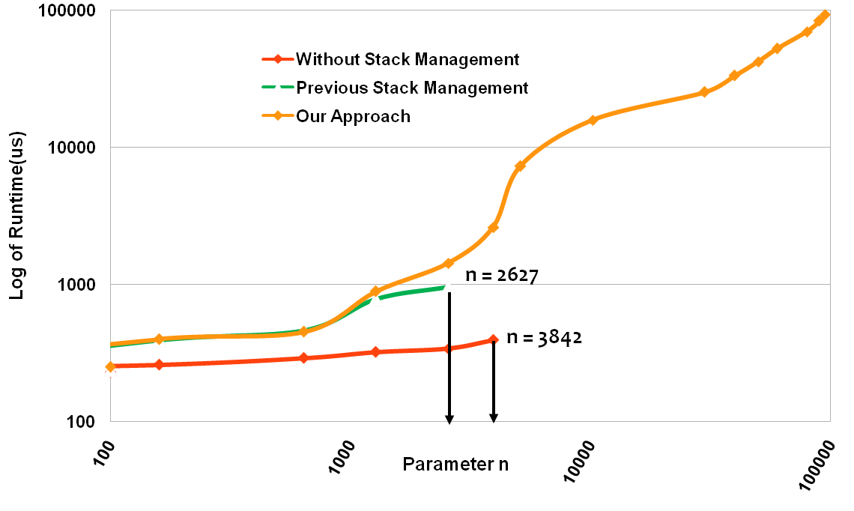
1. Enabling Limitless Stack Depth
Our Technique works for any Large Stack sizes.
Without management the program crashes there is no space left in local memory for the stack.
The previous technique crashes as there is no management of stack table and thus occupies a very large space for the table.
Our technique works for arbitrary stack sizes where as previous technique works for limited values of N

Slide 28
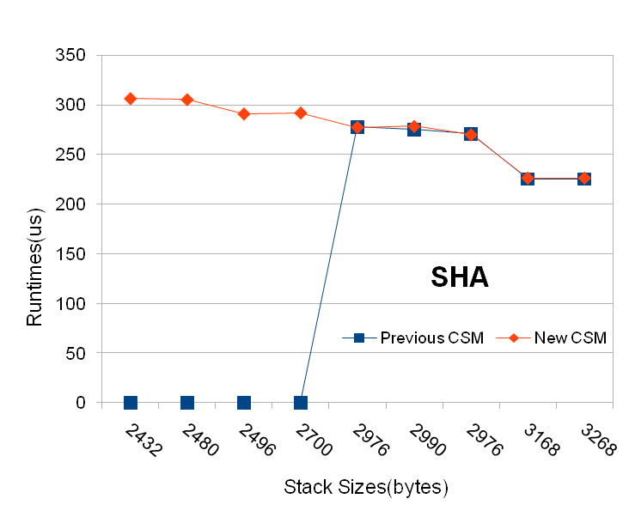
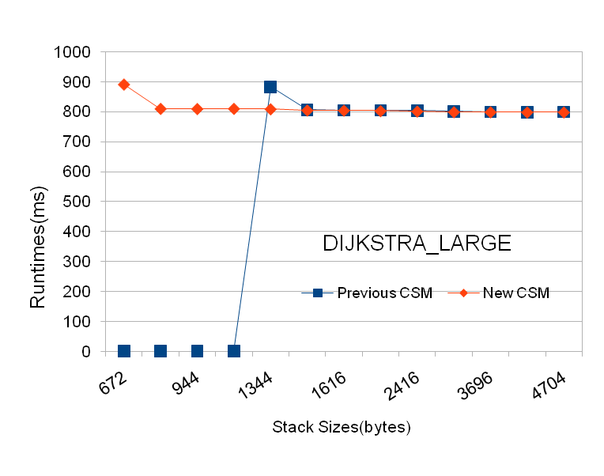
2. Better Performance in Lesser Space
Our technique resolves pointers hence gets the correct result.
The previous technique fails for lesser stack sizes as it cannot resolve pointers as the referenced frames are evicted.
Our technique utilizes much lesser space in local memory and still has comparable runtimes with previous technique.

Slide 29
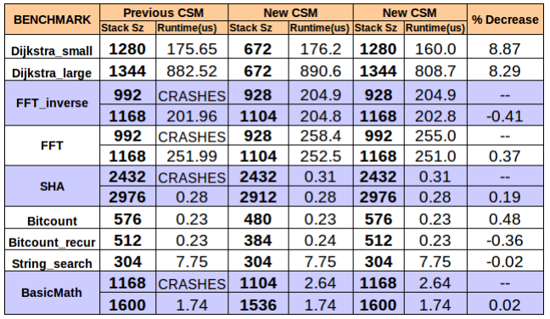
3. Wider Applicability
Our technique runs in smaller space and still WORKS!!!
Our technique gives similar runtimes when we match the stack space as compared to the previous technique.

Slide 30
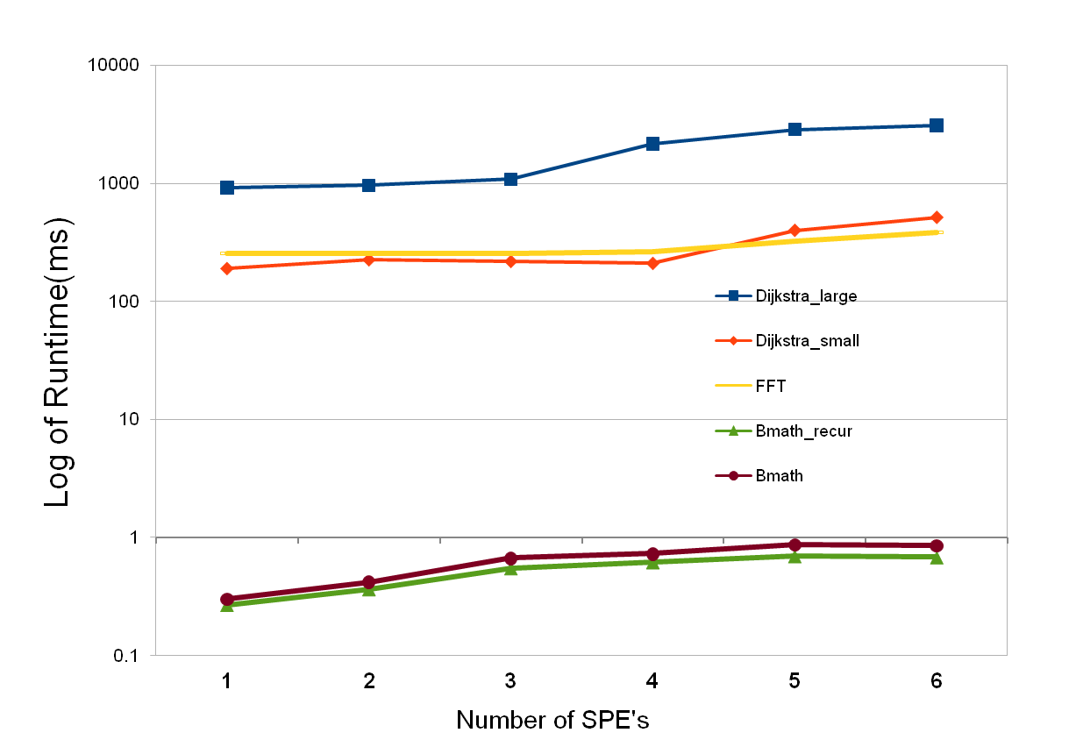
4. Scalability
Graph of Performance v/s Scalability for our technique
Runtime increases as the single PPU thread gets flooded with the allocation requests

Slide 31
Summary
LLM architectures are scalable architectures and have a promising future.
For efficient execution of applications on LLM, Data Management is needed.
We propose a comprehensive stack data management technique for LLM architecture that:
  Manages any arbitrary stack depth
  Resolves pointers and thus ensures correct results
  Ensures memory management of main memory thus enabling scaling
  Our API is semi automatic, consisting of only 4 simple functions

Slide 32
Outcomes
International Conference for Compilers Architectures and Synthesis for Embedded Systems ( CASES ) , 2010.
- “Managing Stack Data on Limited Local Memory(LLM) Multi-core Processors”
Software release:
“LLM Stack data manager plug-in”
  Implementing in GCC 4.1.2 for SPE architecture.

Slide 33
Thank You!
?

