Slide 1
Mitigating Soft Error Failures for Multimedia Applications by Selective Data Protection
Kyoungwoo Lee¹, Aviral Shrivastava², Ilya Issenin¹,
Nikil Dutt¹, and Nalini Venkatasubramanian³
¹ACES Lab. and ³DSM Lab.
University of California at Irvine
²Compiler and Microarchitecture Lab.
Arizona State University
Notes:
Good afternoon, I’m Kyoungwoo Lee. I’m going to present our paper titled “Mitigating Soft Error Failures for Multimedia Applications by Selective Data Protection”, which has been studied at UCI and ASU.

Slide 2
Soft Errors – Major Concern for Reliability
Soft Errors cause Failures
  Transient faults in electronic devices
  Program can crash, give wrong output, go into infinite loop etc.
Causes of Soft Errors
  Poor system design
  Random-noise or signal-integrity such as crosstalk
  Radiations-induced
    Alpha particles, neutrons, protons etc.
    Dominant contributor to soft errors
    Radiations can not be completely shielded
      e.g. - neutron can pass through 5 feet of concrete
Radiation-induced soft errors are dominant
Notes:
Soft errors are transient faults randomly occurring in electrical devices.
There are a couple of reasons for soft errors such as poor system design, cross-talk, and external radiations.
Compared to the other problems, radiations are known as the main contributions to soft errors.
And also, while the other two sources can be avoided or prevented with careful design and extra shielding, radiations can not be prevented completely since it can go through most man-made construction. For example, a neutron can easily pass through 5 feet of concrete.
Let me show how radiation causes a soft error. This is a transistor, which has a bit value according to the charge. And now it has a value of 0.
When external radiations such as alpha particles and neutrons strike a sensitive area of the device, it generates the electron-hole pairs in the wake, which can create the collected charge. If this charge is large enough to flip the bit value, it can change the value such as from 0 to 1 or vice versa
These radiation-induced soft errors are considered predominant.

Slide 3
The Phenomenon of Radiation-Induced Soft Errors
Radiation
source
drain
1
0
+
+
-
-
+
+
-
-
+
-
+
-
Bit Value
Transistor
Bit Flip
Notes:
What is a soft error?
Soft errors are effects from upsets or bit-flips.
This is a transistor, which has a bit value according to the charge. And now it has a value of 0.
When external radiations such as alpha particles and neutrons strike a sensitive area of the device, it generates the electron-hole pairs in the wake, which can create the collected charge. If this charge is large enough to flip the bit value, it can change the value such as from 0 to 1 or
vice versa

Slide 4


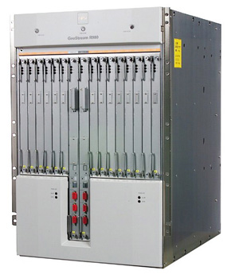
Impact of Soft Errors
Soft Error Rate (SER)
  FIT: How many failures in one billion hours
Mean Time To Failure (MTTF)
Examples -
  Cellphone with 4 Mbit of low-power SRAM @ 1,000 FIT per Mbit
    MTTF = 28 years
  Laptop PC with 256 MB of DRAM @ 600 FIT per Mbit
    MTTF = 1 month
  Router Farm with 100 Gbit of SRAM @ 600 FIT per Mbit
    MTTF = 17 hours
Notes:
Soft error rate is measured as in FIT or represented as in MTTF. FIT indicates the number of failures for one billion operation hours. For example, one Mbit of SRAM has 1,000 FITs, which can be translated into 114 years MTTF. It means that it may have one failure for more than one hundred hours. This is not a big deal.
But if we think about systems with larger or more integrated memories, soft errors are becoming more important. For example, cellphone with 4 Mbit of SRAM, which has 1000 FIT per Mbit, may have a failure every 28 years. Labtop PC with 256 MB with 600 FIT per Mbit has a failure every month. Further, router farm with huge memory like 100 Gbit of SRAM with 600 FIT has a failure every day.

Slide 5
Soft Errors on an Increase
Q_{critical}
SER
∝
N_{flux}
x
CS
x
exp
{-
}
Q_{s}
where
Q_{critical}
=
C
x
V
Increase exponentially due to technology scaling
  0.18 µm
    1,000 FIT per Mbit of SRAM
  0.13 µm
    10,000 to 100,000 FIT per Mbit of SRAM
Voltage Scaling
  Voltage scaling increases SER significantly
Soft Error is a main design concern!
[Hazucha et al., IEEE] P. Hazucha and C. Svensson. Impact of CMOS Technology Scaling on the Atmospheric Neutron Soft Error Rate. IEEE Trans. on Nuclear Science, 47(6):2586–2594, 2000.
Notes:
Process technology continues to shrink

Slide 6
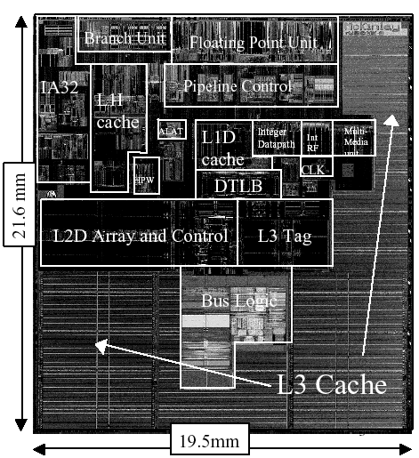
Soft Errors in Caches are Important
Soft errors in memory are much more important than in combinational logic
  Strong temporal masking in combinational logic
  Most upsets in memory manifest as soft errors
  Only 11 % of Soft Errors in combinational logic
Redundancy techniques are popular for Memories
  ECC-based solutions
  Not applicable for caches
    Very sensitive to performance and power overheads
Caches are most vulnerable to soft errors
  Caches occupy majority area in processors (can be more than 50 %)
Intel Itanium II (0.18 um) –
More than 50 % Area
Need to minimize failures due to
Soft Errors in Caches
Notes:
Caches are more vulnerable to soft errors in processors than any other components since caches take up the most area of processors by up to 90 %.
This is the floor plan for Intel Itanium II processor, caches occupy more than 50 % area of the total.
Soft errors in memory are more important than those in combinational logic because logic has more robust structure against soft errors and many upsets in logic do not propagate to soft errors due to maskings such as logical and temporal maskings while most upsets in memory can propagate to soft errors.
Redundancy techniques such as error correcting codes can protect memory from soft errors but they may not be applicable due to high overheads especially for caches.
This is simplified cache without any protection. If we use ECC to protect caches, we need to encode data every write operation and also store the ECC at the extra storage. For every read operation, they need to decode data. Thus it has high overheads in terms of performance, power and area. For instance, Hamming Codes have performance overhead by up to 95 %, energy overhead by up to 22 %, and area cost by more than 18 % according to the previous research.
Again, soft errors for caches must be protected but ECC for every cache access is expensive.
The three natural masking effects in combinational logic that determine whether a single event upset (SEU) will propagate to become a soft error are electrical masking, logical masking, and temporal (or timing-window) masking. An SEU is logically masked if its propagation is blocked from reaching an output latch because off-path gate inputs prevent a logical transition of that gate's output. An SEU is electrically masked if the signal is attenuated by the electrical properties of gates on its propagation path such that the resulting pulse is of insufficient magnitude to be reliably latched. An SEU is temporally masked if the erroneous pulse reaches an output latch, but it does occur close enough to when the latch is actually triggered to hold.

Slide 7
ECC Protection
ECC (Error Correcting Codes) is popular technique to protect memory from soft errors
But has high overheads in terms of Area, Performance and Power
  e.g., SEC-DED
  - Hamming Code (32, 6)
    Performance by up to 95 %
      [Li et al., MTDT ’05]
    Energy by up to 22 %
      [Phelan, ARM ’03]
    Area by more than 18 %
      [Phelan, ARM ’03]
Protected Cache
Coding
Unprotected Cache
Data
ECC
Decoding
ECC protection for caches is expensive!
Notes:
How can we protect it?
Error Correcting Codes are the effective approach to protect memory from soft errors using information redundancy.
It encodes data and stores extra control data every write operation.
Whenever it reads data, it decodes and corrects error by comparing the control data. So it needs extra modules and extra storage for control data.
Again, it’s very effective but it requires high overheads in terms of area cost, performance and power consumption.

Slide 8
Problem Statement
Dual Optimization
  Reduce failures due to soft errors in caches
  Minimize power and performance overheads
Notes:
In this work, our problem is how to reduce the failures with minimizing the power and performance overheads.
Our idea is that we partition data into FNC data and FC data, and map them into partitioned caches where one is without ECC and the other one with ECC. We’ll look into this idea in more detail in the rest of today’s talk.

Slide 9
Outline
Motivation and Problem Statement
Related Work
Our Solution
Experiments
Conclusion
Notes:
Let’s look at how to avoid soft errors and how to reduce overheads, and our contribution.

Slide 10
Related Work in Combating Soft Errors
Process Technology Solutions
  Hardening: [Baze et al., IEEE Trans. On Nuclear Science ’00]
  SOI: [O. Musseau, IEEE Trans. On Nuclear Science ‘96]
  Process complexity, yield loss, and substrate cost
Microarchitectural Solutions for Caches
  Cache Scrubbing: [Mukherjee et al., PRDC ’04]
  Low Power Cache: [Li et al., ISLPED ’04]
  Area Efficient Protection: [Kim et al., DATE ’06]
  Multiple Bit Correction: [Neuberger et al., TODAES ’03]
  Cache Size Selection: [Cai et al., ASP-DAC ’06]
  High overheads in terms of power, performance, and area
Our Solution
  Compiler-based Microarchitectural Technique
  Provide protection from soft errors while minimizing the power, performance, and area overheads
Notes:
Enhanced process technologies such as hardening, purifying and new processes may reduce soft errors. However, it is still there and it makes process more complex and decreases yield with high cost.
In order to reduce soft errors or to reduce the overheads, many studies have been done such as cache scrubing, low power cache, area reduction protection, multiple bit correction with reduced overheads, and cache size exploration for soft errors.
However, these microarchitecture techniques protect all data by using expensive ECC.
What we contribute here is that, first, we propose PPC architecture for SDP, which is less expensive in terms of power, performance and area compared to other techniques at the cost of slight quality degradation.
They work well with multimedia applications and our approach can be in conjunction with any other architectural techniques.

Slide 11
Outline
Motivation and Problem Statement
Related Work
Our Solution
  Observation
  Software Support
  Architectural Support
Experiments
Conclusion
Notes:
Let’s look at how to avoid soft errors and how to reduce overheads, and our contribution.

Slide 12
Observation
Memory is divided into pages
Suppose you could protect pages from soft errors independently
Application
Data Memory
N x 1 KB page
1
Random
Error
Injection
2
N KB
Number of
Failures
1000 Simulations
K
K
N
Notes:
What we’ve observed is that all data are not equally important for failures.
To observe this, we partitioned data memory into 1KB pages. For instance, if an application uses N KB, we may have N 1 KB pages.
For each page, we injected soft errors only on that page, and ran simulations to get the number of failures out of 1000 runs.
Thus we can get the following result graph.
This is a graph showing our observation. X-axis represents a partitioned data page, which has about 80 pages in this benchmark (Susan Edges).
As you can see here, some pages are sensitive to soft errors resulting in failures.
On the other hand, many pages are not sensitive at all. We couldn’t see any single failure for the whole simulations when we generate soft errors for these pages.
This observation indicates that we don’t have to protect all data, and we can reduce overheads if we can only protect these critical data set.

Slide 13
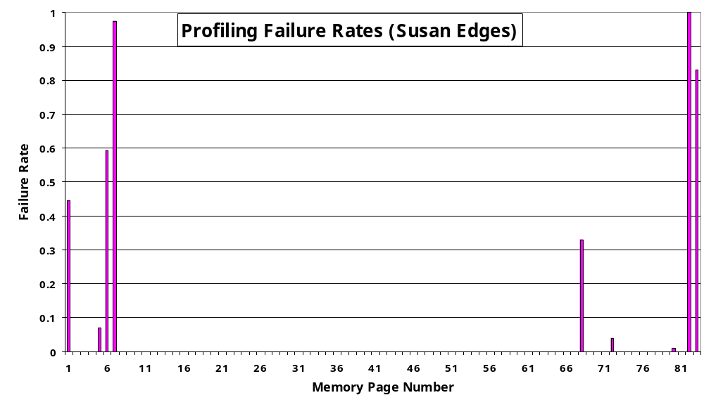
Observation
For a multimedia application - susan
Failure: Application crashes, goes into infinite loop, broken header of image file, wrong size of image etc..
Loss in Quality of Service is not a failure
All pages are not important!!
Notes:
What we’ve observed is that all data are not equally important for failures.
To observe this, we partitioned data memory into 1KB pages. For instance, if an application uses N KB, we may have N 1 KB pages.
For each page, we injected soft errors only on that page, and ran simulations to get the number of failures out of 1000 runs.
Thus we can get the following result graph.
This is a graph showing our observation. X-axis represents a partitioned data page, which has about 80 pages in this benchmark (Susan Edges).
As you can see here, some pages are sensitive to soft errors resulting in failures.
On the other hand, many pages are not sensitive at all. We couldn’t see any single failure for the whole simulations when we generate soft errors for these pages.
This observation indicates that we don’t have to protect all data, and we can reduce overheads if we can only protect these critical data set.

Slide 14
Outline
Motivation and Problem Statement
Related Work
Our Solution
  Observation
  Software Support
  Architectural Support
Experiments
Conclusion
Notes:
Let’s look at how to avoid soft errors and how to reduce overheads, and our contribution.

Slide 15
Data Partitioning
Failure Critical (FC) data
  Loop bounds, loop iterators, branch decision variables etc…
  An error may result in a failure
Failure Non Critical (FNC) data
  Multimedia data (e.g. image pixel bits)
  An error may not cause failures
  Only loss in QoS
sample code (FNC, FC)
…
if ( condition )
{
for ( loop = 1; loop < 64 ; loop++ )
{
local = MM[loop] / ( 2*constant );
MM[loop] = min( 127,
max( -127, MM[loop] ) );
}
}
…
Our Approach for Multimedia Applications
Simple Data Partitioning
  All multimedia data is FNC
  Everything else is FC
User marks the FNC (multimedia) data
  Very simple to do
Notes:
For this study, first, we categorize data into two data such as FNC data and FC data.
Soft errors in FNC data do not cause failures but cause quality degradation while soft errors in FC data can result in failures such as infinite loop, crash, wrong output, and something like that.
These are sample codes from one of multimedia applications. If soft errors occur at these red ones like condition variable, loop variable, and local variable, it may result in failures. MM array is an example of FNC data because multimedia data such as image pixel values do not cause failures but they may degrade a quality a little bit or not at all.
In our approach, we consider multimedia applications for our study and treat MM data as FNC data and non-MM data as FC data.
For this study, we select specific benchmark suite for multimedia applications.
For multimedia applications, we can simply separate data into multimedia data such as image pixel values, and the other data.
The important thing is that multimedia data does not cause a failure.
If you look at these sample codes from one of benchmarks, it has condition variable, loop variable, local variables, and subroutines. And it processes the multimedia data array. Any soft errors in these multimedia data, which only degrade quality a little but it doesn’t cause failures at all. They are two images. One of them is original one without any errors and the other one has a couple of soft errors. But most people can not appreciate differences here.
However, any soft errors in some other data may result in failures such as infinite loop, crashes and wrong outputs.
In our work, these multimedia data is defined as failure non-critical data and all other data is named as failure critical data.
And remember we can easily separate multimedia data from other data.

Slide 16
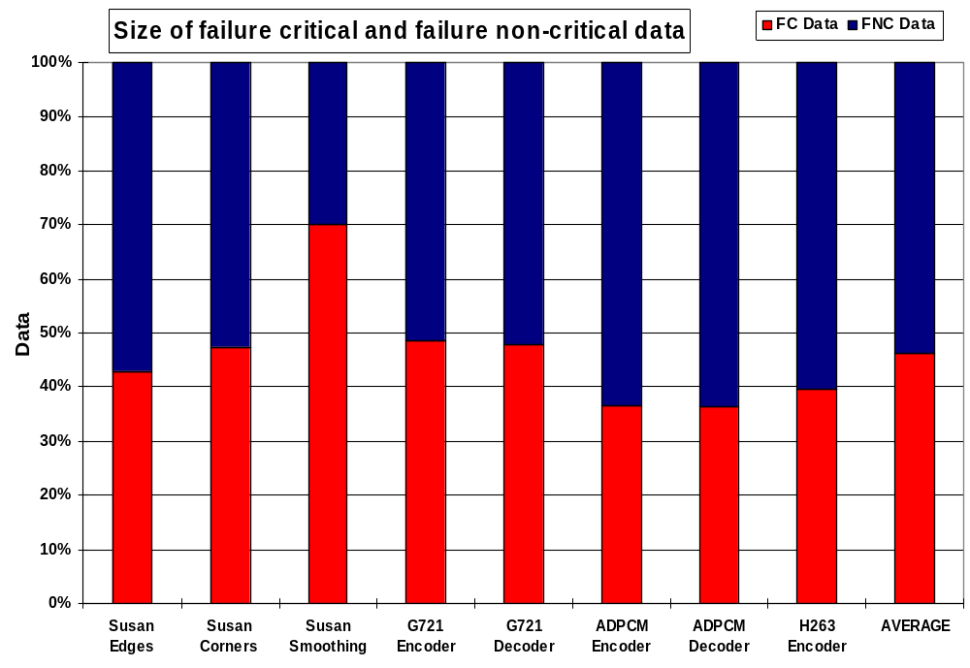
Composition of FC and FNC data
54 %
On average 50% pages are FNC
Should be able to reduce ECC overheads by half
Notes:
When we analyze and profile the data according to this simple partitioning approach, failure non-critical data takes up 30 % to 60 % out of whole data for several multimedia benchmarks,
Which means that we may reduce overheads by up to 60 % in terms of power and performance, if we only protect the failure-critical data.

Slide 17
Outline
Motivation and Problem Statement
Related Work
Our Solution
  Observation
  Software Support
  Architectural Support
Experiments
Conclusion
Notes:
Let’s look at how to avoid soft errors and how to reduce overheads, and our contribution.

Slide 18
HPC (Horizontally Partitioned Caches)
HPC
  More than one cache at the same level of hierarchy
  Each page in memory is mapped to exactly one cache
Originally proposed to separate stack data and array data
  Performance Improvements
But also very effective in reducing energy consumption
[Shrivastava et al., CASES’05]
  Performance improvements
  Mini Cache is typically smaller than Main Cache
Processor (e.g.: Intel XScale)
Processor Pipeline
HPC
Main Cache
Mini Cache
Page Mapping
Memory Controller
Memory
Notes:
HPC standing for Horizontally Partitioned Caches has more than one caches at the same level of hierarchy, they are Main cache and mini cache. Generally, mini cache is smaller than Main one.
As you can see this graph, caches share the interface to processor and memory and each page of memory is mapped to exactly one cache.
HPC can improve not only performance but also energy saving with help of compilers.
There is no study to exploit HPC architecture for reliability. We can separate data into FC and NC data.
Our idea for this architecture is that we can protect only mini cache and not Main cache. Then we can protect only FC data selectively in HPC architecture, which can reduce the overheads for protecting FNC data.

Slide 19
PPC (Partially Protected Caches)
We propose
  Partially Protected Caches
    Main Cache
    Mini Cache Protected from soft errors
  Compiler maps data to the two caches
    Map FNC to Unprotected Main Cache
    Map FC to Protected Mini Cache
Intuition is to provide protection to only the FC data
Processor
Processor Pipeline
HPC
PPC
Unprotected Main Cache
Protected Mini Cache
Main Cache
Mini Cache
Page Mapping
Memory Controller
FNC
FC
Memory
FNC
FC
Notes:
We propose PPC based on HPC, which consists of Unprotected Main Cache and Protected mini cache.
For selective data protection, we map FNC data to Unprotected main cache and FC to Protected mini cache.
Through this architecture and selective protection, we can result in overheads reduction from no protection for unnecessary data.

Slide 20
Outline
Motivation
Related Work
Partially Protected Caches and Selective Data Protection
Experiments
  Experimental Framework
  Results
Conclusion
Notes:
I’ll go into experimental framework and our experimental results.

Slide 21
Data Cache Configurations
Traditional
Proposed
Traditional
Coding
Unprotected
Cache
Unprotected
Cache
Protected
Cache
Prot.
Cache
ECC
Decoding
Configuration 1
- Unsafe Cache
Configuration
High Failures
High Performance
Low Energy
Configuration 3
- PPC Cache
Configuration
Low Failures
High Performance
Low Energy
Configuration 2
Safe Cache
Configuration
Low Failures
Low Performance
High Energy
Notes:
For our experiments, we evaluate three data cache configurations including our architecture.
First configuration has unified cache without any protection. Thus it is highly sensitive to soft errors. We call it Unsafe Configuration in our study.
Second configuration is unified caches with protection. It can correct all single bit soft errors with high overheads, which is named Safe Configuration.
The last configuration is our proposed architecture, which has partitioned caches with selective data protection, which can reduce failures with less power and performance costs than Safe one. Now we call it PPC configuration.

Slide 22
Experimental Framework
Image: SUSAN
Audio: ADPCM, G.721
Video: H.263
MiBench
MediaBench
Application
(MiBench etc)
No
Protection
Selective
Protection
Protection
UNSAFE
SAFE
PPC
Compiler
(gcc)
Multimedia
Data informed
Cache
Simulator
(SimpleScalar)
Synthesis
(Synopsys)
Executable
CACTI
Page Mapping
Accelerated
Soft Error
Injection
Hamming
Code
REPORT : Failure Rate
Runtime
Energy
FNC
FC
FNC
FC
FNC
FC
Notes:
We have a set of multimedia benchmarks for our experiments such as Susan, ADPCM and H.263 from benchmark suites such as MiBench and MediaBench.
And our GCC compiler with multimedia data information generates not only executable but also page mapping tables, which has FNC data and FC data for multimedia applications.
In our experiments, we map these FNC and FC data to protected cache and unprotected cache according to each cache configuration.
In case of UNSAFE configuration, both data are unprotected.
In case of SAFE configuration, they are all protected.
In case of HPC configuration, FNC is mapped to unprotected cache and FC mapped to protected cache.
For each configuration, we ran simulations to get failure rate, performance, and energy consumption. To estimate power overheads for ECC, we implemented their modules and synthesized them using Synopsis tool. And CACTI provides power number and runtime for each configuration.
Through these simulations, synthesis, and tool’s help, we got three result figures, which are failure rate for reliability, runtime for performance, and energy consumption for power.

Slide 23
Experimental Results 1
Effectiveness of our approach - Selective Data Protection using PPC architecture
  Data Cache similar to Intel XScale
    Unsafe: 32 KB (no protection) data cache
    Safe: 32 KB (protection) data cache
    PPC: 32 KB (no protection) & 2KB (protection) data caches
  Data Cache Configuration
    32 bytes line size, 4 way set-assoc, and FIFO
  Soft Error Injection
    Randomly inject Soft Errors every cycle if data in cache is valid
    Accelerated Soft Error Rate (SER)
      Base SER = 1e-9 per cycle per 1 KB of data cache
    Multiple-Bit Errors (MBE) and Single-Bit Errors (SBE)
      SER for MBE is 100 times less than SER for SBE
  Metrics
    Reliability in terms of Failure Rates
      Number of failures in 1,000 runs
    Performance
      System Performance : Number of processor cycles + Data Cache accesses + main memory accesses
    Energy Consumption
      System energy : Processor energy + Data Cache energy (Protected one and Unprotected one) + main memory bus energy + main memory access energy
Notes:
The first experimental set shows the effectiveness of our selective protection approach with perspectives of failure rate, performance and energy cost.
In this experiments, we fixed cache sizes similar to popular architecture, Intel Xscale. Unsafe and Safe configurations have 32 KB cache and HPC has 32 KB unprotected main cache and 2 KB protected mini cache.
Data cache configurations are 32 bytes line size, 4 way set-assoc, and FIFO for replacement policy.
We randomly inject soft errors every cycle if data in cache is valid with accelerated SER. Base SER is 10 to the negative 9th per cycle per 32 KB of data cache.
We also considered Multiple-Bit Errors with 100 times less SER than that of Single-Bit Errors.
For reliability, we used failure rate, which is the number of failures in 1,000 runs.
For performance evaluation, we used system performance consisting of number of processor cycles, data cache accesses and main memory accesses.
For energy consumption, we considered the whole system energy including processor energy, data cache energy, and main memory energy.

Slide 24
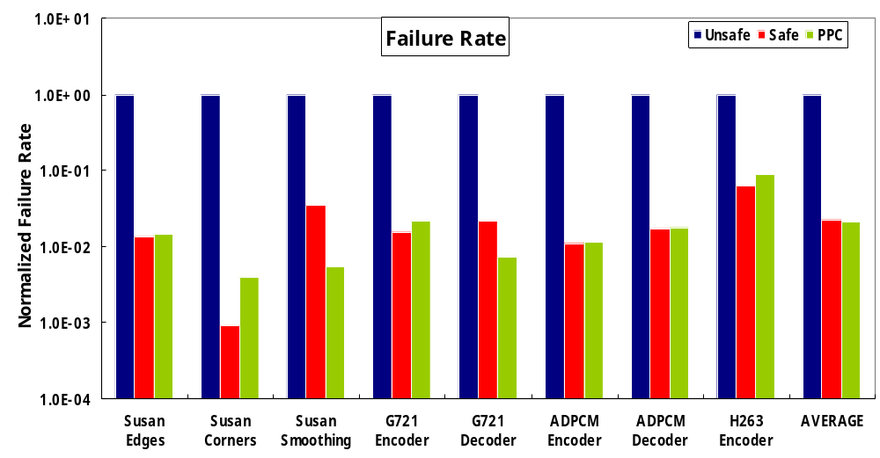
Failure Rate
Normalized Failure Rate : Ratio of failure rate for each configuration to that of Unsafe configuration
Failure Rate of PPC is close to that of Unsafe
Notes:
We ran more than 1,000 simulations for each configuration for every benchmark.
In this graph, x-axis represents benchmarks and y-axis shows the normalized failure rates to failure rate of Unsafe configuration. Blue one indicates failure rate for Unsafe, Red one for Safe and Green one for HPC.
As you can see, compared to Safe one, our approach shows the similar failure rates over most benchmarks.
HPC configuration provides the comparable failure rate to Safe configuration. And HPC and Safe configurations show 45 times less failure rates than that of Unsafe configuration.
Which means that our proposing PPC architecture provides the comparable reliability to Safe architecture where all data are protected in data cache while our architecture protects only failure critical data.

Slide 25
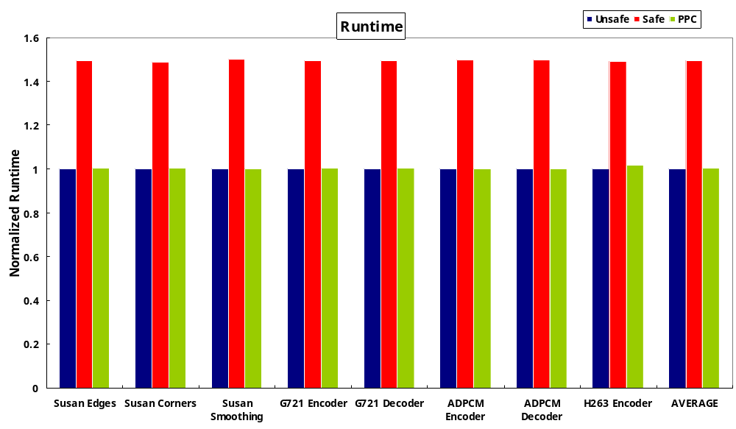
Performance
Normalized Runtime : Ratio of runtime for each configuration to that of Unsafe configuration
PPC has performance close to Unsafe
On average, PPC has 32 % runtime reduction compared to Safe
PPC has only 1 % performance overhead compared to Unsafe
Our paper in CASES ’06 has more conservative numbers due to a mistake of performance calculations for a couple of benchmarks.
Notes:
This graph shows the performance over benchmarks, which is normalized one to that of Unsafe configuration. On average Safe configuration has more than 40 % overheads in performance but HPC can reduce most of these overheads.
Thus, we can say that HPC configuration has much less performance than Safe one, which is 32 % runtime reduction on average.
Remember that we can perform the similar failure rates with less performance overheads.

Slide 26
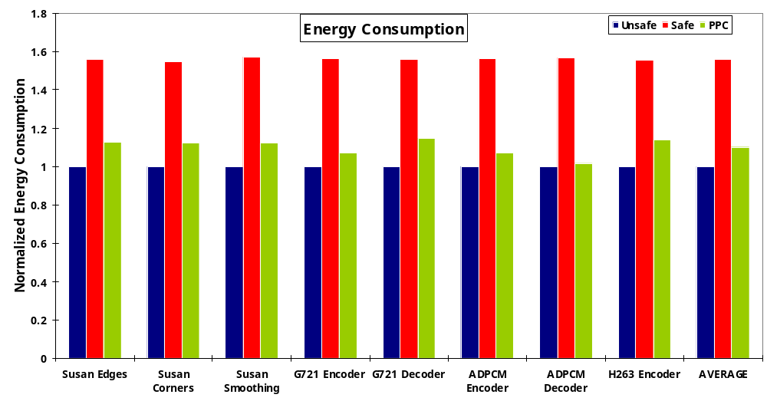
Energy Consumption
Normalized Energy Consumption : Ratio of energy consumption for each configuration to that of Unsafe configuration
PPC has energy consumption close to Unsafe
On average, PPC has 29 % energy reduction compared to Safe
PPC has 10 % energy consumption overhead compared to Unsafe
Notes:
This is a energy consumption plot, which shows that Safe configuration where all data are protected with ECC has more than 50 % energy overhead.
But our approach can remove most of energy overheads from Safe one, which is 29 % energy reduction on average.
When we evaluate these three configurations, we can claim that HPC works better than Safe since we can perform the same failure rates with about 30 % power and performance improvements.

Slide 27
Experimental Results 2
Design Space Exploration
  Various Cache Configurations
    Impact of Cache Size: 512 Bytes to 32 KB in exponents of 2
    Set Associativity: directed-map, 4 way, 32 way
  Metrics
    Reliability in terms of Failure Rates
    Performance
    Energy Consumption
Notes:
Our second set explores design space how to find a best configuration in HPC with metrics of failure rates, runtimes and energy consumptions again.
To evaluate cache size, Main cache without protection ranges from 512 B to 32 KB in exponents of 2 with less size of mini cache with protection, and use about 21 combinations and different set-associativities. Today, we’re going to look at only 4 way set-assoc and others have shown similar results.

Slide 28
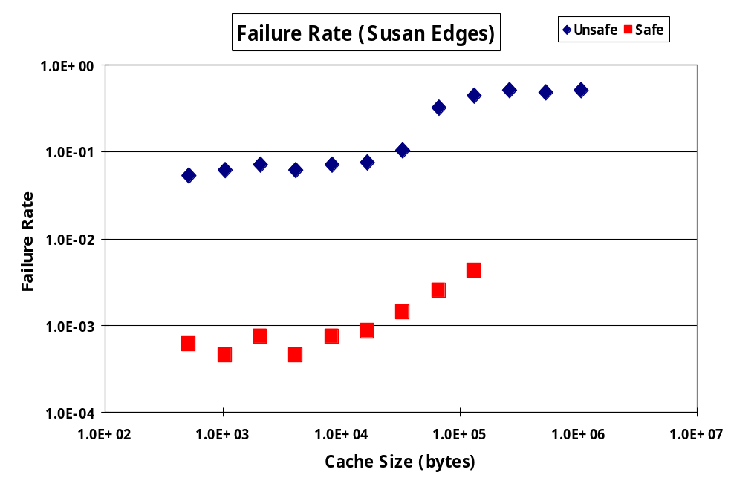
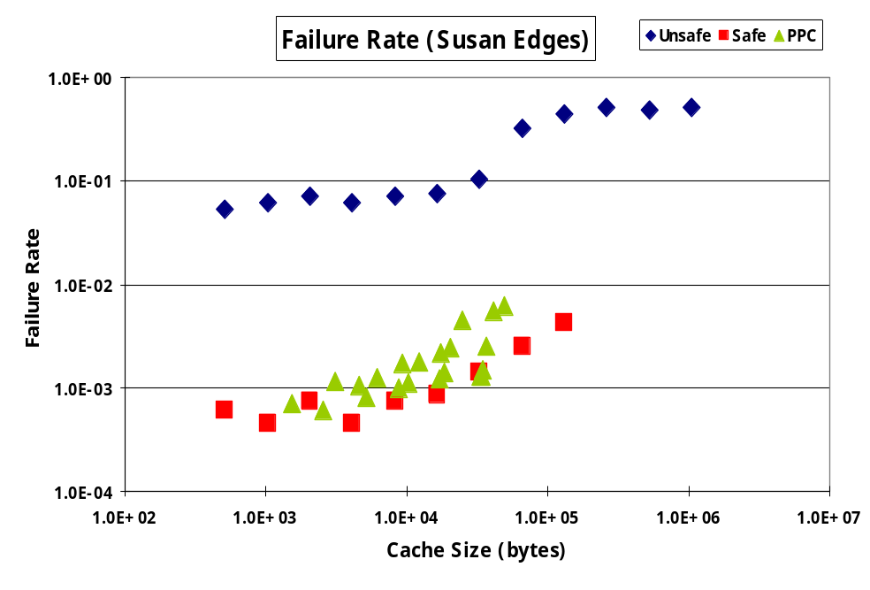
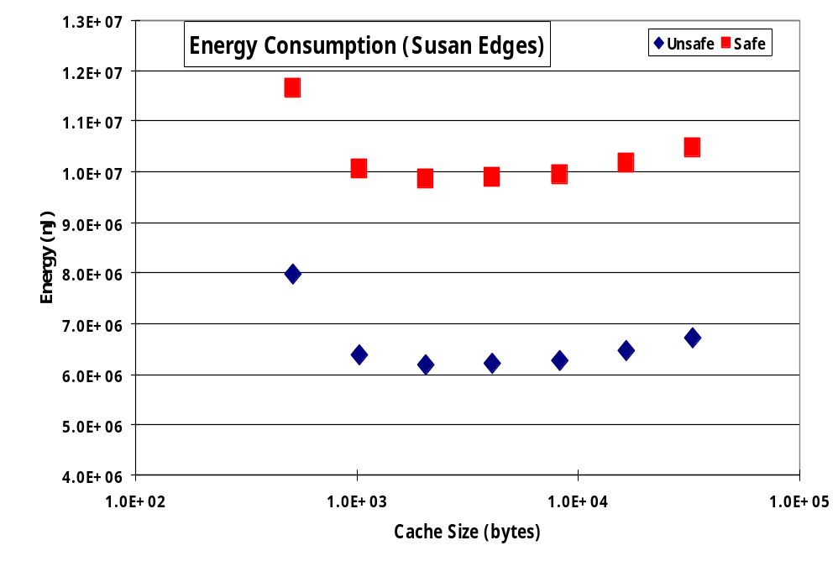
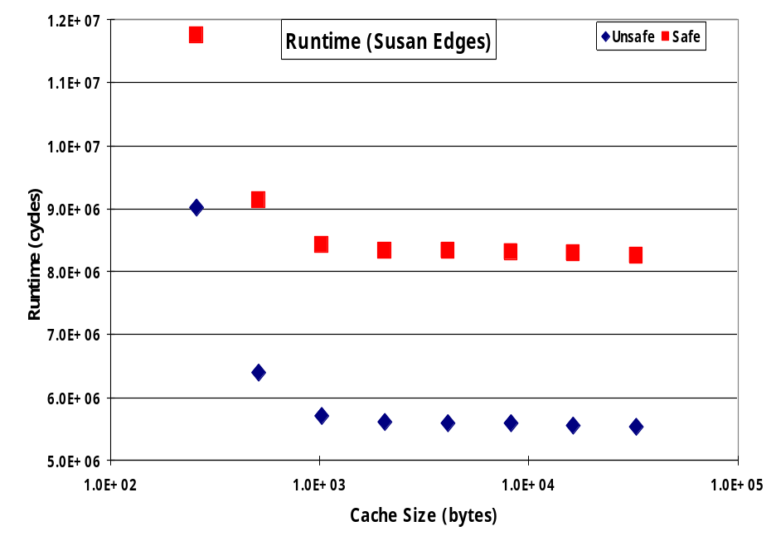
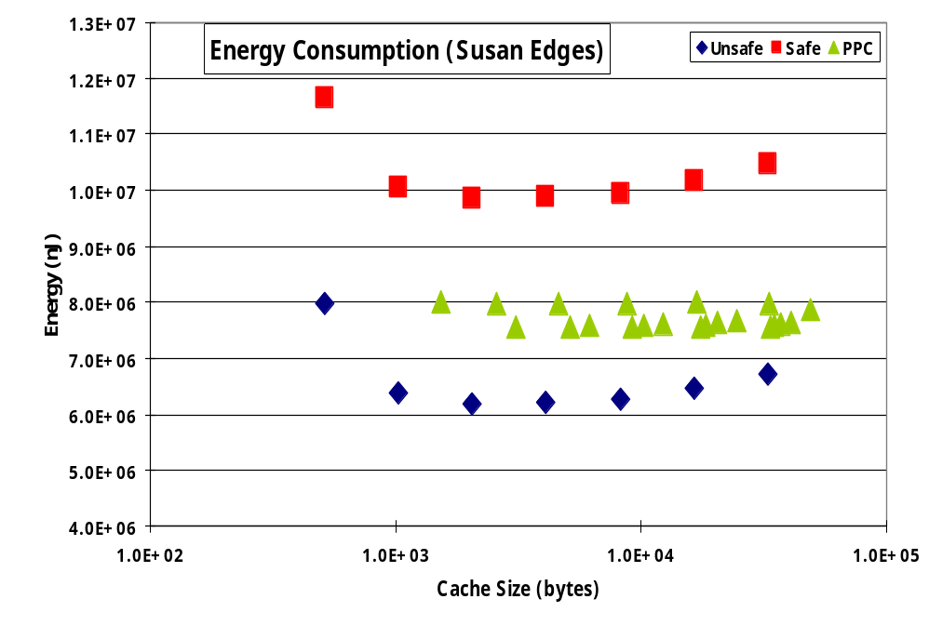
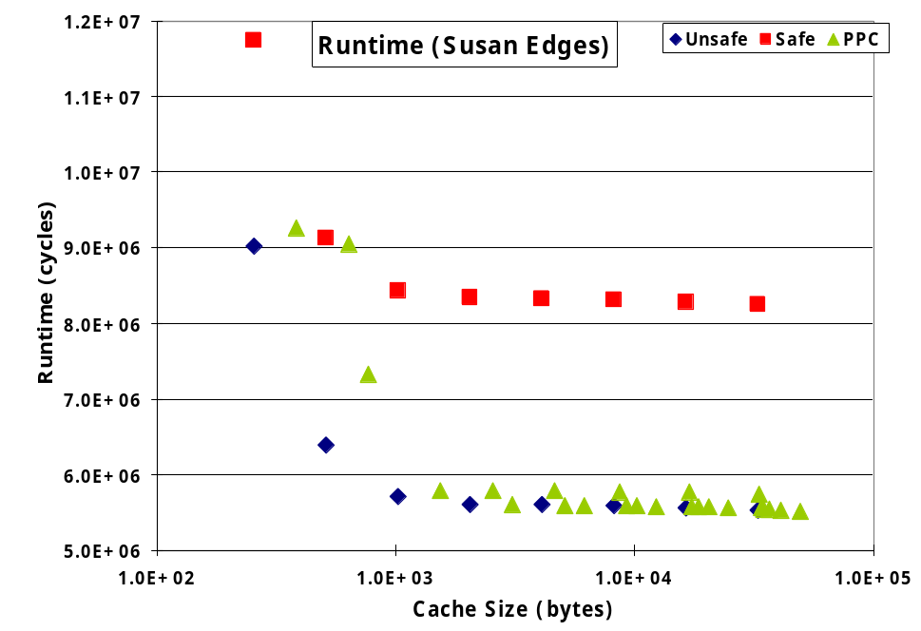
Results 2: Design Space Exploration
Failure rate of PPC is close to that of Safe
Performance and energy consumption of PPC are close to those of Unsafe
PPC can hold failure rate, performance, and power between Safe and Unsafe
Notes:
This is a graph showing that failure rates over cache sizes done for Susan Edges benchmark.
Blue one indicates simulation results for Unsafe Configuration, red one for Safe and green one for HPC.
Failure rates are increasing first but it’s going to be saturated after some point. First increasing comes from increasing cache size and saturation is from where all data are on cache. For example, this benchmark has about 50 KB of data footprint thus after 64 KB the failure rates remain.
As you can see clearly from this graph, Failure rate of HPC is much closer to that of Safe for most cache sizes.

Slide 29
Conclusion
Soft Errors are major design concern for system reliability
We propose the Partially Protected Caches and the Selective Data Protection for Multimedia Applications
Our approach as compared to the Safe configuration
  Comparable failure rates
  32 % performance improvement
  29 % energy saving
Our approach works across cache configurations
Future Work
  Selective Data Protection for general applications
  Selective Data Protection in other components such as logic
Notes:
We propose the selective data protection in HPC for multimedia applications in order to reduce failures due to soft errors.
Our experimental results show that we can perform the high reliable cache system with significant reduction of performance and power, both are about 30 % reductions.
We also obtained the similar results with different cache configurations.
Our future work lies in this approach for general applications and for other architectures such as logic components.

Slide 30
Thanks!
Any Questions?
kyoungwl@ics.uci.edu
Notes:
Thank you! Any questions?

Slide 31
Backup Slides

Slide 32
Focus
Who is your audience? CASES ’06 – compiler people
  High-level presentation, more focus on compiler approaches
What is the strong motivation? Soft Error and its high-overhead protection
  Specific motivation
What is our problem? Soft Error Protection in Caches for Multimedia Applications
What is our contribution? Selective Data Protection without Losing Reliability
  Key Idea
  Clear experimental framework
Every slide should have at least a tiny picture, which can visualize and help the contents. ➔ Unified $ and HPC $

Slide 33
Outline
Soft Errors in Cache
ECC protection: High Overheads in terms of Performance and Power
Selective Data Protection in HPC
  Reduce Overheads with Comparable Reliability
  Multimedia Applications
Experiments
  Experimental Framework
  Results
Conclusion

Slide 34
Strong Motivation
Soft error is critical
ECC is expensive
All data are not equally critical to failures
  Multimedia is a good example

Slide 35
Radiation-Induced Soft Errors
Radiation
source
drain
1
0
+
+
-
-
+
+
-
-
+
-
+
-
Bit Value
Transistor
Bit Flip
Notes:
What is a soft error?
Soft errors are effects from upsets or bit-flips.
This is a transistor, which has a bit value according to the charge. And now it has a value of 0.
When external radiations such as alpha particles and neutrons strike a sensitive area of the device, it generates the electron-hole pairs in the wake, which can create the collected charge. If this charge is large enough to flip the bit value, it can change the value such as from 0 to 1 or
vice versa

Slide 36
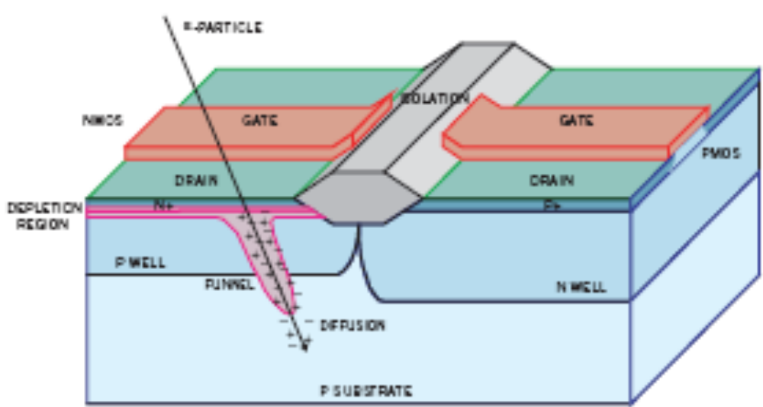
Soft Error
R. Mastipuram and E. C. Wee. Soft Errors’ Impact on System Reliability. EDN online, Sep 2004

Slide 37
Soft Errors vs. Hard Errors
Soft Errors vs. Hard Errors
  Randomly radiation-induced Single Event Effects (SEE)
  Transient faults vs. Permanent faults
  Probability of soft errors is up to 100x higher than that of hard errors

Slide 38
SER formula
Q_{critical}
    N_{flux} - intensity of the Neutron Flux
    CS - the area of the cross section of the node
    Q_{S} - the charge collection efficiency
    Q_{critical} - the min charge required for a cell to retain data
      Q_{cirtical} = C x V where C is Capacitance and V is Supply Voltage
SER
∝
N_{flux}
x
CS
x
exp
{-
}
Q_{s}

Slide 39
Soft Error is Critical
High Integration
  High integration raises soft errors potentially [Mastipuram et al., EDN ’04]
    (e.g.) Cellphone with 4 Mbit of low-power SRAM : 1,000 FIT per Mbit
    ➔ 28 years in MTTF
    (e.g.) Laptop PC with 256 MB of DRAM : 600 FIT per Mbit
    ➔ one month in MTTF
    (e.g.) Router Farm with 100 Gbit of SRAM : 600 FIT per Mbit
    ➔ 17 hours in MTTF
[Mastipuram et al., EDN ’04] R. Mastipuram and E. C. Wee. Soft Errors’ Impact on System Reliability. EDN online, Sep 2004.
Notes:
This graph predicts the soft error rate of SRAM.
In this graph, x-axis represents technology generation and y-axis presents the normalized soft error rate. As you can see, the system SER is increasing exponentially with advance of technology while bit SER is going to be saturated.
For example, the next generation expects to give us 10 times or 100 times higher soft error rate than current technology.
Voltage scaling is a popular technique to reduce dynamic power but it is bad at SER. If we reduce supply voltage, it decreases critical charge, which increases SER exponentially according to this formula.
Also, SER depends on where we are. For instance, at flight it shows much higher SER than that at ground level.
boro-phospho-silicate glass; silicon dioxide (silica) with boron and phosphorus added to lower temperature at which glass (oxide) starts to flow from about 950 oC for pure SiO2 to about 500 oC for BPSG; used to planarize the surface; deposited by CVD.

Slide 40
Soft Errors on an Increase
Q_{critical}
SER
∝
N_{flux}
x
CS
x
exp
{-
}
Q_{s}
where
Q_{critical}
=
C
x
V
Increase exponentially due to technology scaling
  0.18 µm
    1,000 FIT per Mbit of SRAM
  0.13 µm
    10,000 to 100,000 FIT per Mbit of SRAM
Voltage Scaling
  Voltage scaling increases SER significantly
Soft Error is a main design concern!
[Hazucha et al., IEEE] P. Hazucha and C. Svensson. Impact of CMOS Technology Scaling on the Atmospheric Neutron Soft Error Rate. IEEE Trans. on Nuclear Science, 47(6):2586–2594, 2000.
Notes:
Process technology continues to shrink

Slide 41
Soft Errors increase with technology advances
Soft errors are affected by [Hazucha et al., IEEE] :
  Process Technology
    Shrinking increases SER exponentially
      (e.g.) 1,000 FIT per Mbit of SRAM in 0.18 µm
      ➔ 10,000 to 100,000 FIT per Mbit of SRAM in 0.13 µm
      [Mastipuram et al., EDN ’04]
  Voltage Scaling
    Voltage scaling increases SER significantly
Q_{critical}
SER
∝
N_{flux}
x
CS
x
exp
{-
}
Q_{s}
where
Q_{critical}
=
C
x
V
source
drain
source
drain
0.18 µm Transistor
C and V
decrease
Soft Error is a main design concern!
0.13 µm Transistor
[Hazucha et al., IEEE] P. Hazucha and C. Svensson. Impact of CMOS Technology Scaling on the Atmospheric Neutron Soft Error Rate. IEEE Trans. on Nuclear Science, 47(6):2586–2594, 2000.
Notes:
Soft errors are affected by process technology and voltage scaling.
As technology scales, SER increases exponentially. For instance, 1000 FIT per Mbit in 0.18 micro meter technology increases to 10,000 to 100,000 FIT at 0.13 micro meter technology.
Voltage scaling is popular power management technique to reduce dynamic power, but it’s not good for soft errors. If we reduce supply voltage, soft error rate increases significantly.
Thus, due to high integration, high technology and low-power technique, soft error is a main design concern.

Slide 42
Soft Errors increase with technology advances
Soft errors are affected by [Hazucha et al., IEEE] :
  Process Technology
    Shrinking increases SER exponentially
      (e.g.) 1,000 FIT per Mbit of SRAM in 0.18 µm
      ➔ 10,000 to 100,000 FIT per Mbit of SRAM in 0.13 µm [Mastipuram et al., EDN ’04]
  Voltage Scaling
    Voltage scaling increases SER significantly
  Radiation intensity
    Latitude and Altitude
      (e.g.)10 to 100 times higher SER at flight than at ground
Q_{critical}
SER
∝
N_{flux}
x
CS
x
exp
{-
}
Q_{s}
where
Q_{critical}
=
C
x
V
source
drain
source
drain
0.18 µm Transistor
C and V
decrease
Soft Error is a main design concern!
0.13 µm Transistor
[Hazucha et al., IEEE] P. Hazucha and C. Svensson. Impact of CMOS Technology Scaling on the Atmospheric Neutron Soft Error Rate. IEEE Trans. on Nuclear Science, 47(6):2586–2594, 2000.
Notes:
Process technology continues to shrink

Slide 43
Soft Error is Critical
High Integration
  Raises SE linearly
Process Technology
  Shrinking decreases Q_{critical} and increases SER exponentially
    (e.g.) 1,000 FIT per Mbit of SRAM in 0.18 µm
    ➔ 10,000 to 100,000 FIT per Mbit of SRAM in 0.13 µm [Mastipuram et al., EDN ’04]
Q_{critical}
SER
∝
N_{flux}
x
CS
x
exp
{-
}
Q_{s}
where
Q_{critical}
=
C
x
V
source
drain
source
drain
0.18 µm Transistor
C and V
decrease
0.13 µm Transistor
Notes:
Process technology continues to shrink

Slide 44
Soft Error is Critical
High Integration
  Raises SE linearly
Process Technology
  Shrinking decreases Q_{critical} and increases SER exponentially
Voltage Scaling
  Voltage scaling decreases Q_{critical} and increases SER exponentially
Q_{critical}
SER
∝
N_{flux}
x
CS
x
exp
{-
}
Q_{s}
where
Q_{critical}
=
C
x
V
R. Mastipuram and E. C. Wee. Soft Errors’ Impact on System Reliability. EDN online, Sep 2004.
Notes:
This graph predicts the soft error rate of SRAM.
In this graph, x-axis represents technology generation and y-axis presents the normalized soft error rate. As you can see, the system SER is increasing exponentially with advance of technology while bit SER is going to be saturated.
For example, the next generation expects to give us 10 times or 100 times higher soft error rate than current technology.
Voltage scaling is a popular technique to reduce dynamic power but it is bad at SER. If we reduce supply voltage, it decreases critical charge, which increases SER exponentially according to this formula.
Also, SER depends on where we are. For instance, at flight it shows much higher SER than that at ground level.
boro-phospho-silicate glass; silicon dioxide (silica) with boron and phosphorus added to lower temperature at which glass (oxide) starts to flow from about 950 oC for pure SiO2 to about 500 oC for BPSG; used to planarize the surface; deposited by CVD.

Slide 45


Soft Error is Critical
High Integration
  Raises SE linearly
Process Technology
  Shrinking decreases Q_{critical} and increases SER exponentially
Voltage Scaling
  Voltage scaling decreases Q_{critical} and increases SER exponentially
Latitude and Altitude
  10 to 100 times higher SER at flight than at ground
Q_{critical}
High Integration
  Raises SE linearly
Process Technology
  Shrinking decreases Q_{critical} and increases SER exponentially
Voltage Scaling
  Voltage scaling decreases Q_{critical} and increases SER exponentially
Latitude and Altitude
  10 to 100 times higher SER at flight than at ground
    (e.g.) Potentially Laptop PC with 256 MB of Memory on an airplane at 35,000 ft ➔ 5 hours MTTF [Mastipuram et al., EDN ‘04]
∝
CS
SER
N_{flux}
x
x
exp
SER
N_{flux}
{-
}
Q_{s}
where
Q_{critical}
=
C
x
V
5 hours MTTF
5 hours MTTF
1 month MTTF
1 month MTTF
Soft Error is a main design concern!
R. Mastipuram and E. C. Wee. Soft Errors’ Impact on System Reliability. EDN online, Sep 2004.
Notes:
This graph predicts the soft error rate of SRAM.
In this graph, x-axis represents technology generation and y-axis presents the normalized soft error rate. As you can see, the system SER is increasing exponentially with advance of technology while bit SER is going to be saturated.
For example, the next generation expects to give us 10 times or 100 times higher soft error rate than current technology.
Voltage scaling is a popular technique to reduce dynamic power but it is bad at SER. If we reduce supply voltage, it decreases critical charge, which increases SER exponentially according to this formula.
Also, SER depends on where we are. For instance, at flight it shows much higher SER than that at ground level.
boro-phospho-silicate glass; silicon dioxide (silica) with boron and phosphorus added to lower temperature at which glass (oxide) starts to flow from about 950 oC for pure SiO2 to about 500 oC for BPSG; used to planarize the surface; deposited by CVD.

Slide 46
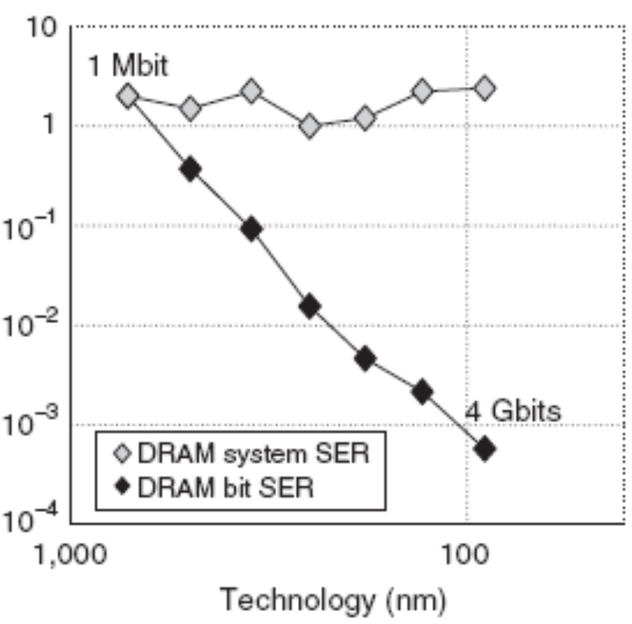
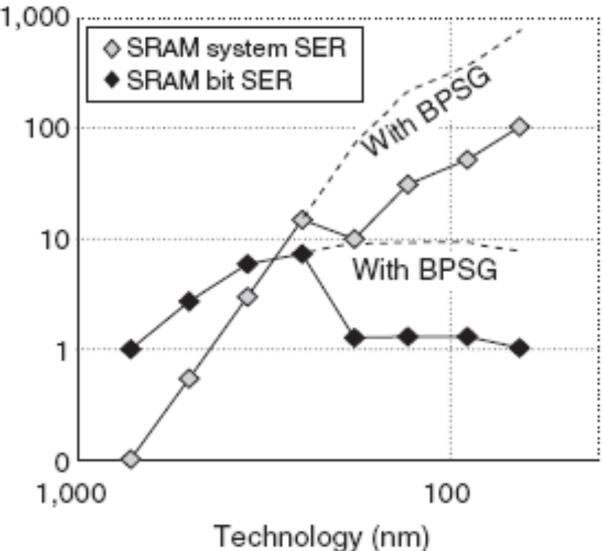
Soft Errors in Caches are Important
Core : Combinational Logic
  Robust structure
  Masking (e.g.: logical, electrical, and temporal maskings)
  Only 10 % of Soft Errors
  in combinational logic
Main Memory: DRAM
  Upset of memory is not masked
  SER is not increasing with technology generations
Cache: SRAM
  Upset is not masked
  SER is increasing significantly with technology generations
  Most area of processor
  Cache affects performance and power consumption significantly
Intel Itanium II (0.18 um) -
More than 50 % Area
SRAM SER
DRAM SER
Robert Bauman, Soft Errors in Advanced Computer Systems in IEEE Design and Test of Computers 2005
S. Mitra, N. Seifert, M. Zhang, Q. Shi, and K. S. Kim, Robust System Design with Built-In Soft-Error Resilience, IEEE Computer 2005
Richard Loft, Supercomputing Challenges at the National Center for Atmospheric Research
Notes:
When SE occurred, four maskings exist. In combinational components, that’s why it’s not that important.
Every upset in memory is not masked.
Memory (cache) takes up most area.
If we use ECC to cache, it’s very expensive
Since cache is very sensitive for performance and power,
The three natural masking effects in combinational logic that determine whether a single event upset (SEU) will propagate to become a soft error are electrical masking, logical masking, and temporal (or timing-window) masking. An SEU is logically masked if its propagation is blocked from reaching an output latch because off-path gate inputs prevent a logical transition of that gate's output. An SEU is electrically masked if the signal is attenuated by the electrical properties of gates on its propagation path such that the resulting pulse is of insufficient magnitude to be reliably latched. An SEU is temporally masked if the erroneous pulse reaches an output latch, but it does occur close enough to when the latch is actually triggered to hold.

Slide 47
Most Effective Protection: ECC
ECC (Error Correcting Codes) - Information Redundancy
  Code data and store extra control data
  Decode data and detect/correct errors in data
  High overheads in terms of Area, Performance and Power
    (e.g.) SEC-DED
    (Single Error Correction
    and Double Error Detection)
    for cache (or SRAM)
    – Hamming Codes (32, 6)
      Performance by up to 95 %
      Energy by up to 22 %
      Area by more than 18 %
Protected Cache
Coding
Unprotected Cache
Data
Control
Decoding
ECC protection for every cache access
is too expensive!
J.-F. Li and Y.-J. Huang. An Error Detection and Correction Scheme for RAMs with Partial-Write Function. In MTDT’05, pages 115–120, 2005.
R. Phelan. Addressing Soft Errors in ARM Core-based Designs. Technical report, ARM, 2003.
Notes:
How can we protect it?
Error Correcting Codes are the effective approach to protect memory from soft errors using information redundancy.
It encodes data and stores extra control data every write operation.
Whenever it reads data, it decodes and corrects error by comparing the control data. So it needs extra modules and extra storage for control data.
Again, it’s very effective but it requires high overheads in terms of area cost, performance and power consumption.

Slide 48
ECC Protection for Caches is Expensive
ECC (Error Correcting Codes) is the most effective technique to protect memory from soft errors
ECC has high overheads in terms of Area, Performance and Power
  (e.g.) SEC-DED
    – Hamming Codes (32, 6)
      Performance by up to 95 %
      [Li et al., MTDT ’05]
      Energy by up to 22 % [Phelan, ARM ’03]
      Area by more than 18 % [Phelan, ARM ’03]
Protected Cache
Coding
Unprotected Cache
Data
ECC
Decoding
ECC protection for every cache access
is expensive!
[Li et al., MTDT ’05] J.-F. Li and Y.-J. Huang. An Error Detection and Correction Scheme for RAMs with Partial-Write Function. In MTDT’05, pages 115–120, 2005.
[Phelan, ARM ’03] R. Phelan. Addressing Soft Errors in ARM Core-based Designs. Technical report, ARM, 2003.
Notes:
How can we protect it?
Error Correcting Codes are the effective approach to protect memory from soft errors using information redundancy.
It encodes data and stores extra control data every write operation.
Whenever it reads data, it decodes and corrects error by comparing the control data. So it needs extra modules and extra storage for control data.
Again, it’s very effective but it requires high overheads in terms of area cost, performance and power consumption.

Slide 49
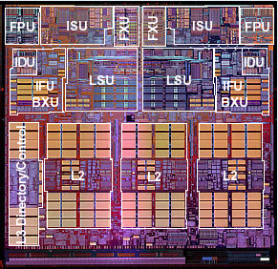
Power PC 4

Slide 50
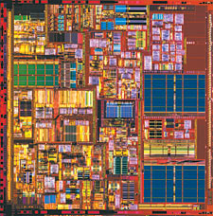
Pentium 4

Slide 51
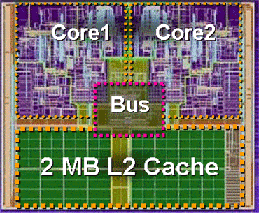
Intel Duo

Slide 52
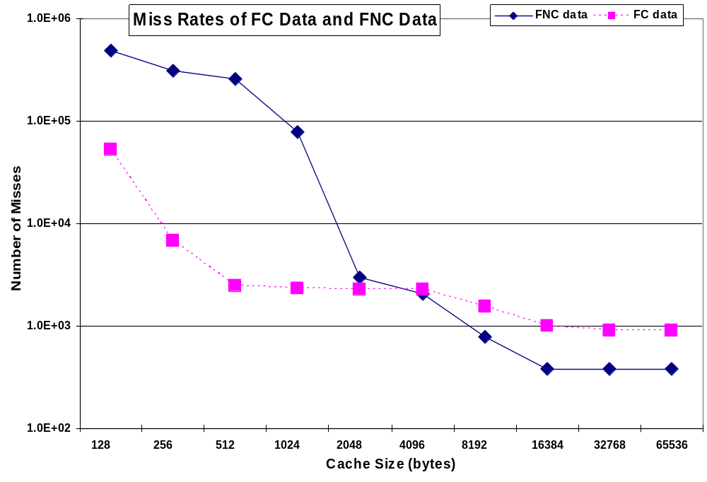
Cache Miss Rates of FC and FNC data

Slide 53
Benchmarks
MiBench
  Image Processing: Susan Edges, Susan Corners, Susan Smoothing
  Audio Codec: ADPCM Encoder/Decoder
Media Bench
  Audio Codec: G.721 Encoder/Decoder
PeaCE (Ptolemy extension as Codesign Environment)
  H.263 Video Encoder

Slide 54
Failures
Can not open output of multimedia processing
  No output
  Incorrect output name
  Wrong header
  Different output size
Crash
Infinite Loop

Slide 55
Performance
Unsafe
  Num_Inst + Access*2 + Miss*25
Safe
  Num_Inst + Access*3 + Miss*25
HPC
  Num_Inst + 2*(Main_Access + Mini_Access) + 25*(Main_Miss + Mini_Miss)

Slide 56
Energy Consumption
Energy consumption of the whole system
  Processor Pipeline: 0.67 nJoules per cycle
  Cache: nJoules from CACTI
  Memory: 42.19 nJoules per access
  Off-chip bus
Tools: CACTI and Synopsys Design Compiler
E = {(A_{SEprone} × E_{SEprone}) + A_{SEprotected}×(E_{SEprotected}+E_{dec})+(W_{SEprotected}×E_{cod})} + {(M_{SEprone}+M_{SEprotected})×(E_{bus}+E_{mem})}+{(M_{SEprotected}×E_{cod}) + (R_{SEprotected} × E_{dec})} + {E_{proc} ×(A_{SEprotected} +A_{SEprone})}

Slide 57
Clear Problem Definition and Intensive Experiments
Problem should be clear and very specific
Selective Data Protection in HPC for Multimedia Applications
Our strength is experimental framework and extensive experiments
  Detailed presentation about our simulation environments and benchmarks
  Experimental sets
    Effects of our approach in terms of power, performance and reliability
    Design space exploration

Slide 58
Problem Definition
Configurations
  Unsafe
  Safe
  HPC
Our interest lies on mitigating failures due to soft errors, instead of decreasing soft errors

Slide 59

Failure Rate
Normalized Failure Rate : Ratio of failure rate for each configuration to that of Unsafe configuration
PPC provides the comparable reliability to Safe
On average, both have 45 times less failures than Unsafe
Notes:
We ran more than 1,000 simulations for each configuration for every benchmark.
In this graph, x-axis represents benchmarks and y-axis shows the normalized failure rates to failure rate of Unsafe configuration. Blue one indicates failure rate for Unsafe, Red one for Safe and Green one for HPC.
As you can see, compared to Safe one, our approach shows the similar failure rates over most benchmarks.
HPC configuration provides the comparable failure rate to Safe configuration. And HPC and Safe configurations show 45 times less failure rates than that of Unsafe configuration.
Which means that our proposing PPC architecture provides the comparable reliability to Safe architecture where all data are protected in data cache while our architecture protects only failure critical data.

Slide 60
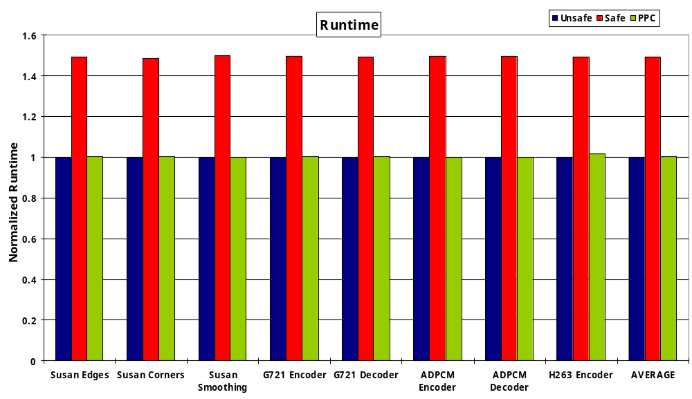
Performance
Normalized Runtime : Ratio of runtime for each configuration to that of Unsafe configuration
PPC removes performance overhead from Safe
On average, PPC has 32 % runtime reduction compared to Safe
PPC has only 1 % performance overhead compared to Unsafe
Our paper in CASES ’06 has more conservative numbers due to a mistake of performance calculations for a couple of benchmarks.
Notes:
This graph shows the performance over benchmarks, which is normalized one to that of Unsafe configuration. On average Safe configuration has more than 40 % overheads in performance but HPC can reduce most of these overheads.
Thus, we can say that HPC configuration has much less performance than Safe one, which is 32 % runtime reduction on average.
Remember that we can perform the similar failure rates with less performance overheads.

Slide 61
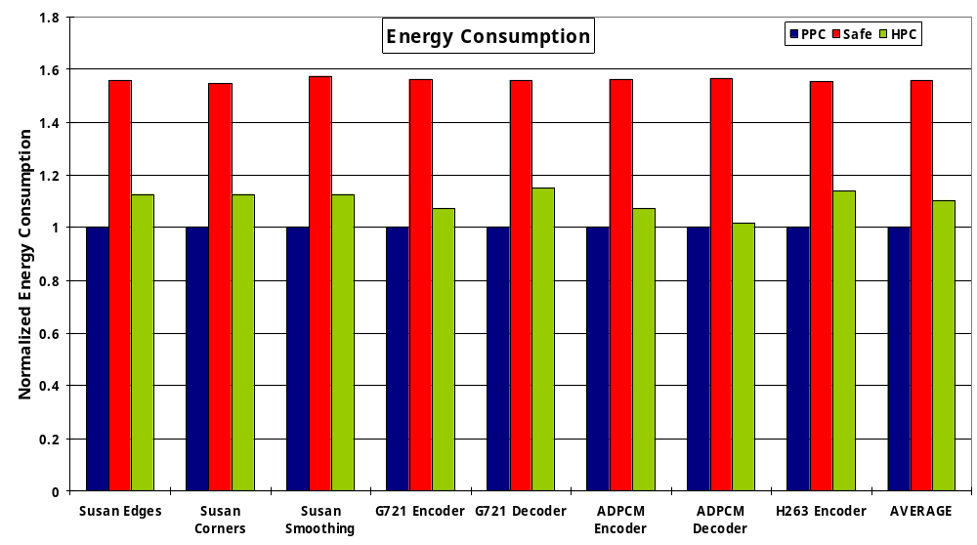
Energy Consumption
Normalized Energy Consumption : Ratio of energy consumption for each configuration to that of Unsafe configuration
PPC has less energy overhead than Safe
On average, PPC has 29 % energy reduction compared to Safe
PPC has 10 % energy consumption overhead compared to Unsafe
Notes:
This is a energy consumption plot, which shows that Safe configuration where all data are protected with ECC has more than 50 % energy overhead.
But our approach can remove most of energy overheads from Safe one, which is 29 % energy reduction on average.
When we evaluate these three configurations, we can claim that HPC works better than Safe since we can perform the same failure rates with about 30 % power and performance improvements.

Slide 62
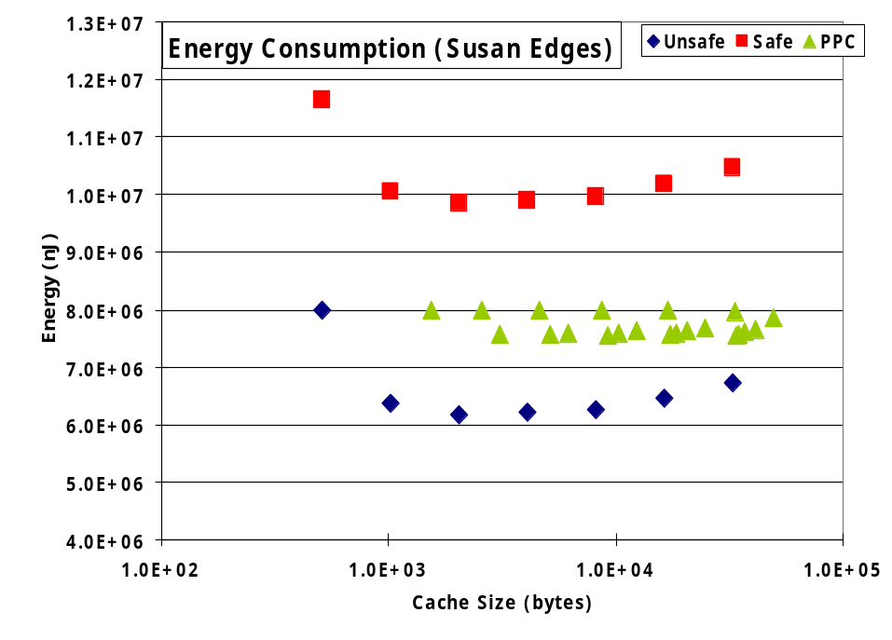
Results 2: Design Space Exploration
Failure rate of PPC is close to that of Safe
Performance and energy consumption of PPC are close to those of Unsafe
PPC can hold failure rate, performance, and power between Safe and Unsafe
Notes:
This is a graph showing that failure rates over cache sizes done for Susan Edges benchmark.
Blue one indicates simulation results for Unsafe Configuration, red one for Safe and green one for HPC.
Failure rates are increasing first but it’s going to be saturated after some point. First increasing comes from increasing cache size and saturation is from where all data are on cache. For example, this benchmark has about 50 KB of data footprint thus after 64 KB the failure rates remain.
As you can see clearly from this graph, Failure rate of HPC is much closer to that of Safe for most cache sizes.

Slide 63
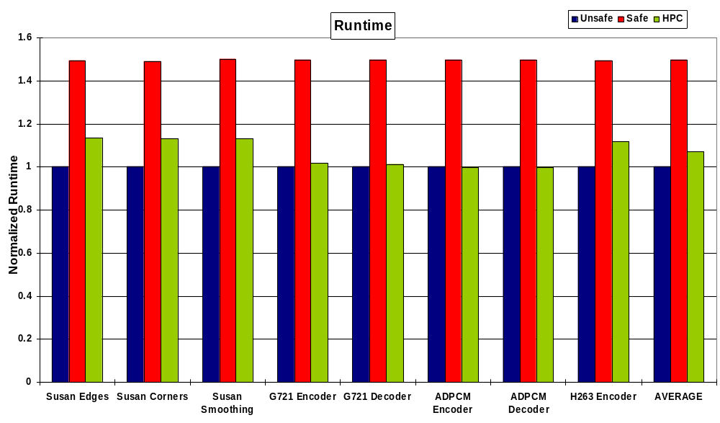
Runtime

Slide 64
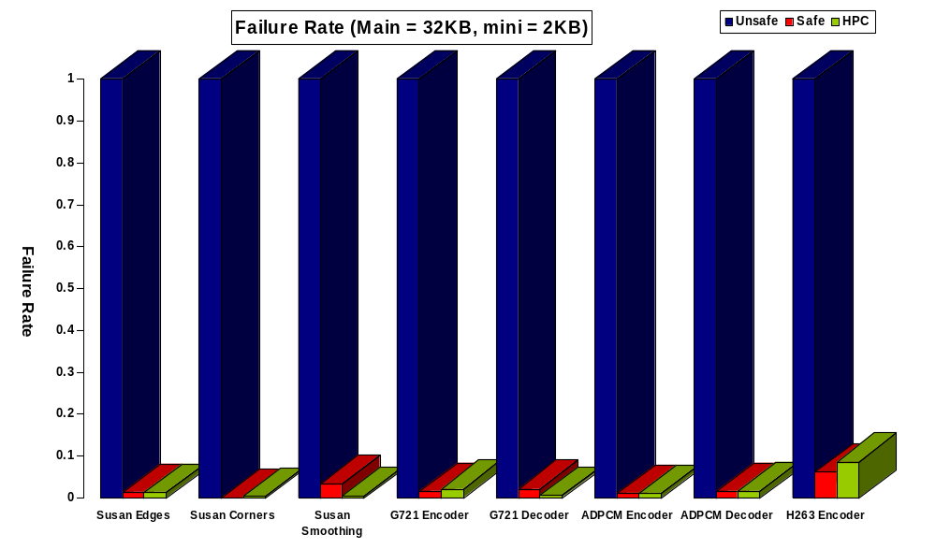
Failure Rate

Slide 65
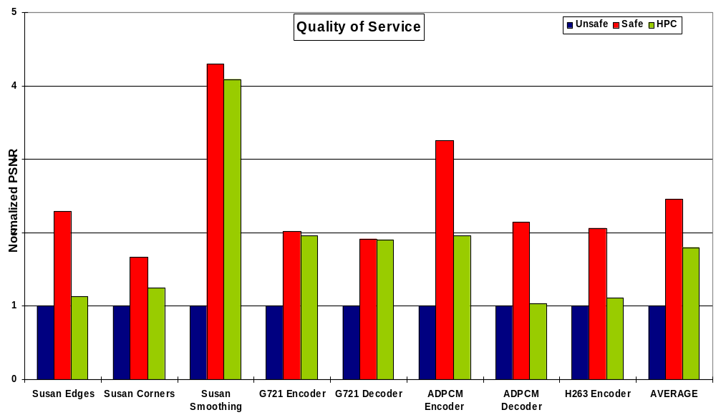
QoS
PSNR = 10LOG₁₀(MAX²/MSE)
  MSE : Mean Squared Error

Slide 66
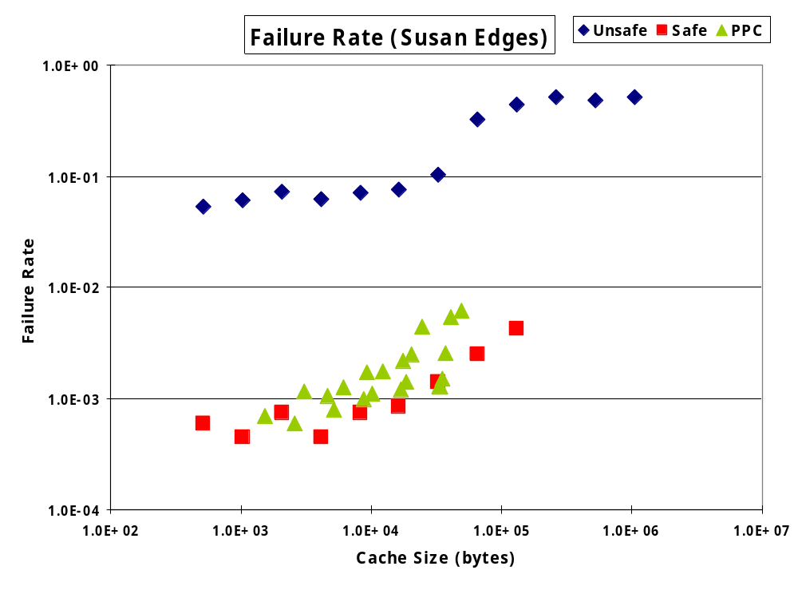
Results 2: Design Space Exploration
Failure Rate
Failure Rates increasing and saturated
Failure Rate of PPC is close to that of Safe

Slide 67
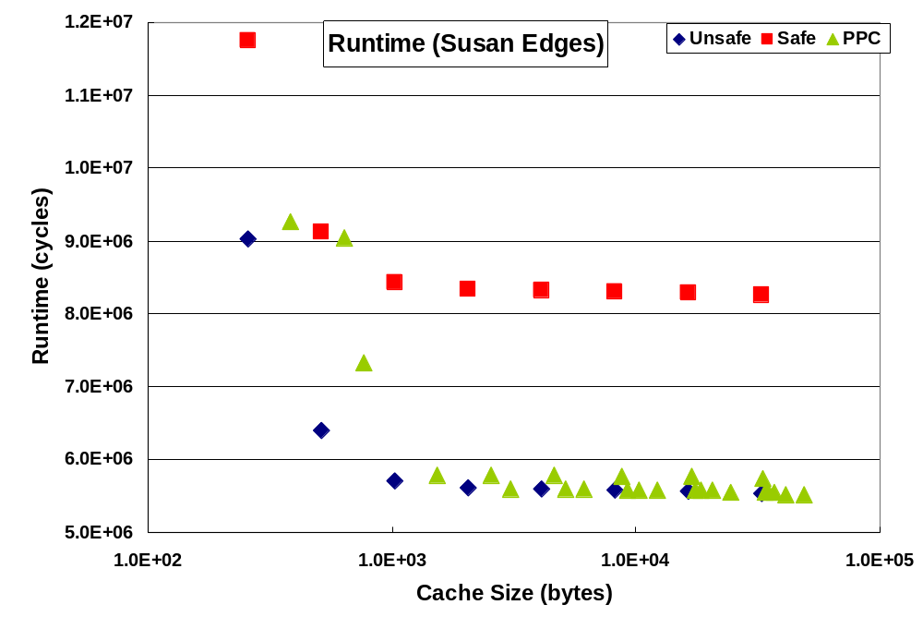
Results 2: Design Space Exploration
Performance
Performance of PPC is close to that of Unsafe
  (32 % reduction compared to Safe)
Notes:
This graph shows that the performance overheads of Safe and HPC configurations compared to Unsafe configurations. As you can see here, runtime of HPC is very close to that of Unsafe, which means that HPC doesn’t have performance overhead much. Compared to Safe configuration, our proposed approach can reduce more than 30 % of performance overhead.

Slide 68
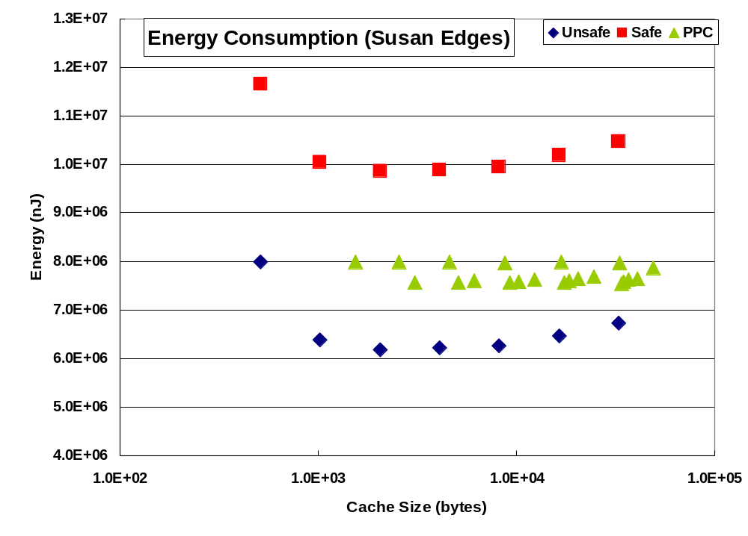
Results 2: Design Space Exploration
Energy Consumption
Miss rate reduction and high access power cost
Energy consumption of PPC is located b/w Safe and Unsafe (24 % reduction compared to Safe)
Notes:
This graph plots the energy consumptions of each configuration (again blue one for Unsafe, red one for Safe and green one for HPC).
Basically, the energy consumption decreases and then increases. First reduction comes from miss rate reduction with an increase of cache size and then following increase is from high power value for access to larger caches.
The thing is here the energy consumption of HPC is located between safe and unsafe but closer to unsafe configuration. We can save 24 % energy with our approach for all cache sizes on average.

Slide 69
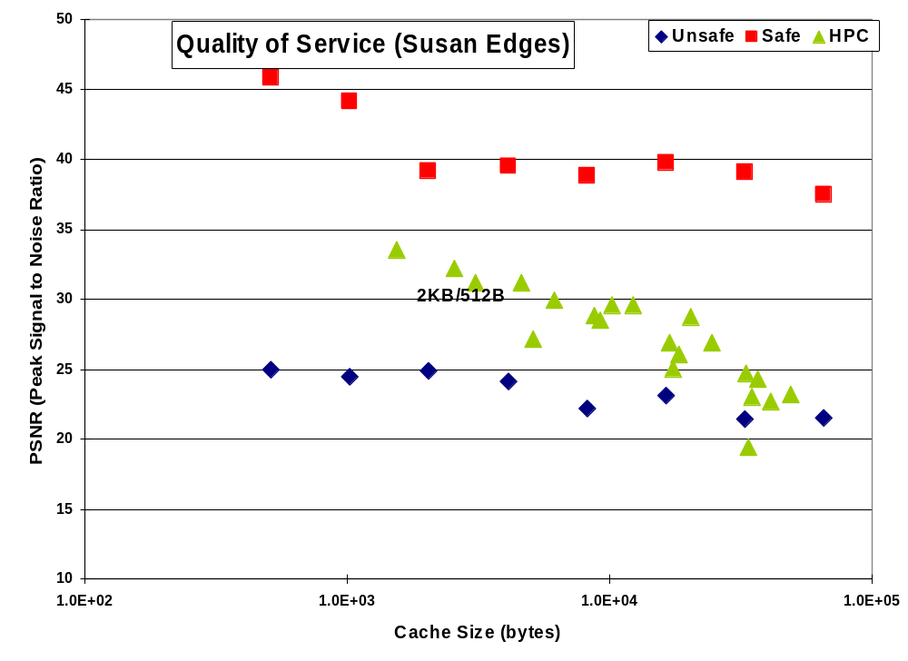
QoS

Slide 70
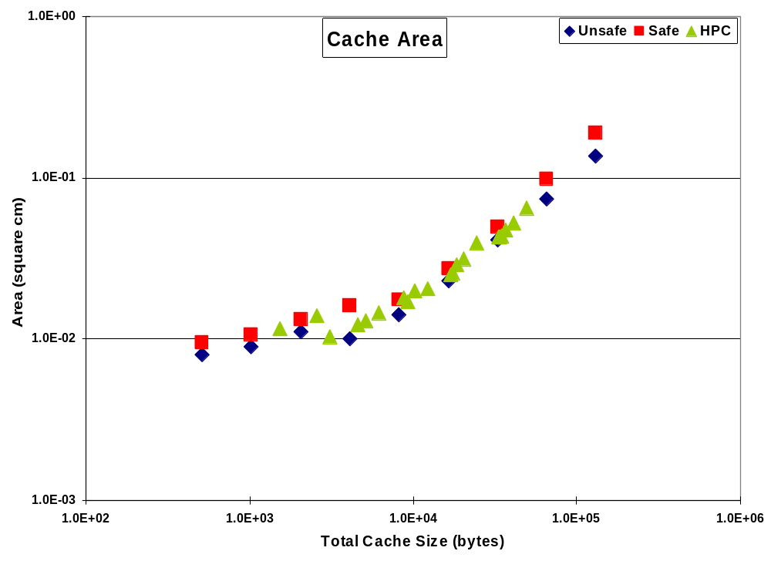
Area

Slide 71
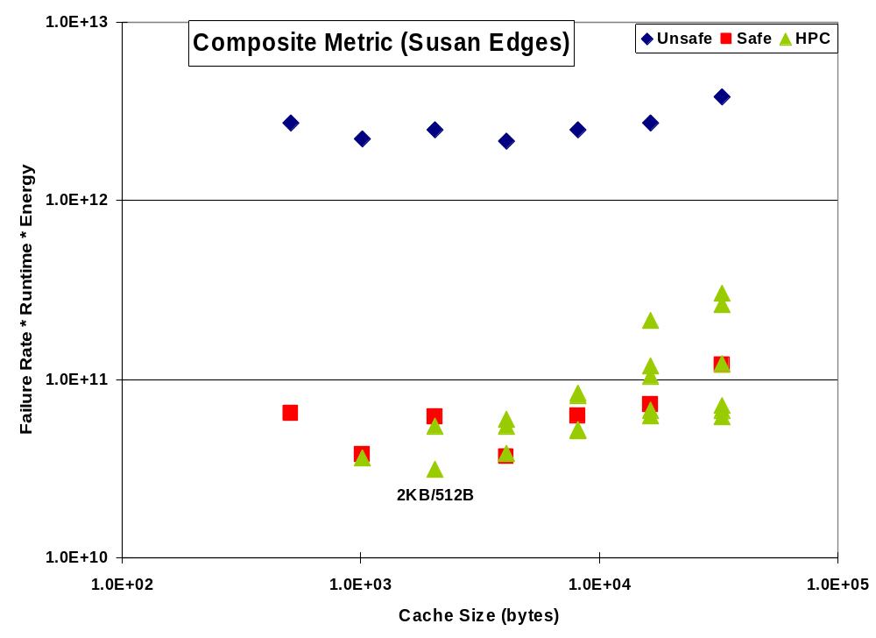
Composite Metric
LOG(Failure_Rate) * Performance * Energy

