Slide 1

Static Analysis to Mitigate Soft Errors in Register Files
Jongeun Lee, Aviral Shrivastava
Compiler Microarchitecture Lab
Arizona State University, USA
M
C
L

Slide 2
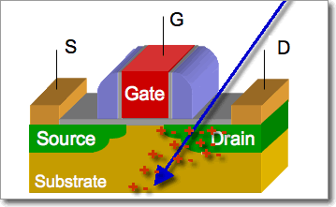
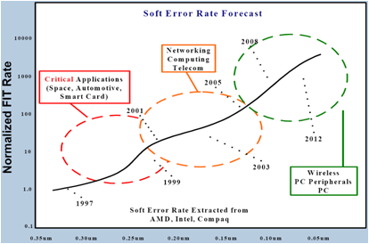
Soft Errors
What is Soft Error?
  Transient error, or bit-flip
  Cause
    energetic particle strikes
    voltage fluctuation
    signal interference
How often does it occur?
  Currently: ~ 1 error per year
  Soft error rate increasing exponentially with technology
  Projected to increase to 1 per day in a decade

Slide 3
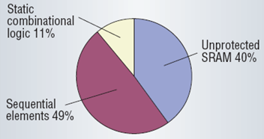
Reliability Problem
Not all errors are visible
  Logical masking
  Temporal masking
  Electrical masking
Register File needs protection
  Large memory structures
    Typically HW protected
  Combinatorial circuit
    Errors can be masked
  Register file
    Has most of architecturally visible errors for ARM926EJ [Blome ‘06]
1
→ 0
1
→ 1
0
Logical masking
[Mitra ’05]

Slide 4
Overview
Increasing impact of soft errors
Why protect RFs?
Related Work
What is RF vulnerability?
Difficulties in estimating RF vulnerability?
Our idea of RFV decomposition
Experiments
  RFV estimation Accuracy
  Using RFV estimation in compilers
  Need of RFV estimation
Conclusion

Slide 5
Prior Art in RF Protection
Significance of Soft Errors in registers
  IBM G5 protects every latch and register by either ECC or parity
    T. J.Slegel et al., “IBM’s S/390 G5 microprocessor design,” IEEE Micro, vol. 19, pp. 12–23, 1999.
Program Duplication Techniques
    Reis et al., “SWIFT: Software Implemented Fault Tolerance”, CGO 2005.
  Very high execution time and power overheads
Hardware protection of RF is extremely costly
  Power and area overhead
  Power ➔ temperature ➔ SER
  Partial RF protection
    J. A.Blome et al., “Cost-efficient soft error protection for embedded microprocessors,” in CASES ’06, 2006, pp. 421–431
    G.Memik et al., “Engineering over-clocking: Reliability-performance trade-offs for high-performance register files,” DSN ’05, 2005
    P.Montesinos et al., “Using register lifetime predictions to protect register files against soft errors,” in DSN ’07, 2007, pp. 286–29
    M.Kandala et al., “An area-efficient approach to improving register file reliability against transient errors,” in ISEC, 2007.
Compiler Techniques are cheaper
    J.Yan and W.Zhang, “Compiler-guided register reliability improvement against soft errors,” in EMSOFT ’05, 2005, pp. 203–209.
Need a way to estimate RF vulnerability

Slide 6

RFV: Register File Vulnerability
Register File Vulnerability
  Captures soft error rate in register file
  Based on AVF (Architectural Vulnerability Factor)
  Length of intervals with useful data
  Unit: byte * cycle
Vulnerable interval
W
R
time
Any interval finishing in a read is vulnerable.
W
R
R
R
R
W
W
R
time
Not vulnerable

Slide 7
Computing RFV
entry
BB₁
W₁
R₁
Procedure
List all intervals
Select vulnerable ones
Find their total length
BB₂
R₂
p
1-p
BB₃
BB₄
W₂
BB₅
R₃
exit

Slide 8
Computing RFV
entry
BB₁
W₁
L₁
Interval | Freq | Vulnerable? | Length
entry~W1 | 1 | No
W1~R1 | 1 | Yes | L1
R1~R2 | 1 | Yes | L2
R2~R3 | p | Yes | L3
R2~W2 | 1-p | No | L4
W2~R3 | 1-p | Yes | L5
R3~exit | 1 | No
R₁
L₂
BB₂
R₂
L₃
p
1-p
L₄
BB₃
BB₄
W₂
L₅
RFV₁ = 1 * L1 + 1 * L2 +
p * L3 + (1-p) * L5
BB₅
R₃
exit

Slide 9
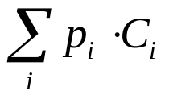
Challenges of RFV Estimation
entry
Performance estimation (Dynamic instruction count)
  C1 + C2 + p * C3 + (1-p) * C4 + C5
  Can be simply broken down into BB components
RFV estimation
  RFV of a basic block is ill-defined
  It depends on what comes next, or much, much later
BB₁
W₁
L₁
R₁
L₂
BB₂
R₂
L₃
p
1-p
L₄
BB₃
BB₄
W₂
L₅
BB₅
How can we represent RFV
in simple linear form?
R₃
exit

Slide 10
Overview
Increasing impact of soft errors
Why protect RFs?
Related Work
What is RF vulnerability?
Difficulties in estimating RF vulnerability?
Our idea of RFV decomposition
Experiments
  RFV estimation Accuracy
  Using RFV estimation in compilers
  Need of RFV estimation
Conclusion

Slide 11










Computing RFV -- Alternative
entry
BB₁
W₁
Define for each block
v^{i}: Intrinsic vulnerability
  - Block entry ~ Last access
v^{c}: Conditional vulnerability
  - Last access ~ Block exit
S: Post-condition
  - Probability of next access being a read
L₁
R₁
S₁=1
L₂
BB₂
R₂
S₂=p
L₃
p
1-p
L₄
BB₃
BB₄
W₂
S₃=1
S₄=1
RFV of a basic block
V(j) = v^{i} (j) + v^{c} (j) * S(j)
RFV2 = ∑_{j} f_{j} * V(j)
f_{j} is the execution frequency of BB_{j}
L₅
BB₅
R₃
S₅=0
exit

Slide 12
Computing RFV -- Alternative
entry
Basic block vulnerability
BB₁
W₁
V1 = v^{i}₁ + 1 * v^{c}₁
V2 = v^{i}₂ + p * v^{c}₂
V3 = 0 + 1 * v^{c}₃
V4 = 0 + 1 * v^{c}₄
V5 = v^{i}₅ + 0 * 0
L₁
R₁
S₁=1
RFV2 = ∑_{j} p_{j}*V(j)
L₂
BB₂
R₂
RFV2 =
1*(v^{i}₁ + v^{c}₁)
+ 1*(v^{i}₂ + p*v^{c}₂ )
+ p*v^{c}₃
+ (1-p)*v^{c}₄
+ 1*v^{i}₅
S₂=p
L₃
p
1-p
L₄
BB₃
BB₄
W₂
= p*v^{i}₅ + (1-p) v^{i}₅
S₃=1
S₄=1
L₅
RFV2 =
L1
+ L2
+ p*L3
+ (1-p)*L5
BB₅
R₃
S₅=0
exit

Slide 13
RFV Decomposition
RFV of a basic block can be defined exactly
  Using a linear function: A * x + B
    A: Conditional vulnerability (v^{c})
    B: Intrinsic vulnerability (v^{i})
    x: Post-condition (S)
  A & B: Attributes of a block
    Can be determined by the block itself
  x: Depends on control flow, data flow
    Can be found through program analysis
Block vulnerability gives exact RFV of a program
  Through a very simple summation
Computing Post condition
  Is similar to, but is slightly different from liveness

Slide 14
Path-sensitive Post-condition
–
1
Two Possible Execution Scenarios
(assuming the CFG is executed twice)
w
2
 | Execution | 1 | 2 | 3 | 4 | 5 | 6
A | 1 2 3 (5 4)¹⁰ 5 6 1 2 4 (5 4)¹⁰ 5 6 | 0 | 1/2 | 1 | 19/21 | 20/22 | 0
B | 1 2 3 5 6 1 2 4 (5 4)²⁰ 5 6 | 0 | 1/2 | 0 | 20/21 | 20/22 | 0
1/2
1/2
w
3
r
4
–
5
1/11
10/11
Branch probabilities are the same;
Post-conditions are different!
w
6

Slide 15
Finding Post-condition
Register Liveness Problem:
  Given a register and a point in a program,
  what is the probability of
  the next access to the register being a read?
  Similar to but different from Live Variables Problem
Exact computation of post-condition
  Requires path-sensitive analysis
  Very expensive
Approximation
  Length-n conditional probability to branch probability
  Prob(B1 | B2, B3, B4 ) ~= Prob(B1 | B2)
We present Linear Equation Method

Slide 16
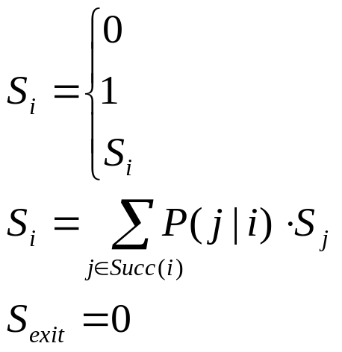
Linear Equation Method
Exact computation of post-condition
  Requires path-sensitive analysis
  Very expensive
Approximation
  Length-n conditional probability to branch probability
  Prob(B1 | B2, B3, B4 ) ~= Prob(B1 | B2)
We propose Linear Equation Method
T₁
–
1
S₁
T₂
w
2
1/2
1/2
T₃
S₂
T₄
w
3
r
4
For a given register:
S₃
T₅
S₄
–
5
if first-access in BB_{i} is write
if first-access in BB_{i} is read
10/11
1/11
S₅
if no-access in BB_{i}
T₆
w
6
S₆

Slide 17
Linear Equation Method
Exact computation of post-condition
  Requires path-sensitive analysis
  Very expensive
Approximation
  Length-n conditional probability to branch probability
  Prob(B1 | B2, B3, B4 ) ~= Prob(B1 | B2)
We propose Linear Equation Method
T₁
–
1
S₁
T₂
w
2
1/2
1/2
T₃
S₂
T₄
w
3
r
4
 | Execution | 1 | 2 | 3 | 4 | 5 | 6
A | 1 2 3 (5 4)¹⁰ 5 6 1 2 4 (5 4)¹⁰ 5 6 | 0 | 1/2 | 1 | 19/21 | 20/22 | 0
B | 1 2 3 5 6 1 2 4 (5 4)²⁰ 5 6 | 0 | 1/2 | 0 | 20/21 | 20/22 | 0
C | Linear Eq. Method | 0 | 1/2 | 20/22 | 20/22 | 20/22 | 0
S₃
T₅
S₄
–
5
10/11
1/11
S₅
T₆
w
6
S₆

Slide 18
Overview
Increasing impact of soft errors
Why protect RFs?
Related Work
What is RF vulnerability?
Difficulties in estimating RF vulnerability?
Our idea of RFV decomposition
Experiments
  RFV estimation Accuracy
  Using RFV estimation in compilers
  Need of RFV estimation
Conclusion

Slide 19
Experiments
Setup
  SimpleScalar cycle-accurate simulator
    instrumented for RFV calculation
  MiBench embedded applications (8 applications)
  For static estimation v^{i} & v^{c} :
    approximated with # instructions
  Branch probability from profiling
Experiments
  Accuracy of static RFV estimation
  Using Static RFV analysis on PPRF (Partially Protected RF) architectures
  Need of RFV estimation

Slide 20
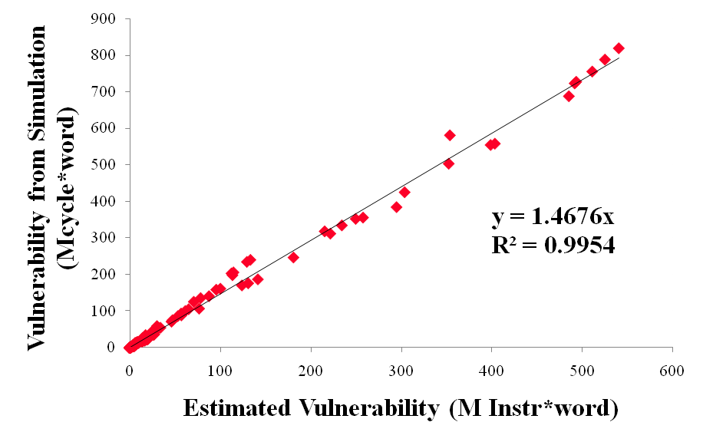
RFV Estimation vs. Measurement
One register,
One application
Slope
= CPI
For all registers, for all 8 applications
Strong correlation between estimated vulnerability and simulation measurements

Slide 21
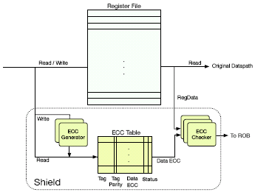
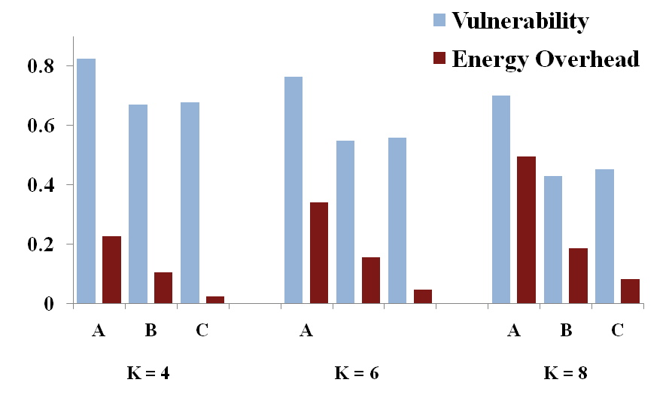

Case A : HW Protection
A: PPRF using runtime prediction [Shield, Torellas, DSN 2007]
  At issue stage predict whether the destination register needs protection
    If yes, generate a ECC for it.
    ECC table maintained as cache
  20-30% vulnerability reduction
  Effective with more number of protected registers
  More power with less protected registers
Technology Independent Conservative Power Model
No power for prediction
RF Access power = ECC generation/checking + access power
K: Number of protected registers

Slide 22
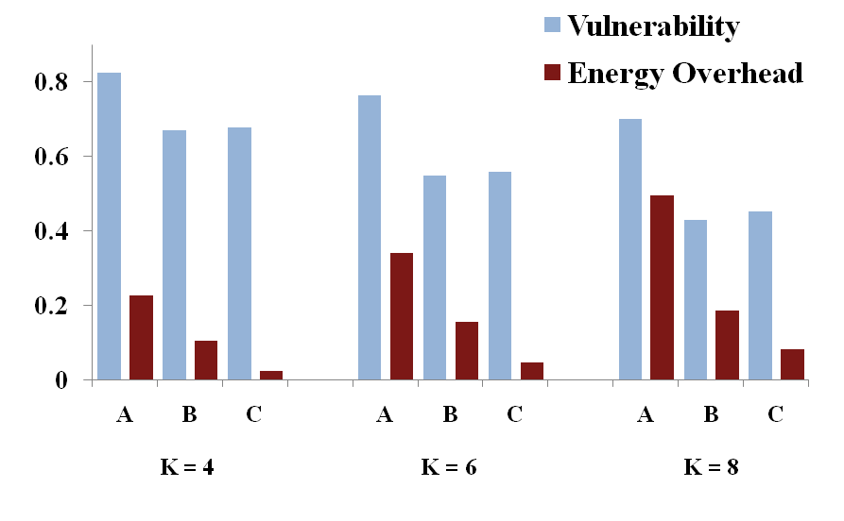

Case B : Static Analysis for min RFV
B: Hardwired PPRF for Vulnerability Minimization
  Perform static analysis, and sort the registers by vulnerability
  Protect top “K” registers with highest vulnerability
  30-40% vulnerability reduction
    Better analysis than can be done at runtime
  No replacements of protected registers ➔ low power
K: Number of protected registers

Slide 23

Case C : Power-Aware Protection
C: Power-Aware Protection on Hardwired PPRF Architecture
  Perform static analysis, and sort the registers by cost
    Power-cost = register vulnerability / #accesses
  Protect top “K” registers with highest power-cost
  30-40% vulnerability reduction
  Save power by picking up registers that are not accessed often
50%
75%
K: Number of protected registers

Slide 24
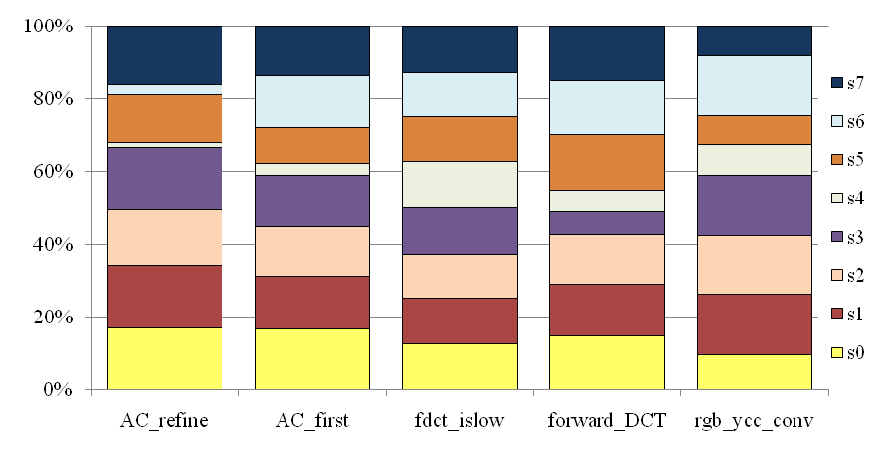
Need of Static Estimation - JPEG
Distribution of power-cost in top 5 functions of JPEG
S-registers have highest vulnerability
The set of top K registers varies across functions ➔
Need for compiler approach

Slide 25
Conclusion
Soft errors becoming and important concern
RFs are important site of soft errors, but h/w techniques to protect RF have high power/performance overhead
Compiler techniques for RF protection are low-overhead
  But need a mechanism to estimate RFV
  Not easy to formulate RFV in terms of BB RFV
Propose RFV decomposition scheme to enable efficient estimation of RFV
Demonstrated how compiler can use RFV estimation for effective and power-efficient RFV reduction
  30-40% RFV reduction, at 50-75% lesser RF power

Slide 26
Overview
Increasing impact of soft errors
Why RFs need protection?
How to estimate RF vulnerability?
Our idea of RFV decomposition
RFV Reduction by RFV estimation
Experimental results
Conclusion

Slide 27
Register File Protection
Full HW scheme (ECC, parity, etc.)
  Very costly: power, area
  Increased power aggravates temperature problem
  Increased temperature decreases reliability exponentially
Software schemes
  Code duplication / Control flow checking
  Very high overhead in code size, performance
Compiler schemes
  Can effectively reduce error rate
  Can be much more effective with partial hardware schemes
  The Key is Static Analysis

Slide 28
Linear Equation Method
T₁
T₁=S₁
T₂=0
T₃=0
T₄=1
T₅=S₅
T₆=0
S₁=T₂
S₂=(T₃+T₄)/2
S₃=T₅
S₄=T₅
S₅=(T₆+10*T₄)/11
S₆=0
–
1
S₁
T₂
w
2
1/2
1/2
T₃
S₂
T₄
w
3
r
4
 | Execution | 1 | 2 | 3 | 4 | 5 | 6
A | 1 2 3 (5 4)¹⁰ 5 6 1 2 4 (5 4)¹⁰ 5 6 | 0 | 1/2 | 1 | 19/21 | 20/22 | 0
B | 1 2 3 5 6 1 2 4 (5 4)²⁰ 5 6 | 0 | 1/2 | 0 | 20/21 | 20/22 | 0
C | Linear Eq. Method | 0 | 1/2 | 20/22 | 20/22 | 20/22 | 0
S₃
T₅
S₄
–
5
10/11
1/11
S₅
T₆
w
6
S₆

Slide 29
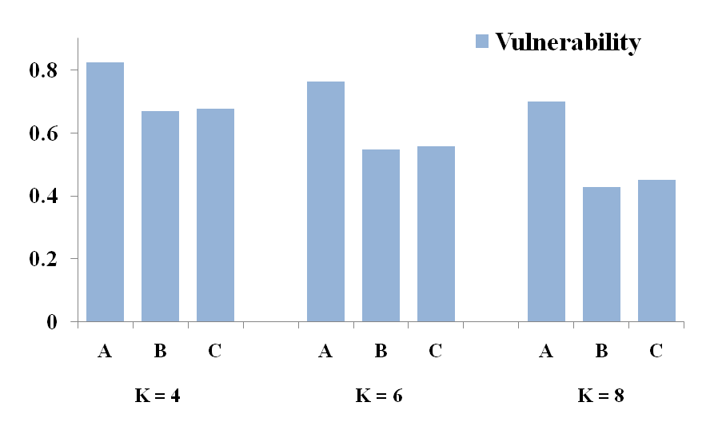

Compiler Optimization
A: PPRF using runtime prediction (full HW)
B: Hardwired PPRF (domain-specific HW)
  Protect top K registers with highest vulnerability
C: Hardwired PPRF with compiler optimization
  For each application, statically rename top K regs with most cost to be mapped to protected registers
    Cost = vulnerability/accesses
K: Number of protected registers

Slide 30
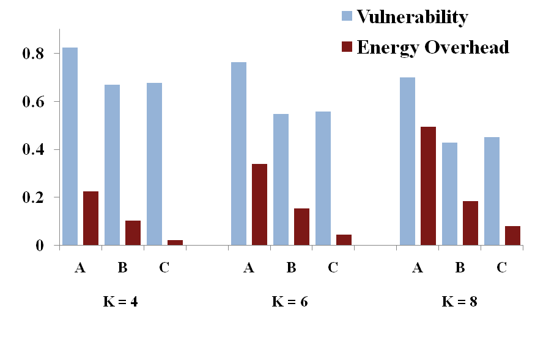
Compiler Optimization
A: PPRF using runtime prediction (full HW)
B: Hardwired PPRF (domain-specific HW)
  Protect top K registers with highest vulnerability
C: Hardwired PPRF with compiler optimization
  For each application, statically rename top K regs with most cost to be mapped to protected registers
    Cost = vulnerability/accesses
50%
75%
K: Number of protected registers

