Slide 1
Compiler Optimization to Reduce Soft Errors in Register Files
Jongeun Lee, Aviral Shrivastava*
Compiler Microarchitecture Lab
Department of Computer Science and Engineering
Arizona State University
http://www.public.asu.edu/~ashriva6/CML

Slide 2
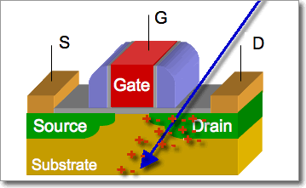
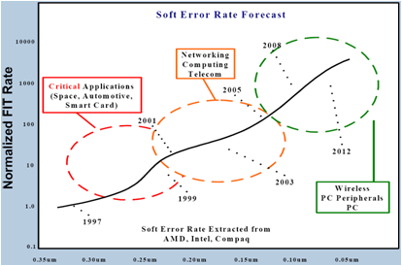
Reliability Problem
What is Soft Error?
  Transient error, or bit-flip
  Cause
    energetic particle strikes
    voltage fluctuation
    signal interference
How often does it occur?
  Currently: ~ 1 per year
  Soft error rate increasing exponentially with technology
  Can be 1 per day in a decade

Slide 3
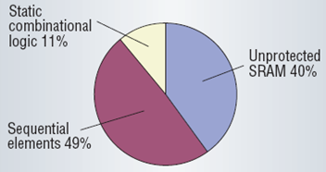
Reliability Problem
Not all errors are visible
  Logical masking
  Temporal masking
  Electrical masking
Register File needs protection
  Large memory structures
    Typically HW protected
  Combinatorial circuit
    Errors can be masked
  Register file
    Has most of architecturally visible errors for ARM926EJ [Blome ‘06]
1
→ 0
1
→ 1
0
Logical masking
[Mitra ’05]

Slide 4
RF Protection – HW Approaches
Full HW protection
  Protect registers through ECC, parity, duplication
  Very costly in terms of power, area
    [Blome’06] [Kandala’07] [Memik’05] [Montesinos’07] [Slegel’99]
  Increased power aggravates temperature problem
  Increased temperature decreases reliability
Proposed - Partially Protected Register File
  Runtime decision by hardware to select registers to be protected
  [Lee DATE 2009] demonstrated that compiler can decide which variables to protect
  Power-efficient protection, but still requires HW modification

Slide 5
RF Protection SW - Approaches
Software schemes
  Code duplication [Oh’02b] [Reis’05]
  Control flow checking [Oh’02a]
  Very high overhead in code size, performance
Compiler Techniques
  Can be very effective at very little overhead
    No hardware overhead, and Minimal power overhead
  [Yan and Zhang 2005] Instruction Scheduling
    Reducing distance between loads and stores
    Local effect
This Work: Compiler Technique
  Explicitly saving and restoring long lifetime variables
    Add additional load stores

Slide 6
Outline
Soft Error Problem
RF susceptible to soft errors
Previous schemes to reduce soft errors in RF
  HW, SW, compiler approaches
RF Vulnerability
http://www.public.asu.edu/~ashriva6

Slide 7
RFV: Register File Vulnerability
Register File Vulnerability
  Captures failure rate due to soft errors in the RF
  Based on AVF (Architectural Vulnerability Factor)
  Length of intervals with useful data
  Unit: byte * cycle
Vulnerable
interval
Any read-finished interval is vulnerable.
W
R
time
W
R
R
W
W
R
time
Not vulnerable

Slide 8
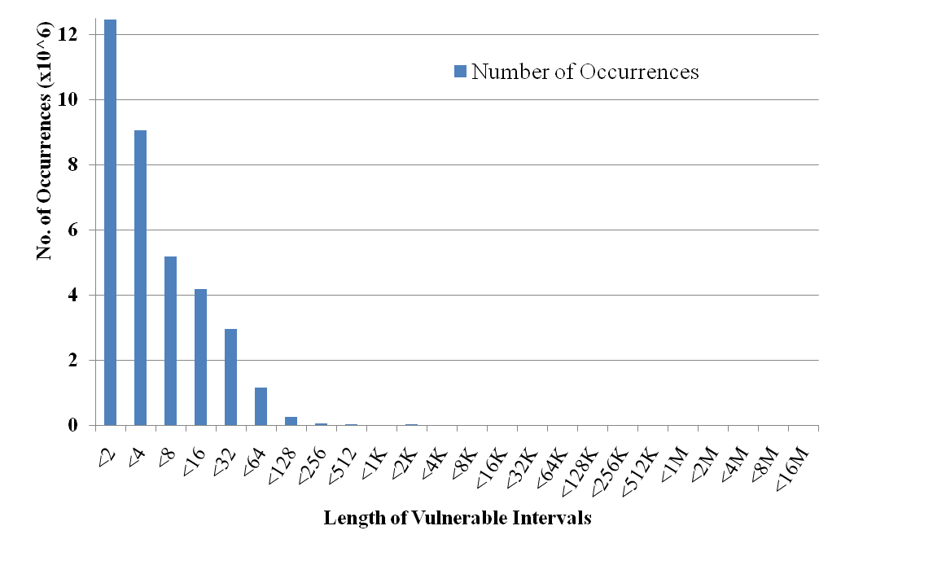
Scope of Compiler Approach
# of vulnerable intervals by their lengths (simulation, jpeg)
Non-zero counts up to ~16M cycles
http://www.public.asu.edu/~ashriva6
Notes:
Simulation result for jpeg

Slide 9
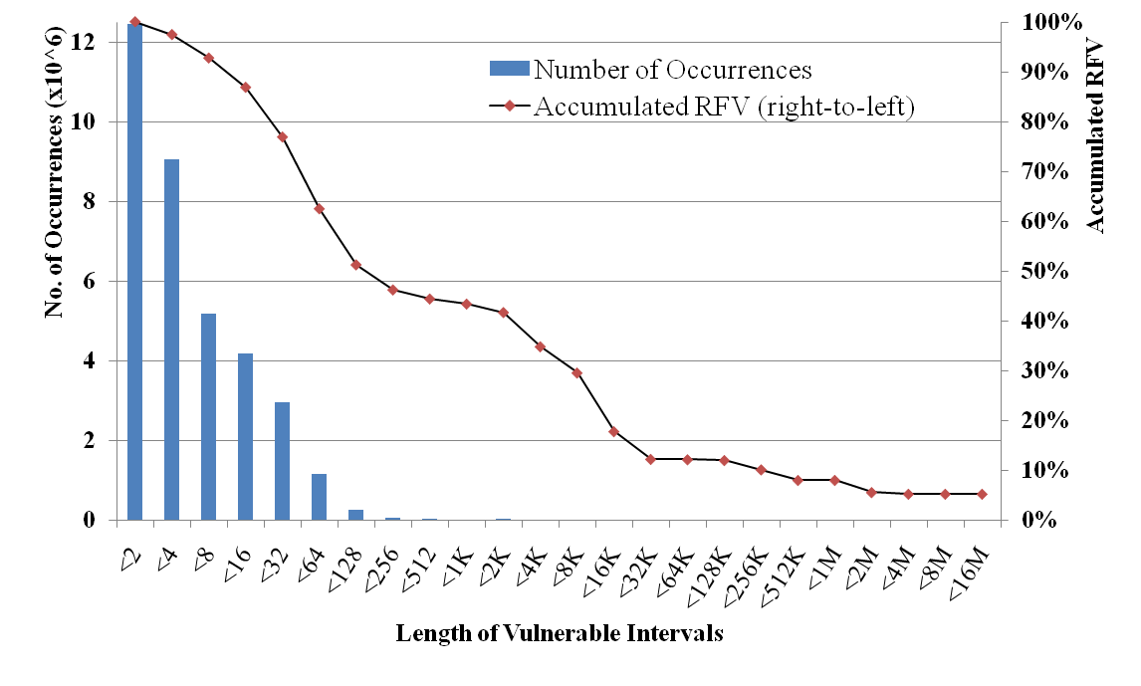
Scope of Compiler Approach
RFV contribution of vulnerable intervals (simulation, jpeg)
Scope for a compiler
More than 40% of total RFV is contributed by
very few, but long live ranges
http://www.public.asu.edu/~ashriva6
Notes:
Simulation result for jpeg

Slide 10
Research Problem
  Goal
  To reduce RFV, with no hardware modification
  Idea
  In most architectures, the memory is already protected with hardware ECC
  Saving variable in the memory can reduce RFV
  Issues
  Additional load/store can increase runtime
  Increased runtime is generally bad
  Increased runtime generally increases RFV
http://www.public.asu.edu/~ashriva6

Slide 11
Outline
Soft Error Problem
RF susceptible to soft errors
Previous schemes to reduce soft errors in RF
RF Vulnerability
  Variable lifetime ending in a read
Scope to reduce RF vulnerability
  Lot of vulnerability caused by few long lifetimes
Overall Research Problem
  Explicitly spill and restore long lifetime variables
Solutions
http://www.public.asu.edu/~ashriva6

Slide 12
Starting Point
A Simple Solution
  Find heavily executed loop kernels
  Identify unused registers in them
  Protect them by saving the unused registers before the loop starts and restoring them after the loop ends
Problem
  Local transformation
  Whether a variable is vulnerable or not is not a local decision
  Inter-procedural analysis is required
  Difficult to achieve efficient solution
http://www.public.asu.edu/~ashriva6

Slide 13
Save and Restore unused registers
function-main() {
save register s1, s2;
use register s1, s2;
function-foo();
s2 = function-bar(); //
writing to s2
s1 = s1 + s2;
restore register s1, s2;
}
function-foo() {
loop1 {
use register t1;
}
use register t1, t2;
}
function-bar() {
save register s1;
loop2 {
use register s1, t1, t2;
}
restore register s1;
}
Loop1: uses local register t1 ➔ save s1, s2, and t2
Loop2: uses s1, t1, and t2 ➔ save s2
http://www.public.asu.edu/~ashriva6

Slide 14
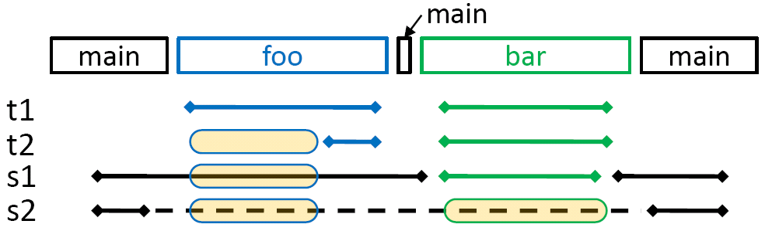
Need inter-procedural analysis
function-main() {
save register s1, s2;
use register s1, s2;
function-foo();
s2 = function-bar(); //
writing to s2
s1 = s1 + s2;
restore register s1, s2;
}
function-foo() {
loop1 {
use register t1;
}
use register t1, t2;
}
function-bar() {
save register s1;
loop2 {
use register s1, t1, t2;
}
restore register s1;
}
http://www.public.asu.edu/~ashriva6

Slide 15
Outline
Soft Error Problem
RF susceptible to soft errors
Previous schemes to reduce soft errors in RF
RF Vulnerability
Scope to reduce RF vulnerability
Overall Research Problem
  Explicitly spill and restore long lifetime variables
Solutions
  Simple Strategy
  ILP
http://www.public.asu.edu/~ashriva6

Slide 16
Problem
Problem
Challenges
  Inter-procedural analysis
  How to accurately estimate the effect on RFV and performance ?
  How to devise simple, yet effective save/restore operation ?
  Huge design space
  “For a given performance bound, what is the set of program points in which to insert save/restore operations, such that the transformed program will have minimum RFV ?”
Should also minimize code size overhead
http://www.public.asu.edu/~ashriva6

Slide 17

Problem Analogy
Dynamic dual-mode system
  The processor has a Boolean state for each register
  State is determined at runtime, by the execution path of the program
  Difficult to guarantee correctness of program transformation
Static dual-mode system
  A program point has a Boolean state for each register
  State is determined at compile-time
  Appropriate for static analysis
Problem is to partition program points or blocks into two modes
ILP
Formulation
http://www.public.asu.edu/~ashriva6

Slide 18
Overview of Proposed Solution
Definitions
  Access-free block (AFB)
  Access-free region (AFR)
    Connected subgraph of ICFG consisting of AFBs only
  Maximal AFR
Proposed method
  Find all maximal AFRs
  Evaluate all maximal AFRs for benefit/cost
  Select the most profitable ones
Mode change ops will be inserted
  Along the boundaries of selected maximal AFRs
http://www.public.asu.edu/~ashriva6
Notes:
Yellow = AFB
ICFG = interprocedural CFG

Slide 19
Mode Change Operation Issues
What memory address to use?
  Options: Stack-relative or Absolute
    Stack-relative: Use existing Stack Pointer register
    Absolute: Use either Global Pointer or constant register
  Register used in address calculation cannot be protected using our scheme
  Stack-relative addressing requires AFR be intra-procedure
Where to put mode change ops?
  Option 1: In basic blocks (nodes)
    Requires only one instruction (store/load)
    Can reduce the static number of mode change ops
  Option 2: In edges between basic blocks
    Minimizes the dynamic number of mode change ops
    Usually requires two instructions (unconditional jump)
http://www.public.asu.edu/~ashriva6
Notes:
We choose Absolute.
We choose Option 2, but convert edges into nodes during pre- & post-optimization
For an example of “May reduce the static number of mode change ops” -> Previous slide

Slide 20
Evaluating AFR
Benefit
  RFV reduction: RFV contributed by the AFR
Cost
  Runtime increase: proportional to # dynamic instructions due to mode change ops
  Code size increase: proportional to # static instructions due to mode change ops
Two questions
  What is RFV contribution by an AFR?
    Use static RFV model in [Lee’09b]
  Where must we insert mode change ops?
    No need to insert mode change op if we know the next access to the register is a write
http://www.public.asu.edu/~ashriva6

Slide 21


Analysis & Selection
Finding all maximal AFRs
  Keep adding neighbors (predecessor or successor) until reaching a non-AFB
Selection problem
  Given, for each maximal AFR k,
    v_{k} (RFV reduction), c_{k} (code size increase), t_{k} (runtime increase)
  Binary variables: x_{k} (1 if selected)
  Determine { x_{k} }
    Objective
    Constraint
  Knapsack problem
α: weighting parameter
τ: performance tolerance
http://www.public.asu.edu/~ashriva6

Slide 22
Pre- and Post-Optimization
Goal: to convert edge insertion points into node insertion points
Inward move: before selection (pre-optimization)
Outward move: after selection (post-optimization)
Inward move
Outward move
S’
S
S
S
S
S’
http://www.public.asu.edu/~ashriva6

Slide 23











Overall Flow
Original Binary
Inter-procedural CFG
For all
registers
Find all maximal AFRs
Analysis
Set of Maximal AFRs
RFV, runtime, code size
Evaluation
Pre-Optimization
Selection
ILP
Heuristic
Cycle-Accurate Simulation
Post-Optimization
Modified Binary
Runtime, RFV
http://www.public.asu.edu/~ashriva6

Slide 24
Experiments
Setting
  MiBench benchmark suite
  SimpleScalar simulator with MIPS instruction set
  Performance tolerance: 1% or 2%
Comparisons
  Potential (512 cycle)
    If every vulnerable interval at least 512 cycles long is protected
  Naïve approach
    Similar to Simple Solution
    Restricted to intra-procedural opportunity
  Global-gp, Global-r0
    Our method based on inter-procedural analysis
    GP vs. R0: Register used in mode change instruction
http://www.public.asu.edu/~ashriva6

Slide 25
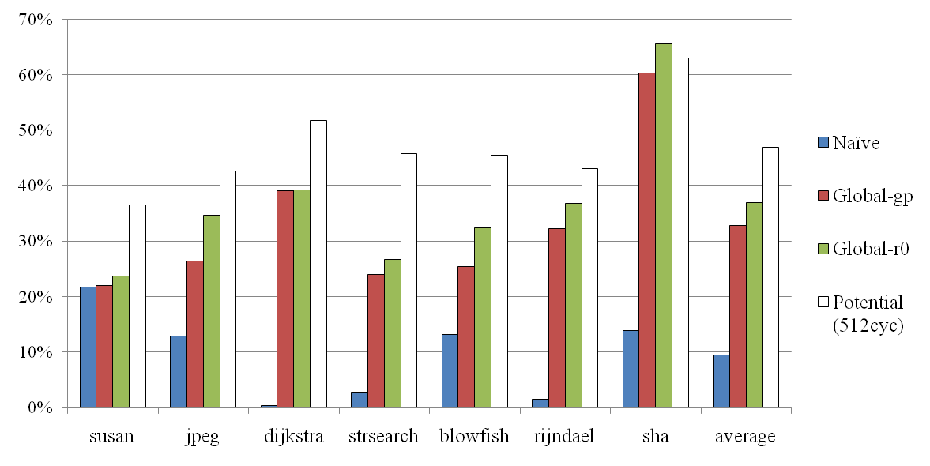
RFV Reduction
RFV Reduction compared to Original RFV
Our techniques can reduce RFV by up to 66%, and 33~37% on average
Naïve method works well only on simple benchmarks
  In susan, 95% runtime is spent in one function, in one stretch
http://www.public.asu.edu/~ashriva6

Slide 26
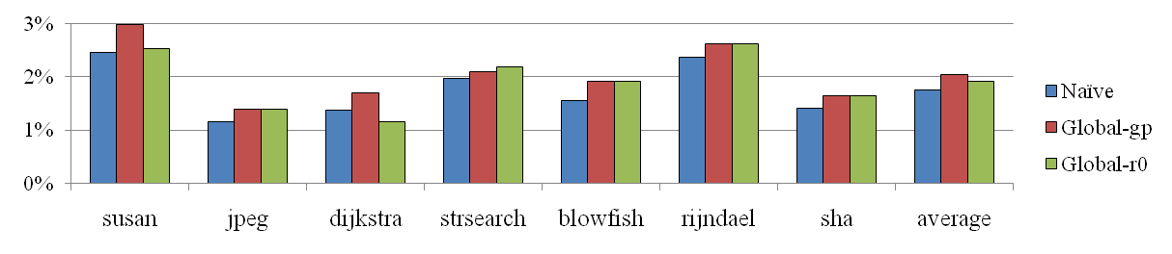
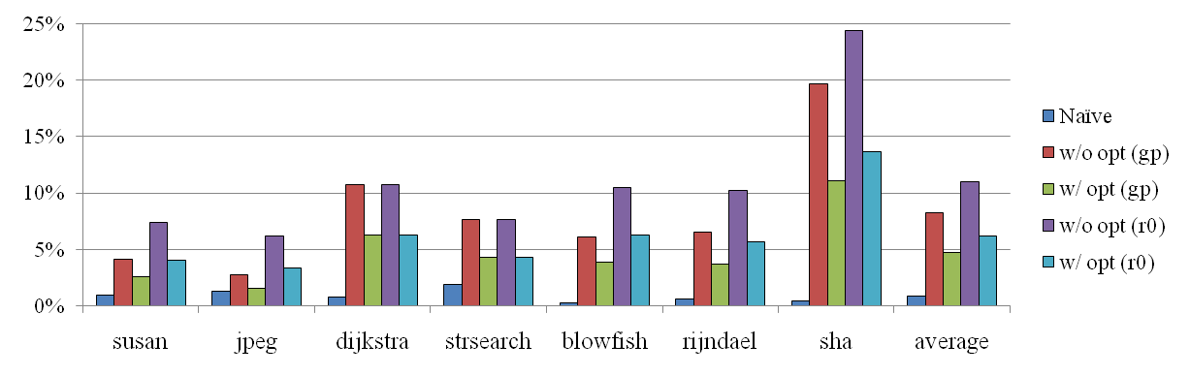
Runtime & Code Size Increase
Runtime overhead compared to Original
Code size overhead compared to Original
Pre- & post-optimizations can reduce code size overhead by 40%
http://www.public.asu.edu/~ashriva6

Slide 27
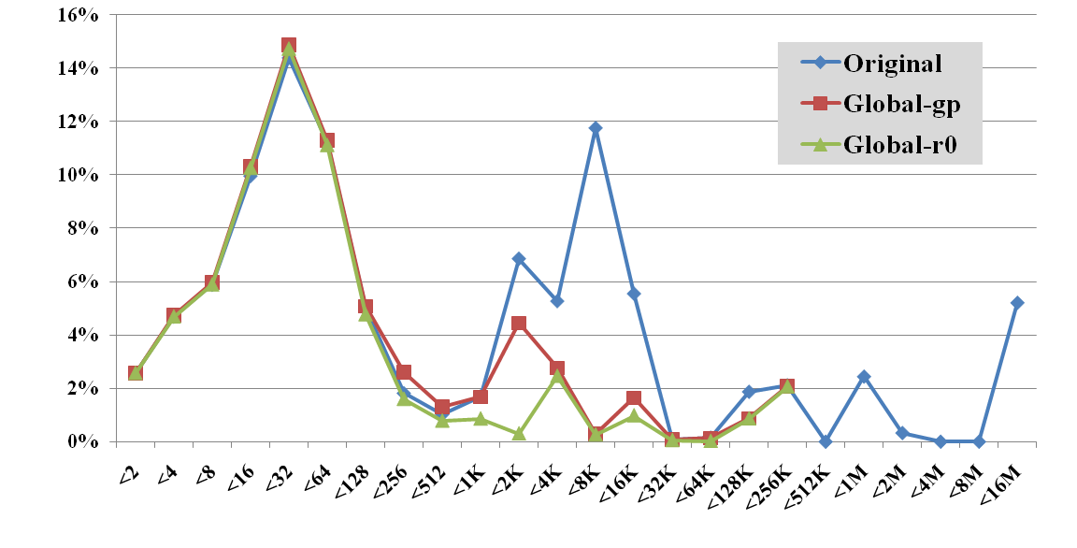
RFV Distributions
RFV contributions by long vulnerable intervals are effectively suppressed
http://www.public.asu.edu/~ashriva6

Slide 28
Conclusion
Motivated Compiler Approach to soft errors
  Pure-compiler approach can also be effective
  No modification is necessary in hardware
Proposed optimization framework
  Model the problem as binary partitioning problem
  Propose efficient heuristic based on access-free region
  Propose optimizations to reduce code size overhead
Our techniques can be very effective
  Can reduce RFV by up to 66%, and 33~37% on average
  Can explicitly control runtime overhead
  Naïve method without inter-procedural analysis can be very ineffective
http://www.public.asu.edu/~ashriva6

