Slide 1
Compiler-in-the-Loop Exploration of Programmable Embedded Systems
Aviral Shrivastava
Final Defense
Prof. Nikil Dutt (Chair)
Prof. Alex Nicolau
Prof. Alex Veidenbaum
Eugene Earlie

Slide 2


Programmable Embedded Systems
Embedded Systems market
  $45 billion in 2004
  > $90 billion by 2010
Increasing Complexity of Embedded Systems
  Increasing demands
    PDAs becoming comparable to laptops
  Convergence of Functionality
    Cell Phone + MP3 Player + …
Time-to-market
Designer Productivity
On-Chip
Memory
Embedded
Processor
Off-Chip
Memory
Synthesized
HW
Interface
Programmable Embedded System
  Faster development, Easier reusability and upgradability
    via software
Embedded Processor is the focus

Slide 3

Embedded Processors (Constraints → Architecture)
Multi-dimensional design constraints
  Performance, power, weight, cost, etc..
Strict design constraints
  Directly impacts the usability
    Imagine cell phone you have to charge every hour
Application Specific
  Application-set known before-hand
Highly Customized designs
  Different Interfaces/Protocols, ISA Extensions, datapath variations
“Light-weight” versions of features in high-end processors
  Limited Register Renaming, Incomplete Predication, Minimal support for prefetching, Partitioned register files
Cross-dimensional techniques are important
  E.g. trade off performance for weight

Slide 4

Embedded Systems (Architecture → Compiler)
Highly Customized architecture
Leaves compiler in a tough spot
  Limited compiler technology
  Difficult and costly analysis
Compiler can be very effective
  Exploit the existing design features
  Avoid loss due to missing design features
Architecture-Sensitive Compiler
Given the impact of compiler on the power, performance
  Compiler should be involved in the design of ES
Compiler-in-the-Loop Design Space Exploration

Slide 5
Embedded Processors – Design Space Exploration
Traditional Exploration
Compiler-in-the-Loop Exploration
Application
Application
Compiler
Sensitive Compiler
Processor Configuration
Executable
Executable
Cycle Accurate
Simulator
Cycle Accurate
Simulator
Best processor Configuration
Synthesize
Compiler as a tool for architecture exploration

Slide 6
Embedded Processor Design – Levels of Abstraction
Processor Pipeline Level
Instruction Set Architecture Level
Processor Memory Interface
Memory Design
Contribution of thesis
Architecture-Sensitive Compilation
Compiler-in-the-Loop Exploration

Slide 7
Thesis Outline
Processor Pipeline Level
  Partial Bypassing - Performance
    [CODES+ISSS 04]
    [DATE 05]
    [DATE 06]
    [TechCon 05]
    [TVLSI]
Instruction Set Architecture Level
Processor Memory Interface
Memory Design
Processor Pipeline Level

Slide 8
Partial Bypassing
RF
F
D
OR
X1
X2
WB
Pipeline Bypasses
  Increases Performance, but also increases Power, Area, Complexity
  Customize Bypasses => Partial Bypasses
Traditionally compilers are unaware of the bypasses in the processor pipeline.
Developed a Bypass-Sensitive Compilation Technique
  Can generate up to 20% better performing code than GCC
Performed Compiler-in-the-Loop Exploration of Bypasses
  Traditional exploration is inaccurate
  May lead to suboptimal design decisions

Slide 9
Thesis Outline
Processor Pipeline Level
Instruction Set Architecture Level
  rISA
    [DATE02]
    [DATE 03]
    [ASPDAC 04]
    [TODAES]
Processor Memory Interface
Memory Design
add R1 R2 R4
sub R3 R1 R4
beq Label
..
..
Label: add R2 R2 R1
ISA Level

Slide 10
rISA
Normal 32-bit Instruction
20-bit
4-bit
4-bit
4-bit
16-bit rISA Instruction
Accessibility to 16 registers
7-bit
3-bit
3-bit
3-bit
Fewer opcodes
Accessibility to only 8 registers
reduced bit-width Instruction Set Architecture
  2 Instruction Sets (32-bit and 16-bit wide instructions)
  Can achieve up to 50% code size reduction
  ARM/Thumb, MIPS 32/16
Existing techniques perform conversion
  Routine-level granularity
  High register pressure result in spilling and increase code size
Developed rISA Compiler
  Register pressure based, Instruction-level conversion
  Consistently achieve high degrees of code compression (35%)
Performed Compiler-in-the-Loop Exploration of rISA Designs
  Code compression obtained is very sensitive on rISA (2X)

Slide 11
Thesis Outline
Processor Pipeline Level
Instruction Set Architecture Level
Processor Memory Interface
  Processor Free-time Aggregation
    [CODES+ISSS 05]
  Memory Free-time Aggregation
Memory Design
Processor
Request bus
Data bus
Memory
Processor-Memory Interface

Slide 12
Processor Free-time Aggregation
Processors stall for significant time
  Intel XScale has IPC of 0.7
  Each stall duration is small
    < 100 cycles
  Switching power state
    > 360 cycles
Developed a Compiler Technique
  Memory bound loops
    Processor stall is inevitable
  Aggregate processor stalls
    Aggregated up to 50,000 stall cycles
  Saves up to 18% processor energy
    By switching processor to low-power
Processor Activity
Activity
Memory Bus Activity
Time
Aggregation
Activity
Processor Activity
Memory Bus Activity
Time

Slide 13
Memory Activity Aggregation
Memory keeps switching states
  low-power and high-power
  Each switching
    power, performance overhead
Developed Compiler Technique
  Compute-bound Loops
    Switching is inevitable
  Aggregate memory activity
    Up to 3000 switches reduced
  23% memory energy reduction
Compiler-in-the-Loop Exploration of memory bandwidth
  Discover lower-cost memory interface implementations
Memory Activity
High Power Mode
Low Power Mode
Time
Aggregation
High Power Mode
Memory Activity
Low Power Mode
Time

Slide 14
Thesis Outline
Processor Pipeline Level
Instruction Set Architecture Level
Processor Memory Interface
Memory Design
  Horizontally Partitioned Cache
    [CASES 05]
Processor Pipeline
Main Cache
Mini Cache
Memory

Slide 15
Horizontally Partitioned Caches
Processor Pipeline
Multiple caches at same level of memory hierarchy
  Performance Improvement
Existing compiler techniques
  Focus on performance improvement
  Complex O(m³n)
Main Cache
Mini Cache
Memory
Energy/Access of mini-cache is smaller than main cache
  Even though more mini-cache misses, energy improvement
Compiler technique aimed at Energy Reduction
  Simple Heuristic O(n²)
  50% energy reduction of memory subsystem
Compiler-in-the-Loop Exploration of mini-cache parameters
  Energy reduction is very sensitive to mini-cache parameters

Slide 16
Thesis Outline
Processor Pipeline Level
  Bypass-Sensitive Compiler
  Register File Power
Instruction Set Architecture Level
Processor Memory Interface
Memory Design
Processor Pipeline Level

Slide 17
Register File Power
Register File consumes significant power
  15-25% of total processor power, Motorola M.CORE
Register File Power Density (power-per-unit-area)
  Small size, causes Hotspots, e.g. Alpha 21264
Heat Stroke
  Frequent access => temperature beyond critical
  Must stall/slow down to cool
  1.2ms to heat, 12ms to cool => 90% slowdown
Trend of increasing RF Power
  Microarchitectural enhancements to improve IPC
  Compiler techniques to improve IPC
  Large Register Files (esp. VLIW processors)
Very important to reduce Register File Power Consumption

Slide 18
Extensive Previous Research
Thorough Research
  Evaluation
    [ISLPED 98], [TCAD 01], [DATE 02]
  Several Architectural Techniques
    2X[MICRO 01], 2X[MICRO 02], [ICS 03], [SBCCI 00], [MICRO 04]
  Compiler Technique
    [MICRO 04] Register Packing
Existing processors anticipatorily read RF
  Pentium 4, Alpha 21264
Up to 70% values read from RF are discarded
Read RF only if necessary
For Intel XScale
  58% energy reduction, 1% performance loss
In such architectures (Read RF only when needed)
  Scope for further reduction in RF Power by instruction scheduling

Slide 19
Further Scope by Instruction Scheduling
Schedule instructions
  Dependent instruction transfer operands using bypasses
  Reduce RF usage
Compiler needs to know
  When does an instruction bypass result?
  Which operands can read the result?
  When result is written into register file?
  Need 2 numbers per instruction for completely bypassed processor
    When result ready, when result written to RF.
For partially bypassed processor?
  Embedded processors often have partial bypassing
  Complete bypassing has high power, area, wiring complexity
RF
F
D
OR
X1
X2
WB

Slide 20
Operation Table
RF
1. F
2. D
3. OR
ReadOperands
R2
C1 RF
R3
C2 RF
C4 OR
DestOperands
R1 RF
4. X1
WriteOperands
R1
C4 X1
5. X2
6. XWB
WriteOperands
R1
C3 RF
C3
C1
C2
C4
F
D
OR
X1
X2
WB
Model all the resources and registers used by an operation in each cycle of it’s execution
Can determine which operands are available for each source operand
Use OTs for scheduling to reduce the usage of RF
Operation Table for ADD R1 R2 R3

Slide 21
Experimental Setup
Application
Intel XScale
  7 –stage, partially bypassed
MiBench benchmarks
Scheduler
  Within Basic Block Scheduling
GCC –O3
OT – based Scheduler
Assembly
GCC
Executable
Cycle-Accurate
Simulator
Runtime
RF Reads

Slide 22
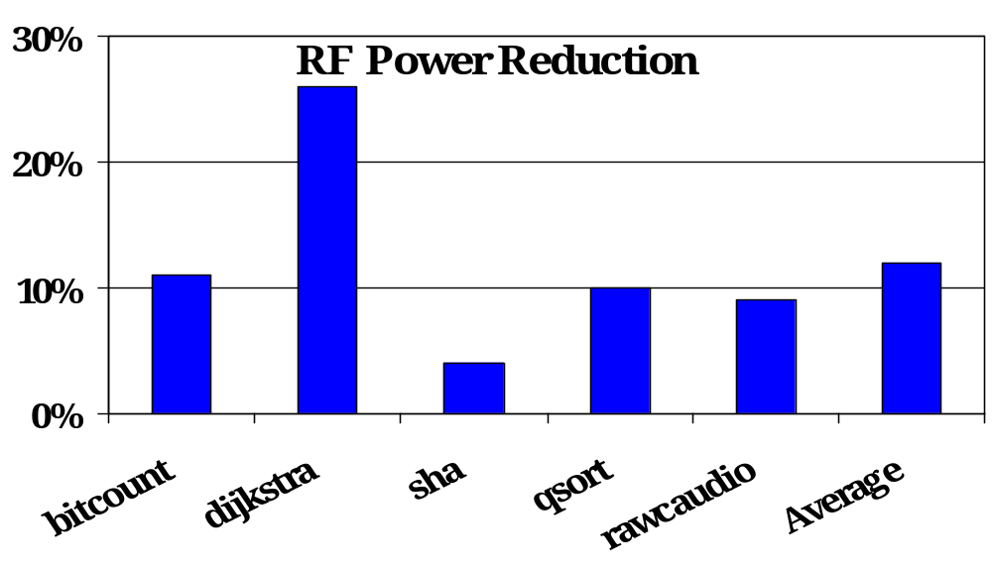
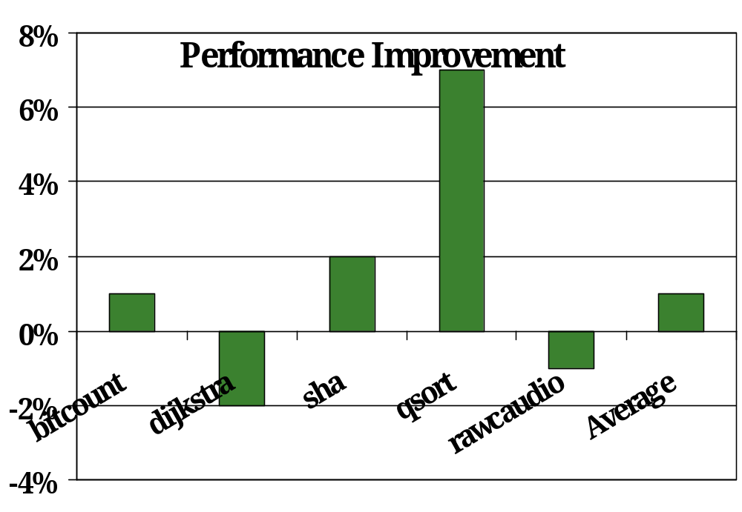
RFPEX Scheduling
26% reduction
Exhaustive
  Try all legal permutations of instructions
Compilation Time
  Hours
  Could not schedule susan, rijndael (2 days)
RF Power Reduction
  Average 12%
Performance Improvement
  Average 1.4%
7% improvement

Slide 23
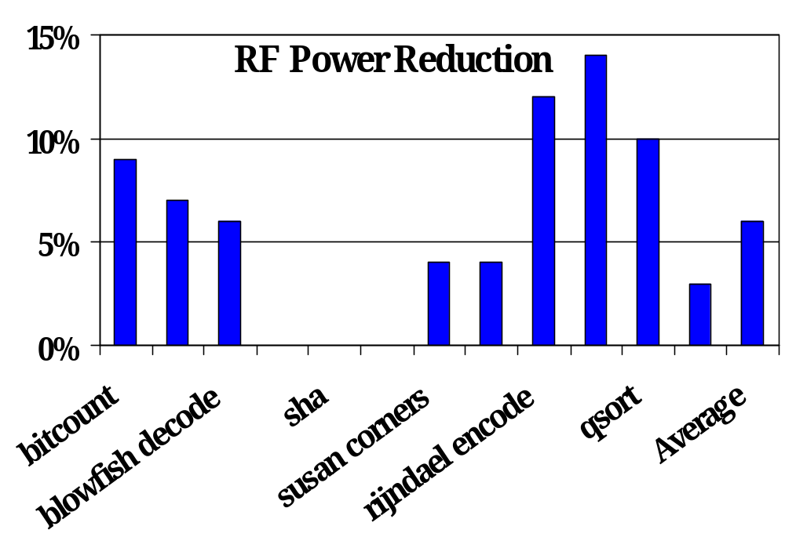
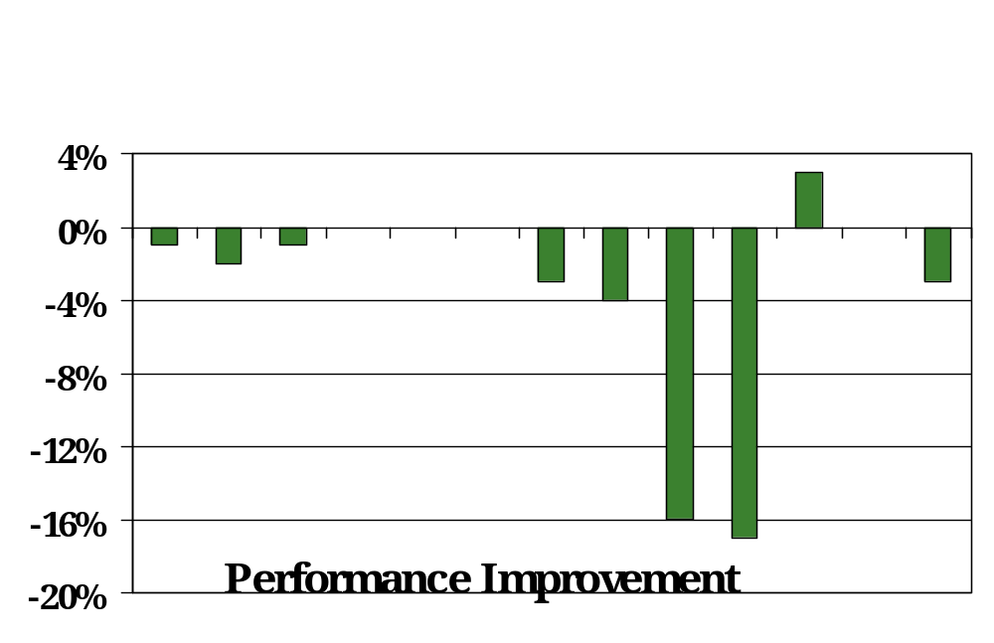
RFPN Scheduling
O(n) scheduling
  n – number of instructions in BB
  Pick instructions one by one
  Pick instruction which gets most operands from bypass
Compilation time
  Seconds
RF Power Reduction
  Average 6%
Performance Improvement
  Average: -3.5%

Slide 24
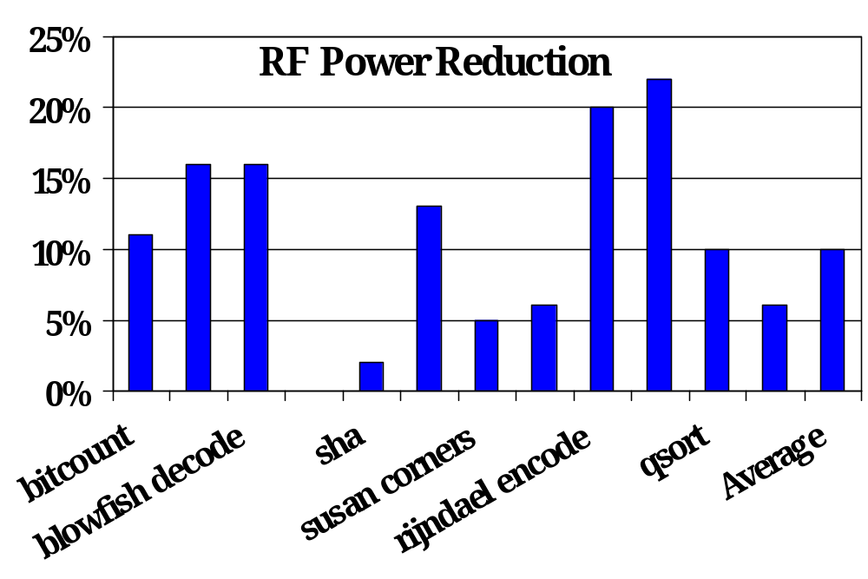
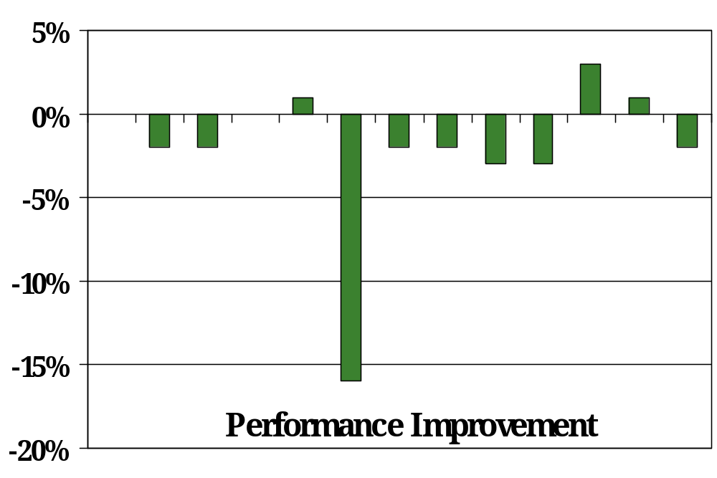
RFPN2 Scheduling
Average
10% reduction
O(N²) complexity
  n - # instructions in BB
Compilation time
  Minutes
RF Power Reduction
  Average 10%
Performance Improvement
  Average: -2%
RFPN2 is good!!

Slide 25
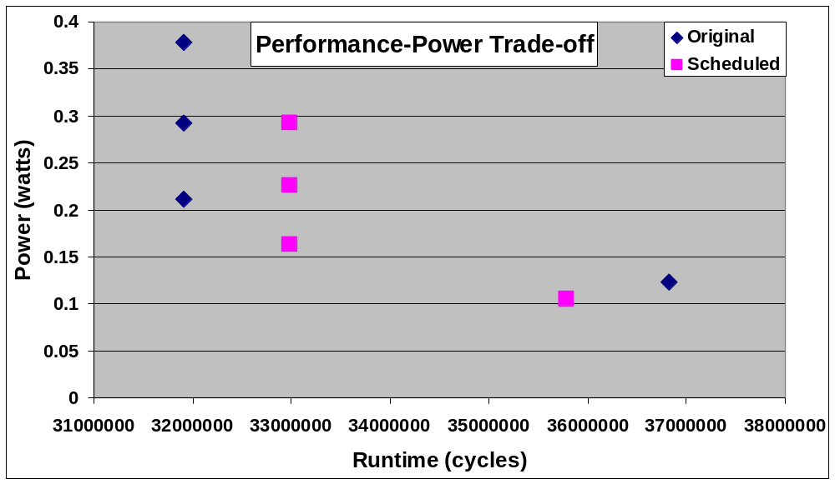
Reducing Read Ports in RF
RF Power, area, cost proportional to (ports)²
Reduce RF ports
  Possible performance degradation
  Compiler can help reduce the performance degradation
Example Design Decision
  If RF Power < 0.2 W
  Traditional Exploration
    1 read ports
  CIL Exploration
    2 read ports
    Better performance
Traditional Exploration
  Suboptimal design decision
4
4
3
3
2
2
1
1

Slide 26
RF Power Saving - Conclusion
Register File is one of the main hotspots in processors
Very important to reduce RF Power
  Repeated accesses cause “Heat Stroke”
  Up to 90% performance degradation
Reading RF only when needed is an effective technique
Scope of further RF power reduction via instruction scheduling
  Up to 26%, Average 12%
Developed Compiler Technique to reduce RF Power
  RFPN2 is an effective heuristic
Compiler-in-the-Loop Exploration of number of RF ports
  Discover low-cost RF designs

Slide 27
Dissertation Contributions
Architecture-Sensitive Compilation Techniques
Compiler-in-the-Loop Exploration
Processor Pipeline Level
  Bypass-Sensitive Compiler
    [CODES+ISSS 04], [DATE05], [DATE 06], [TechCon], [TVLSI]
  Register File Power
Instruction Set Architecture Level
  reduced bit-width ISA
    [DATE02], [DATE 03], [ASPDAC 04], [TODAES]
Processor Memory Interface
  Processor free time aggregation
    [CODES+ISSS 05]
  Memory Activity aggregation
Memory Design
  Horizontally Partitioned Cache
    [CASES 05]

Slide 28
Summary and Conclusions
Traditional Compiler
  Facilitator to port the application to the processor
Compiler has significant impact on the power/performance of the System
Compiler should have influence on the architecture design
Adhoc methods may be erroneous
Proposed – Compiler-in-the-Loop Exploration
  Our Compiler - Exploration Compiler
    Tool for architect
    Aid in designing the processor and Embedded Systems
Demonstrated the need and usefulness of CIL Exploration
  Sensitize compiler to architectural features
  Perform automated DSE of processor architecture
  Various levels of processor design abstraction
Looking Ahead
  Increase the sphere of influence of the Compiler
  Increase Design Automation in Embedded Systems
  Optimal Embedded System Design

Slide 29
Thank You

Slide 30
Aggregation Summary
Processor stalls frequently due to mismatch in the computation and the memory bandwidth
  Compiler was not able to save energy during small stall periods in the application
Aggregate the processor free time and reduce energy
  Up to 50,000 processor free cycles can be aggregated
  Up to 18% processor energy savings
  Minimal overhead
    Area, Power, Performance (all < 1%)
Compiler significantly alters the energy profile
To do
  Perform Architectural Exploration
  Increase the scope of application of aggregation techniques

Slide 31
Compiler-in-the-Loop (CIL) Exploration
Architectural explorations necessitate CIL exploration
  Instruction Set
  Register File Size
Exploration only as good as the compiler
Microarchitectural explorations may be done w/o CIL
  Processor Pipeline Exploration
  Memory Exploration
Meaningful exploration with compiler support

