Slide 1

Application Mapping onto Coarse-Grained Reconfigurable Architectures
Jonghee Yoon, Aviral Shrivastava*, Minwook Ahn, Sanghyun Park, Doosan Cho and Yunheung Paek
*Compiler and Microarchitecture Lab,
Center for Embedded Systems,
Arizona State University, Tempe, AZ, USA.
Software Optimization And Restructuring,
Department of Electrical Engineering,
Seoul National University, Seoul, South Korea
M
C
L
SO&R and CML Research Group

Slide 2
Need of Re-configurability
1. Short time to market
  First time, and then frequent upgrades, bug-fixes etc.
Cannot use ASICs, need programmable environments
2. High Performance and high Power-Efficiency
  General Purpose Processors
    Low Performance, High Power
      Power Efficiency : up to 1 GHz/Watt, beyond that very low performance
      GPPs inefficient as only software adapts, hardware remains same
  ASICs
    Power Efficiency is orders of magnitude higher
      Custom-built, no adaptation
Need to adapt hardware to the application
  Reconfiguration (vs. programmability)
SO&R and CML Research Group

Slide 3
Reconfigurable Architectures
Power Efficiency and Adaptation
  Adaptation <=> Power Efficiency
Field Programmable Gate Arrays (FPGAs)
  Fine Grain Reconfigurable Architectures, logic adapts
  Much loss of programmability
Coarse Grain Reconfigurable Architectures (CGRAs)
  Programming is easy (“generating a program is easy”)
History
  Programmability steals the show!
ASIC
FPGA
Ease of Programming
CGRA
GPP
Power Efficiency
SO&R and CML Research Group

Slide 4
Outline
Why Reconfigurable Architectures ?
CGRAs
Customization of CGRAs
Compiler challenges for CGRAs
Problem Formulation
Graph Drawing Algorithm
Experimental Results
Conclusion
SO&R and CML Research Group

Slide 5
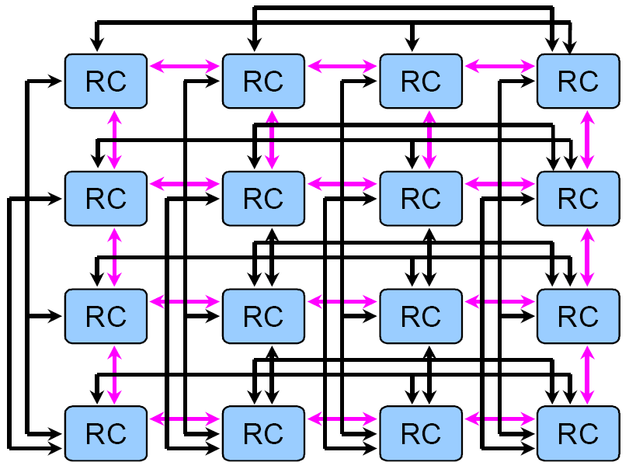
Coarse Grain Reconfigurable Arrays
An array of reconfigurable processing elements (PEs)
  PE (or reconfigurable cell, RC, in MorphoSys)
    Light-weight processor
    No control unit
    Simple ALU operations
  E.g., Morphosys, RSPA, ADRES, .etc
MUX A
MUX B
A L U
Register
File
Shift Logic
Register
SO&R and CML Research Group
MorphoSys RC Array
Processing Element

Slide 6
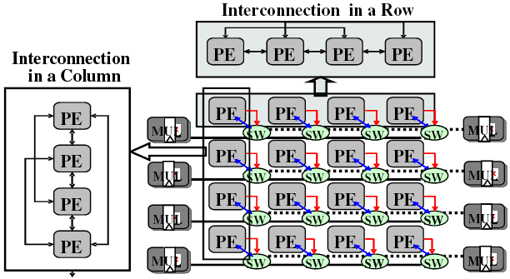
Customization of CGRAs
Processing Element (PE) Interconnection
  2-D mesh structure is not enough for high performance
Shared Resources
  Multipliers and load/store
  units can be shared
  To reduce cost, power,
  complexity
Routing PEs
  PE can be used for routing only
  To map a node with degree
  greater than the # of connections of a PE
1
4
5
2
3
R
4
5
6
7
8
7
8
9
10
RSPA structure
SO&R and CML Research Group

Slide 7
Compiler challenges for CGRAs
Compilers have a critical role in CGRAs
  Analyze the applications for effective exploitation of computational resources
  Map wide variety of applications to the CGRA with optimal use of resources
Two main compiler issues in CGRAs are…
  Parallelism
    finding more parallelism in the application for better use of CGRA features
    E.g., S/w pipelining
  Resource Minimization
    to reduce power consumption
    to increase throughput
    to have more opportunities for further optimizations
    E.g., Power gating of unused PEs
SO&R and CML Research Group

Slide 8
Existing compilers assume simple CGRAs
Various Compiler Techniques for CGRAs
  MorphoSys and XPP : Can only evaluate simple loops
  DRESC for ADRES : Too long mapping time, low utilization of PE
  ➔ Do not model complex CGRA designs (shared resources, irregular interconnections, row constraints, memory interfaces etc.)
  AHN et al. for RSPA : Spatial mapping, shared multiplier & memory
  ➔ Only consider 2-D mesh PE interconnection
  Do not consider PEs as routing resources
Consequently, existing code is either inefficient, or incorrect
Our Contribution
  We propose a compiler technique that considers
    irregular PE interconnection
    resource sharing
    routing resource
SO&R and CML Research Group

Slide 9
Problem Formulation
Inputs
  Given a kernel DAG K = (V, E), and a CGRA C = (P, L)
Outputs
  Mapping M1: V → P (of vertices to PEs)
  Mapping M2: E → 2^{L} (of edges to paths)
Objective is to minimize
  Routing PEs
  Number of rows
    More useful in practice because of optimizations
    like power gating an entire row.
Constraints
  Path existence: links share a PE (routing PE)
  Simple path (no loops in a path)
  Uniqueness of routing PE (Routing PE can be used to route only one value)
  No computation on routing PE (No computation on routing PE)
  Shared resource constraints
Directly Leads to an ILP formulation
1
P 1
P 2
2
3
P 3
P 4
1
3
1
P 1
P 2
P 1
P 2
2
P 3
P 4
2
P 3
P 4
3
SO&R and CML Research Group
Notes:
Utilizing less # of rows → more opportunities for novel power and performance optimization techniques.
(e.g.,
for power reduction : power gating of a whole row
for performance improvement : executing another application
)

Slide 10
Outline
Why Reconfigurable Architectures ?
CGRAs
Problem Formulation
Graph Drawing Algorithm
  Split & Push
  Matching-Cut
  Kernel Mapping
Experimental Results
Conclusion
SO&R and CML Research Group

Slide 11
SPKM: Split & Push Kernel Mapping
Split
Split
Push
Split
Push
Push
Split
Fork occurs!!
Push
Dummy node insertion
3
1
3
1
3
1
3
1
3
1
3
3
4
1
1
4
2
4
2
4
2
2
4
2
Dummy node insertion
8
4
4
2
2
Kernel DAG
CGRA
Kernel DAG
CGRA
Good Mapping
Bad Mapping
Bad split decision incurs more uses of resources
  2 vs. 3 columns
Forks happen
  When adjacent edges are cut by a split
  Forks incurs dummy nodes, which are ‘unnecessary routing PEs’
How to reduce forks?
SO&R and CML Research Group
¹G. D. Battista et. al. A split & push approach to 3D orthogonal drawing. In Graph Drawing, 1998.

Slide 12
Graph Drawing Problem ( II )
Matching-Cut²
  Matching: A set of edges which do not share nodes
  Cut: A set of edges whose removal makes the graph disconnected
: shared
A cut, but not a matching
A matching, but not a cut
A matching-cut
Forks can be avoided by finding matching-cut in DAG
3
1
A cut, need 6 PEs, 2 routing PEs
3
1
A matching-cut, need 4 PEs, no routing PEs
4
2
4
2
SO&R and CML Research Group
²M. Patrignani and M. Pizzonia. The complexity of the matching-cut problem. In WG ’01: Proceedings of the
27th International Workshop on Graph-Theoretic Concepts in Computer Science, 2001.

Slide 13
SPKM Example
PE is connected to at most 6 other PEs.
At most 2 load operations and one store Operation can be scheduled.
  Load : Store : ALU : RPE : Fork :
SPKM models:
  Irregular connections: Vertical/Horizontal Split based on the row/column connectivity
  Shared Resources: No. of rows used, ROW_{min} is dependent on no. of shared resources
  Routing Resources: Inherently modeled using “dummy node insertion”
1
8
8
8
1
1
1
1
4
1
10
4
10
4
10
10
8
8
8
4
4
4
10
8
4
4
10
8
10
2
3
1
10
1
1
1
10
1
1
1
1
1
1
9
3
1
3
9
9
4
5
6
9
3
1
3
1
3
9
9
3
7
1
2
1
9
1
1
9
3
6
5
7
5
7
7
5
2
5
7
7
5
2
6
2
7
6
5
2
7
8
9
2
2
6
5
10
6
6
6
No Matching Cut ➔ Forks occur
Row-wise Scattering
Repeat with increased ROWmin
➔ RPEs Insertion
Violation
Matching Cut
Split & Push
Initial Position
SO&R and CML Research Group

Slide 14
Outline
Why Reconfigurable Architectures ?
CGRAs
Problem Formulation
Graph Drawing Algorithm
Experimental Results
  Experimental Setup
  Effectiveness of SPKM
  Flexibility of SPKM
  Real benchmarks
Conclusion
SO&R and CML Research Group

Slide 15
Experimental Setup (RSPA)
We test SPKM on a CGRA called RSPA
  RSPA has orthogonal interconnection (irregular interconnection)
  Each row has 2 shared multipliers
  Each row can perform 2 loads and 1 store (shared resource)
  PE can be used for routing only (routing resource)
4x4 CGRA
SO&R and CML Research Group

Slide 16
Experimental Setup - Synthetic Benchmarks
Random Kernel DAG generator
  First choose n (1-16) – number of nodes in DAG – cardinality
  Then randomly create non-cyclical edges between nodes of DAG
100 DAGs of each cardinality
Run ILP, [AHN]¹ and SPKM on them
Compare
  Map-ability
  Number of RRs
  Mapping Time
¹M. Ahn, J. W. Yoon, Y. Paek, Y. Kim, M. Kiemb, and K. Choi. A spatial mapping algorithm for heterogeneous coarse-grained
reconfigurable architectures. In DATE ’06: Proceedings of the conference on Design, automation and test in Europe
SO&R and CML Research Group

Slide 17
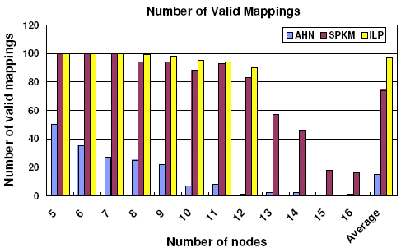
SPKM maps more applications
SPKM maps well on applications on which we could compare with ILP
SPKM can map 4.5X more applications than [AHN]
Y axis : # of applications that each technique can map
X axis : # of nodes that each application has
SPKM performs comparable to ILP on the benchmarks ILP runs
SPKM can on average map 4.5X more applications than AHN
For large application, SPKM shows high map-ability since it considers orthogonal interconnections effectively and exploits routing PEs
SO&R and CML Research Group

Slide 18
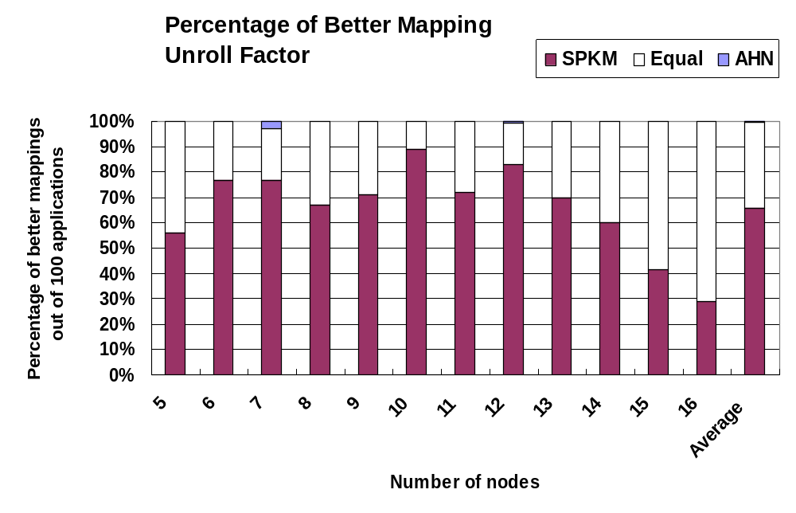
SPKM generates better mapping
[AHN] uses less Rows
[AHN] and SPKM use equal number of Rows
SPKM uses less Rows
For 62% of the applications, SPKM generates better mapping as [AHN]
For 99% of applications, SPKM generates at least as good mapping as [AHN]
SO&R and CML Research Group

Slide 19
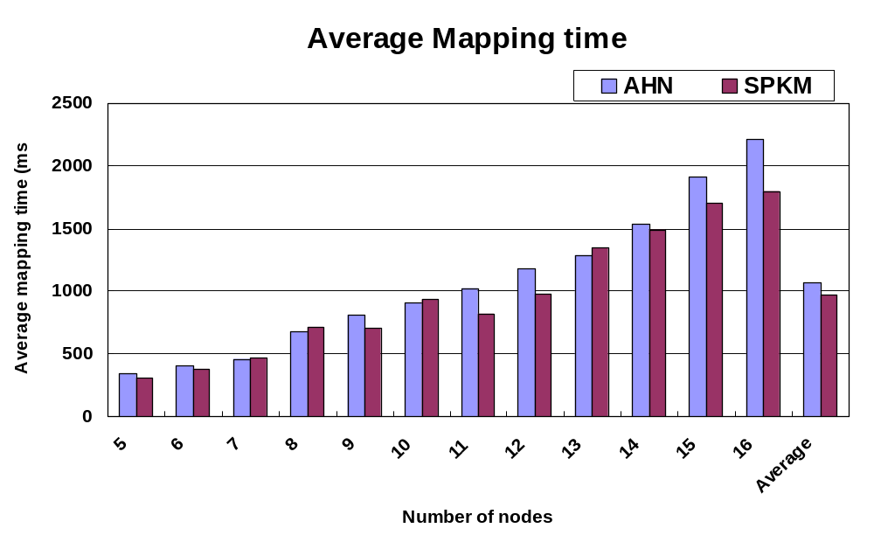
No significant difference in mapping time
SPKM has 8% less mapping time as compared to AHN.
SO&R and CML Research Group

Slide 20
Outline
Why Reconfigurable Architectures ?
CGRAs
Problem Formulation
Graph Drawing Algorithm
Experimental Results
  Experimental Setup
  Effectiveness of SPKM
  Flexibility of SPKM
  Real benchmarks
Conclusion
SO&R and CML Research Group

Slide 21
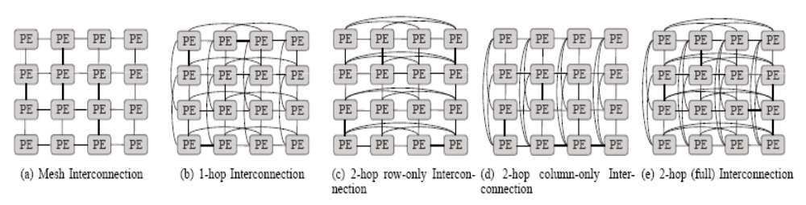
Design Space Exploration
Exploration on various PE interconnections
  PE interconnection topology determines the schedule-ability of an application
SO&R and CML Research Group

Slide 22
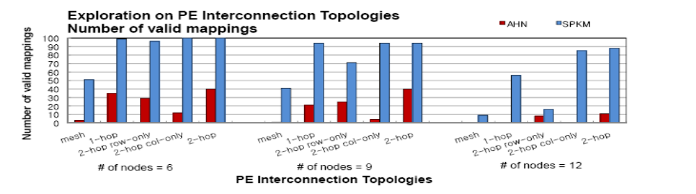
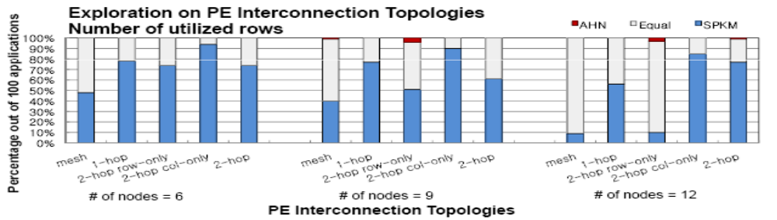
Exploration on PE interconnections
SPKM can map more applications even if PE interconnection topology changes
SPKM generates better-quality mappings for any interconnection topologies
SO&R and CML Research Group

Slide 23
Exploration of shared resources
Shared resource configurations
  1M-1L-1S: PEs of each row share 1 multiplier, 1 load, and 1 store
  2M-2L-1S: PEs of each row share 2 multiplier, 2 load, and 1 store
  2M-2L-2S: PEs of each row share 2 multiplier, 2 load, and 2 store
  4M-4L-4S: PEs of each row share 4 multiplier, 4 load, and 4 store
SO&R and CML Research Group

Slide 24
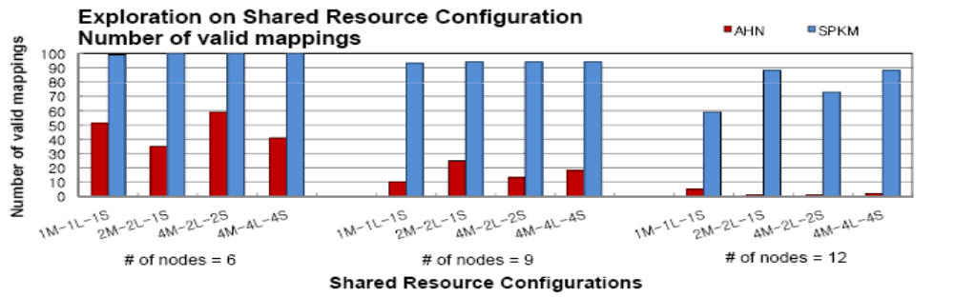
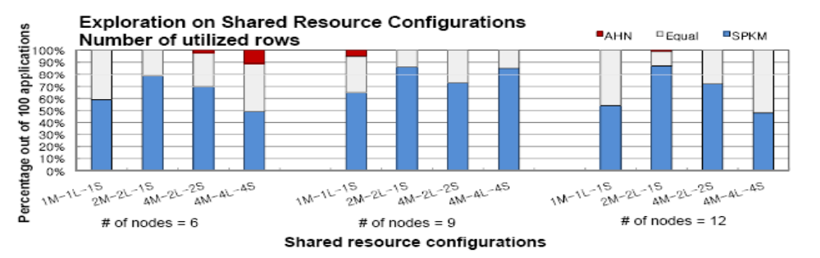
Exploration of shared resources
SPKM can map more applications even if shared resource configuration changes
SPKM generates better-quality mappings for any configurations of the shared resources
SO&R and CML Research Group

Slide 25
Outline
Why Reconfigurable Architectures ?
CGRAs
Problem Formulation
Graph Drawing Algorithm
Experimental Results
  Experimental Setup
  Effectiveness of SPKM
  Flexibility of SPKM
  Real benchmarks
Conclusion
SO&R and CML Research Group

Slide 26
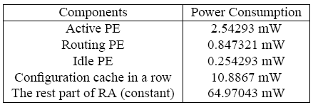
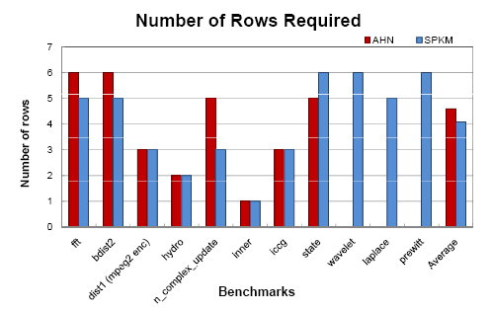
Real benchmarks
6x4 RSPA
Benchmarks: Livermore loops, MultiMedia, and DSPStone
Translates to 10% reduction in power consumption
Graph shows the number of rows
required for the mapping generated by SPKM and AHN.
Note that ILP is unable to find a
mapping for any of these
benchmarks in reasonable time.
Average mappings generated by SPKM uses less number of rows
AHN is unable to map three of the given applications, demonstrating
that SPKM can map more applications than AHN
SO&R and CML Research Group

Slide 27
Conclusion
CGRAs are a promising platform
  High throughput, power efficient computation
Applicability of CGRAs critically hinges on the compiler
CGRAs are becoming complex
  Irregular interconnect
  Shared resources
  Routing resources
Existing compilers do not consider these complexities
  Cannot map applications efficiently
We propose Graph-Drawing based heuristic, SPKM, that considers architectural details of CGRAs, and uses a split-push algorithm
  Can map 4.5X more DAGs
  Less number of rows in 62% of DAGs
  Same mapping time
  Scales well with different PE interconnections and shared resource constraints
SO&R and CML Research Group

Slide 28
Thank you
SO&R and CML Research Group

Slide 29
CGRAs vs. FPGAs
CGRAs (Coarse-Grained Reconfigurable Architectures)
  Operation level programmability and word level data paths
  Higher performance in more application fields
  Software development is easy
  More area and power efficient than FPGAs
FPGAs (Field-Programmable Gate Arrays)
  Bit-level programmability hence inefficient performance even
  for basic arithmetic and logic operations
  Slower clock speed and higher configuration time
  Increased design time
SO&R and CML Research Group

