Slide 1

Design Space Description Language (DSDL) for Comprehensive, Automated Exploration of Next-Gen Hardware Accelerators
Shail Dave and Aviral Shrivastava School of Computing and Augmented Intelligence Arizona State University
Notes:
Hi. I am Shail from ASU. This talk presents a language and framework for designing efficient hardware accelerators, while the approach being reusable, explainable, and agile.
SHA-ay-el DA-vay

Slide 2
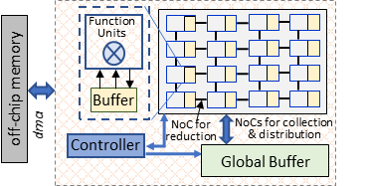
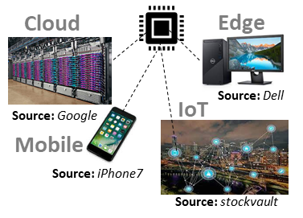


NPUs: Throughout Datacenters and Wearables
Neural Processing Units
Google TPU
NVIDIA A100 Tensor Cores
Samsung NPU
Sambanova's RDU
IBM's AI Accelerator
Microsoft Brainwave
ARM ML Processor
Xilinx xDNN
Qualcomm AI 100
Intel-Habana Goya
Cerebras Wafer-Scale Engine
Tesla's Self-Driving computer
Facebook's ML accelerator
Cambricon AI accelerators
Example NPU
NPU
Ref: A Brief Guide of xPU for AI Accelerators. Y Xie. ACM SIGARCH Computer Architecture Today, 2018.
Notes:
Accelerators, especially for machine learning, have been deployed throughout.

Slide 3
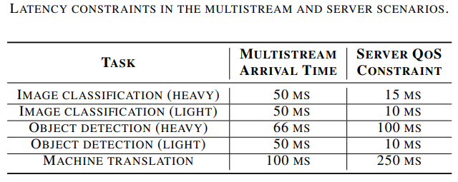
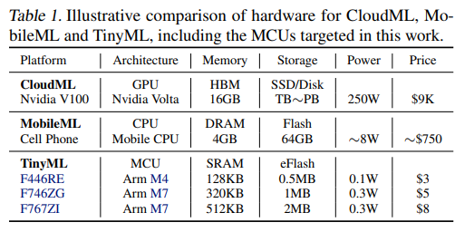
Need for Efficient Hardware/Software Codesigns
Strict constraints on accelerator design and execution under various deployment scenarios. [R2, R3]
Latency, energy, chip area, throughput, power, storage, accuracy.
Different Design Budgets and Execution Constraints
Under Various Deployment Scenarios
Ref: [R2]
Ref: [R1]
Ref: [R3]
[R1] Towards Agile Design Methodology for Efficient, Reliable, and Secure AI Systems. In VTS 2022.
[R2] MLPerf Inference Benchmark. V. J. Reddi et al. In ISCA 2020.
[R3] MicroNets: Neural Network Architectures for Deploying TinyML Applications on Commodity Microcontrollers. C. Banbury et al. In MLSys 2021.
Notes:
These deployment scenarios have strict constraints for designing accelerator for multiple workloads, such as latency, throughput, energy, and chip area.

Slide 4
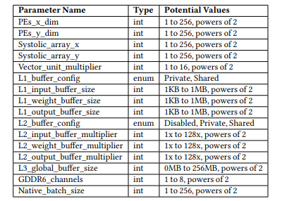
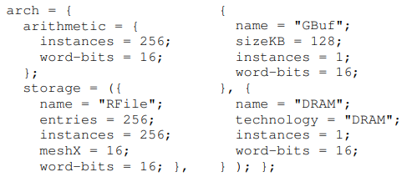
Design Exploration with ADL-based Approaches
Single architecture is defined via template.
Fixes what kinds of computation and memory units are interconnected in what manner [R1–R4].
Design space bounded to architecture.
Designs are hyperparameters of the template architecture [R2–R5].
Example NPU architecture.
Defining Eyeriss-like architecture in Timeloop [R3]
Accelerator Datapath Search Space [R5]
[R1] Architecture description language (ADL)-driven software toolkit generation for architectural exploration of programmable SOCs. P. Mishra et al. In TODAES 2004.
[R2] CGADL: An architecture description language for coarsegrained reconfigurable arrays. J. Filho et al. In TVLSI 2009.
[R3] Timeloop: A systematic approach to dnn accelerator evaluation. A. Parashar et al. In ISPASS 2019.
[R4] MAGNet: A Modular Accelerator Generator for Neural Networks. R. Venkatesan et al. In ICCAD 2019.
[R5] A Full-Stack Search Technique for Domain Optimized Deep Learning Accelerators. D. Zhang et al. In ASPLOS 2022.
Notes:
Common approach for design is defining an architecture template in architecture description language or ADL. So, we define one architecture in ADL, like what kinds of computation and memory units are connected in what way.
It is a fixed architectural organization. And the whole system stack like power and performance cost models, simulators, and compilers are heavily built manually by experts around this one architecture template. And the design space is nothing but hyperparameters of the template like number of function units and buffer size. All these are great. But

Slide 5
Challenges with ADL-based Design Approaches
1. Design Inefficiency
2. Reusability
3. Explainability
4. Agility
Notes:
There are a couple of challenges here.

Slide 6
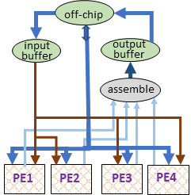
1. Inefficiency: Leaving Broad Space Unexplored
Need for efficient designs.
App execution requirements may become more stringent over time [R1].
Workload functionality evolve [R2].
Architectures unexplored during design process can be much more efficient, over pre-designed template.
For memory-bounded ML models, data may not be reused. So, architectures obviating shared buffers can be efficient. [R2, R3]
Accelerator with buffer shared among PEs.
[R1] In-Datacenter Performance Analysis of a Tensor Processing Unit. N. Jouppi et al. In ISCA 2017.
[R2] Hardware Acceleration of Sparse and Irregular Tensor Computations of ML Models: A Survey and Insights. S. Dave et al. In Proceedings of the IEEE 2021.
[R3] TETRIS: Scalable and Efficient Neural Network Acceleration with 3D Memory. M Gao et al. In ASPLOS 2017.
[R4] Cambricon-X: An Accelerator for Sparse Neural Networks. S. Zhang et al. In MICRO 2017.
Accelerator with unicasting tensors to PEs [R4].
Notes:
First, is design inefficiency. Over time, execution requirements become stricter or even functionalities of some workloads change, so we need to deliver efficient architectures exploring from the vast space, which is not automated here.

Slide 7
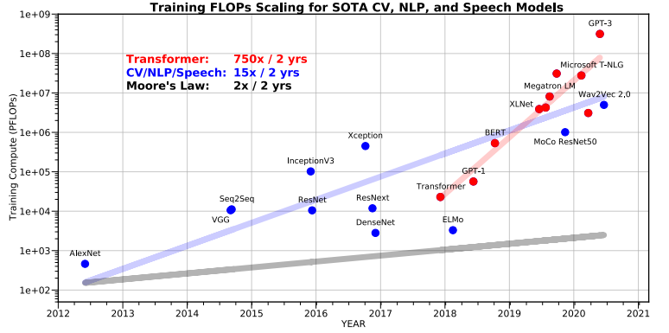
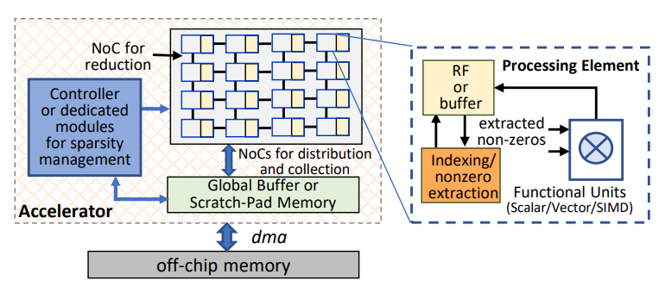
2. Reusability: Tools Unapplicable for New Architecture
Architectural innovations required as workload evolve.
Memory, compute needs for AI models double every few months [R1, R2].
Support specializations like sparsity or novel implementations of components, e.g., mixed-precision compute units [R2].
But we can’t reuse tools from system stack.
Mapping space formulation, simulators, cost models were built for one template.
AI and Compute [R1, R2]
Exploiting sparsity, especially unstructured, requires additional HW support. [R2]
[R1] AI and Memory Wall. A. Gholami et al. Medium Blogpost, 2021
[R2] Hardware Acceleration of Sparse and Irregular Tensor Computations of ML Models: A Survey and Insights. S. Dave et al. In Proceedings of the IEEE 2021.
Notes:
Also, as workloads evolve, processing requirements explode, like memory and computation doubling for AI models every few months. So a lot of design innovations are required to sustain acceleration. We should be able to reuse full system-stack like compilers, cost models, and simulators, when we integrate some specialization such as sparsity support, or novel implementations of the architectures like mix-precision compute units.
Currently, we can't reuse these tools, which were built just for this one template. Now, architecture changed, but there is no plug-and-play kind of extension and it requires heavy rework throughout the system stack.

Slide 8




3. Explainability: Hard to Infer Outputs and Decisions
Execution Costs from Simulation
or Analytical Modeling:
Not obvious why design yields certain costs
Understand implications
How variations in workloads, architecture, software optimizations impact costs
Productivity
Fine-tuning of design is challenging.
Optimality of obtained solution
DSE Output:
Notes:
Third challenge is about explainability. Say we have a simulator and we get some latency cost for a design. But, it is usually not obvious to reason about why we got this cost, right?
And we do design exploration through black-box approaches, like simulated annealing, or even reinforcement learning, or Bayesian optimization. It is challenging to justify the decisions behind the optimality of the solutions, and in fact, you may not even get the same quality design next time.

Slide 9
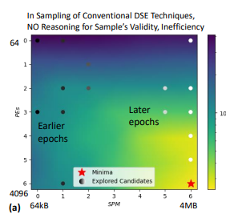


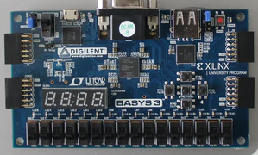


4. Agility: Trial-and-Error Optimization Consume Days
DSEs use black-box optimizations.
Simulated Annealing, Bayesian Optimization, Reinforcement Learning, etc.
Cannot reason about high costs obtained and how to lower them.
For vast space, need thousands of trials (often days) for obtaining feasible solution.
Emerging Apps Not Mainstreamed
Several applications can need dynamic HW/SW DSE during deployment on reconfigurable resources.
Fast deployment of a new ML model on end-user’s desktop
or cloud resources
Runtime deployment of tasks on partial resources of edge nodes
DSE of #PEs and shared memory sizes for ResNet CONV5_2b with HyperMapperV2.
Traffic Incident
Haboob Detection
Tracking a rouge car
[R1] TickTalk - Timing API for Dynamically Federated Cyber-Physical Systems. B. Iannucci et al. 2019.
[R1]
Notes:
Fourth challenge is agility. Because exploration is non-explainable, it is kind of trial and error based. So, even finding best hardware/software configurations for just one fixed architecture, it could require thousands of trials taking days if not weeks.

Slide 10
DSDL: Design Space Description Language
Key Idea
Formulate architecture candidates from the design space description.
set: {
nodes:{PE,BUF,ASSEMBLE}
edges:{P2P,Unicast,DMA} }
params: {
PE:[4,8],
BUF:range(4,10)
BUF.size:[256,1024]
}
Notes:
To overcome all these, we propose DSDL or design space description language. The key idea is that, in DSDL, designers can specify the set of components through a library, workload specification, and execution constraints/objectives, and it can explore various architectures and their efficient hardware/software designs.

Slide 11
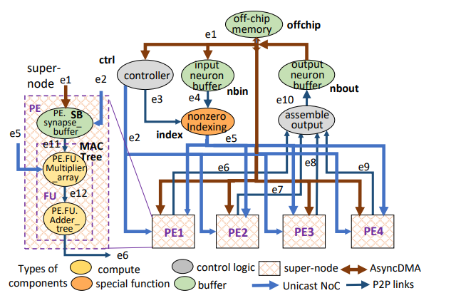
Architecture Design Abstraction: Flow Graphs
A flow graph represents an architecture.
Nodes: Compute, Memory, Control units, user-defined components, subgraph
Edges: Fixed or reconfigurable interconnects, synchronous/async
Models arbitrary grouping and hierarchy of components.
Design Libraries:
Defines components for flow graphs.
Functionality, execution costs, program representation, instruction, synthesis code
Defines flow graph construction.
Nodes, edges, super-modules, replication
Flow Graph of Cambricon-X like Accelerator.
Notes:
DSDL uses flow graph abstraction. So, each architecture is formulated as a flow graph, where nodes are components for computation, memory, or control logic, and edges represent interconnects. These components can be even user-defined like for specialization. The nodes can be even a sub-graph. Thus, DSDL can construct variety of architectures.

Slide 12
Design Space Specification in DSDL
set: {
nodes:{MAC,BUF,DMA}
edges:{P2P,Unicast} }
params: {
MAC:[4,8,16],
BUF:range(4,20)
BUF.size:[256,1024]
}
constr_legal: {...}
constr_opt: {...}
(3) Legality constraints (connection rules, constraints on hyperparameters of components that can be connected)
(4) Optimization constraints for pruning search space
(e.g., homogeneity and hierarchy)
Set of components
(2) Parameters (how many MACs, Buffers) and hyperparameters (sizes of buffers)
IRs: { IR1: { ld %0, %in1 mul %1, %0, 2 st %out1, %1 }}
Like DSE for ADLs:
DSDL Output:
HW/SW codesign (or Pareto front) with minimized objective costs while satisfying all constraints.
(5) IRs or DFGs of target workloads.
dse_constr: [tdp<4W]
(6) constraints on execution costs
dse_obj: [latency]
(7) DSE objectives
Notes:
DSDL allows defining rules in terms of the legality of the designs that we could generate in the space, like what components can be interconnected or not, any relationships among their hyperparameters or rules for a valid organization. In addition, there are also optimization rules for meaningful exploration. So designers may explore designs with only homogeneous child nodes, or a certain hierarchy for buffers.

Slide 13
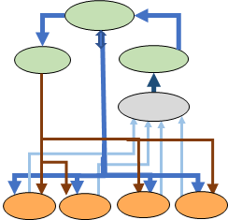
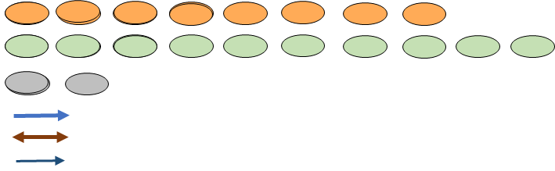
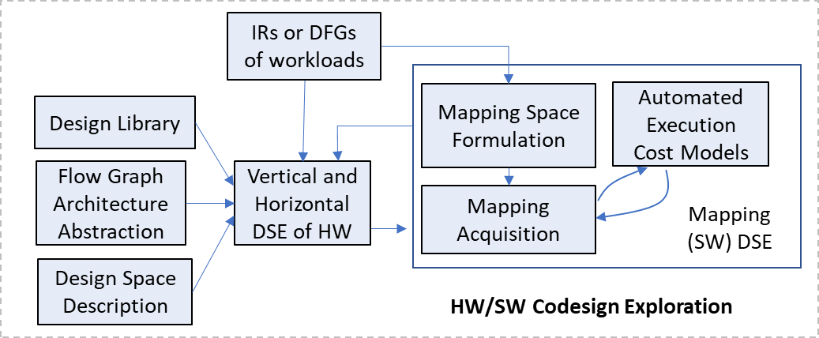
Exploration Dimensions in DSDL
Vertical Exploration:
Obtain valid flow graphs (architectures).
Fast – In-built legality check for compatibility of the flow graph with workloads.
Horizontal Exploration:
Optimize hyperparameters of a flow graph (designs of an architecture).
Optimizing Software Configurations:
For each design per architecture.
Joint Codesign:
Can be enabled with explainablity, which helps pointing out to the new values of parameters that mitigate bottlenecks behind high costs.
Explore architecture organization.
Optimize hyperparameters of an architecture.
Notes:
Once the description is in, DSDL can explore iteratively in three steps. First is vertical exploration, so it would pick a flow graph, and based on the workload description, it would quickly make sure that whether this flow graph is usable for workloads. Once a flow graph is found as a valid sample, then second step is horizontal exploration. Essentially, it figures out what are optimized hyperparameters like buffer sizes.
Then, once a design is sampled, DSDL does codesign, so optimizes software for it. In fact, all three steps could be a joint exploration especially when we enable explainable DSE.

Slide 14
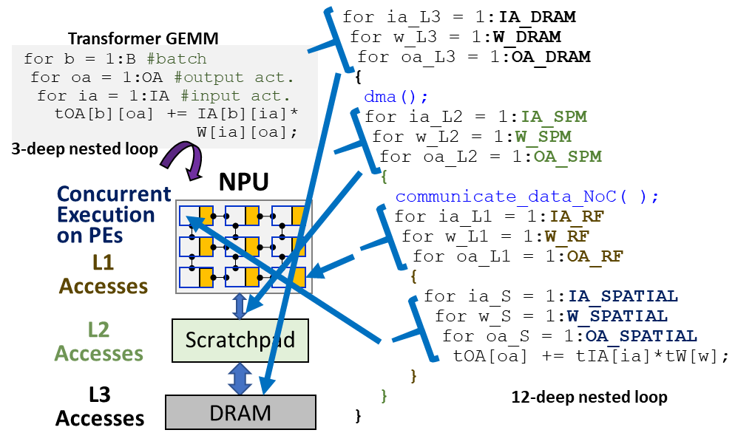
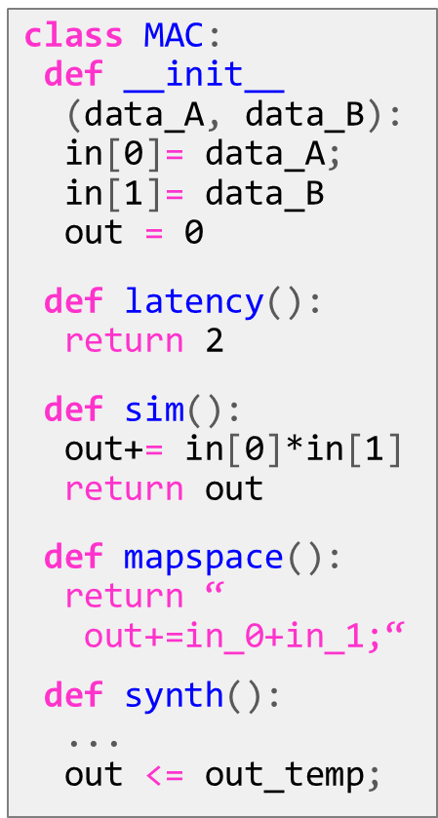
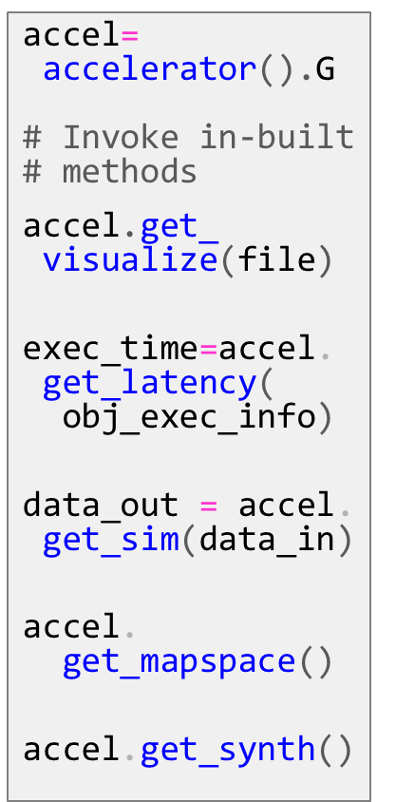
Full-Stack Automation in DSDL
Individual components are attached with definitions for tools.
Overall outputs are obtained by parsing the flow graph and processing definitions for nodes and edges.
Example: Mapping Space Formulated for an NPU Architecture [R1].
[R1] dMazeRunner: Executing Perfectly Nested Loops on Dataflow Accelerators. S. Dave et al. In TECS 2019.
Notes:
We can also do full stack automation because, we can parse flow graphs, get definitions of individual nodes and edges, and develop the collective feature.
For instance, we can parse latency costs associated with each node, and we can construct a cost model. We can also construct the simulators and compilation by this. For simulation, all non-accelerator functionality is mapped to a synthetic controller, which would also ensure the triggering of the flow graph, provide the input data, and collect the output data.
And, we develop these tools for the flow graph abstraction, instead of a specific NPU architecture. So we could still do full stack automation when architecture is reorganized or enhanced.

Slide 15
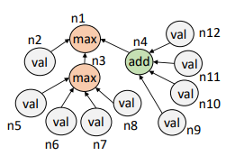
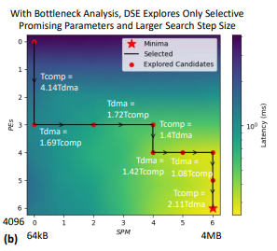
Enabling Explainability with Bottleneck Analysis
Cost graphs are constructed from the cost models of flow graphs.
Iterative exploration with bottleneck analysis ensures explainable and usually quick convergence.
DSE of #PEs and shared memory sizes for ResNet CONV5_2b with Explainable-DSE
Accelerator with buffer shared among PEs.
Example: n1: Latency; n2: Tcomp; n3: Tnoc; n4: Tdma; n5: Tnoc_I, n6: Tnoc_W, n7: Tnoc_PsumIn; n8: Tnoc_PsumOut; n9: Tdma_I, n10: Tdma_W, n11: Tdma_PsumIn; n12: Tdma_PsumOut p1: num_PEs; P2: RF_size; P3: SPM_size, …
Bottleneck analysis on cost graphs yield bottleneck factors and feedback about mitigation strategies.
DSE figures out appropriate scaling of PEs or SPM, based on computation time and DMA time.
e.g., bottleneck: ‘n2’
Relevant params: [p1]
Ref: Explainable-DSE: Explainable and Agile Exploration of Hardware/Software Codesigns of DNN Accelerators with Bottleneck Analysis. S. Dave et al.
Notes:
We can have explainability because we do bottleneck analysis of flow graphs. It informs us about major factors that contribute to the cost by parsing the cost graph. For instance, computation time is 4 times higher than time to communicate over interconnects. So, it can point to such bottleneck information, and usually also the parameters associated. With the required scaling, we can predict the next values of those parameters. It helps us for driving explainable DSE. Thus, it helps in building agile design flow.

Slide 16
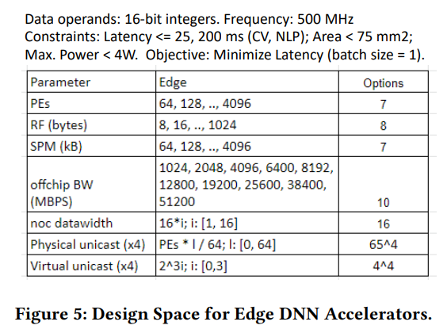
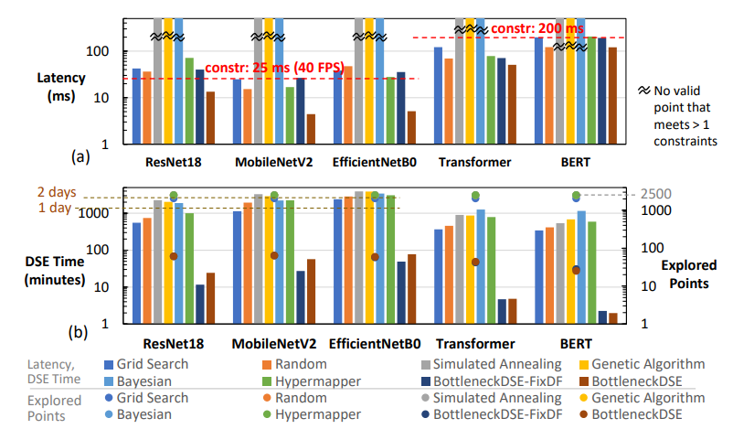
Power of Explainable DSE
Example: Exploring HW/SW codesigns of an architecture for DNN models.
3.74x low latency, on average.
Ref: Explainable-DSE: Explainable and Agile Exploration of Hardware/Software Codesigns of DNN Accelerators with Bottleneck Analysis. S. Dave et al.
124x less search time, on average.
Notes:
Our recent results for individual flow graphs show that we can achieve efficient designs just in order of a few minutes, instead of days with black-box approaches

Slide 17
Conclusions
DSDL for addressing needs of accelerator design methodology:
Efficiency: Comprehensive design space formulation for exploring HW/SW.
Explore architectures automatically, not just designs.
Reusability: Automate development of full system-stack.
Develop tools for architecture abstraction, not for a specific architecture.
Explainability: Bottleneck analysis of design costs.
Reason about outputs you get (costs, designs) and how to improve them.
Agility: Fast (feasible at run-time) exploration through explainable-DSE.
Know what you explore and why.
Notes:
To conclude, we need to have a robust design methodology, which can provide efficient designs through comprehensive exploration. DSDL can enable it along with full-stack automation, including supporting novel architectures and functionalities. DSDL can also provide explainable exploration through bottleneck analysis and exploration agility.

Slide 18
Thank You !
Share your feedback at:
Email: shail.dave@asu.edu
Twitter: @shail_dave
LinkedIn: daveshail
Website: sites.google.com/view/shail
Notes:
Thanks for listening and I look forward to your feedback!

Slide 19
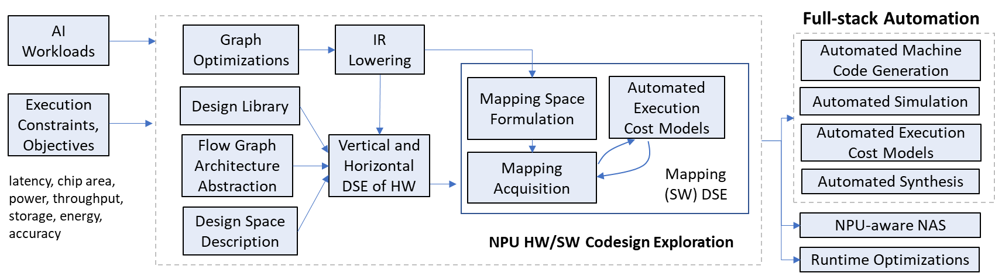
Towards Efficient, Reusable, Explainable, Agile Design Methodology
Efficient Hardware and Software Codesigns
Explainable Design Costs and Design Decisions
Agile
Exploration
Automated Full System-Stack
Ref: Towards Agile Design Methodology for Efficient, Reliable, and Secure AI Systems. In 40th IEEE VLSI Test Symposium (VTS), 2022

