Slide 2
CONClave - Secure and Robust Cooperative Perception for CAVs Using Authenticated Consensus and Trust Scoring
Edward Andert, Francis Mendoza, Hans Walter Behrens, and Aviral Shrivastava Arizona State University

Slide 3
Agenda
Motivation
Related Work
Our Approach
Experimental Setup
Results
Summary

Slide 4

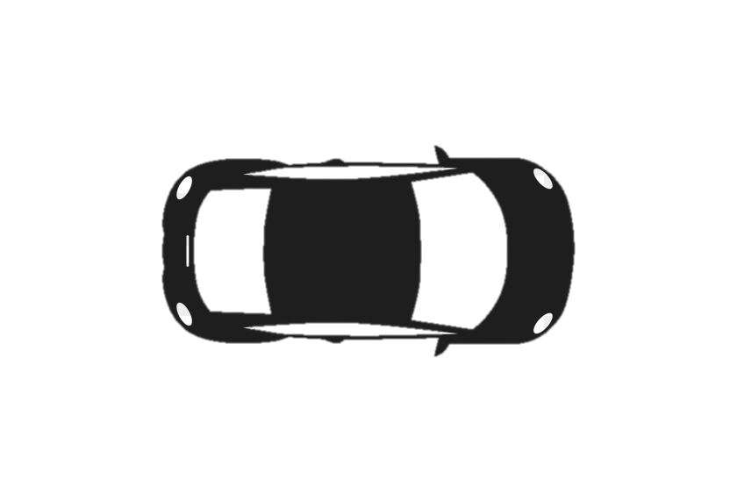



Motivation
Consider an intersection of Cooperative Autonomous Vehicles (CAVs)
Two CAVs are approaching the intersection
The two CAVs must come to agreement on the obstacles to go through

Slide 5


Motivation
Scenario 1: Everything Goes Perfectly
Sensing is perfect, communication is perfect, and both CAVs are trustworthy
The two CAVs agree, and the intersection is successful

Slide 6

Motivation
Scenario 2: A Byzantine Fault Occurs Due to Packet Drop
During transmission, a packet is lost form CAV #2
The two CAVs do not agree, thankfully everything stops in deadlock

Slide 7
Motivation – Sensing Fault
Scenario 3: A CAV Has a Sensing Fault
CAV #1 sensor fails to see the pedestrian, CAV #2 sees the pedestrian
The two CAVs do not agree, thankfully everything stops in deadlock

Slide 8



Motivation – Malicious CAV
Scenario 4: A CAV is Malicious and Purposely Tries To Deceive Others
CAV #1 cannot see the pedestrian due to obstruction, CAV #2 is malicious
The two CAVs agree, and crash into the person

Slide 9
Related Work
Previous works on cooperation with CAVs only tackle single issues
Byzantine Faults
Tarak Nandy et al . 2021. A Secure, Privacy-Preserving, and Lightweight Authentication Scheme for VANETs. IEEE Sensors Journal (2021).
Weizheng Wang et al . 2021. Blockchain and PUF-based Lightweight Authentication Protocol for Wireless Medical Sensor Networks. IEEE Internet of Things Journal (2021).
Sensing Errors
Edward Andert et al . 2022. Accurate Cooperative Sensor Fusion by Parameterized Covariance Generation for Sensing and Localization Pipelines in CAVs. In 2022 IEEE 25th International Conference on Intelligent Transportation Systems (ITSC). IEEE, 1–8
Malicious Agents
Braden Hurl et al . 2020. Trupercept: Trust modelling for autonomous vehicle cooperative perception from synthetic data. In 2020 IEEE Intelligent Vehicles Symposium (IV). IEEE, 341–347.
All three should be tackled at the same time because:
Faults can have a similar effect but be from different sources
It is more efficient to tackle all three at once

Slide 10
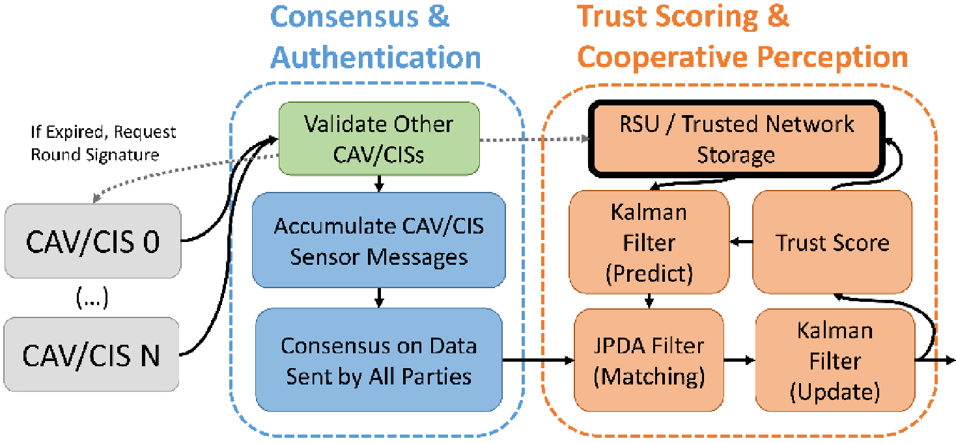
Our Method – Overview
Three stages
Authentication
Consensus
Trust Scoring & Sensor Fusion
Notes:
Low resolution

Slide 11
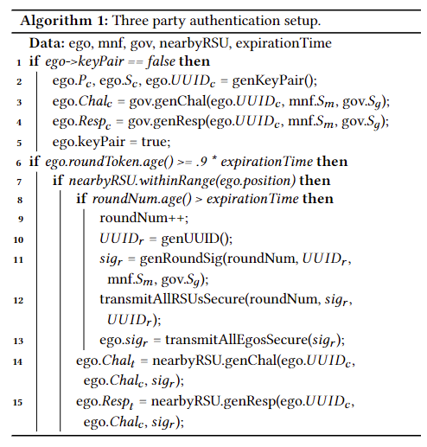
Our Method – Three Party Authentication
Necessary to protect against
Unauthorized participants
DDOS, Replay attack, etc.
Three Stakeholders
Government / Municipality
Manufacturer
Vehicle Itself
Notes:
Low resolution

Slide 12

Our Method – Three Party Authentication
Time limited round token
Acquired from an RSU
Valid for time T
Vehicle to Vehicle Authentication
Any vehicle can challenge and authenticate another
No shared secrets
RSU
Notes:
Less text No cars over text

Slide 13
Our Method – Single Shot Consensus
Necessary to protect against
Communication faults
Disagreement between participants
Malicious agents
We come to consensus on the data that all participants sent using Bosco
Allows for fast, binary consensus
Correctness of data is left for next step
Vehicle to Vehicle Authentication is performed as a step in consensus
Much faster
Notes:
Low resolution Less text

Slide 14
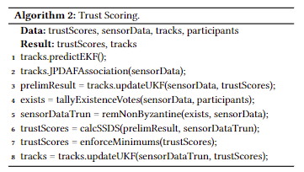
Our Method – Sensor Fusion & Trust Scoring
Necessary to protect against
Sensor faults
Recognition algorithm faults
Malicious agents
We use an expected sensor accuracy rather than camera confidence as an initial weight
Allows for accurately identifying faults down to the sensor level
Robust to heterogenous sensing sets that don’t need to share a modality
We take into account expected field of view
This must be done as not all vehicles can see everything
Scores cannot be negatively weighted for lack of FOV
Notes:
Less text

Slide 15
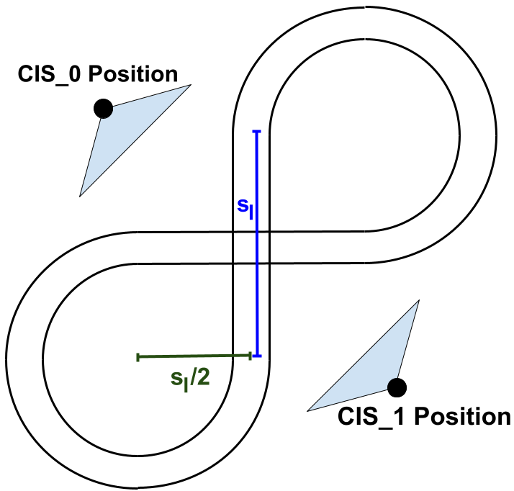
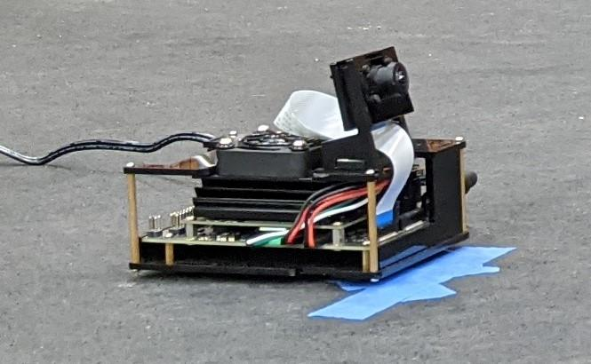
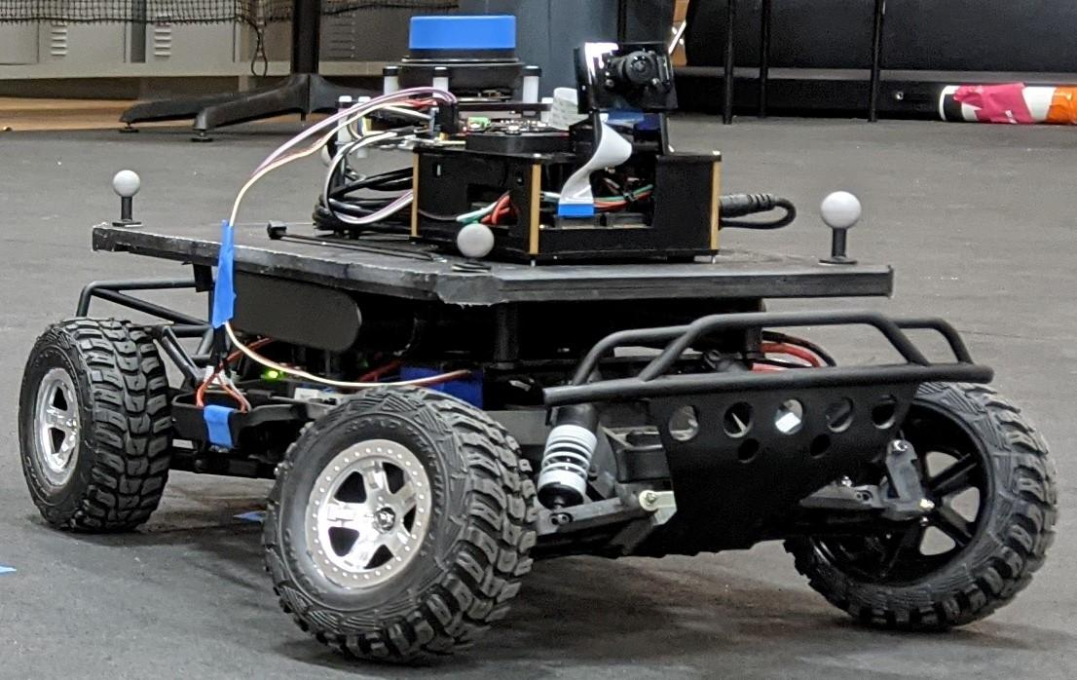
Experimental Setup
Ten – ten minute long tests runs recorded online
14 Classes of Faults / Malicious activity injected
Randomized location, 10 times for each severity
1100 test total
CIS x2
CAV x4

Slide 16
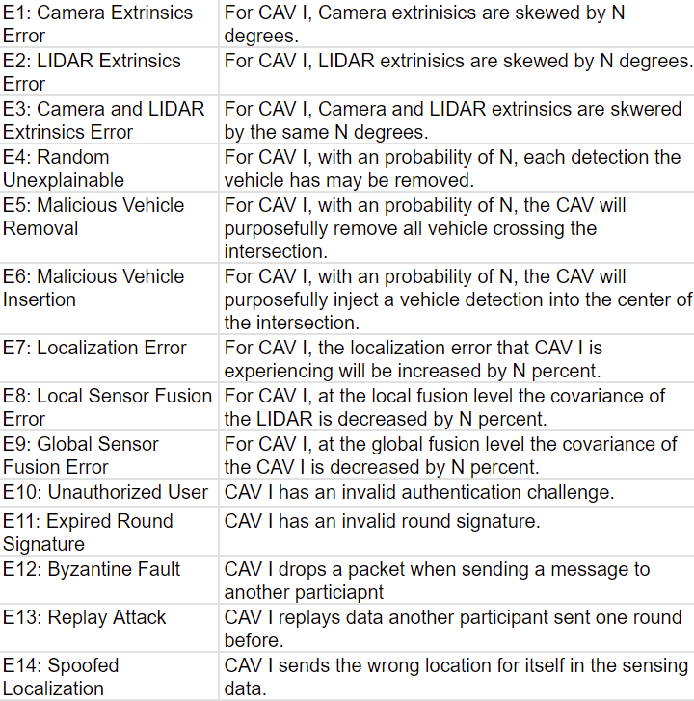
Experimental Setup
Compared CONClave again TruPercept
A fault/attack is considered detected when the Trust Score of the offending vehicle reaches 20% above expected
CIS x2
CAV x4
Notes:
Low resolution

Slide 17
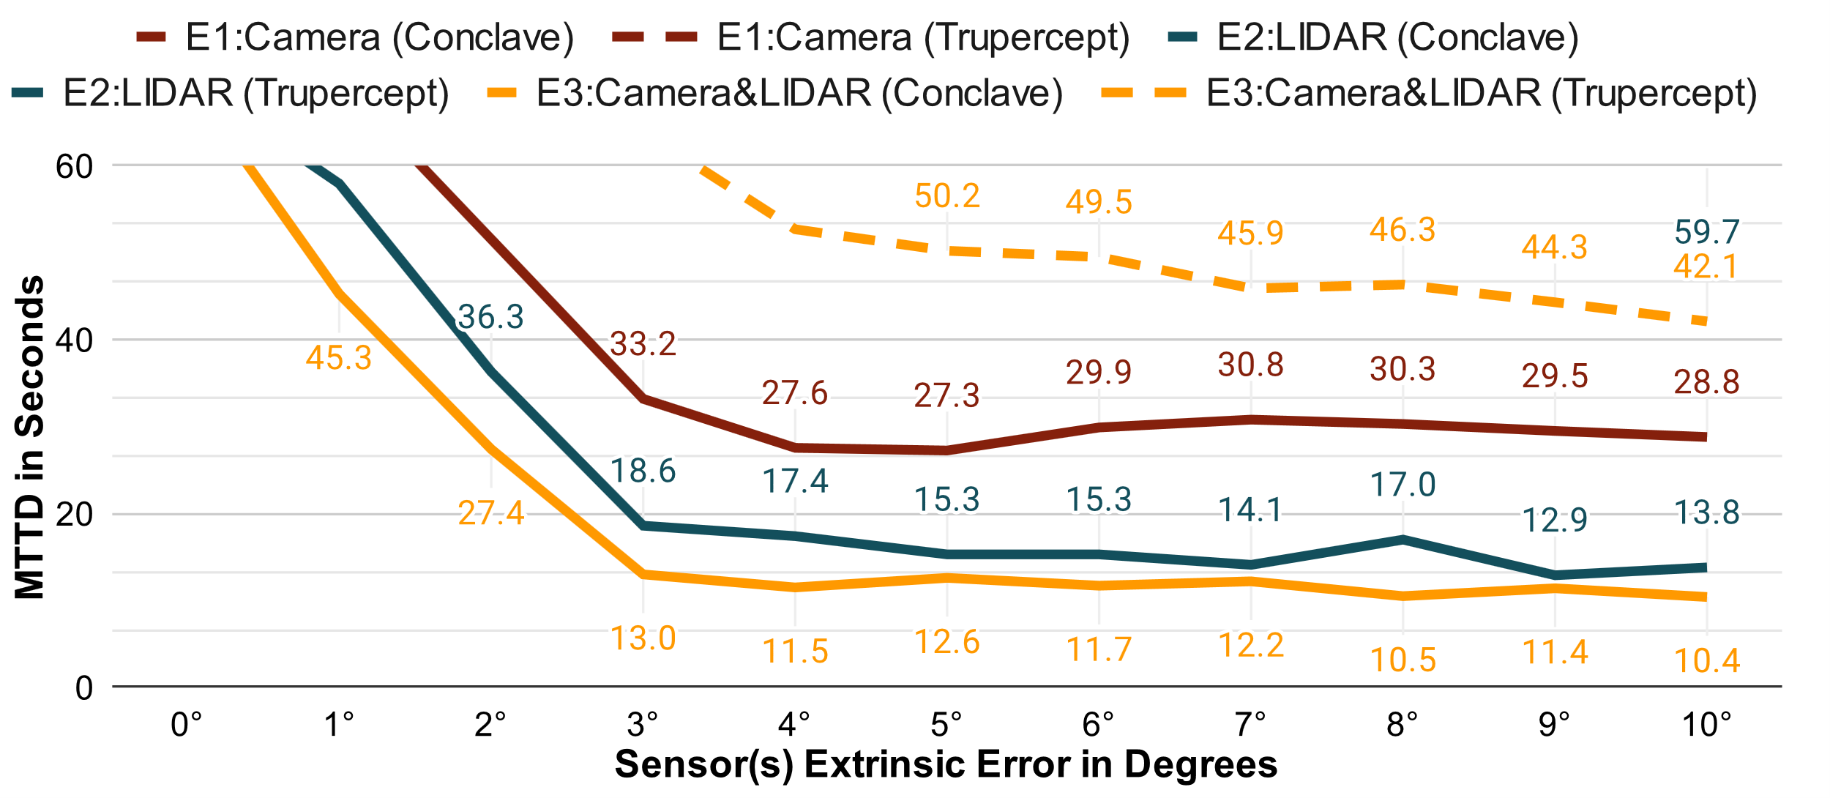
Results
Notes:
Marking for Trupercept is too close to Conclave indicate that Trupercept does not detect E1 at all

Slide 18
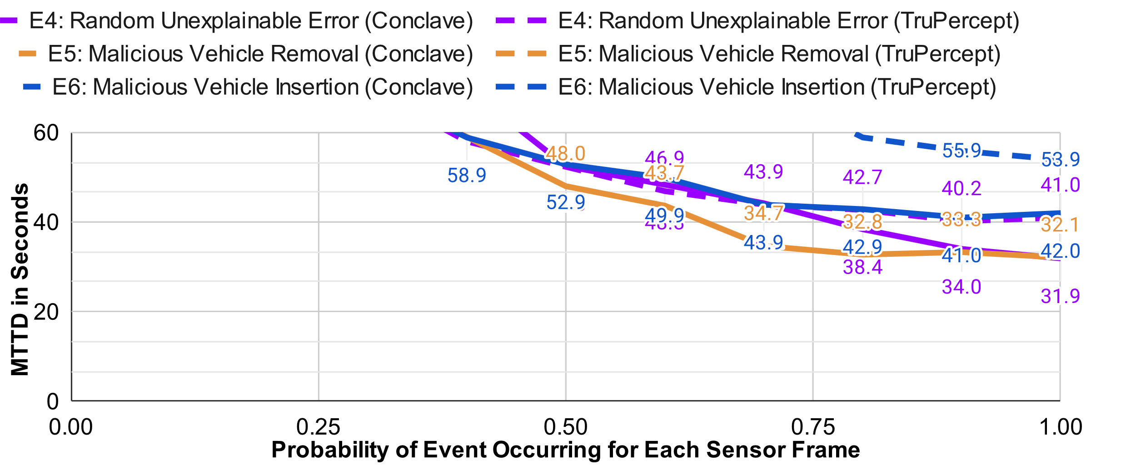
Results
Notes:
Long line for conclave in the legend so that it is easier to differentiate indicate that Trupercept does not detect E5 at all

Slide 19
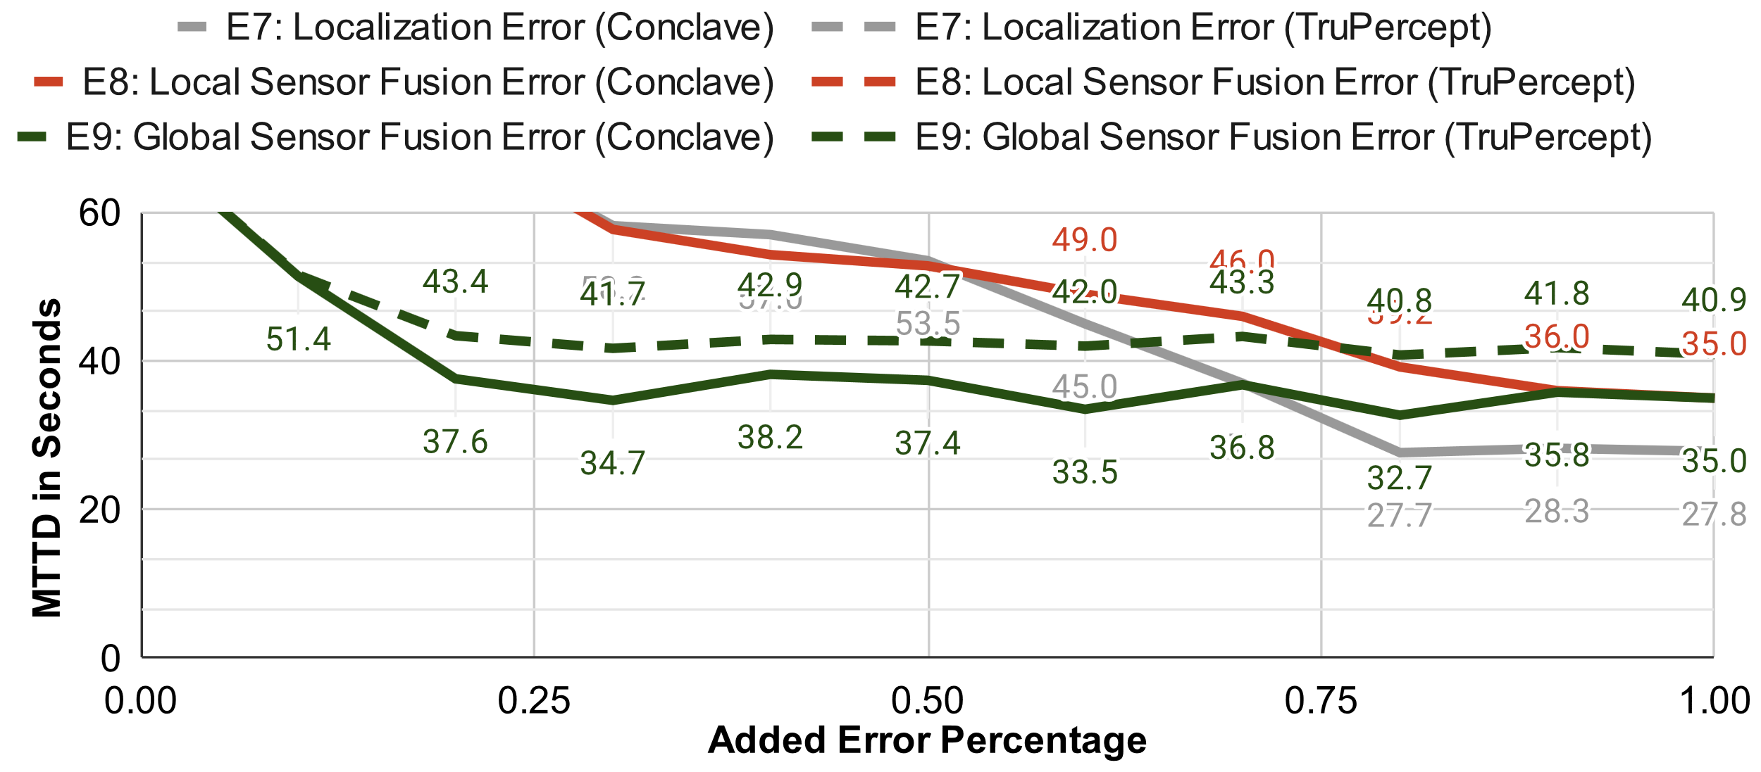
Results
Notes:
Long line for conclave in the legend so that it is easier to differentiate indicate that Trupercept does not detect E8+9 at all

Slide 20
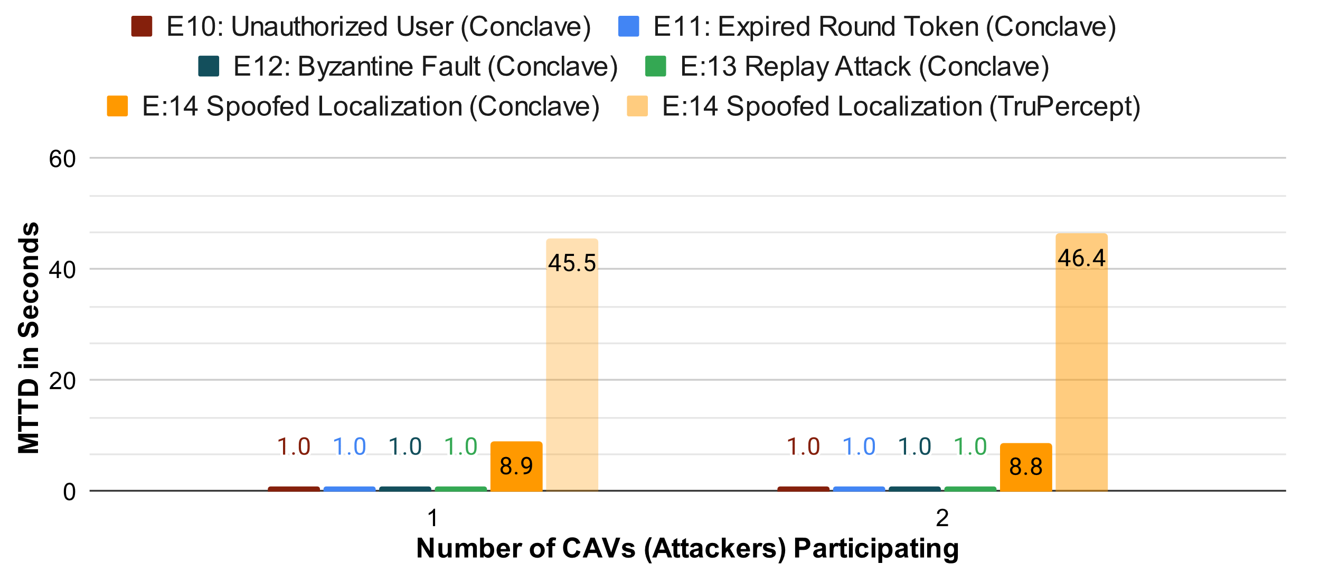
Results

Slide 21
Conclusion
CONClave combined authentication, consensus, and trust scoring can protect cooperative applications
CONClave detected and prevented:
96.7% of the 300 sensor extrinsic faults injected
83.5% of the 300 software faults injected
67.3% of the 300 malicious injections / removals
100% of the 200 communication faults and malicious
CONClave was able to run on 4 CAVs and 2 CISs with 1 RSU in real time.
Future work
Expand to include path planning and actuation of a path plan
Notes:
Less text

Slide 22
Thank You – Questions?

