Slide 1
HELM: Compiler-Guided Heterogeneous Execution for Large Language Models on Memory-Constrained Systems
Master's Thesis Defense​
Presented By : Shashwat Pandey
Thesis Committee :​
​
Dr. Aviral Shrivastava​
Dr. Aman Arora​
Dr. Vidya Chhabria​

Slide 2
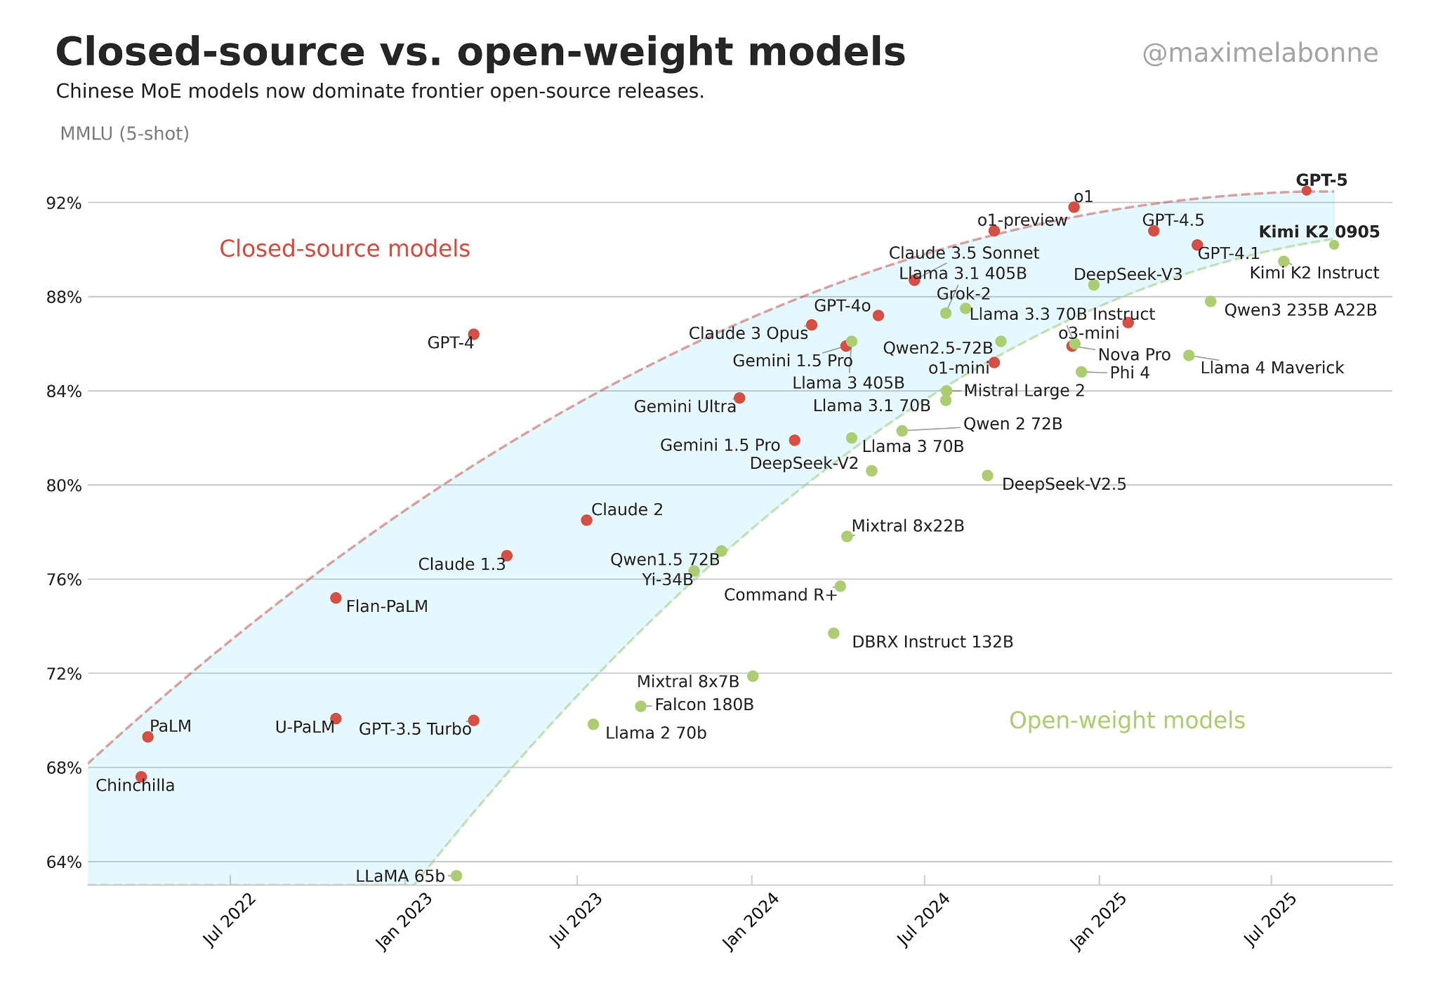
LLM inference is constrained by GPU memory on commodity systems
Two ways GPU memory becomes a bottleneck
Model Capabilities keep increasing with model size
Qwen3-14b model different quantizations
Weights
7 GB
int 4
KV Cache
13.4 GB
24 GB VRAM
Works Fine
Others
Weights
14 GB
int 8
KV Cache
26.8 GB
24 GB VRAM
OOM during
Inference
Others
Weights
28 GB
fp 16
KV Cache
53.7 GB
24 GB VRAM
OOM at
Load time
source : https://x.com/maximelabonne/status/1972615048511250647
Others
Notes:
The core question this thesis answers is: how do you run large language models on commodity hardware that simply doesn't have enough GPU memory — without sacrificing throughput?
As open-weight models keep getting better, they also keep getting larger. The chart on the left shows
that model capabilities have been consistently scaling with parameter count.
But this creates a real problem on commodity hardware. Take Qwen3-14B as an example. In int4, it
fits comfortably in 24 GB of VRAM. But in int8 or fp16, the weights plus KV cache together exceed
what a 24 GB card can hold — and you either get an OOM during inference, or you can't even load the
model at all.
So the question is: what do you do when your model doesn't fit?

Slide 3
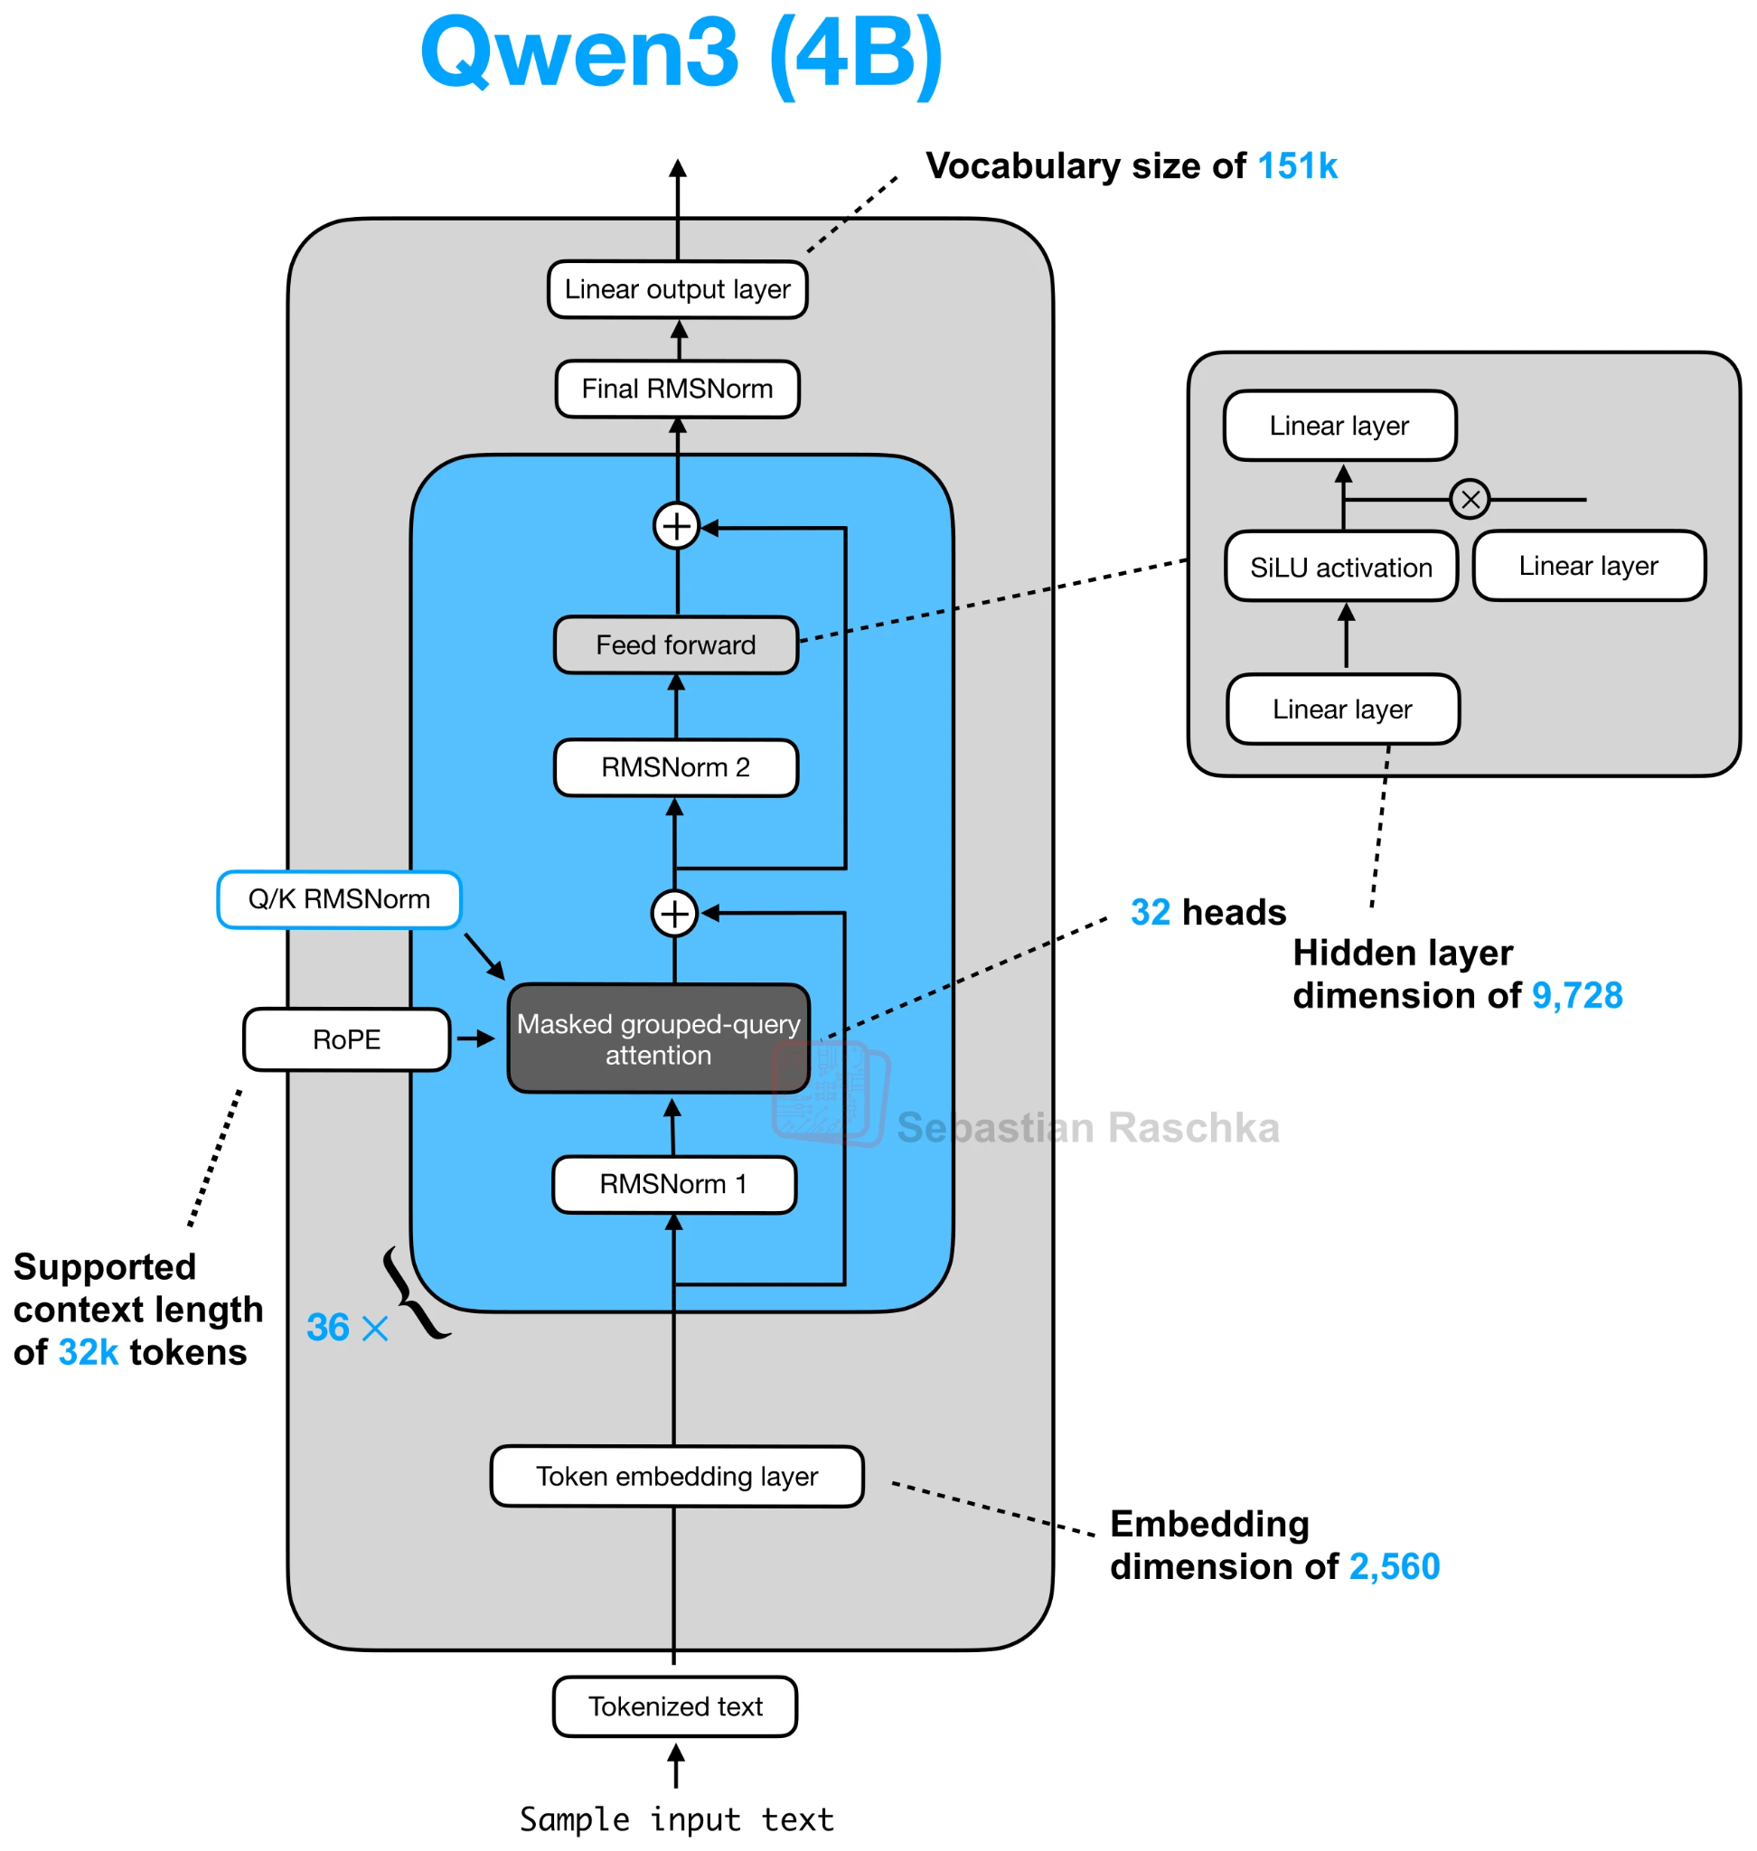
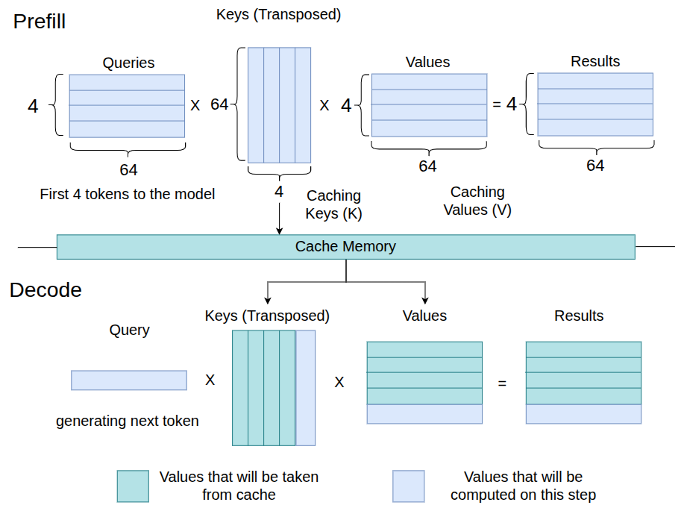
LLM Inference runs in two phases : prefill and decode
Attention
[2]
[1] https://sebastianraschka.com/llm-architecture-gallery/
[2] inspired from https://developer.nvidia.com/blog/mastering-llm-techniques-inference-optimization/
[1]
Notes:
Let me walk through this diagram step by step using a concrete example.
Say you type: "Hello how are you" — 4 words, 4 tokens. You send this to the model.
PREFILL PHASE — top right of the diagram.
All 4 tokens are processed together in a single forward pass. The model computes a Query matrix,
a Key matrix, and a Value matrix — each of shape 4×64, where 4 is the number of input tokens
and 64 is the per-head dimension. You do Q times K-transposed, which is a 4×64 multiplied by
64×4 — a full matrix multiply. The output is a 4×4 attention score matrix, then scaled by
Values to get a 4×64 result.
The important thing is: the Keys and Values get saved — that's the KV cache shown in the middle.
Every layer in the model generates and stores its K and V. This is done once, upfront, for all
input tokens in parallel. It's compute-heavy — a full GEMM — and the GPU handles it well.
DECODE PHASE — bottom right of the diagram.
Now the model generates the response, one token at a time. Say it's generating the 5th token.
The Query is now just a single vector of size 1×64 — one token. But it must attend to all 4
previously cached Keys, so K-transposed is 64×4, and we do a 1×64 times 64×4 — that's a
matrix-vector product, not a matrix-matrix multiply.
And here's the critical part: to do this, the model must read the entire weight matrix from
memory — H×H weights per layer, where H is the hidden dimension. For Qwen3-4B, that's
roughly 9000×9000 elements in fp16. That's 2H² FLOPs — one multiply and one add per weight —
but also 2H² bytes — since each weight is 2 bytes in fp16. FLOPs equals bytes.
Arithmetic intensity = 1 FLOP per byte.
And this happens at every layer, every single token. Each new token requires reading the entire
model from memory. That is the bottleneck we are solving.

Slide 4
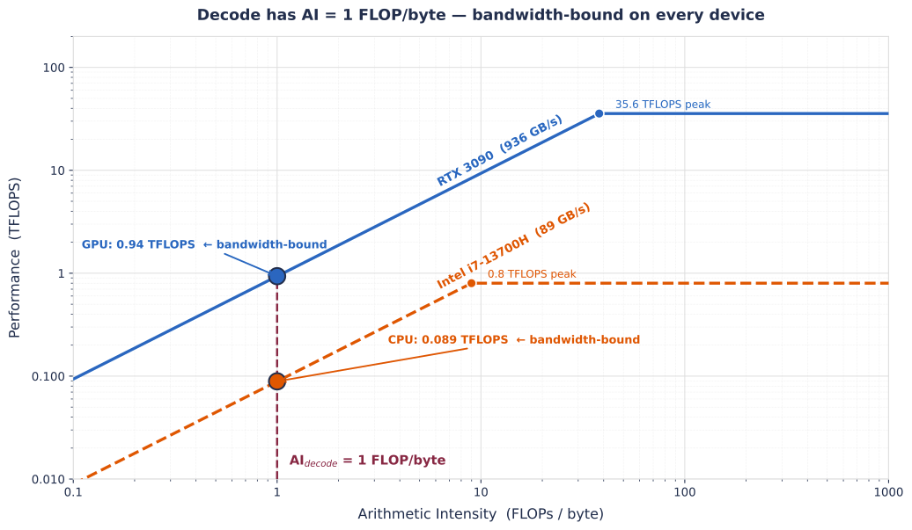
Decode is memory-bound, making weight movement the bottleneck
During decode, each weight matrix is matrix-vector product - we do 2H² FLOPs but also load 2H² bytes so (H - the hidden dimension )
Arithmetic Intensity(AI) = 1 Flop/Byte
AI = 1 falls below every device’s ridge point, Always bandwidth bound
tokens/sec ∝ memory bandwidth, CPU layers contribute real throughput
Notes:
Here's why decode is hard. At each decode step, we do 2H^2 FLOPs but also load 2H^2 bytes — one
for compute, one for the weight matrix. This gives an arithmetic intensity of exactly 1 FLOP per byte.
Looking at the roofline plot, that AI=1 falls below the ridge point of every device — both GPU and
CPU. That means decode is always bandwidth-bound, never compute-bound.
The critical implication is this: tokens per second is proportional to memory bandwidth. And this
means CPU layers actually contribute real throughput — the CPU's DRAM bandwidth, while slower than
HBM, is not zero.

Slide 5
Current inference systems either fail or become inefficient under memory limits
System | Approach | Limitations
vLLm [1] & SGLang [2] | Entire model must fit in GPU VRAM | OOM at load time when model exceeds VRAM.
Accelerate [3] | Fills GPU first, spills rest to CPU CPU-layer weights streamed to GPU per-layer via Python hooks | No performance-aware placement PCIe weight transfers per token Python hook overhead at every layer boundary
DeepSpeed [4] | All weights in CPU RAM Each layer streamed to GPU on demand, async prefetch overlaps transfer with compute | PCIe round-trips per token incur lots of overhead
[1] Kwon et al., "Efficient Memory Management for Large Language Model Serving with PagedAttention," SOSP, 2023.
[2] Zheng et al., "SGLang: Efficient Execution of Structured Language Model Programs," NeurIPS, 2024.
[3] Gugger et al., "Accelerate: Training and inference at scale made simple, efficient and adaptable," GitHub, 2022.
[4] Rajbhandari et al., "ZeRO: Memory Optimizations Toward Training Trillion Parameter Models," SC, 2020.
Notes:
So what do existing systems do? Let's look at the three main approaches.
vLLM and SGLang require the entire model to fit in GPU VRAM. When it doesn't, they simply OOM at
load time. They have no fallback.
Accelerate takes a different approach — it fills the GPU first, then spills remaining layers to CPU.
But it streams CPU-layer weights to the GPU every single token via Python hooks. This adds per-token
PCIe transfers plus hook overhead at every layer boundary. There's also no performance-aware
placement — it just fills greedily.
DeepSpeed puts all weights in CPU RAM and streams each layer to the GPU on demand, with async
prefetch. But the round-trip PCIe overhead per token adds up significantly.
All of these share a fundamental problem: weight movement happens at runtime, every token.

Slide 6
LLM layer placement should be decided at compile time, not during execution
Runtime Placement cannot make optimal decisions
if model fails to load due to OOM, runtime never gets to make placement decisions
No joint view of CPU cost, GPU cost or PCIe Transfer cost
All inputs for optimal placement can be known ahead of time
Model graph traceable symbolically, no need to load weights in memory
Model Layers costs can be derived analytically
Hardware capabilities can be measured at startup
Optimal split never changes
Compile-time placement unlocks what runtime cannot
Searching over all CPU-GPU splits for a globally optimal partition
Weights loaded to assigned device once, no weight movement during inference
Execution graph restructured into static CPU-GPU subgraphs before first token
Runtime dispatch hooks eliminated entirely, not possible during inference
Notes:
This leads to the central insight of HELM. Why are these systems making placement decisions at runtime?
First, runtime placement can't make optimal decisions. If the model fails to load due to OOM, the
runtime never even gets a chance. And even when it runs, it has no joint view of CPU cost, GPU cost,
and PCIe transfer cost simultaneously.
Second — and this is important — all the inputs needed for optimal placement can be known
before a single token is generated. The model graph is symbolically traceable without loading weights.
Layer costs can be derived analytically. Hardware capabilities can be measured once at startup. And
the optimal split never changes across tokens.
Third, compile-time placement unlocks things that runtime simply cannot do: searching over all
possible CPU-GPU splits globally, loading weights to their assigned device once and keeping them
there, and restructuring the execution graph into static subgraphs that eliminate all runtime
dispatch overhead.

Slide 7
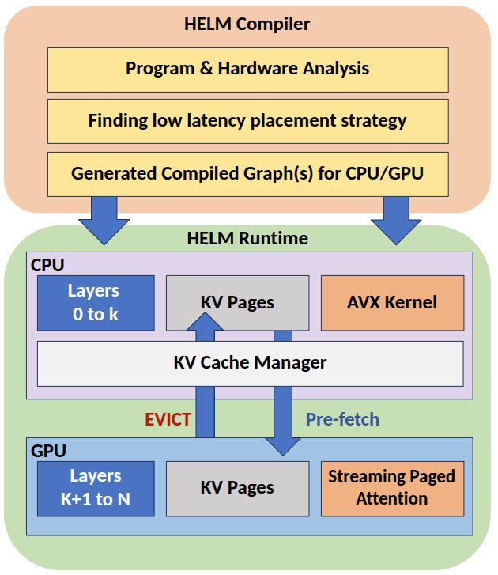
HELM: Compiler-guided heterogeneous execution for LLM inference
Traces the model execution graph offline - loading weights not required
Finds Optimal CPU-GPU layer partitioning via hardware-aware cost modeling
Reconstructs Static subgraphs that pin weights at their assigned devices
At Runtime, executes a fixed CPU-GPU pipeline with paged KV offloading
Notes:
This brings us to HELM. HELM is a compiler and runtime system for heterogeneous LLM inference.
The HELM compiler does three things. It traces the model's execution graph offline — no weight
loading required. It finds the optimal CPU-GPU layer partition using a hardware-aware cost model.
And it generates compiled execution graphs for both CPU and GPU.
At runtime, HELM executes these static graphs — one for the CPU, one for the GPU — with weights
pinned at their assigned devices. A KV Cache Manager handles paged KV allocation and, when
necessary, spills pages to CPU RAM.
The result is a system where weights never move after startup, and the only thing crossing PCIe
each decode step is a single small activation tensor.

Slide 8
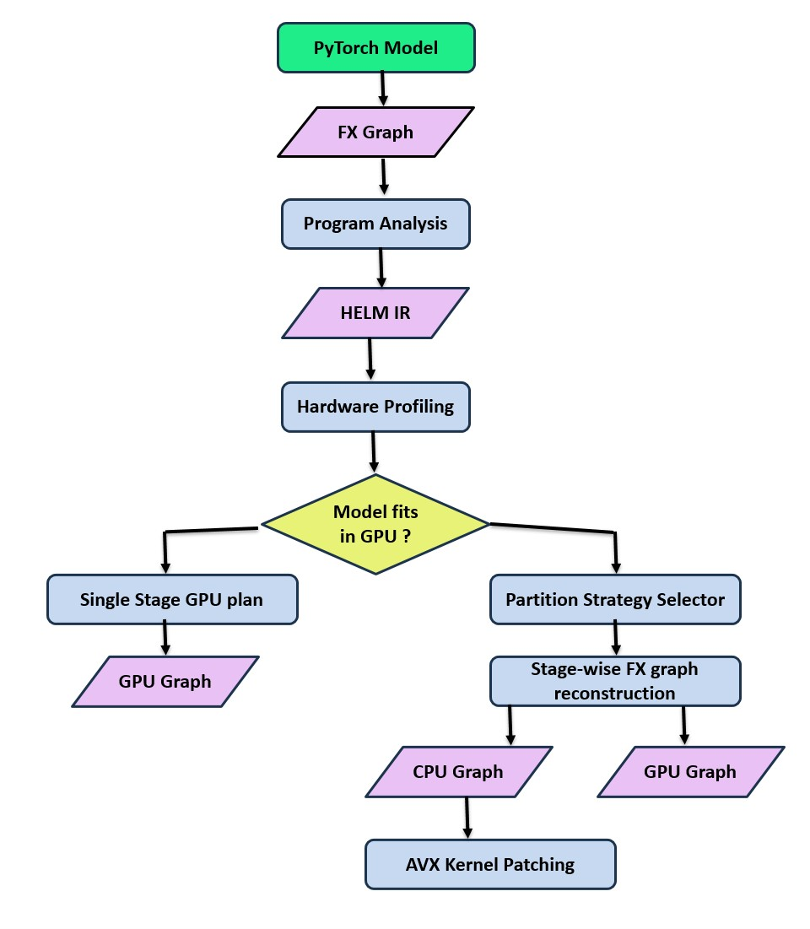
HELM Compilation flow
FX symbolic trace captures the full compute graph without loading weights
Compute analysis pass walks each node, linear layers: FLOPs = 2 × rows × cols, params = rows × cols × 2 bytes
This per-node data is what makes the cost model possible
torch.fx.Node​ .Op = “call_module”​
.name = “q_proj”​
.target = “self_atten.q_proj”​
.args = (hidden_states,)​
​
HelmGraph.IRNode​
​
.Op = “call_module”​
.name = “q_proj”​
.target = “self_atten.q_proj”​
.args = (hidden_states,)​
.shape = (1,4096) ​
.dtypes = torch.float.16​
.flops = 33.6MFLOPS​
.params = 33.6 MB​
.act = 8kb​
.device = None (to be set later)​
symbolic trace with dummy input
from model config
2 x M x N from weight shape
weight bytes in FP16
output tensor size
Notes:
Let me walk through the compilation flow. It starts with a standard PyTorch model.
We use torch.fx to symbolically trace the model, which gives us the full compute graph without
loading any weights. Each node captures the operation type, target module, and argument structure.
We then run a compute analysis pass over this graph. For each linear layer, we compute FLOPs as
2 × rows × cols, parameter bytes as rows × cols × 2 for fp16, and the activation tensor size at
the output. This produces the HELM IR — one IRNode per operation — which contains everything the
cost model needs: flops, params, activation size, dtype.
This is what makes the cost model possible — all of this is derived statically, before execution.

Slide 9
HELM Compilation flow (Continued)
What we measure:
- CPU DRAM bandwidth — 64 MB tensor read on CPU
- GPU DRAM bandwidth — 64 MB tensor read on GPU
- PCIe bandwidth — 64 MB transfer CPU→GPU and GPU→CPU
- Effective FLOPS — timed GEMM on GPU and timed GEMV on CPU (decode regime)
Why profile instead of using reported specs?
- Reported numbers are theoretical peak; actual sustained bandwidth and FLOPS are lower and vary by system configuration
Why 64 MB?
- Large enough that DRAM bandwidth saturates (avoids cache effects) but small enough that it completes quickly at startup
- Represents the working set size of a typical transformer layer weight matrix
Notes:
What we measure:
- CPU DRAM bandwidth — 64 MB tensor read on CPU
- GPU DRAM bandwidth — 64 MB tensor read on GPU
- PCIe bandwidth — 64 MB transfer CPU→GPU and GPU→CPU
- Effective FLOPS — timed GEMM on GPU and timed GEMV on CPU (decode regime)
Why profile instead of using reported specs?
- Reported numbers are theoretical peak; actual sustained bandwidth and FLOPS are lower
and vary by system configuration
Why 64 MB?
- Large enough that DRAM bandwidth saturates (avoids cache effects) but small enough that
it completes quickly at startup
- Represents the working set size of a typical transformer layer weight matrix

Slide 10
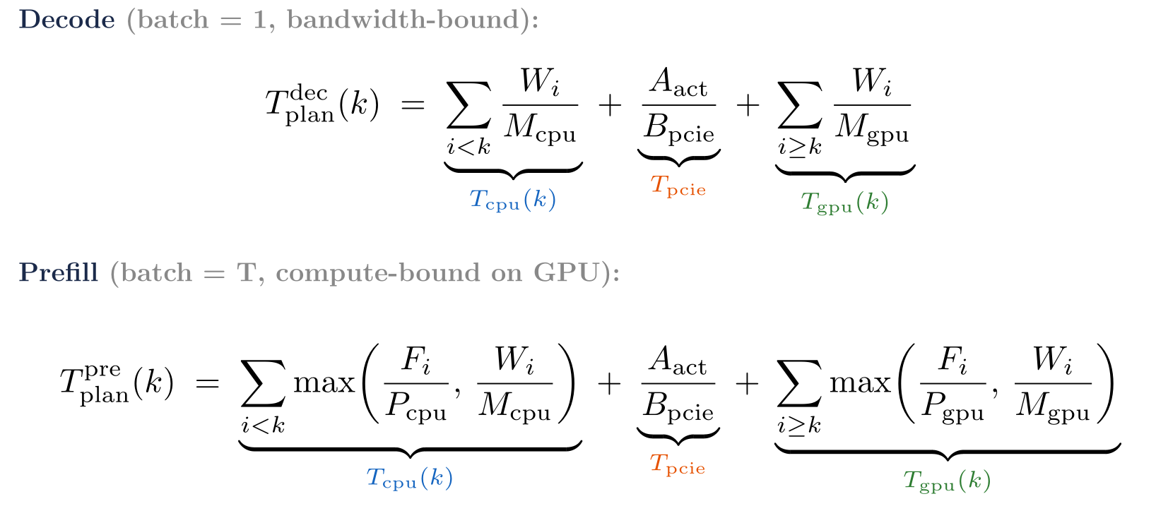
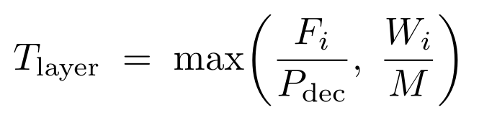
Building the Cost Model
From HELM IR we get :
From Hardware Profiling we get :
F_{i} : Flops per forward pass
W_{i} : parameters bytes (FP16)
A_{i} : Activation bytes at device boundary (i.e. PCIe)
P_{device} : Peak effective flops of that device
M : Achievable DRAM bandwidth
B_{PCIe} : Achievable PCIe abndwidth
Roofline Cost per layer :
Roofline Cost for
the entire placement :
Notes:
With the HELM IR and hardware profile in hand, we can now build the cost model.
From the IR we get F_i (FLOPs), W_i (parameter bytes), and A_i (activation bytes at the device
boundary). From hardware profiling we get P_dec (effective FLOPS in GEMV regime), M (achievable
DRAM bandwidth), and B_pcie (achievable PCIe bandwidth).
The roofline cost per layer is: T_layer = max(F_i / P_dec, W_i / M).
For decode at batch=1, arithmetic intensity is 1 FLOP/byte, so the bandwidth term always dominates
and T_layer reduces to W_i / M. The decode plan cost is therefore:
T_plan_decode(k) = sum_{i<k} W_i/M_cpu + A_act/B_pcie + sum_{i>=k} W_i/M_gpu.
Purely bandwidth-driven — the compute term never matters here.
For prefill, batch size is T (all input tokens), arithmetic intensity scales with T, and the GPU
GEMM becomes compute-bound. So prefill uses the full roofline:
T_plan_prefill(k) = sum_{i<k} max(F_i/P_cpu, W_i/M_cpu) + A_act/B_pcie + sum_{i>=k} max(F_i/P_gpu, W_i/M_gpu).
Here F_i/P_dec actually matters on the GPU side.
k* is chosen by minimizing T_plan_decode, since decode latency is the primary bottleneck for
autoregressive generation. The same k* is then applied to prefill as well.

Slide 11
Searching for the minimum-latency CPU–GPU partition
Exhaustive search over all L+1 split points at compile time
VRAM feasibility check first, OOM splits are skipped
k* = min (T_plan(k)), lowest estimated decode latency
O(L) search, completes in less than 1ms
k* leans toward fewer CPU layers, GPU is faster, VRAM is the constraint
Notes:
Finding k* is a simple exhaustive search over all L+1 possible split points.
For each candidate k, we first do a VRAM feasibility check — if the GPU stage requires more memory
than is available, we skip it. For all feasible k, we evaluate T_plan(k) using the cost model. k*
is the split with the lowest estimated decode latency.
This is an O(L) search that completes in under 1ms — it's not the bottleneck. The key insight from
the bar chart is that k* leans toward fewer CPU layers, because GPU bandwidth is higher. The cost
model penalizes every CPU layer with the DRAM bandwidth cost, so it naturally pushes as many layers
to GPU as the VRAM constraint allows.

Slide 12
HELM eliminates per-token weight movement with static execution graphs
Once the optimal split k* is found, HELM re-construct the FX graphs into two independent per-device subgraphs
CPU Graph :
FP16 weights for CPU stage layers are pre-loaded into DRAM once at startup
AVX2 kernel is patched at compile time to utilize CPU’s SIMD capabilities
Output activation is buffered and stage for PCIe transfer
GPU Graph :
FP16 weights for GPU stage layers are pre-loaded into VRAM once at startup
Recieves single activation tensor from PCIe continues forward pass
Utilizes existing PyTorch GPU kernels
How this helps :
No weights transfers during inference
Only a small activation tensor crosses the device boundary
No weights streaming overhead
Notes:
Once k* is found, HELM reconstructs the FX graph into two independent per-device subgraphs.
The CPU graph covers layers 0 to k*. FP16 weights are pre-loaded into DRAM once at startup.
The AVX2+F16C kernel is patched in at compile time. The output activation is buffered for PCIe
transfer, and the graph topology is fixed — no runtime recompilation ever happens.
The GPU graph covers layers k* to N. FP16 weights are pre-loaded into VRAM once at startup.
It receives a single activation tensor from PCIe and continues the forward pass using standard
PyTorch GPU kernels.
What this eliminates is the O(L) weight transfers per decode step that streaming systems pay.
HELM replaces this with a single O(1) activation transfer — only 2H bytes at decode time.

Slide 13
A custom AVX2 kernel enables efficient CPU execution
PyTorch does not utilize FP16 GEMV kernel for x86, it falls back to a scalar loop. HELM ships a JIT-compiled AVX2+F16C kernel that reaches the DRAM bandwidth ceiling, which is required for the roofline cost model to be correct.
PyTorch FP16 Fallback :
Achieves only ~ 3.7 GB/s, far below DDR4, DDR5 ceiling of 40-50 GB/s
Even if you find the optimal partition here, latency doesn’t improves significantly
CPU stage becomes compute-bound, not memory-bound
AVX2 kernel :
loads 16 FP16 weights per AVX2 register (16x16 = 256 bit)
Achieves ~50 GB/s at the practical DDR4 ceiling
JIT Compiled on the first use via cpp.extension.load , cached on disk
Without AVX kernel roofline assumption breaks and k* is wrong
Notes:
There's a subtle but critical implementation requirement here.
PyTorch has no native fp16 GEMV kernel for x86. It falls back to a scalar loop that achieves only
about 3.7 GB/s — far below the DDR4/DDR5 ceiling of 40 to 50 GB/s. If you run the cost model's
bandwidth assumption with this fallback in place, the CPU stage is 10 times slower than predicted,
and k* will be completely wrong.
HELM ships a JIT-compiled AVX2+F16C GEMV kernel that fixes this. The F16C instruction set provides
hardware fp16-to-fp32 conversion. We load 16 fp16 weights per AVX2 register — that's 256 bits —
convert with _mm256_cvtph_ps, and accumulate with _mm256_fmadd_ps. This achieves approximately
50 GB/s, at the practical DDR4 ceiling.
This is not just an optimization — it's a correctness requirement. Without it, the roofline
assumption breaks and k* is wrong.

Slide 14
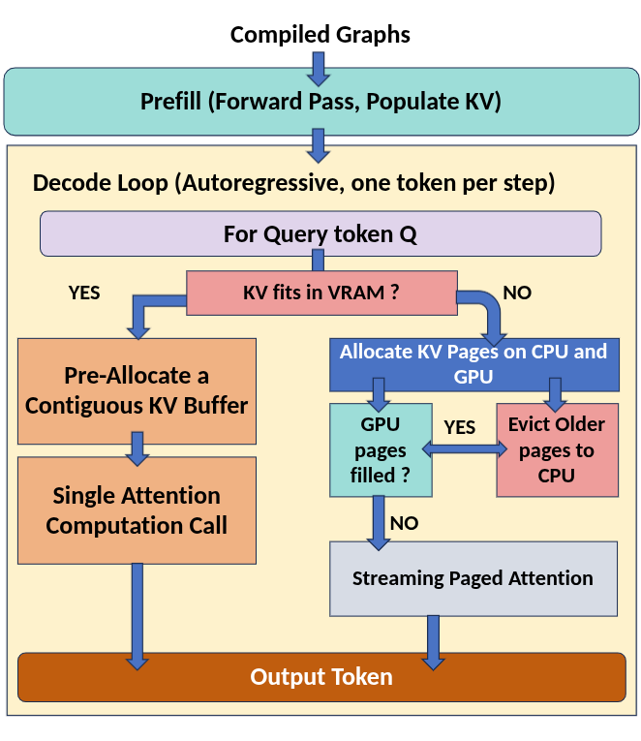
HELM Runtime
Static compiled graphs eliminate recompilation overhead, the same graphs execute every decode step
Two-path KV design handles both memory-constrained and unconstrained hardware with a single runtime
Streaming Paged Attention is only triggered when needed, no overhead on hardware where KV fits in VRAM
Notes:
At runtime, HELM executes two phases.
First is prefill: the compiled graphs run a forward pass over all input tokens and populate the
KV cache.
Then comes the autoregressive decode loop. At each step, we check whether the KV cache fits in
VRAM. If yes — the fast path — we pre-allocate a contiguous KV buffer and run a standard single
attention computation call.
If KV doesn't fit, we take the paged path: KV pages are allocated across both CPU and GPU. If GPU
pages are filled, older pages are evicted to CPU RAM. Then streaming paged attention runs over the
paged layout.
Two important properties: the same compiled graphs run every decode step, so there's zero
recompilation overhead. And streaming paged attention is only triggered when needed — there's no
overhead on hardware where KV fits in VRAM.

Slide 15
Streaming Paged Attention
How We Page the Attention
KV cache split into fixed-size pages; allocated on demand, tracked in a page table, no contiguous VRAM reservation
Watermark (80% VRAM) triggers LRU eviction cold pages spilled to CPU RAM over PCIe
How Streaming Paged Attention Works
Only pages needed for the current window are prefetched into VRAM; GPU runs online softmax page-by-page as they arrive
Partial softmax stats are merged into a running accumulator final token produced after all pages streamed, VRAM footprint stays constant
Notes:
Let me explain how paged attention works in HELM.
The KV cache is divided into fixed-size pages allocated on demand and tracked in a page table —
no contiguous VRAM reservation is needed. When VRAM hits an 80% watermark, LRU eviction kicks in
and cold pages are spilled to CPU RAM over PCIe.
When the GPU runs attention, only the pages needed for the current window are prefetched into VRAM.
The GPU compute unit runs online softmax page-by-page as each page arrives. Partial softmax
statistics are merged into a running accumulator — so the final output token is produced after all
pages are streamed, with constant VRAM footprint regardless of sequence length.
The animation here shows this: initial state with pages in both VRAM and RAM, the watermark being
hit, eviction of the bottom row, prefetch of needed pages back to VRAM, and then computation.

Slide 16
HELM enables efficient LLM inference on memory-constrained systems
Contributions
Compiler-driven heterogeneous inference : Formulate CPU-GPU layer placement as a compile-time problem, static per-device execution graphs eliminate per-token weight transfers.
Hardware-calibrated roofline partitioning : Transformer block level cost modeling using measured FLOPS, memory bandwidth, and PCIe costs, leading to optimal partition search.
AVX2+F16C GEMV kernel : JIT compiled C++ kernel using F16C and AVX2 FMA, achieves near peak bandwidth on CPU decode, replacing pytorch’s unoptimized FP16 path.
Paged KV Cache with streaming attention : KV Cache manager decouples context length from GPU memory via paging, and streaming online-softmax attention bounds GPU memory usage without sacrificing the throughput
Notes:
Let me now summarize the four contributions of this thesis before moving to results.
Contribution 1 is compiler-driven heterogeneous inference: formulating CPU-GPU layer placement as
a compile-time problem, with static per-device execution graphs that eliminate per-token weight
transfers.
Contribution 2 is hardware-calibrated roofline partitioning: transformer block-level cost modeling
using measured FLOPS, memory bandwidth, and PCIe costs, leading to an optimal partition search.
Contribution 3 is the AVX2+F16C GEMV kernel: a JIT-compiled C++ kernel that achieves near-peak
bandwidth on CPU decode, replacing PyTorch's unoptimized FP16 path.
Contribution 4 is the paged KV cache with streaming attention: decoupling context length from GPU
memory via paging, with online softmax streaming that bounds VRAM usage without sacrificing
throughput.

Slide 17

Evaluating increasingly large models on affordable, memory-constrained hardware
Hardware Configurations
Models (all in FP16)
System | GPU | CPU
1. | RTX 4060 Laptop GPU (8GB) | Intel i7-13700H (16GB)
2. | RTX 3090 (24GB) | AMD EPYC 7H12 (125GB)
3. | NVIDIA L40S (48GB) | AMD EPYC 7413 (60GB)
Qwen3 - 4B
Qwen3 - 8B
Qwen3 - 14B
Qwen3 - 32B
Baselines
vLLm
Accelerate
DeepSpeed
Notes:
For evaluation, we test on three hardware configurations: an RTX 4060 Laptop GPU with 8 GB VRAM
paired with an Intel i7-13700H, an RTX 3090 with 24 GB paired with AMD EPYC, and an NVIDIA L40S
with 48 GB paired with another EPYC.
We test four Qwen3 models in FP16: 4B, 8B, 14B, and 32B, giving us 12 model-hardware combinations.
Our baselines are vLLM, Accelerate, and DeepSpeed

Slide 18
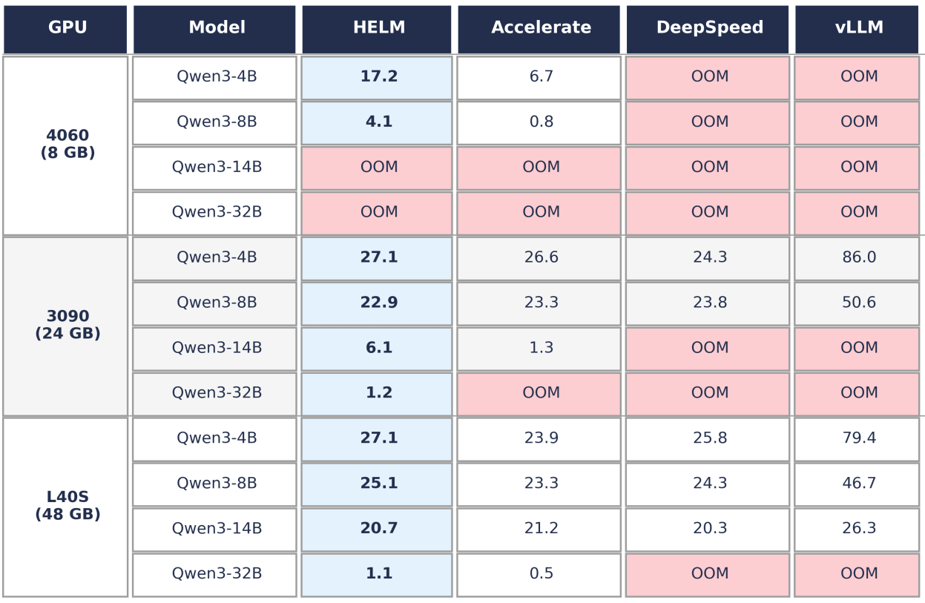
Claim 1 : HELM sustains inference where existing systems fails (OOM)
HELM is the only backend that runs all 12 Model x hardware configurations
vLLM and DeepSpeed fail to initialise on the RTX 4060 entirely
On the RTX 3090, both OOM on Qwen3-14B and 32B despite having 24 GB VRAM
Accelerate handles some cases but OOMs on Qwen3-32B across all systems
Notes:
Our first claim is that HELM is the only system that runs all 12 model-hardware configurations
without OOM.
Looking at the 4060 with 8 GB VRAM: vLLM and DeepSpeed fail to initialize on every model.
Accelerate manages to run 4B and 8B but at much lower throughput. HELM runs both successfully.
On the RTX 3090 with 24 GB, even Qwen3-14B and 32B cause OOM in vLLM and DeepSpeed despite
having 24 GB VRAM — because weights plus KV cache together overflow. HELM handles both.
Accelerate covers more cases but still OOMs on Qwen3-32B across all three systems.
HELM is the only backend in this evaluation that never fails due to memory.

Slide 19
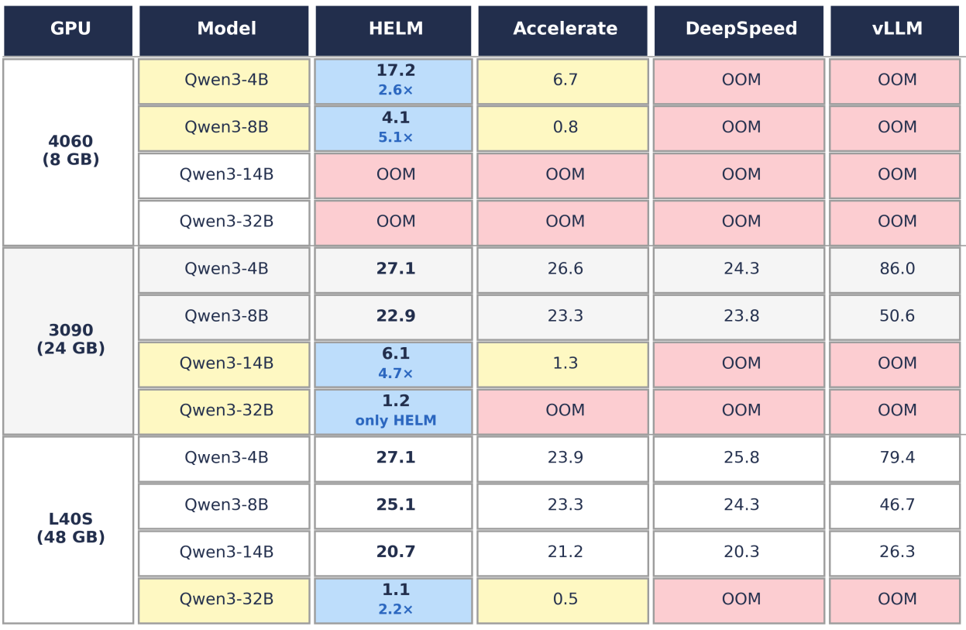
Claim 2 : HELM achieves significantly higher throughput and lower latency
Up to 5.1x higher decode throughput over the best feasible baseline (4060, Qwen3-8B)
Mean 3.6x speedup across all memory-constrained configurations
On unconstrained hardware (L40S, models ≤ 14B), HELM matches baselines within 5% compile-time overhead is negligible when no CPU offloading is needed
Notes:
Beyond just running, HELM runs significantly faster.
On the RTX 4060 with Qwen3-8B, HELM achieves 4.1 tok/s versus Accelerate's 0.8 — that's a 5.1x
speedup. On the 3090 with Qwen3-14B, HELM achieves 6.1 tok/s versus Accelerate's 1.3 — a 4.7x
speedup.
The mean speedup across all memory-constrained configurations is 3.6x over the best feasible
baseline.
On unconstrained hardware — the L40S running models up to 14B where everything fits in VRAM —
HELM matches baselines within 5%. The compile-time overhead is negligible when no CPU offloading
is needed. The system doesn't hurt you when it's not needed.

Slide 20
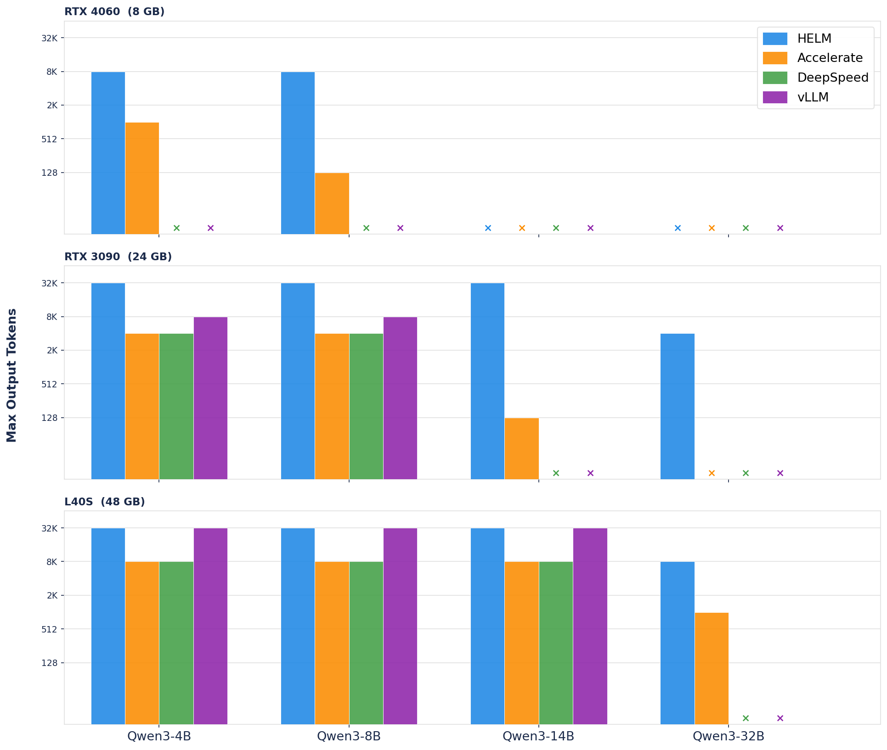
Claim 3 : HELM enables significantly longer context lengths
GPU-only backends exhaust VRAM after weights load context ceiling is set by leftover VRAM, not the model's native 32K window HELM pages KV entries to host RAM, shifting the ceiling from VRAM to the much larger host memory pool
RTX 4060: HELM reaches 8K on both 4B and 8B, 8× over Accelerate on 4B, 64× on 8B. DeepSpeed and vLLM produce no output at all
RTX 3090: HELM reaches full 32K on 4B, 8B, and 14B; vLLM caps at 8K, Accelerate at 4K/128 tokens
L40S: HELM matches vLLM on all models that fit in VRAM; reaches 8K on 32B while DeepSpeed OOMs and vLLM fails to load
Notes:
The third claim is about context length. GPU-only backends exhaust VRAM after weights load, so
their context ceiling is set by leftover VRAM — not the model's native 32K window. HELM pages
KV entries to host RAM, shifting that ceiling to the much larger host memory pool.
On the RTX 4060: HELM reaches 8K context on both 4B and 8B. That's 8x over Accelerate on 4B,
and 64x on 8B. DeepSpeed and vLLM produce no output at all.
On the RTX 3090: HELM reaches full 32K context on 4B, 8B, and 14B. vLLM caps at 8K, Accelerate
at 4K to 128 tokens depending on the model.
On the L40S: HELM matches vLLM on all models that fit in VRAM, and reaches 8K on 32B where
DeepSpeed OOMs and vLLM fails to load.

Slide 21
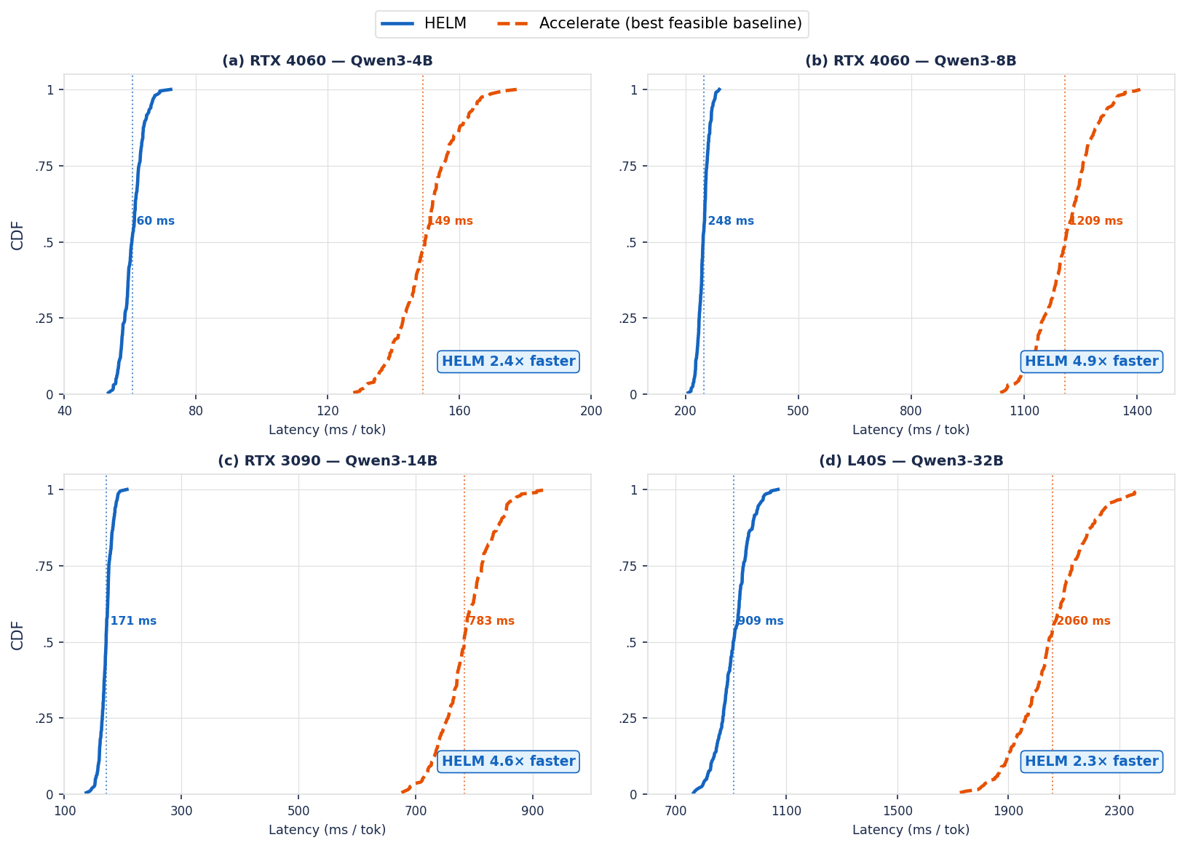
Optimal partitioning is critical for performance
- When a model exceeds VRAM, layers are split across CPU and GPU, the split point directly determines throughput
- A suboptimal split either bottlenecks on slow CPU DRAM bandwidth or runs out of GPU memory
- HELM exhaustively searches all feasible splits at compile time and selects the plan that best balances CPU and GPU bandwidth, Accelerate uses a greedy load-time heuristic with no search
- Result: 2.4x – 4.9x lower p50 latency across all memory-constrained configurations
Notes:
Let me first explain the plot type. These are CDF — cumulative distribution function — plots.
The x-axis is per-token latency in milliseconds. The y-axis is the fraction of tokens generated
at or below that latency. A curve that rises steeply at a low x value means the system is fast
and consistent. A curve shifted to the right means it's slower. The p50 — the median latency —
is where the curve crosses 0.5. You want your curve as far left as possible.
HELM's curves (solid blue) rise steeply at much lower latency than Accelerate (dashed orange) in
every memory-constrained configuration.
This is because the split point directly determines throughput when a model exceeds VRAM. Assign
too few layers to CPU and you OOM. Assign too many and you bottleneck on slow CPU DRAM bandwidth.
Accelerate fills the GPU greedily at load time with no search. HELM exhaustively evaluates all
feasible splits using the cost model and picks the one that minimizes T_plan.
The result: 2.4x to 4.9x lower p50 latency. The gap is largest on the 8B model on the 4060 and
the 14B on the 3090 — exactly where the partition choice matters most.

Slide 22
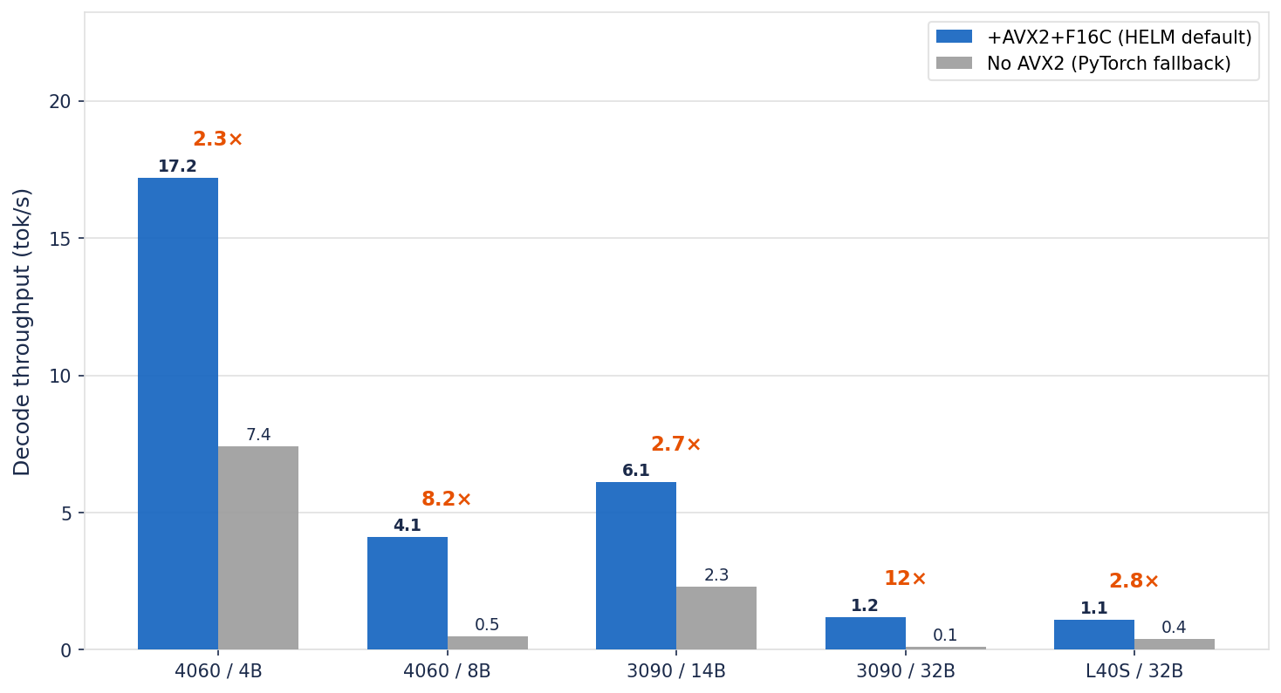
Efficient CPU execution is necessary to realize the partition benefits
- Decode on CPU is memory-bandwidth bound GEMV reads the full weight matrix from DRAM every token
- HELM's AVX2+F16C kernel saturates CPU DRAM bandwidth; PyTorch's fallback is
significantly slower
- Impact scales with CPU stage size, 43 CPU layers on Qwen3-32B causes an 11× collapse
without AVX2
- No effect when all layers fit in VRAM, the gain is purely from CPU execution
Notes:
Even with the right partition, you can't realize the gains without efficient CPU execution.
CPU decode is memory-bandwidth-bound — GEMV reads the full weight matrix from DRAM every token.
HELM's AVX2+F16C kernel saturates CPU DRAM bandwidth. PyTorch's scalar fallback does not.
The bar chart shows the impact. On the 4060 with 4B, the AVX2 kernel gives a 2.3x speedup —
17.2 tok/s versus 7.4 without. On the 4060 with 8B, which has more CPU layers, it's 8.2x —
4.1 versus 0.5. On the 3090 with 32B, which has 43 CPU layers, the speedup is 12x — without
AVX2, throughput collapses to 0.1 tok/s.
The effect scales directly with the size of the CPU stage. On the L40S with small models where
everything fits in VRAM, AVX2 makes no difference — both bars are identical. The kernel only
matters when CPU execution is active, but when it is, it is not optional.

Slide 23
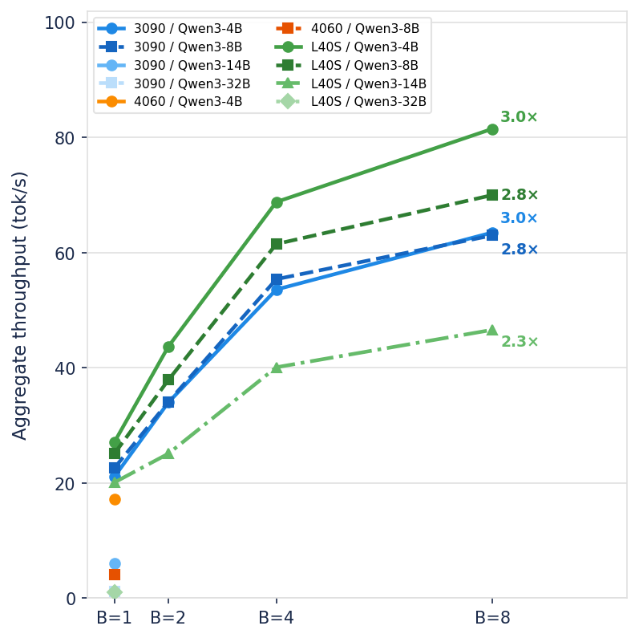
Efficient KV Management Enables Concurrent Request Processing
HELM's paged KV offload keeps VRAM free from KV cache growth, leaving headroom for concurrent requests
When all layers fit in VRAM, throughput scales near-linearly with batch size, up to 3× at B=8.
Without paged KV, VRAM is fully occupied by weights and KV cache, batch>1 immediately OOMs
Notes:
The fourth benefit of HELM's paged KV design is throughput scaling with batch size.
When all layers fit in VRAM — as on the 3090 and L40S with smaller models — throughput scales
near-linearly with batch size, reaching 3x aggregate throughput at batch size 8.
This is because HELM's paged KV offload keeps VRAM free from KV cache growth, leaving headroom
for concurrent requests. Without paged KV, VRAM is fully occupied by weights and KV cache, and
batch size greater than 1 immediately OOMs.
On constrained hardware like the 4060, the KV offload is what enables any batching at all —
without it, you can't even fit two requests simultaneously.

Slide 24
HELM opens several directions for heterogeneous inference research
1. Multi-device topologies. Extending the partition search to multi-GPU and heterogeneous multi-device topologies utilizing parallelism strategies.​ ​
2. Quantized execution. Supporting quantised execution paths (INT4/INT8 via bit-
sandbytes, AWQ, or GGUF).​
​ 3. Mixture-of-Experts (MoE) models. Extending the partition search to sparse MoE architectures.​
​ 4. Vision-language models (VLMs). Supporting models with a vision encoder prepended to the language backbone.​
​

Slide 25
Compile-time placement and heterogeneous execution enables LLM inference beyond GPU memory limits
HELM treats CPU-GPU inference as a compile-time optimisation problem, finding the globally optimal partition before the first token is generated.
Results:
Only backend that runs all 12 model×hardware configurations without OOM
Up to 5.1× higher decode throughput and 4.9× lower per-token latency over the strongest feasible baseline; mean 3.6× speedup across all constrained pairs
Reaches the full native 32K context window where host RAM allows; extends context substantially even on the most constrained systems
Negligible overhead (within 5%) when all weights fit in VRAM, no penalty on unconstrained hardware
Takeaway : The memory wall is not a hard barrier. A principled compile-time approach, grounded in hardware measurement rather than heuristics, sustains efficient LLM inference across a broad range of configurations, without quantization, multi-GPU infrastructure, or cloud resources.
Submitted to ESWEEK
Notes:
That concludes my presentation. The core result is that by moving layer placement decisions to
compile time, HELM enables heterogeneous LLM inference that is feasible where others fail, up to
5.1x faster, supports 32K context on memory-constrained hardware, and scales throughput with
concurrent requests — all with no degradation in model quality.
I'm happy to take questions. Thank you.

