Slide 1
Crossroads - A Time-Sensitive Autonomous Intersection Management Technique
Edward Andert, Mohammad Khayatian, Aviral Shrivastava
Arizona State University

Slide 2
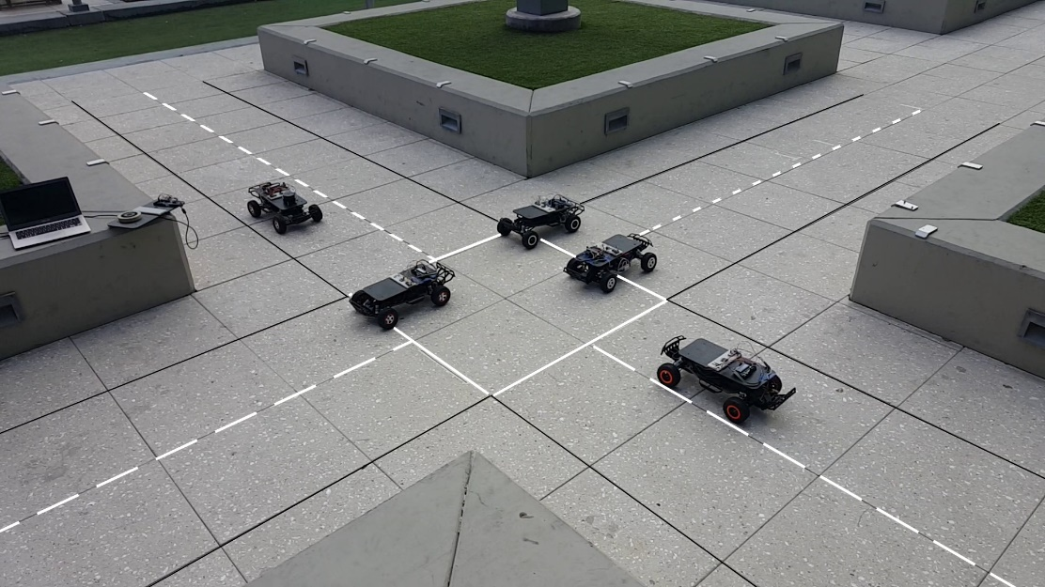
Testbed for our Scale Model
“1/10 scale” model of an intersection
Arduino Mega 2560 is used as the main controller.
Arduino Nano is used for monitoring encoder data.
Network is handled by 2.4GHz transceivers.
Intersection manager platform a laptop and program is implemented in Matlab®

Slide 3
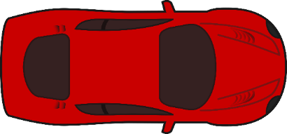





Model Specifications
Single lane intersection
${Lane}_{Width}$ = 0.605 m
Request line distance from intersection= 3 m
${Vehicle}_{Length}=$0.568 m
${Vehicle}_{Width}=$0. 296 m
Request
Line
Request
Line
1
1
1
$${Vehicle}_{Length}$$
1
$${Request}_{LineDist}$$
Request
Line
Request
Line
$${Vehicle}_{Width}$$
$${Lane}_{Width}$$

Slide 4


Velocity Transaction Intersection Management
When a vehicle reaches request line, transmits its current and destination lane, speed and position.
Intersection Manager processes the received data and returns a target velocity to vehicle.
Vehicle execute the command when the receives the new target velocity.
We will call this “Velocity Transaction Intersection Management” or VT-IM.
Request
Line
Request
Line
1
1
1
$${Request}_{LineDist}$$
Request
Line
1
Request
Line
$${Lane}_{Width}$$
Notes:
One way to implement, define charecteristics

Slide 5
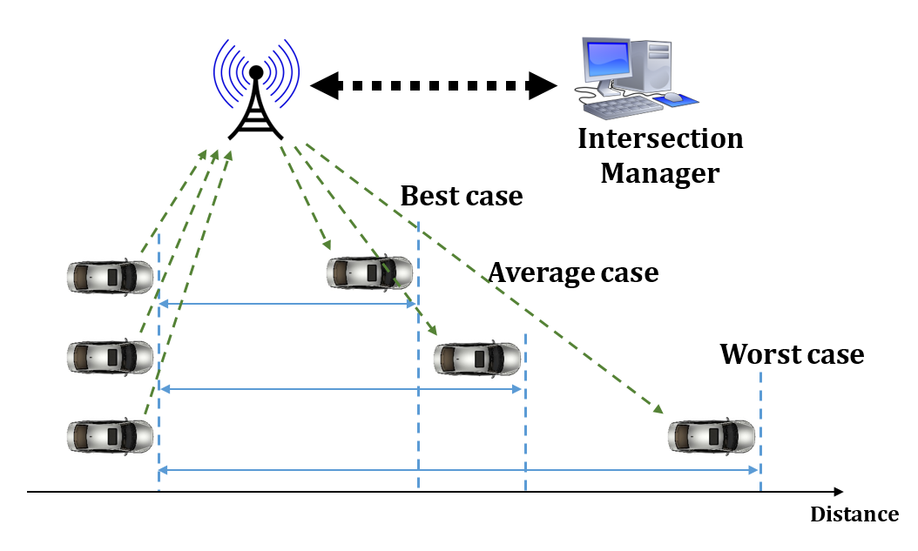




VT-IM (Velocity Transaction Intersection Management)
Intersection Manager
$V_{T}=$ 3.0
$V_{T}=$ 2.5
Request Line
Enter
Exit
Notes:
When the car reaches the request line, sends its info (speed, in/out lane, position, ID, etc.) to IM.
IM processes the data considering the other cars which are already in the intersection and send back the target velocity to the car.
Car tracks the received target velocity as soon as it receives the command.

Slide 6
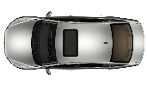
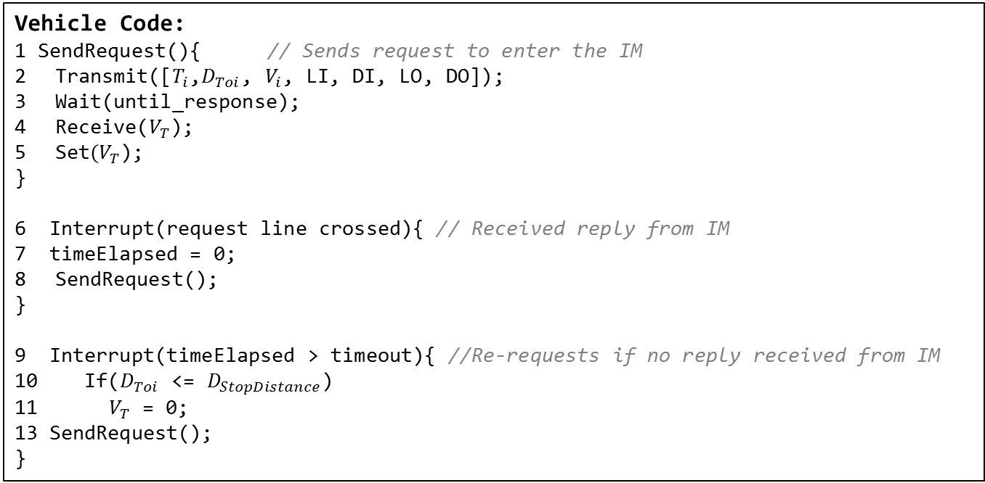
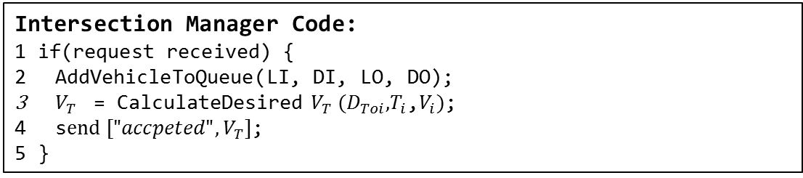
VT-IM Pseudo-Code
Vehicle Code:
1 SendRequest(){ // Sends request to enter the IM
Transmit([${T_{i}\text{,} D}_{Toi}$, $V_{i}$, LI, DI, LO, DO]);
Wait(until_response);
Receive($V_{T}$);
Set$(V_{T}$);
}
6 Interrupt(request line crossed){ // Received reply from IM
7 timeElapsed = 0;
SendRequest();
}
9 Interrupt(timeElapsed > timeout){ //Re-requests if no reply received from IM
10 If($D_{Toi}$ <= $D_{StopDistance}$)
11${ V}_{T}$ = 0;
13 SendRequest();
}
Intersection Manager Code:
1 if(request received) {
AddVehicleToQueue($\text{LI}\text{, }\text{DI}\text{, }\text{LO}\text{, }\text{DO}$);
$V_{T}$ = CalculateDesired $V_{T} (D_{Toi}\text{,}T_{i}\text{,}V_{i})$;
s$end ["{accpeted", V}_{T}]$;
5 }
Notes:
More to algorithm, not present here for berevity

Slide 7
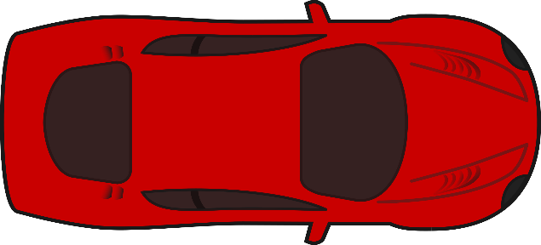






VT-IM Must Account for Position Uncertainty
For safe operation, the intersection manager should take into account all kinds of errors and uncertainties in the system.
Sensor Error (GPS, encoder, etc.)
Time Synchronization Error (Synchronization accuracy, clock precision, etc.)
Tracking Error (delays due to dynamics of the system and controller parameter)
Error is modelled as a Safety Buffer around the vehicle:
$$E_{Long}$$
$$L$$
$$E_{Long}$$
$$E_{Lat}$$
$$W$$
$$E_{Lat}$$

Slide 8







How Large is the Safety Buffer
Using our real-life implementation, we measured how big a Safety Buffer needed to be.
${Vehicle}_{Length}=$0.568 m
$E_{Long}=$0.15m @ $V_{Max} of our\frac{1}{10}model, 3.5m/s$, 12.6km/h, 7.8 mph
$$E_{Long}$$
$$L$$
$$E_{Long}$$
$$E_{Lat}$$
$$W$$
$$E_{Lat}$$
Notes:
We measured worst case error for safety buffer by comparing expected position and actual one.

Slide 9





Large Safety Buffer Lowers Throughput
Intersection Manager
$${V_{T}=3.0}_{}$$
$${V_{T}=2.5}_{}$$
$${V_{T}=1.5}_{}$$
Request Line
Enter
Exit

Slide 10


Defining the Timing Problem
Round Trip Delay (RTD) is being ignored
Caused by computation delay and network delay.
Request Position
Actual Receive Position (ARP)
IM
$$P_{r}$$
Best
Worst
Average
Worst Case Receive Position Difference
Expected Message Receive Position
Actual Receive Position =$P_{r}+(RTD ∗V)$

Slide 11



Time Delays Will Cause Crashes
Intersection Manager
$${V_{T}=3}_{}$$
$${V_{T}=2.5}_{}$$
Request Line
Notes:
Depending on network delay and IM computation time, vehicle receives the target velocity with some delays.

Slide 12
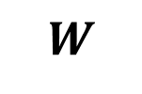






Accounting for Delays
A real intersection manager must also take into account delay in the system.
Transmission Delay
Computation Delay
Summation: Round Trip Delay (RTD)
In existing implementations, delays will have to be modeled as additional Time Buffer around the vehicle:
123.791 milliseconds
(Source: our implementation)
36.885 milliseconds
(Source: our implementation)
150 milliseconds
(Source: our implementation)
$$E_{Long}$$
$$L$$
$$E_{Long}$$
$$E_{Delay}$$
$$E_{Lat}$$
$$W$$
$$E_{Lat}$$

Slide 13
Real-life Computation and Network Delay

Slide 14








How Large is the RTD Buffer
Using our real-life implementation, we measured how big a Safety Buffer considering RTD needed to be.
$E_{Delay}=3.5×0.15=0.525$ ($V_{Max} in our\frac{1}{10}model is 3.5m/s$)
3x $E_{Long}$
$$E_{Long}$$
$$L$$
$$E_{Long}$$
$$E_{Delay}$$
$$E_{Lat}$$
$$W$$
$$E_{Lat}$$

Slide 15
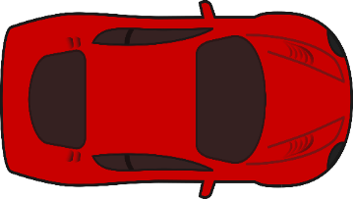
How Large is the RTD Buffer
Using our real-life implementation, we measured how big a Safety Buffer considering RTD needed to be.
3.46x Original Vehicle Length
Adding the safety buffer due to timing error will degrade the throughput.

Slide 16
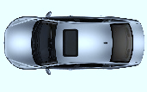
Our Approach: Crossroads
We set the execution location (execution time) according to the Worst-Case Round-Trip Delay (WCRTD) on our system.
E$xecution Position=Request Position + VMAX×(WCRTD)$
Execution Position
Request Position
IM
Actual Receive Position
Best
Worst
Average
Actuation Begins
Actuation Begins
Expected Message Execution Position = EP
Notes:
Different animation, show 2 cars with different RTDs being fixed by execution position
Fix animation with expected location

Slide 17

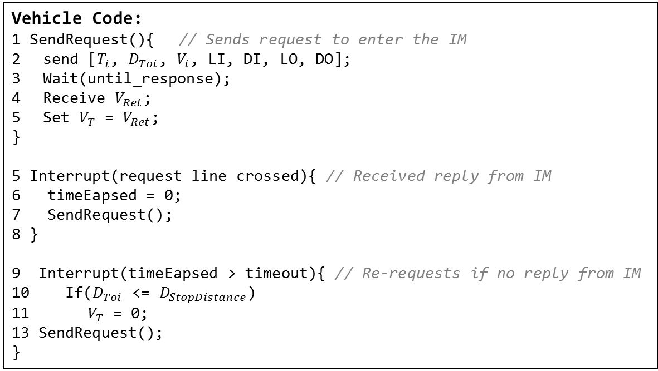
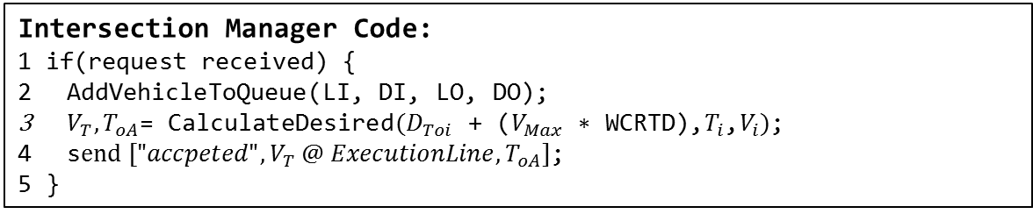
Crossroads Code
Vehicle Code:
1 SendRequest(){ // Sends request to enter the IM
send [${T_{i}\text{,} D}_{Toi}$, $V_{i}$, LI, DI, LO, DO];
Wait(until_response);
Receive $V_{Ret}$;
Set $V_{T}$ = $V_{Ret}$;
}
5 Interrupt(request line crossed){ // Received reply from IM
6 timeEapsed = 0; 7 SendRequest();
8 }
9 Interrupt(timeEapsed > timeout){ // Re-requests if no reply from IM
10 If($D_{Toi}$ <= $D_{StopDistance}$)
11${ V}_{T}$ = 0;
13 SendRequest();
}
Intersection Manager Code:
1 if(request received) {
AddVehicleToQueue($\text{LI}\text{, }\text{DI}\text{, }\text{LO}\text{, }\text{DO}$);
$V_{T},T_{oA}$= CalculateDesired$(D_{Toi}\text{ + (}V_{Max}\text{ ∗ }\text{WCRTD}\text{),}T_{i}\text{,}V_{i})$;
s$end ["{accpeted", V}_{T} @ ExecutionLine,T_{oA}]$;
5 }
Notes:
IM calculates the desired Time of Arrival, T oA, and the execution time, TE, (actuation position PE) based on WCRTD
Fix this slide

Slide 18
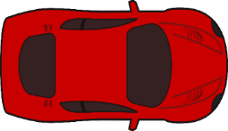
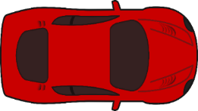
Crossroads Eliminates Time Buffer
Unlike the VT-IM methodology, Crossroads does not require a Time Buffer
~ 3.5x Original Vehicle Length -> ~ 1.5x

Slide 19
AIM (Autonomous Intersection Management)
A tested and effective FCFS (First Come First-Served) policy
Dresner and Stone propose and IM that:
Vehicle requests to entire intersection at T_{oA} and V_{oA}
IM simulates the trajectory of the vehicle
Responds YES if the trajectory has no overlap with the reserved spots of other vehicles
Responds NO otherwise.
Notes:
Must state problem - RTD is ignored – the problem is RTD is ignored

Slide 20
AIM is a query-based approach
Intersection Manager
Request Time of Entry, (TOE) Velocity of Entry
Receive Accept
Vehicle Begins Actuation
of Proposed TOE
Request Line
Enter
Exit
Notes:
Explain timing problem and how it is solved

Slide 21
AIM is a query-based approach
Intersection Manager
Request Time of Entry, (TOE) Velocity of Entry
Receive Reject
Vehicle Begins Actuation
of Proposed TOE
Request Line
Enter
Exit
Notes:
Explain timing problem and how it is solved

Slide 22
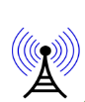
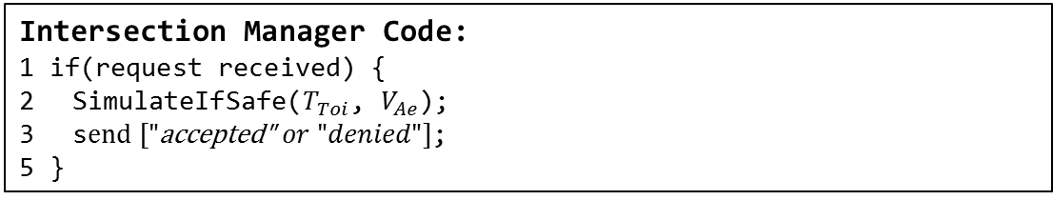
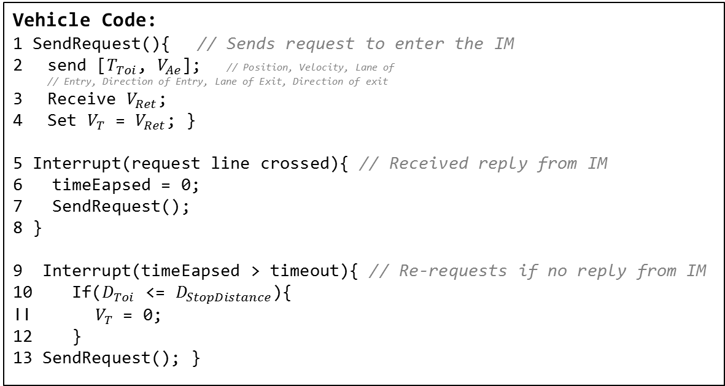
Related Work: AIM
Vehicle Code:
1 SendRequest(){ // Sends request to enter the IM
send [$T_{Toi}$, $V_{Ae}$]; // Position, Velocity, Lane of // Entry, Direction of Entry, Lane of Exit, Direction of exit
Receive $V_{Ret}$;
Set $V_{T}$ = $V_{Ret}$; }
5 Interrupt(request line crossed){ // Received reply from IM
6 timeEapsed = 0; 7 SendRequest();
8 }
9 Interrupt(timeEapsed > timeout){ // Re-requests if no reply from IM
10 If($D_{Toi}$ <= $D_{StopDistance}$){
11${ V}_{T}$ = 0;
12 }
13 SendRequest(); }
Intersection Manager Code:
1 if(request received) {
SimulateIfSafe($T_{Toi}$, $V_{Ae}$);
s$end ["\text{accepted}\text{"} or "denied"]$;
5 }

Slide 23
Related Work: AIM
Aim was tested virtually with 1 real and a number of simulated autonomous vehicles for the Darpa 2007 challenge
AIM was implemented in real life with Four 1/10 scale vehicles
Vmax .5m/s, or at scale 18 km/h so they may have missed the problem
√ Achieves a theoretical throughput of .5 vehicles/lane/s.
√ Considers a Safety Buffer
X Computation time is large
X High communication overhead
X Many re-requests
X Cannot efficiently schedule vehicles
Notes:
AIM communication overhead
AIM cannot re-schedule effeciently

Slide 24
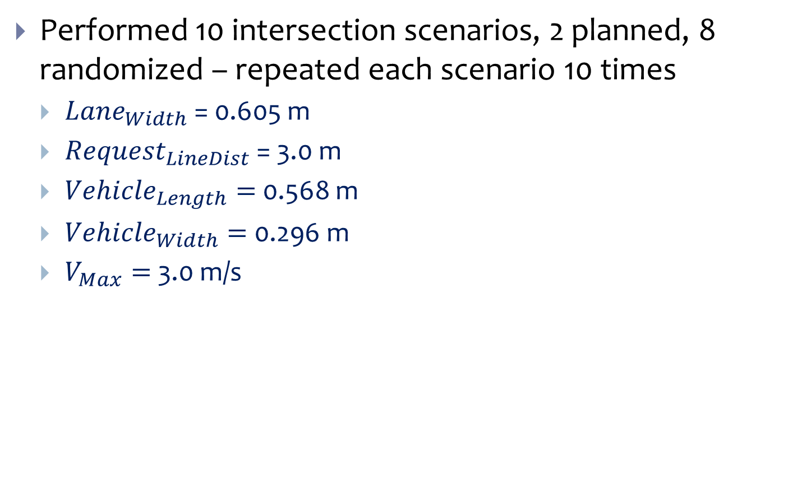
Scale Model Test Setup
Performed 10 intersection scenarios, 2 planned, 8 randomized – repeated each scenario 10 times
${Lane}_{Width}$ = 0.605 m
${Request}_{LineDist}$ = 3.0 m
${Vehicle}_{Length}=$0.568 m
${Vehicle}_{Width}=$0.296 m
$V_{Max}=$ 3.0 m/s
Request
Line
Request
Line
1
1
1
1
$${Request}_{LineDist}$$
Request
Line
Request
Line
$${Lane}_{Width}$$

Slide 25
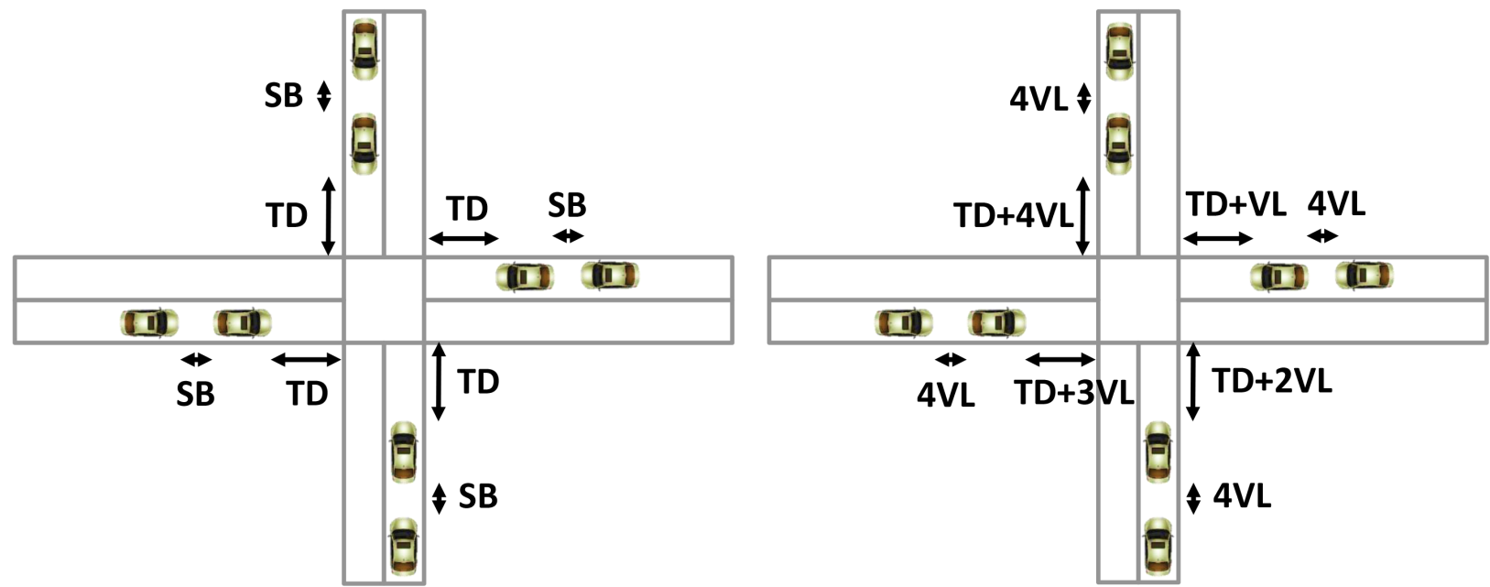
Results of Scale Models
Boundary Cases:
SB – SafetyBuffer, TD – TransmitDistance, VL – Vehicle Length
Intersection Scenario #1 Heavy Traffic Load
Intersection Scenario #10 Light Traffic Load
Scenario 1
Scenario 10
Not to scale
Not to scale

Slide 26
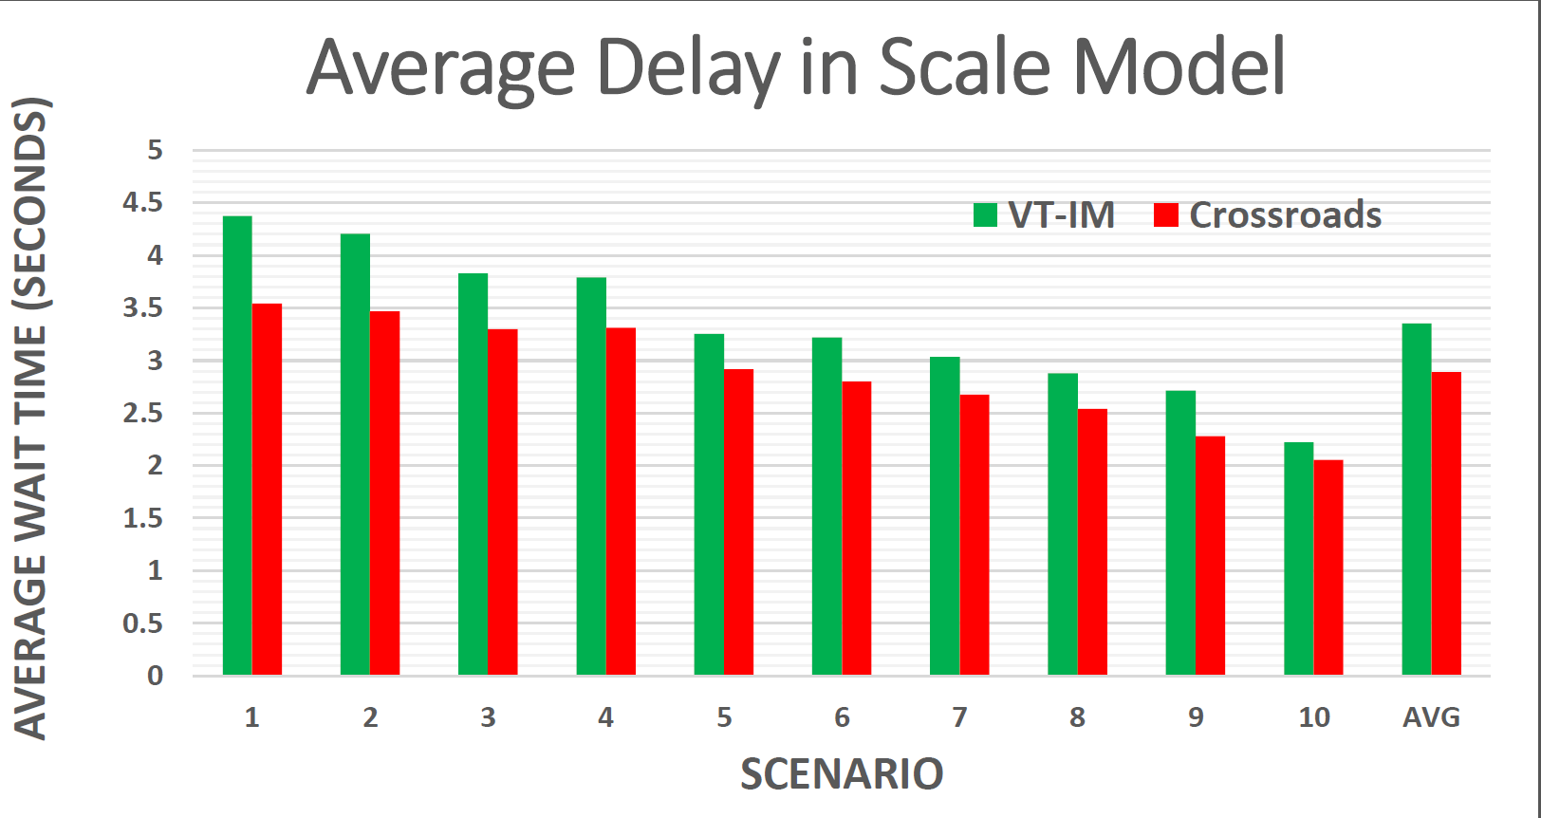
Crossroads Performs Better in Scale Tests
Heavy
Traffic
INTERSECTION SCENARIO NUMBER
Light
Traffic
Notes:
Car arrival scenarios instead

Slide 27
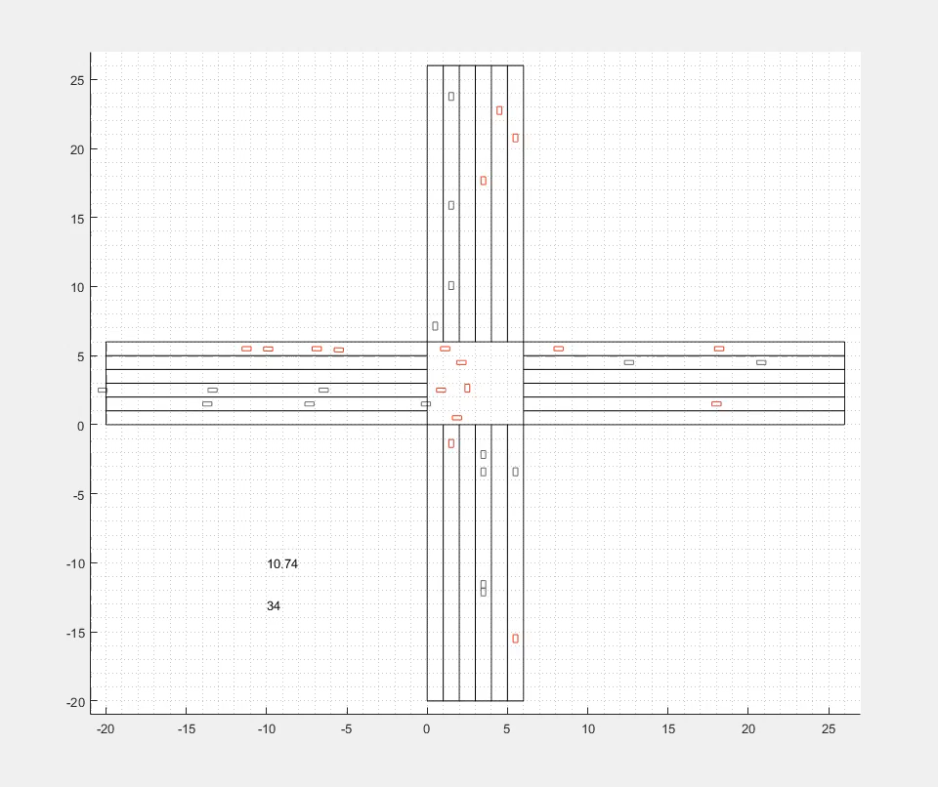
Simulation in Matlab, N=160

Slide 28
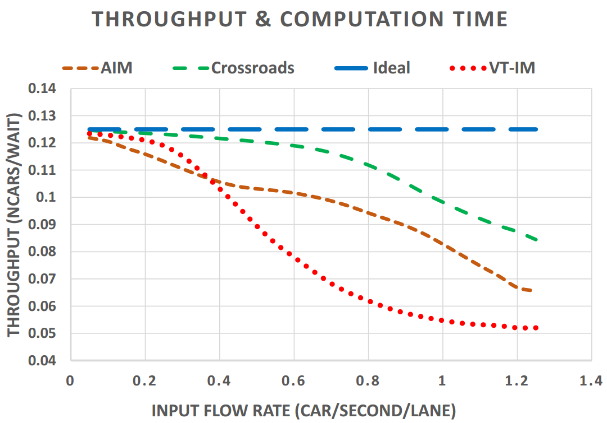
Crossroads Performs Better in Simulation
.35 Traffic
Light
Max
Flow
.5 Round-
about
Light
Max
Flow
Notes:
Figure out ideal that is possible
Mark interesting region
Mark traffic signal limits
Spend more time, add more slides

Slide 29
Conclusion
An Intersection Manager (IM) must account for position uncertainty as a Safety Buffer
Position uncertainty comes from sensors, actuators, etc.
An IM must account for timing problems as Time Buffer
Computation Delay
Network Delay
AIM approach solves timing problem with a yes/no approach.
Our technique (Crossroads) eliminates the Time Buffer
It is replaced by timestamp-based execution
Crossroads maintains high schedulablility in addition to safety, thus increasing throughput
1.62x Crossroads vs VT-IM and 1.36x Crossroads vs AIM on average
Notes:
Missing main points
Needs work

