Slide 1
Crossroads - A Time-Sensitive Autonomous Intersection Management Technique
Edward Andert
Thesis Defense – January 12th 2017
Committee: Dr. Aviral Shrivastava, Dr. Georgios Fainekos, and Dr. Heni Ben Amor

Slide 2
Autonomous Intersection Management
As cars become autonomous, so too can intersections
Why?
683 died in vehicles crashes from running red lights in 2012 (NCSR)
127,000 sustained injuries in 2012 (NCSR)
Average person estimated to wait 6 months of their life at traffic lights (http://www.thefactsite.com/2010/03/how-much-time-people-spend-doing-stuff.html)
We must design an autonomous Intersection Manager (IM) such that the following criteria are met:
Safe
High Throughput
Notes:
Inersection specific data only

Slide 3
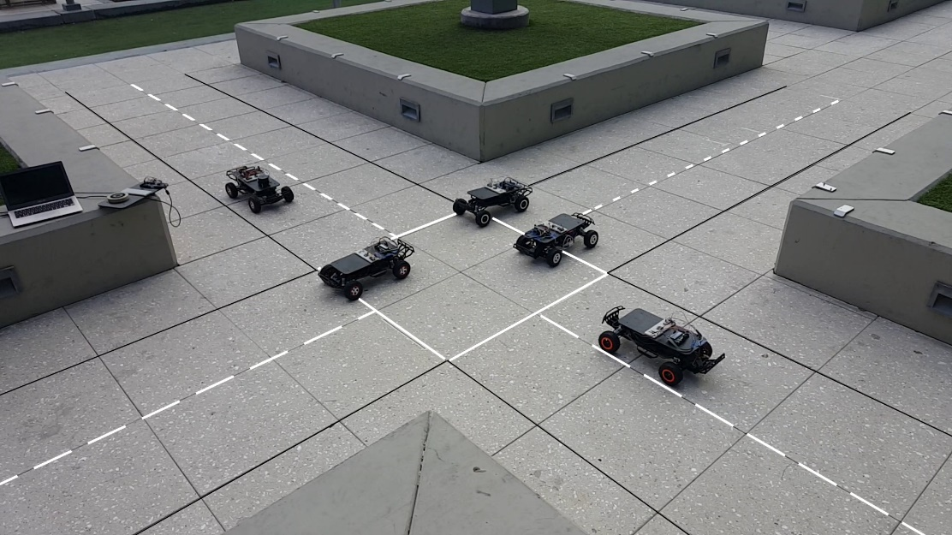
Testing Assumptions With Scale Model
“1/10 scale” model of an intersection
System supports 8 vehicles.
Vehicles are built on a Traxxas platform with Arduino Mega 2560 as a controller.
Positioning is handled by quadrature encoder attached to motor.
Network is handled by 2.4GHz transceivers.

Slide 4
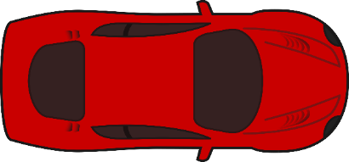





Scale Model Specifications
Single lane intersection
$N_{Lanes}$ = 1
${Lane}_{Width}$ = .605 m
${Request}_{LineDist}$ = 3 m
${Vehicle}_{Length}=$.568 m
${Vehicle}_{Width}=$. 296 m
Request
Line
Request
Line
1
1
1
$${Vehicle}_{Length}$$
$${Request}_{LineDist}$$
Request
Line
1
Request
Line
$${Vehicle}_{Width}$$
$${Lane}_{Width}$$

Slide 5
Velocity Transaction Intersection Manager (VT-IM)
Method #1 (VT-IM) - A simple approach to scheduling cars in an intersection.

Slide 6


Defining a Simple Intersection Manager
Vehicle reaches request line and transmits current speed and position
Vehicle receives new target velocity from IM.
We will call this a Velocity Transaction Intersection Manager or VT-IM.
Request
Line
Request
Line
1
1
1
1
$${Request}_{LineDist}$$
Request
Line
Request
Line
Vt-im references
$${Lane}_{Width}$$
Notes:
One way to implement, define charecteristics

Slide 7
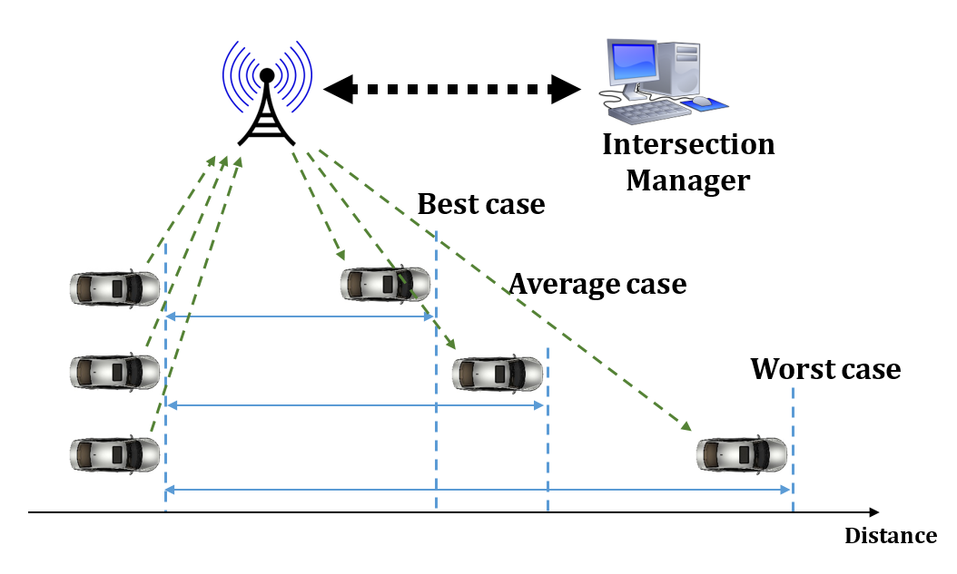




Demo VT-IM (Velocity Transaction Intersection Manager)
Intersection Manager
$V_{T}=$ 3.0
$V_{T}=$ 2.5
Request Line
Enter
Exit

Slide 8
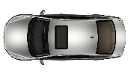
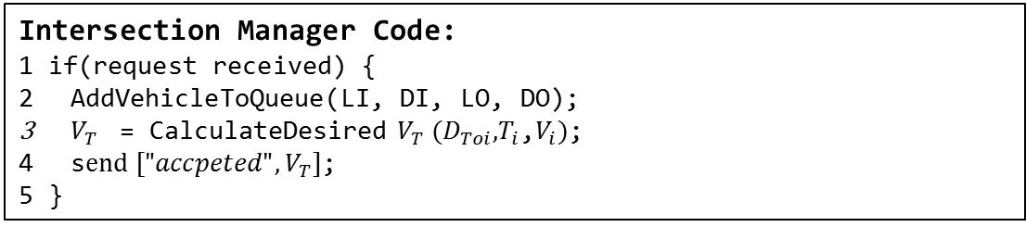
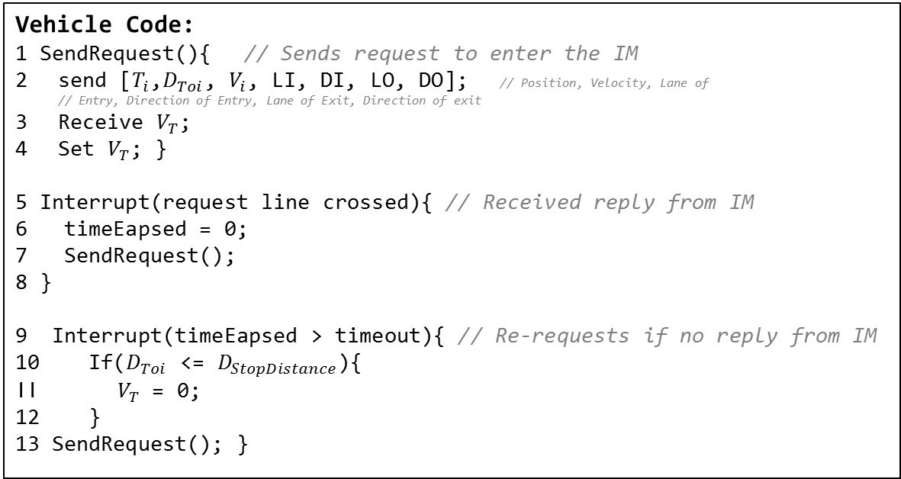
Demo VT-IM Code
Vehicle Code:
1 SendRequest(){ // Sends request to enter the IM
send [${T_{i}\text{,} D}_{Toi}$, $V_{i}$, LI, DI, LO, DO]; // Position, Velocity, Lane of // Entry, Direction of Entry, Lane of Exit, Direction of exit
Receive $V_{T}$;
Set $V_{T}$; }
5 Interrupt(request line crossed){ // Received reply from IM
6 timeEapsed = 0; 7 SendRequest();
8 }
9 Interrupt(timeEapsed > timeout){ // Re-requests if no reply from IM
10 If($D_{Toi}$ <= $D_{StopDistance}$){
11${ V}_{T}$ = 0;
12 }
13 SendRequest(); }
Intersection Manager Code:
1 if(request received) {
AddVehicleToQueue($\text{LI}\text{, }\text{DI}\text{, }\text{LO}\text{, }\text{DO}$);
$V_{T}$ = CalculateDesired $V_{T} (D_{Toi}\text{,}T_{i}\text{,}V_{i})$;
s$end ["{accpeted", V}_{T}]$;
5 }
Notes:
More to algorithm, not present here for berevity

Slide 9
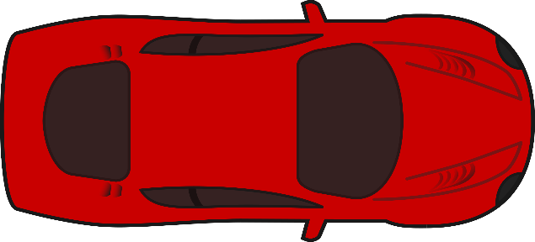






VT-IM Must Account for Position Uncertainty
An intersection manager should take into account all kinds of errors and uncertainties in the system.
Sensor Error
Time Synchronization Error
Control Error
Error is modelled as a Safety Buffer around the vehicle:
$$E_{Long}$$
$$L$$
$$E_{Long}$$
$$E_{Lat}$$
$$W$$
$$E_{Lat}$$

Slide 10







How Large is the Safety Buffer
Using our real-life implementation, we measured how big a Safety Buffer needed to be.
${Vehicle}_{Length}=$.568 m
$E_{Long}=$.15m @ $V_{Max} of our\frac{1}{8.5}model, 3.0m/s$, 12.6km/h
$$E_{Long}$$
$$L$$
$$E_{Long}$$
$$E_{Lat}$$
$$W$$
$$E_{Lat}$$

Slide 11





Large Safety Buffer Lowers Throughput
Intersection Manager
$${V_{T}=3.0}_{}$$
$${V_{T}=2.5}_{}$$
$${V_{T}=1.5}_{}$$
Request Line
Enter
Exit

Slide 12
Even with Safety Buffer, Accidents Will Still Happen
Despite adding in the Safety Buffer to our real implementation, we were still seeing crashes in fringe cases.
Notes:
Accenturate Problem

Slide 13

Defining the Timing Problem
Round Trip Delay (RTD) is being ignored
Caused by computation delay and network delay.
Request Position
Actual Receive Position (ARP)
IM
Best
Worst
Average
Worst Case Receive Position Difference
Expected Message Receive Position
Actual Receive Position =$RP+(RTD ∗V)$

Slide 14



Time Delays Will Cause Crashes
Intersection Manager
$${V_{T}=3}_{}$$
$${V_{T}=2.5}_{}$$
Request Line

Slide 15








Accounting for Delays
A real intersection manager must also take into account delay in the system.
Transmission Delay
Computation Delay
Summation: Round Trip Delay (RTD)
In existing implementations, delays will have to be modeled as additional Time Buffer around the vehicle:
123.791 milliseconds
(Source: our implementation)
36.885 milliseconds
(Source: our implementation)
150 milliseconds
(Source: our implementation)
$$L$$
$$E_{Long}$$
$$E_{Delay}$$
$$E_{Delay}$$
$$E_{Long}$$
$$E_{Lat}$$
$$W$$
$$E_{Lat}$$

Slide 16
Real-life Computation and Network Delay

Slide 17









How Large is the RTD Buffer
Using our real-life implementation, we measured how big a Safety Buffer considering RTD needed to be.
$E_{Delay}$ $=$.45m @ $V_{Max} of our\frac{1}{8.5}model, 3.0m/s$, 12.6km/h
3x $E_{Long}$
$$L$$
$$E_{Long}$$
$$E_{Delay}$$
$$E_{Delay}$$
$$E_{Long}$$
$$E_{Lat}$$
$$W$$
$$E_{Lat}$$

Slide 18
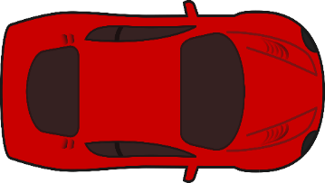
How Large is the RTD Buffer
Using our real-life implementation, we measured how big a Safety Buffer considering RTD needed to be.
3.46x Original Vehicle Length

Slide 19
Crossroads
Method #2 (Crossroads) - Our scheduling approach

Slide 20
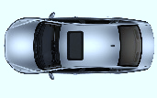
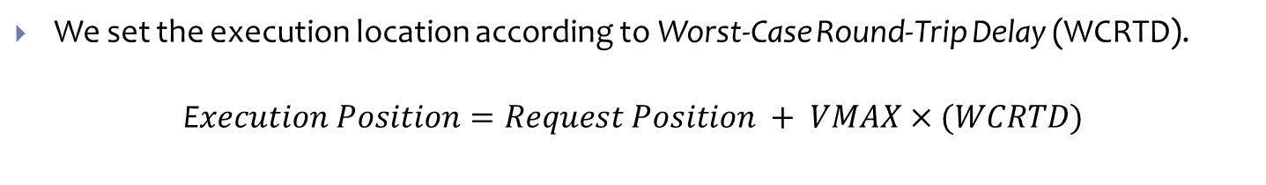
How We Solve RTD - Crossroads
We set the execution location according to Worst-Case Round-Trip Delay (WCRTD).
E$xecution Position=Request Position + VMAX×(WCRTD)$
Execution Position
Request Position
IM
Actual Receive Position
Best
Worst
Average
Actuation Begins
Actuation Begins
Expected Message Execution Position = EP
Notes:
Different animation, show 2 cars with different RTDs being fixed by execution position
Fix animation with expected location

Slide 21

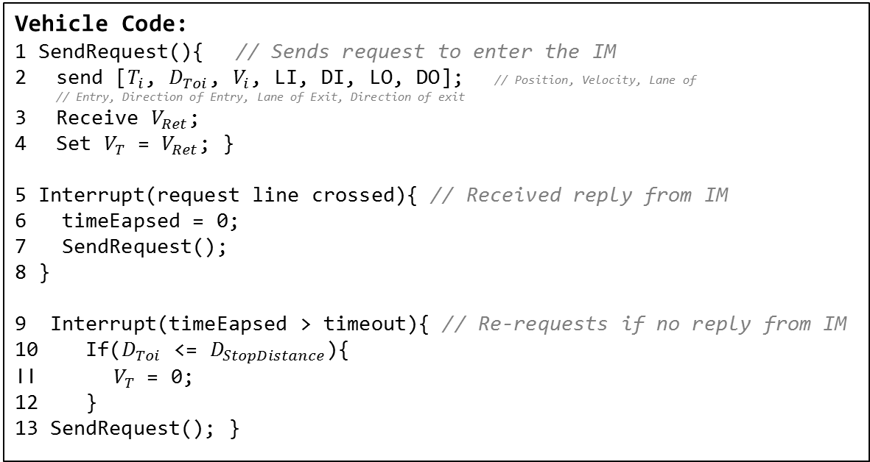
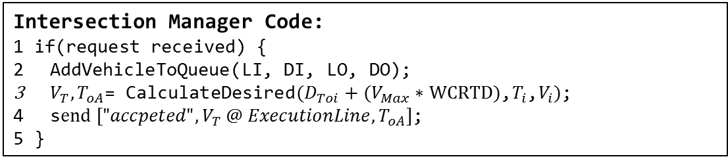
Crossroads Code
Vehicle Code:
1 SendRequest(){ // Sends request to enter the IM
send [${T_{i}\text{,} D}_{Toi}$, $V_{i}$, LI, DI, LO, DO]; // Position, Velocity, Lane of // Entry, Direction of Entry, Lane of Exit, Direction of exit
Receive $V_{Ret}$;
Set $V_{T}$ = $V_{Ret}$; }
5 Interrupt(request line crossed){ // Received reply from IM
6 timeEapsed = 0; 7 SendRequest();
8 }
9 Interrupt(timeEapsed > timeout){ // Re-requests if no reply from IM
10 If($D_{Toi}$ <= $D_{StopDistance}$){
11${ V}_{T}$ = 0;
12 }
13 SendRequest(); }
Intersection Manager Code:
1 if(request received) {
AddVehicleToQueue($\text{LI}\text{, }\text{DI}\text{, }\text{LO}\text{, }\text{DO}$);
$V_{T},T_{oA}$= CalculateDesired$(D_{Toi}\text{ + (}V_{Max}\text{ ∗ }\text{WCRTD}\text{)}\text{,}T_{i}\text{,}V_{i})$;
s$end ["{accpeted", V}_{T} @ ExecutionLine,T_{oA}]$;
5 }
Notes:
IM calculates the desired Time of Arrival, T oA, and the execution time, TE, (actuation position PE) based on WCRTD
Fix this slide

Slide 22
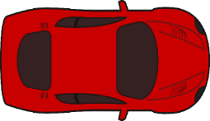
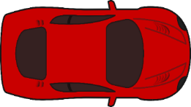
Crossroads Eliminates Time Buffer
Unlike the VT-IM methodology, Crossroads does not require a Time Buffer
~ 3.5x Original Vehicle Length -> ~ 1.5x

Slide 23
Related Work: Autonomous Intersection Management
Method #3 (AIM) - Avoids the RTD problem.

Slide 24
AIM (Autonomous Intersection Management)
A tested and effective FCFS (First Come First-Served) policy
Dresner and Stone propose and IM that:
Vehicle requests to entire intersection at T_{oA} and V_{oA}
IM simulates the trajectory of the vehicle
Responds YES if the trajectory has no overlap with the reserved spots of other vehicles
Responds NO otherwise.
Notes:
Must state problem - RTD is ignored – the problem is RTD is ignored

Slide 25
AIM is a query-based approach
Intersection Manager
Request Time of Entry, (TOE) Velocity of Entry
Receive Accept
Vehicle Begins Actuation
of Proposed TOE
Request Line
Enter
Exit
Notes:
Explain timing problem and how it is solved

Slide 26
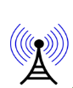
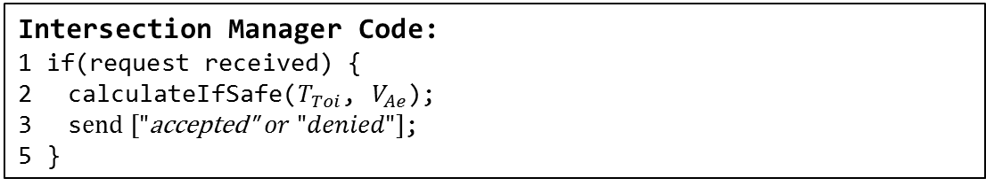
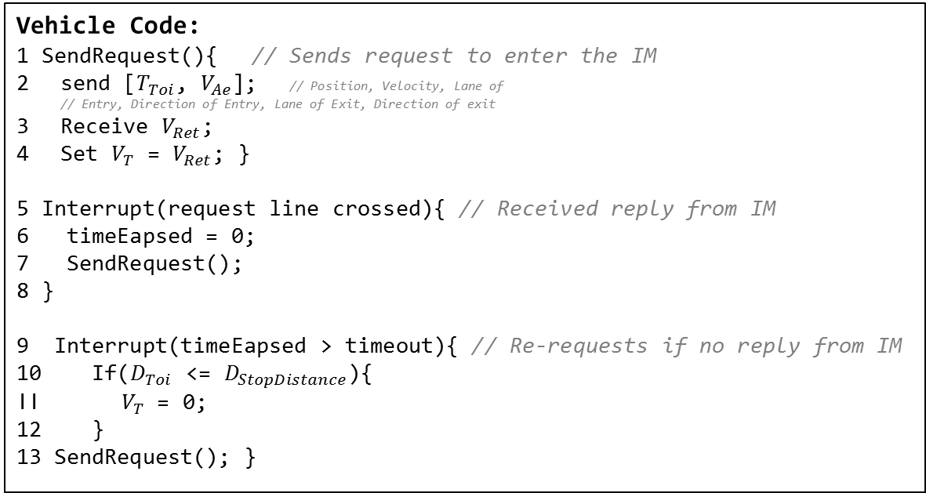
Related Work: AIM
Vehicle Code:
1 SendRequest(){ // Sends request to enter the IM
send [$T_{Toi}$, $V_{Ae}$]; // Position, Velocity, Lane of // Entry, Direction of Entry, Lane of Exit, Direction of exit
Receive $V_{Ret}$;
Set $V_{T}$ = $V_{Ret}$; }
5 Interrupt(request line crossed){ // Received reply from IM
6 timeEapsed = 0; 7 SendRequest();
8 }
9 Interrupt(timeEapsed > timeout){ // Re-requests if no reply from IM
10 If($D_{Toi}$ <= $D_{StopDistance}$){
11${ V}_{T}$ = 0;
12 }
13 SendRequest(); }
Intersection Manager Code:
1 if(request received) {
calculateIfSafe($T_{Toi}$, $V_{Ae}$);
s$end ["\text{accepted}\text{"} or "denied"]$;
5 }
Notes:
Algorithm 3 needs to be more specific, use comments or descriptive name

Slide 27
Related Work: AIM
Aim was tested virtually with 1 real and a number of simulated autonomous vehicles for the Darpa 2007 challenge
AIM was implemented in real life with Four 1/10 scale vehicles
Vmax .5m/s, or at scale 18 km/h so they may have missed the problem
√ Achieves a theoretical throughput of .5 vehicles/lane/s.
√ Considers a Safety Buffer
X Computation time is large
X High communication overhead
X Many re-requests
X Cannot efficiently schedule vehicles
Notes:
AIM communication overhead
AIM cannot re-schedule effeciently

Slide 28
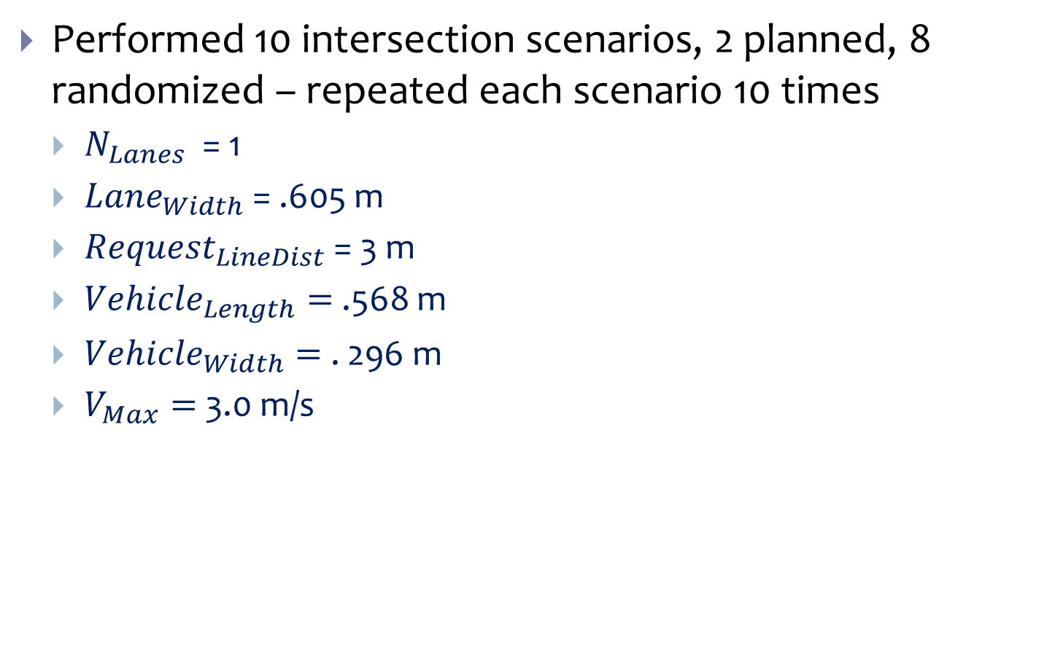
Scale Model Test Setup
Performed 10 intersection scenarios, 2 planned, 8 randomized – repeated each scenario 10 times
$N_{Lanes}$ = 1
${Lane}_{Width}$ = .605 m
${Request}_{LineDist}$ = 3 m
${Vehicle}_{Length}=$.568 m
${Vehicle}_{Width}=$. 296 m
$V_{Max}=$ 3.0 m/s
Request
Line
Request
Line
1
1
1
1
$${Request}_{LineDist}$$
Request
Line
Request
Line
$${Lane}_{Width}$$

Slide 29
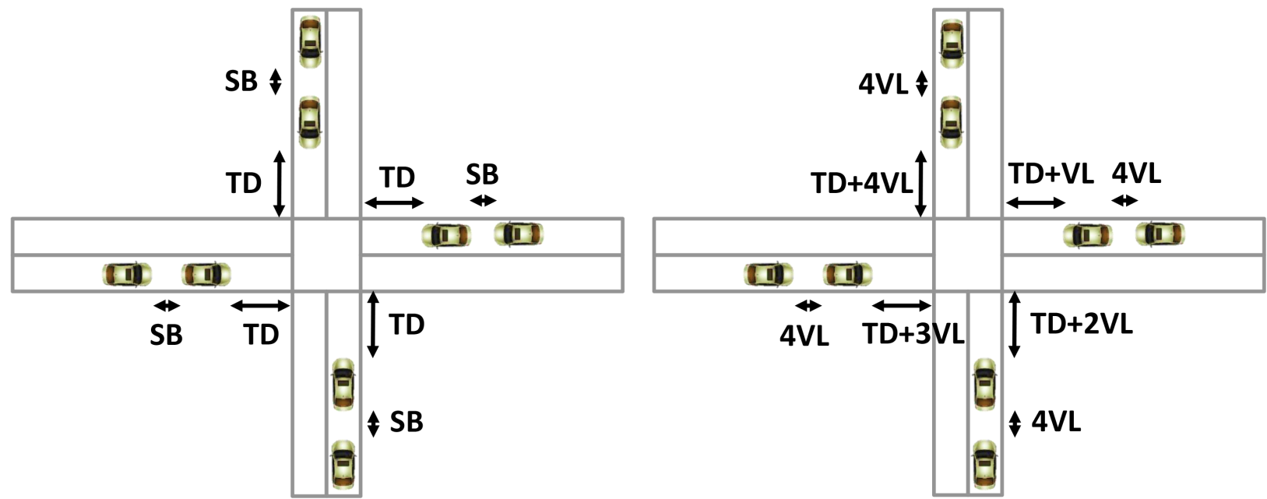
Results of Scale Models
Boundary Cases:
SB – SafetyBuffer, TD – TransmitDistance, VL – Vehicle Length
Intersection Scenario #1 Heavy Traffic Load
Intersection Scenario #10 Light Traffic Load
Scenario 1
Scenario 10
Not to scale
Not to scale

Slide 30
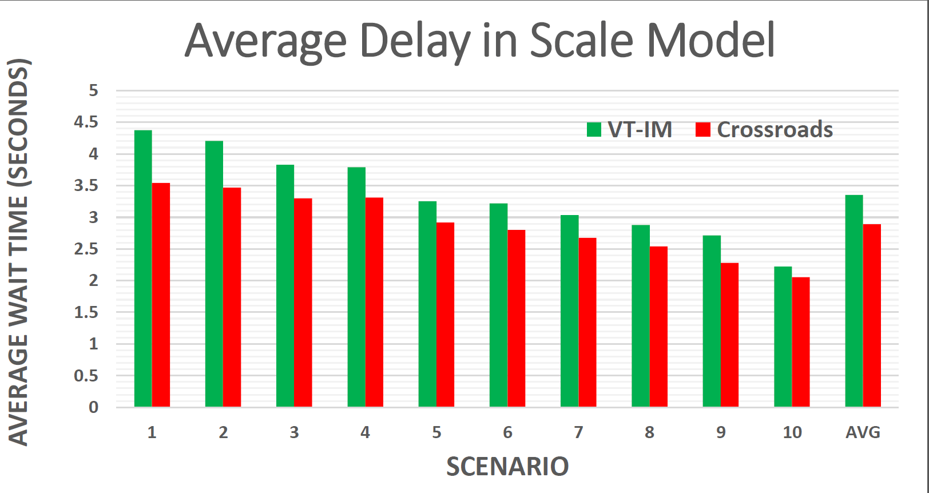
Crossroads Performs Better in Scale Tests
Heavy
Traffic
INTERSECTION SCENARIO NUMBER
Light
Traffic
Notes:
Car arrival scenarios instead

Slide 31
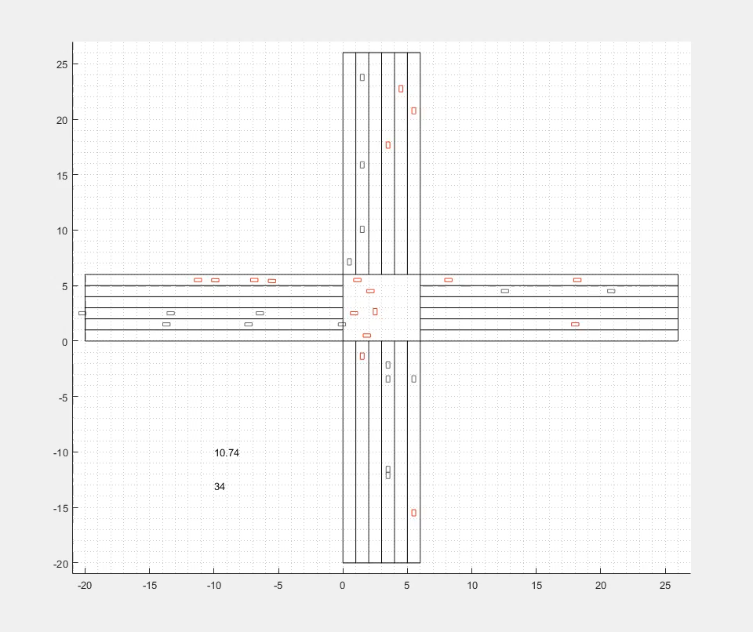
Simulation in Matlab, N=160

Slide 32
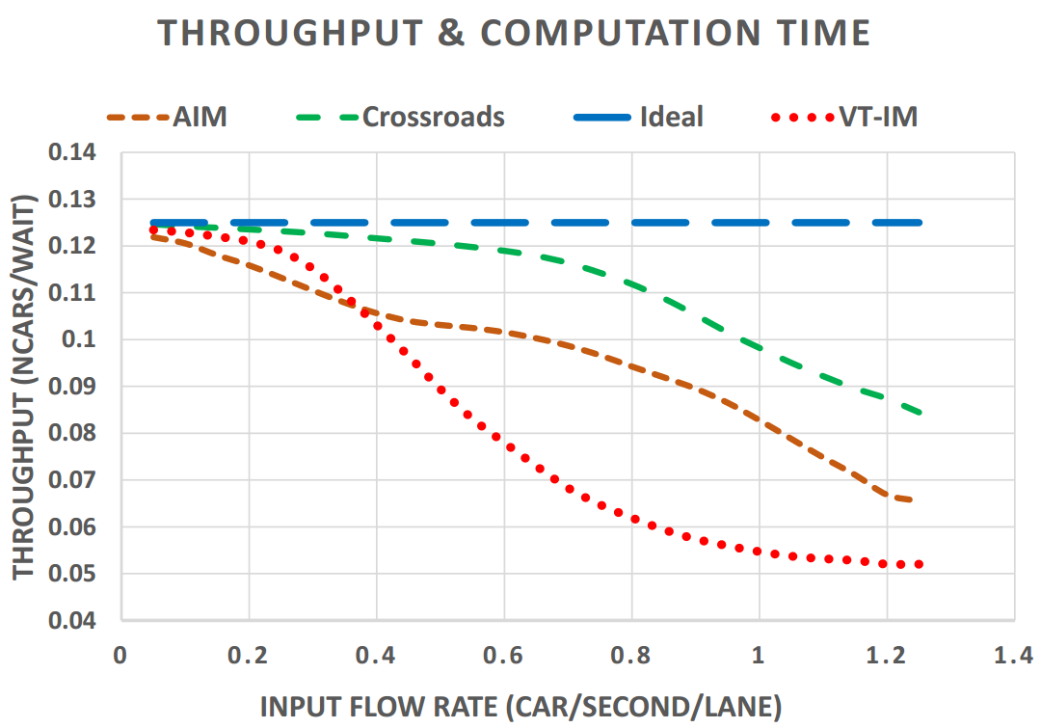
Crossroads Performs Better in Simulation
.35 Traffic
Light
Max
Flow
.5 Round-
about
Light
Max
Flow
Notes:
Figure out ideal that is possible
Mark interesting region
Mark traffic signal limits
Spend more time, add more slides

Slide 33
Summary
An Intersection Manager (IM) must account for position uncertainty as a Safety Buffer
Position uncertainty comes from sensors, actuators, etc.
An IM must account for timing problems as Time Buffer
Computation Delay
Network Delay
AIM solves timing problem with a yes/no approach.
Our technique (Crossroads) eliminates the Time Buffer
It is replaced by timestamp-based execution
Crossroads maintains high schedulablility in addition to safety, thus increasing throughput
1.62x Crossroads vs VT-IM and 1.36x Crossroads vs AIM on average
Notes:
Missing main points
Needs work

