Slide 1

Heap Data Management for Limited Local Memory (LLM) Multicore Processors
Ke Bai，Aviral Shrivastava
Compiler Micro-architecture Lab

Slide 2
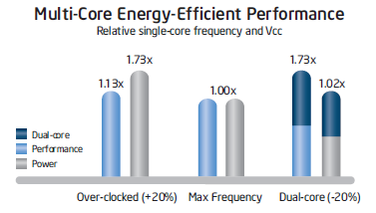
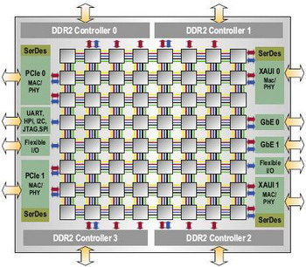
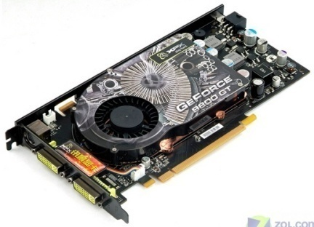
From multi- to many-core processors
Simpler design and verification
Reuse the cores
Can improve performance without
much increase in power
Each core can run at a lower frequency
Tackle thermal and reliability problems at core granularity
IBM XCell 8i
Tilera TILE64
GeForce 9800 GT
Notes:
Moving to multi-core was inevitable to get performance improvements we have enjoyed over the past two decades
Early multi-cores were based on the shared memory architecture
What happens if we have 100’s of cores?
Shared memory architectures are not scalable and can limit the potential performance available, Cache coherency is a problem
Within same process technology, a new processor design with 1.5x to 1.7x performance consumes 2x to 3x the die area [1] and 2x to 2.5x the power[2]
Dynamic increases squarely, leakage increases exponentially
Needs outstanding performance, especially on game and multimedia applications.
Challenges: Power Wall, Frequency Wall, Memory Wall;
Complicate in architecture design;
Can’t achieve high performance and high power efficiency at the same time (Caches consume 44% in core);
Can’t scales well in power consumption.
2. Power components:
– Active power
– Passive power
• Gate leakage
• Sub-threshold leakage (source-drain leakage)
Result: air cooling, power consumption
3. Branch predictor, cache
4. Distributed system with single core can’t scale well in power consumption

Slide 3
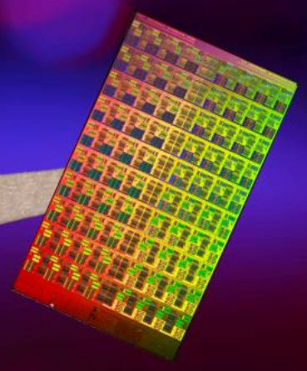
Memory Scaling Challenge
In Chip Multi Processors (CMPs) , caches provide the illusion of a large unified memory
Bring required data from wherever into the cache
Make sure that the application gets the latest copy of the data
Caches consume too much power
44% power, and greater than 34 % area
Cache coherency protocols do not scale well
Intel 48-core Single Cloud-on-a-Chip, and Intel 80-core processors have non-coherent caches
Strong ARM 1100
Intel 80 core chip

Slide 4
Limited Local Memory Architecture
Cores have small local memories (scratch pad)
Core can only access local memory
Accesses to global memory through explicit DMAs in the program
E.g. IBM Cell architecture, which is in Sony PS3.
SPU
PPE
LS
SPE 1
SPE 3
SPE 5
SPE 7
Element Interconnect Bus (EIB)
Off-chip Global Memory
SPE 0
SPE 2
SPE 4
SPE 6
PPE: Power Processor Element
SPE: Synergistic Processor Element
LS: Local Store

Slide 5
LLM Programming
Thread based programming, MPI like communication
#include<libspe2.h>
extern spe_program_handle_t hello_spu;
int main(void)
{
int speid, status;
speid
(&hello_spu);
}
<spu_mfcio.h>
int main(speid, argp)
{
printf("Hello world!\n");
}
<spu_mfcio.h>
int main(speid, argp)
{
printf("Hello world!\n");
}
<spu_mfcio.h>
int main(speid, argp)
{
printf("Hello world!\n");
}
Local Core
Local Core
Local Core
= spe_create_thread
<spu_mfcio.h>
int main(speid, argp)
{
printf("Hello world!\n");
}
<spu_mfcio.h>
int main(speid, argp)
{
printf("Hello world!\n");
}
<spu_mfcio.h>
int main(speid, argp)
{
printf("Hello world!\n");
}
Main Core
Local Core
Local Core
Local Core
Extremely power-efficient computation
If all code and data fit into the local memory of the cores

Slide 6
What if thread data is too large?
Two Options
Repartition and re-parallelize the application
Can be counter-intuitive and hard
24 KB
32 KB
24 KB
32 KB
24 KB
Two threads with 32 KB memory each
Three cores with 24 KB memory each
Manage data to execute in limited memory of core
Easier and portable
Notes:
There are two closely coupled challenges in developing applications for such architectures.
All data should be located in the local memory of a core.
If they can fit in the local memory, execution is efficient!

Slide 7
Managing data
int global;
f1(){
int a,b;
global = a + b;
f2();
}
int global;
f1(){
int a,b;
DMA.fetch(global)
global = a + b;
DMA.writeback(global)
DMA.fetch(f2)
f2();
}
Original Code
Local Memory Aware Code

Slide 8
Heap Data Management
All code and data need to be managed
Stack, heap, code and global
This paper focuses on heap data management
Heap data management is difficult
Heap size is dynamic, while the size of code and global data are statically known
Heap data size can be unbounded
Cell programming manual suggests “Use heap data at your own risk”.
Restricting heap usage is restrictive for programmers
stack
stack
heap
heap
heap
global
code
main() {
for (i=0; i<N; i++) {
item[i] = malloc(sizeof(Item));
}
F1();
}
Notes:
Since malloc() is being used for a long time, restriction would require programmers to abandon many dynamic structures and related algorithms, which would impede the imagination and creativity of programmers.
Grow opposite to stack and data dependent
Use or not to use malloc() function
Not use: severely restrict programming.
Use: be responsible for the size of heaps.
Best case: program crash
Worst case: generate wrong results

Slide 9
Outline of the talk
Motivation
Related works on heap data management
Our Approach of Heap Data Management
Experiments

Slide 10
Related Works
Local memories in each core are similar to SPMs
Extensive works are proposed for SPM
Stack: Udayakumaran2006,Dominguez2005, Kannan2009
Global: Avissar2002, Gao2005, Kandemir2002, Steinke2002
Code: Janapsatya2006, Egger2006, Angiolini2004, Pabalkar2008
Heap: Dominguez2005, Mcllroy2008
direct access
ARM
SPM
SPE
LLM
DMA
DMA
Global
Memory
Global
Memory
ARM Memory Architecture
IBM Cell Memory Architecture
SPM is for Optimization
SPM is Essential
Notes:
Dominguez2005: statically allocate heap data in the scratch-pad memory; everything is decided at the compile-time.
1, it partitions the program into regions, e.g. the start and end of every procedure;
2, it did some analysis to determine the time-order between the regions by finding the set of possible predecessors and successors of each region;
3, copy portions of heap variables into the scratch-pad.
Mcllroy2008:This paper presents memory management algorithm. This algorithm uses a variety of techniques to reduce the size of data structures required to manage memory.
They are all simplistic. (statically decide which heap should go to where)

Slide 11
Our Approach
typedef struct{
int id;
float score;
}Student;
main() {
for (i=0; i<N; i++) {
student[i] = malloc( sizeof(Student) );
}
for (i=0; i<N; i++) {
student[i].id = i;
}
}
Heap Size = 32bytes
sizeof(student)=16bytes
malloc3
malloc2
malloc1
HP
GM_HP
Local Memory
Global Memory
malloc()
allocates space in local memory
mymalloc()
May need to evict older heap objects to global memory
It may need to allocate more global memory

Slide 12
How to evict data to global memory?
Can use DMA to transfer heap object to global memory
DMA is very fast – no core-to-core communication
But eventually, you can overwrite some other data
Need OS mediation
Global Memory
Execution Core
DMA
malloc
Global Memory
Execution Core
Main Core
malloc
malloc
Thread communication between cores is slow!

Slide 13
Hybrid DMA + Communication
Can use DMA to transfer heap object to global memory
DMA is very fast – no core-to-core communication
But eventually, you can overwrite some other data
Need OS mediation
DMA write from local memory to global memory
malloc() {
if (enough space in global memory) then
write function frame using DMA
else
request more space in global memory
}
S
mail-box based communication
allocate
≥S space
startAddr endAddr
Execution Thread on execution core
Main core
Global Memory
free() frees global space.
Communication is similar to malloc().
Sent the global address to global thread

Slide 14
Address Translation Functions
main() {
for (i=0; i<N; i++) {
student[i] = malloc( sizeof(Student) );
}
for (i=0; i<N; i++) {
student[i].id = i;
}
}
Heap Size = 32bytes
sizeof(student)=16bytes
malloc3
student[i] = p2s(student[i]);
malloc2
HP
student[i] = s2p(student[i]);
malloc1
GM_HP
Local Memory
Global Memory
Mapping from SPU address to global address is one to many.
Cannot easily find global address from SPU address
All heap accesses must happen through global addresses
p2s() will translate the global address to spu address
Make sure the heap object is in the local memory
s2p() will translate the spu address to global address
More details in the paper

Slide 15
Heap Management API
Original Code
Code with Heap Management
malloc()
allocate space in local memory and global memory and return global addr
free()
free space in the global memory
p2s()
Assures heap variable exists in the local memory and uses spuAddr.
s2p()
Translate the spuAddr back to ppuAddr.
typedef struct{
int id;
float score;
}Student;
main() {
for (i=0; i<N; i++) {
student[i] = malloc(sizeof(Student));
student[i].id = i;
}
}
typedef struct{
int id;
float score;
}Student;
main() {
for (i=0; i<N; i++) {
student[i] = malloc(sizeof(Student));
student[i].id = i;
}
}
student[i] = p2s(student[i]);
student[i] = s2p(student[i]);
Our approach provides an illusion of unlimited space in the local memory!

Slide 16
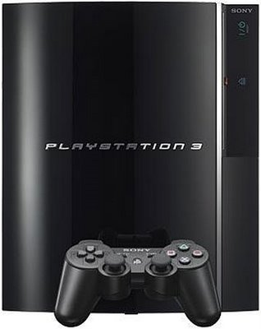
Experimental Setup
Sony PlayStation 3 running a Fedora Core 9 Linux
MiBench Benchmark Suite and other possible applications
http://www.public.asu.edu/~kbai3/publications.html
The runtimes are measured with spu_decrementer() for SPE and _mftb() for the PPE provided with IBM Cell SDK 3.1

Slide 17
Unrestricted Heap Size
Runtimes are comparable

Slide 18
Larger Heap Space ➔ Lower Runtime

Slide 19
Runtime decreases with Granularity
Granularity: # of heap objects combined as a transfer unit

Slide 20
Embedded Systems Optimization
If the maximum heap space needed is known
No thread communication is needed.
DMAs are sufficient
Average 14% improvement

Slide 21
Scalability of Heap Management

Slide 22
Summary
Moving from multi-core to many-core systems
Scaling the memory architecture is a major challenge
Limited Local Memory architectures are promising
Code and data should be managed if they can not fit in the limited local memory
We propose a heap data management scheme
Manage any size of heap data in a constant space in local memory
It’s automatable, then can increase productivity of programmers
It’s scalable for different number of cores
Overhead ~ 4-20%
Comparison with software cache
Does not support pointer
One SW cache for one data type
Cannot optimize any further

Slide 23
Future Research Directions
We foresee improvements in the following directions:
Reduce the calls to p2s and s2p functions;
…
student[i] = p2s(student[i]);
student[i].id = i;
student[i] = s2p(student[i]);
student[i] = p2s(student[i]);
printf(“ID of student is %d\n”, student[i].id);
student[i] = s2p(student[i]);
…
…
student[i] = p2s(student[i]);
student[i].id = i;
printf(“ID of student is %d\n”, student[i].id);
student[i] = s2p(student[i]);
…
Use prefetching and double buffering.
Overlap communication and computation
Get Heap
DMA engine is idle
Get heap
SPU is idle
Compute
Compute
Synchronization point

Slide 24
Summary
Moving from single core to multi-core is inevitable;
Multi-core processor should have a better memory hierarchy;
LLM architecture is promising;
Code and all the data should be managed if they can not fit in the limited local memory;
Previous work for SPM is related, but is not applicable to LLM architectures;
Our heap management is comprehensive and intuitive for all LLM architectures.
Manage any heap size in the local memory
It’s automatable, then can increase productivity of programmers
It’s scalable for different number of cores

