Slide 1
LLMGuard: Compiler and Runtime Support for Memory Management on Limited Local Memory (LLM) Multi-Core Architectures
Ke Bai and Aviral Shrivastava
Compiler and Microarchitecture Lab, Arizona State University, Tempe, 85281.
{Ke.Bai, Aviral.Shrivastava}@asu.edu

Slide 2
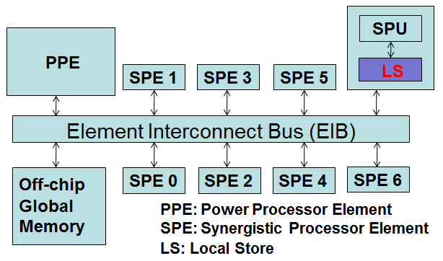
Motivation
Embedded multi-core processor
  Simpler hardware design and verification
  High throughput and low power consumption
  Tackle thermal and reliability problems at core granularity
  Multicore processors: IBM Cell Broadband Engine (BE), Nvidia GPU, TI TMS320C6472
Memory Scaling Challenge
  In Chip Multi Processors (CMPs) , caches provide the illusion of a large unified memory
  Caches consume too much power
  Cache coherency protocols do not scale well
  Therefore, many multi-core processors adopt scratch pad memories (SPM) to replace cache architectures
Limited local memory architecture
  Core can only access its local memory (scratch pad)
  Access to the global memory through explicit DMA in the program
  e.g. IBM Cell architecture, which is in Sony PS3.
We propose a compiler and runtime support infrastructure that automatically compiles programs onto SPM based multi-core processors and guarantees their safe use of the limited local memory.

Slide 3
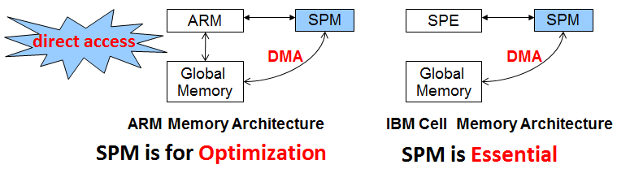
Previous Work
  Local memories in each core are similar to SPMs
  Extensive works are proposed for SPM
  Stack: Udayakumaran2006, Dominguez2005, Kannan2009
  Global: Avissar2002, Gao2005, Kandemir2002, Steinke2002
  Code: Janapsatya2006, Egger2006, Angiolini2004, Pabalkar2008
  Heap: Dominguez2005, Mcllroy2008
  Works on IBM Cell
  Eichenberger2005, Zhao2007, Lee2008, Kudlur2008, Chen2008, Liu2009, Saxena2010, Yeom2010, Gallet2010
  They all optimize performance without too much consideration on memory constraint

Slide 4
Application Code
Problem Description
typedef struct
{
int label;
…
} Item;
main()
{
for (i=0; i<N; i++)
{
item[i] = malloc(sizeof(Item));
item[i].label = i;
F1();
}
}
stack
heap
global
code
Memory Layout
  Code and data of the thread cannot fit into the limited local memory
  Repartition and re-parallelize the application (counter-intuitive and formidable)
  Manage code and data to execute application in the limited memory of core (easier, more natural and portable)

Slide 5
Contribution
Our memory management infrastructure for Limited Local Memory (LLM) multi-core architectures is the first memory management system to integrate an optimizing compiler with a runtime library. We present a new runtime API tailored for SPE code in a carefully managed environment. We present compiler support to release the burden of multi-core programmers and show how the compiler intermediate representation can be leveraged to automate the insertions of memory management operations in such a way that existing or newly implemented applications can safely access the limited local memory on multi-core processors.
Our runtime library support includes efficient techniques to manage each kind of data, i.e. code, stack and heap, in constant-sized regions for each of them on the local memory. We also optimize the data transfers needed for this management, by reducing the inter-task communication, and maximizing the use and granularity of DMAs. Our results show that this strategy is crucial to lowering the overheads of memory management while at the same time achieving good scalability when multiple threads concurrently execute on different cores.
We firstly propose a heuristic that can partition the local memory into regions for code, stack and heap data. For embedded systems, our results show that our scheme can find a good local memory partition that is on an average only 2% worse than the best partition, but only takes 19% of exhaustive exploration time.
Finally, if we know the maximum size of heap data and stack data of embedded system, we optimize data transfers to further improve runtime by an average of 11%.

Slide 6
Compiler and Runtime Support Infrastructure
SPE
Source
Optimized SPE Compiler
SPE
Objects
SPE Linker
SPE
Executable
Runtime
Library
Code Overlay Script Generating Tool
Linker
Script
  Our infrastructure provides an illusion of unlimited space in the local memory
  It includes: code overlay script generating tool, runtime library and optimized SPE compiler.
Runtime Library API
void * my_malloc(int size, int chunkSize); void free (void *ppeAddr);
void _fci(int func_stack_size);
void _fco();
void * _p2s(void *ppeAddr, int size, int wrFlag);
void * _s2p(void *speAddr, int size, int wrFlag);

Slide 7
Circular Stack Management
main
F3
F1
F2
Stack Size = 128 bytes
No Space
GM_SP
F3
main
28
Need to be evicted
F1
Function | Frame Size (bytes)
main | 28
F1 | 40
F2 | 60
F3 | 54
68
F2
128
SP
Stack region
in Local Memory
Stack region
in Global Memory

Slide 8
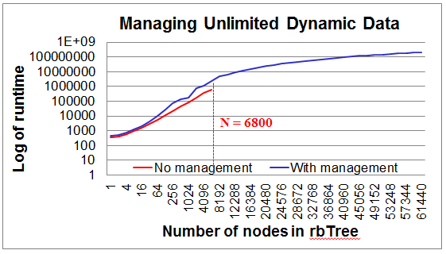
Experimental results
Hardware
  IBM Cell BE
    1 PPE @ 3.2 GHz
    6 SPE @ 3.2 GHz
Benchmarks
  Mibench – modified to multi-threaded
  Other possible applications

Slide 9
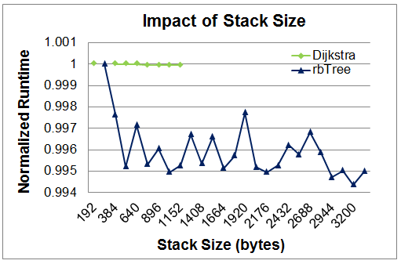
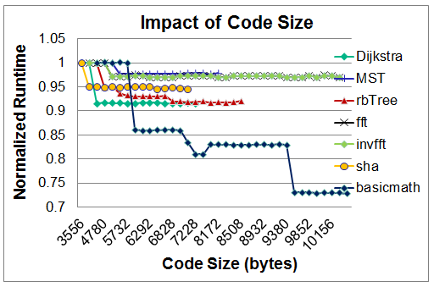
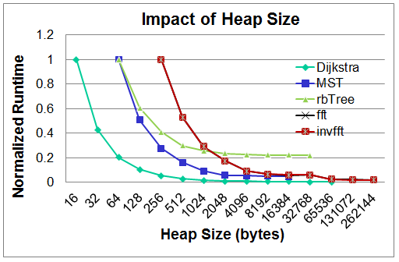
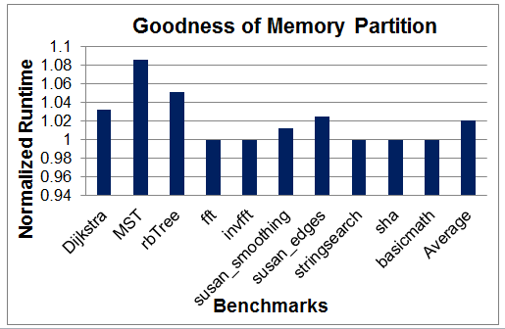

Slide 10
