Slide 1
Efficient & Effective Code Management for Software Managed Multicores CODES+ISSS 2013, Montreal, Canada
Ke Bai, Jing Lu, Aviral Shrivastava, and Bryce Holton
Compiler Microarchitecture Lab
Arizona State University

Slide 2
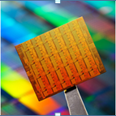
Memory Scaling Challenge
Cache coherency protocols do not scale well
One option is Non-Coherent Cache Architectures
Intel 48-core Single-chip Cloud Computer
8-core DSP from Texas Instruments, TI 6678
Caches still consume too much power
44% power, and greater than 34 % area [1]
Intel 48 core chip
[1] Segars et al., International Solid-State Circuits Conference Tutorial 2001

Slide 3
SPM based Multicore Architecture
Tag Array
Data Array
Fast and low-power memory close to the core
30% less area and power than a direct mapped cache of the same effective capacity [2]
SPM based Multicore
A truly distributed memory architecture on-a-chip
Tag Comparators, Muxes
Address Decoder
Cache
SPM
Execution Core
Execution Core
Execution Core
Execution Core
Execution Core
Execution Core
Main Processor
SPM
SPM
SPM
SPM
SPM
SPM
DMA
DMA
DMA
DMA
DMA
DMA
Interconnect Bus
Main Memory
[2] Banakar CODES’02.
DMA
[2] Banakar CODES’02.

Slide 4
Need Data Management in Software
int global;
f1(){
int a,b;
DMA.fetch(global)
global = a + b;
DMA.writeback(global)
DMA.fetch(f2)
f2();
}
int global;
f1(){
int a,b;
global = a + b;
f2();
}

Slide 5
Data Management in SMM multicores
Manage any amount of heap, stack and code, in the core of an SMM manycore
Global data
If small, can be permanently located in the local memory
Stack data
‘liveness’ depends on call path
Function stack size know at compiler time, but not stack depth
Heap data
dynamic and size can be unbounded
Code
Statically linked
Our strategy
Partition local memory into regions for each kind of data
Manage each kind of data in a constant amount of space
stack
stack
heap
heap
heap
global
code

Slide 6
Problem Context
If all code fits into SPM – very efficient execution
In general - Dynamic Code management is needed
All code must be managed
ARM
SPM
SPE
SPM
DMA
DMA
Global
Memory
Global
Memory
ARM Memory Architecture
IBM Cell Memory Architecture
SPM is for Optimization
SPM is Essential

Slide 7
Code Management: Problem
Static Compilation
Functions need to be linked before execution
Divide code part of SPM in regions
Map functions to these SPM regions
Functions in the same region placed at the same address
F1
F5
REGION
F2
REGION
F3
F7
REGION
F6
•
•
•
F4
Local Memory Code Section

Slide 8
Code Management: Solution
stack
F1
heap
F1
F1
F2
global
F2
F2
Code
region
F1
F3
F3
F3
F3
F2
(a) Application call graph
SECTIONS {
OVERLAY {
F1.o
F3.o
}
OVERLAY {
F2.o
}
}
(c) Local Memory
(d) Global Memory
# of Regions and Function-To-Region Mapping
Two extreme cases
Need careful code placement – Problem is NP-Complete
Minimum data transfer with given space
(b) Linker script
Notes:
I haven’t mentioned that the architecture is the Cell processor

Slide 9
Optimizing Code Management
Maximum (7.5KB)
Given (5.5KB)
F1
F1
1KB
1.5KB
F1,F5
1.5KB
F2
1.5KB
F2
F3
0.5KB
F2
1.5KB
1.5KB
F3
0.5KB
F3
0.5KB
F4
2KB
F4
2KB
F4
2KB
F5
F5
1.5KB
F6
F6
1KB
F6
1KB
(a) Start
(b) Next step
(c) Final
Previous attempts
[Pabalkar08HIPC], [Baker10CODES+ISSS], [Jung10ASAP]
4 problems in interference calculation
1. Interference cost is not updated
2. Incorrect calculation, when a function is called at multiple places
3. Incorrect interference cost calculation in some cases
4. Do not consider branches

Slide 10
Update Interference Cost
Previous works
Computed interference cost between functions before the start of the algorithm, and did not update it
However
Where intermediate functions are mapped matters
main(), 3KB
14KB Data Transfer
11.5KB Data Transfer
9.5KB Data Transfer
F1(), 2KB
Region 0
3KB
Main()
F3()
F2(), 1KB
Region 1
2KB
F1()
F2()
F3(), 0.5KB

Slide 11
Correct Interference Cost Calculation
Estimate interference between
F3 and F5
Suppose
F3 and F5 are mapped to the same region.
Nothing else is mapped to the region
Previous techniques
Estimate: 15*(size(F3) + size(F5))
Min execution count of F3 and F5
Correct
3*(size(F3)+size(F5))
main: 1
F1: 1
Loop
2
0
F2:
1
3
Loop
F4:
1
0
3
2
15
Loop
0
F3:
30
45
F5:
5
0
10
15

Slide 12
Consider Branch Probabilities
main: 1
Previous works
Assume that both branches taken
If F4 is called 90% of the time
Mapping F2, F1 in same region may be better than mapping F2, F4, F5 in same region
F2: 1
Loop
F3: 1
condition
F4: 9
F1: 1
F5: 9

Slide 13
Features of Our Technique
Update interference costs after mapping each function
Allow multiple instances of a function call
Correct interference cost calculation
Proof is provided in the paper
Consider branch probabilities
Estimate branch probabilities statically [Smith81ISCA]

Slide 14
Effective Technique
Hardware
Cell Processor in Sony PS3, running Linux
Compiler modifications in
GCC 4.6
Benchmarks
Mibench
Effective
Performance improvement from cost calculation
CMSM gives a better result than other two algorithms 89% of time

Slide 15
Accurate Cost Calculation
12% performance improvement when previous techniques use accurate cost estimation

Slide 16
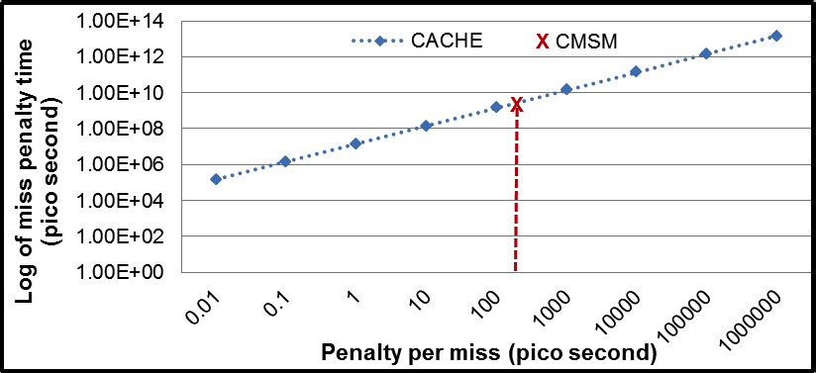
Comparison with Caches
Cache Miss penalty = # misses * miss latency
SPM miss overhead = # API function calls * no. of instructions in API function + # times DMA is called * delay of the DMA (dep. on DMA size)
Cache is better when miss latency < 260 ps
260 ps = 0.86 * cycle time

Slide 17
Scalability
Running identical benchmarks on each core

Slide 18
Summary
SPM based multicore architectures are scalable and power-efficient
However need to perform code and data management
Code Management
We identified 4 shortcomings in previous techniques
Our approach
Correctly calculates interference between functions
Considers branch probabilities
Better mapping 89% of time
Accuracy improves performance by 12%

